Slide 1
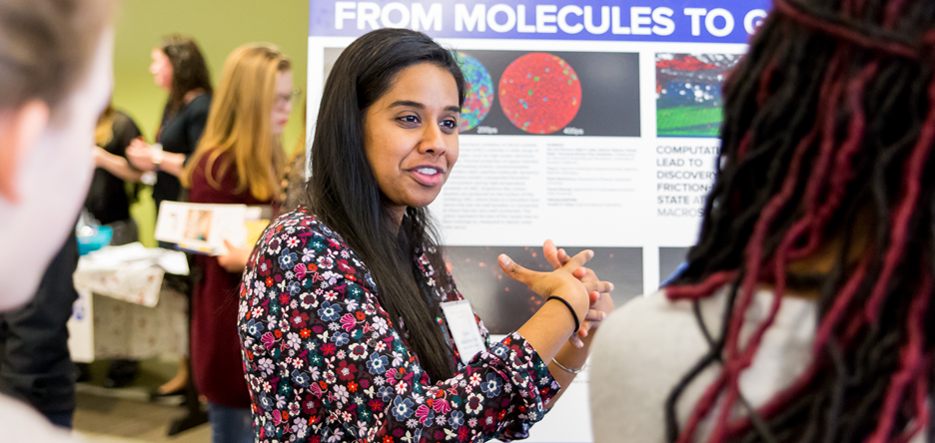
Science Communication 101
erhtjhtyhy
January 21, 2023
Jessica Burgess
Savannah Mitchem
Katie Yurkewicz
STEM Education Outreach Lead
Integrated Communications Coordinator
Physical Sciences & Engineering
Head of Scientific & Technical Communications

Slide 2
Benefits of science communication
Helps you understand your work better
Improves your communication skills
Expands your research network
Enhances public image/ breaks down barriers
Widens your audience and expands reach outside of fellow researchers
Inspires future generations
Notes:
9:45

Slide 3
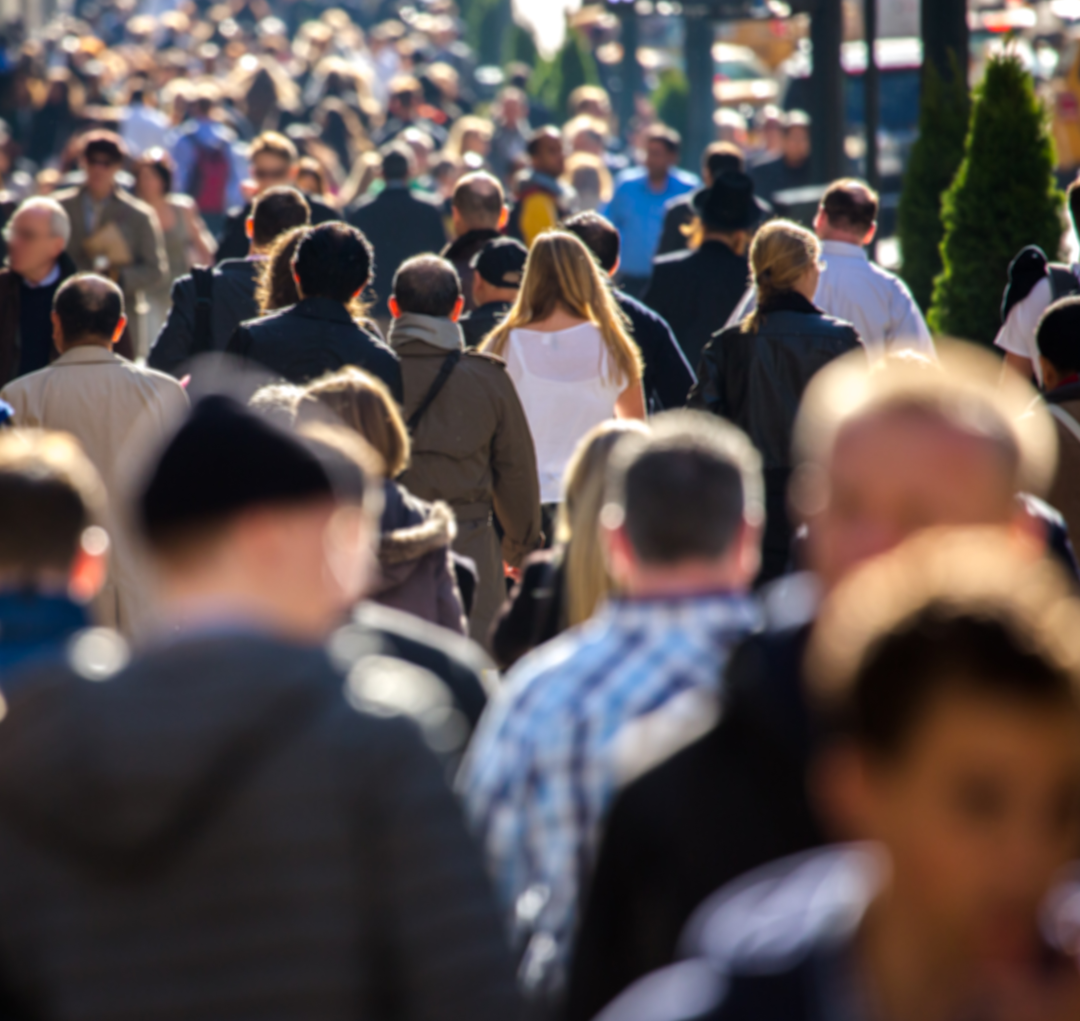




Why is this important
And how you get there
KNOW YOUR
AUDIENCE
TELL
A STORY
AVOID JARGON
MAKE IT RELATABLE
IMPACT
Notes:
Knowing Your Audience helps you Tell a Story which helps you Build Relationships that can lead to you Raise Funding to Conduct Research that continues to have Impact

Slide 4
know your audience
Who are you speaking to?
What is your goal?
What matters to THEM?
ASK QUESTIONS!

Slide 5
Storytelling

Slide 6
Intro to A-B-T storytelling: VIDEO
Randy Olson
https://youtu.be/ERB7ITvabA4​
Watch from start until 5:18 to learn about the ABT template and how to use it​

Slide 7

A-B-T Story Exercise

Slide 8
TEMPLATE FOR STORY-ABT
AND
BUT
THEREFORE
Word of agreement and positivity
Starts your story without tension or conflict
Other words also work
(ex. also, likewise, similarly, etc.)
Word of contradiction, negation and denial
Establishment of tension or conflict
Driving force in stories
Other words also work
(ex. despite, yet, however, conversely, etc.)
Word of consequence
What’s your point?
What are you getting at?
Other words also work
(ex. thus, hence, consequently, etc.)
Notes:
This is the A-B-T exercise

Slide 9
Jargon

Slide 10
Definition of jargon
“The technical terminology or characteristic idiom of a special activity or group”
  Any word or phrase that loses or changes meaning when you use it with people who aren’t in your field.
Taken from: https://sharingscience.agu.org/jargon-and-how-to-avoid-it/

Slide 11
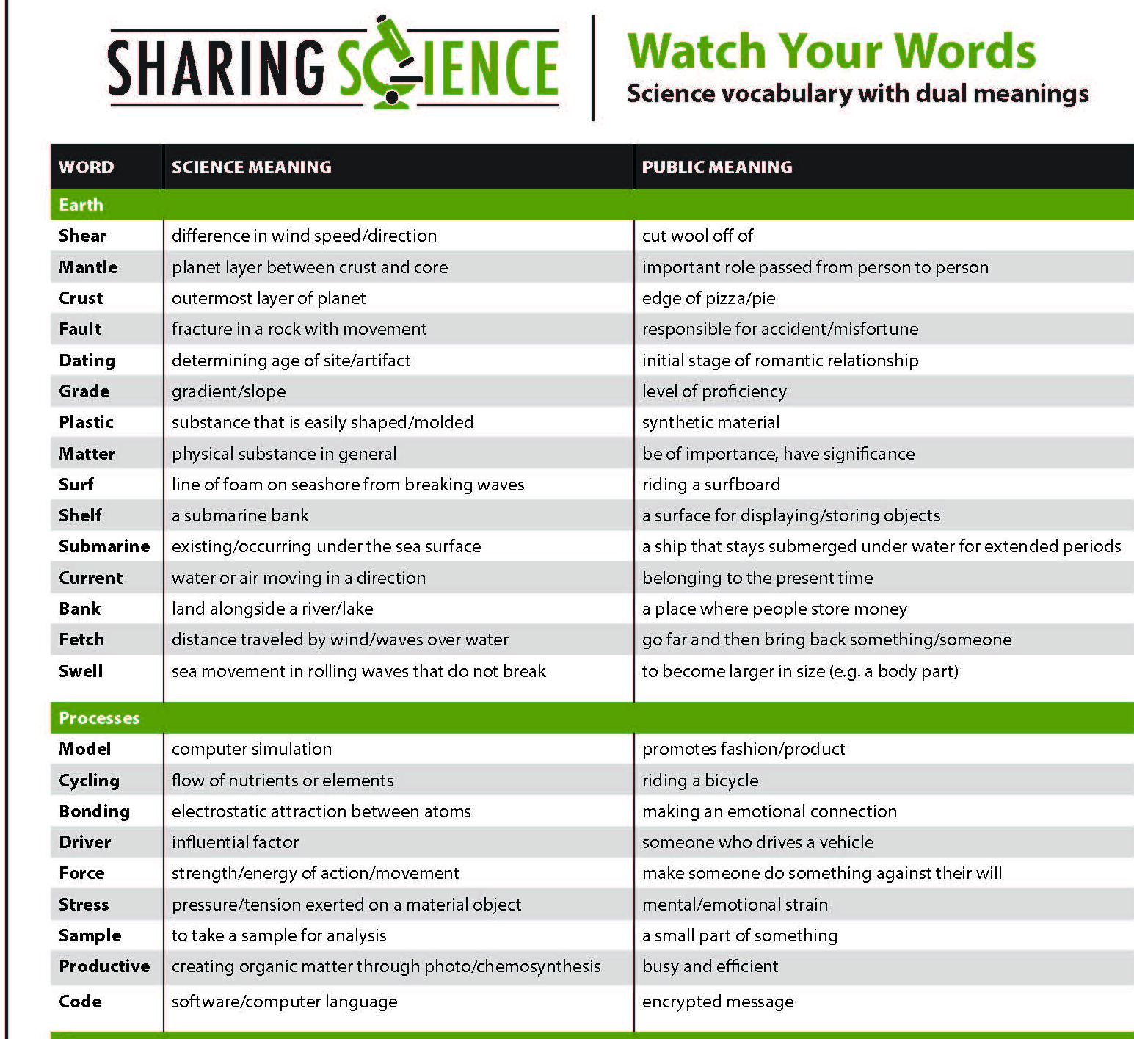

Slide 12
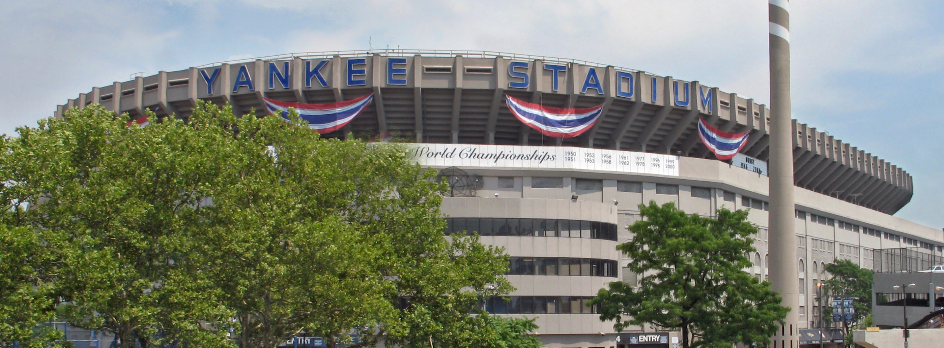
Baseball anyone?

Slide 13
What does this mean?
In the bottom of the ninth, Jeter worked a one-out walk and stole second. But the Red Sox’s ace reliever got Ellsbury and Teixeira to strike out swinging to end the game.

Slide 14
Tell a story
Stress meaning, not details
The home team was losing to its most hated rival. The game was almost over when the captain of the home team, playing in his last season, made a last-ditch effort to win. He took a big risk, and it looked like it might pay off. But when his teammates tried to help him score, a key player on the rival team shut them down. The game ended, and the home team went down to bitter defeat.

Slide 15
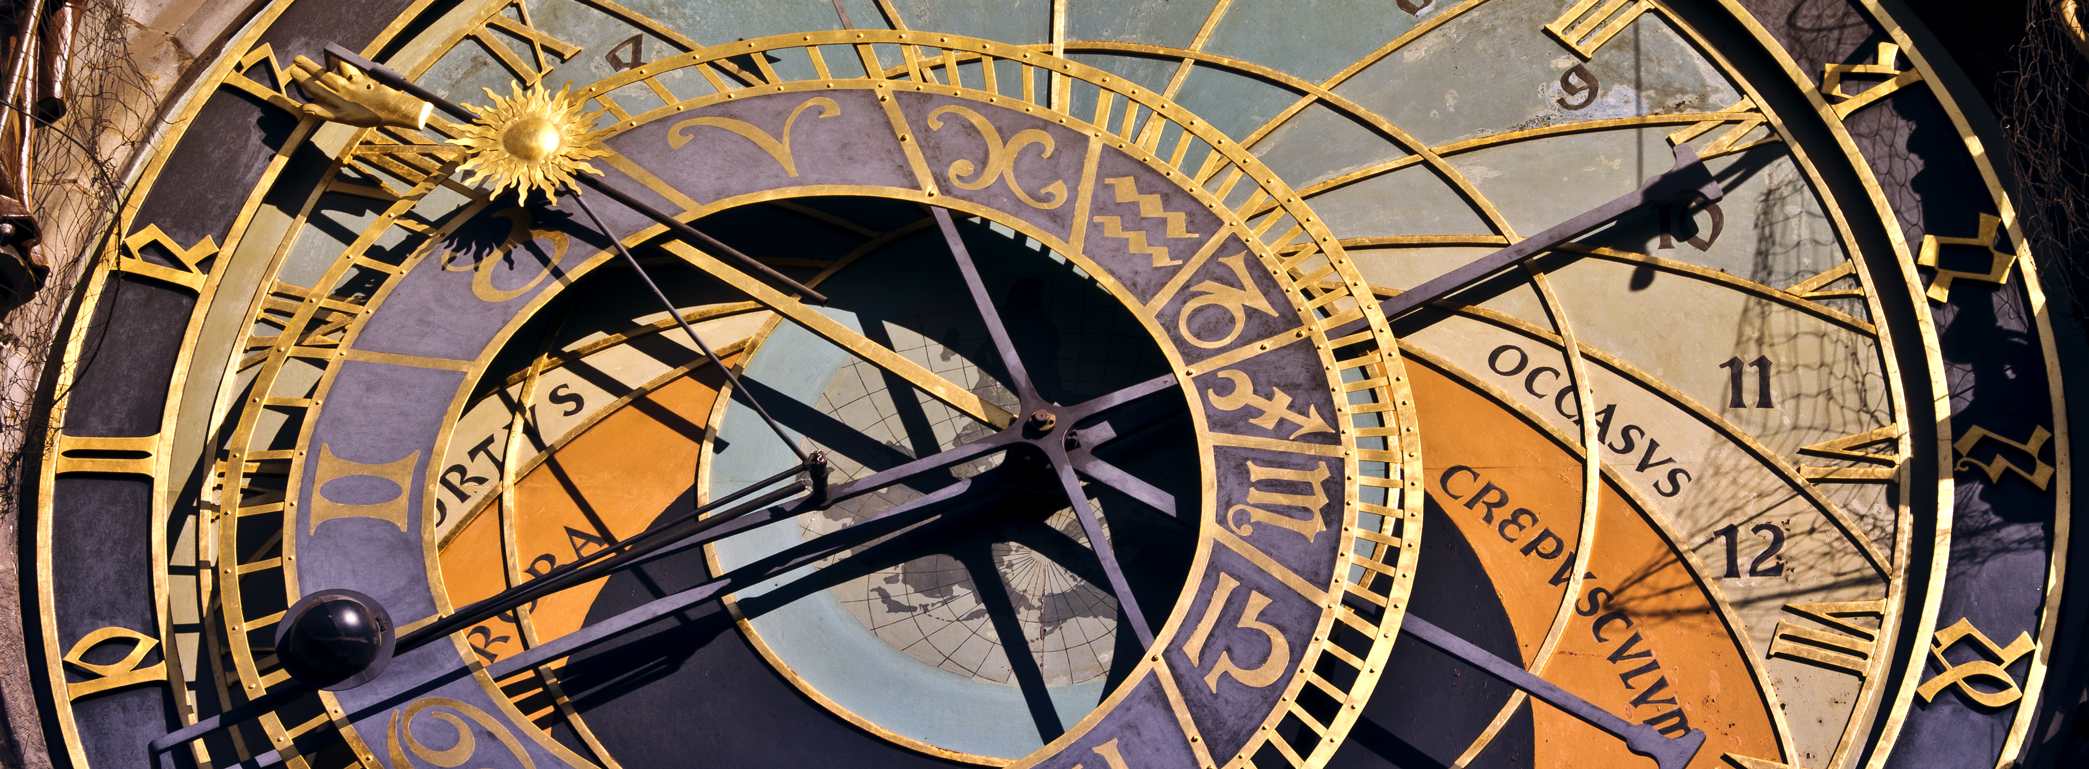
Time travel!

Slide 16
make it relatable
Ask a question to gauge understanding
Use an analogy to make complex concepts accessible
Relate complex concepts to everyday life
Explain why the work matters to people

Slide 17
Recent examples from argonne stories
Explaining nanoscale using Alice in Wonderland's "Drink Me" potion to shrink a person down until they're a nanometer tall (3X larger than a water molecule).
Explaining quantum repeaters using the "telephone game" from childhood.
Explaining nuclear excitations using a bag of microwave popcorn.
Supercomputers are often used to simulate experiments that might be too costly, dangerous, or even impossible to conduct in real life. For example, researchers use simulations to understand how stars explode or how fuel is injected inside an engine.
The world’s best artists can take a handful of differently colored paints and create a museum-worthy canvas that looks like nothing else. They do so by drawing upon inspiration, knowledge of what’s been done in the past and design rules they learned after years in the studio. Chemists work in a similar way when inventing new compounds.

Slide 18
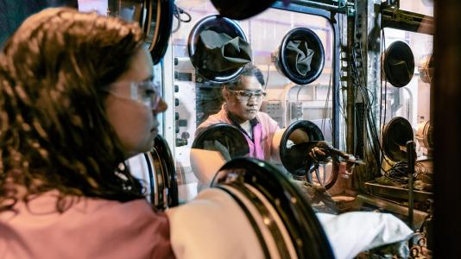
review
ACHIEVE YOUR GOALS
KNOW YOUR
AUDIENCE
TELL
A STORY
AVOID JARGON
MAKE IT RELATABLE

Slide 19
Next steps
Practice!
  An upcoming presentation (can be any subject)
  An upcoming assignment
  Explaining what you’re studying to friends, family
  Social media
Learn more
  Your institution’s communications group
  Google “science communication” to find journals, conferences (Science Talk ’23 is coming up in March/April, books, and much more)
  Suggested resources (see slides 20 and 21)

Slide 20
Questions & Survey

Slide 21
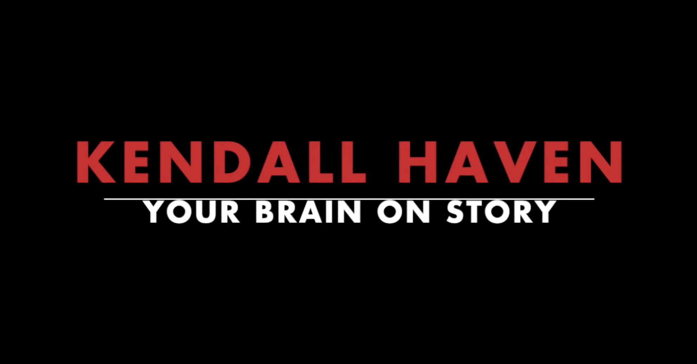
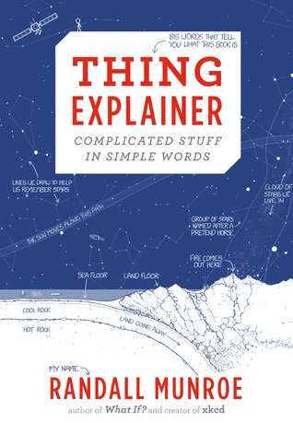
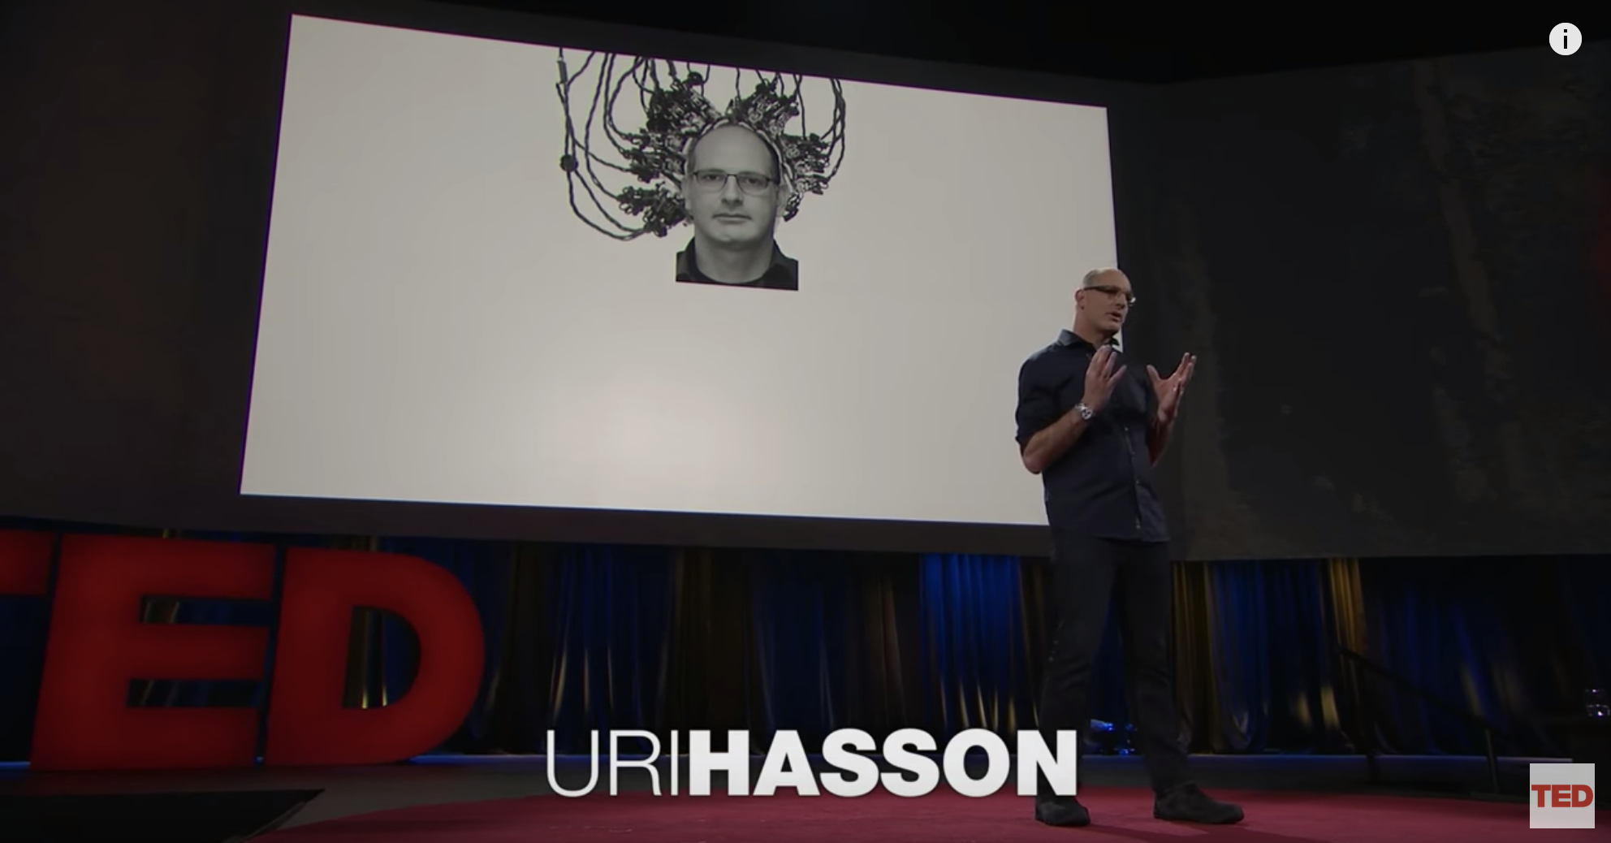
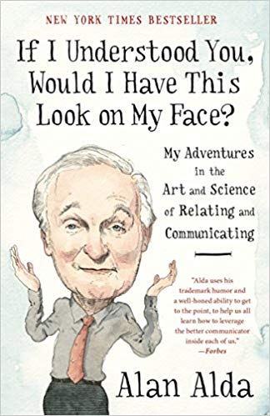
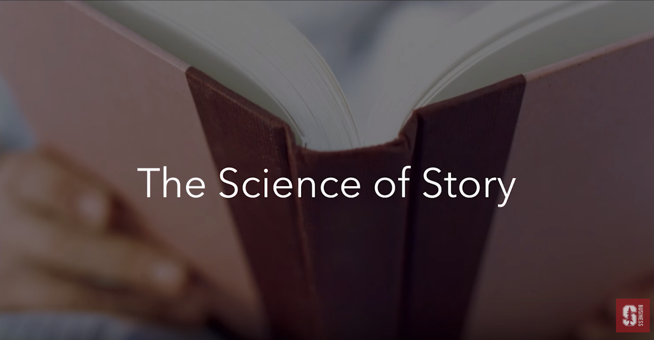
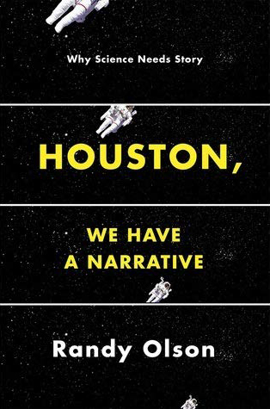
RESOURCES
Storytelling and brain research
Books on science communication
Your Brain on Story
Kendall Haven
tinyurl.com/rscm8tx
Thing Explainer
by Randall Munroe
This is Your Brain
on Communication
Uri Hasson
tinyurl.com/vkhwuee
If I Understood You,
Would I Have This
Look on My Face
by Alan Alda
Science of Storytelling
Ash Agarwal, Jeff Hau, Dylan Moore, Wendy Tsu
tinyurl.com/sxtqw38
Houston, We Have
a Narrative
by Randy Olson
Notes:
Storytelling and the brain research:
https://www.youtube.com/watch?v=zGrf0LGn6Y4&t=1055s
https://www.youtube.com/watch?v=FDhlOovaGrI&t=197s
https://www.youtube.com/watch?v=dIA2vxqvn04&t=186s
Books on science communication:
Thing Explainer by Randall Munroe
If I Understood You, Would I Have This Look on My Face by Alan Alda
Houston, We Have a Narrative by Randy Olson

Slide 22
3-minute thesis
https://youtu.be/IHXZscrV24E​
Further tips and tricks from student ​

