Slide 1
Meredith Fore
Science Writer, Chicago Quantum Exchange

Slide 2
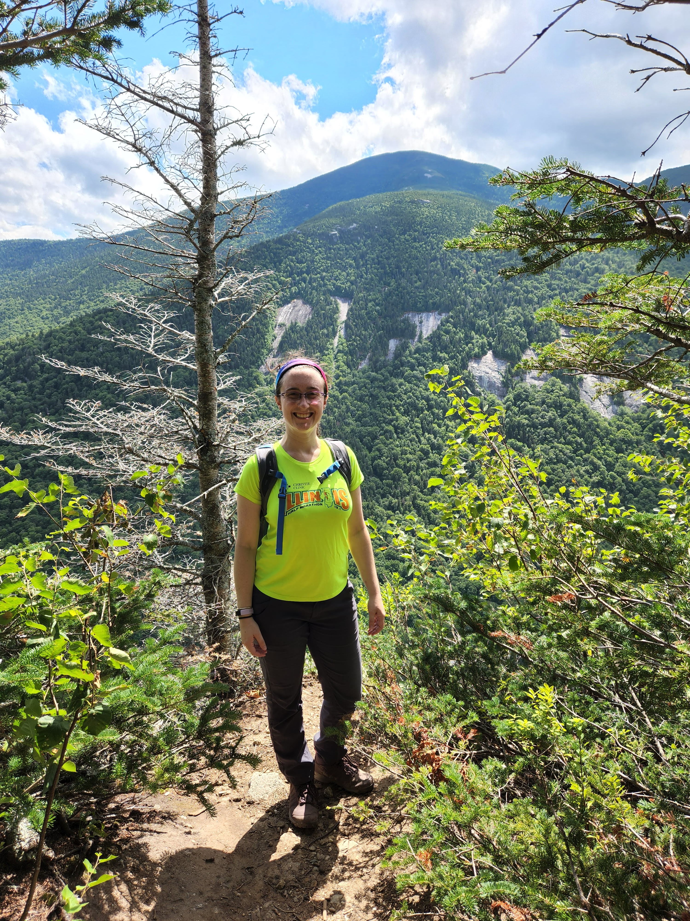
Background
Naperville, IL
University of Illinois Urbana-Champaign
Bachelor’s in Physics
Theoretical condensed matter
University of Washington
Master’s in Physics
Four years of a PhD program before leaving
Theoretical physical chemistry
AAAS Mass Media Fellow at WIRED
Freelance writer
Inside Science, Symmetry, WIRED, Physics, Live Science, Chemical & Engineering News, APS News
Notes:
BIGGEST SWERVE IN MY CAREER PATH

Slide 3
My Career Path
College
Grad School – working on my PhD
Took science journalism course – decided not for me
Went to women in STEM conference
2011
2017
AAAS Mass Media Fellowship
2 years of freelancing
2019
Met PhD science writer
Took ENGAGE class at UW, joined the board
Become the science writer for the CQE!
2021
First freelance article!
First science writing job, mechanical engineering department
2018
AAAS Annual Conference
Joined NASW, got added to FB group
Notes:
Bring up Jessica Marshall and Tia Ghose, Jane Hu

Slide 4
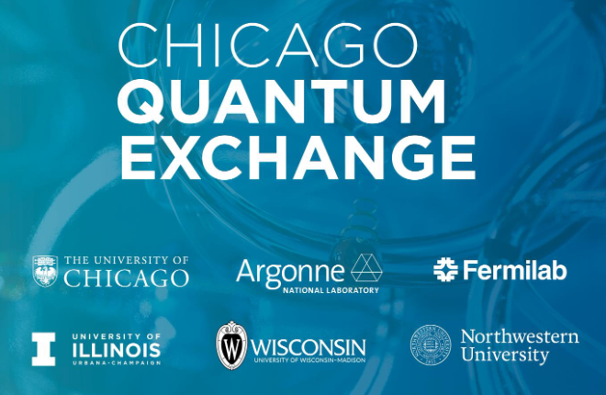
Microsoft
Intel
Toshiba
IBM
Ohio State U.
U. New South Wales
P33
A hub for the science and engineering of quantum information
The Quantum Prairie
Notes:
150+ researchers
Connect people, drive research forward, help train the quantum workforce
Make this region the heart of quantum technology research in the US

Slide 5
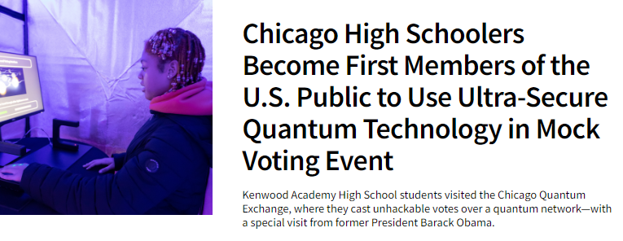
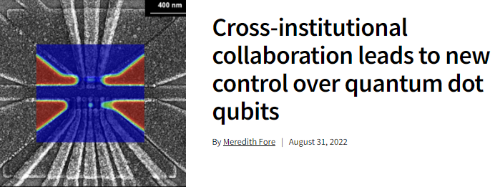
What I Do
Write!
Press releases
Research
New partners/events
Subject articles
Researcher profiles
Communications
Coordinate with members & partners
Compile quarterly newsletter
Edit others’ work
Promote our events

Slide 6
Resources
National Association of Science Writers* nasw.org
The Open Notebook theopennotebook.com
NPR SciCommers sites.bu.edu/scicommers
AAAS Mass Media Fellowship* aaas.org/programs/mass-media-fellowship
Open Quantum Initiative Undergraduate Fellowship
Quantum research at a CQE institution
Deadline: Feb 5

