Slide 1
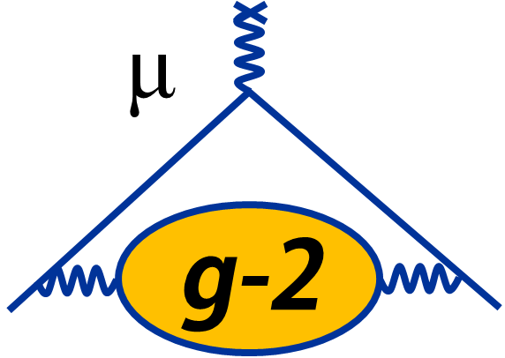
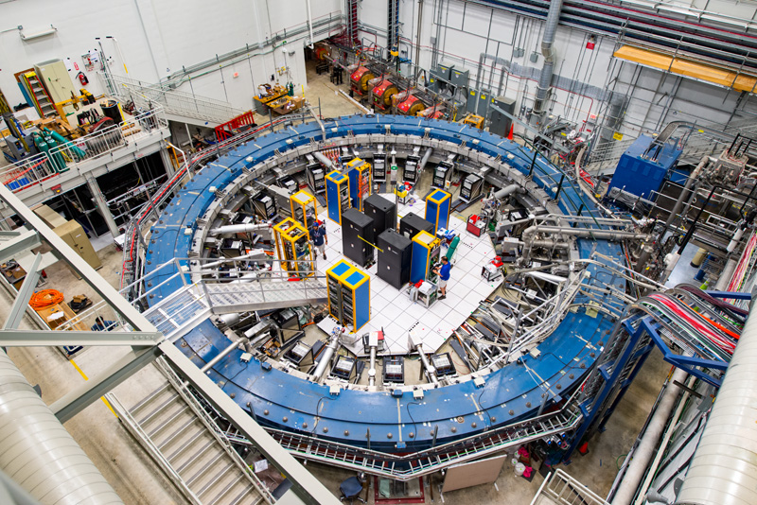

Graduate research on Muon $g−2$
Lucy Bailey
CUWiP
22/1/2023

Slide 2
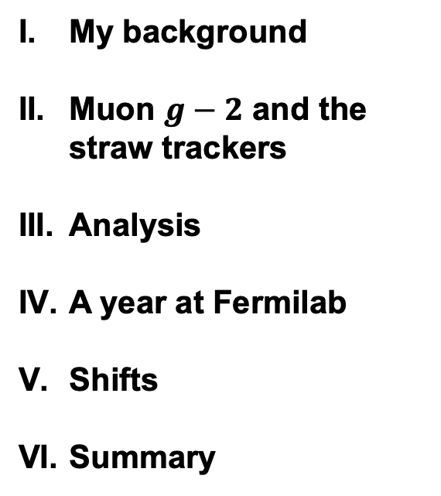
Overview
My background
Muon $g−2$ and the straw trackers
Analysis
A year at Fermilab
Shifts
Summary

Slide 3
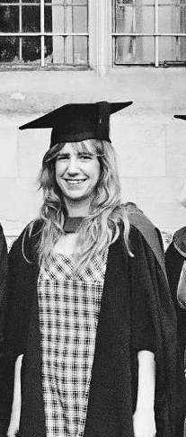
I. My background
Graduated from the University of Bristol with an MSci in Theoretical physics.
Started my PhD program in September 2021 with the high energy physics group at UCL, working on Muon g-2 .
Spent the first term completing some lectures on the Standard Model and statistics.
Been working on research for just over a year.

Slide 4
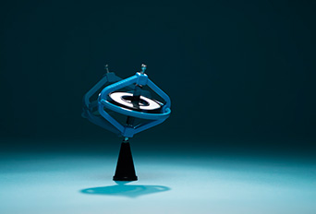
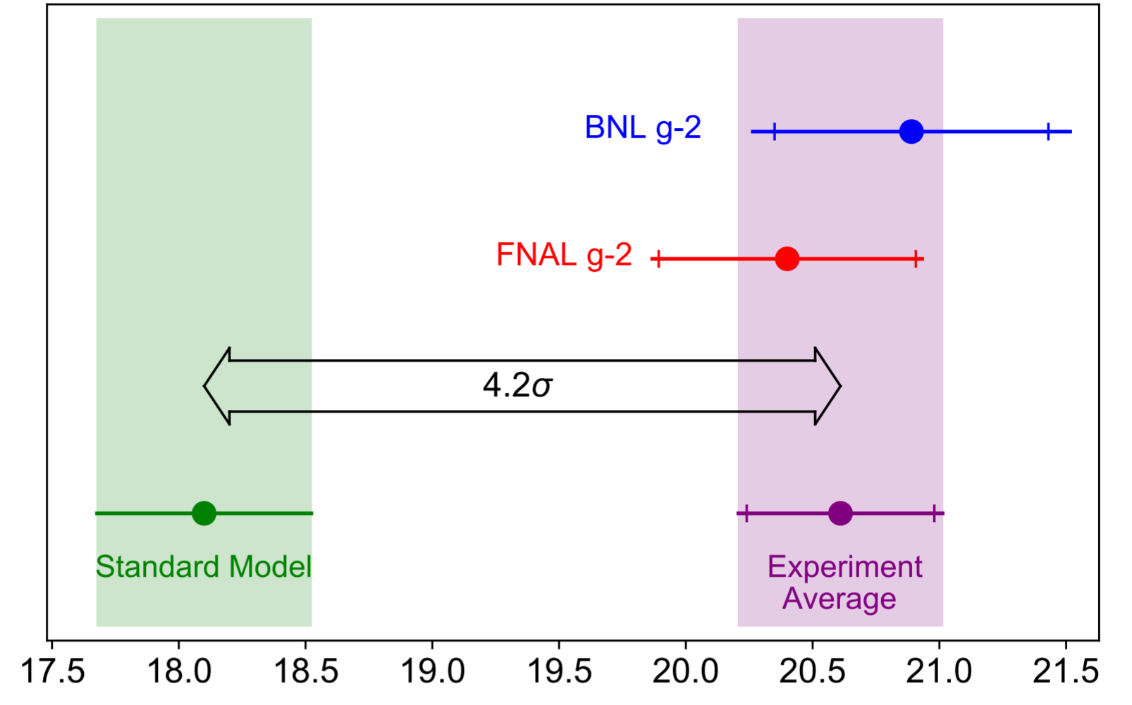




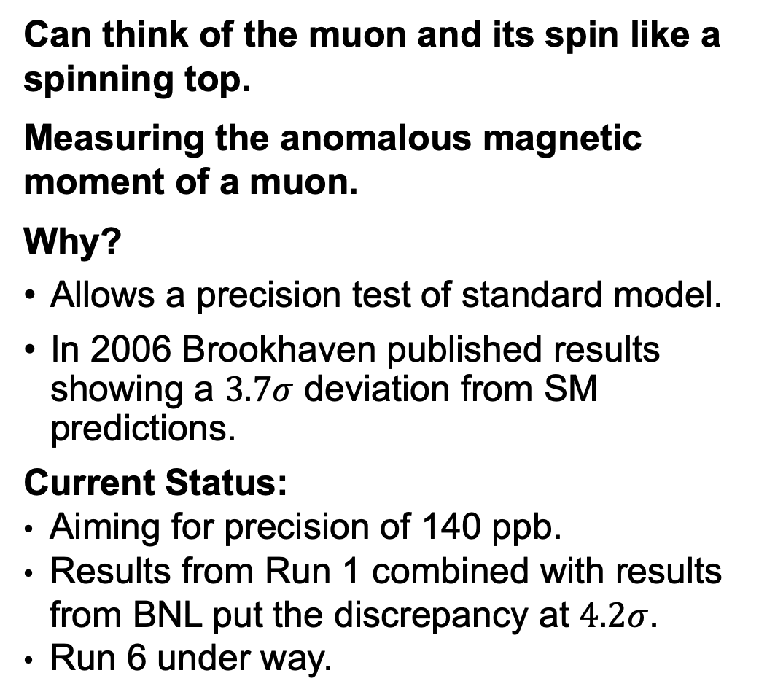
II. Muon $g−2$
Can think of the muon and its spin like a spinning top.
Measuring the anomalous magnetic moment of a muon.
Why?
Allows a precision test of standard model.
In 2006 Brookhaven published results showing a $3.7σ$ deviation from SM predictions.
Current Status:
  Aiming for precision of 140 ppb.
  Results from Run 1 combined with results from BNL put the discrepancy at $4.2σ$.
  Run 6 under way.
$$\vec{B}$$
$$\vec{s}$$
$$μ^{+}$$

Slide 5
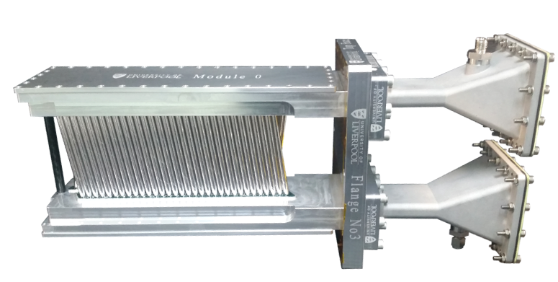
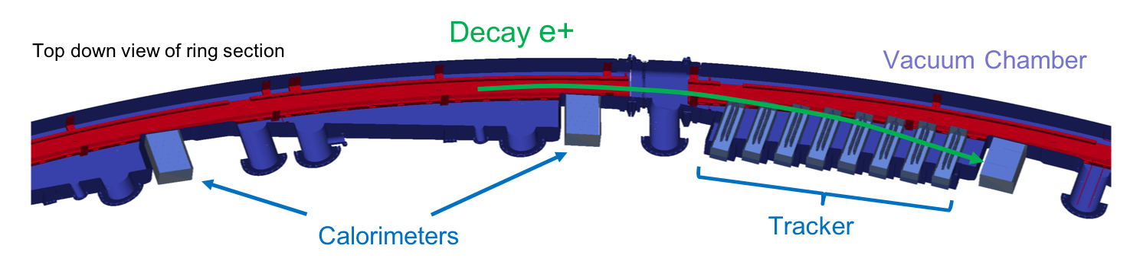
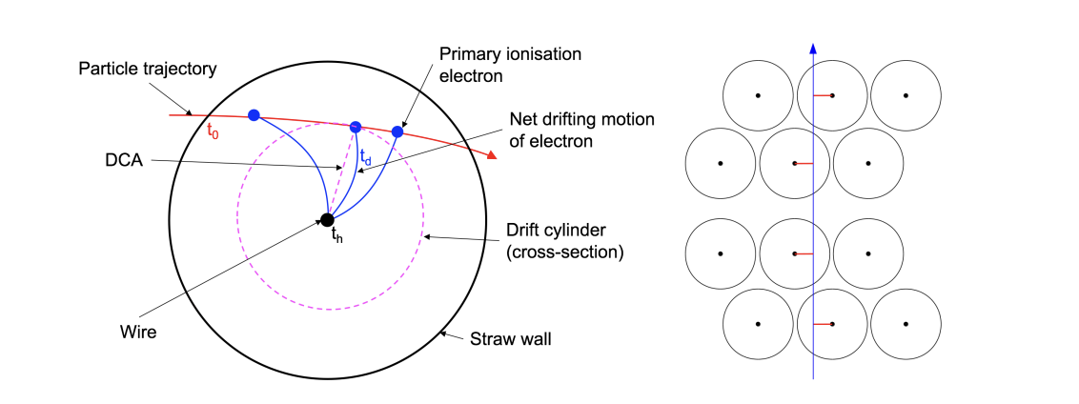
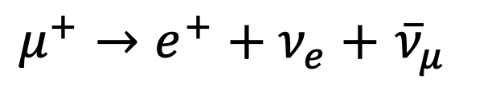
II. Straw trackers
$μ^{+}→e^{+}+ν_{e}+$ ${\overline{ν}}_{μ}$
Positrons ionise the gas in straw → electrons travel to the central wire → signal is produced.
Forwards extrapolation → calorimeters → pile-up identification
Backwards extrapolation → muon decay point → beam profiling
Track → vertical decay angle → EDM measurement

Slide 6
III. Analysis
Looking at ways we can improve our tracking to increase the number of tracks and reduce statistical errors.
- Checking the calibrations are still working.
- Assessing the appropriateness of the quality cuts.
Analysing the tracker data to extract a measurement of the muon EDM (electric dipole moment).
Running large analysis jobs a cluster.
Learning to write ROOT and C++ code.

Slide 7
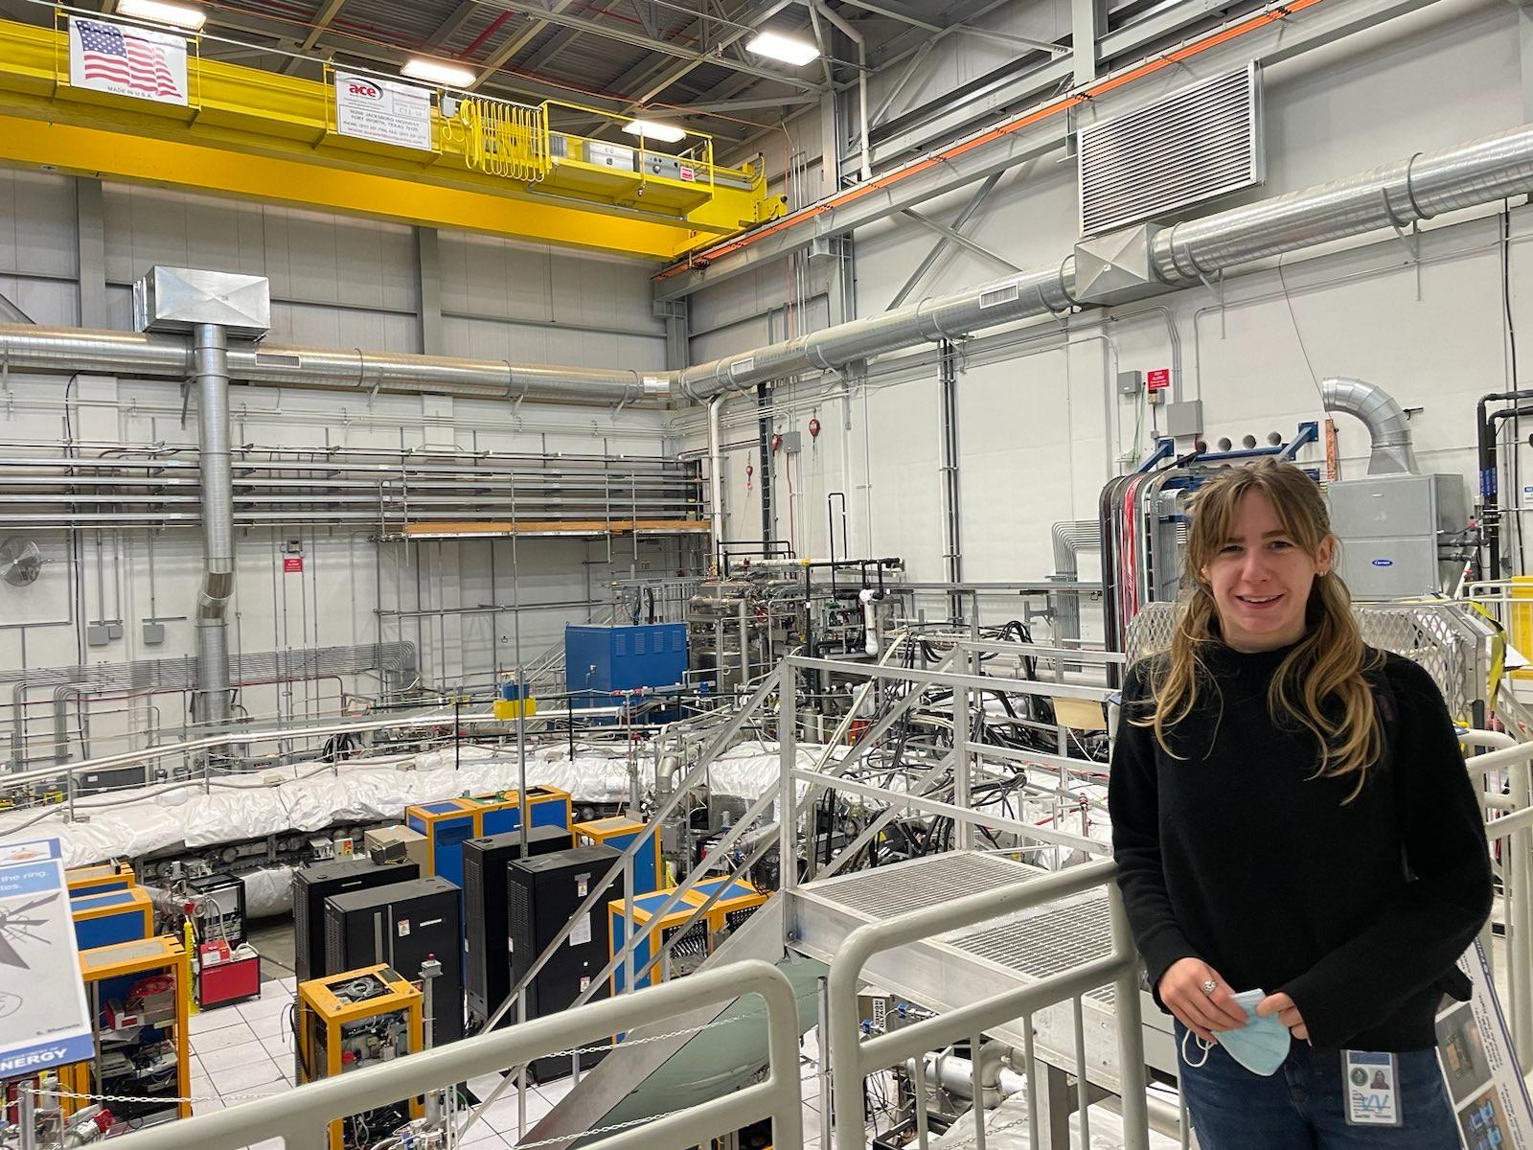
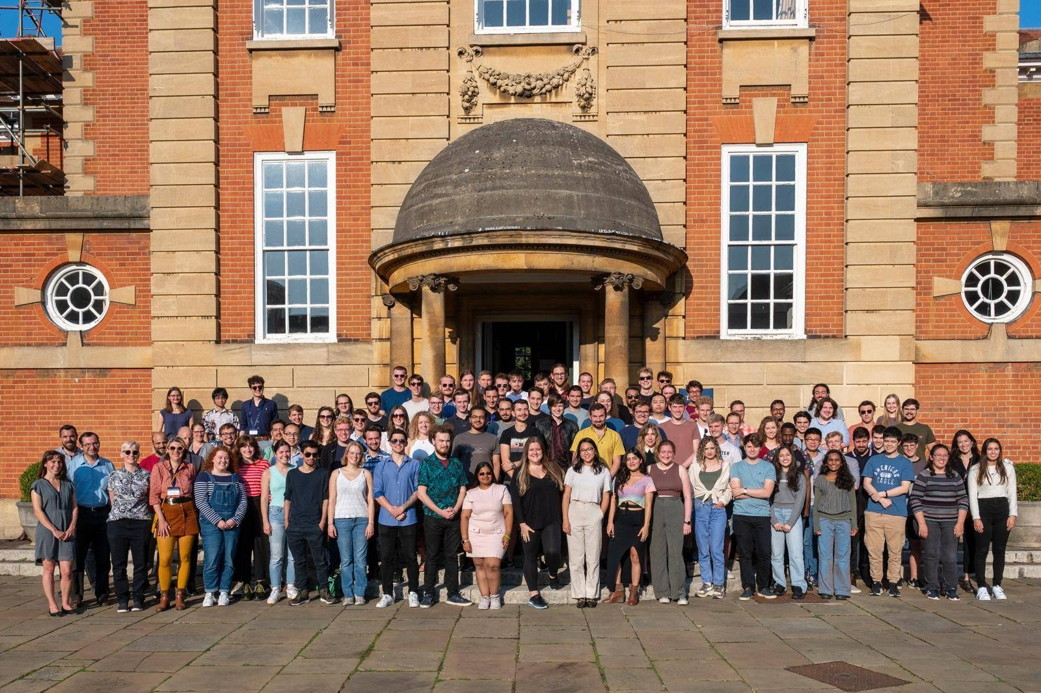
IIII. A year at Fermilab
As part of my PhD, I am spending a year working at Fermilab.
Allows me to get some hands on experience with the experiment.
Great chance to meet other students working on different experiments and more experienced scientists.
Other opportunities for travel...
Attended a Summer School in Oxford, lectures on the Standard Model and phenomenology.
Collaboration meetings hosted by different institutions.

Slide 8
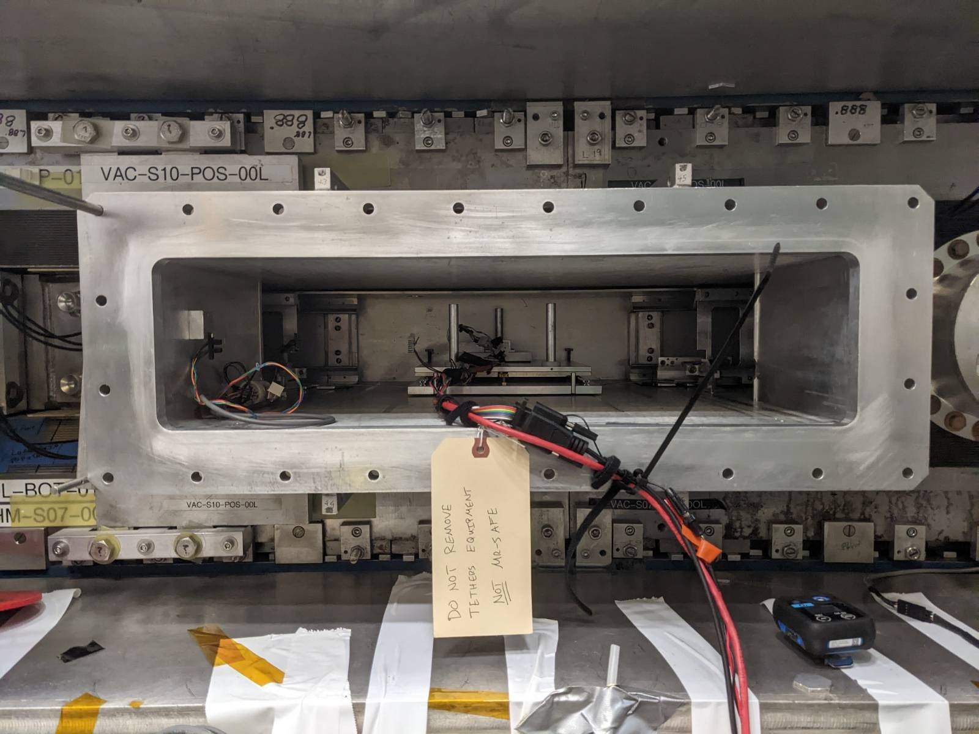
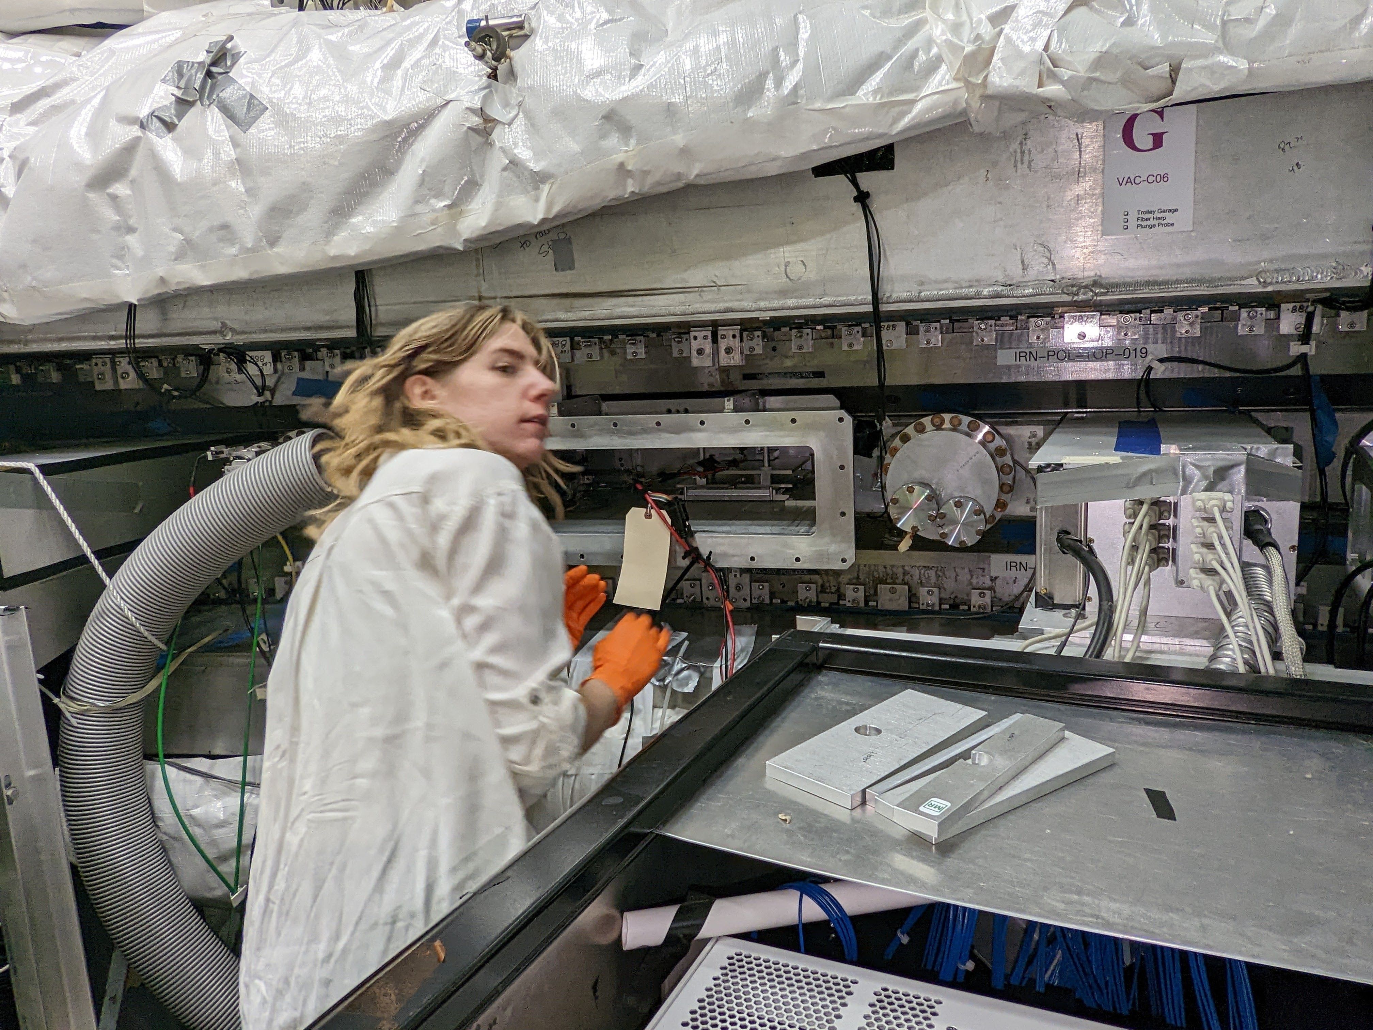
IIII. Getting hands-on
Radial field measurement
Important for reducing systematic errors, especially for the EDM measurement.
Done during the summer shutdown to take a direct measurement inside the ring.
Tracker leaks
Working in a clean room.
Looking for leaks in the trackers using a flammable gas detector.

Slide 9
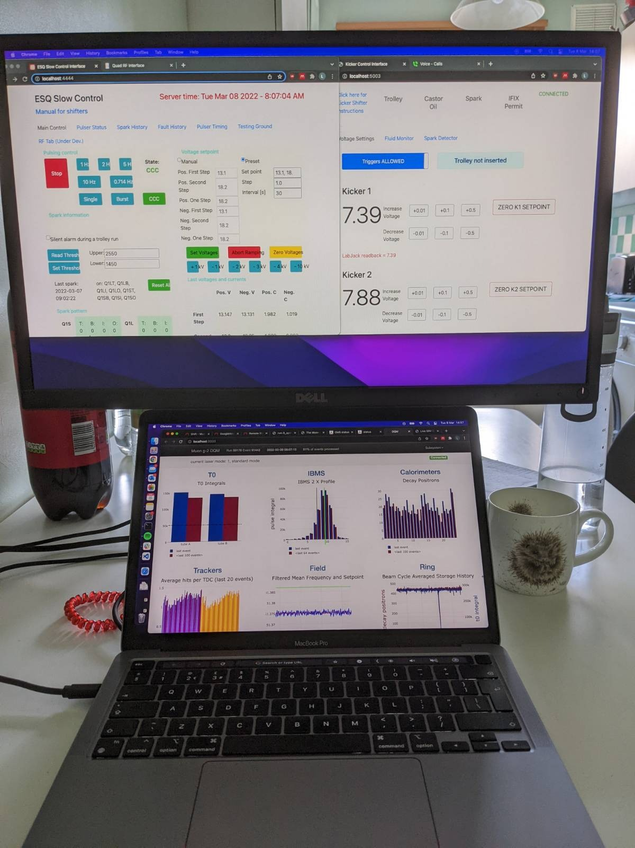
IV. Shifts
Working on a running experiment:
Taking shifts on the experiment.
- Adapted to remote shifts during the pandemic.
- Monitoring the main components of the experiment.
- Completing checklists.
- Fixing smaller issues such as restarting the DAQ or recovering from sparks.
- Calling the appropriate expert if required.
’Offline’ shifts monitoring and submitting production jobs.

Slide 10
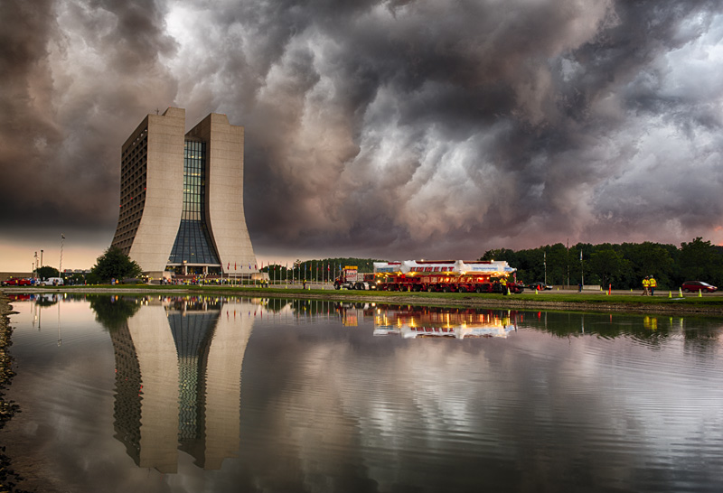
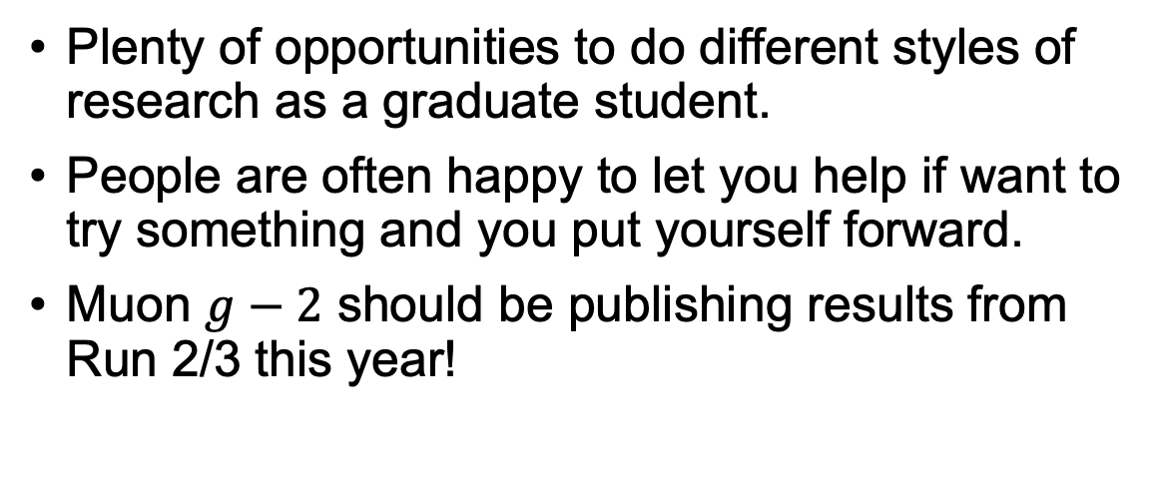
Summary
Plenty of opportunities to do different styles of research as a graduate student.
People are often happy to let you help if want to try something and you put yourself forward.
Muon $g−2$ should be publishing results from Run 2/3 this year!
Thanks for listening!

Slide 11
Backup

Slide 12
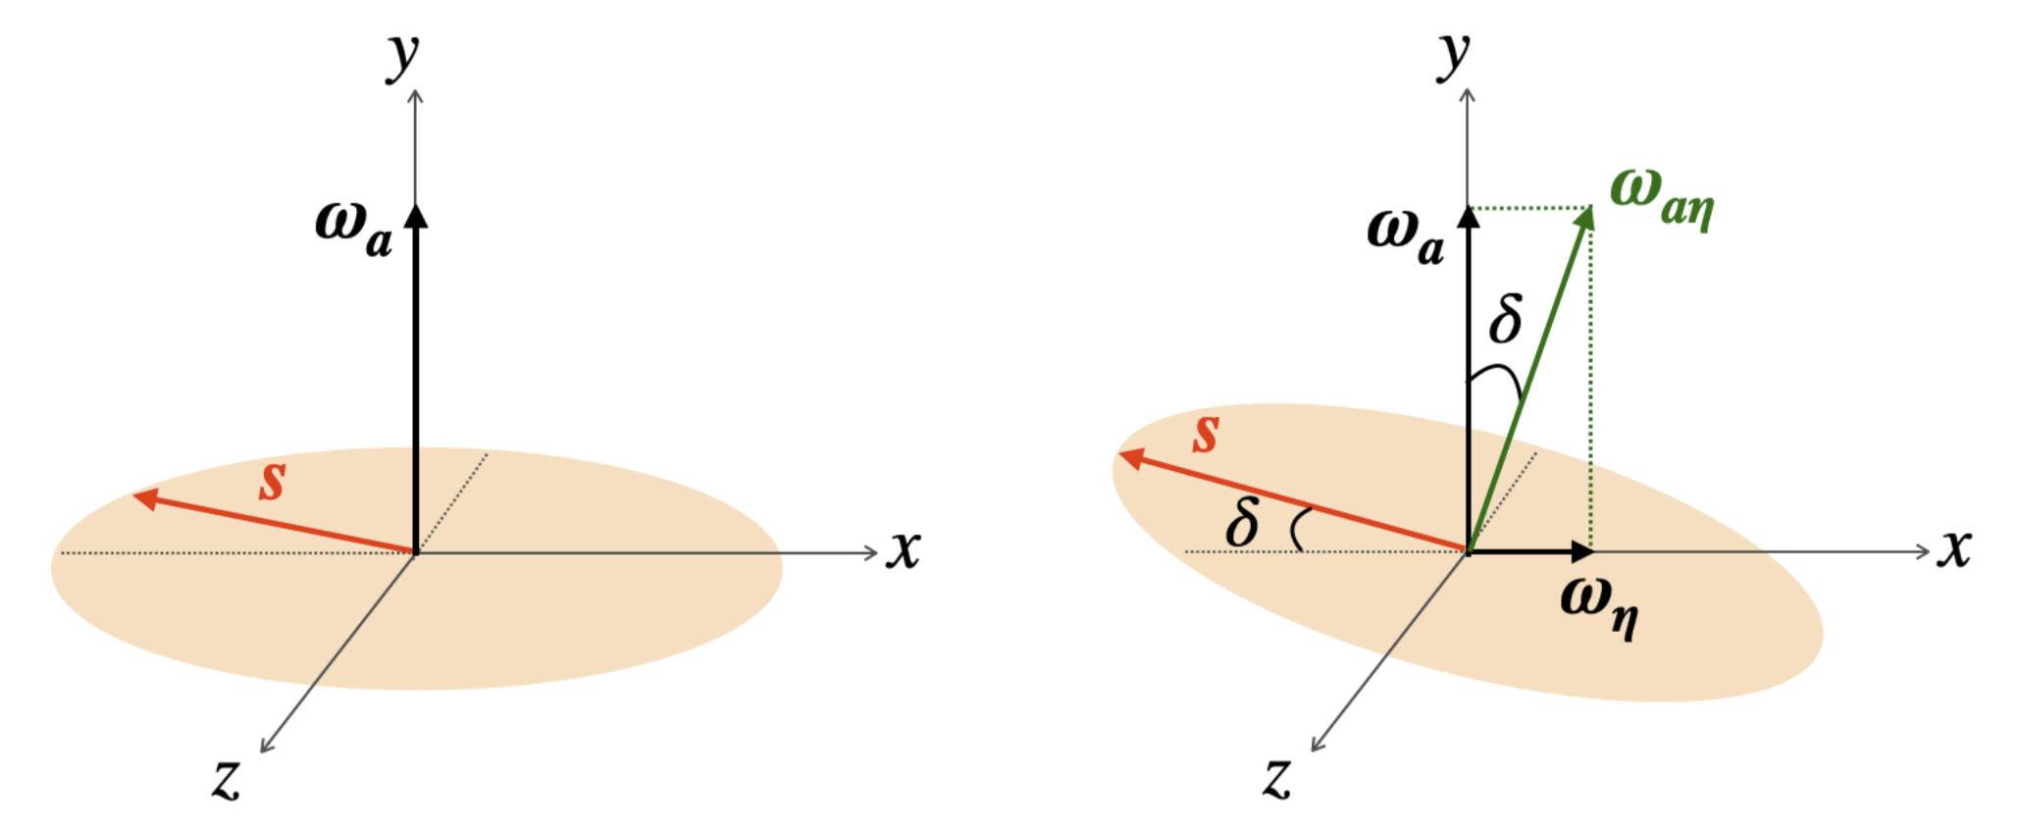
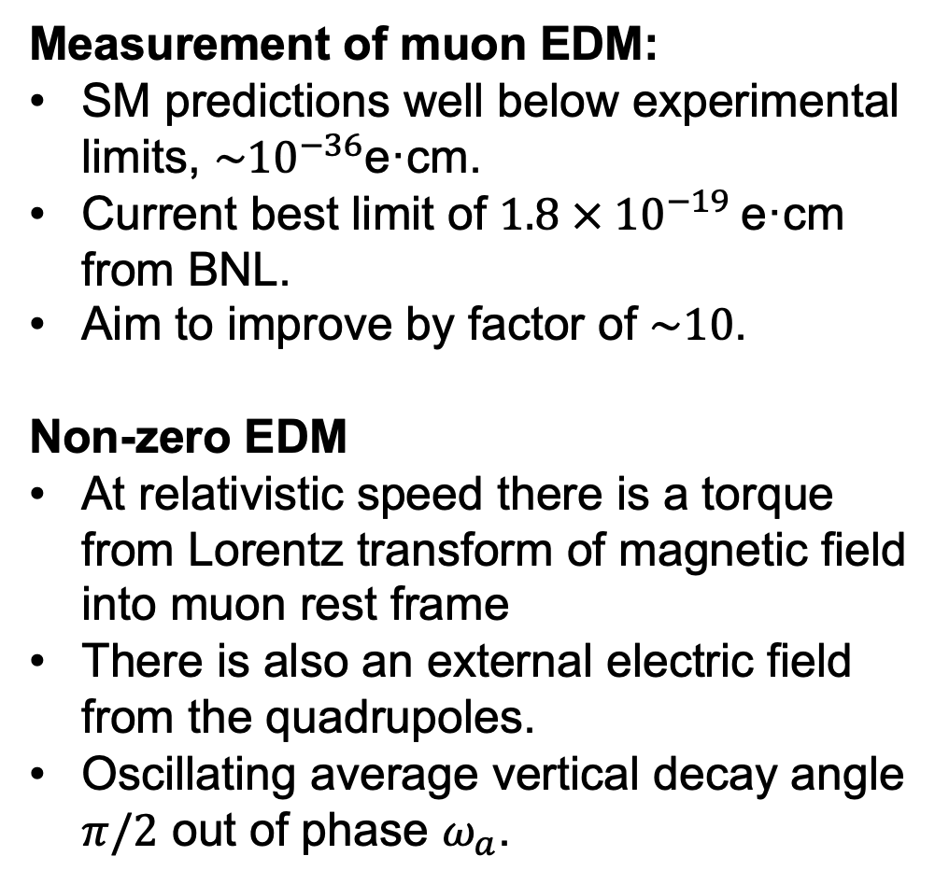
EDM
Measurement of muon EDM:
SM predictions well below experimental limits, $\sim {10}^{−36}$e·cm.
Current best limit of $1.8 × {10}^{−19}$e·cm from BNL.
Aim to improve by factor of $\sim 10$.
Non-zero EDM
At relativistic speed there is a torque from Lorentz transform of magnetic field into muon rest frame
There is also an external electric field from the quadrupoles.
Oscillating average vertical decay angle $π/2$ out of phase $ω_{a}$.
Radial magnetic field
Any radial component of the vertical storage field can will also tilt the spin precession plane.
Measurement allows us to reduce this systematic uncertainty.

