Slide 1
Impostorism in Science
What is it? What can we do about it?
Rachel Ivie
January 22, 2023

Slide 2
Topics today
The imposter syndrome
Impostorism
Why reducing impostorism is important
Research based on this in physics/astronomy
Solutions

Slide 3
Imposter syndrome
The imposter syndrome concept was first used by psychologists Pauline Clance and Suzanne Imes in 1978
They described highly successful women who nevertheless had difficulty internally recognizing their own achievements and continued to feel as though they were imposters in their careers.
Since that time, further research has demonstrated that men can also exhibit characteristics of the imposter syndrome.
Notes:
However, this concept is VERY gendered

Slide 4
Imposter syndrome characteristics
“Believing that one's accomplishments came about not through genuine ability, but as a result of having been lucky, having worked harder than others, and having manipulated other people's impressions.” Langford and Clance, 1993
Attribution of your own success to factors beyond your control, such as luck, while attributing the success of others to skill or knowledge.
Discounting successes by attributing them to hard work, while believing that others sail through based on natural talent.
Another version of the imposter syndrome is to feel that you have in some way, probably not consciously, tricked or fooled your colleagues into believing that you are much smarter than you really are.
Notes:
Perhaps you studied really hard and made a high score, but secretly you “know” that these achievements don’t reflect your true “inadequate” self.
I don’t belong here, and some day, someone is going to figure that out.

Slide 5
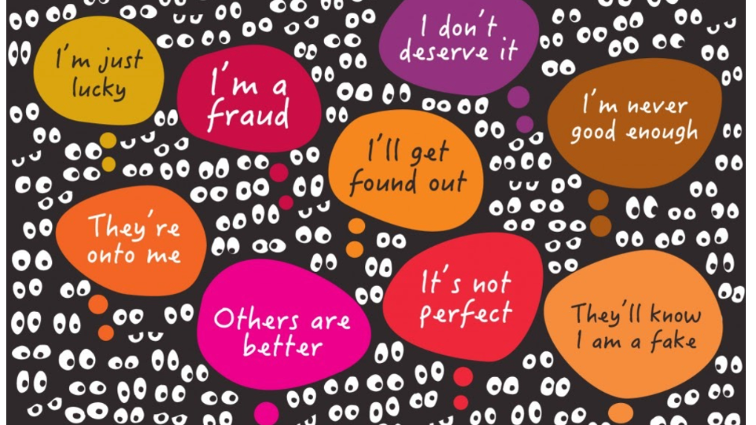
https://www.directactioneverywhere.com/theliberationist/do-you-suffer-from-imposter-syndrome

Slide 6
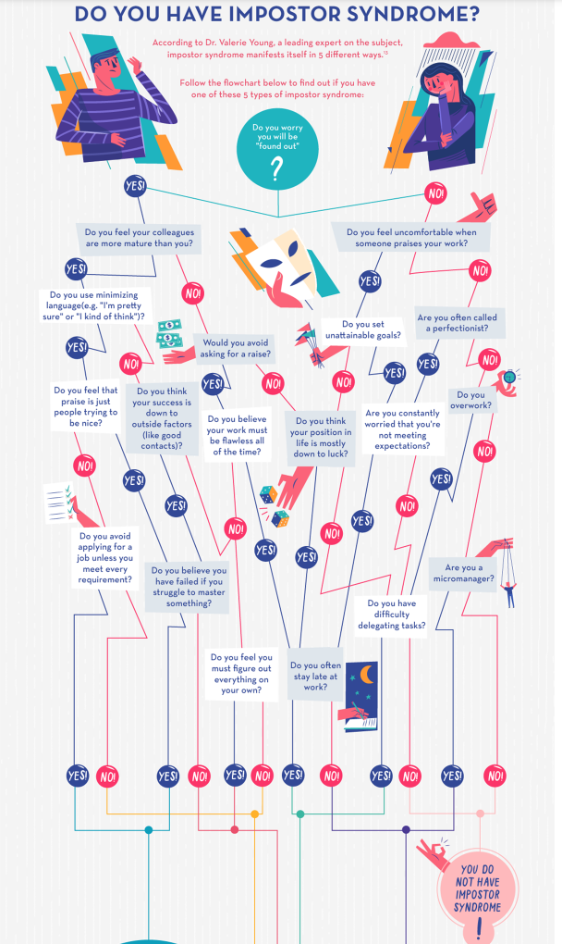
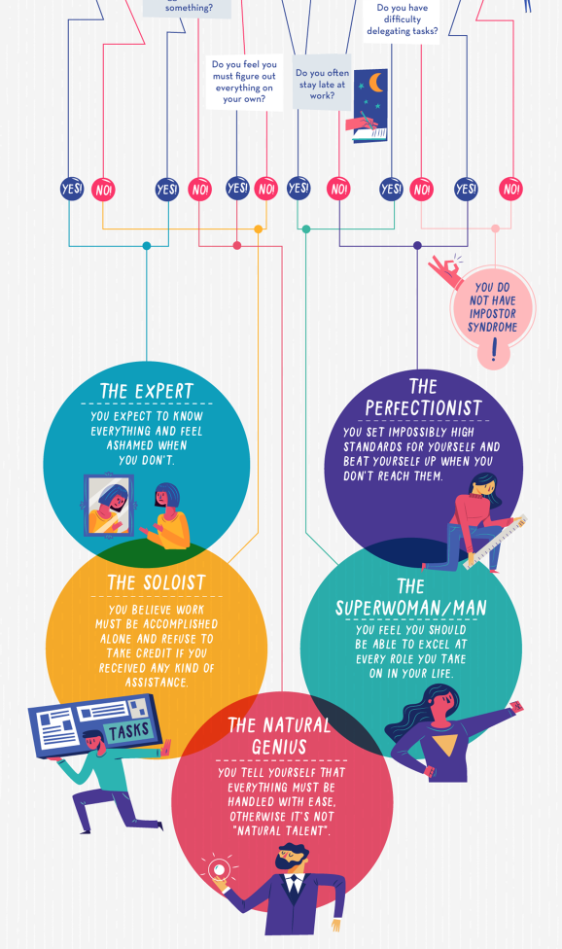
https://www.visualcapitalist.com/are-you-suffering-from-impostor-syndrome/

Slide 7
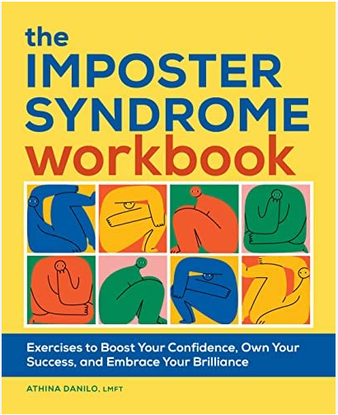

Slide 8
How has this concept been used in research?
Often used to try to explain why women drop out or are less successful
We wanted to know whether women who had gone to grad school in astronomy or astrophysics would be less likely than men to stay in astronomy

Slide 9
Longitudinal Study of Astronomy Graduate Students (funded by NSF)
Includes everyone who was in graduate school in astronomy or astrophysics in the US, 2006-07
Data have been collected from the same cohort of people in order to document individual career paths
Three waves of data have been collected:
2007-08
2012-13 five years later
2015-16 eight years later
Notes:
More than 1100 to first survey
More than 800 to second survey

Slide 10
Measures of imposter syndrome in our study
In general, people tend to believe I am more competent than I really am.
Sometimes, I am afraid others will discover how much knowledge or ability I lack.
At times, I feel I am in my current career position though some kind of mistake.
When I succeed, it is because I work much harder than others.
The major cause of success in my life is my high ability.
I feel highly confident that I will succeed in my future career.
I am at least as smart as my peers.
Notes:
The tendency to agree with items one through four below is indicative of the imposter syndrome.
The tendency to disagree with items five through seven below also is indicative of the imposter syndrome.

Slide 11
Interpretation of Imposter Syndrome Measures for Women, published 2011
Imposter Syndrome Measure | Women generally | Response Indicates …
Sometimes, I am afraid others will discover how much knowledge or ability I lack.** | Agree | Imposter syndrome
The major cause of success in my life is my high ability.* | Disagree | Imposter syndrome
I feel highly confident that I will succeed in my future career.** | Disagree | Imposter syndrome

Slide 12
Maya Angelou
Notes:
Speaking at Clinton’s inauguration
I know why the caged bird sings

Slide 13
Imposter?

Slide 14
Why would Maya Angelou feel like an imposter?

Slide 15
It’s not 1978
We now have a better understanding of causes of feeling like an imposter.
Now we refer to “impostorism.”
An example

Slide 16
Difference between imposter syndrome and impostorism
Imposter syndrome connotes that there is something wrong with the person
Impostorism connotes that the problem is with other people or is systemic
Notes:
The term Impostorism is designed to sound like racism or sexism

Slide 17
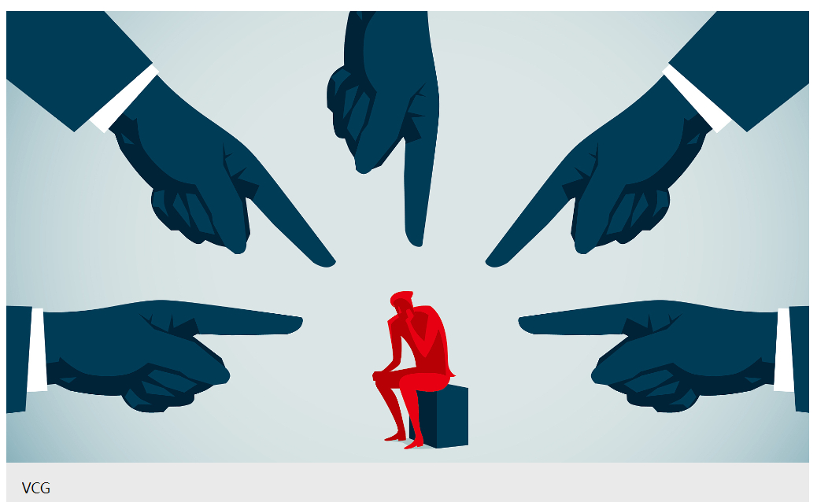
Imposter syndrome
You lack confidence
You need training
You need a workbook
You need therapy
You . . .
https://news.cgtn.com/news/2020-04-14/COVID-19-no-finger-pointing-allowed--PGacVekJ5S/index.html

Slide 18
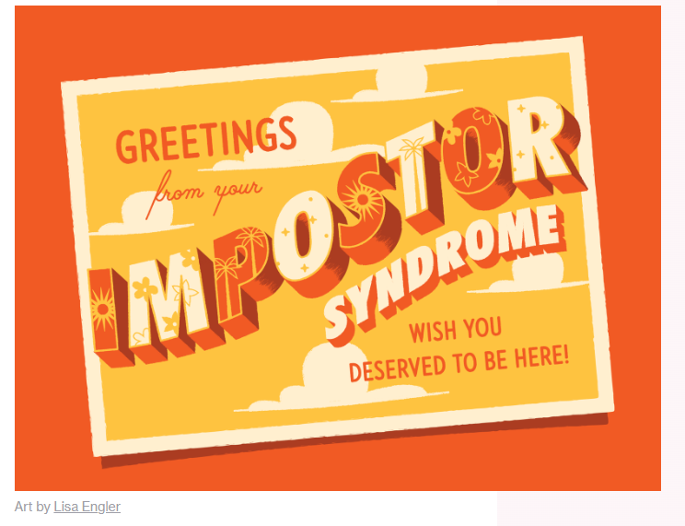
https://alltogether.swe.org/2022/07/am-i-doing-enough-imposter-syndrome-during-covid-19/

Slide 19
Impostorism
Someone made you feel less than
Someone ignored you
Someone took credit for your work
There are not many people like you
You are in a new situation
Expectations are not clear
You don’t have as many opportunities as similar colleagues
You make less money than similar colleagues

Slide 20
Impostorism
Microaggressions
Harassment/bullying
Racism
Gender discrimination
Ableism
Anti-LGBTQ+
Other kinds of discrimination
https://intheworks.helpscout.com/its-not-imposter-syndrome/
Notes:
What’s this lurking behind her?

Slide 21
Experiencing harassment and discrimination by gender and race/ethnicity, Longitudinal Study of Astronomy Graduate Students, Second Survey
Notes:
Not only is it related to having a marginalized status, it’s related to being a postdoc

Slide 22
Why would Maya Angelou feel like an imposter?

Slide 23
In our research we wanted to know if showing characteristics of the imposter syndrome made it more likely that you would leave the field

Slide 24
Second survey Is working in or out of field affected by
Being male or female (40% female respondents)
Taking a postdoc
Two-body problem (a work/family balance problem that refers to the difficulty of finding 2 jobs in same geographic area)
Having a mentor other than advisor
Relationship with advisor
Imposter syndrome (at time of first survey)
Time since degree

Slide 25
Model we tested, Longitudinal Study of Astronomy Graduate Students
Gender
Post-doc
Mentor other than advisor
Working out of the field
Advisor relationship
Imposter score
Two-body problem
Time since degree

Slide 26
Factors that influence working out of field
Notes:
In multivariate models of working out of field, we controlled for the two-body problem, having a mentor other than one’s advisor in graduate school, time since degree, completing a postdoc, advisor rating, the imposter syndrome, and changing advisors during graduate school. We found that two measures of the two-body problem significantly increased the odds of working outside of astronomy or physics: relocating for spouse or partner, and limiting career options. We also found that changing advisors in graduate school significantly increased the odds of working outside the field. On the other hand, completing a postdoc significantly increased the odds of working in physics or astronomy. The other variables we tested had no significant effects. The numbers on the horizontal axis reflect odds ratios calculated from logistic regression results.

Slide 27
Why is reducing impostorism important?
We should do what we can to reduce the forces that cause impostorism
Impostorism causes problems in physics

Slide 28
Percentage of Bachelor's Degrees Earned by Women in Selected Fields,
Classes 1984 Through 2018
Source: National Center for Education Statistics. Data compiled by AIP Statistical Research Center.
Notes:
Physics 2017- 20% women
Astronomy 2017- 33% women
All fields- 57% women

Slide 29
Percentage of PhDs Earned by Women in Selected Fields,
Classes 1982 Through 2018
Source: National Center for Education Statistics. Data compiled by AIP Statistical Research Center.
Notes:
Physics 2018 21% women
Astronomy 2018 30% women
All fields 2017- 46% women

Slide 30
Percentage of Bachelor’s Degrees in Physics Earned by African American and Hispanic People
Notes:
Hispanic, 19%
Black 13.5%

Slide 31
Race and Ethnicity of Physics Bachelors Classes of 2017 and 2018 (2-Year Average)
 | Number | Percent of all Physics Bachelors
White | 6140 | 77
Asian American | 651 | 8
Hispanic American | 686 | 9
African American/Black | 284 | 4
Other US citizens | 228 | 3
Total US Citizen | 7989 | 100
Notes:
Non-citizens = 9%
Overall ratio phd/bach =12%
White 14%
Asian Americans 14%
Hispanic 6%
For Black, 3%

Slide 32
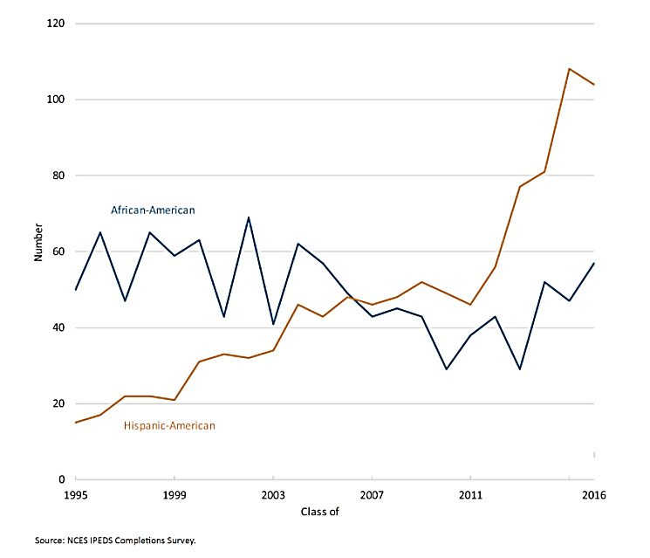
Number of African American and Hispanic Women Earning Physics Bachelor’s Degrees

Slide 33
Science is more innovative with diversity
The Diversity–Innovation Paradox in Science (Hofstra et al., 2020)
“By analyzing data from nearly all US PhD recipients and their dissertations across three decades, this paper finds
demographically underrepresented students innovate at higher rates than majority students,
but their novel contributions are discounted and less likely to earn them academic positions.
The discounting of minorities’ innovations may partly explain their underrepresentation in influential positions of academia.” (PNAS April 14, 2020, https://doi.org/10.1073/pnas.1915378117)
Notes:
Is there something wrong with the students? NO

Slide 34
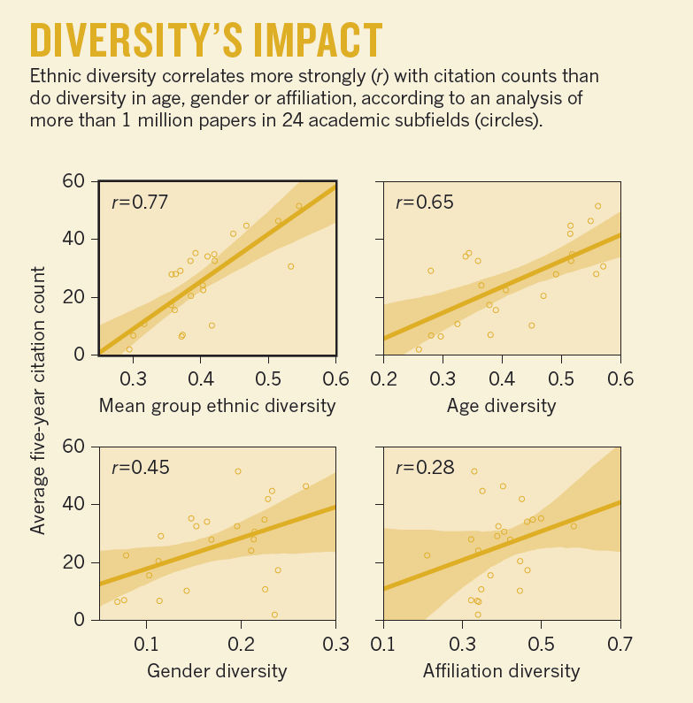
Science goes farther with diversity
Notes:
It’s not just diversity that we need to work toward

Slide 35
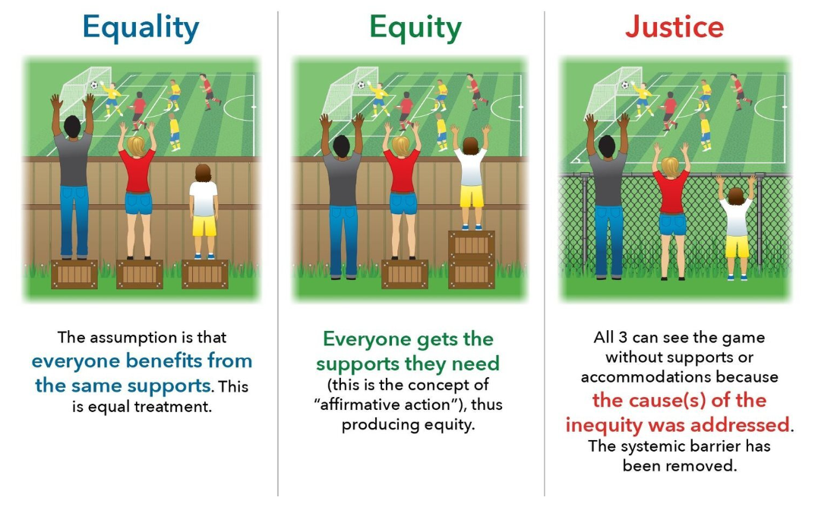
https://www.mobilizegreen.org/blog/2018/9/30/environmental-equity-vs-environmental-justice-whats-the-difference

Slide 36
Goal:
https://dartmed.dartmouth.edu/spring19/html/features_impostor_syndrome/

Slide 37
Things that reduced impostorism in the Longitudinal Study of Astronomy Graduate Students
Feeling mentored: this caused people to
Believe they will succeed
Believe that they’re at least as smart as their peers.
Financial support: this led to people
Believe that they will succeed
Believe that they’re as at least as smart as peers
Disagree that “people think I’m more competent than I really am”
Disagree that “others will discover I lack ability or knowledge”
Notes:
Financial support other than TA, RA, or fellowship
Neither of these things has anything to do with the respondents’ personally

Slide 38
Solutions
Self-disclose. Everyone struggles in school. This can help other people realize they aren’t the only one.
Participate in mentoring. Could YOU mentor or help someone?
Participate in DEI initiatives at your school.
Before you think: What’s wrong with someone else? Ask yourself: What could be going on in this situation that I don’t see?
Work for diversity and justice whenever you can.
You’re here; so now you know!

Slide 39
Thank you!
Thanks to my colleagues: Susan White, Starr Nicholson, Raymond Y. Chu, and Patrick Mulvey
Thanks to the National Science Foundation (1347723)
Rachel Ivie
rivie@aip.org

