Slide 1
Quantum Anomalous Energy Effects on the Nucleon Mass
Yizhuang Liu , University of Regensburg
Based on work with XD.Ji, 2101.04483

Slide 2
Outline
Proton Mass Decomposition
Anomalous Energy Effects
QAE and mass decomposition in 1+1 non-linear sigma model
Anomalous Energy as Dynamical Higgs Effect

Slide 3
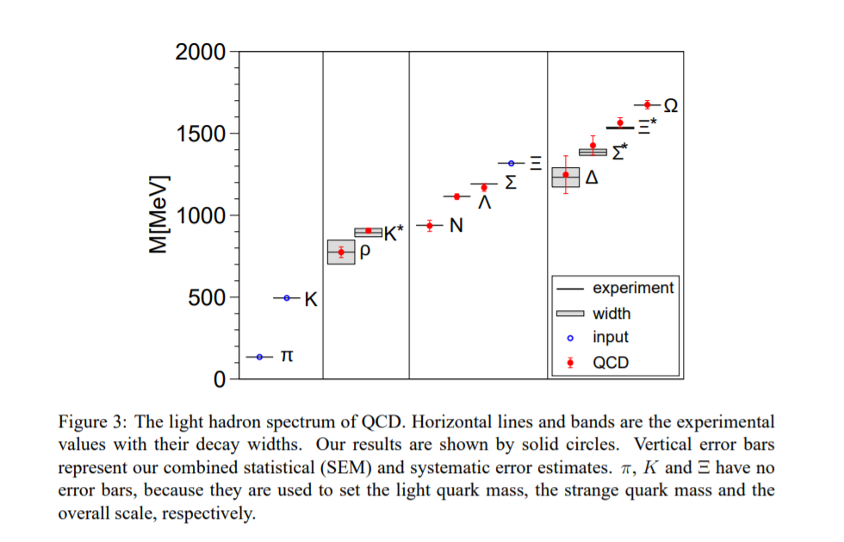
Proton Mass Decomposition
S.Durr, Z. Fodor, J. Frison, C. Hoelbling, R. Hoffmann, S.D. Katz, S. Krieg, T. Kurth, L. Lellouch, T. Lippert, K.K. Szabo, G. Vulvert, Science 322 (2008)
Origin of electron mass: Higgs mechanism
Origin of proton mass: Millennium problem
High-precision numerical calculations in Lattice QCD
Ab-initio Determination of Light Hadron Masses

Slide 4
Proton Mass Decomposition
Sz. Borsanyi, S. Durr, Z. Fodor, C. Hoelbling, S.D. Katz, S. Krieg, L. Lellouch, T. Lippert, A. Portelli, K.K. Szabo, B.C. Toth, Science 347 (2015) 1452-1455
Ab initio calculation of the neutron-proton mass difference

Slide 5
Proton Mass Decomposition
X.-D. Ji, Phys. Rev. Lett. 74, 1071 (1995) X.-D. Ji, Phys. Rev. D 52, 271 (1995)
$H=∫d^{d−1}\vec{x} T^{00 }(\vec{x})$ where $T^{μν}$ is the stress tensor.
(1,1)+(0,0): $T^{μν}={\overline{T}}^{μν}+{\hat{T}}^{μν}$.
$H=H_{T}+H_{S}$. Tensor and scalar parts.
$\left\langle H_{S}\right\rangle =\frac{1}{d}M$. Scale-setting.
$\left\langle H_{T}\right\rangle =\left(d−1\right)\left\langle H_{S}\right\rangle ,$ the Virial theorem.
Leads to virial theorm $2K+V=0$ in NR limit.
Relation between energies. No pressure for hydrogen atom.

Slide 6
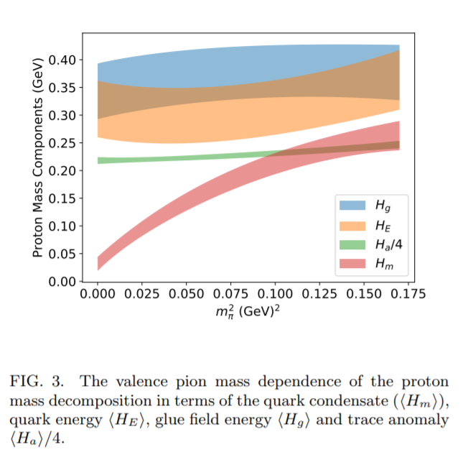
Proton Mass Decomposition
X.-D. Ji, Phys. Rev. Lett. 74, 1071 (1995) X.-D. Ji, Phys. Rev. D 52, 271 (1995)
$H_{S}=\frac{1}{4}∫d^{3}\vec{x}\left(m\overline{ψ}ψ\right)+\frac{1}{4}∫d^{3}\vec{x}\left(\frac{β}{2g }F^{2}+m γ_{m}\overline{ψ}ψ\right)$
$H_{a}$: the quantum anomalous energy (QAE).
Scale invariant.
Lattice studies.
$$H_{a}$$
Y.-B. Yang, J. Liang, Y.-J. Bi, Y. Chen, T. Draper, K.-F. Liu, and Z. Liu, Phys. Rev. Lett. 121, 212001 (2018) ETMC, Phys. Rev. Lett. 116, 252001 (2016) ETMC, Phys. Rev. Lett. 119, 142002(2017)

Slide 7
Outline
Proton Mass Decomposition
Quantum Anomalous Energy Effect
QAE and mass decomposition in 1+1 non-linear sigma model
QAE as Dynamical Higgs Effect

Slide 8
Anomalous Energy Effect
X.-D. Ji, YZ.Liu, to appear
Rescale in time: $t→t^{′}=\left(1+δλ\right)t$.
The action changes as $S→S+δλ∫dt H.$ For pure gauge theory.
$S→\frac{1}{2g_{0}^{2}}∫d^{4}x \left(−\frac{1}{1+δλ }{\vec{B}}^{2}+\left(1+δλ\right){\vec{E}}^{2}\right)$.
Naively, $H=$ $\frac{1}{2g_{0}^{2}}∫d^{4}x \left({\vec{B}}^{2}+{\vec{E}}^{2}\right)$. True for classical theory.

Slide 9
Anomalous Energy Effect
F. Karsch, Nucl. Phys. B 205, 285 (1982) J. Rothe, Phys. Lett. B 364, 227 (1995)
For quantum theory, a cutoff is needed, such as the lattice spacing.
By rescaling time, the cutoff in temporal direction is also rescales.
This leads to an anisotropic lattice, $\frac{a_{τ}}{a_{s}}≠1$.

Slide 10
Anomalous Energy Effect
F. Karsch, Nucl. Phys. B 205, 285 (1982) Rothe, Phys. Lett. B 364, 227 (1995)
$S=\frac{1}{2g_{0}^{2}(a,δλ)}∫d^{4}x′ \left(−\frac{1}{1+δλ }{\vec{B}}^{2}+\left(1+δλ\right){\vec{E}}^{2}\right)$
The coupling must depend on $δλ$ to be equivalent to the time-rescaled theory.
One can prove rigorously : $\frac{dg_{0}}{dδλ}{\left.​\right|}_{δλ=0}=\frac{1}{4}β(g_{0})$.

Slide 11
Anomalous Energy Effect
F. Karsch, Nucl. Phys. B 205, 285 (1982) J. Rothe, Phys. Lett. B 364, 227 (1995)
Thus, by taking $δλ$ derivative
$M=$ $⟨\frac{1}{2g_{0}^{2}}∫d^{4}x \left({\vec{B}}^{2}+{\vec{E}}^{2}\right)⟩$ $+$ $⟨\frac{β}{4g_{0}^{3}}$ $∫d^{4}x \left({\vec{B}}^{2}−{\vec{E}}^{2}\right)⟩$
Precisely Ji’s mass sum rule.
The anomalous contribution naturally arises due to quantum fluctuations at short distance.
Dimensional regularization is trickier.
$$H_{a}$$

Slide 12
Outline
Proton Mass Decomposition
Anomalous Energy Effects
QAE and mass decomposition in 1+1 non-linear sigma model
QAE as Dynamical Higgs Effect

Slide 13
QAE in 1+1 non-linear sigma model
V. Novikov, M. A. Shifman, A. Vainshtein, and V. I. Zakharov, Phys. Rept. 116, 103 (1984).
A more interesting case with dimensional transmutation: 1+1 non-linear sigma model.
$S=\frac{1}{2g_{0}^{2}}∫d^{2}x\sum_{i=1}^{N}{∂_{μ}π^{i}∂_{μ}π^{i}}$,
The $π^{i}$ lives on a sphere $\sum_{i=1}^{N}{π^{i}π^{i}}=1$.
The theory can be solved in large $N$ limit, $λ=g_{0}^{2}N$ fixed.

Slide 14
QAE in 1+1 non-linear sigma model
Auxiliary field $Σ:$
$S=\frac{1}{2g_{0}^{2}}∫d^{2}x\sum_{i=1}^{N}{∂_{μ}π^{i}∂_{μ}π^{i}}$+ $\frac{i}{2g_{0}^{2}}∫d^{2}xΣ(\sum_{i=1}^{N}{π^{i}π^{i}}−1)$
An effective potential $V(Σ)$ for $Σ$ is generated.
Minimum at $Σ=−im^{2},$ mass term for $π^{i}$.

Slide 15
QAE in 1+1 non-linear sigma model
V. Novikov, M. A. Shifman, A. Vainshtein, and V. I. Zakharov, Phys. Rept. 116, 103 (1984).
Dimensional transmutation:
$\frac{1}{g_{0}^{2}N}=∫\frac{d^{2}k}{{\left(2π\right)}^{2}}\frac{1}{k^{2}+m^{2}}∼\frac{1}{4π}\ln{\frac{Λ_{UV}^{2}}{m^{2}}}$ $→β\left(g_{0}\right)=−\frac{Ng_{0}^{3}}{4π}$.
The anomalous energy reads:
$H_{a}=−$ $\frac{β\left(g_{0}\right)}{2g_{0}^{3}}∫dx\sum_{i=1}^{N}{∂_{μ}π^{i}∂_{μ}π^{i}.}$

Slide 16
QAE in 1+1 non-linear sigma model
The tree-level and one-loop diagram for $\left\langle π^{i}\left|H^{a}\right|π^{i}\right\rangle$. Solid lines are $π^{i}$ and dashed line is the auxiliary field.
Easy to check that $\left\langle π^{i}\left|H^{a}\right|π^{i}\right\rangle =\frac{m}{2}$.
UV divergence from the loop cancels the overall $g_{0}^{2}.$

Slide 17
QAE in 1+1 non-linear sigma model
For the “classical” $T+V$ part:
$H_{c}=\frac{1}{2g_{0}^{2}}∫dx {\left(∂_{t}π^{i}\right)}^{2}+{\left(∂_{x}π^{i}\right)}^{2}$.
For symmetric cutoff, ${⟨π}^{i}\left|H_{c}\right|π^{i}⟩=\frac{m}{2}$.
The one-loop diagram vanishes due to lattice symmetry.
Therefore, $H_{c}=H_{T}.$

Slide 18
QAE in 1+1 non-linear sigma model
In DR, the naïve $H_{c}$ contains the anomalous energy.
One-loop diagram proportional to
$∫\frac{d^{2−2ε}k}{{\left(2π\right)}^{2−2ε}}\frac{k_{τ}^{2}−k_{x}^{2}}{{\left(k^{2}+m^{2}\right)}^{2}}∼ε×∫\frac{d^{2−2ε}k}{{\left(2π\right)}^{2−2ε}}\frac{k^{2}}{{\left(k^{2}+m^{2}\right)}^{2}}$, finite .
This contribution exactly corresponds to $H_{a}.$
$H_{a}$ is always there ! In DR it is just hidden in loop-corrections.

Slide 19
QAE in 1+1 non-linear sigma model
The naive $H_{c}$ is scheme dependent. Finer temporal cutoff $→$ larger $H_{c}$.
Natural and scheme independent decomposition is $H_{T}+H_{S}$.
In symmetric cutoff, $H_{T}=H_{c}$ and the anomalous contribution is explicit.
The $H_{T}$ relates to first moments of PDFs.
Regulator | $$H_{c}$$ | $$H_{a}$$
$$k^{2}<Λ_{UV }^{2}$$ | $$\frac{m}{2}$$ | $$\frac{m}{2}$$
Symmetric lattice | $$\frac{m}{2}$$ | $$\frac{m}{2}$$
$${|k}^{x}|<Λ_{UV }$$ | $$m$$ | $$\frac{m}{2}$$
DR | $$m$$ | $$\frac{m}{2}$$
$$λ^{2}{\left(k^{τ}\right)}^{2}+{\left(k^{x}\right)}^{2}<Λ_{UV}^{2}$$ | $$\frac{m}{1+|λ|}$$ | $$\frac{m}{2}$$
$$\frac{1}{g_{0}^{2}N}=\frac{1}{2π}\ln{\frac{Λ_{UV}}{m}−\frac{1}{2π}\ln{\frac{\left|λ\right|+1 }{2}}}$$

Slide 20
Proton Mass Decomposition
X.-D. Ji, Phys. Rev. Lett. 74, 1071 (1995) X.-D. Ji, Phys. Rev. D 52, 271 (1995)
$$H_{T}$$
$$H_{S}$$
Mass decomposition: $H=H_{g}+H_{q}+\frac{3}{4}H_{m}+\frac{1}{4}H_{m}+H_{a}$
$H_{g}=∫d^{3−2ε}\vec{x}\frac{1}{μ^{2ε}}\left(\frac{1−ε}{2−ε}{\vec{E}}^{2}+\frac{1}{2−ε}{\vec{B}}^{2} \right)$ : gluon energy.
$H_{q}=∫d^{3−2ε}\vec{x}\overline{ψ}\left(−i\vec{α}⋅\vec{D}\right)ψ$: quark kinematic energy.
$H_{m}=∫d^{3−2ε}\vec{x} m\overline{ψ}ψ$: quark mass .
$H_{a}=\frac{1}{4}∫d^{3−2ε}\vec{x}\left(\frac{β\left(g\right)}{2g}F^{2}+mγ_{m}\overline{ψ}ψ\right)$ : anomalous energy .
Three RG-invariant parts. $H_{g}+H_{q}$ and $H_{m}$ and $H_{a}$.

Slide 21
Outline
Proton Mass Decomposition
Anomalous Energy Effects
QAE and mass decomposition in 1+1 non-linear sigma model
QAE as Dynamical Higgs Effect

Slide 22
QAE as Dynamical Higgs Effect
A simple model: $V\left(Φ\right)=−\frac{μ^{2}}{2}Φ^{2}+\frac{λ}{4!}Φ^{4}$.
Couples to fermion through $−g Φ\overline{Ψ}Ψ.$
${\left\langle Φ\right\rangle }^{2}=\frac{6μ^{2}}{λ},Φ=\left\langle Φ\right\rangle +h.$ $m_{h}^{2}=2μ^{2}.$
Mass term for $Ψ:$ $m_{Ψ}=g\left\langle Φ\right\rangle$.

Slide 23
QAE as Dynamical Higgs Effect
On the other hand, $H_{S}=−\frac{1}{2}μ^{2}∫d^{3}\vec{x}\left\langle Φ\right\rangle h+O\left(h^{2}\right).$
In the presence of $Ψ,$ the response of $h$ contributes to the fermion mass through an intermediate Higgs particle.
$\left\langle Ψ\left|H_{S}\right|Ψ\right\rangle =\frac{−gf_{s}}{m_{h}^{2}}=\frac{1}{4}m_{Ψ},$ where $f_{s}=−\frac{1}{2}μ^{2}⟨Φ⟩$ is a scalar constant.
Mass can be measured both by mass term and response of Higgs field.

Slide 24
QAE as Dynamical Higgs Effect
Dynamical response of the scalar Hamiltonian HS in the presence of a fermion. The coupling g is proportional to the fermion mass.

Slide 25
QAE as Dynamical Higgs Effect
Similar scenario for the non-linear sigma model.
The anomalous energy reads $H_{a}=−\frac{iNm^{2}}{8π}∫dx σ.$
The $σ=\frac{Σ−⟨Σ⟩}{m^{2}}$ is the fluctuation part of the auxiliary field.
Using $\left\langle σ\left(0\right)σ\left(0\right)\right\rangle =\frac{8π}{Nm^{2}}$, one has $\left\langle π^{i}\left|H_{a}\right|π^{i}\right\rangle =\frac{m}{2}.$

Slide 26
QAE as Dynamical Higgs Effect
M. A. Shifman, A. Vainshtein, and V. I. Zakharov, Nucl.Phys. B 147, 385 (1979). M. A. Shifman, A. Vainshtein, and V. I. Zakharov, Nucl.Phys. B 147, 448 (1979)
The above can be applied to QCD.
The scalar field $Φ=\frac{1}{4}\left(m γ_{m}\overline{ψ}ψ+\frac{β}{2g }F^{2}\right).$
In the massless limit, the only scale is $Λ_{QCD}$.
$Φ_{0}=\left\langle 0\left|Φ\right|0\right\rangle ≠0.$ Gluon condensate.

Slide 27
QAE as Dynamical Higgs Effect
A. Chodos, R. Jae, K. Johnson, C. B. Thorn, and V. Weisskopf, Phys. Rev. D 9, 3471 (1974)
Fluctuation part $φ=Φ− Φ_{0}$. Dynamical version of the bag-constant $B$ of MIT bag model.
$E_{a}=\left\langle N\left|φ\right|N\right\rangle ∼BV$ where $V$ is the volume of the nucleon.
In chiral limit, $E_{a}=\frac{1}{4}m_{N}.$ Scale setting.
$φ$ contributes to a negative pressure. Compensated by the gluon and quark kinetic energies.
Can be measured in photoproduction of $J/ψ$. See Dmitri and Hatta’s talk.

Slide 28
QAE as Dynamical Higgs Effect
J. R. Ellis and J. Lanik, Phys. Lett. B 150, 289 (1985)
$φ$ creates a series of $0^{++}$ glueball states.
Response can be measured through nucleon-glueball coupling.
If $\left\langle φ\left(0\right)φ\left(0\right)\right\rangle =\sum_{s}{\frac{if_{s}^{2}}{−m_{s}^{2}}},$ one has $\left\langle N\left|φ\right|N\right\rangle =$ $\sum_{s}{\frac{g_{NNs}f_{s}}{m_{s}^{2}}}$.
$g_{NNs}=f_{s}g_{φφN}$and $f_{s}=\left\langle s\left|φ\right|0\right\rangle .$
Lowest glueball $σ$ dorminates$:f_{σ}=m_{σ}\sqrt{Φ_{0}}$ and $g_{NNσ}=\frac{m_{N}m_{σ}}{4\sqrt{Φ_{0}}}$.
Proportional to nucleon mass. Like Higgs coupling measured at LHC.

Slide 29
QAE as Dynamical Higgs Effect
Dynamical response of the anomalous Hamiltonian in the presence of a fermion. The coupling $g_{NNs}$ is proportional to the fermion mass.

Slide 30
Proton Mass Decomposition
Higgs Mechanism:
$$−g\overline{Ψ}ΨΦ→m_{Ψ}=g⟨Φ⟩$$
ATLAS Collaboration, Phys.Rev.D 101 (2020) 1, 012002

Slide 31
QAE as Dynamical Higgs Effect
J. R. Ellis and J. Lanik, Phys. Lett. B 150, 289 (1985)
An effective theory for $σ$ consistent with Ward-identities for $T_{μ}^{μ}$ at tree level.
$Φ=−\frac{m_{σ}^{4}}{64\left|Φ_{0}\right|}Σ^{4}, V\left(Σ\right)=\frac{m_{σ}^{4}}{256\left|Φ_{0}\right|}Σ^{4}\ln{\frac{Σ}{σ_{0}e^{\frac{1}{4}}}}.$
Minimal at $Σ=σ_{0}$. $Σ=σ_{0}+σ$, $φ=\frac{m_{σ}^{4}σ_{0}^{3}}{64|Φ_{0}|}σ+O(σ^{2})$ .
$f_{σ}=m_{σ}\sqrt{{|Φ}_{0}|}.$ Couple to nucleon: $−g_{NNσ}\overline{N}NΣ$.

Slide 32
QAE as Dynamical Higgs Effect
X.-D. Ji, Phys. Rev. D 52, 271 (1995) J. R. Ellis and J. Lanik, Phys. Lett. B 150, 289 (1985)
Pion at small $m_{u}=m_{d}=m,$ the mass term contributes
$\left\langle π\left|\frac{1}{4}m\overline{ψ}ψ\right|π\right\rangle =\frac{1}{8}M_{π}$,
Thus, the anomalous energy reads $\left\langle π\left|H_{a}\right|π\right\rangle =\frac{1}{8}M_{π}$.
The scalar glueball couples to pion:
$ℒ=\frac{f_{π}^{2}}{4}{\left(\frac{Σ}{σ_{0}}\right)}^{2}Tr∂U^{†}∂U−{\left(\frac{Σ}{σ_{0}}\right)}^{3}M Tr\left(U+U^{†}\right)−3{M\left(\frac{Σ}{σ_{0}}\right)}^{4}$
$U=e^{\frac{i}{f_{π}}\sum_{a}{π^{a}τ^{a}}}$. $g_{ππσ}∝M_{π}^{2}$.

Slide 33
QAE in 1+1 non-linear sigma model
X.-D. Ji, YZ.Liu, to appear
In QED, the only scale is the electron mass $m_{e},$ although UV divergence leads to $γ_{m}$ and $β\left(e\right)$.
For electron mass, one has $\left\langle e\left|H_{a}\right|e\right\rangle =\frac{3αm_{e}}{8π}$ at one-loop.
${\left\langle n,j\left|H_{a}\right|n,j\right\rangle }^{(5)}=−\frac{7m_{e}α^{5}}{24{πn}^{4}}\left(\frac{3}{8}−\frac{1}{2j+1 }\right) i$n external field $A^{0}=\frac{e}{4πr}$.
Contributes to the Lamb shift.

Slide 34
Summary
Quantum anomalous energy exists due to short distance effect. Relation to a theory on an anisotropic lattice.
The Lamb-shift receives QAE contribution. Detailed study in 1+1 model.
The QAE contribution is similar to a dynamical Higgs effect. The coupling to the anomaly scalar proportional to fermion mass.
The QAE contributes as negative pressure.

