Slide 1
Pion and Kaon Structure and the Origin of Mass
Rolf Ent (Jefferson Lab)
3rd Proton Mass Workshop; Origin and Perspective
Argonne National Lab
January 14-16, 2021

Slide 2
Pion and Kaon Structure and the Origin of Mass
“presentation of the JLab/EIC proposed measurements as it relates to the origin of mesons masses.”
Context: much work related to this by large group of theorists and experimentalists in context of EIC-related workshops (“Pion and Kaon Structure at the EIC”), an EIC white paper, and a sub-group on meson structure as part of the EICUG Yellow Report initiative.

Slide 3
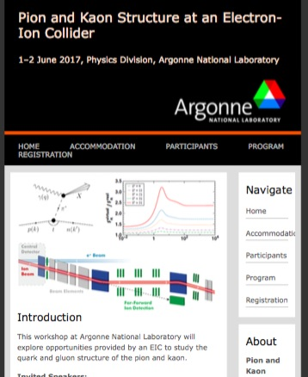
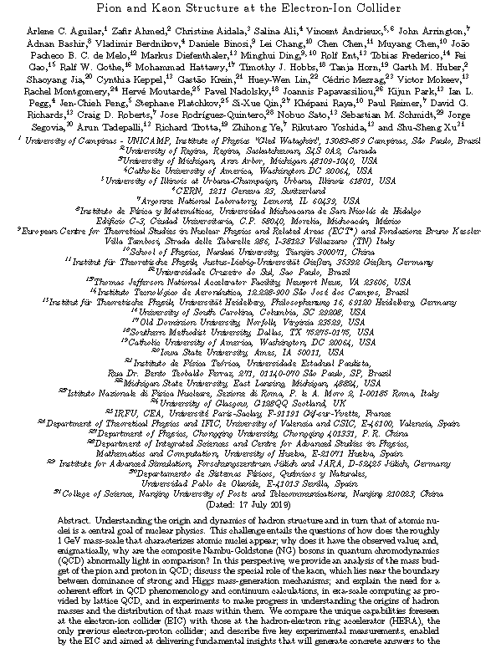
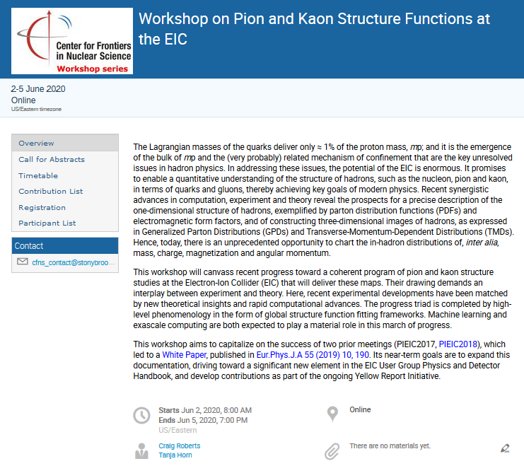
Pion and Kaon Structure at the EIC – History
PIEIC Workshops hosted at ANL (2017) and CUA (2018)
ECT* Workshop: Emergent Mass and its Consequences (2018)
PIEIC White Paper (2019)
Pion and Kaon Structure at an EIC
Eur. Phys. J. A 55 (2019) 10, 190
AMBER/CERN Workshop (2020)
CFNS Workshop (2020)
EHM through AMBER@CERN (2020)
ECT* Workshop in 2021 (remote) & 2022

Slide 4

Meson Structure Functions Yellow Report Working Group
Formed in 2019 in context of the EIC User Group Yellow Report Effort
Meson SF WG: 22 members, 13 institutions, 7 countries
Meson SF Working group members:
John R. Arrington (LBNL), Carlos Ayerbe Gayoso (Mississippi State U), Daniele Binosi (ECT*), Lei Chang (Nankai U.), Rolf Ent (Jlab), Tobias Frederico (Instituto Tecnologico de Aeronautica), Timothy Hobbs (SMU), Tanja Horn (CUA), Garth Huber (U. Regina), Stephen Kay (U. Regina), Cynthia Keppel (Jlab), Bill Lee (W&M) ), Huey-Wen Lin (MSU), Rachel Montgomery (U. Glasgow), Ian L. Pegg (CUA), Paul Reimer (ANL), David Richards (Jlab), Craig Roberts (Nanjng U.), Jorge Segovia (Universidad Pablo de Olavide), Arun Tadepalli (JLab), Richard Trotta (CUA), Rik Yoshida (ANL)
BlueJeans meetings every 2-3 weeks since January 2020
To join the Meson Structure Functions WG mailing list, contact T. Horn (hornt@cua.edu)
Within Yellow Report activities, part of the EIC Diffractive Reactions & Tagging PWG
Very successful effort, and lively discussions, so Meson SF WG is likely to continue existing.

Slide 5
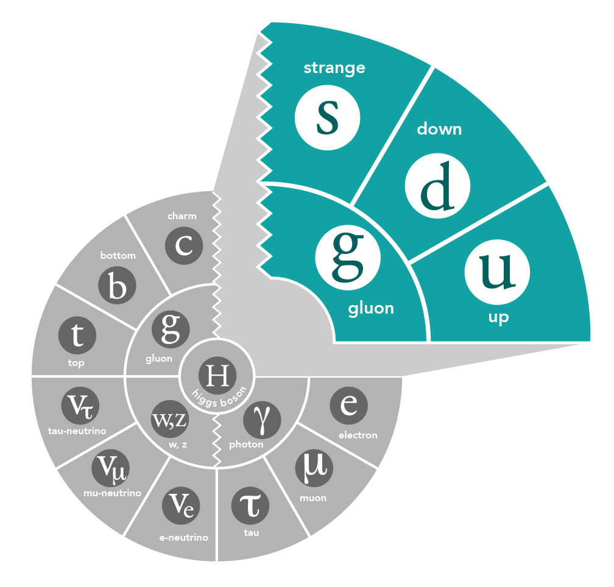
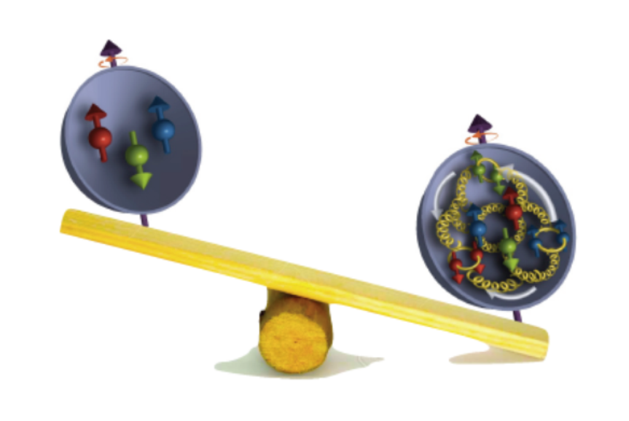
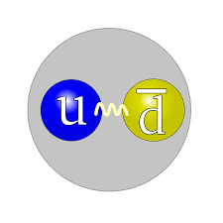
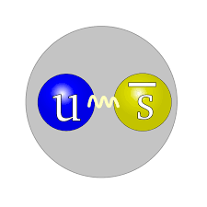
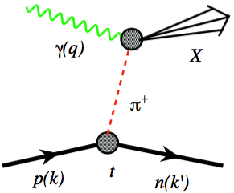
Mass of the Proton, Pion, Kaon
Visible world: mainly made of light quarks – its mass emerges from quark-gluon interactions.
“Mass without mass!”
MeV
Proton
Quark structure: uud
Mass ~ 940 MeV (~1 GeV)
Most of mass generated by dynamics.
Gluon rise discovered by HERA e-p
GeV
Pion
Kaon
Quark structure: ud
Mass ~ 140 MeV
Exists only if mass is dynamically
generated.
Empty or full of gluons?
Quark structure: us
Mass ~ 490 MeV
Boundary between emergent-
and Higgs-mass mechanisms.
More or less gluons than in pion?
For the proton the EIC will allow determination of an important term contributing to the proton mass, the so-called “QCD trace anomaly”
For the pion and the kaon the EIC will allow determination of the quark and gluon contributions to mass with the Sullivan process.

Slide 6



Origin of Mass in the EIC Yellow Report
Yellow Report, exec. summary, pages 9/10

Slide 7
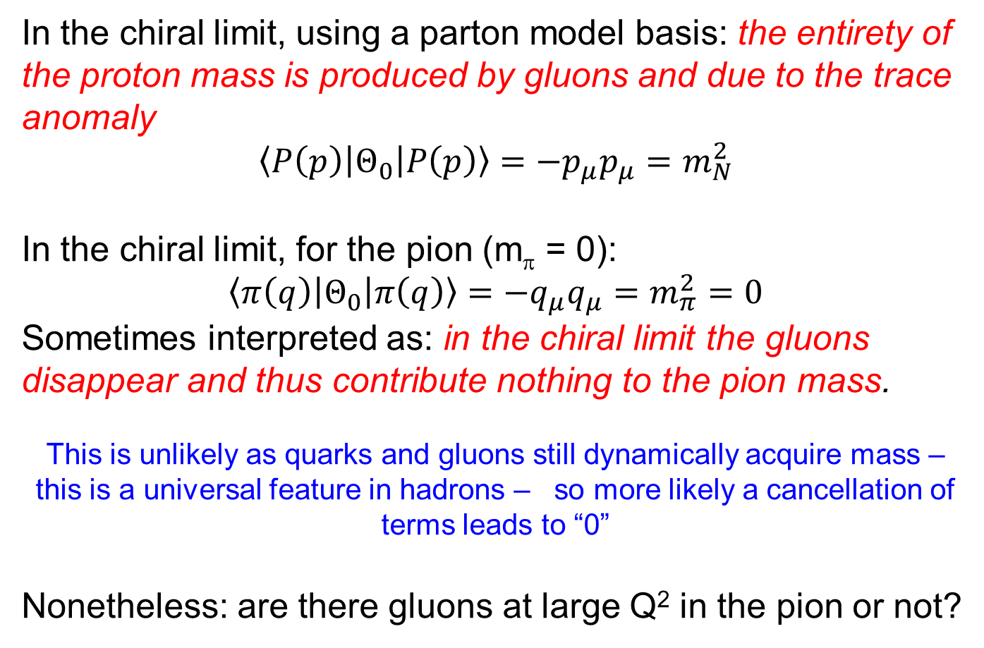
The Role of Gluons in the Chiral Limit
In the chiral limit, using a parton model basis: the entirety of the proton mass is produced by gluons and due to the trace anomaly
$$\left\langle P\left(p\right)\left|Θ_{0}\right|P\left(p\right)\right\rangle =−p_{μ}p_{μ}=m_{N}^{2}$$
In the chiral limit, for the pion (m_{π} = 0):
$$\left\langle π\left(q\right)\left|Θ_{0}\right|π\left(q\right)\right\rangle =−q_{μ}q_{μ}=m_{π}^{2}=0$$
Sometimes interpreted as: in the chiral limit the gluons disappear and thus contribute nothing to the pion mass.
This is unlikely as quarks and gluons still dynamically acquire mass – this is a universal feature in hadrons – so more likely a cancellation of terms leads to “0”
Nonetheless: are there gluons at large Q² in the pion or not?

Slide 8
Mass Budgets for the Proton, Kaon and Pion

Slide 9
Strong Synergy with Lattice QCD
Huey-Wen Lin et al.
Parton distribution amplitudes
Pion at two different pion masses & extrapolated to the physical mass
Fit to lattice data for kaon, and using machine learning approach
As the pion mass decreases, the distribution amplitude gets broader
Note the slight asymmetry in the distribution amplitude around x = 0.5
Calculations using meson-boosted momentum at P_{z} = 1,.73 GeV and renormalized at 2 GeV in MS-bar scheme

Slide 10
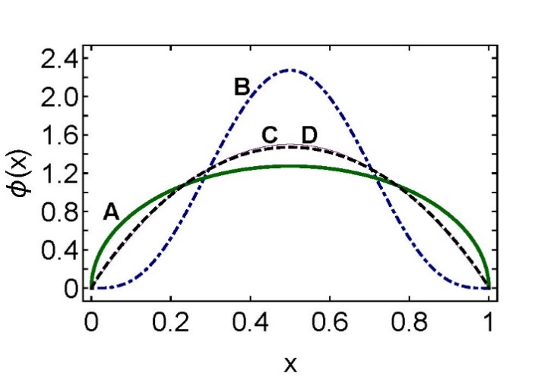
Emergent- versus Higgs-Mass Generation
Twist-2 PDA at Scale ζ = 2 GeV
A solid (green) curve – pion ⇐ emergent mass is dominant;
B dot-dashed (blue) curve – η_{c} ⇐ primarily, Higgs mass generation;
C solid (thin, purple) curve – conformal limit result, 6x(1 - x); and
D dashed (black) curve – “heavy-pion”, i.e., a pion-like pseudo-scalar meson (~η_{s}) in which the valence-quark current masses take values corresponding to a strange quark ⇐ the border, where emergent and Higgs mass generation are equally important.
Unfortunately, experimental signatures of the exact PDA form are, in general, difficult.
In the limit of infinitely-heavy quark masses, the Higgs mechanism overwhelms every other mass generating force, and the PDA becomes a δ-function at x = ½.
The sufficiently heavy η_{c} meson (B), feels the Higgs mechanism strongly.
The PDA for the light-quark pion (A) is a broad, concave function, a feature of emergent mass generation.

Slide 11
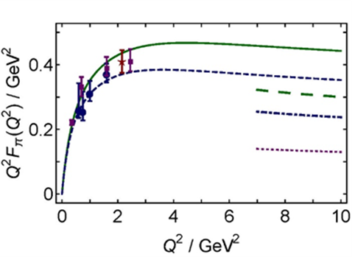
Pion Form Factor and Emergent Mass
Muyang Chen, Craig Roberts
Left panel. Two dressed-quark mass functions distinguished by the amount of DCSB: emergent mass generation is 20% stronger in the system characterized by the solid green curve, which describes the more realistic case. Right panel. F_{π}(Q²) obtained with the mass function in the left panel: r_{π} = 0.66 fm with the solid green curve and r_{π} = 0.73 fm with the dashed blue curve. The long-dashed green and dot-dashed blue curves are predictions from the QCD hard-scattering formula, obtained with the related, computed pion PDAs. The dotted purple curve is the result obtained from that formula if the conformal-limit PDA is used, ϕ(x)=6x(1-x).

Slide 12
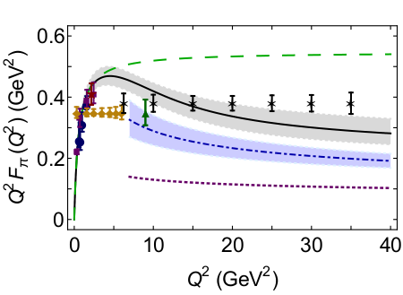
Pion Form Factor Prospects @ EIC
1. Models show a strong dominance of σ_{L} at small –t at large Q².
2. Assume dominance of this longitudinal cross section
3. Measure the π⁻/π⁺ ratio to verify – it will be diluted (smaller than unity) if σ_{T} is not small, or if non-pole backgrounds are large
A.C. Aguilar et al., EPJ A 55 (2019) 10, 190
Assumed 5 GeV(e⁻) x 100 GeV(p) with an integrated luminosity of 20 fb⁻¹/year, and similar luminosities for d beam data
R=σ_{L}/σ_{T} assumed from VR model – and assume that π pole dominance at small t confirmed in ²H π⁻/π⁺ ratios
Assumed a 10% experimental systematic uncertainty, and a 100% systematic uncertainty in the model subtraction to isolate σ_{L}
Can we measure the kaon form factor at EIC? Or only through L/T separations emphasizing lower energies? Not clear – needs guidance from JLab 12- GeV.

Slide 13
Pion and Kaon Structure - 12 GeV
Jefferson Lab will provide, at its CM energy of 5 GeV, tantalizing data for the pion (kaon) form factor up to Q² ~ 10 (5) GeV², and measurements of the pion (kaon) structure functions at large-x (> 0.5) through the Sullivan process.
Pion FF – first quantitative access to hard scattering scaling regime?
JLab/12 GeV projection
Pion SF – (1-x)¹ or (1-x)² dependence at large x?
and kaon

Slide 14
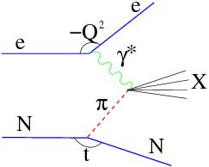
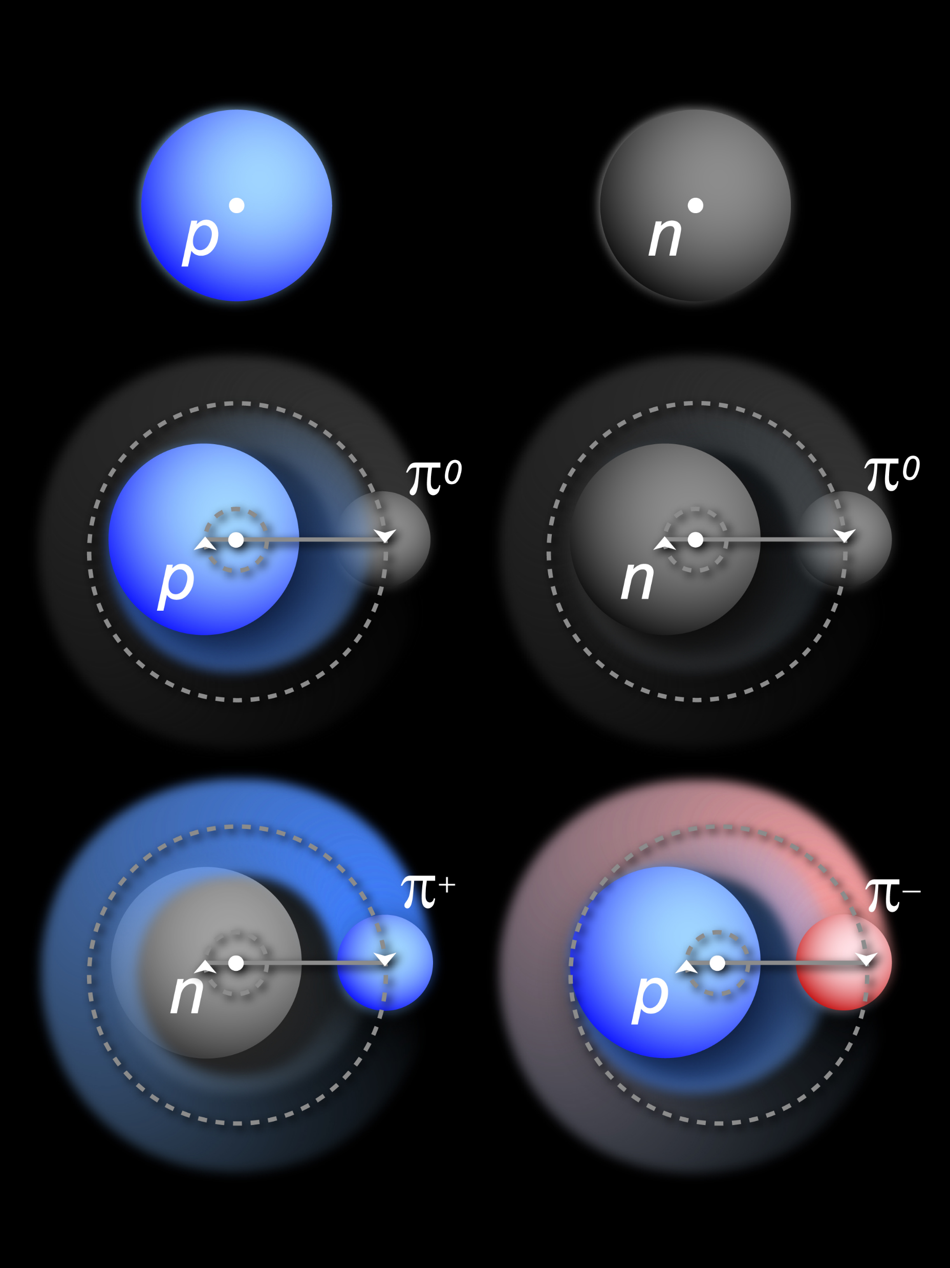
Physics Objects for Pion/Kaon Structure Studies
Sullivan process – scattering from nucleon-meson fluctuations
Detect scattered electron
DIS event – reconstruct x, Q², W², also M_{X} (W_{π}) of undetected recoiling hadronic system
Pion/Kaon target (undetected)
Detect “tagged” neutron/lambda
i = π, ρ, …
“Flux factor”

Slide 15
EIC Meson Structure Kinematics
Electron x Proton beam energies
5 GeV x 41 GeV
10 GeV x 135 GeV
Scattered electron goes in EIC central detector region
Leading neutron (or lambda) are at small forward angles and carry most of the proton beam momentum

Slide 16
Meson Structure: Summary of EIC Detector Requirements
For π-n:
Lower energies (5 on 41, 5 on 100) require at least 60 x 60 cm²
For all energies, the neutron detection efficiency is 100% with the planned ZDC
For π-n and K⁺/Λ:
All energies need good ZDC angular resolution for the required -t resolution
High energies (10 on 100, 10 on 135, 18 on 275) require resolution of 1cm or better
K⁺/Λ benefits from low energies (5 on 41, 5 on 100) and also need:
𝜦→𝒏+𝝅^{𝟎} : additional high-res/granularity EMCal+tracking before ZDC – seems doable
    $Λ→p+π−$: additional trackers in opposite direction on path to ZDC – more challenging
Standard electron detection requirements
Good hadron calorimetry for good x resolution at large x

Slide 17
EIC – Versatility and Luminosity is Key
Why would pion and kaon structure functions, and even measurements of pion structure beyond (pion GPDs and TMDs) be feasible at an EIC?
L_{EIC} = 10³⁴ = 1000 x L_{HERA}
Detection fraction @ EIC in general much higher than at HERA
Fraction of proton wave function related to pion Sullivan process is roughly 10⁻³ for a small –t bin (0.02).
Hence, pion data @ EIC should be comparable or better than the proton data @ HERA, or the 3D nucleon structure data @ COMPASS
If we can convince ourselves we can map pion (kaon) structure for –t < 0.6 (0.9) GeV², we gain at least a decade as compared to HERA/COMPASS.
Ratio of the F₂ structure function related to the pion Sullivan process as compared to the proton F₂ structure function in the low-t vicinity of the pion pole, as a function of Bjorken-x (Jefferson Lab TDIS Collaboration, JLab Experiment C12-15-005)

Slide 18
Pion Structure Function Projections vs x
Integrated over –t from –t_{min} to 1

Slide 19
Pion Structure Function Projections vs -t
-t-dependence can verify robustness of data interpretation

Slide 20
Reduction of Pion 1-D Structure Information by EIC
From ongoing EIC Yellow Report,
P. Barry, W. Melnitchouk, N. Sato et al.

Slide 21
EIC – Meson Structure Questions

Slide 22
EIC – Meson Structure Questions
Can we even do SIDIS or DES off meson target?

Slide 23
Summary – Pion and Kaon Structure
Protons, neutrons, pions and kaons are the main building blocks of nuclear matter
If we really want to claim we understand hadron structure as relevant for the visible world, we HAVE to understand at least the pion, kaon, proton, neutron (and likely the Lambda) at the same level.
Paradoxically, the lightest pseudoscalar mesons appear to be the key to the further understanding of the emergent mass and structure mechanisms.
  These mesons, namely the pion and kaon, are the Nambu-Goldstone boson modes of QCD.
Unraveling their exact partonic structure and interplay with the Higgs mass mechanism is a common goal of three independent methodologies – phenomenology with continuum QCD based approaches, Lattice QCD, and the global analysis of parton distributions – linked to experimental measurements of hadronic structure.

Slide 24
Summary – Role of EIC
The unique role of EIC is its access to pion and kaon structure over a versatile
large CM energy range, ~20-140 GeV. With its larger CM energy range, the EIC will have the final word on the contributions of gluons in pions and kaons as compared to protons, settle how many gluons persist as viewed with highest resolution, and vastly extend the x and Q² range of pion and kaon charts, and meson structure knowledge.

Slide 26
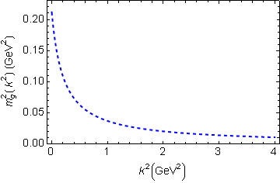
Mass of the Visible Universe
Gluon mass-squared function
Visible world: mainly made of light quarks – its mass emerges from quark-gluon interactions. Higgs mechanism hardly plays a role
The strange quark is at the boundary - both emergent-mass and Higgs-mass generation mechanisms are important.
Emergent mass of the visible universe

Slide 27
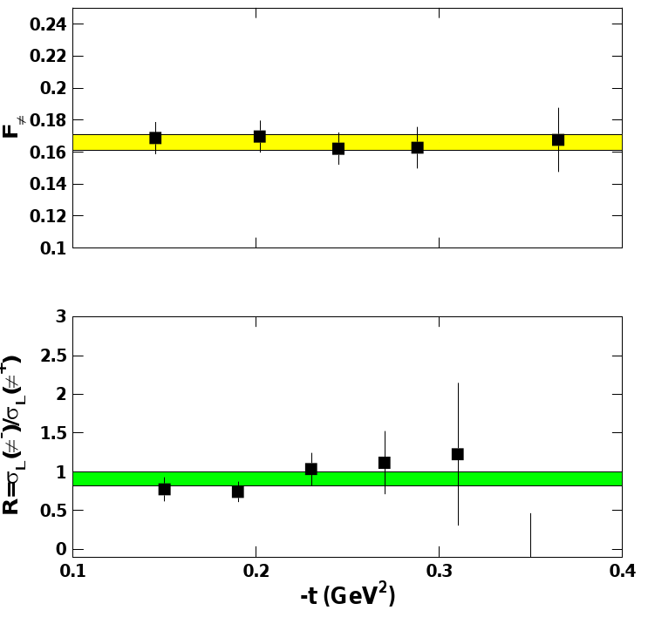
Experimental Validation (Pion Form Factor example)
Experimental studies over the last decade have given confidence in the electroproduction method yielding the physical pion form factor
Experimental studies include:
F_{π}
Take data covering a range in –t and compare with theoretical expectation
F_{π} values do not depend on -t – confidence in applicability of model to the kinematic regime of the data
-t [GeV²]
Verify that the pion pole diagram is the dominant contribution in the reaction mechanism
R_{L} (= σ_{L}(π⁻)/σ_{L}(π⁺)) approaches the pion charge ratio, consistent with pion pole dominance
-t [GeV²]
[T. Horn, C.D. Roberts, J. Phys. G43 (2016) no.7, 073001]
[G. Huber et al, PRL112 (2014)182501]

Slide 28
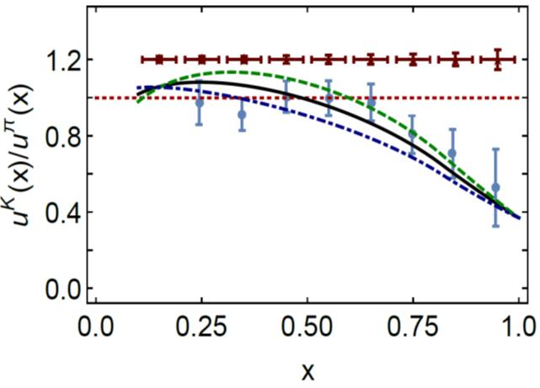
Kaon structure functions – gluon pdfs
A.C. Aguilar et al., EPJ A 55 (2019) 10, 190
Based on Lattice QCD calculations and DSE calculations:
Valence quarks carry 52% of the pion’s momentum at the light front, at the scale used for Lattice QCD calculations, or ~65% at the perturbative hadronic scale
At the same scale, valence-quarks carry ⅔ of the kaon’s light-front momentum, or roughly 95% at the perturbative hadronic scale
EIC Projections
0%
10%
1st DSE analysis (Tandy et al., fully numerical DSE solutions)
gluon content of the kaon
Thus, at a given scale, there is far less glue in the kaon than in the pion:
  heavier quarks radiate less readily than lighter quarks
  heavier quarks radiate softer gluons than do lighter quarks
  Landau-Pomeranchuk effect: softer gluons have longer wavelength and multiple scatterings are suppressed by interference.
  Momentum conservation communicates these effects to the kaon's u-quark.

Slide 29
Intermezzo - Summary
Protons, neutrons, pions and kaons are the main building blocks of nuclear matter
If we really want to claim we understand hadron structure as relevant for the visible world, we HAVE to understand at least the pion, kaon, proton, neutron (and likely the Lambda) at the same level.
The broad science program to understand pion and kaon structure and the QCD mechanism behind the emergent hadron masses requires a strong interplay between experiment and theory, matching experimental prospects by new theoretical insights, rapid computational advances, and high-level phenomenology
  The EIC with its versatile large CM energy range will play a key role in the experimental program to chart in-pion and in-kaon distributions of interalia, mass, charge, magnetization and angular momentum, but...
  … to provide experimental measurements guiding theoretical understanding requires a coherent, worldwide effort.

Slide 30
12 GeV/EicC/AMBER/EIC Complementarity
COMPASS++/AMBER will play a crucial role as they can uniquely provide pion (kaon) Drell-Yan measurements in the CM energy region ~10-20 GeV. Some older pion and kaon Drell-Yan measurements exist, but for the kaon this is limited to less than 10 data points worldwide, so these measurements are absolutely important for a global effort of the pion structure function measurements (allowing a handle on determination of the so-called “pion flux" for the EIC Sullivan process measurements) and a sinequanon for any kaon structure function data map. The COMPASS++/AMBER data in themselves will already give new fundamental insights in the emergent-hadron mass mechanism.
Pionic Drell-Yan, 2 years: pionic sea!
Kaonic Drell-Yan, 140 days: much-needed precise data!

Slide 31
12 GeV/EicC/AMBER/EIC Complementarity
An Electron-Ion Collider in China (EicC) is under consideration with a similar
CM energy range as COMPASS++/AMBER of 10-20 GeV and bridging the energy range from Jefferson Lab to EIC. EicC on its own, and even more in combination with COMPASS++/AMBER, can provide good access to the region of x > 0.01 for pion, and especially kaon, structure function determination and the impact on emergent-hadron mass mechanisms on valence quark and gluon structure. In addition, EicC can extend the Rosenbluth L/T-separated cross section technique beyond Jefferson Lab and access pion and kaon form factors to higher Q² values, roughly by a factor of 2-4.
Pion structure function measurement projections at Q² ~ 4 GeV². Likely similar kaon structure function data possible at high x_{π}. (arXiv:2008.00102)

Slide 32
EIC Meson Structure Kinematics
Scattered electron goes in EIC central detector region
Leading neutron (or lambda) are at small forward angles and carry most of the proton beam momentum

Slide 33
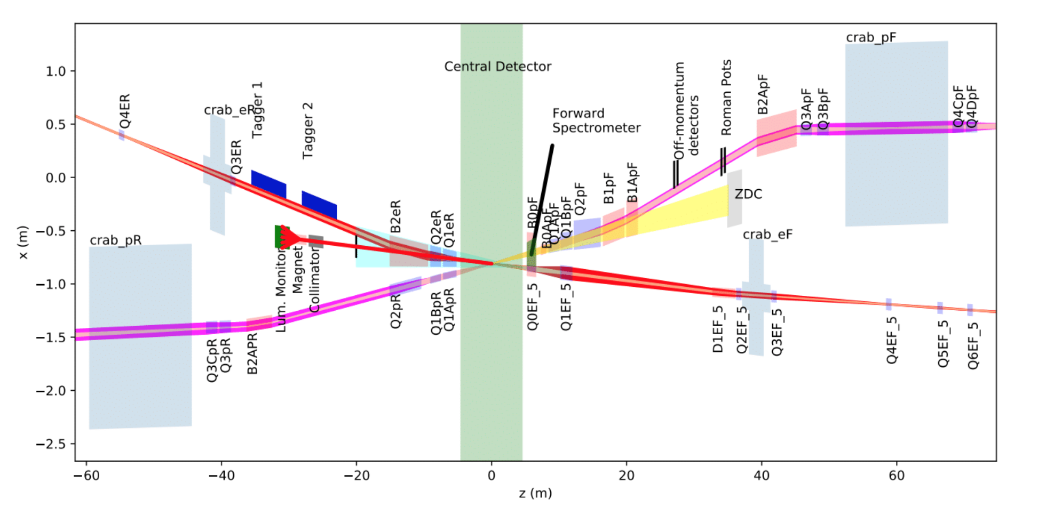
EIC Far-Forward Detector
Highly Integrated detector system: ~75m
1.Central detector: ~10m
2.Backward electron detection: ~35m
3.Forward hadron spectrometer: ~40m
Lesson learned from HERA – ensure low-Q² coverage
Various stage detector to capture forward-going protons and neutrons, and also decay products (Δ, Λ).
far-backward detectors
far-forward detectors

