Slide 1
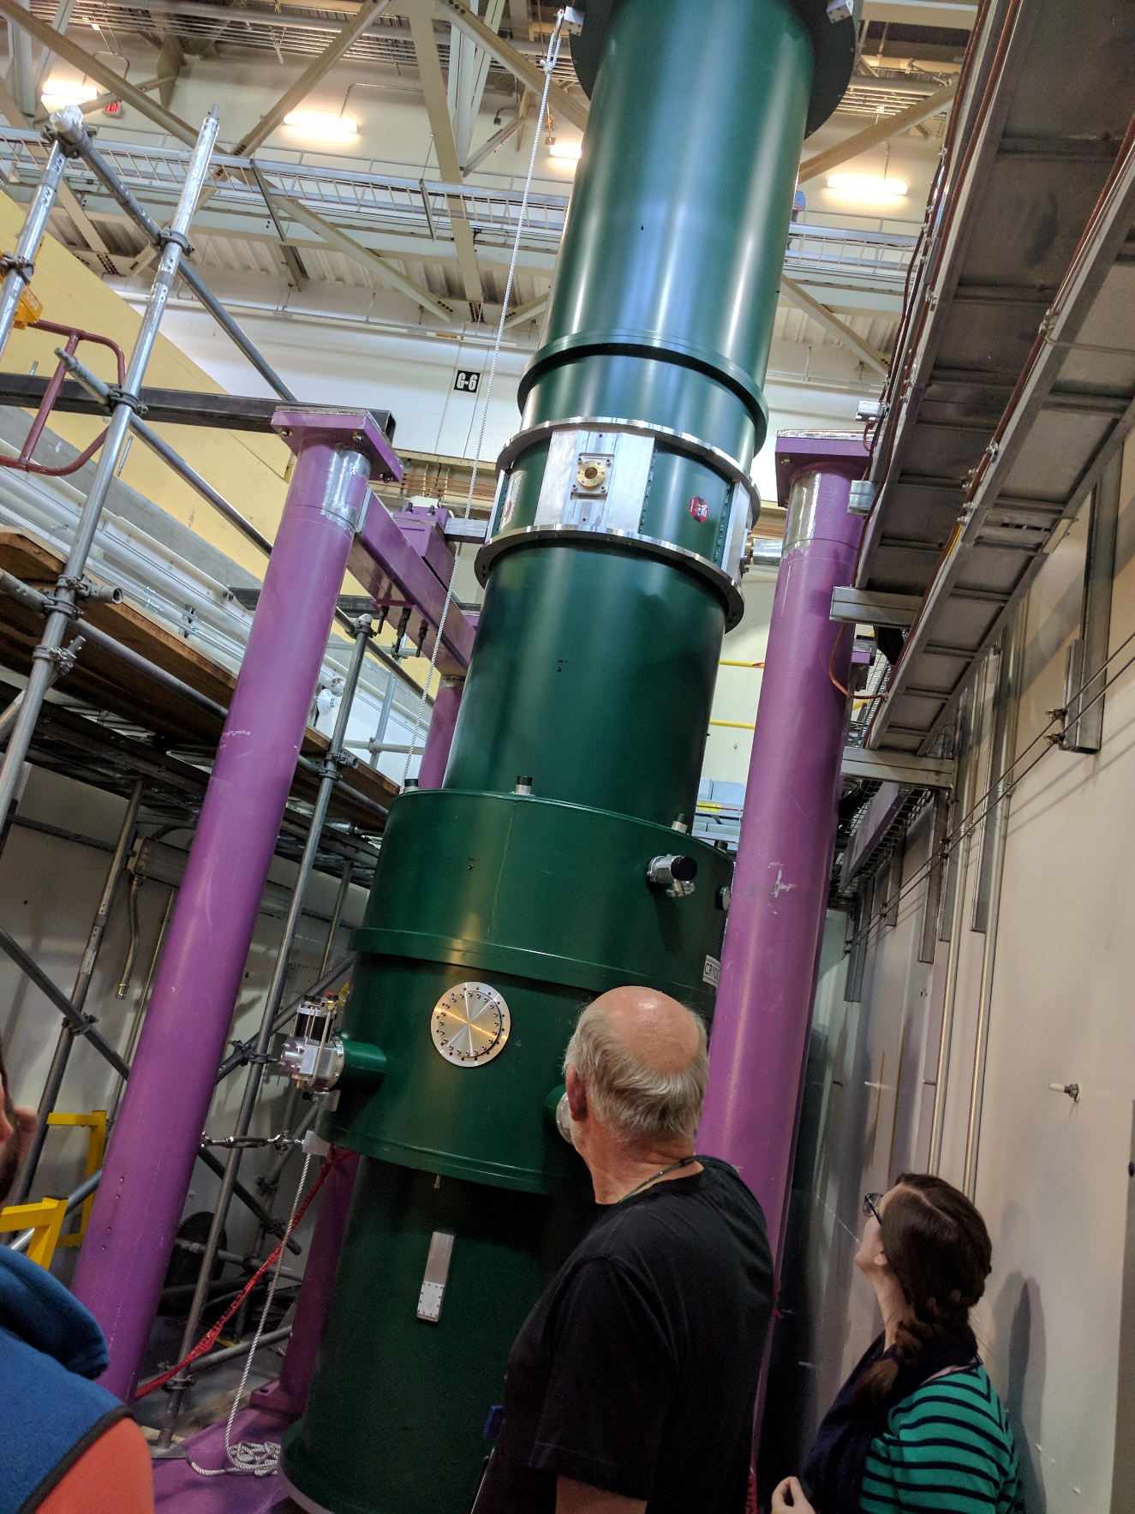
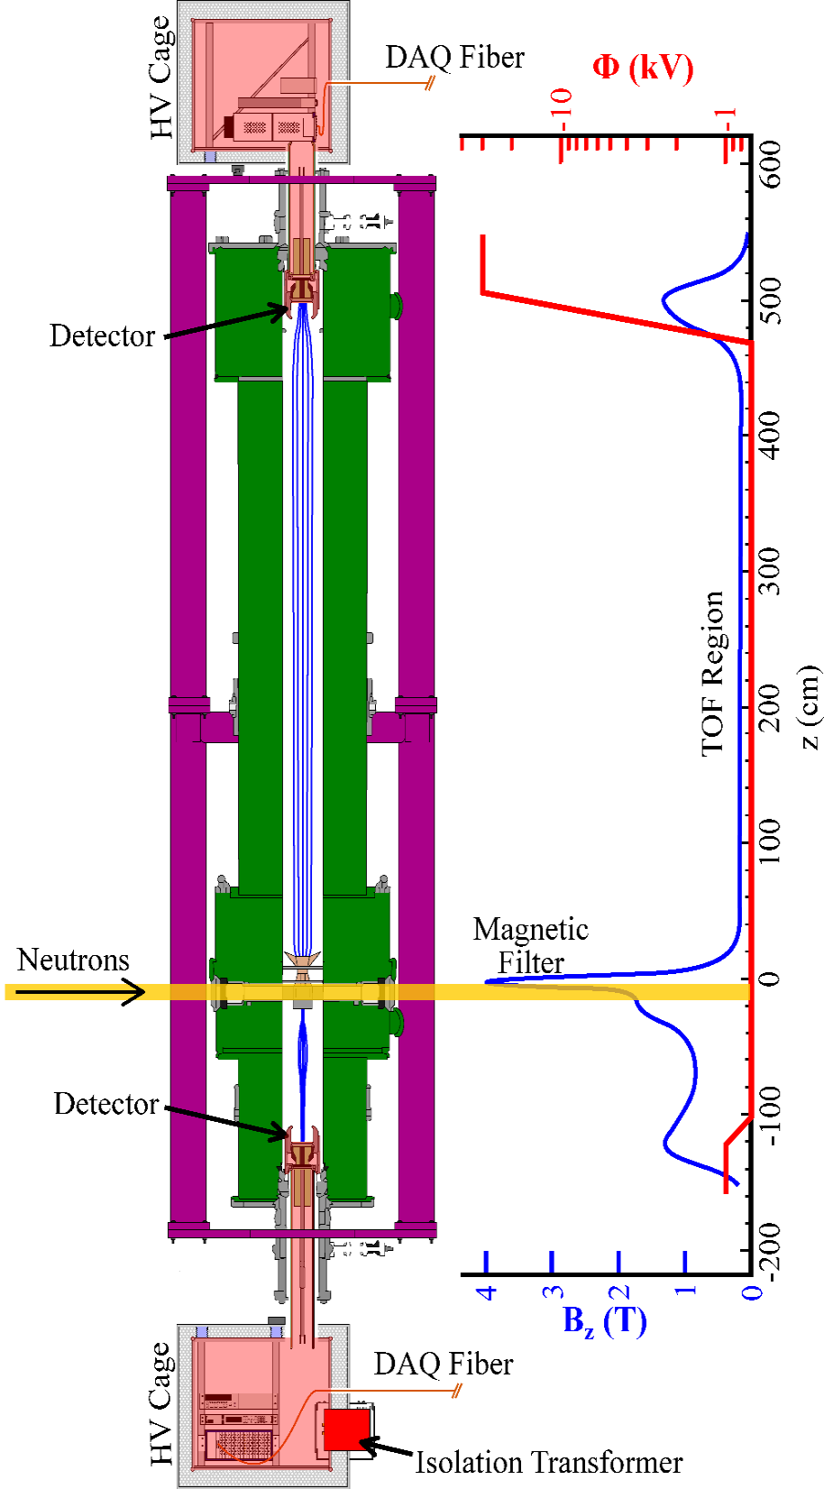
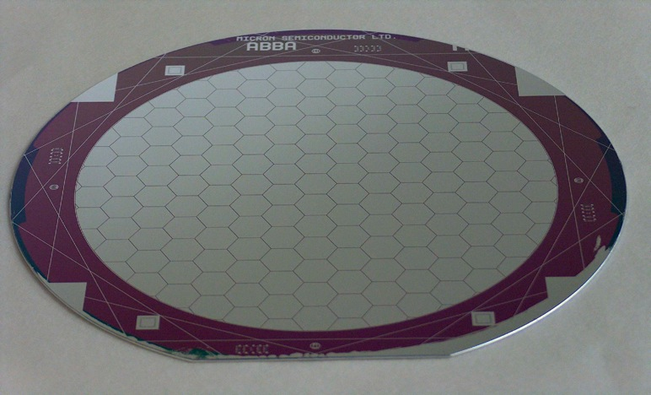
Introduction—DSP for the Nab experiment
Christopher Crawford, Univ. Kentucky
2x 128 pixels det, 250 MS/s ADC
30 keV proton/ e⁻ coincidences

Slide 2
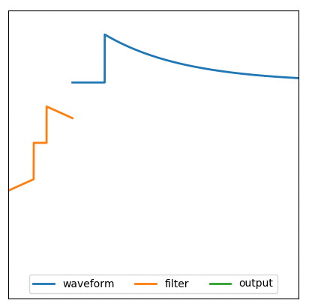
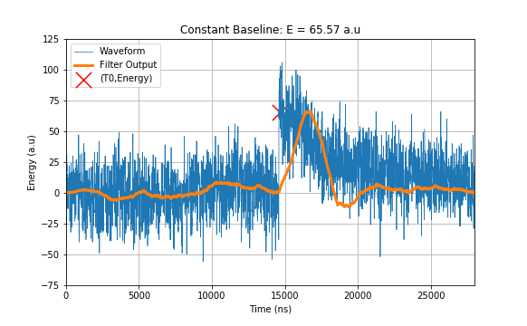
DSP Algorithms for HPC—Trapezoid filter and components
basic arithmetic: multiply-accumulate in DSP48 hardware
unit impulse: basis function delay (identity)
unit step: const function integration
David Mathews, UK, APS DNP, April 2019
shift register/buffer
accumulator

Slide 3
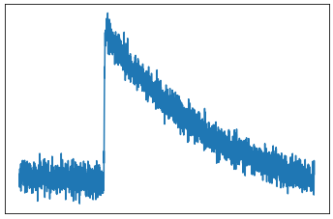
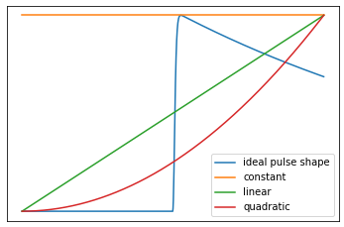
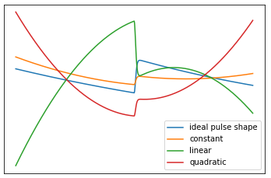
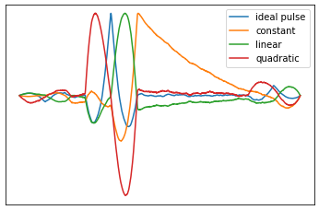
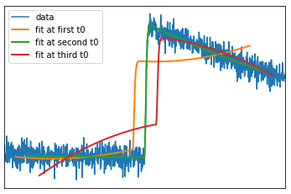
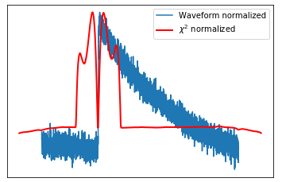
Least Squares fitter – Piecewise Recursive Polynomial filter
Data:
Fit Functions:
Pseudoinverse Fit Functions
Calculate Fit Parameters:
Fit using Parameters
Find Best Fit with
arXiv:2012.05937
David Mathews, University of Kentucky, APS DNP talk, April 2019
Notes:
Now we add the nonlinear fit parameter T0 by essentially performing the linear fit at each time. The matrix or dot products turn into convolutions or sliding dot products as we scan across the waveform. Here you can see all 4 coefficients as a function of T0, and a peak in the template amplitude with all noise amplitudes falling away as the template matches the waveform at just the right spot.
Here you can see a bad fit in orange just before it reaches T0, and the bad fit in red just afterward.
By expanding out the normal expression of chi2, we get an expression suitable for streaming implementation: convolution of waveform pointwise squared with a box filter, and pointwise sandwiching of the small vector of fit parameters around a constant matrix. We minimize this to complete the chi2 fit.

Slide 4
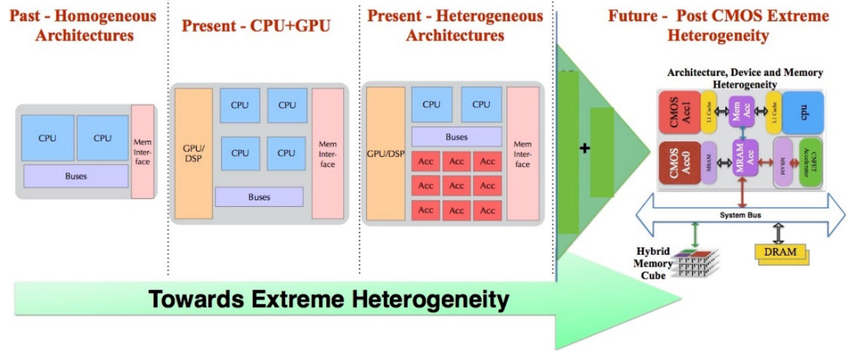
New algorithms for extreme heterogeneity
post-Moore’s Law—shift toward dedicated hardware accelerators
FPGA compute modules suitable for highly repetitive tasks
Firmware convolution/fitting and other new DSP-inspired algorithms will be useful as accelerators for general heterogeneous HPC applications
from: Extreme Heterogeneity 2018: Productive Computational Science in the Era of Extreme Heterogeneity, 2018-01-23

