Slide 1
Computing working group
Session on High Performance Computing (HPC):
  Introduction (5 mins) followed by four 15 minutes talks and a short 5 minute presentation. At the end we had a 20 minutes discussion
Session on New Computing Technologies (QC, AI/ML):
  Divided into two smaller sessions, one on quantum computing (QC) and one on Artificial Intelligence/Machine Learning (ML). Both QC and AI/ML started with an overview talk (15 mins) followed by 5 mins presentations (9 in total). The end of each session was followed by a 20 mins discussion

Slide 2
What are the overarching scientific challenges in HPC?
Need resources to aid in migration to GPUs
Strengthen collaborations between applied mathematicians, computer scientists, and nuclear physicists in order to efficiently utilize leadership-class computing resources
Better articulate ‘best practices’ for data and code management

Slide 3
What are the overarching scientific challenges in QC and AI/ML?
(QC) Real nuclear physics calculations will require a large number qubits and low error rates
(QC) Current devices are still quite noisy and have limited numbers of qubits
(QC) It is not easy to prepare energy eigenstates for large quantum systems
(AI/ML) Understanding model biases for deep learning is not always straightforward
(AI/ML) There can be a trade off between efficiency and interpretability
(AI/ML) In applications such as accelerator science, need to account for time variability
(AI/ML) Need more open access, data sharing, and data standards

Slide 4
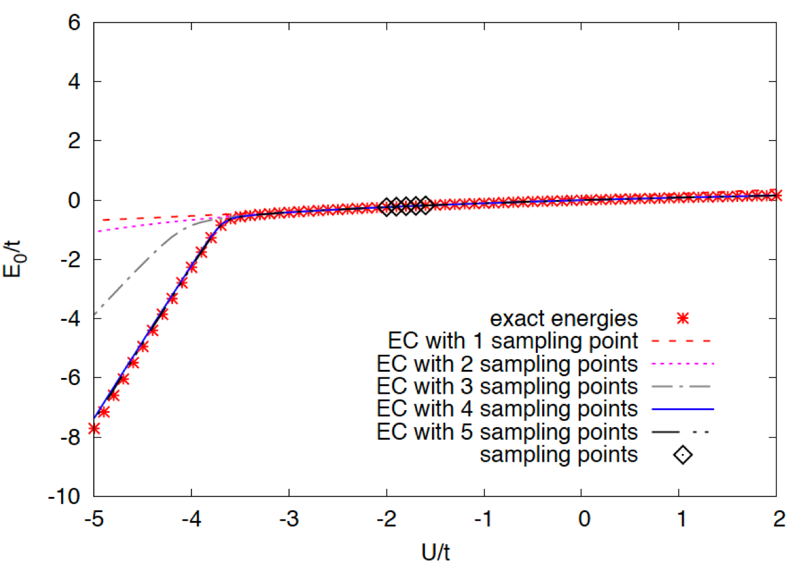
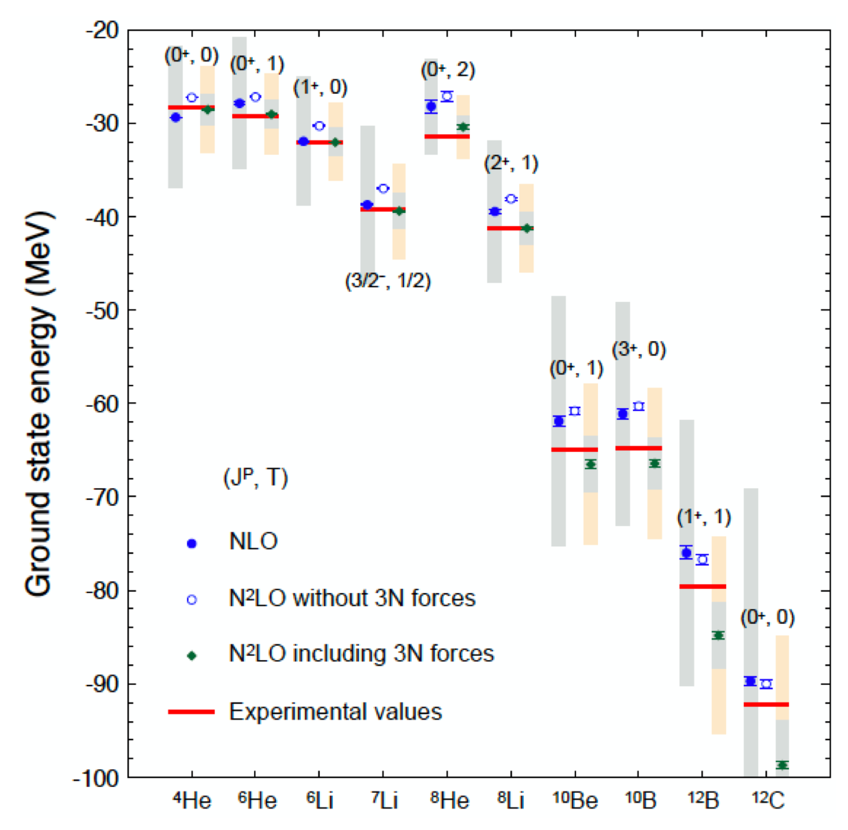
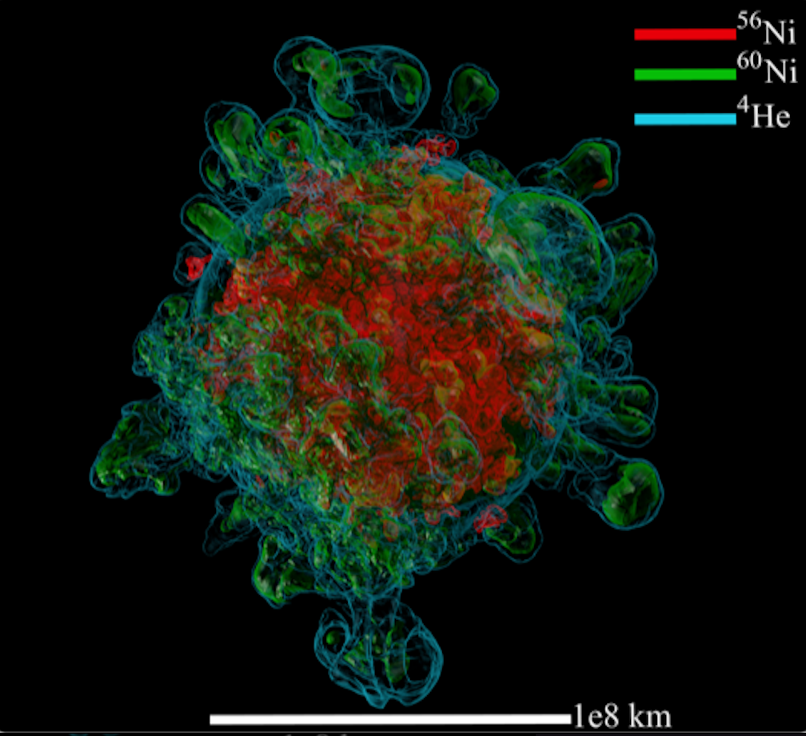
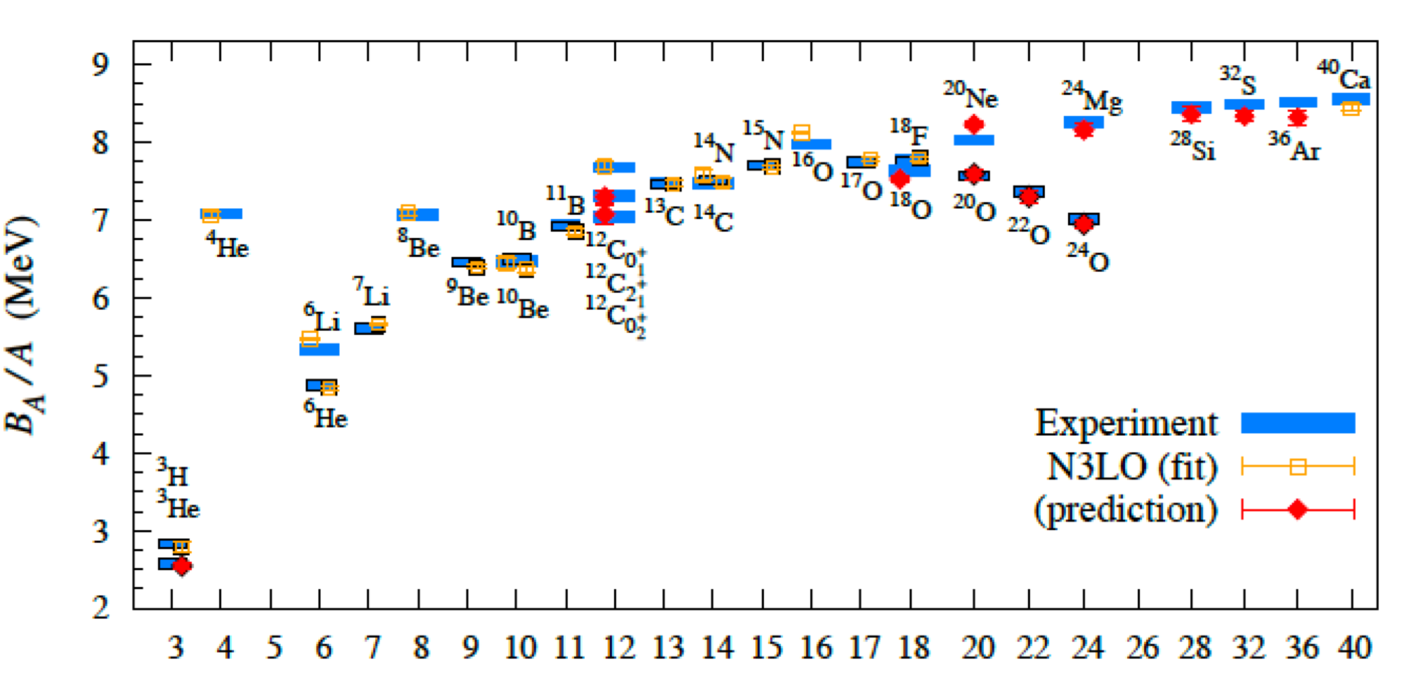
What progress has been made since the last LRP?
2022
Adapted from talks by
T. Papenbrock and J. Carlson
Notes:
Need to add something from GFMC group

Slide 5
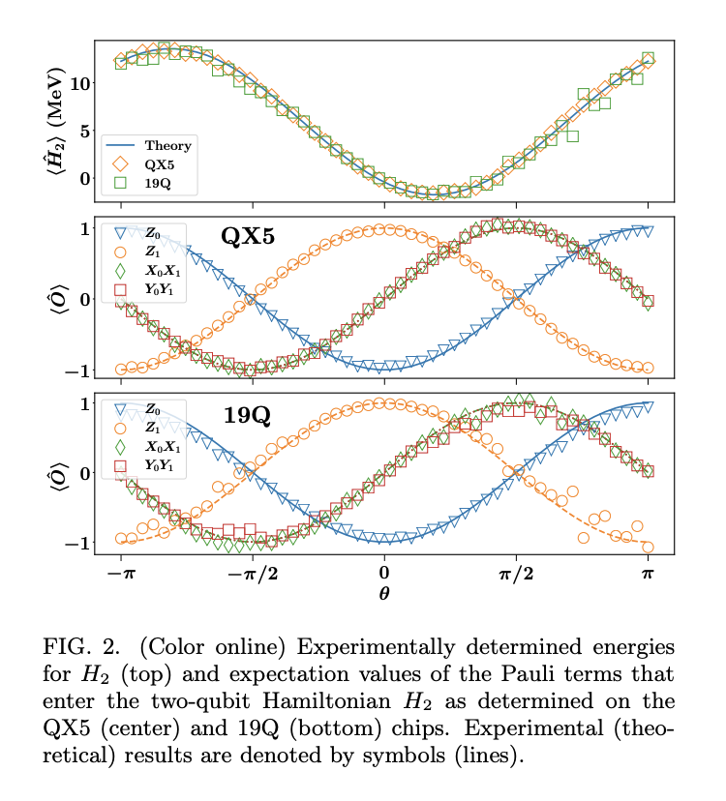
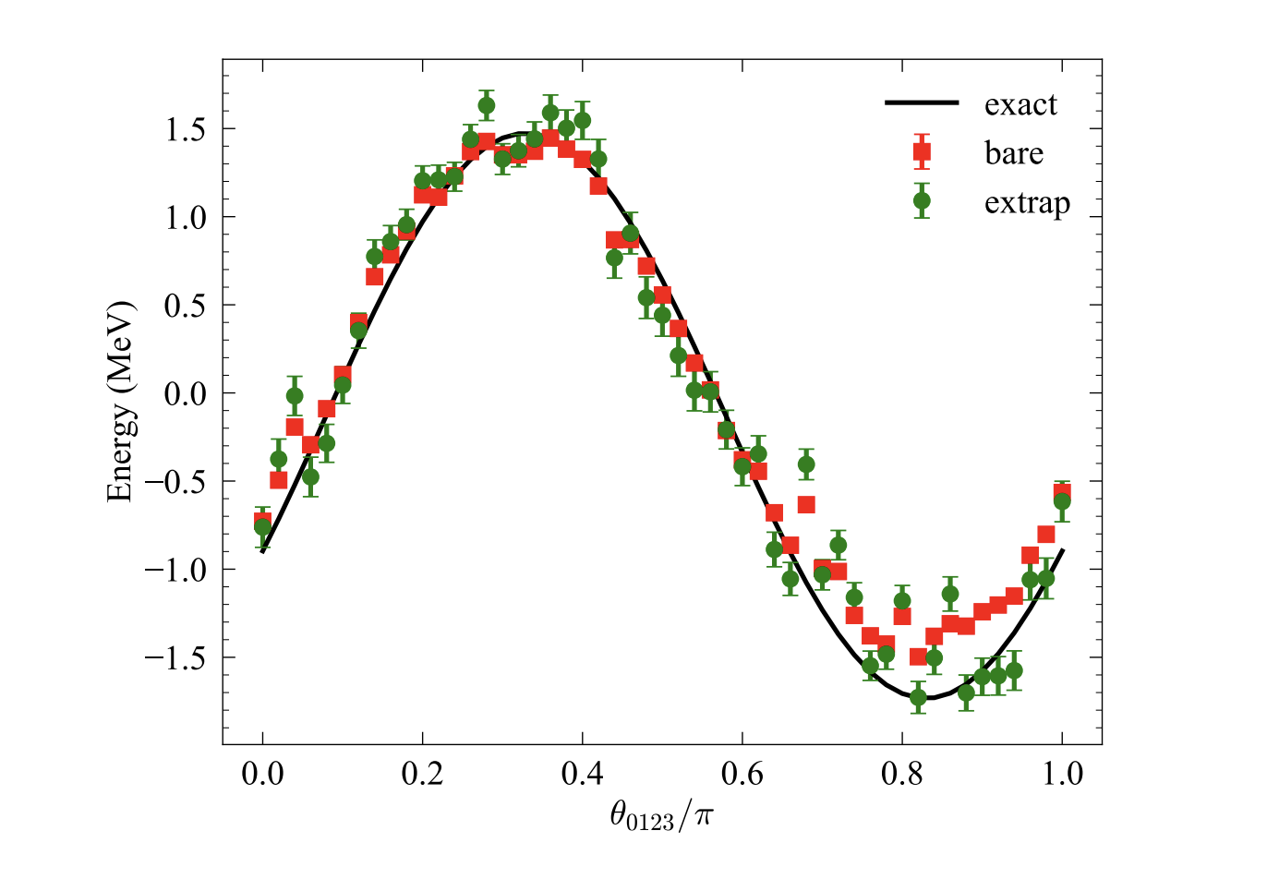
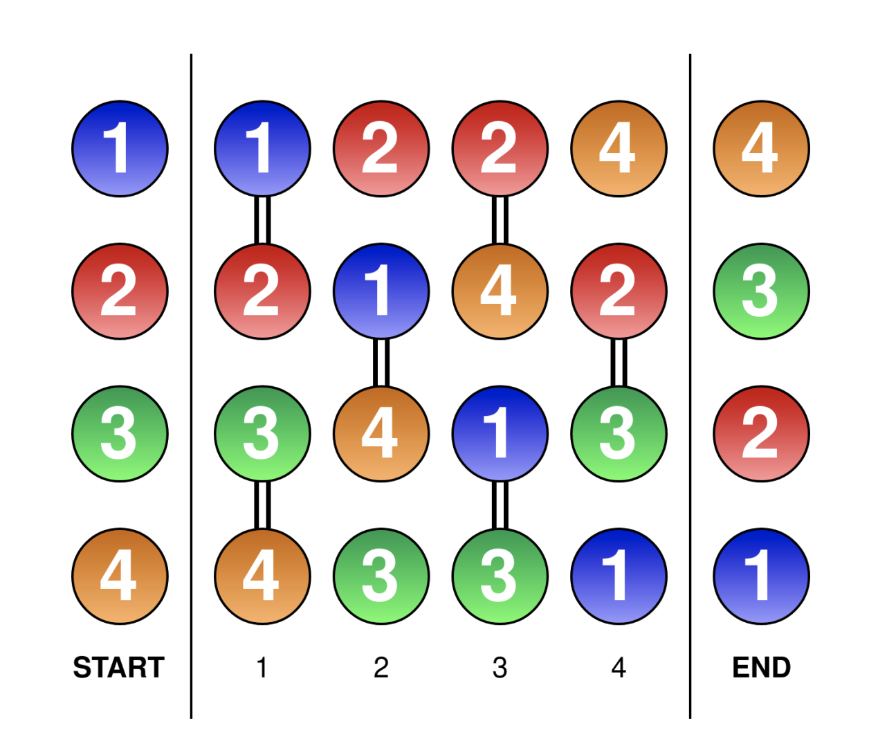
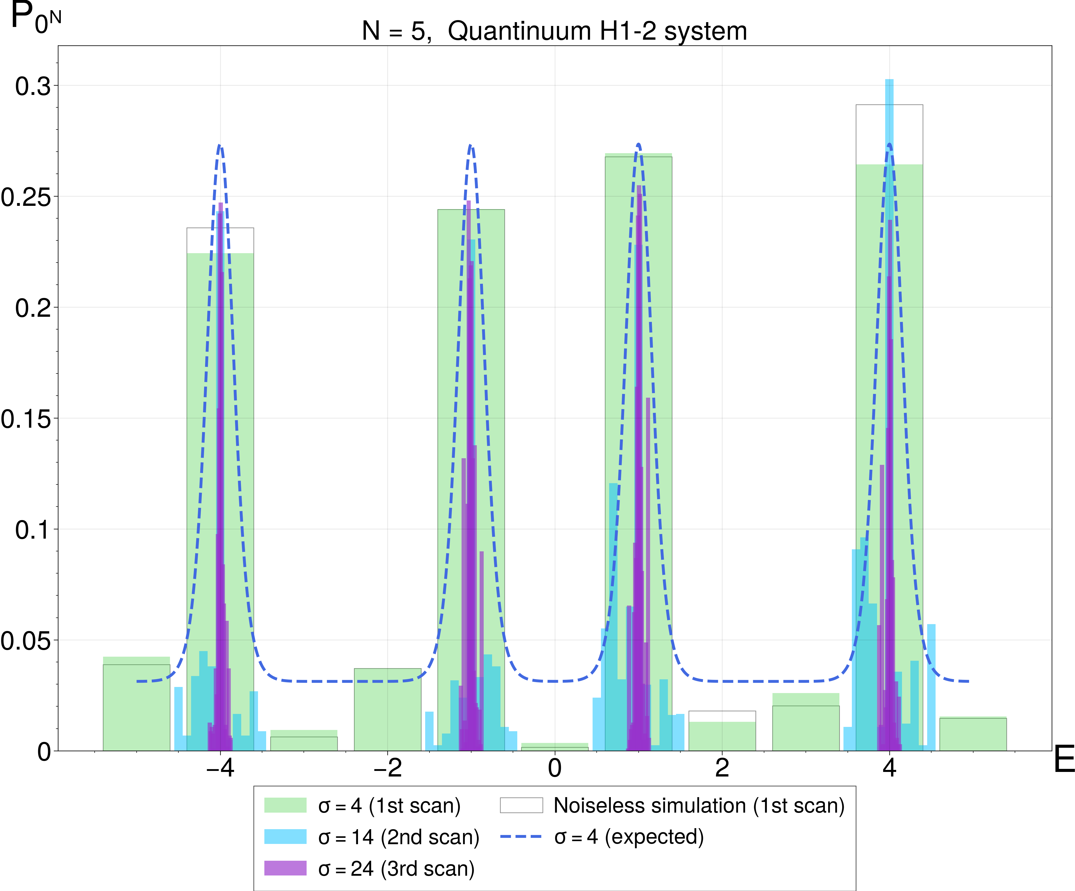
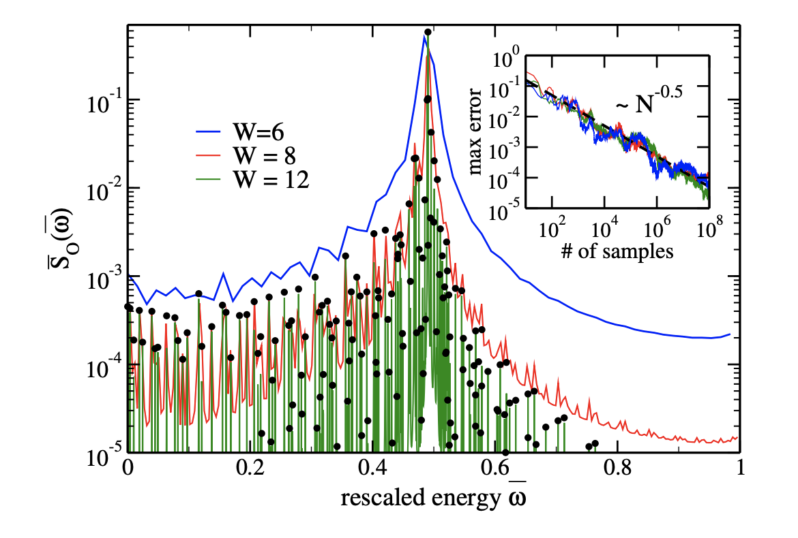
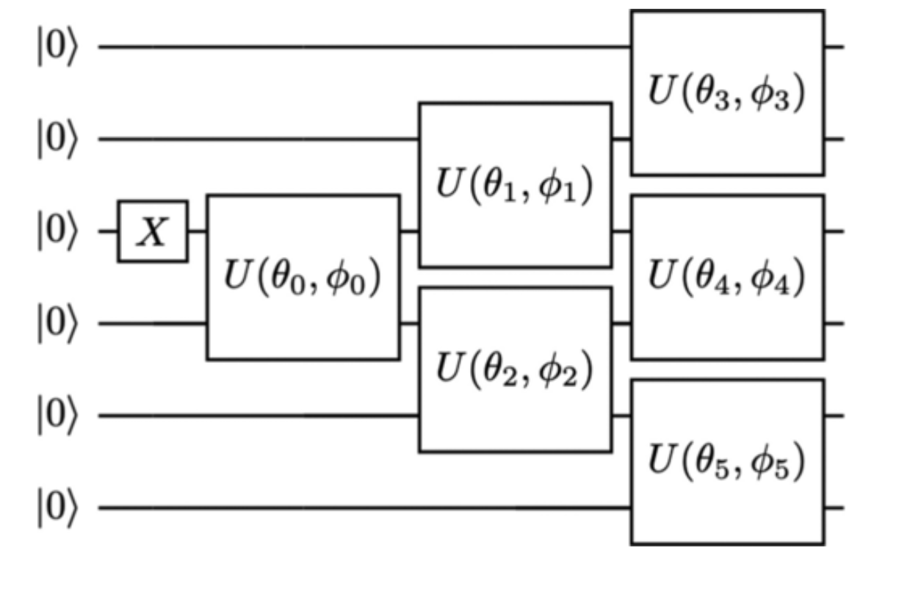
What progress has been made since the last LRP?
QC not discussed in the last LRP
Notes:
Need to add something from GFMC group

Slide 6
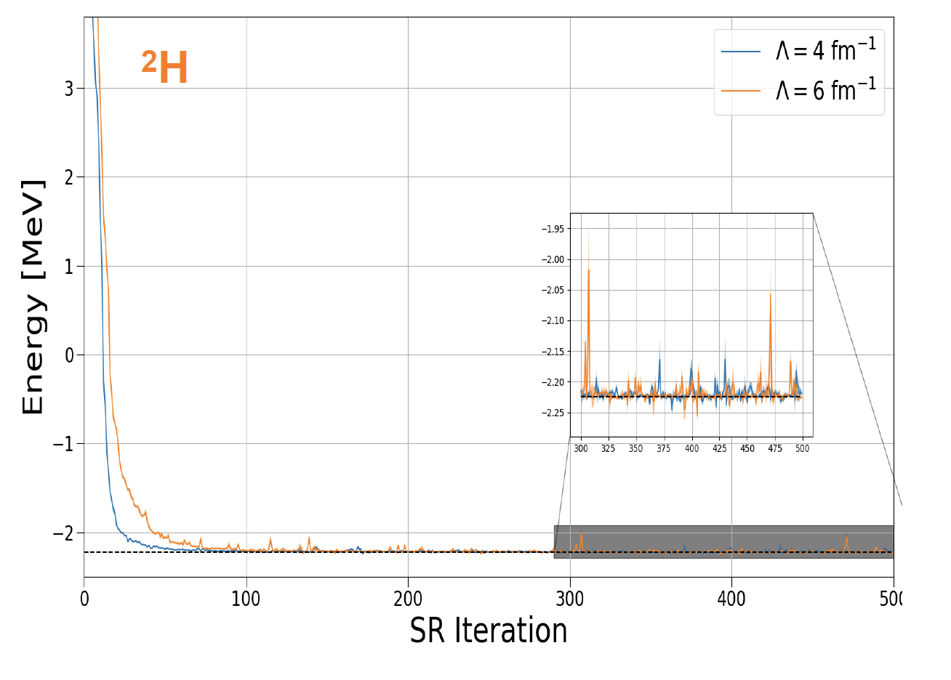
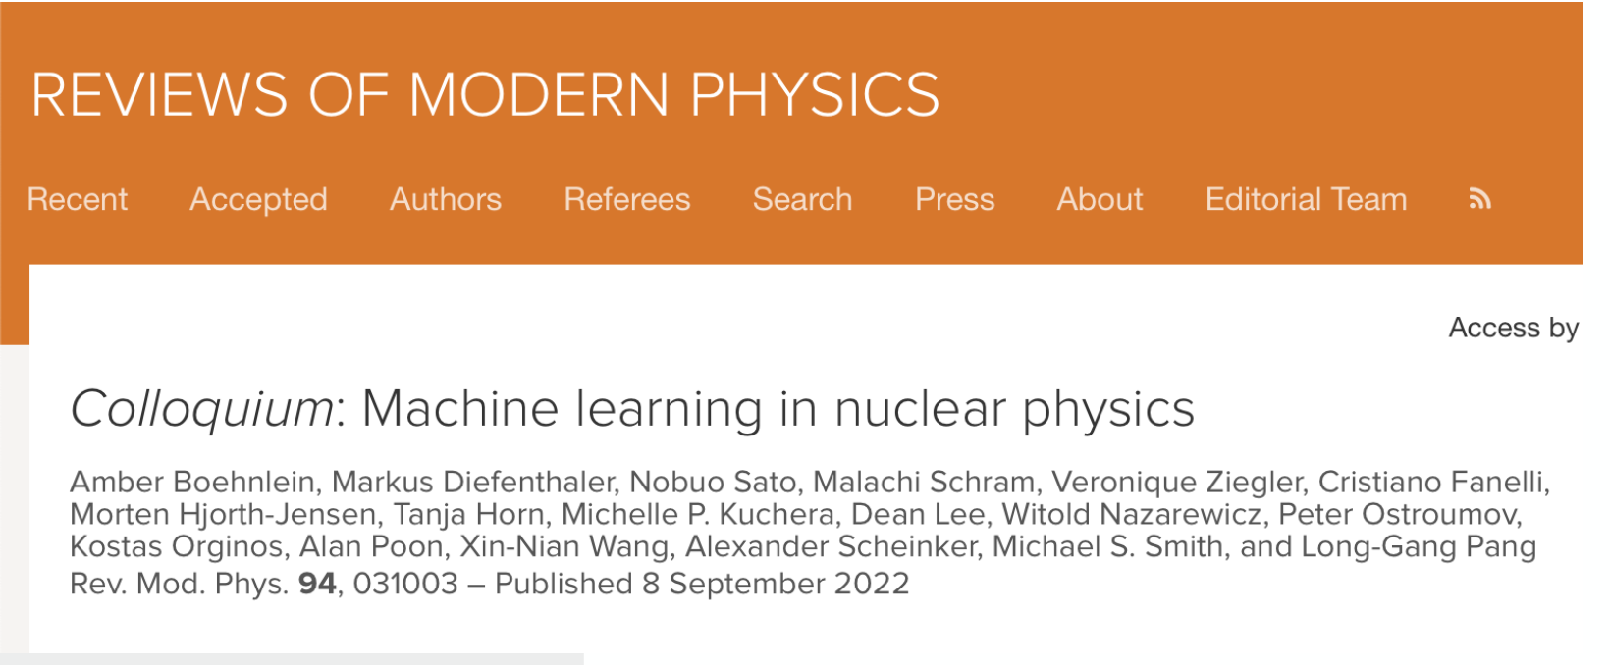
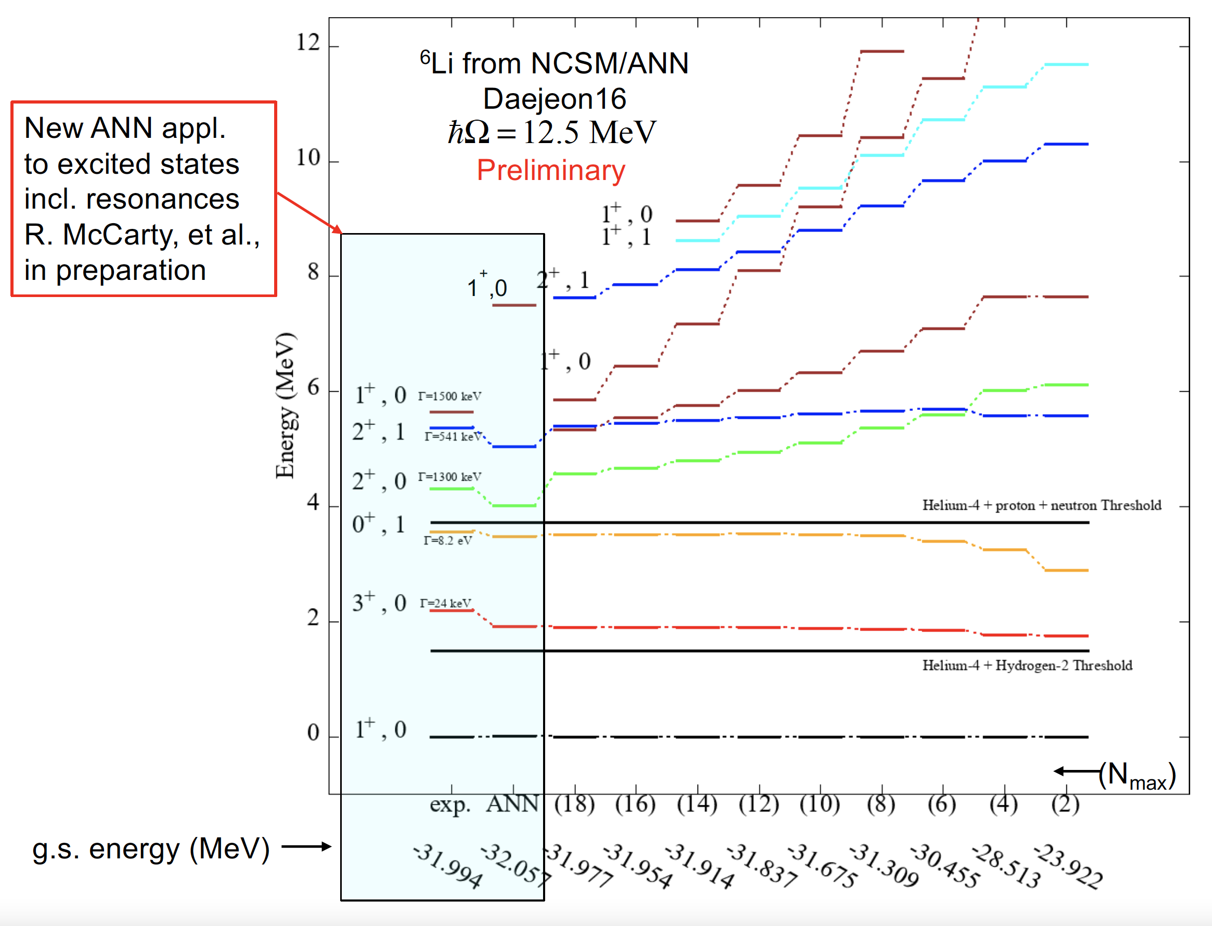
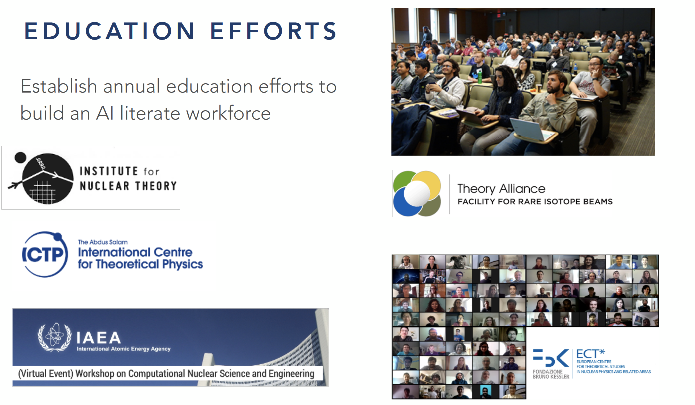
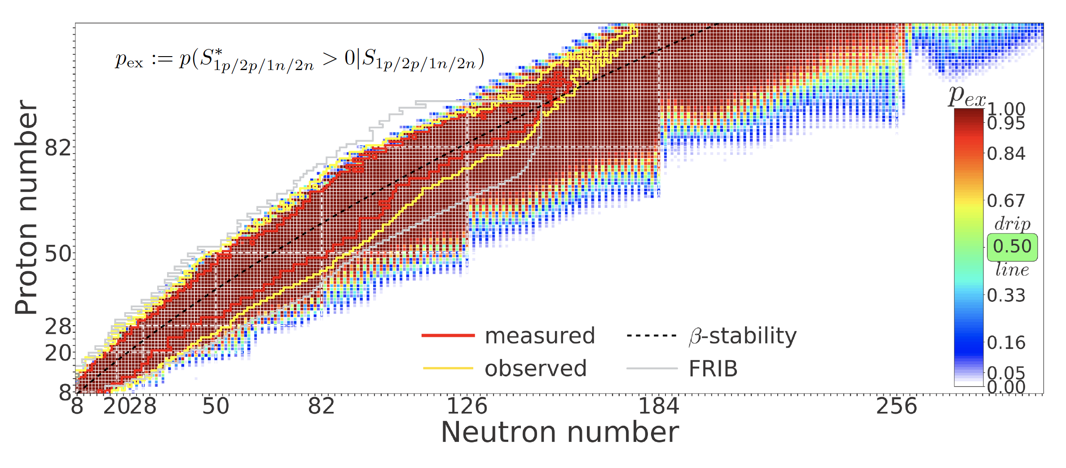
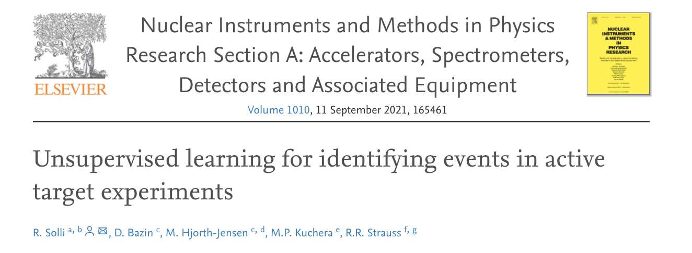
What progress has been made since the last LRP?
AI/ML not discussed in the last LRP
Notes:
Need to add something from GFMC group

Slide 7
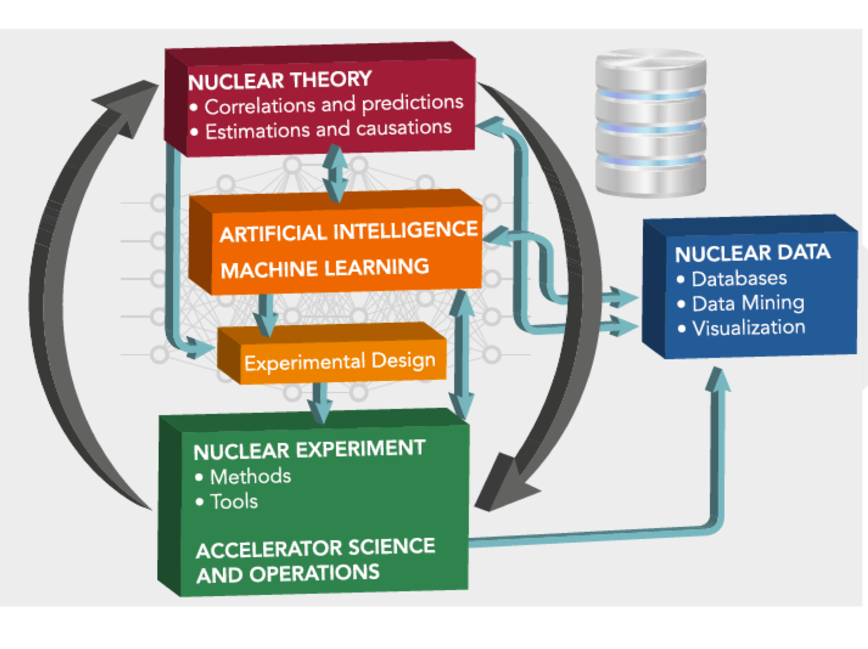
What are the most compelling scientific opportunities over the next decade & their potential scientific impact?
Development of emulators, AI/ML and Bayesian methods:
  Opens up entirely new ways to make predictions relevant for experimental DOE facilities
  Experimental design: which measurements will help constrain/inform theoretical models (maximize the success of an experiment)
Experimental design: Emulators, built using ML and HPC, could enable real-time analysis of experiments

Slide 8


What are the most compelling scientific opportunities over the next decade & their potential scientific impact?
Large Neutron-Rich Nuclei:
  masses and decays
  Confronting FRIB, ATLAS data, ...
  Input to important new experiments
Connections to Astro and Fundamental Symmetries
  Double Beta Decay and beta decay for BSM, nuclear EDM
  Neutron Skins and Neutron Star Matter
  Improved EOS (higher densities, finite T, ...)
  Neutrinos in astrophysical environments
Nuclear Dynamics:
  Electron and Neutrino Inclusive Scattering
  Reactions at low energies (resonances, ...)
  Reactions at higher energy in ab initio
  Coexistence phenomenon and Large amplitude collective motion in fission and fusion
Adapted from J. Carlson’s talk on Monday

Slide 9
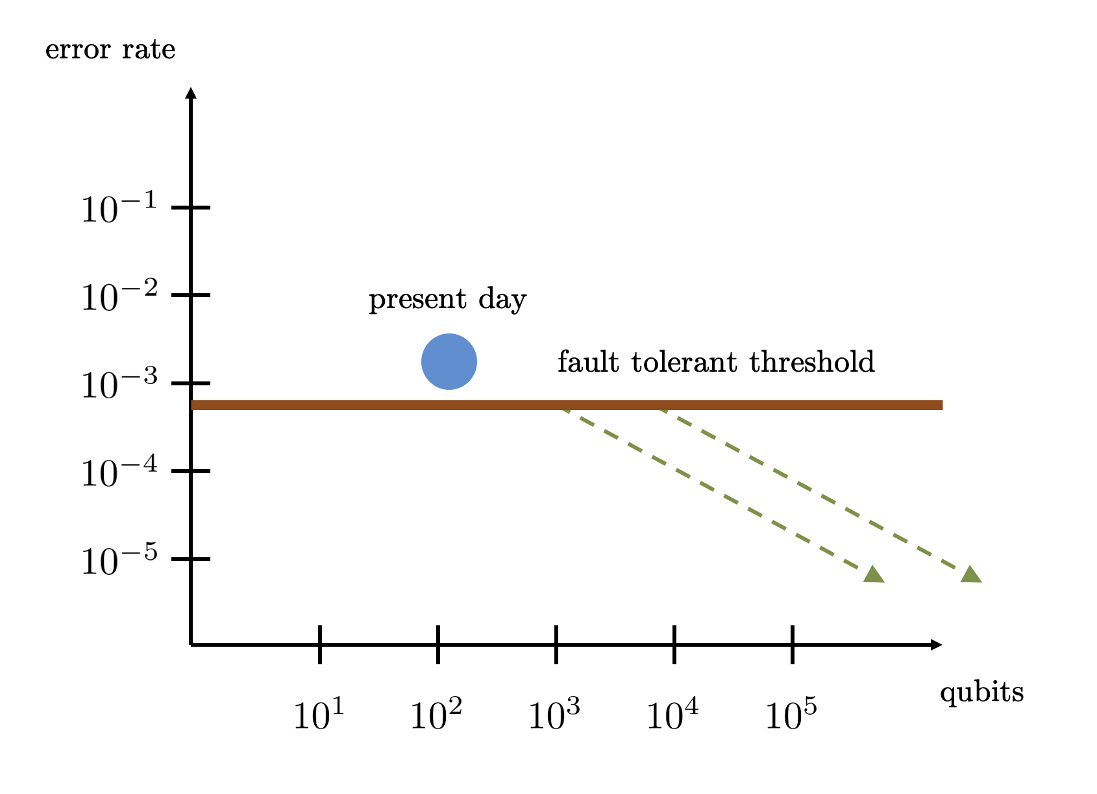
What are the most compelling scientific opportunities over the next decade & their potential scientific impact?
(QC) Calculate real time dynamics and spectral functions
(QC) Nuclear physics problems are nearly ideal for quantum computing due to short range interactions
(QC) Opportunity to design new quantum algorithms with potentially widespread applications
(QC) New talent considering nuclear physics through opportunities in quantum computing
(QC) Interdisciplinary partnerships with quantum information scientists, including DOE Quantum Testbed researchers

Slide 10
Priorities for the next decade
SUMMIT @OLCF

Slide 11
What are the overarching scientific challenges?
What progress has been made since the last LRP?
This will have already been discussed in the Day 1 plenary talk.
A very brief reminder of the main points (through text and/or visuals) should suffice.

Slide 12
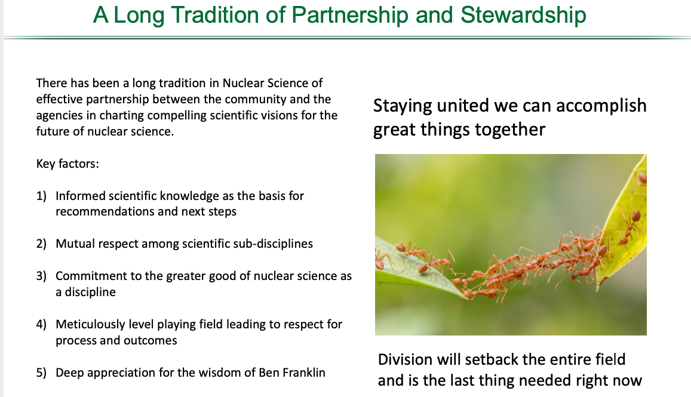
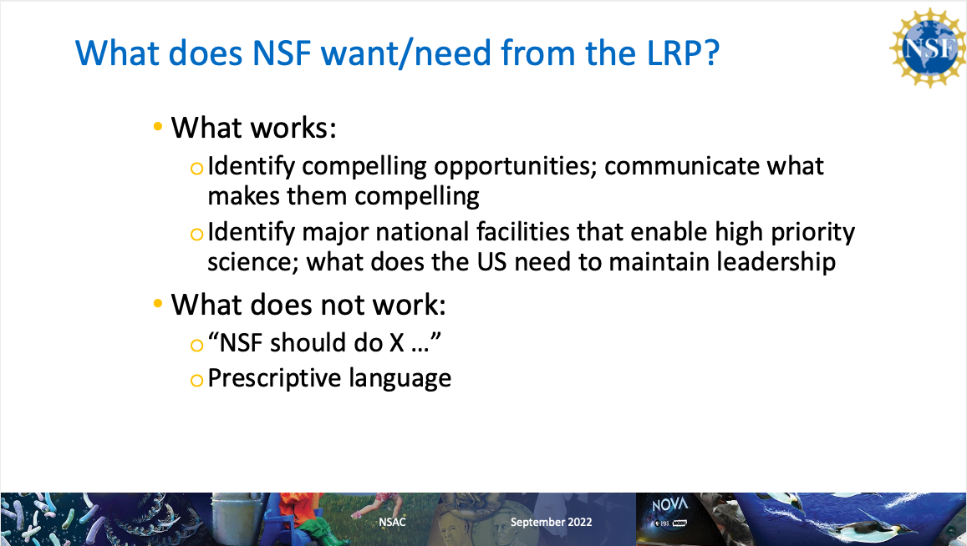
What are the most compelling scientific opportunities over the next decade & their potential scientific impact?
This is the most important part
Please, remember that our job is to identify compelling science opportunities, articulate what makes them compelling, what is needed to maintain leadership
It is not our job to prescribe/micromanage solutions by the DOE and NSF.
T. Hallman
A. Opper

