Slide 1

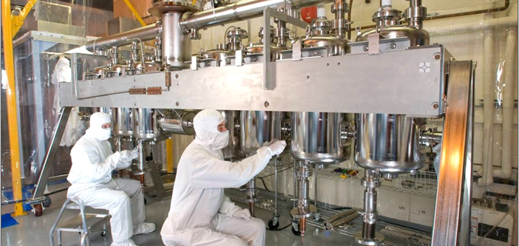
Topic: Maintaining clean systems for high performance accelerators
Importance:
  Modern accelerating structures require ultra clean environments and surfaces thus driving the need to maintain clean systems and to develop and improve upon techniques to mitigate performance degradation and support reliable operation at ATLAS and all NP accelerator facilities.
Clean room work on β = .14 cavities
Recent accomplishments:
  Continuous operation from 2009 to 2021 of 7 - 109MHz β = 0.14 quarter wave resonators with accelerating fields up to 5.2 MV/m
    These cavities were recently removed for refurbishment and reinstalled
    Addition of a 8th cavity
  Continuous operation from 2014 until present of 7 - 72MHz β = 0.077 quarter wave resonators with accelerating fields up to 8.2 MV/m
  60.625 MHz CW-RFQ with a maximum vane voltage of 70 kW. Continuous operation since 2013

Slide 2
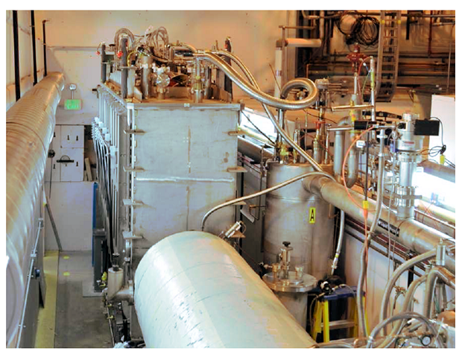
Topic: Maintaining clean systems for high performance accelerators
Challenges and opportunities:
  ATLAS has begun to see a decrease in performance in some systems that cannot be recovered from RF conditioning techniques alone.
    Degradation in Q0 and an increase in field emission as a result of surface contamination
  Removing these systems for maintenance is costly, time intensive, and often comes with a high risk to equipment.
  Opportunities: Better in-situ methods for cleaning and reprocessing accelerating cavities and better designs for new ion linacs that will reduce the need for more cumbersome maintenance and improve operational efficiency at ATLAS as well as many other NP facilities.
Cramped quarters make cryostats difficult to remove for reprocessing
Actions moving forward
  Develop and improve upon in-situ techniques for conditioning and cleaning accelerator systems.
    In-situ high pressure rinse, helium processing, plasma processing
  Develop and implement additional diagnostics to provide a better understanding of a systems cleanliness and to characterize particle migration to RF and SRF systems from adjacent beam transport lines.
IFMIF Particle Monitor

