Slide 1
Detector Technology Development and Support to User Programs
Marco Cortesi
Detector Systems, Group Leader

Slide 2
FRIB Detector Lab
Objectives:
Fabricate & maintain detector systems for Operations and Nuclear Physics experiments;
Perform R&D projects (new detector systems) to enhance the performance of the facility
Detector Upgrade & new Detector Concepts:
High-rate applications:
High efficiency counting system based on SiPM technology
Low radiation damage gaseous ToF readout
Low straggling, high rate Optical PPAC
Fiber detector for high rate Tracking
High-spatial resolution delay-line PPAC for target stations
High resolution PID detector system for high Z beams:
Low IBF MPGD readouts
ELOSS for dE measurement for the focal plane detector system (S800, HR, Sweeper)
High resolution ToF (HRToF) for the focal plane detector system (S800, HR)
Cryogenic “liquid” calorimeter for TKE measurement for S800
Large-area 2D Imaging detector for fission experiment
Future Major Projects
HRS diagnostics/FP detectors
Sweeper magnet beam line diagnostics and focal-plane PID detectors

Slide 3
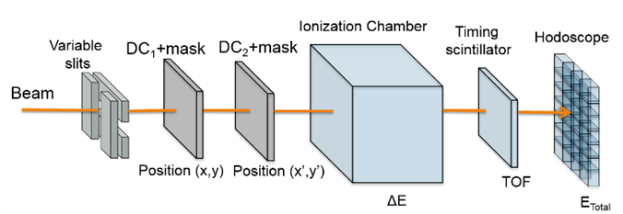
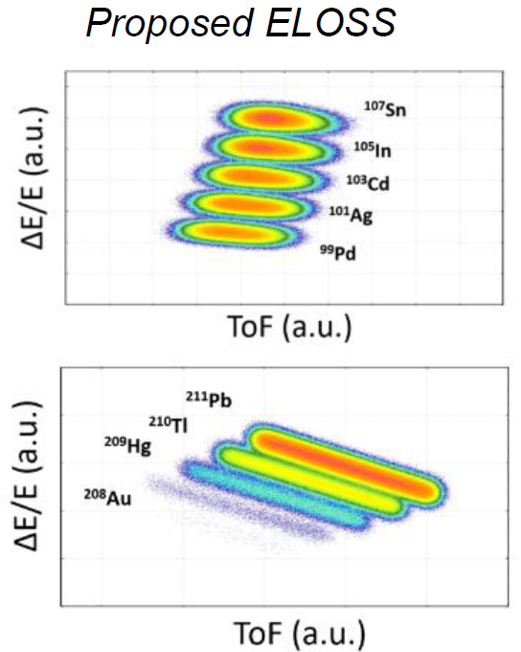
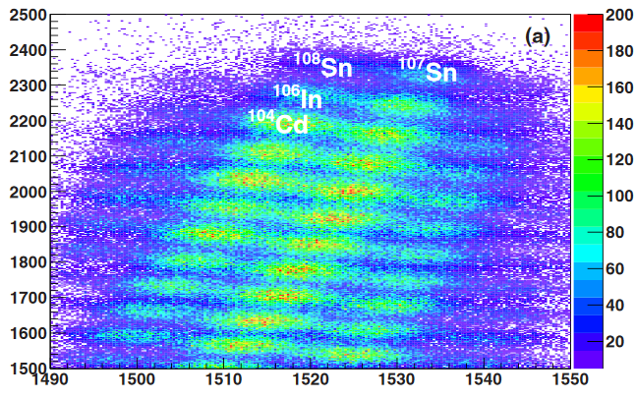
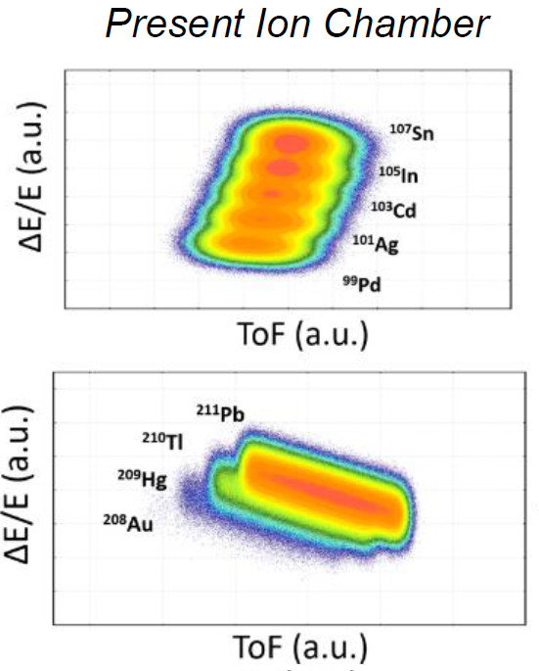
Limit of the current S800 PID System
-) Time resolution (plastic scintillator) ≈ 450 ps (FWHM)
-) Good PID resolution up to A < 100
-) Rate capability < 5 kHz
-) Obsolete (STAR) DAQ
-) Aging problem in the CRDC
(1.2%)
Present Ion Chamber
(0.4%)
ΔE/E (a.u.)
ToF (a.u.)
Cerizza,et al, Phys. Rev. C 93, 021601 (2016)
Lise++ Simulations
Improve FP performance to explore new regions of the nuclear chart for nuclear structure and nuclear astrophysical studies ➔ heavier beams, high rate @ FRIB!

Slide 4
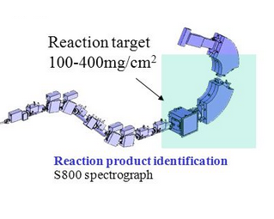
Upgrade FC PID Detector System
S800 FP detectors serve as a benchmark for the design of HRS & Sweeper Magnet
Cathode Readout Drift Chamber
-) Slow → Rate < 5 kHz
-) Resolution ≈ 1 mm FWHM
-) Obsoleted DAQ
-) Aging
New MPGD readout
Commissioning: Dec. 2022
ToF (timing/triggering)
-) Resolution ≈ 450 psec σ
-) Better uniform response needed
Ionization Chamber
-) Slow → Rate < 5 kHz
-) Low SNR
-) Good Resolution (≈ 1.2% σ) for Z<50
CsI Hodoscope
-) Crystal Edge effects
-) Maintenance
-) Moderate TKE resolution
HRToF
Commissioning: Early 2023
ELOSS
Commissioning: Sep. 2023
➔ Cryogenic “liquid” calorimeter

Slide 5
Conclusions
FRIB is premiere facility for production of Rare Isotopes Beam, state of the art diagnostic/detector technologies is required
A powerful, 400kW, Superconducting Linear Accelerator will produce nearly 4,500 rare isotopes, with experimental facilities for fast, stopped, and reaccelerated beams
Strong R&D plan to enhance Diagnostics/Detector to support operation and user science program
New upgrade of the S800 focal plane detector system will allow FRIB science program and serve as benchmark for the development of other similar infrastructure (High-Rigidity Spectrometer / Sweeper Magnet)

Slide 6
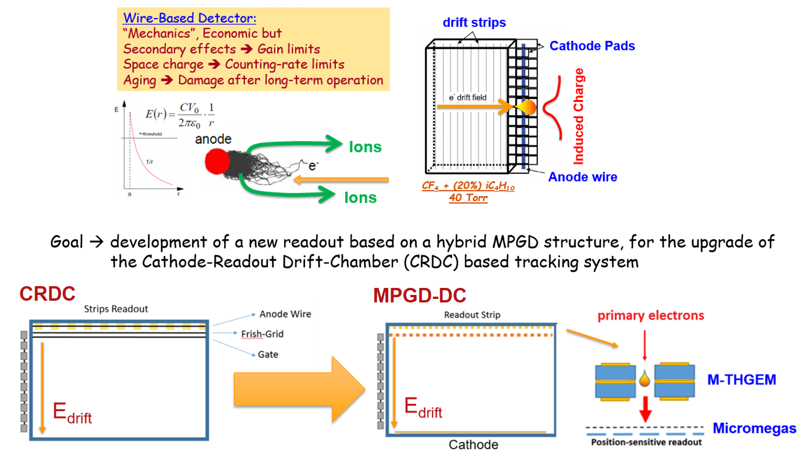
M-THGEM applications: FP Tracking

Slide 7
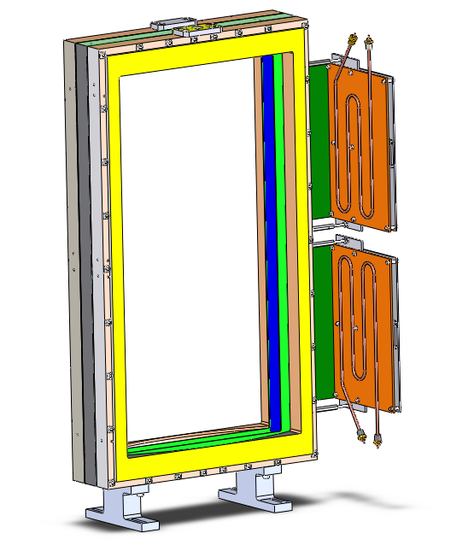
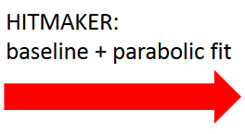
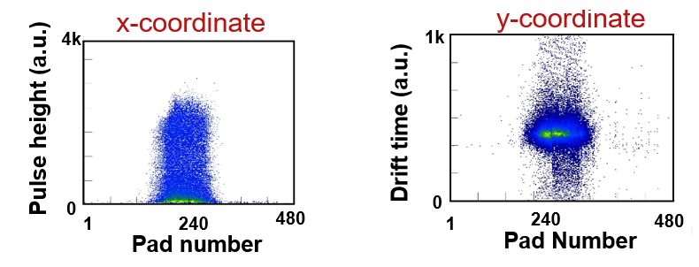
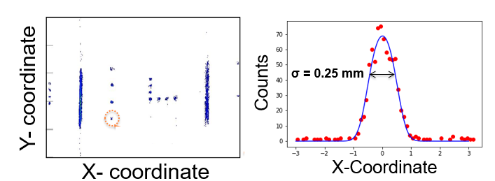
New Tracking System Performance
30 cm
⁷⁸Kr³⁶⁺ (150 MeV/u)
-) Pulse Height
-) Peak location (time)
X ➔ charge distribution (center of the gravity)
Y ➔ Arrival time (external trigger)
60 cm
DAQ Based on the GET electronics
fully integrated into the FRIBDAQ
-) Simple & robust Assembly
→ No aging problems expected
-) Better ions-backflow suppression
-) High detector gain @ low pressure (MM+THGEM)
→ large dynamic range
-) High counting rate (up to 20 kHz)
→ faster electronics + Multi-hit capability
→ expected up to 3 time lower dead time
-) High granularity (480 pads individually readout)
→ better position resolution (0.25 mm σ)

Slide 8
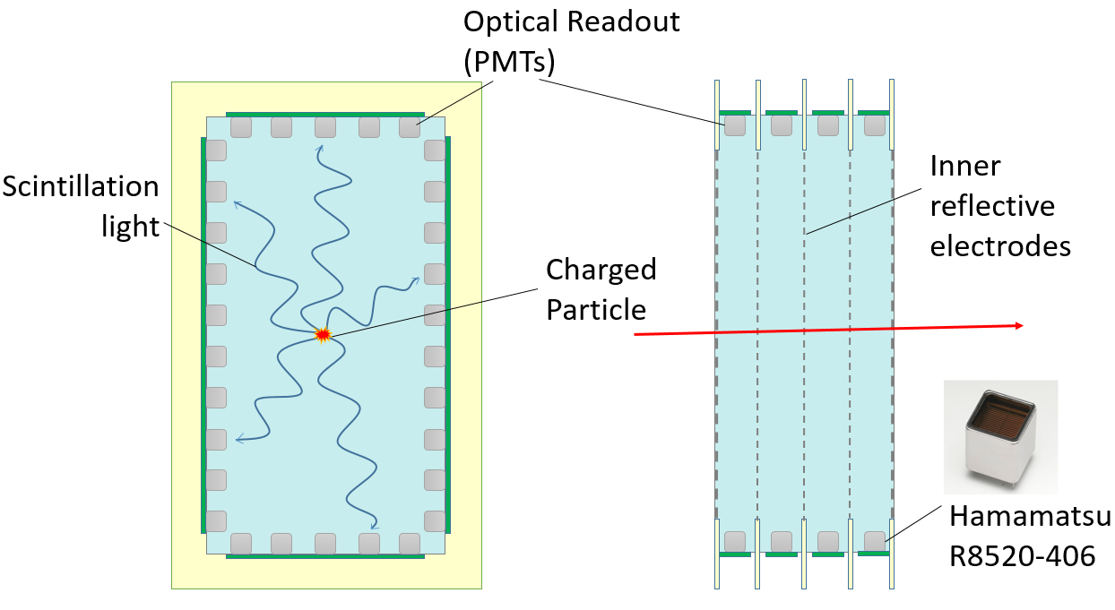
Z-number identification ➔ ELOSS
Operational principle:
-) Large volume filled with high-scintillation yield gas (Xe)
-) Excitation created along the track of a charged particle that crosses the volume
-) De-excitation with emission of intense, prompt scintillation light
*) Optionally: stimulated emission of electro-luminesce light
-) The light readout by array of photodetectors that surround the detector effective volume
Energy-Loss Optical Scintillation System
ELOSS
-) dE/E based on Xe scintillation light detection
-) High scintillation yield ➔ 28 photons/keV - 70% of NaI(Tl)
-) Fast process ➔ scintillation photons emitted within a few ten nsec
-) Homogeneous medium, no radiation damage
-) Compact and flexible geometry
-) Increase resolution ➔ stimulated electroluminescence
-) Scintillation light detection based on well-developed technology
➔ single-electron sensitivity with 30% quantum efficiency
➔ time resolution < 100 ps
-) Easy purification and high efficiency gas recovery technique
-) Readout decoupled from the sensitive medium ➔ high SNR
-) Thee optical readout configurations evaluated
-) Array of Hamamatsu PMTs (120 units) model R8520
-) Commercially available DAQ
-) Based on MDPP-32 for PMT-based readout
Xenon (300-800 Torr)
Work supported by the NSF-MRI, grant number PHY-2017986

Slide 9
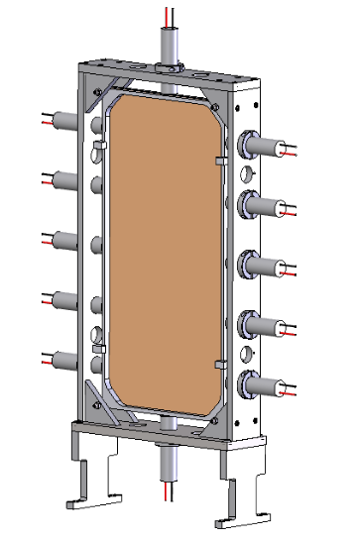
The new S800 Plastic Scintillator
HRToF prototype (FRIB/CMU collaboration)
PI: Jorge Pereira
Approved Design

