Slide 1
ATLAS Accelerator Science
Clayton Dickerson
ATLAS Technical Manager
15-Nov 2022

Slide 2
Overview
ATLAS overview and strategy
Major projects
High intensity beam delivery
In-flight improvements
Helium recovery

Slide 3
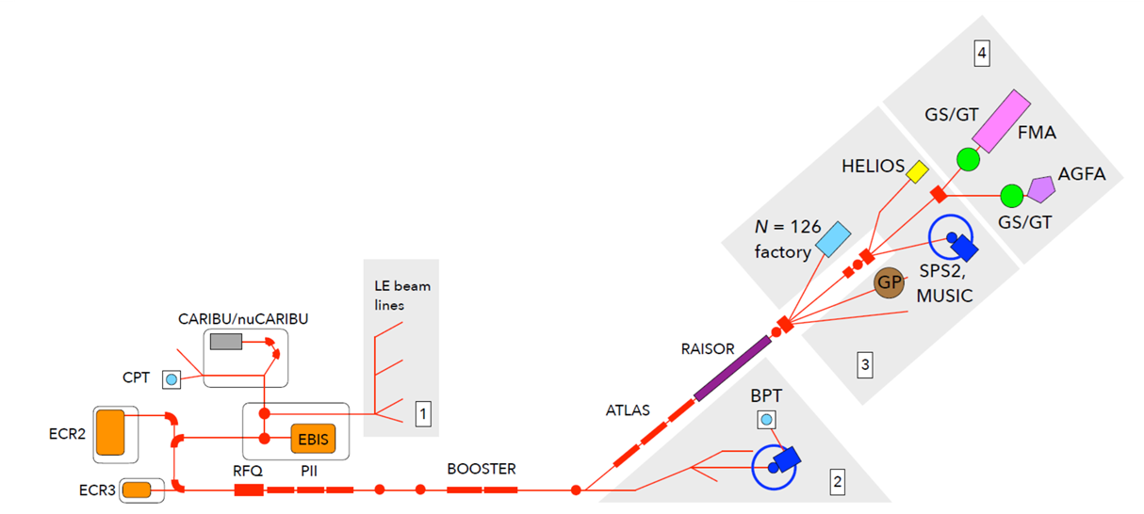
ATLAS overview
Focus on high intensity stable beams at energies up to 10-20 MeV/u
Light in-flight radioactive beams with RAISOR
Heavy n-rich beams from CARIBU
Deliver ~6000 hrs/year with ~1 experiment/week

Slide 4
ATLAS Strategy
There is a general trend of exploring rarer physics with
  Lower cross-section reactions
  More challenging beam production
  Or both
Almost 600 days of beam time were requested at the May 2022 PAC meeting
To address the high demand
  Implementing the Multi-User Upgrade will enable two experiments to run simultaneously
  ATLAS will continue to develop high intensity stable beam capabilities

Slide 5
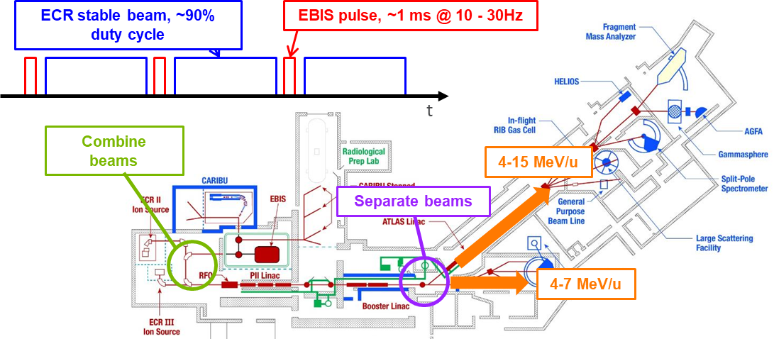
ATLAS Multi-user upgrade
EBIS beams represents 1-3% duty factor
Combine pulsed EBIS beam with ECR beam
  Address high demand on facility
  Enable long duration
  experiments
  Maximize efficient
  accelerator usage
Either pulse (long or short)
can be delivered to both target areas
This scheme is based on reliable,
consistent ECR2 and CARIBU/EBIS
operation

Slide 6
Switchyard Kicker Development
Pulsed switching magnet needed to separate interleaved beams
Multi-User requirements pushing state-of-the art capabilities
Field stability and repeatability are important in the flat-top and between pulses
Challenges and opportunities
  Magnetic materials
  Magnet fabrication
  Power supply development
Pulsed magnetic systems needed for heavy ion radiation therapy as well
Field pulse profile – rise/fall & stability

Slide 7
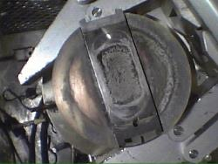
CARIBU Status
CARIBU beams are a cornerstone for multi-user operation
Source needs to be changed roughly every 3 years and it has proven very challenging to obtain a good thin ²⁵²Cf source
The current plate was deposited in 2017 and
installed in May 2018
  Originally 0.52 Ci with 40-50% release
Next ~5 attempts yielded no usable deposits
Current yield: ~2 x 10⁷ fissions/sec
Solution: nuCARIBU, a neutron-generator-based source of fission fragments to obtain more reliable and higher intensity access to fission products

Slide 8
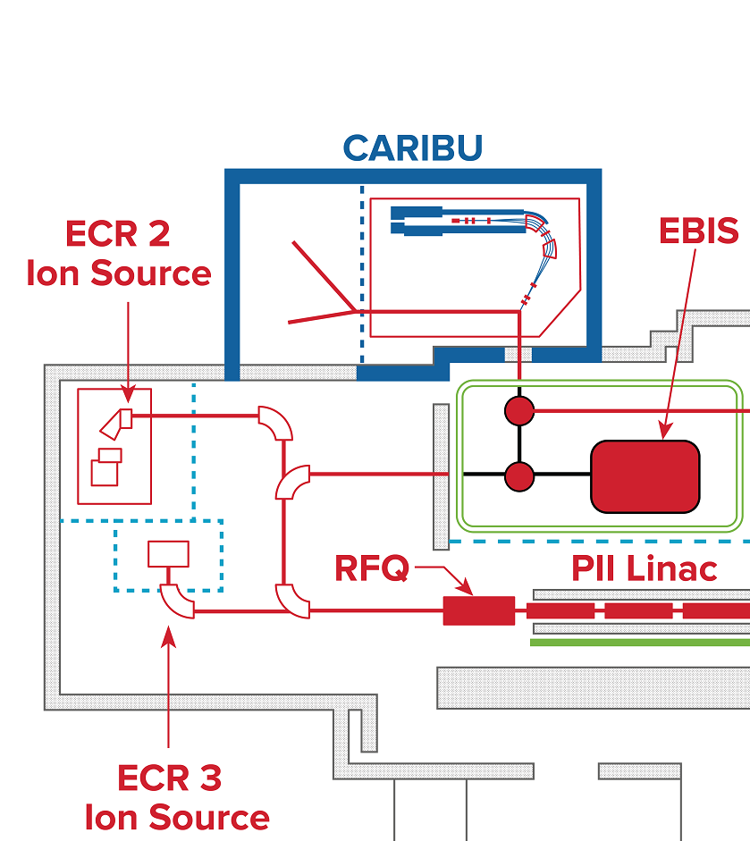
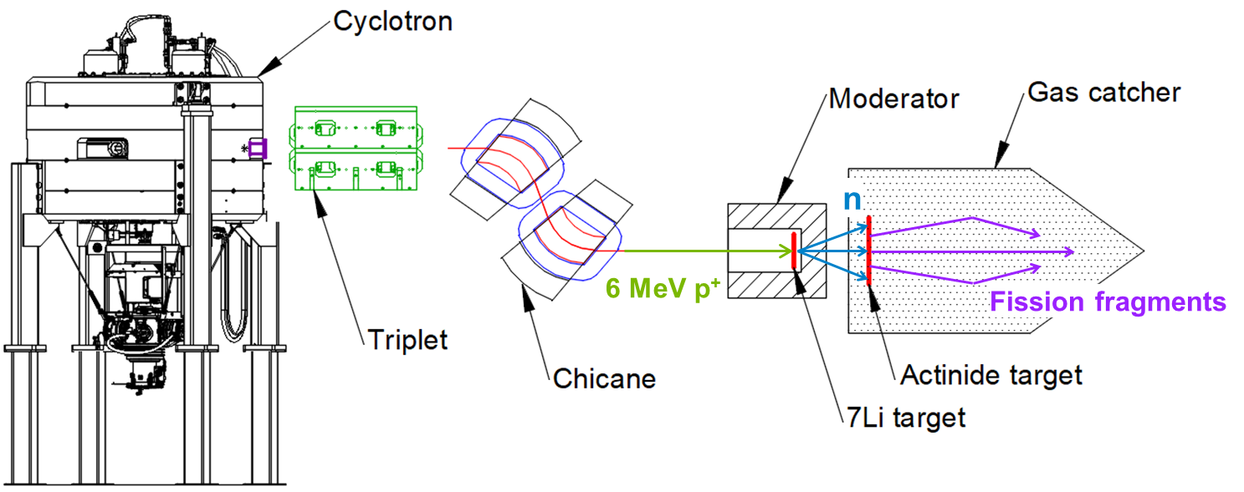
nuCARIBU overview
nuCARIBU
Neutron induced fission of actinide foils
Replace the ²⁵²Cf source and infrastructure with p+ cyclotron, transport, and targets
p-⁷Li reaction for neutron production
Chicane provides room for cyclotron ion source and enables shielding at 180°

Slide 9
nuCARIBU goals
Intensity | Consistency | Reliability | Safety | Cost
A reproducible and controllable source of fission
We expect ~1 x 10⁹ fissions/s from a thin ²³⁵U (5 mg/cm²) foil in the gas catcher
(The current effective CARIBU rate ~2 x 10⁷ fissions/s)
Main source of radiation can be turned off, simplifying safety and maintenance at CARIBU
Less expensive to operate
Opportunity to focus on different regions by choosing the best suited fission target

Slide 10
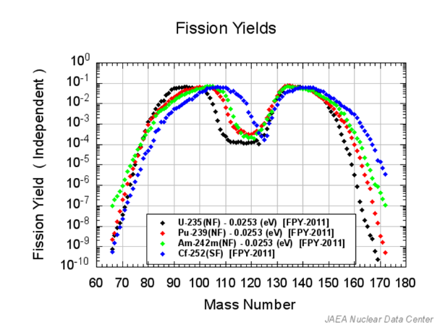
Actinide target development
Target determines fission fragment distribution
²³⁵U at 93% purity available, and planned to be first target
²³⁹Pu, ^{242m}Am and other fissionable isotopes are available but more difficult to handle
Opportunity to develop separation, fabrication, and handling techniques to “tune” the nuCARIBU output

Slide 11
High intensity Delivery
High intensity beams are essential for lower cross-section, longer experiments
  Multi-nucleon transfer reactions
  Super heavy element spectroscopy
  In-flight production
Beam power lost to superconducting solenoids and cavities, especially at lower energies, is limiting
We have transported ~7 pμA mid-mass beam but only ~1 pμA of heavy beams

Slide 12
High Intensity Delivery
We are developing a holistic facility plan
  ECR source improvements
  Implement additional single cavity buncher
  Investigate and develop 12 MHz chopper to remove satellite bunches from the RFQ
  Replace remaining 3 cryomodules of split ring resonators with one cryomodule of world-class quarter wave resonators
  Instrumentation and machine protection

Slide 13
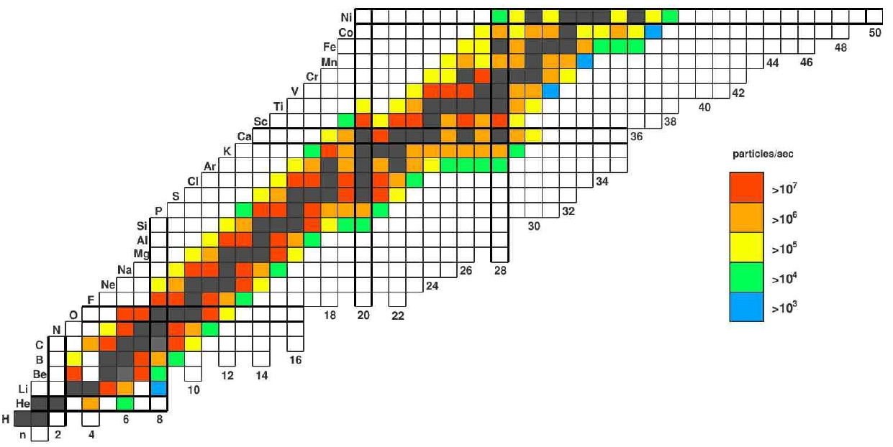
ATLAS In-flight System
Low mass RIB production via in-flight method
Achromatic magnetic chicane followed by RF rebuncher and sweeper
  Momentum selection followed by velocity selection
RAISOR chicane was installed and commissioned in 2018
Improvements will come with higher intensities
and better selection
  Higher power targets – gas cell windows;
  rotating and/or cooled thin films
  Higher intensity beams
  Modern, high field single cavity
  cryomodule rebuncher to time focus
  beam at RF sweeper for better
  separation of contaminants

Slide 14
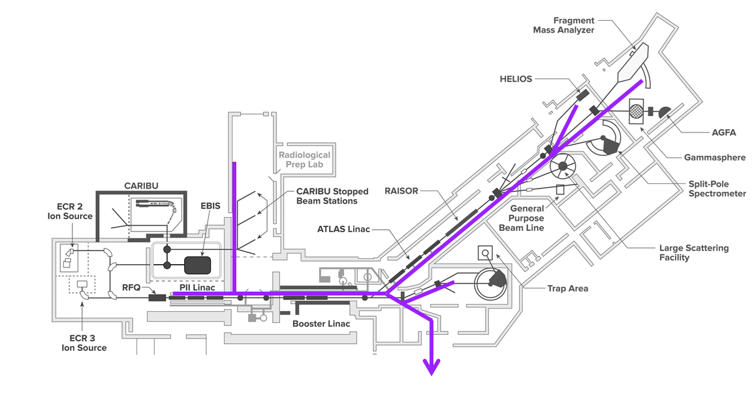
Helium Recovery
Helium shortages and price volatility challenge reliable accelerator operations
Recently the ATLAS cryogenics group developed and implemented a lab-wide plan to collect, purify, and re-liquify He gas for on-site use
This is an opportunity for the community to develop low power,
low consumption, high performance technologies
Different organizations have a variety
of priorities and resources
A community-wide approach
would help coordinate
and align efforts
4” copper piping installed to transfer He exhaust

Slide 15
Summary
ATLAS is positioned to support the physics of the low energy community via large initiatives like the Multi-user upgrade, nuCARIBU, and high intensity delivery improvements
Compact, low-power single cavity cryomodules are needed several places to provide needed performance and flexibility
  Low energy bunching of high intensity beams
  Re-bunching of in-flight beams
  Energy adjustment for Area 2 experiments during multi-user operation
Targetry developments are needed for nuCARIBU flexibility and in-flight production improvements
Coordinated helium conservation and recovery efforts will ensure sustainable accelerator operations

