Slide 1
AI/ML for Heavy-ion Accelerators
Yue Hao Associate Professor of Physics, Accelerator Physics

Slide 2
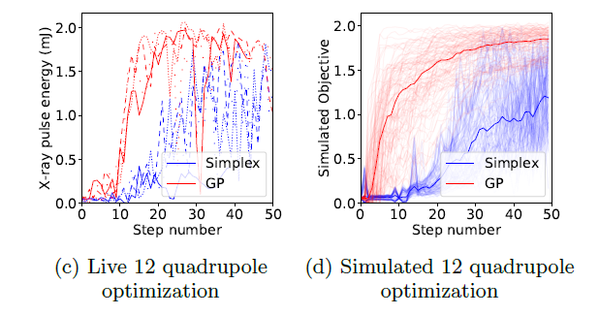
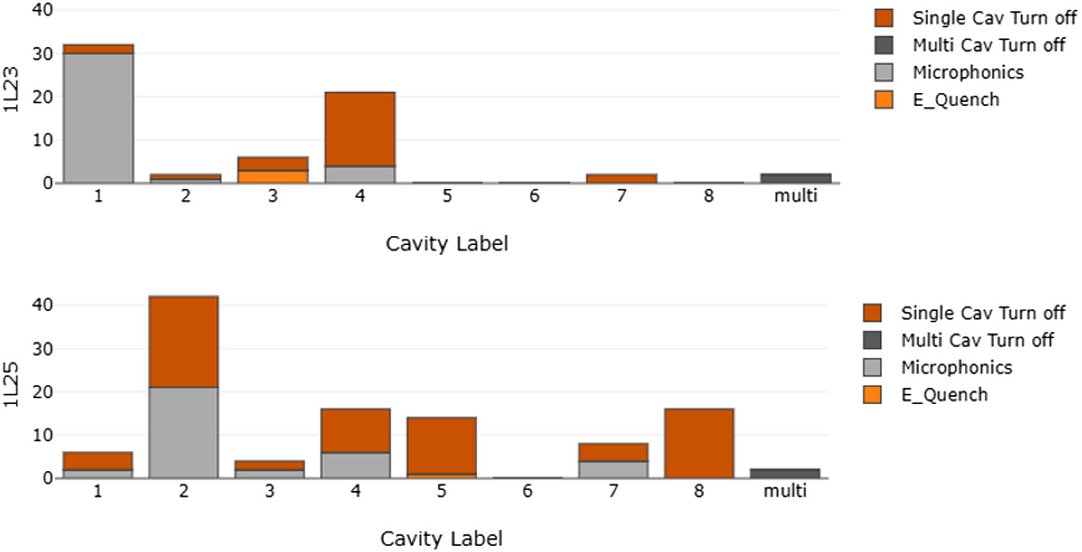
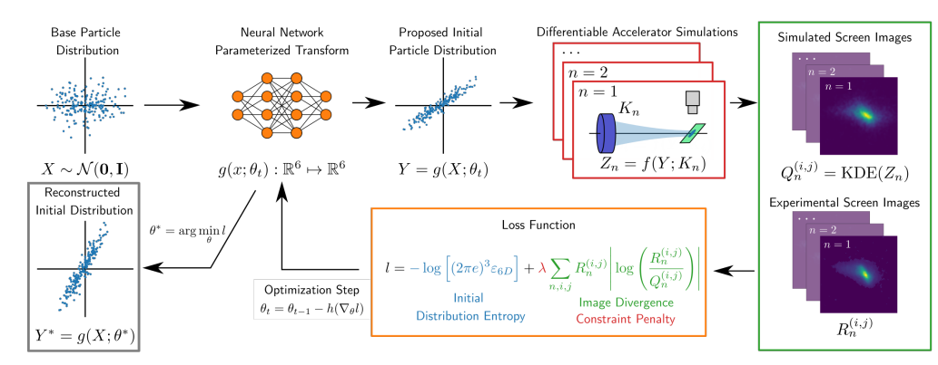
Topic of Interest
AI/ML method has the potential to enhance the performance of accelerators (including heavy-ion accelerators) operation by
Optimizing the performance: surrogate models established from large-scale data that retrieved from the digital diagnostic instruments and simulations
Anomaly detection: classification and/or unsupervised learning for identify and predicting the outliners
Beam by design: Tomography of beam distributions, managing/minimizing beam loss
Safety enhancement: data driven machine protection system
Bayesian Optimization of photon energy using 12 quads at LCLS
@ J.Duris, et.al., PRL 124, 124801 (2020)
SRF cavity fault classification with ML at J-Lab
@ C. Tennant, et.al., PRAB 23, 114601 (2020)
Differentiable-ML based phase space reconstruction at AWA, ANL
@ R. Roussel, et.al., Arxiv 2209.04505(2022)

Slide 3
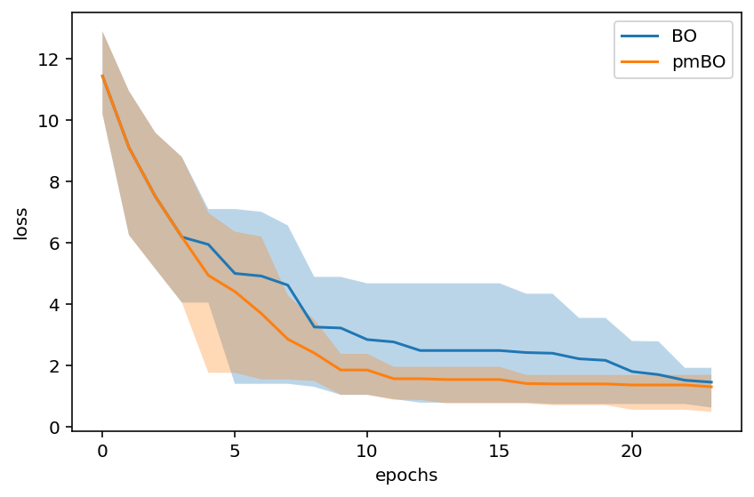
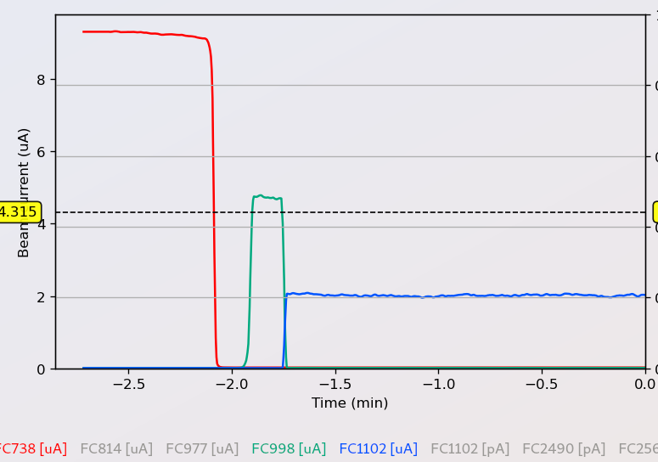
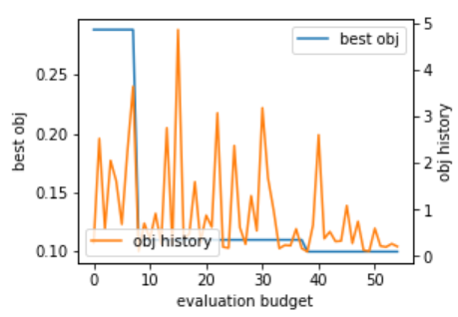
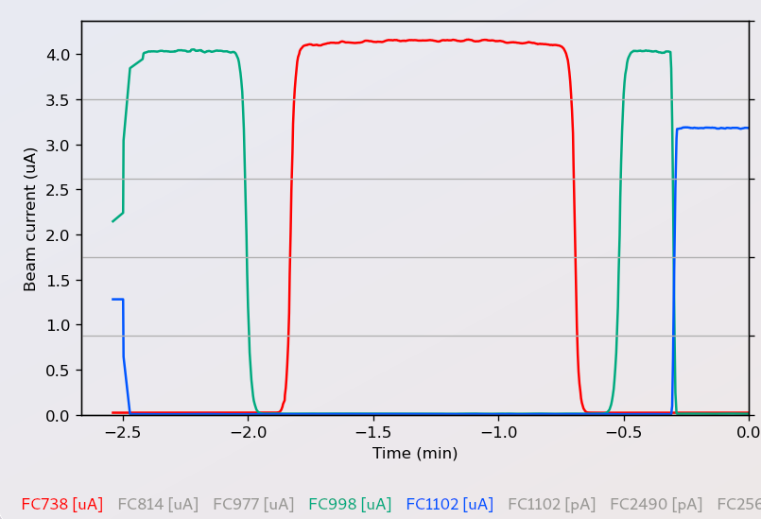
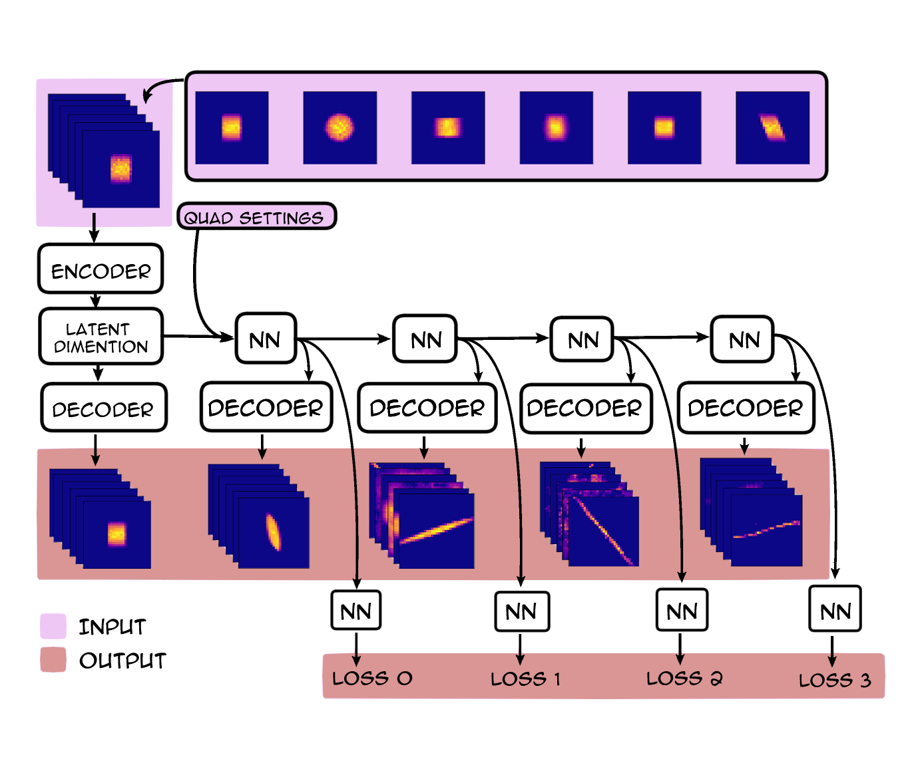
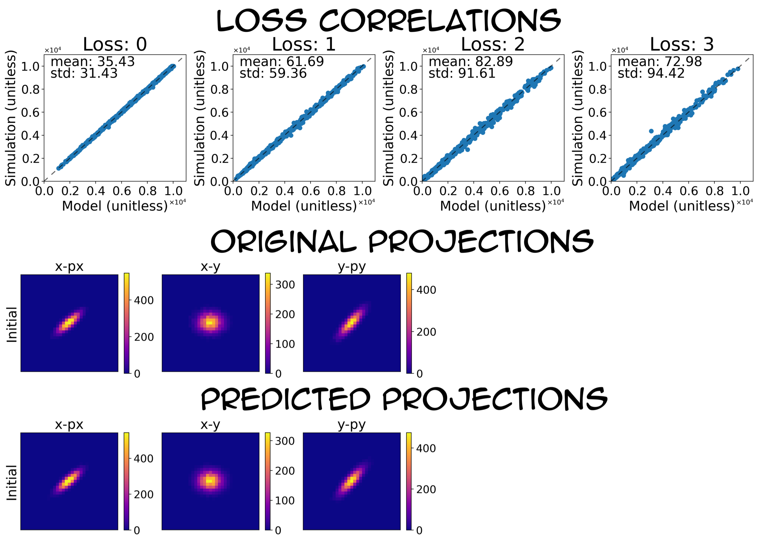
Recent Examples
Prior Mean model assisted Bayesian Optimization (pmBO)
Use historical data / simulations to improve the sampling efficiency of BO
Proof of principle demonstration using FRIB Frontend.
Beam loss prediction with tomography from beam profiles.
Reduce the dimension of beam profile using Autoencoder
Combination of 2-D profiles
Various locations
Simulation studies

Slide 4
Challenges and Expected Advances
Challenges:
Most successful demonstrated AI/ML cases are within few 10s features. Algorithms for high dimension data are needed to be applied to more complex accelerators or components
Most current AL/ML models are lack of explainability. Retraining are usually needed when the machine status is changing. Time-varying systems are generally hard to handle by AI/ML methods.
Expected Advances:
Demonstration of benefiting points where AI/ML based methods exceed the conventional methods in an accelerator complex.
In beam tuning; anomaly detection; controlling beam loss, etc
Developing Algorithms to reduce the need of experimental data
Embed physics/domain information into data-driven model
Using prior information, effective transfer learning.
Effective AI based control method for time-varying system
Considering the uncertainty in the data driven models and safely apply AI/ML models in operation.

