Slide 1
SRF Development for CW Ion Linacs
Sang-hoon Kim
SRF Systems Engineering and Testing Group Leader

Slide 2
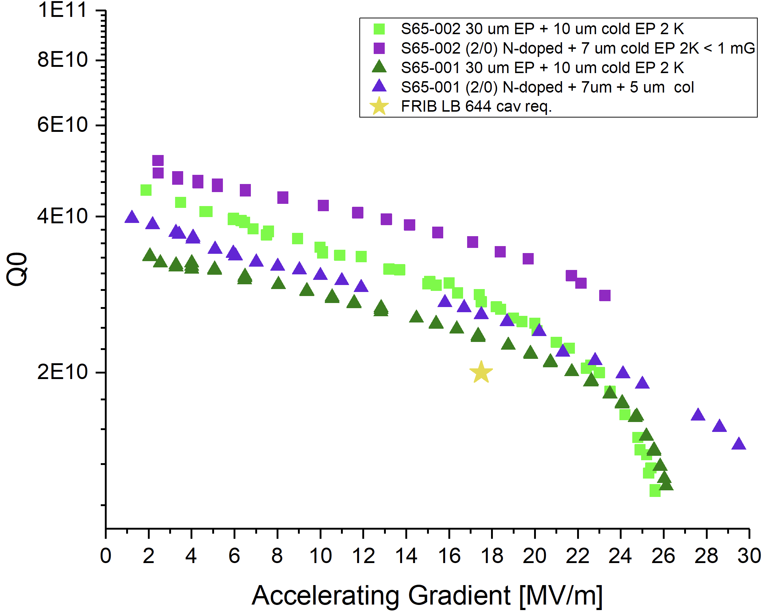
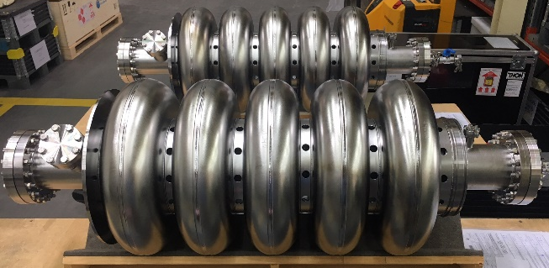
High-performance CW Medium-β Elliptical Cavity Cryomodule
For Next-generation CW Ion Linacs such as the FRIB Energy Upgrade (FRIB400)
Importance
  FRIB400 is a CW linac, so higher Q₀ and better field-emission (FE) performance are required compared to pulsed linacs such as SNS and ESS
  Successful development of a high-performance cavity and high-power fundamental power coupler (FPC) will allow FRIB400 to be cost-effective and reliable
Challenges
  High Q₀ recipes were extensively studied for the 1.3 GHz TeSLA cavity (nitrogen doping, medium-temperature baking, …), but not for 644 MHz
  Need to develop a new high-power FPC for 15 kW CW at 644 MHz
  Resonance-control stability is needed against microphonics and ponderomotive instabilities due to higher Q_{L} compared to pulsed linacs
  Lack of US vendors for SRF cavity production
Accomplishments
  MSU/ANL/FNAL achieved state-of-the-art performance with medium-β multi-cell Nb cavities with EP and N-doping (first demonstration in this cavity class)
Path forward
  High Q₀ R&D: flux expulsion in cryomodules, recipe optimization for 644 MHz, EP optimization for high-aspect-ratio medium-β cavities
  Develop FE-free methods and techniques
  Develop FPC and demonstrate stable resonance control;validate in a cryomodule test
  Upgrade the FRIB SRF Facility: EP, N-doping
Need strong support for this R&D, similar to 1.3 GHz TESLA cavities (latter supported by HEP and BES)
Cavity | Specification/ Design Goal
FRIB400: β_{opt} = 0.65 644 MHz 5-cell; CW | D: 2x10¹⁰ @ 17.5 MV/m, 2.0 K (under development)
SNS β = 0.61 805 MHz 6-cell; pulsed | S: 5x10⁹ @ 10.2 MV/m, 2.1 K (operational since 2007)
ESS β = 0.67 704 MHz 6-cell; pulsed | S: 5x10⁹ @ 16.7 MV/m, 2.0 K (under construction)
PIP-II LB650: β_{G}= 0.61 650 MHz 5-cell; CW | S: 2.3x10¹⁰ @ 16.9 MV/m, 2.0 K (under development*)
*as of June 2021 (SRF2021)
FRIB400 Design goal
FRIB400 R&D cavities

Slide 3
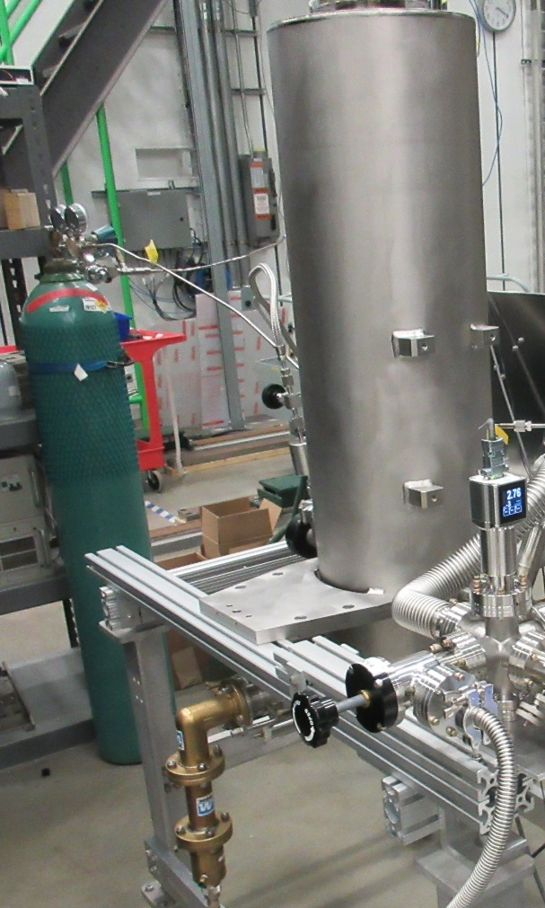
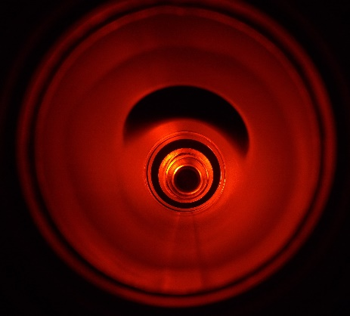
Plasma Processing for Low-β Coaxial Cavities
To Achieve High Availability in Long-term Operation of SC ion Linacs such as FRIB
Importance
  In long-term operation, particularly with high-intensity heavy-ion beams, SC cryomodules may suffer from increased FE, which could eventually reduce the beam energy
  In-situ plasma processing is useful to recover performance with little adverse impact on schedule and budget, as shown at SNS
Challenges
  Avoid coupler breakdown in spite of higher Q_{ext} and absence of higher-order model (HOM) couplers for CW linacs compared to pulsed linacs
  Develop effective plasma cleaning for coaxial cavity shapes: no extensive studies so far compared to elliptical cavities
Accomplishments
  Preliminary studies: achieved FE reduction with plasma processing for
  2 out of 3 FRIB β = 0.085 QWRs with FPCs using the 5λ/4 HOM
Path forward
  More statistics one plasma processing with vertical tests
  Demonstrate plasma processing in cryomodules with offline tests
  R&D to better understand plasma processing:
    Simulations, e.g. plasma density with HOMs
    Diagnostics, e.g. measure the plasma potential (concern: Cu
    sputtering at coupler), plasma density with HOMs
So far, plasma processing development work for
low-β coaxial cavities is a small-scale effort under
the auspices of FRIB Operations
Ne-O plasma
Plasma processing setup:
FRIB β = 0.085 QWR with FPC
Field emission reduction with
plasma processing

Slide 4
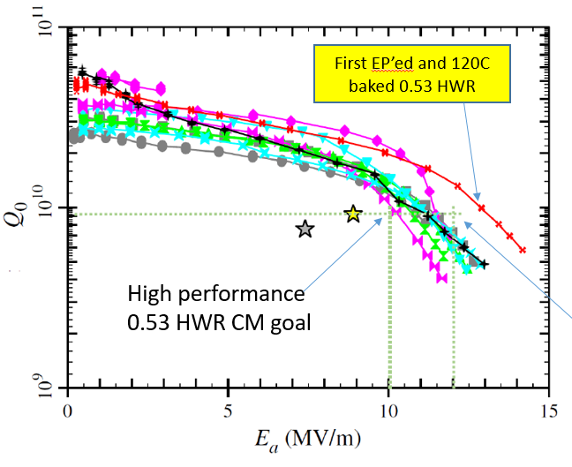
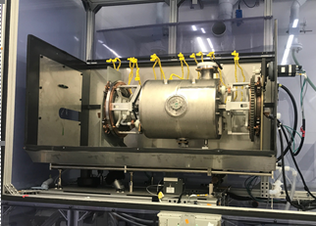
Pushing the Performance Limits of Low-β Coaxial Cavities
Transformative Surface Preparation for FRIB β=0.53 HWRs
Importance
  While the FRIB linac cavities meet the gradient requirements (E_{a} = 7.4 MV/m for β = 0.53 HWRs), higher fields (e.g. E_{a} = 10 MV/m), would provide additional science opportunities: higher beam energy and/or improved reliability against cavity failures
Challenges
  High-field Q slope (HFQS) appears at E_{a} ~ 9 MV/m (B_{p} ~ 80 mT) and hampers reliable operation at E_{a} = 10 MV/m within the FRIB cryo budget
Accomplishments
  Preliminary studies: EP + in-situ 120⁰C baking (ILC recipe) shows promising results for
  reducing HFQS
Path forward
  More statistics on EP + baking with vertical tests
  Study of other recipes, e.g.
    ‘Wet’ doping without heat treatment
    Furnace low- to medium-temperature baking
An R&D project is now funded by DOE-NP:
“Development of transformative preparation methods to
push up high Q&G performance of FRIB spare HWR
cryomodule cavities” (PI: K. Saito, MSU;
September 2022 - August 2024)
Performance improvement with
EP + in-situ baking
EP on β = 0.53 HWR at FRIB

Slide 5
Concluding Remarks
More support is needed for R&D on low- and medium-β SRF cavities. Underfunded areas include
  High Q₀ R&D for medium-β elliptical cavities
  Plasma processing R&D for low-β coaxial cavities
Continuing support for low-β SRF technology development is necessary for world leadership amongst the SRF community
Continued technology development in these areas will facilitate reliable operation of existing machines and cost-effective construction of new machines for NP as well as HEP, BES, and industrial applications

