Slide 1
SRF Activities at RadiaBeam
Sergey V. Kutsaev
2022 NSAC Long-Range Plan Meeting on Nuclear Structure, Reactions and Astrophysics
November 15, 2022

Slide 2
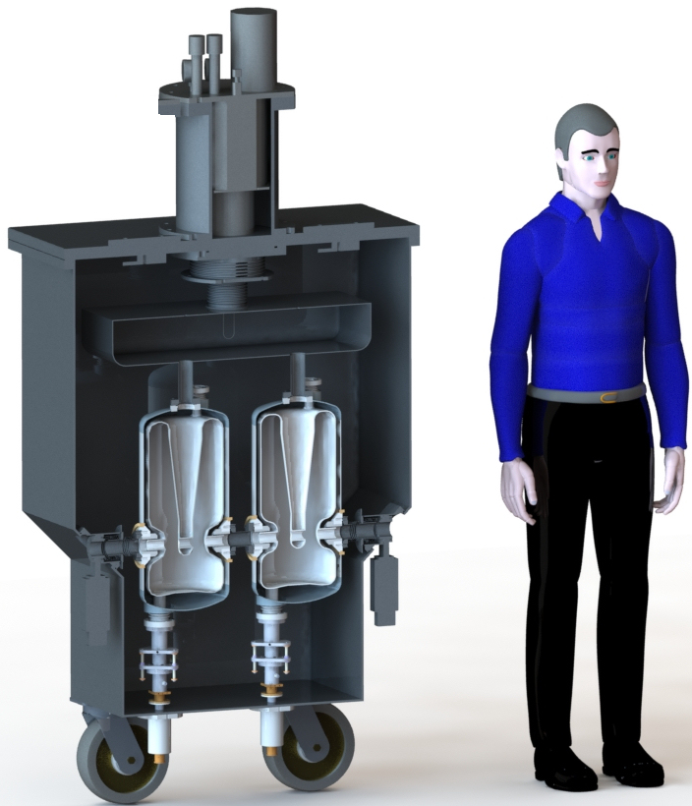
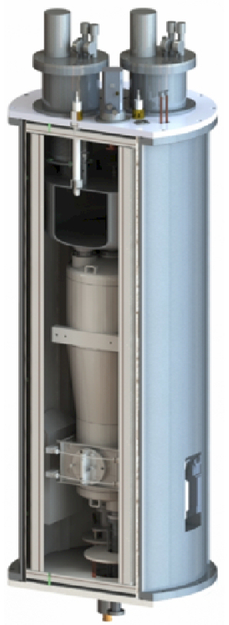
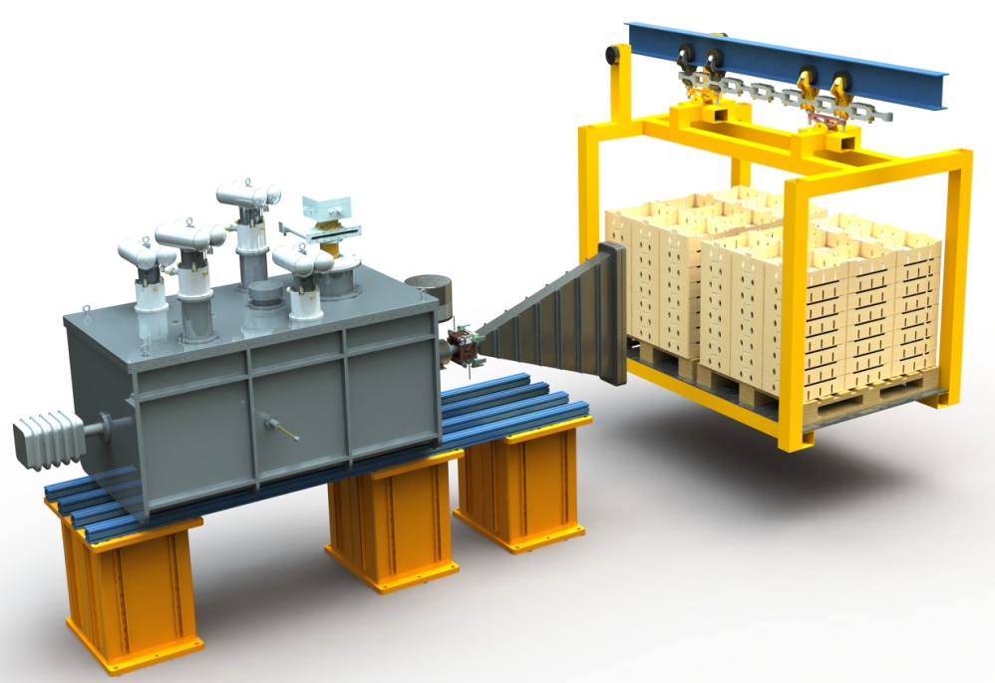
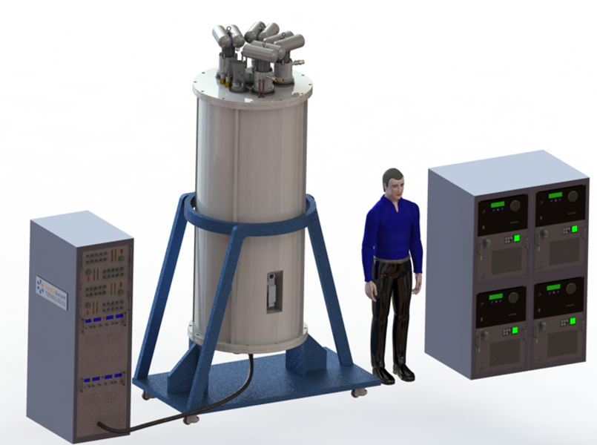
Stand-alone cryomodules
Started in 2017 with DOE NP SBIR Phase I award
In collaboration with ANL
Another Phase I in 2019
Phase IIA for 650 MHz cavity based cryomodule from DOE HEP (FNAL)
In fabrication
Phase II with ANL and FNAL for 218 MHz QWR based cryomodule
S.V. Kutsaev et al., “Design of Stand-Alone Cryomodule based on Superconducting Quarter-Wave Resonator”, IEEE Trans. Appl. Supercond. 30(8), 2020.
S.V. Kutsaev, “Advanced Technologies for Applied Particle Accelerators and Examples of Their Use (Review)”, Tech. Phys. 66(2), p. 161-195, 2021.

Slide 3
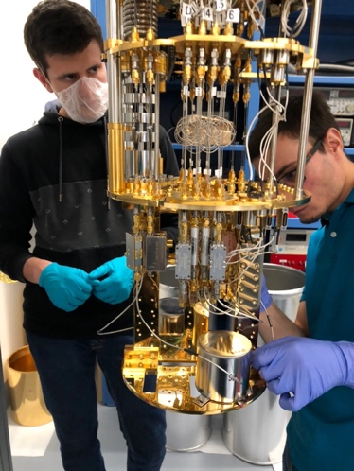
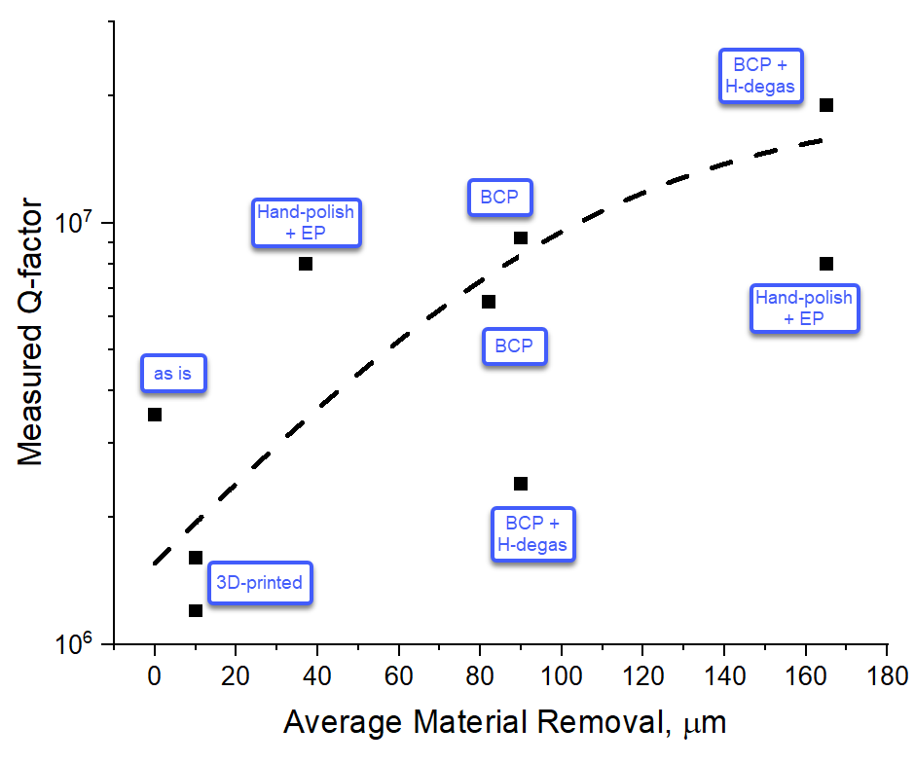
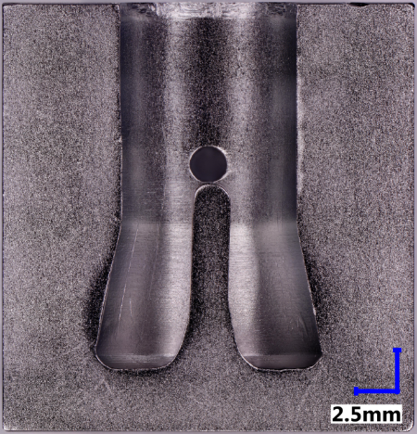
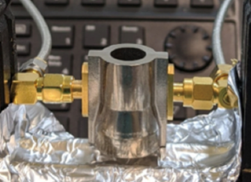
Quantum computing
3 DOE SBIR grants (HEP) to develop 6 GHz QWR cavities for quantum memory
Machining (Phase IIB)
Additive manufacturing (Phase II)
Forming (Phase I)
The projects included fabrication, surface treatment and testing
In collaboration with ANL and U. Chicago
A set of cavities were produced and tested at 20 mK, with Q~1e7 measured
S.V. Kutsaev et al., “Niobium Quarter-Wave Resonator with the Optimized Shape for Quantum Information Systems”, EPJ Quantum Tech. 7(7), 2020.
K. Chen et al., “Mechanical Behavior and Forming of Commercially-pure Niobium Sheet”, Int. J. Solids Struct. 251, 111770, 2022.
A. Riensche et al., “Application of Hybrid Laser Powder Bed Fusion Additive Manufacturing to Microwave Radio Frequency Quarter Wave Cavity Resonators”, J. Adv. Manuf. Technol. 2022, accepted.

Slide 4
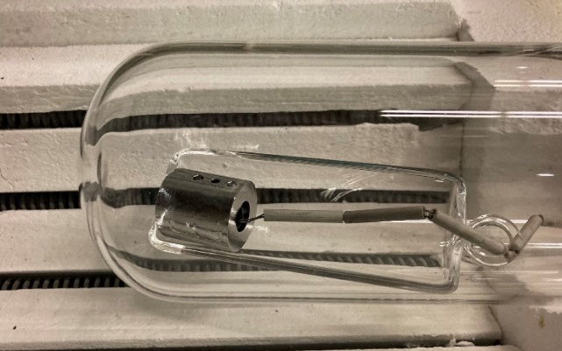
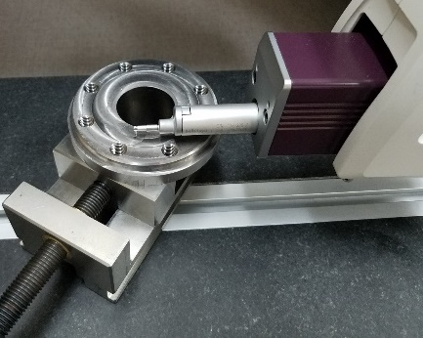
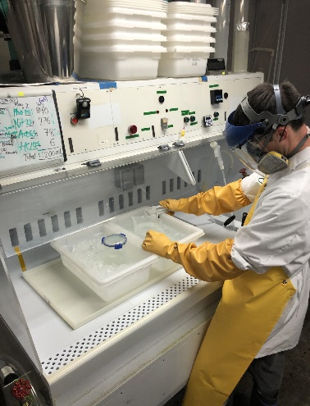
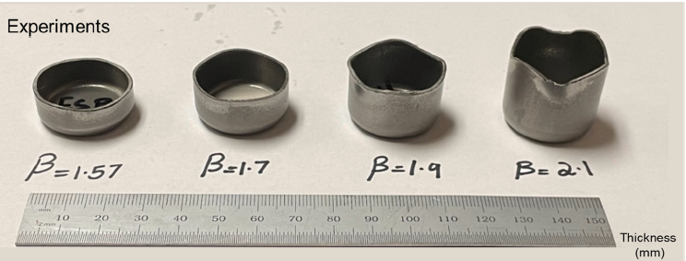
SRF cavities fabrication
Thanks to quantum and cryomodule projects, + consulting from ANL, RadiaBeam developed in-house Nb machining capability
We machined Nb parts for 218 MHz QWR
BCP and cavity baking capabilities were also developed
For small scale cavities
EBW machine exists at RadiaBeam, but requires significant resources to become operational
A new Phase IIB has just be awarded to develop more SRF technology capabilities
Forming, welding, etc.
In discussions with FNAL and other interested parties

