Slide 1
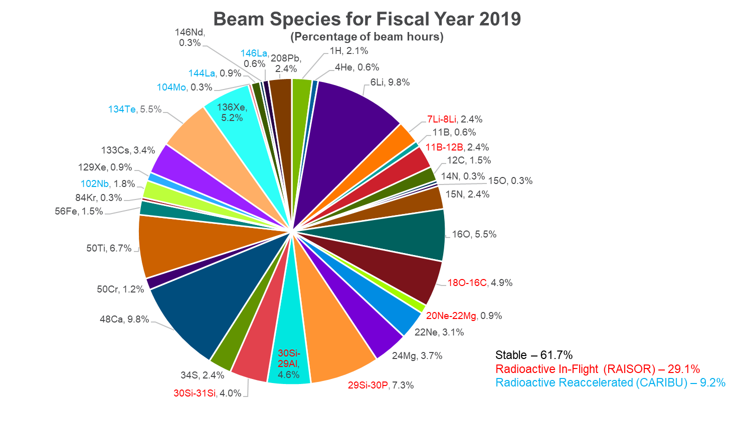
High intensity ion source
Two second generation ECR ion sources provide ATLAS with >5000 hours of beam each year and produce a wide array of beam species.
Programs such as the spectroscopy of isotopes with Z>100 at AGFA, the in-flight production of intense mid-mass radioactive beams with RAISOR, and the N=126 factory would benefit from a higher performing source.
Third generation superconducting sources are complex and costly. An 18 GHz room temperature or hybrid (RT & SC) source reduces the cost and operational complexity and can provide the required beam intensities for most species.
Perform a comprehensive design study of an 18 GHz ECR source which accommodates the introduction of solid materials and develop a cost and workforce profile. Engage U.S. vendors to develop competitive pricing.

Slide 2
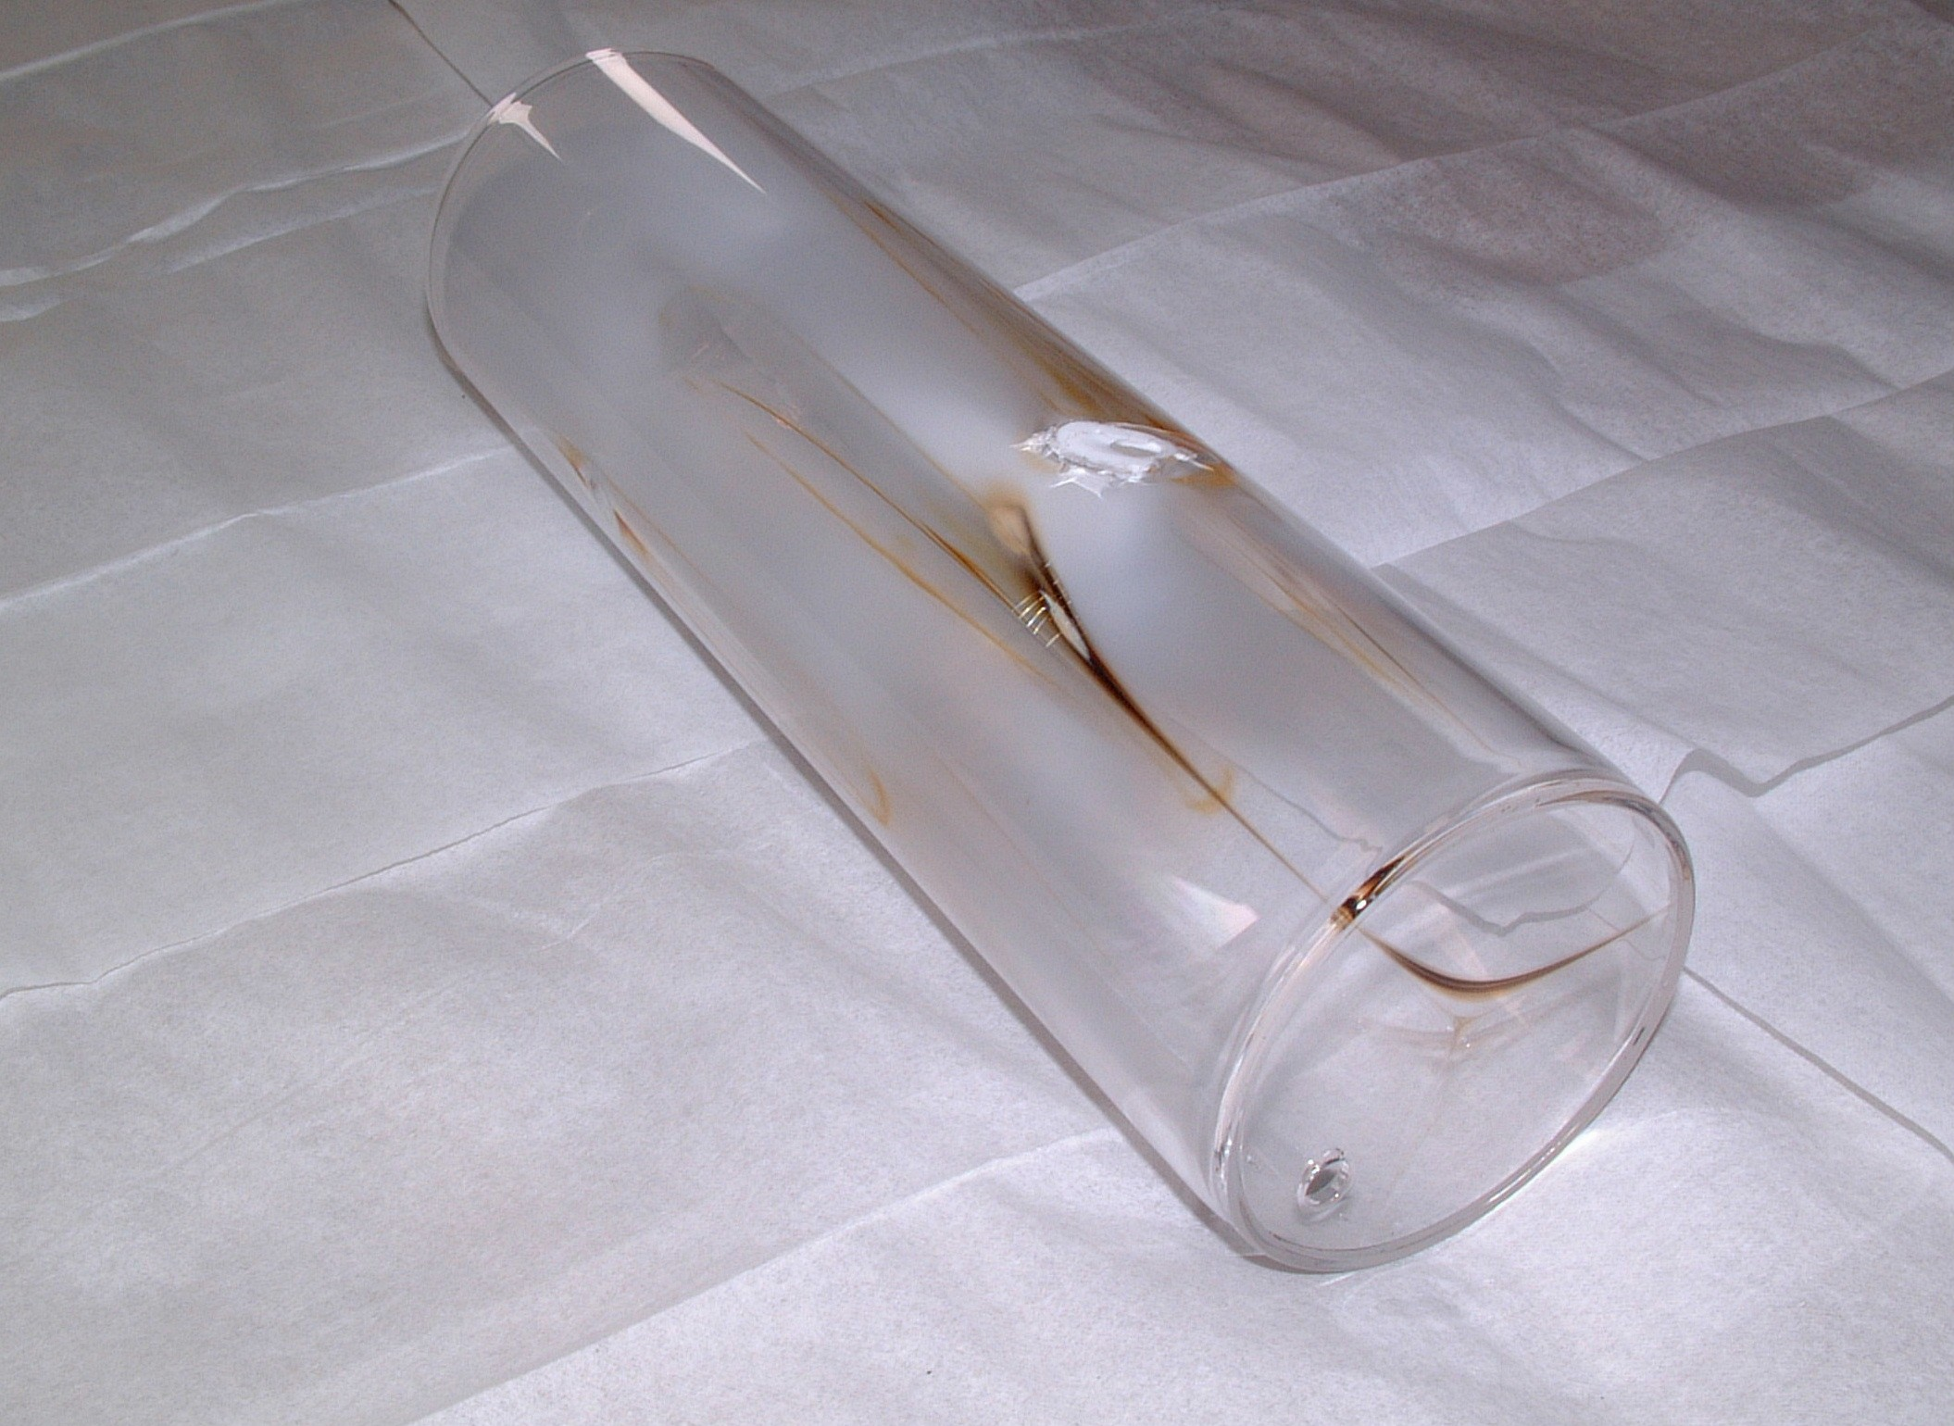
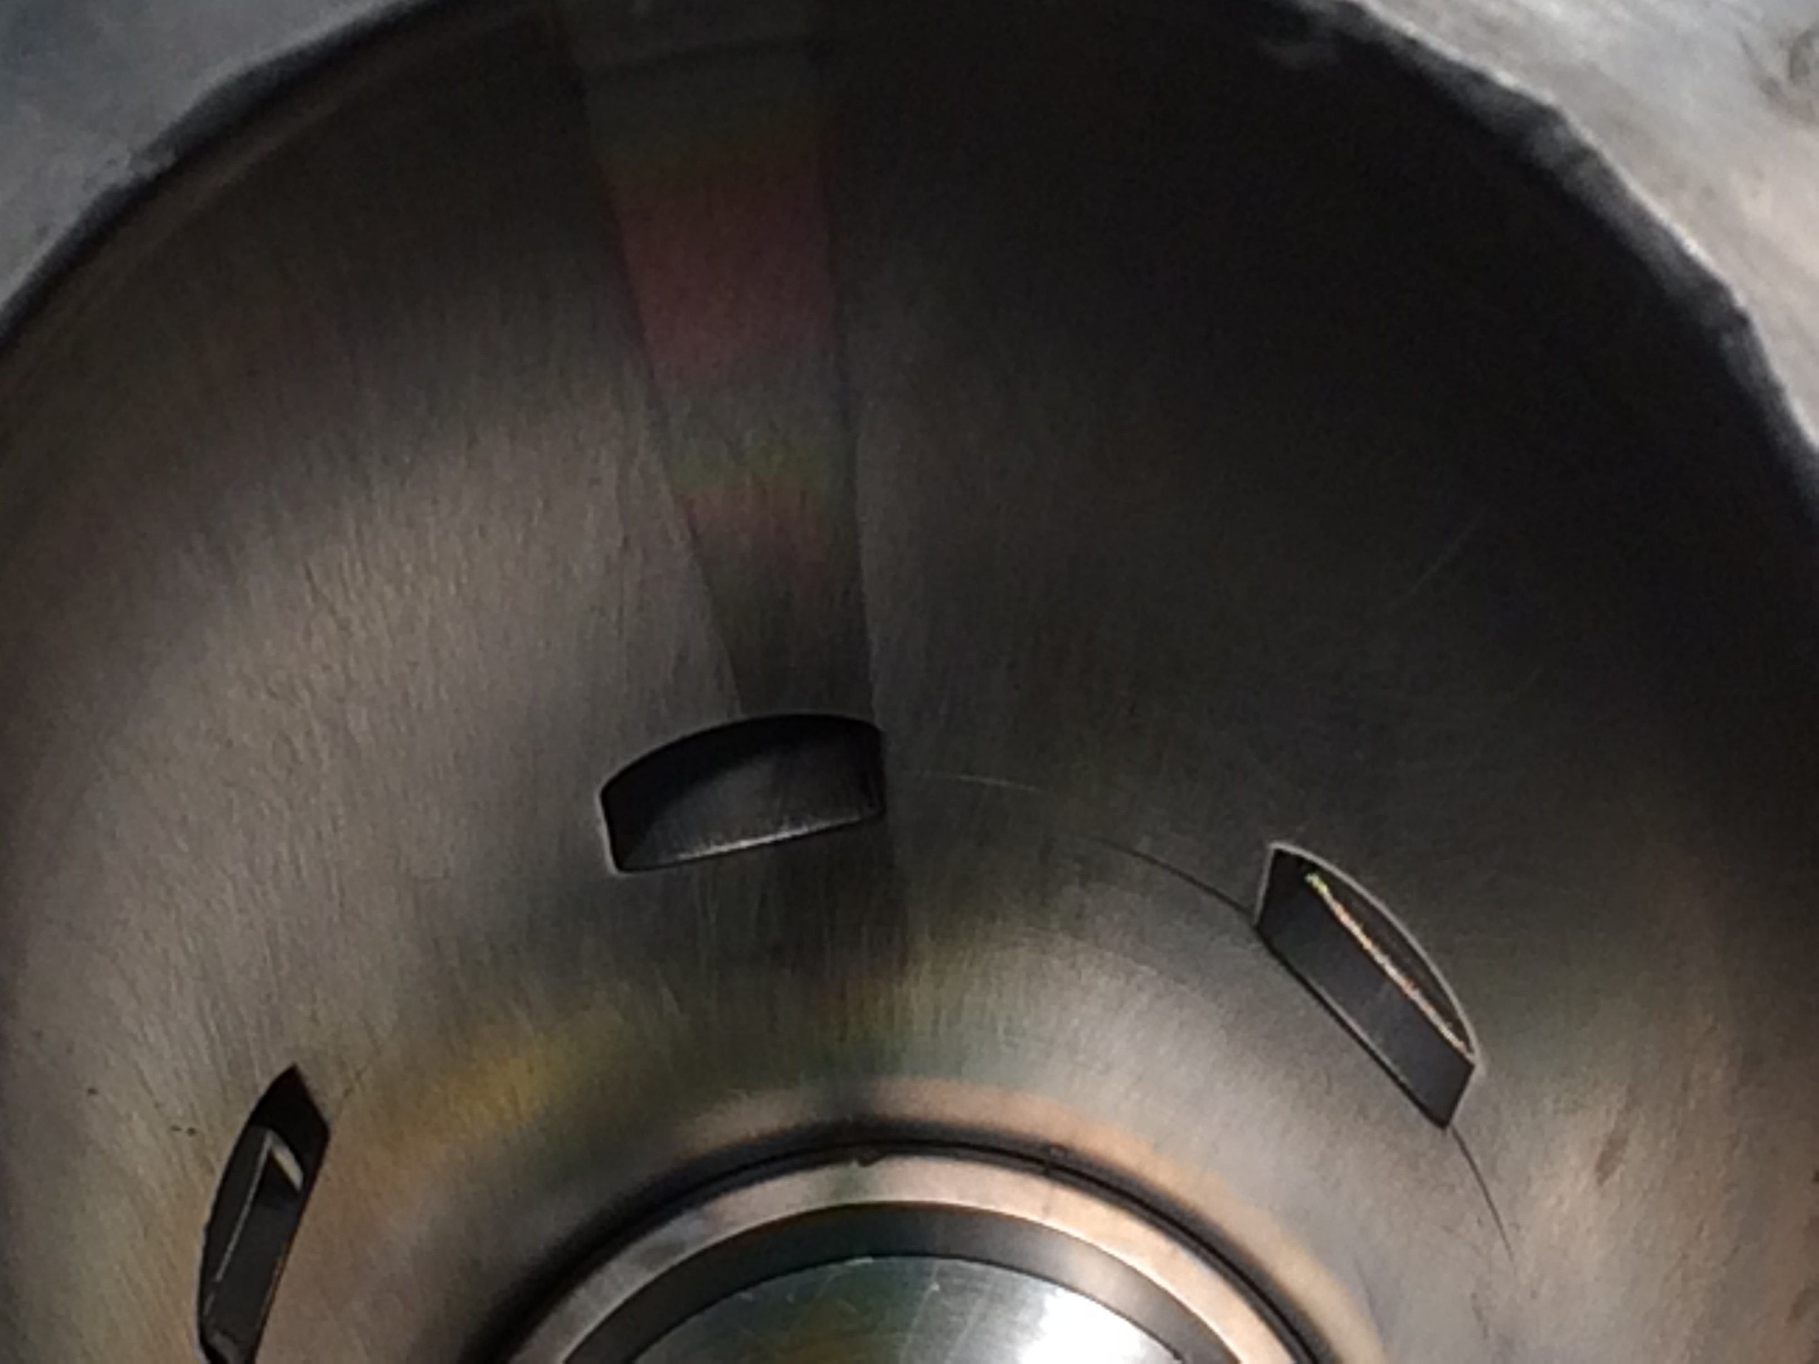
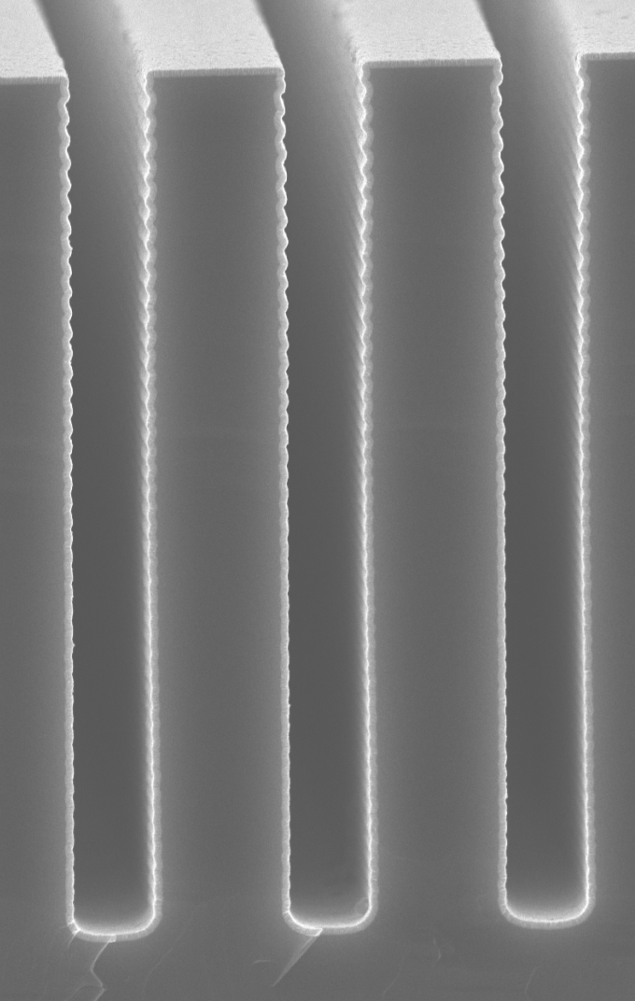
Surface treatment and maintenance
ECR sources are utilized for Accelerator Mass Spectrometry with noble gas radionuclides (Ar-39) and heavier nuclides requiring isobaric discrimination (Sm-146) as well as charge breeding of radioactive ion beams for post-acceleration.
Stable contaminant beams obscure the AMS or RIB species of interest and limit detector rates. Progress has been made with cleaning techniques, surface coatings, and liners, but these are time consuming or hinder source performance.
In situ cleaning or coating techniques which do not introduce additional contaminants are required with Atomic Layer Deposition being a possible path forward.
Perform off-line tests with representative source components benchmarking surface contaminant reduction and ensuring no degradation of component performance before implementing method on the ATLAS ECR3 ion source.
ZnO
Si
1 μm

