Slide 1
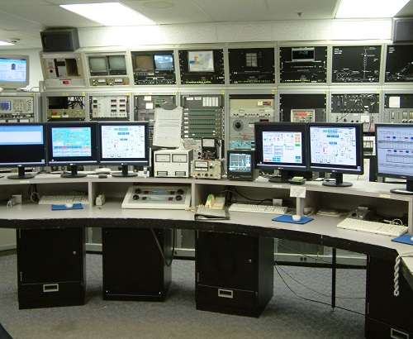
Topic: Infrastructure Modernization to Support AI/ML
Examples of key areas
of modernization
Network speed and capacity
Control system software
High speed data capture
Vacuum system automation
Importance: AI/ML provides an opportunity to increase beam hours by reducing tuning and setup time
AI/ML depends on abundant and accurate data in real-time. Current data infrastructure restricts the amount of data available, limiting the training and usage of AI/ML algorithms.
Dedicated investment in facility infrastructure enables a leapfrog to the cutting edge AI/ML beamline tuning.
Recent accomplishments:
ATLAS testing and investigating AI/ML techniques for beam tuning (PI B. Mustapha) and in-flight experiment setup (PI C. Hoffman).
Added new server to begin the transition away from a 30 year old legacy server
Initiated search for state-of-the-art replacements for legacy I/O hardware
ATLAS Control Room

Slide 2
Topic: Infrastructure Modernization to Support AI/ML
Challenges and opportunities:
Challenge: Legacy equipment and infrastructure is 30+ years old and failing regularly, with little to no replacements available.
Opportunity: Investment in modernization to catch up with rapidly advancing field and take advantage of a long-lasting, high-bandwidth accelerator control and data acquisition system.
Actions moving forward
Continue networking upgrades
Use modern, modular networking components to connect all I/O systems.
Control System hardware transition
Continue push to move off of unsupported legacy computer and I/O platforms.
Research, design, and implement new I/O platform focusing on data acquisition for AI/ML.
Automate where possible
Example: Vacuum system automation upgrade

