Slide 1
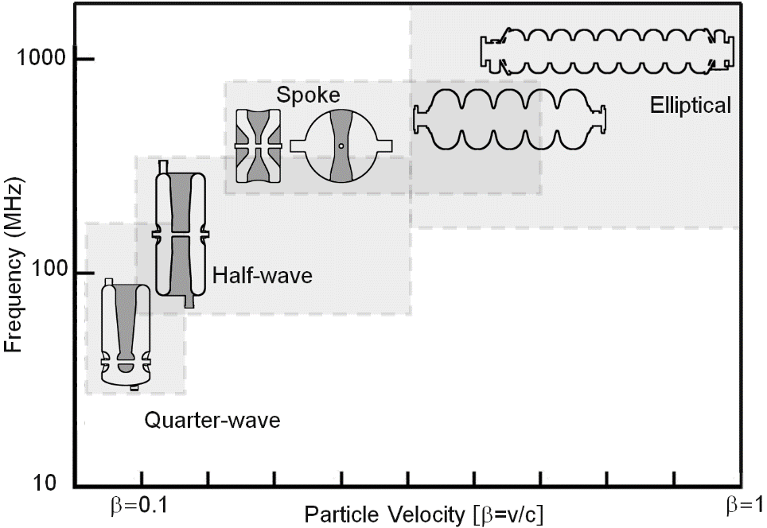
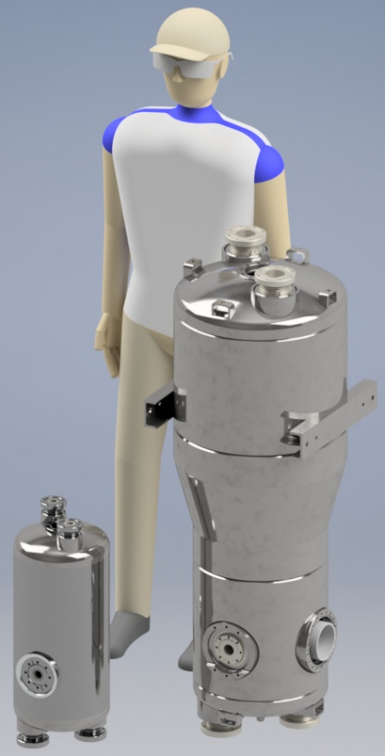
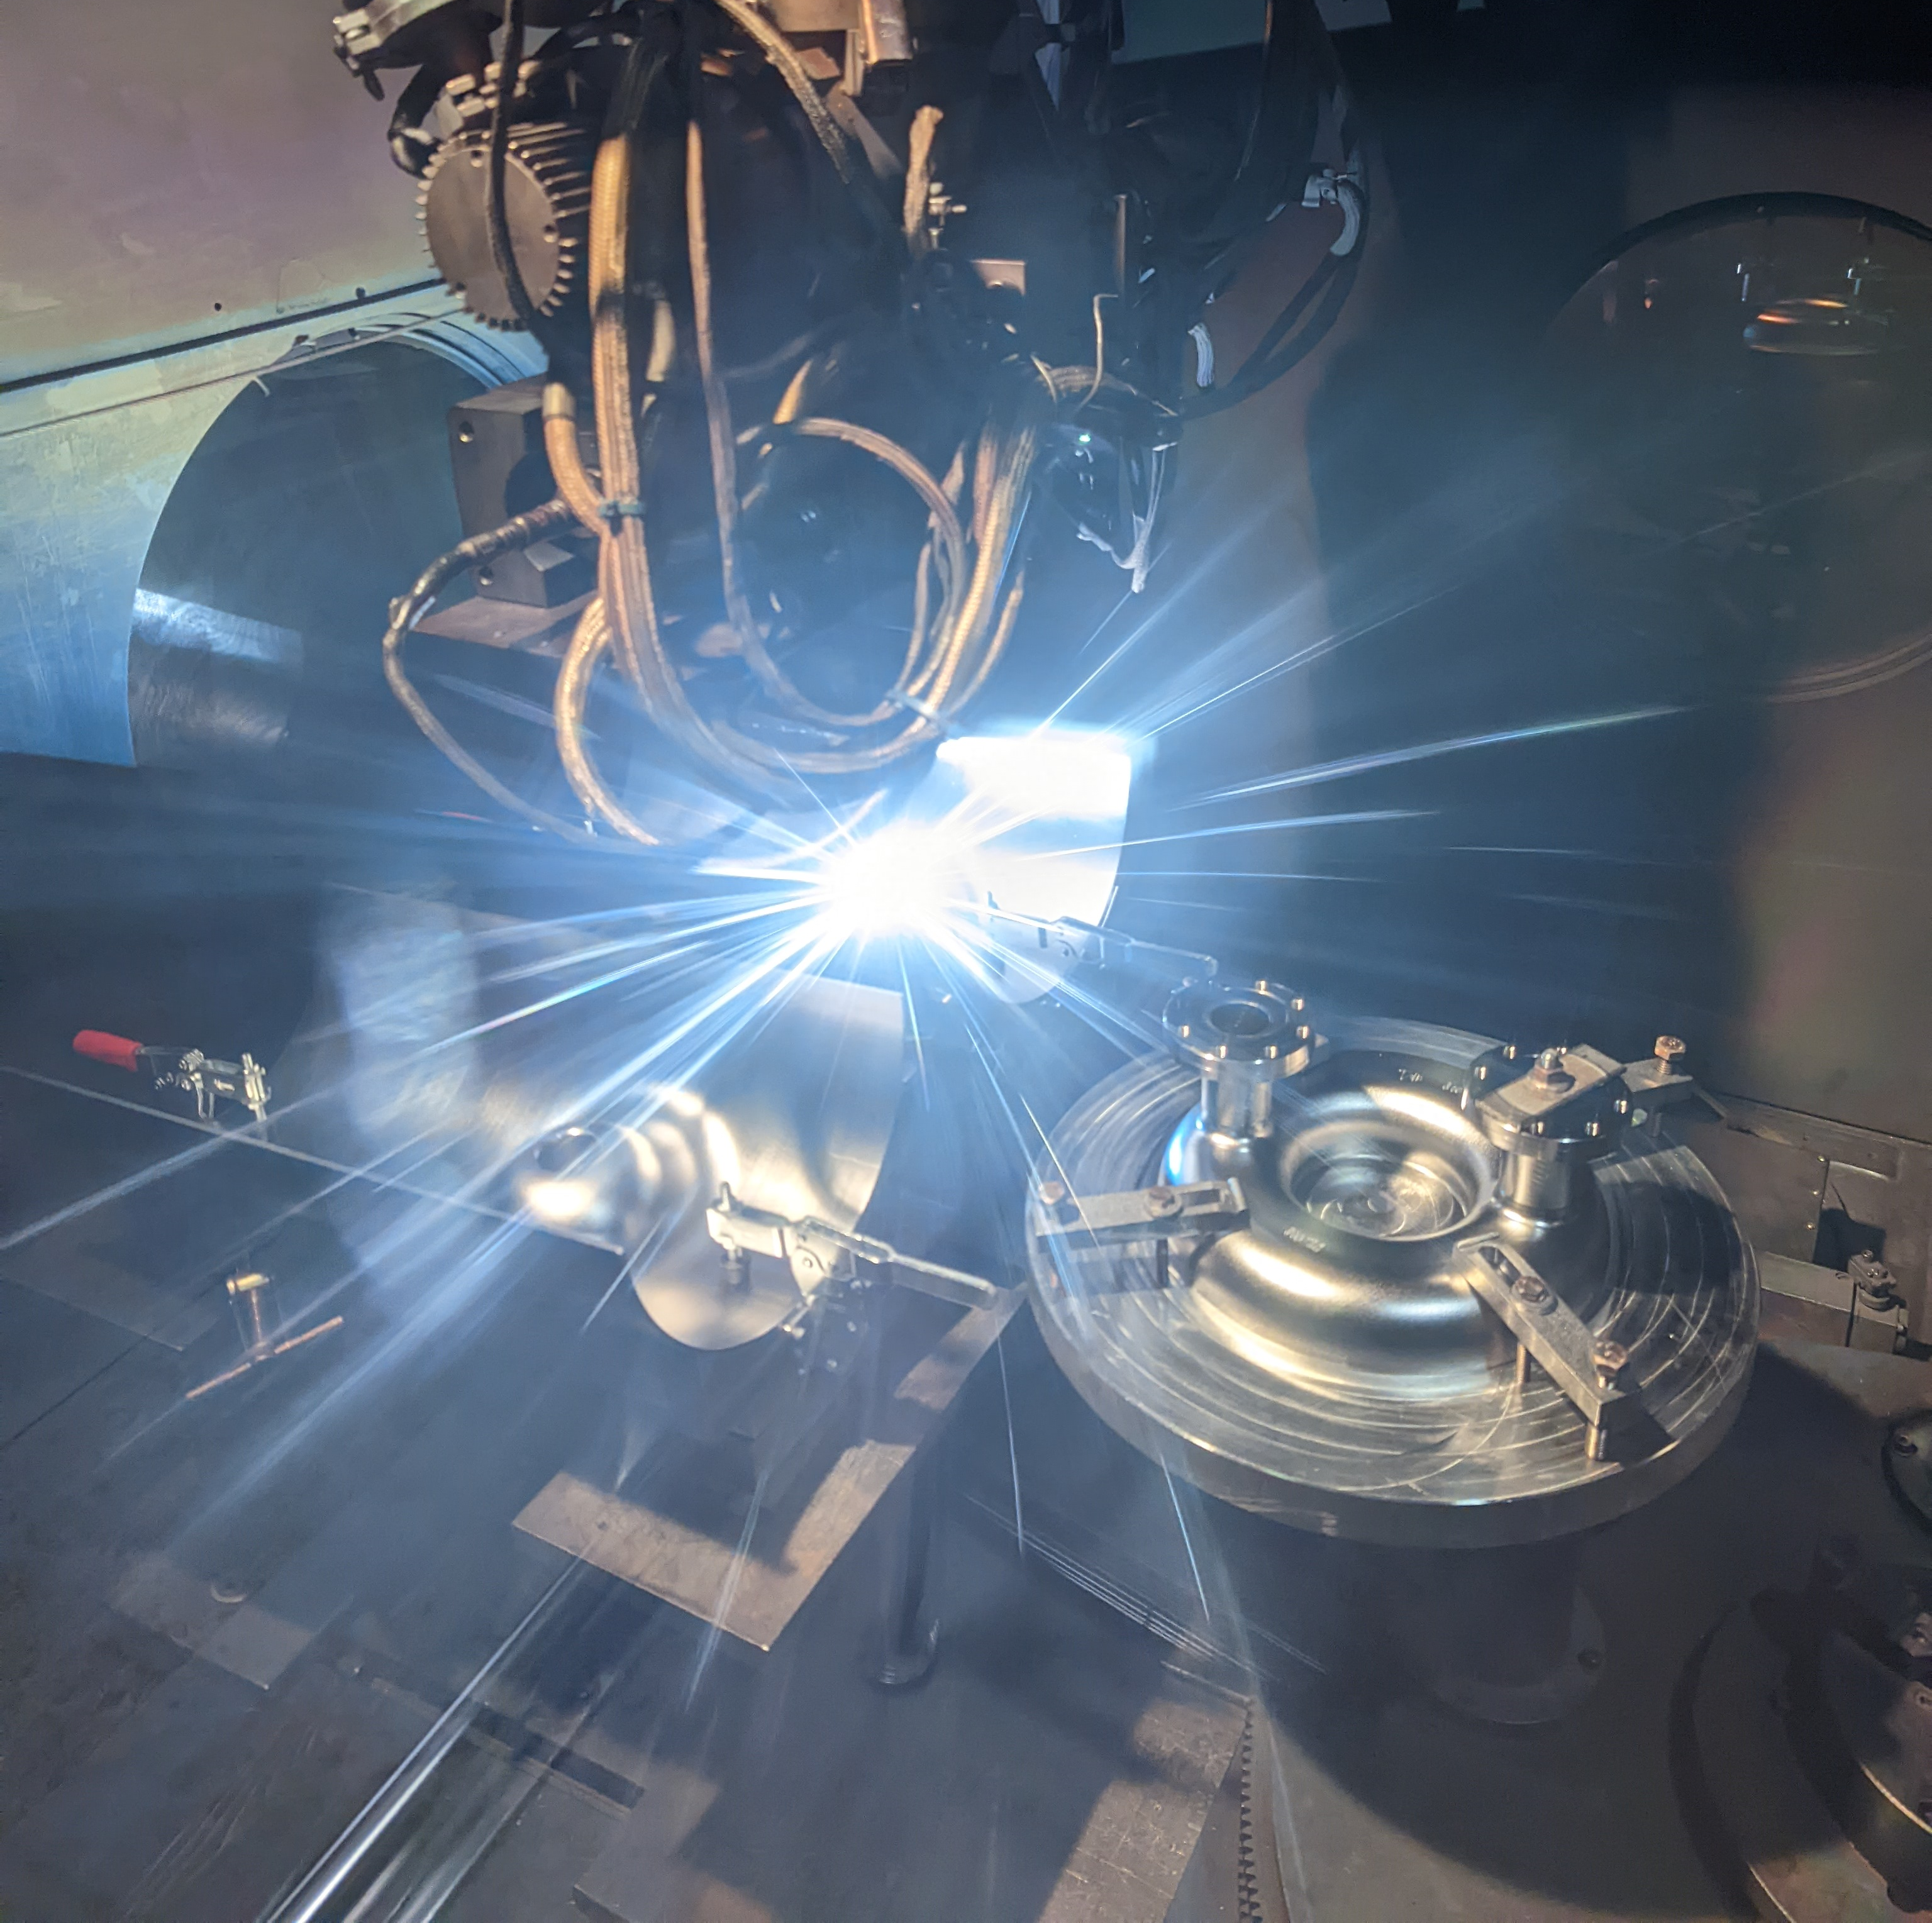
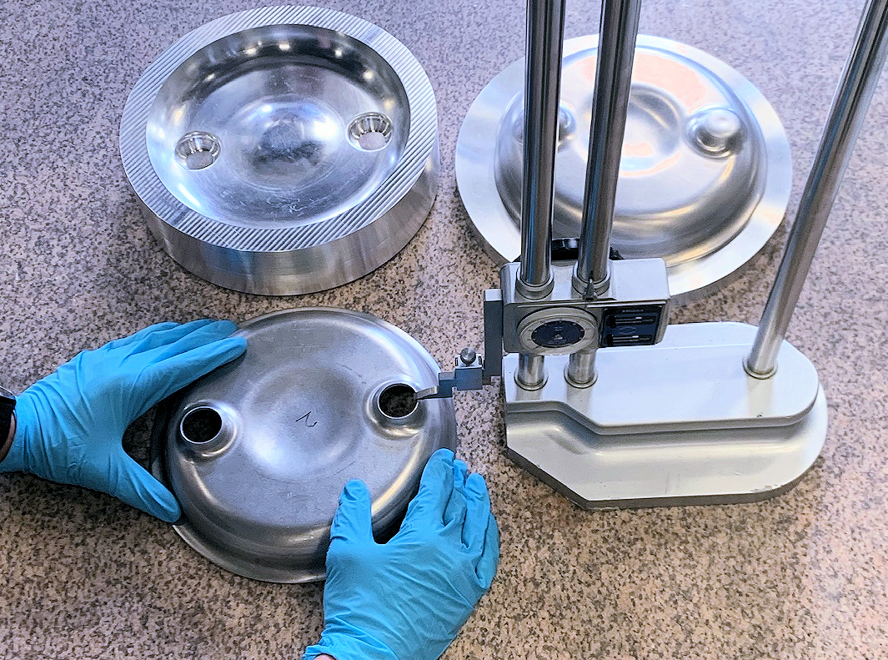
Niobium-Tin as a transformational technique for next gen NP machine
Aim for practical use of niobium-tin in ATLAS
Importance: Nb₃Sn by vapor diffusion is by far the most promising next generation technique for SRF cavities
Paradigm shift for low-beta accelerators, allowing small cavities operated on cryocoolers without large central cryoplants
Enables use of higher frequency for low-beta, allows design of smaller and cheaper accelerators
Recent accomplishments:
Fabrication ongoing for two 218 MHz QWRs for ATLAS
Initial cold test planned in coming months
Nb₃Sn coating process planned after test
Material procurement started for 145 MHz rebuncher cavity for ATLAS
Much smaller QWRs/HWRs practical with Nb₃Sn
New 218 MHz
ATLAS 72 MHz
Notes:
-onto more forward looking R&D project
-start with middle panel, this details the current paradigm of niobium cavities
-each geometry covers different regions
-this paradigm dictated by niobium characteristics, generally limited by surface resistance which is a strong function of temperature
-bottom graph shows BCS resistance (and therefore loss into cavity)
-dashed red line shows niobium at 72 MHz, real ATLAS cavity to the right
-dashed black region is operating point of 4.5 K
-solid red line shows 218 MHz niobium, much higher losses and why we generally use lower frequency
-blue line shows Nb3Sn losses at 218 MHz, vanishingly low at 4.5 K
-Nb3Sn allows us to use higher frequency, meaning MUCH smaller cavities and cryomodules (railway boxcar vs office desk)
-very low losses enables possible operation on cryocoolers instead of cryoplant
-immediate applications for ATLAS as rebuncher and energy adjustment in area II
-material hard to grow without defects
-1100 C vapor deposition temp precludes normal fabrication techniques like brazing
-ceramic like brittle-ness requires more forethought for frequency tuning

Slide 2
Niobium-Tin as a transformational technique for next gen NP machine
Challenges and opportunities:
Fundamental challenge is to grow high quality Nb₃Sn without defects
High coating temperature precludes conventional cavity fabrication techniques such as brazing
Niobium-tin is brittle like ceramic, posing challenges for conventional cavity tuning
Opportunities: provide proof of concept for cryocooler based cryomodules and Nb₃Sn QWRs by installing cavities in ATLAS
Actions moving forward:
-Deliver on plans to install and use Nb₃Sn cavities in ATLAS, demonstrating first practical use of low-beta coated cavities
-Identify opportunities for implementing this technology. Many stand alone cryomodules, cooled by cryocoolers, have been proposed
-ATLAS cavities: continue current fabrication for 218 MHz cavities, begin fabrication of 145 MHz re- buncher, and consider replacement for ATLAS split ring cavity cryomodules
-Consider utilizing technology for design of a new medical isotope production facility
-Additional industrial applications include materials processing, semiconductor manufacturing, and food irradiation among others

