Slide 1
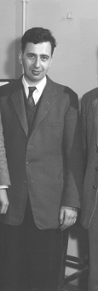
Transparency in Nuclei and in Nuclear Planning
Donald Geesaman
July 11, 2023
John’s Bonner Prize Citation:
"For his significant contributions to numerous aspects of nuclear structure through nuclear reactions, particularly for his work on nuclear coulomb energies and the effective residual interactions in the shell model. We also cite his unusual influence in helping to maintain and spread high standards for precision and clarity"

Slide 2
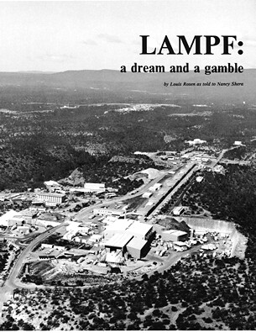
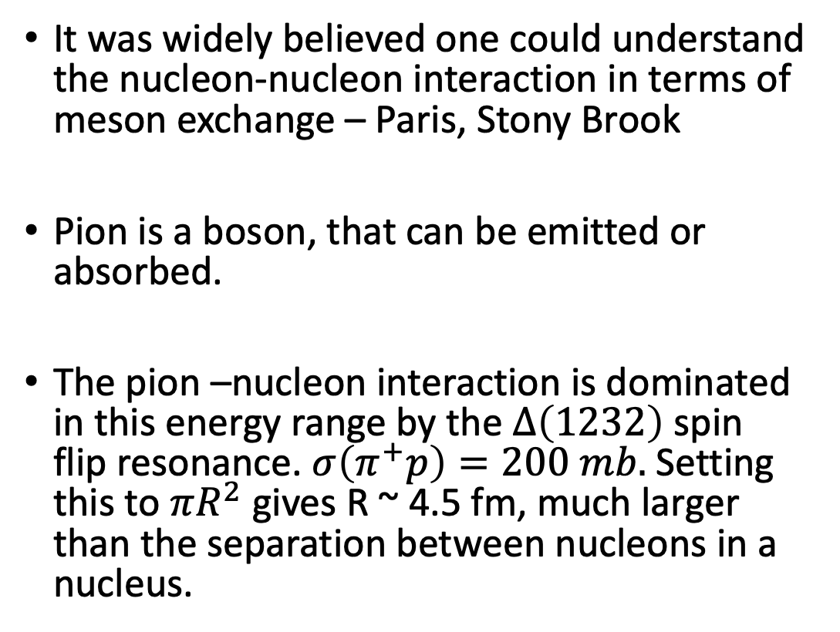
The 1970’s: Pions in Nuclei
Sign Up
It was widely believed one could understand the nucleon-nucleon interaction in terms of meson exchange – Paris, Stony Brook
Pion is a boson, that can be emitted or absorbed.
The pion –nucleon interaction is dominated in this energy range by the $∆\left(1232\right)$ spin flip resonance. $σ\left(π^{+}p\right)=200 mb.$ Setting this to $πR^{2}$ gives R ~ 4.5 fm, much larger than the separation between nucleons in a nucleus.

Slide 3
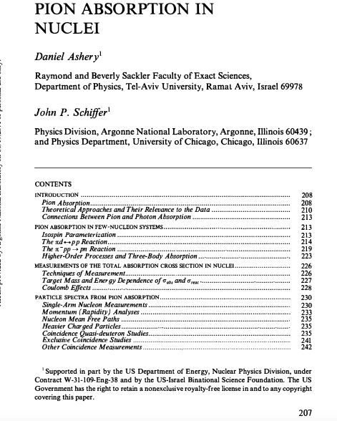
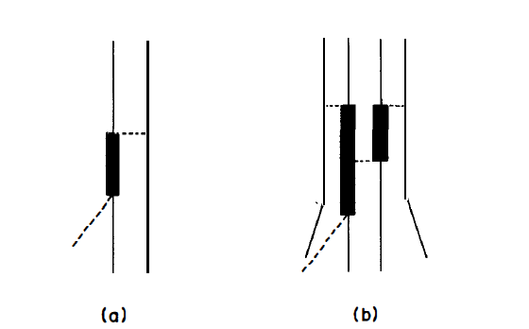



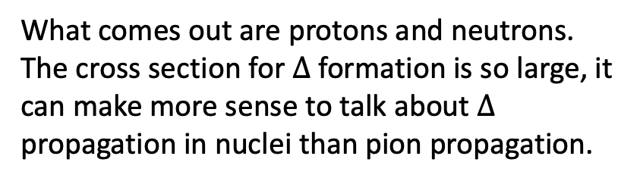
How to see what is happening in pion absorption?
The dominant mechanisms are
$$p$$
$$p$$
$$π^{+}$$
What comes out are protons and neutrons.
The cross section for $Δ$ formation is so large, it can make more sense to talk about $Δ$ propagation in nuclei than pion propagation.
Ashery and Schiffer, Ann. Rev. Nucl. Part. Sci, 36, 207 (1986)
Notes:
Part.

Slide 4
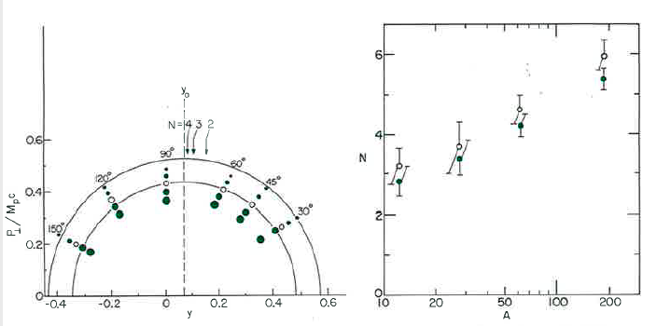
Indeed, the data show that multi-nucleon mechanisms are important in the rapidity distribution of the outgoing protons.
R. D. McKeown et al.
Phys. Rev. Lett. 44, 1033
(1980)
The number of nucleons participating in absorption seem to be similar for positive and negative pions.
But key to understanding this is understanding the interactions of the outgoing protons in the nucleus

Slide 5
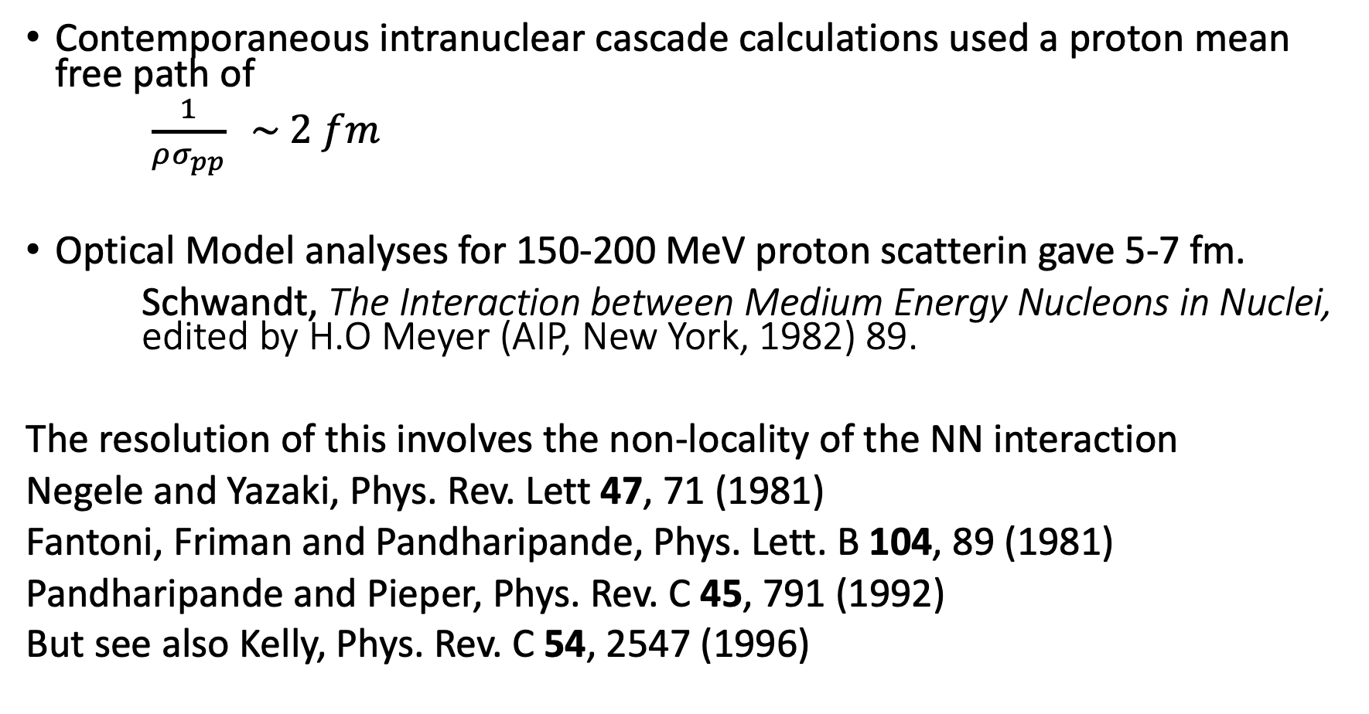
There was an apparent conflict
Contemporaneous intranuclear cascade calculations used a proton mean free path of
$\frac{1}{ρσ_{pp}} \sim 2 fm$
Optical Model analyses for 150-200 MeV proton scatterin gave 5-7 fm.
Schwandt, The Interaction between Medium Energy Nucleons in Nuclei, edited by H.O Meyer (AIP, New York, 1982) 89.
The resolution of this involves the non-locality of the NN interaction
Negele and Yazaki, Phys. Rev. Lett 47, 71 (1981)
Fantoni, Friman and Pandharipande, Phys. Lett. B 104, 89 (1981)
Pandharipande and Pieper, Phys. Rev. C 45, 791 (1992)
But see also Kelly, Phys. Rev. C 54, 2547 (1996)

Slide 6
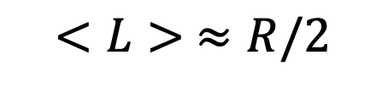
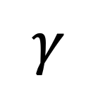
Ralph Segel and I set out to measure this mean free path in a simple macroscopic way using electron scattering and the (e, e’p) reaction,
e’
$$γ$$
e
$$<L> ≈R/2$$

Slide 7
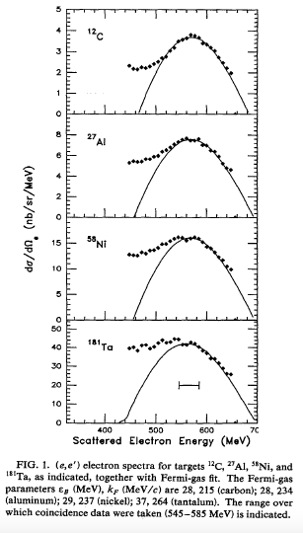
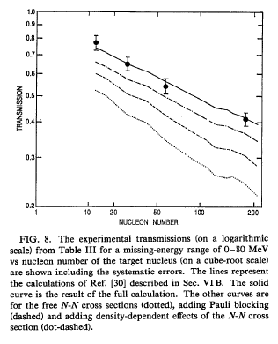
The singles electron spectrum in dominated by quasifree scattering.
Garino et al. Phys. Rev. C 45, 780 (1992)
The mean free path is indeed long

Slide 8
Why is this relevant today?
1) Neutrino oscillation experiments need neutrino-nuclear cross sections to be known to the percent level. Pion production and absorption can make a difference.
Water Cerenkov Detectors are generally not sensitive to the protons from pion production followed by absorption. The threshold for Cerenkov light from a proton in water is 484 MeV. Liquid Argon TPC’s or scintillators have a much lower proton threshold.
See “Summary of the NuSTEC Workshop on Neutrino-Nucleus Pion
Production in the Resonance Region.” L Aliaga et al. hep-ph arXiv:2011.07166
Giessen BUU calculations are among the best but still have some issues with recent single pion production data. PRL 131, 011801 (2023)

Slide 9
2) QCD and Color Transparency
“Color transparency (CT) is a unique prediction of quantum chromodynamics (QCD), the theory of the fundamental constituents of hadrons, quarks and gluons. CT represents the ability of a hadron produced at large momentum transfer, Q, in a hard exclusive process to transit a nucleus with reduced absorption. This property reflects the fact that the dynamics of a hadron produced in a hard scattering reaction is dominated by its valence Fock state where its quark constituents have small transverse separation, 𝑎⊥∝1/𝑄, and, thus, propagate as a small-size color-singlet” Brodsky and de Téramond
For a hard exclusive reaction, the quarks must be very close together and it takes time for a “normal proton” with all Fock states to reform,

Slide 10
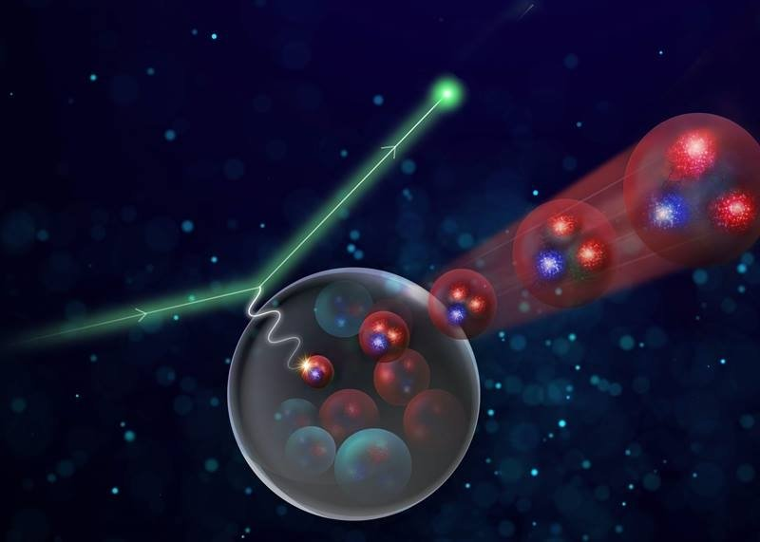
Visually, it looks like this.
Image Credit: JLAB
Bob McKeown and Richard Milner realized this could be tested at SLAC, even with a 0.1% duty factor. NE-18

Slide 11
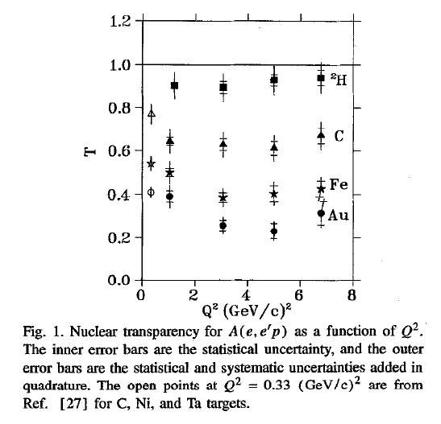
NE-18
T. G. O’Neill et al. Phys, Lett. B 351, 87 (1995)

Slide 12
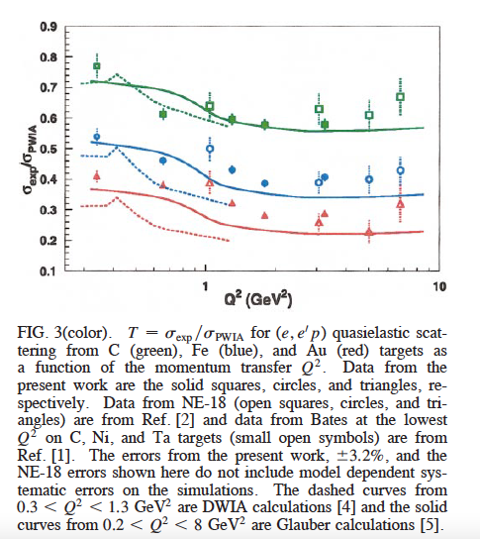
The First CEBAF
Experiment: This is the last experiment I did with John
D. Abbott et al. Phys. Rev. Lett. 80, 5072 (1998)
Dipangkar Dutta (Ralph Segel) and Derek van Westrum (Ed Kinney) theses experiment

Slide 13
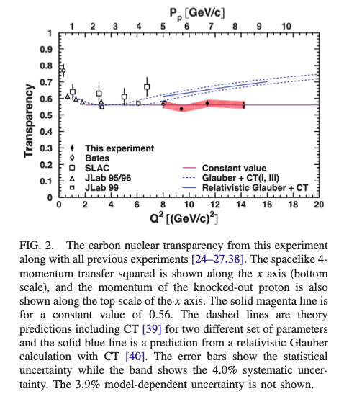
The most recent results from JLAB 12 GeV at high Q²
D. Bhetuwal et al. Phys. Rev. Lett 125, 082301 (2021)

Slide 14
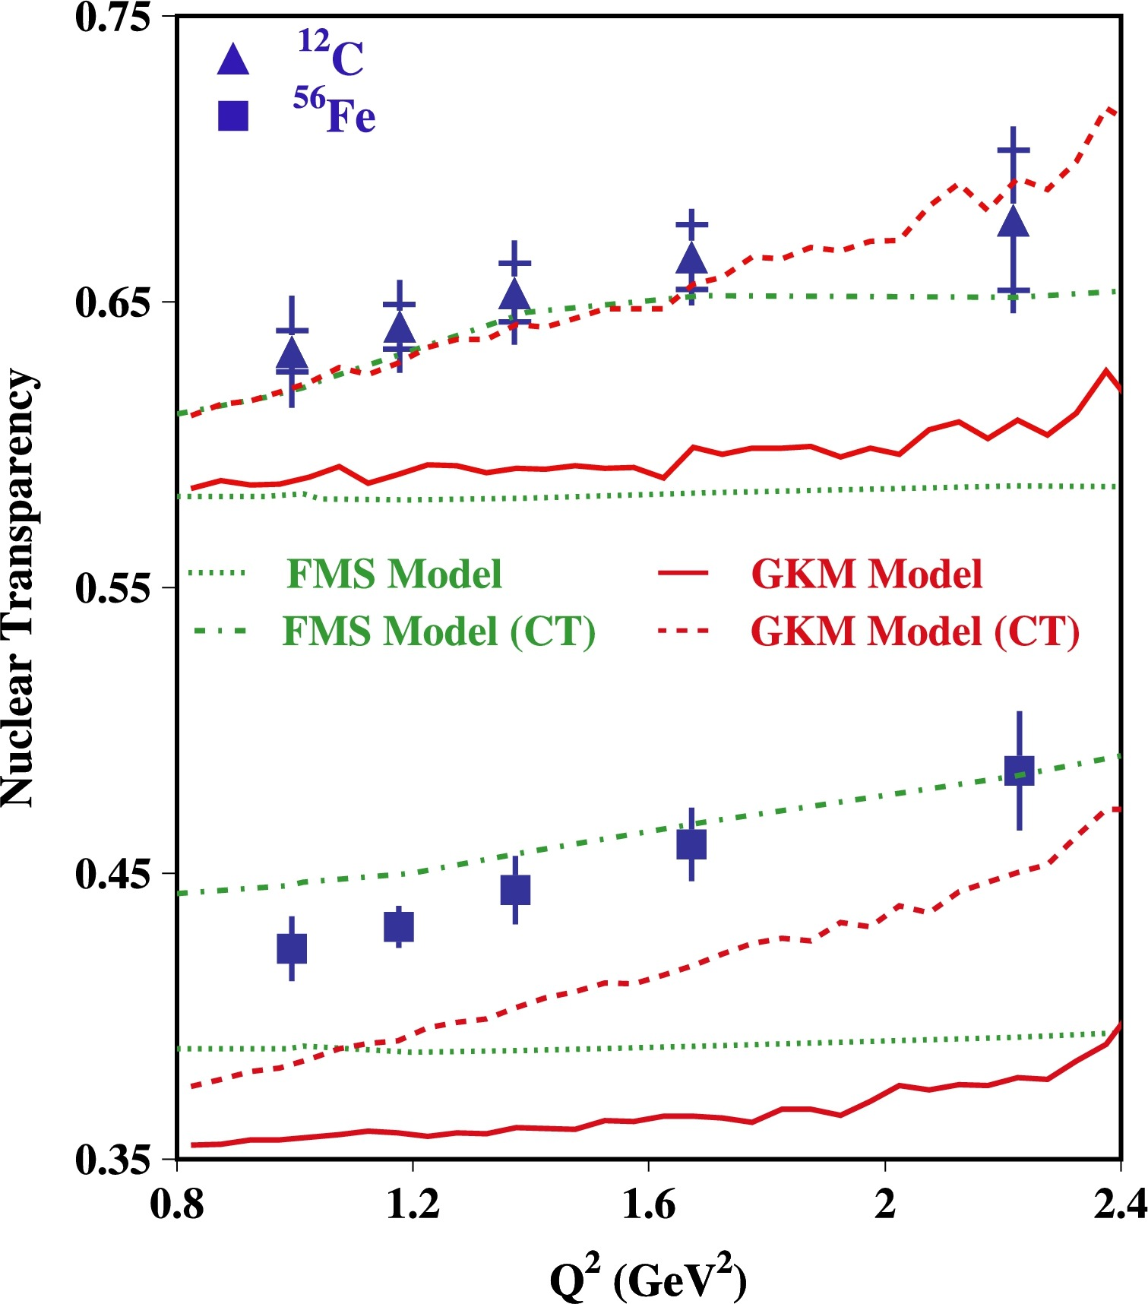
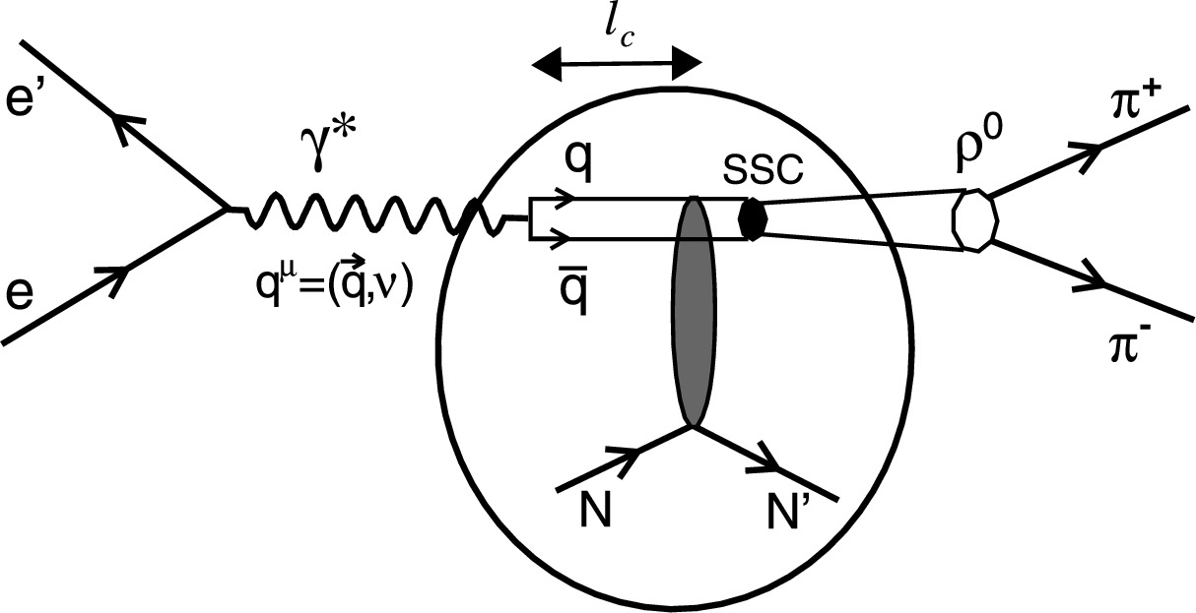
This remains a puzzle
Deep inelastic Scattering would not scale if the cross section did not go like 1/Q²
Rho meson electroproduction does show color transparency
L. El Fassi et al., Phys. Lett. B 712, 326 (2012)

Slide 15
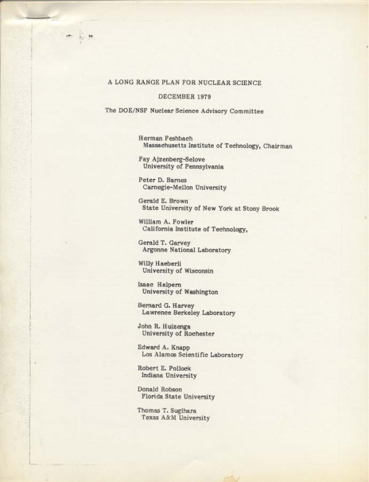
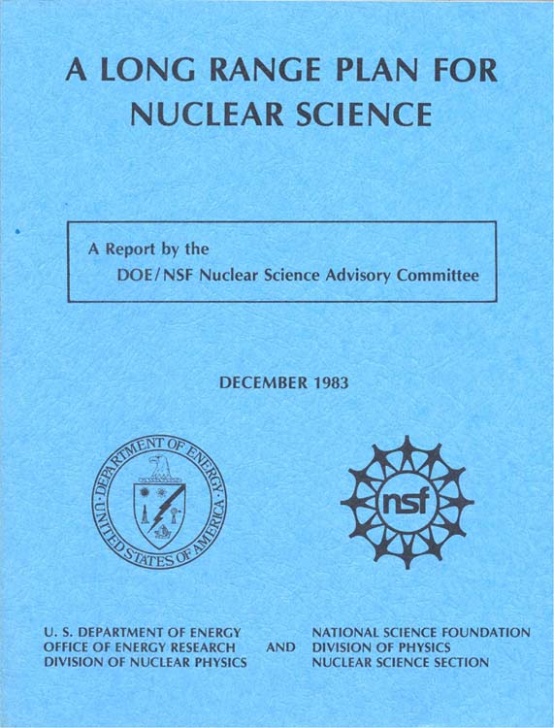
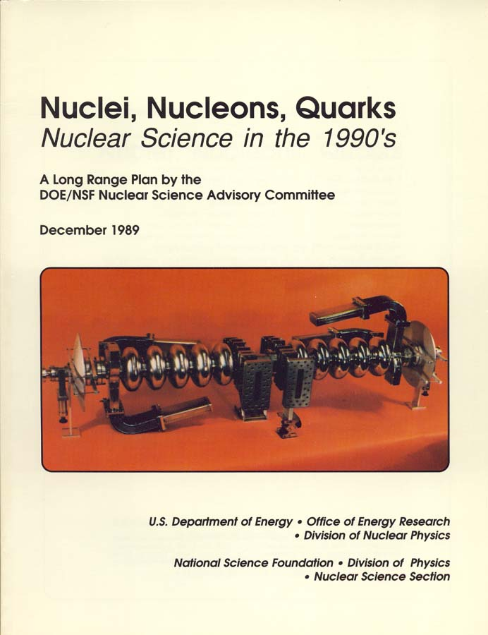
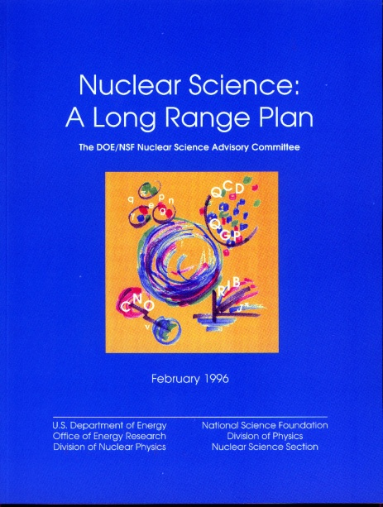
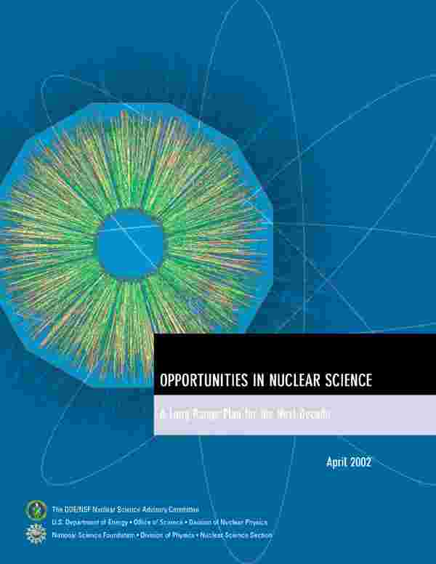
Nuclear Science in the U.S. has been guided by the NSAC Long Range Plans
For large projects ~15 years between recommendation and first operation
1979
1983
Two Rare
Isotope Facilities
–in-flight, ISOL
1989
1996
RIA (Descoped)
JLAB 12 GeV
2002
FRIB
RHIC Upgrade
CW Electron
Accelerator
2007
RHIC
Recommendations that did not
happen, typically recommendation #3-4,
but one was #1
10% budget increase
KAON
LISS
DUSEL

Slide 16
The process has evolved with time
1977- NSAC was formed. Willie Fowler was chair
- Feshbach: First NSAC long range plan: smoke filled room
1983- Schiffer: Working group of ~50 members including younger scientists:
Debevec, Geesaman, McKeown, Redwine, Vigdor.
1989- Paul: NSAC organized community town meetings
1995- Moniz: NSAC and DNP together organized community meetings
2001- Symons: DNP by itself organized community town meetings
2007- Tribble:
2015- Geesaman:
2023- Dodge

Slide 17
The Impact of participation on me was profound.
It opened my eyes to nuclear physics politics. I have served on five of the eight Long Range Plans: 1983, 1989, 1995, 2001, 2015
John asked me to help edit the 1983 document.
This may have been in part because my wife could always find backing for his, sometimes obscure, choice of grammar rules
NSAC went through the document line by line
Allan Bromley – remove mention of Willie Fowler. The only names should be those of Nobel prize winners like Bethe.
Two weeks later Willie was awarded the Nobel prize and his name
was quickly reinserted.
LAMPF II vs RHIC – I have, I believe, the only record of how everyone voted.

Slide 18
In Summary
John Schiffer was the soul of the Physics Division for over six decades. He was either Division Director or Associate Division Director for four decades.
He influenced everything we did at Argonne, and what nuclear science in the United States became.
I, and many of the rest of us that you have heard from over the past two days, came to Argonne to work with John, and become better physicists. We never regretted it.

Slide 19
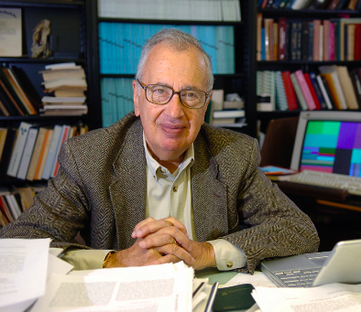
We will sorely miss
"his unusual influence in helping to maintain and spread high standards for precision and clarity”
We will remain inspired by
his spirit.

Slide 20
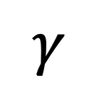
Visually, it looks like this.
e’
$$γ$$
e
Bob McKeown and Richard Milner realized this could be tested at SLAC, even with a 0.1% duty factor. NE-18

