Slide 1
John Schiffer and the U.S. Nuclear Physics Program
Notes:
In this talk I want to give you my view of how John influenced and shaped the U.S. Nuclear Physics Program that we have today
I have single out four incidents that I will start with overview of his roles in the national program and then tell of four incidents in which he played decisive roles

Slide 2
While at Argonne and University of Chicago John served in positions in national Physics Organizations and Journals
APS Fellow (1968) DNP Executive Committee (1972-1977), Chair (1975-1976) Divisional Councilor (1997-1999)
AAAS Fellow (1984) Member of Council (1989-1994) Chair Section B (Physics) (1992-1993)
NAS Member (1987) Panel on the Future of Nuclear Physics (1975-1977) Committee on Nuclear Physics (1996-1999) Neutrino Facilities Assessment Committee (2002) Etc.
Other Organizations Royal Danish Academy of Arts and Sciences Member (1996) American Academy of Arts and Sciences Fellow (1998)
Associate Editor/Editor for Nuclear Physics for several journals Notably, Editor for Nuclear Physics Physics Letters (1978-2003)
Notes:
While at Argonne and University of Chicago John was elected a fellow or a member in science organizations
He took positions in the APS Division of Nuclear Physics and in AAAS and served on National Academy of Science Committees.
He served as Associate Editor or Editor for Nuclear Physics for several journals, notably Editor for Nuclear for Physics Letters for 25 years

Slide 3
He served on Program Advisory Committees (PACs)
Accelerator Facilities
LAMPF (Los Alamos Meson Physics Facility) (1971-1973)
ICUF (Indiana University Cyclotron Facility) (1974-1977)
LBNL/BevaLac (1978-1980)
BNL/ AGS (Alternating Gradient Synchrotron) (1979-1982)
SIN/PSI (Swiss Institute for Nuclear Research) Proton Accelerator (1980-1984)
MIT/Bates Linear Accelerator Center (1984-1987)
CEBAF (Continuous Electron Bean Accelerator Facility) (1986-1991)
GSI (Helmholtz Centre for Heavy Ion Research) (1987-1988)
RIKEN (Nishina Center for Accelerator-Based Science) (1998-2004)
Notes:
He was a member of the Program Advisory Committee for a number of accelerator facilities both in the U.S. and other countries from the early 1970s to the early 2000s
His tenure on the LAMPF PAC resulted in John and his Argonne college performing some of the first experiments at LAMPF
His tenure on the Bevalac PAC led to his early support for RHIC

Slide 4
He served on NSF, DOE and NAS/NRC Committees that developed Reports that influenced/shaped the Nuclear Physics Program
NSF Physics Advisory Panel 1971-1973
NAS/NRC Panel on the Future of Nuclear Physics 1975-1977
Future of Nuclear Science Report (Chair: Gerhart Friedlander) 1977
DOE/NSF NSAC 1981-1982
DOE/NSF NSAC (chair) 1983-1985
NSAC Panel on Electron Accelerator Facilities Apr 1983
NSAC Long Range Plan (Chair) Dec 1883
NSAC Subcommittee on a 4 GeV Electron Accelerator Sep 1984
NSAC Review of the 1983 Long Range Plan (Chair) Nov 1984
NSAC Subcommittee on Implementation of the 1989 LRP (Chair) Apr 1992
NAS Committee on Nuclear Physics 1996-1999
NAS/NRC Decadal Survey of Nuclear Physics (chair) 1999
1
2
3
4
Notes:
He served on NSF, DOE and NAS/NRC Committees of which on a portion are shown here
Those listed pertain to four events where John played central role.
The 1st involves NSF and the Friedlander Report
The 2nd during his term as Chair of NSAC
The 3rd as the Chair of the Implementation of 1989 LRP Report
The 4th is the Academy's 1999 Decadal Survey that he chaired

Slide 5
1. Establishment of NSAC John played a significant role
“According to Howel Pugh, head of the nuclear science section at NSF, the present impetus was for organizing NUSAC came from several directions.
First, there had been several strong recommendation recently for a permanent committee by John Schiffer (Argonne) at the NSF Physics Advisory Committee in December 1975, by a resolution of the Division of Nuclear Physics of the American Physical Society sent to NSF and ERDA in the spring of 1976, and by the Ad Hoc Panel this year.
Secondly, the Ad Hoc Panel, which was headed by Gerhart Friedlander (Brookhaven), demonstrated that a nuclear science committee could function smoothly, and it served as model for for how a permanent committee could be organized, given the intrinsic differences between a permanent and an ad hoc panel.”
NSAC (NUSAC): Established Sep 23 1977
Notes:
1st: Establishment of NSAC
According to the article the present impetus for organizing NSAC came from
(1) John's presentation of NSF Physics Advisory Panel in 1975
(2) The letter from the DNP that John as Chair of Executive Committee wrote
(3) Friedlander Committee Report (John was an active member)
It was in NSF legislation that NUSAC was established in 1977
Apparently, John had played a significant role

Slide 6
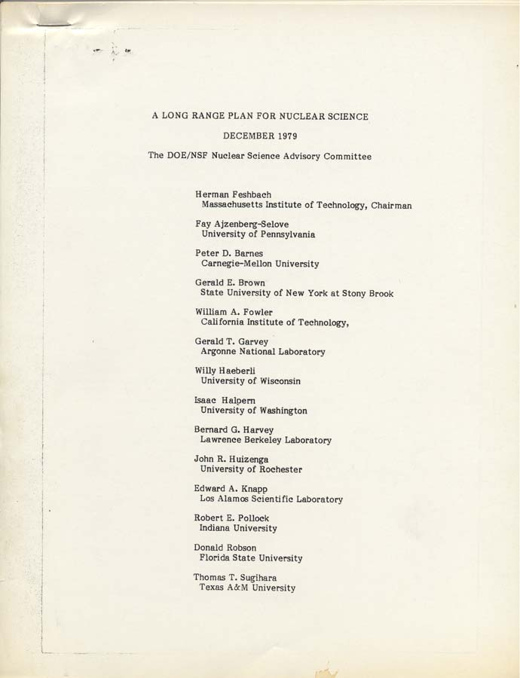
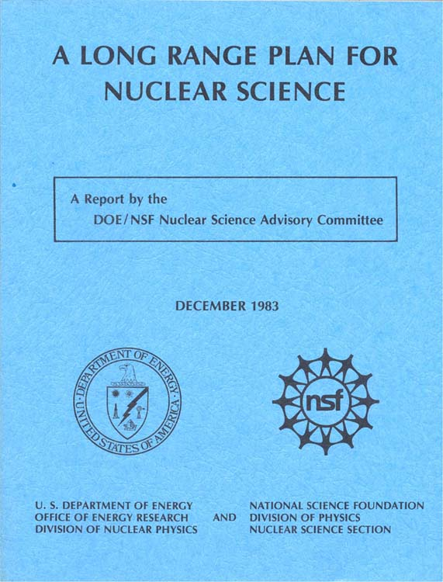
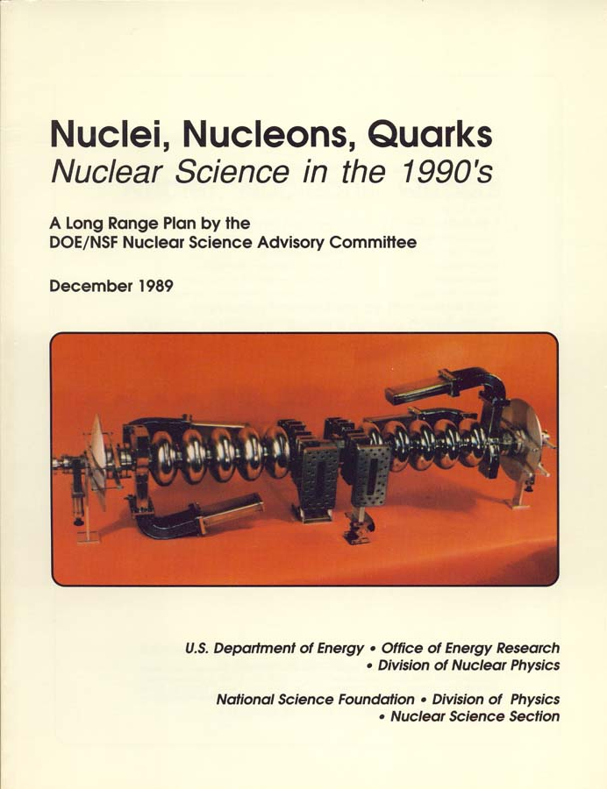
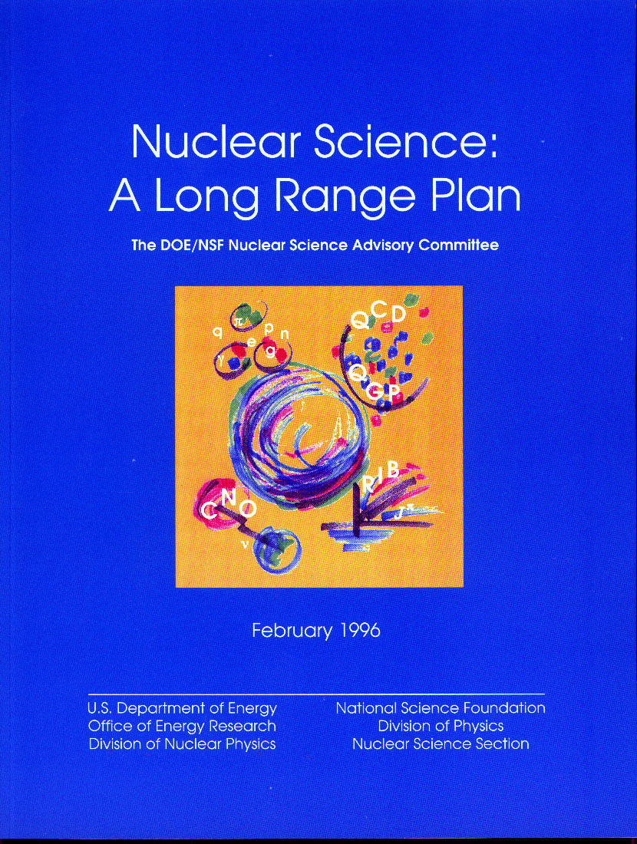
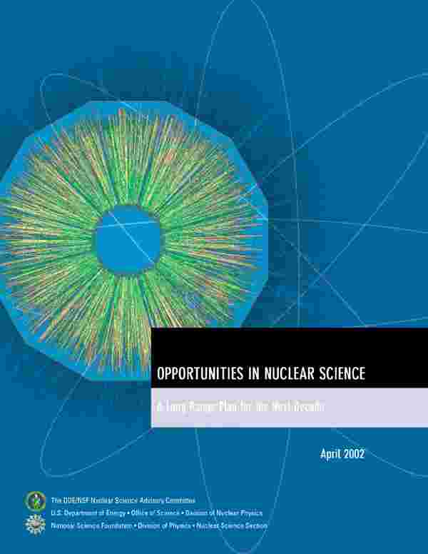
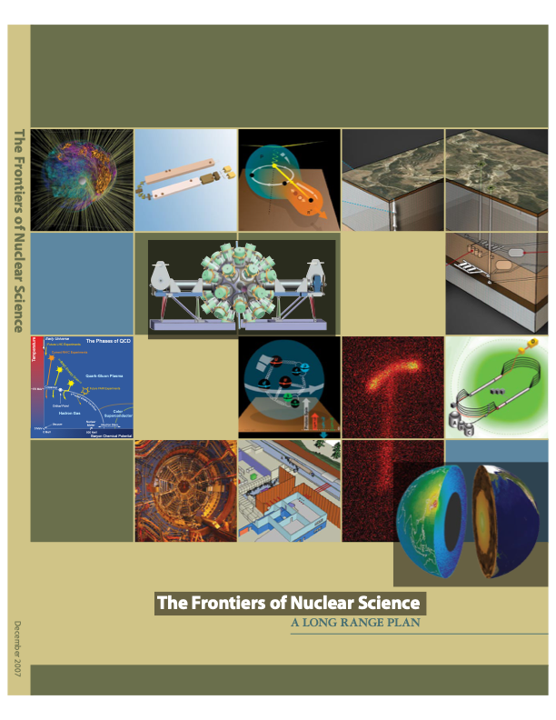
Importance of NSAC over the years to the US Nuclear Physics Program cannot be overestimated
1979 1983 1989 1996
Feshbach Schiffer Paul Moniz
The NSAC Long Range Plans have
Described the science and relevance
Identified the scientific opportunities
Recommended scientific priorities
NSAC committees have recommended
Priorities under budgetary constraints
enumerating what is lost and gained and
their impact on the program
NSAC’s credibility as a responsible advisory body focused on advancement of nuclear physics in the U.S. is now recognized by
the NP community
DOE & NSF
the Administration
Congress.
2002 2007 2015
Symons Tripple Geesaman
Notes:
The Nation's leadership role today in Nuclear Physics is the result of
(1) the responsible strategic planning embodied in NSAC's Long Range Plans, and
(2) Federal government's decision to utilize that guidance and provide the needed funding
When needed funding was projected to not be available, NSAC has recommend priorities under budgetary constraints enumerating what has been lost.
The understanding from the being was that NSAC and the Nuclear Physics Offices in DOE and NSF had different responsibilities: NSAC job was to identify the scientific opportunities and the needed resources/capabilities to be successful: DOE/NSF job were to implement this guidance within available funding levels.

Slide 7
2. Establishment of a GeV CW Electron Accelerator Facility Background
NSAC (Chair: Herman Feshbach , 1979-1983)
Long Range Plan(Chair: Feshbach) Dec 1979 “The R&D for the high energy CW electron accelerator…was assigned high priority”
Panel on Electromagnetic Interactions Apr 1982 “an electron beam facility at both high intensity (Chair: Peter Barnes) and high duty factor, and able to achieve an electron energy of about 4 GeV …”
NSAC (Chair: John Schiffer, 1983-1985)
Panel on Electron Accelerator Facilities Apr 1983 To review and evaluate electron accelerator Chair: Allan Bromley proposals submitted by [ANL, U of Illinois, Chair: Tech. Subcom: Herman Grunder MIT, NBS, and SURA]
The Panel recommended that the proposal of [SURA] ….be accepted
DOE agreed to support the Project
In the Nuclear Physics’ 1985 Budget Request Jul 1983 Funding was requested for Construction of the Electron Accelerator
Long Range Plan (Schiffer) Dec 1983 Recommends “the relativistic heavy ion collider as highest priority for next major facility”
Notes:
Two: Establishment of a GEV CW Electron Accelerator Facility
The 1979 LRP recommended R&D for a high energy CW electron accelerator
The Barnes committee recommended that it achieve an energy of 4 GeV
Unsolicited proposals for electron accelerator facilities had been submitted by ANL. Univ of Illinois, MIT, National Bureau of Standards , and Southeastern Universities Research Association (SURA)
Allam Bromley was appointed by John to chair the Subcommittee to evaluate the proposals. Only ANL and SURA submitted proposals for accelerators that reached 4 GeV. Committee recommended that SURA proposal be accepted.
Nuclear Physics requested funding for construction of electron accelerator in its 1984 Budget Request.

Slide 8
Construction of the Electron Accelerator hits a speedbump in the Senate
Science , Volume 225, Issue 4663, 17 Aug 1984
Senator Bennett Johnson (D. Louisiana) Chair of Appropriations
Committee on Energy and Water Development was unhappy with:
Virginian Delegation’s attempt to fast track the construction project
Responses of Virginia’s Governor Charles Robb and Senator Mark Warner to questions about the facility
He was concerned about whether this project would become another “Isabelle”.
R&D, but no Construction funding provided in FY 1985 Appropriations
Then there were some other things
MIT, U. of Illinois, and NBS proposals were less than 4 GeV
Protest from ANL Director (Walter Massey) :ANL design was just as
good and less expensive, should not create a new National Lab
A paper appeared from some theorists that 4 GeV was not high enough to study quark effects
Argument that NSAC 1983 LRP named a high energy heavy ion collider as highest priority for next major facility
Etc.
(See Jul 1983 Physics Today and “The Founding of CEBAF 1979 to (1987”), Catherine Westfall and CEBAF , Sep 1994))
Notes:
Funding for Construction was not approved in FY 1985 Appropriation Bill.
According to Article, Senator Johnson Chair of Appropriations Committee on Energy and Water Development was unhappy with the Virginian Delegation and response of Rob and Warner
Concerned about another Isabelle
Isabelle was a High Energy Project at BNL that had been delayed by problems in development of magnet needed for project, and HEPAP commitment dealing with budget constraints, identified other projects to be of higher priority and the Isabelle Project was terminated.
Then there were some other things
MIT-Bates Proposal
ANL's Protest
4 GeV was not high enough
1989 LRP said RHIC was highest priority - not CEBAF

Slide 9
John played an important role in getting the CEBAF Project approved and getting its Research Program started
Jay Keyworth (President’s Science Advisor, OSTP) gets involved
Jul 1984 Charged NSAC (Ch. Schiffer) to verify the scientific justification and priority of the Accelerator
Sep 1984 NSAC Erich Vogt Subcommittee reaffirmed the scientific case for a 4 GeV accelerator
Nov 1984 NSAC Review of 1983 LRP (Ch. Schiffer): CEBAF was ”first priority for major construction”
John wrote a letter in rebuttal of the Aug 1984 Science Article
Oct 1984 reaffirming CEBAF’s priority for the NP community and criticizing the author for “concentrating on political hearsay and selecting information to make a juicy story”
Herman Grunder became Director, put together a design team, chose a design, recruited staff
1985-1986 Changed the design to a SRF 6 GeV accelerator. The Conceptual Design Report was approved by DOE. Herman made a good impression on Capital Hill.
Construction funds for the project was provided by Congress in the 1986 Budget.
John became involved in CEBAF and the start of its Research Program
Oct 1984 He became a member of the Search Committee that chose Herman Grunder to be Director
1986-1991 He served as Chairman of the CEBAF PAC.
Notes:
Jay Keyworth callled John to his office of discuss what to do. John knew Jay when he was a graduate student at Duke. Jay was supportive of the electron accelerator. It was decided that NSAC needed to verify the scientific case for a 4 GeV accelerator and its priority for the NP community
NSAC did both
John wrote a letter in rebuttal to the Science Article - according to this autobiography he also testified before a House Committee
Herman Grunder became the Director put together design, chose a design, recruited staff - we changed the design to a SRF 6 GeV accelerator, CDR was approved by DOE, He make a good impression in Congress.
John became involved in CEBAF
Was on the Search Committee to chose Herman Grunder
Was Chairman of the CEBAF PAC for 5 years - where the decisions on the science and experiments in the 3 hall were made. He encouraged ANL physicist to get involved and they play a major role in the experiment program in the early days

Slide 10
NSAC 1989 Long Range Plan was 1st to deal with a Large Project Lessons Learned
NSAC
Even if agency tells you that a project is underway and to focus on the identifying the next major facility. – the highest priority is to complete what has been started
There has to be agreement in the NP community of what the capabilities of a future facility should be.
DOE
To use Request for Proposals (RFPs) instead of Unsolicited Proposals in the competition process
*GAO Report Apr 1986 Found that CEBAF management had identified a requested by superior technology, put together a good and skilled, by Senator Johnson competent staff needed for success. on the CEBAF Project
However, it was critical of the competition process (i.e., Unsolicited Proposals versus Request For Proposals (RFP)).
*GAO – Government Accounting Office
Notes:
This was the 1st NSAC that dealt with construction of large facilities and there were lessons learned by both NSAC and DOE
For NSAC in the LRP the completion of a project should be major recommendation if the working group agrees it has scientific priority
For DOE it was that Request for Proposal instead of Unsolicited Proposals should be used for the competitive process.

Slide 11
3. The Establishment of RHIC The 1989 Long Range Plan and Outyear Funding
NSAC Implementation of 1983 LRP Nov 1984 Priorities for new facilities: (1) a 4 GeV CW Electron Accelerator, (2) (Chair: Schiffer) a relativistic Heavy-ion collider
NSAC Long Range Plan Dec 1989 Priorities for facilities: (1) Completion of CEBAF (2) Reaffirmed (Chair: Peter Paul) importance of RHIC (3) U.S. enter into negotiations with Canada to participate in the construction and use of KAON
Budget Enforcement Act of 1990 Dec 1991 Office of Energy Research was allocated out-year budgetary targets that were flat in as-spent dollars
NP FY 1993 Budget Request Aug 1992 Terminate operations of HHIRF at ORNL and the Fast Neutron Generator for nuclear data measurements at ANL. Complete experiment in progress at Bevalac and LAMPF. A transition plan will be developed to permit an orderly phaseout.
Secretary of Energy Advisory Board Sep 1992 Task Force endorsed the decision to terminate operations of the Task Force on Energy Research Priorities Bevalac and HHIRF, and concluded that the cost of RHIC would (Director of ER: Will Happer) require economics in the NP program, such as in the operation of LAMPF
Recommended that NSAC consider its most recent LRP in light of current and foreseeable budgetary stringencies
Notes:
The 3r is the establishment RHIC
In 1984 RHIC was the next major facility after CEBAF
In the 1989 LRP Completion of CEBAF was highest priority, then RHIC and then involvement the Canadian KAON project
Office of Energy Research was given project Flt-Flat Dollars in the outyears
NP planned to terminate HHRIF at Oak Ridge and reactor at Argonne, and then operate the Bevalac and LAMPF to complete approved experiments and then phaseout their operations
Will Happer Director of Energy Research has the Secretary of Energy's Advisor Board form a Taskforce to recommend priorities for ER's research programs
For NP they agreed with the plans for the Bevalac an HHIRF, and then grappled with what to say about RHIC and LAMPF. The decision was made to send this to NSAC

Slide 12
Implementation of the 1989 Long Range Plan RHIC or LAMPF or KAON?
NSAC charged to provide guidance Jan 1992 Priorities for expenditures under three budget scenarios (Chair: Peter Paul) (Request: Happer/Sanchez)
NSAC Subcommittee Report Apr 1992 “The goals of the 1989 LRP remain valid today” (Chair: John Schiffer) “…construction of CEBAF and RHIC should not be impacted”
Under the three Funding Scenarios
(3) Assuming 3% above inflation o Supports Base Program, CEBAF and RHIC o Allows for productive phaseout of LAMPF, o Possibility for KAON or new initiative in FY 96-97
(2) Constant Dollars (includes inflation) o Supports Base Program, CEBAF and RHIC o Necessitates rapid phaseout of LAMPF, o No KAON participation
(1) Flat Actual Dollars o Reduced Base Program, delayed RHIC completion o Accelerated phaseout of LAMPF o No KAON participation
Notes:
Implementation of the 1998 LRP within budget constraints
Why RHIC or LAMPF or KAON
RHIC was new costly project that opened new scientific frontiers
LAMPF was a costly operating facility with solid program for next few years
KAON was relatively inexpensive that also opened new scientific frontiers
The request was for recommendations for priorities under three budget scenarios
Then reaffirmed 1989 LRP that construction for CEBAF and RHIC not be impacted
This resulted the phaseout of LAMPF in all scenarios. The support for the Base Program, CEBAF and RHIC depended upon how rapidly LAMPF was phaseout.
In Flat-Flat dollar scenarios almost immediate termination of LAMPF operations still results in a delay in RHIC. There was possibility of KAON only in the best scenario
I remember a heated discussion between John and David Hendrie (head of NP at the time) when John presented the report. I believe it had to LAMPF phaseout
I have shown these three budget scenarios - because they are identical to the ones that were given to NSAC for guidance on the Implementation of the 2002 and 2007 LRPs

Slide 13
What happened?
In the FY93 Appropriation:
$53 Million removed from NP
put in the DOE AEDP* for LAMPF Operations.
NP managed the the funds in 1993.
In FY 94 and FY95 NP was provided $23M for LAMPF and research funding for LAMPF users returned.
LAMPF evolved to the Los Alamos Neutron Science Center (LANSCE facility) supported by NNSA, NE, and SC BES
NP’s Funding followed NSAC’s Scenario 1
(i.e.; Flat-Flat Funding) guidance.
RHIC Project was stretched out
AEDP – Atomic Energy Defense Programs. NNSA – National Nuclear Security Administration
NE – Nuclear Energy
BES – Office of Science, Basic Energy Science
Notes:
What Happened
In FY93 Appropriations $53M ($46M Lampf opareations and $7M for all Lampf researchers) was moved out of NP to Atomic Emergy Defense Programs - they didn't know what to do with the money - so Sherman Fizozinsky in NP managed the money - apparently Lewy Rosen talked to his New Mexico Senator
John and Vernon Hughes went to Louis Rosen and concivenced him that there should a productive phaseout of LAMPF.
In FY94 and CF95 NP was provide $23M for LAMPF operation and the LAMPF researcher money was return to NP
LAMPF evolved into LANCE a facilities supported by NNSA, NE and SC BES
This was very good for NP since there would have been significant D&D costs. The D&D for Bevalac was significant and lasted for years.
After all this the funding for NP followed the Flat-Flat Dollars Scenario: RHIC was delayed, the Pre-Ops RHIC for RHIC was insufficient, there were reductions across the program

Slide 14
4. Importance of NAS/NRC Decadal Surveys Assessments by an independent body of where the field is and where it is going
Nuclear Physics Panel 1986 The Panel on Nuclear Physics endorses (Chair: Joe Cerny) - the Construction of CEBAF (John was a reviewer) - NSAC 1983 Long Range Plan in recommending the planning for RHIC
Committee on Nuclear Physics 1999 The Committee recommends (Chair: John Schiffer) - near-term allocation of resources needed for CEBAF and RHIC - the construction of a Rare Isotope Accelerator (RIA) - continued investment in instrumentation for research - the continuation of frequent NSAC Long Range Plan efforts
Committee on the Assessment 2013 The Committee recommends of and Outlook for Nuclear - exploiting strategic investment [CEBAF and RHIC] Physics - DOE/Michigan/ MSU work for the timely completion of FRIB (Chair: Steward Freedman) - DOE/NSF work to implement a program of underground science (John made a presentation) - a balance in funding for facilities and university-based programs - DOE/NSF should have fellowship programs for grads and postdocs. - plan to make forefront computing resources available for theorists - agencies should develop procedures for managing small projects - investments in R&D for an electron-ion collider (EIC) should continue
Notes:
The importance of the Academy's Decadal Surveys is that they are Assessments by an independent body of where the field is where it is going - for Nuclear Physics it is an assessment of how NSAC and the Agencies are doing - it is viewed as such by Agenties, the Executive Branch and Congress
(1) John had input into the last three surveys - I don't know how much feedback John gave in his review of the 1986 survey - but chaired the 1999 Survey, and he gave a presentation to committee writing 2013 survey that I am sure provided guidance - the presentation is impressive
(2) The recommendations of all three Surveys for future facilities and their priorities were those of the NSAC's Long Range Plans. However, in the case of the last Survey there is list of additional recommendations. It is not clear what this means. Does it mean that the NP is not managed well? Then don't say in the text that the NP program has been managed very well.
(3) The support for the RIA in the 1999 Survey came at a criticial time. The path for getting approval was long and time. I spend essential all of time as head of Nuclear Physics in trying to get approval. It was only in 2007 that I was able to approval within DOE to proceed with FRIB a project half the cost of RIS, and it what only in the fy2009 Budget request that Congress provided Construction funding.

Slide 15
What Role did John play in shaping the nation’s Nuclear Physics Program?
He played vital roles:
In getting NSAC established and in establishing NSAC’s credibility as a responsible advisory body (during tenure as NSAC Chair and as the Chair of the Implementation of 1989 LRP Subcommittee)
In helping to get the CEBAF Project approved and ensuring the continuation of the RHIC Project. (and in providing early support for RIA Project (in the 1999 NAS/NRC Decadal Survey)
In providing leadership on how a national laboratory should contribute to the national program (by utilizing the capabilities of existing facilities and helping to develop new capabilities/facilities)
I believe that his leadership in these events have been viewed by subsequent
NSAC Chairs (and members)
DOE SC NP / NSF Physics NP Leadership
As a model for responsible and far-sighted stewardship of the U.S. Nuclear Physics Program
Notes:
What Role did John play in shaping the Nation's Nuclear Physics Program
He played vital roles:
In getting NSAC established and in establishing NSAC credibility
In helping to get CEBAF approved, RHIC completed and FRIB started
In providing leadership on how a national laboratory should contribute to the national program
His leadership (I believe) has been taken as a model for responsible and far-sighted leadership stewardship for the the U.S. Nuclear Physics Program
This I believe this is his Legacy
When at Argonne -John was supportive and a teacher who set high standards
When at DOE - John was wise counsel
At an APS after John and my wife Mary had talked, John sent an email to Mary recommended a book that Ceccia had thought was good.
John was a supportive, a teacher, a wise counsel, sensitive, a mentor whose approval i valued.
That his Legacy for me

