Slide 1
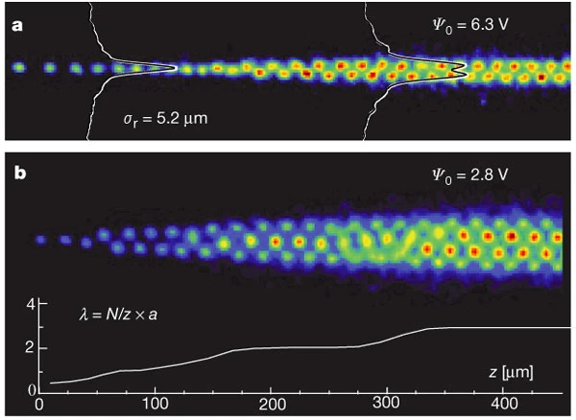
John Schiffer: Crystallizing Ion Beams
Robert Rosner
University of Chicago
Nuclear Physics in the 2020s and Beyond: Celebrating John Schiffer
T. Schätz, U. Schramm & D. Habs (2001)

Slide 2
Why this topic?
I first heard about the possibility of crystallizing ion beams in late 1987 or early 1988 …
The occasion was a lecture by John Schiffer, as part of the regular Physics Dept. colloquium series at UChicago …
… and I was mesmerized!
  It was the first time I encountered John … he was a great lecturer!
  It was the first time I learned in some detail about some of the science being done at Argonne …
  And the topic was really fascinating, to someone who had spent most of his career on the physics of neutral plasmas at temperature above 0.1 keV …

Slide 3
But John also had a much more personal impact …
As I got to know more about Argonne – and its relationship to UChicago – John served as an exemplar to me of what it can mean to have a productive Lab-University relationship
  He was a superb scientist …
  He knew how to navigate the “nerdy” (and frankly elitist) academic culture of UChicago and its physics department …
  He knew exactly how to exploit the enormous experimental and theoretical/computational resources at the Lab …
It was John – and an unfortunately rather small additional group of excellent Argonne scientists – that were my “proof of principle” that a productive relationship between the Lab and the University could be re-established … and it turned out that most of the changes needed to be done at the University …

Slide 4
Now, returning to the science: Some background …
The idea of forming crystalline structures using low spatial density ensembles of heavy ions goes back to E. Wigner¹, and the notion of what are now called Wigner lattices.
Approximations of such lattices have been experimentally realized² in Paul and Penning traps …
In 1985, John Schiffer (with P. Kienle)³ proposed that such structures could also be formed in ion beams, and in particular, in storage rings … that paper, together with a follow-up paper with A. Rahman³, started a virtual industry of attempts to crystallize ion beams …
¹ E.P. Wigner, Physical Review 46, 1002 (1934)
² R.F. Wuelker et al. J. Appl. Phys. 30, 342 (1959); more recently, cf. Andrei, E.Y. et al. PRL 60(26), 2765 (1988)
³ J.P. Schiffer & P. Kienle, Z. Phys. A 321, 181 (1985); A. Rahman, J.P. Schiffer, Phys. Rev. Lett. 57, 1133 (1986)

Slide 5

The essential physics …
The basic challenge is to cool the ions in their rest frame to the point that their energy spread is well below their mutual Coulomb potential energy, all while battling the continued beam heating as the ions circulate.
  In Penning and Paul traps, phase transitions to a highly ordered crystalline state have been observed when
  Coulomb energy btw adjacent ions q²/a
  Random thermal kinetic energy kT
The cooling is typically done by Coulomb scattering cold electrons off the “hot” ions, and/or by laser cooling (which relies on resonant scattering of photons off the ions) … for relativistic ion beams, laser cooling is clearly preferred because the laser force scales with the 3rd power of the ion energy …
=
=
> 175
=
~

Slide 6
Starting with Theory …
Initially, much of the theoretical work focused on using MD calculations to explore the conditions under which the transition to the crystalline state might occur.
As an example, here’s a predicted cross-section for a
cooled beam, based on a MD simulation carried out by Rahman and Schiffer in 1986¹. Here = 180.
¹ A. Rahman & J.P. Schiffer, PRL 57[9], 1133 (1986)

Slide 7
… and succeeding with Experiments!
Attempts to experimentally replicate the MD results started almost immediately, such as for example at the ASTRID ring at Aarhus and the TSR in Heidelberg; and designs for storage rings optimized for beam crystallization were also developed.
An example of such a proposed purpose-designed ring¹ [CRYSTAL], is shown at right …
The first crystallization of (²⁴Mg⁺) ions in storage rings was observed in a miniature (quadrupole) storage ring², also shown at right … data from that experiment is on the next slide!
¹ Tecchio et al. (1997),
https://www.researchgate.net/publications/238765343; see also Tecchio et
al., LNL-INFN (REP) 97/95
² I. Waki et al. PRL 68, 2007 (1992); G. Birkl, S. Kassner & H. Walther,
Nature 357, 310 (1992)

Slide 8
Here’s data from Birkl et al. (1992) …

Slide 9
Why might this be such a big deal?
These crystalline beam structures are strongly coupled plasmas, and the dynamics of such complex, highly nonlinear, systems are intrinsically interesting …
The very low beam emittance of crystalline beams whose lattice structures can be positioned with micron precision can lead to beam luminosities exceeding that of current (thermal) ion beams by orders of magnitude!
  Could this be exploited in colliding beams experiments?

Slide 10
Questions? Discussion!

