Slide 1
Science with Solenoidal Spectrometers: Past, Present and Future
30+ years of adventures with John

Slide 2
Chapter 1. “Strange and wonderful physics”
Scientific American 241(6) 1979
Z_{CRIT}≥173
Physics Today 35(8) 1982
“what Argonne physicist John Schiffer calls ‘strange and wonderful physics.’”
G. Taubes, Science 257 (1997)

Slide 3
How it happens, and a possible signature
U+U collisions (Z_{TOT}=184)
Greenberg and Greiner, Physics Today 35(8) 1982

Slide 4
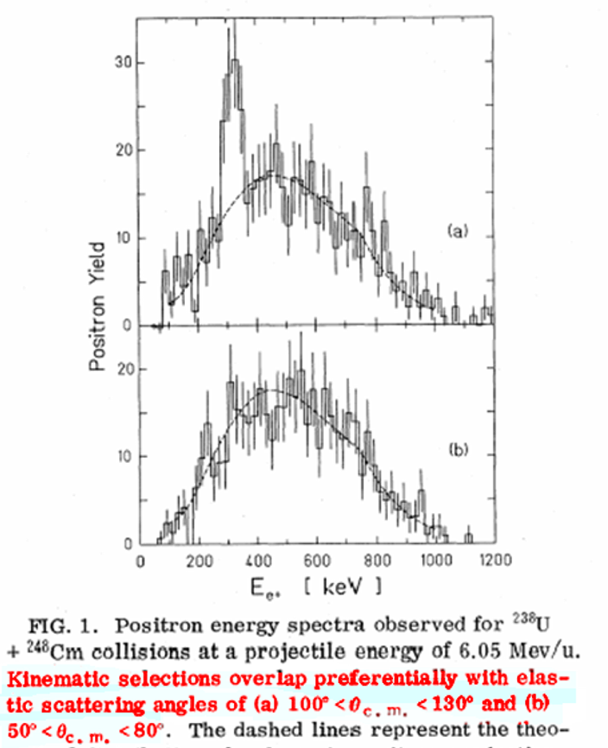
Spark or no spark
No.
Clemente et al, PL
137B, 41 (1984)
(ORANGE)
Yes??
Schweppe et al, PRL
51, 2261 (1983)
(EPOS)
U+U
Z=184
U+Cm
Z=188
U+Th
Z=182

Slide 5
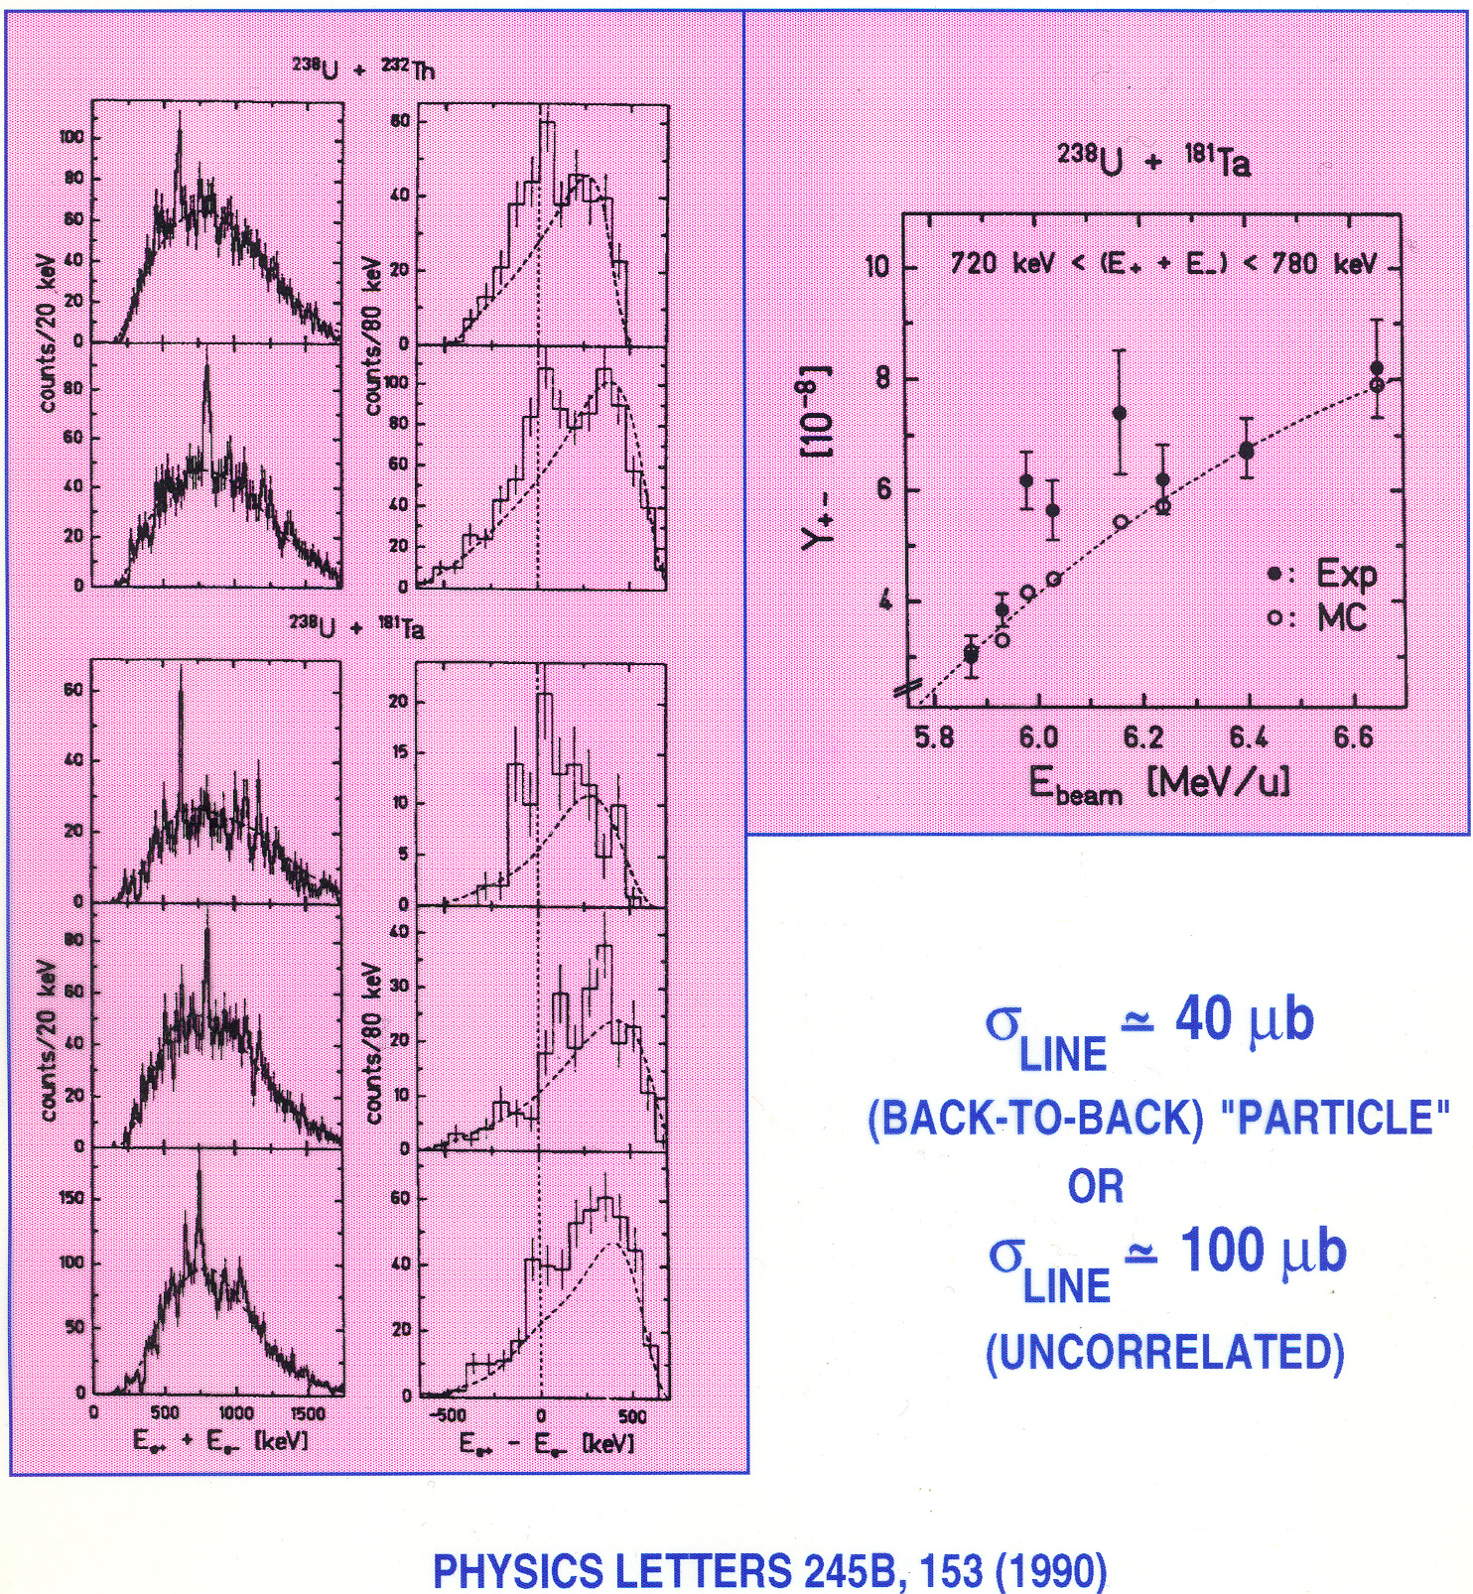
Axion?
New phase of QED?
Unknown neutral particle(s)?
“A ticket to Stockholm”
e⁺e⁻ pairs

Slide 6
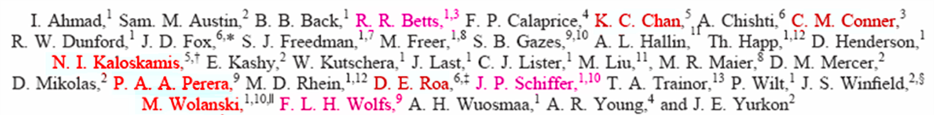
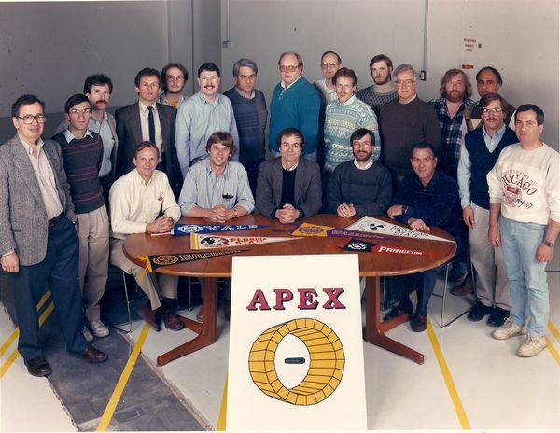
APEX (Atlas Positron EXperiment) Collaboration

Slide 7

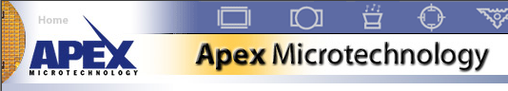

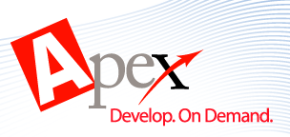
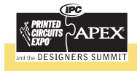


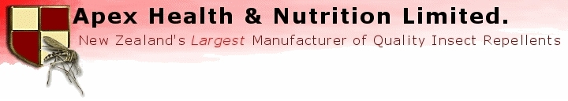

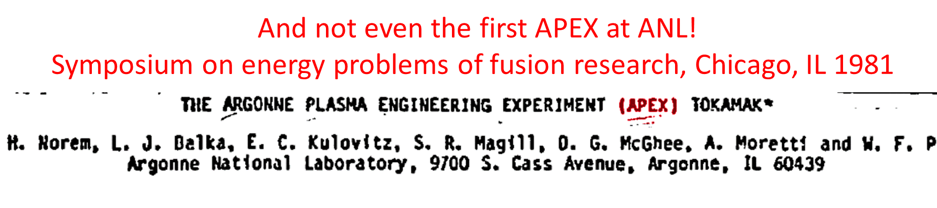



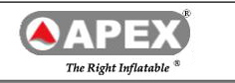
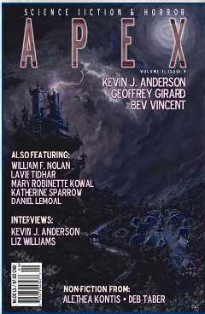

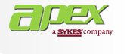
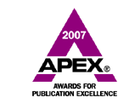
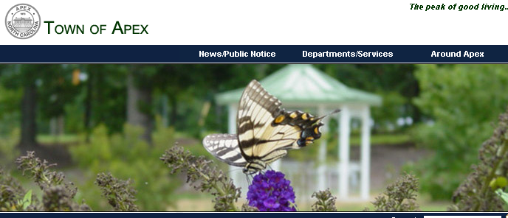

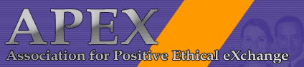



Slide 8
Goals of APEX
Confirmation of "the effect"
Better Statistics
Systematic Studies - Peaks as a function of: you name it!
  - d^{N}σ/d(everything)
A Final Answer to the problem…

Slide 9
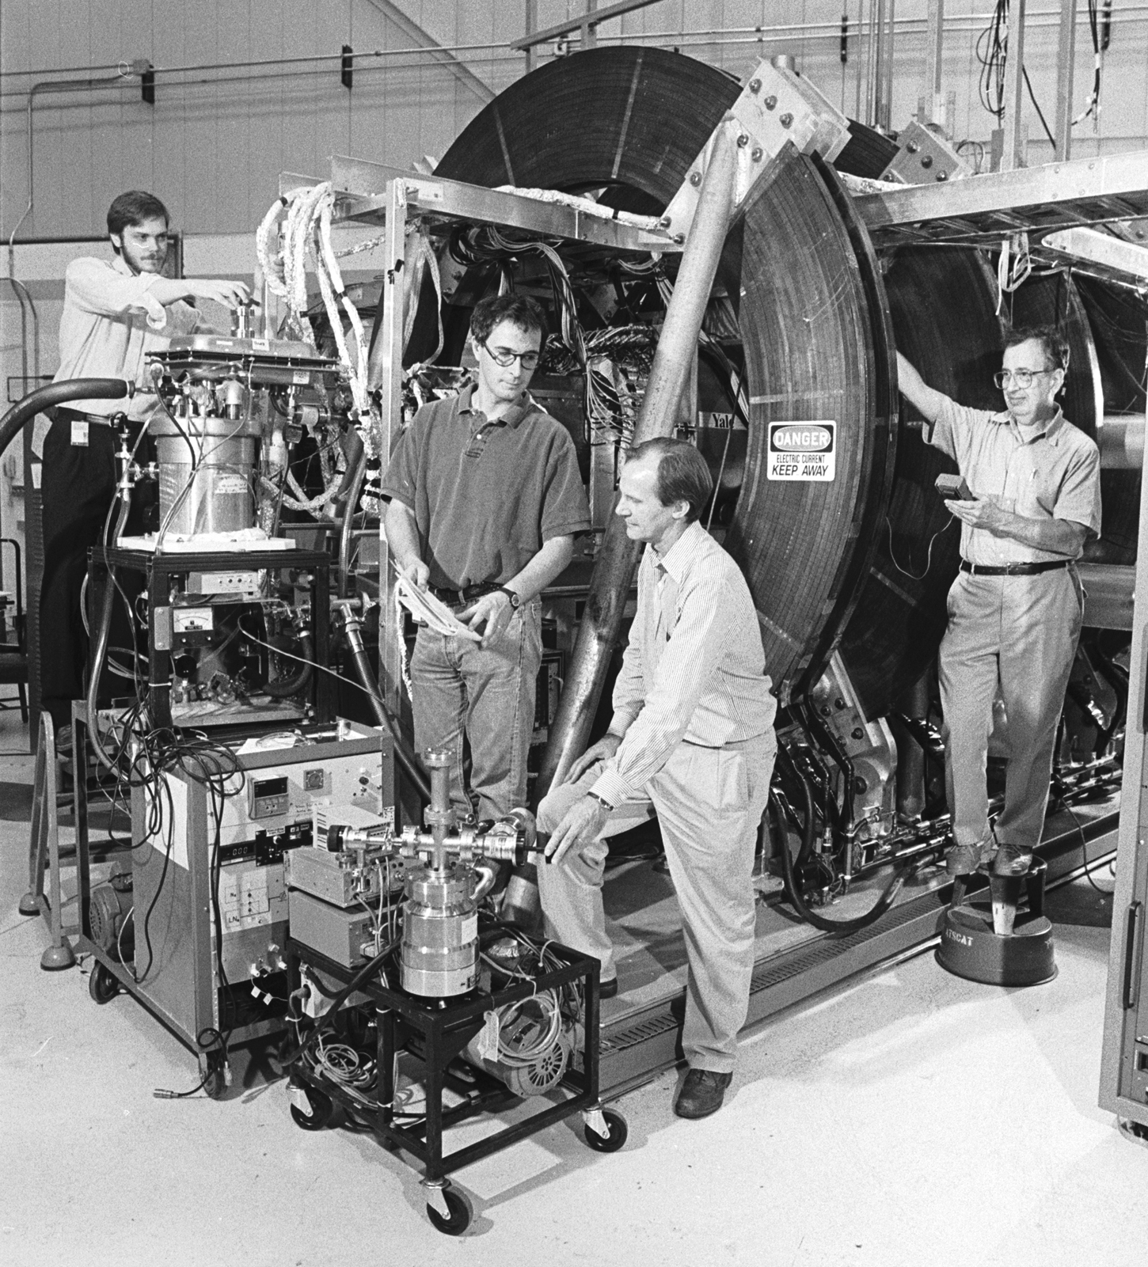
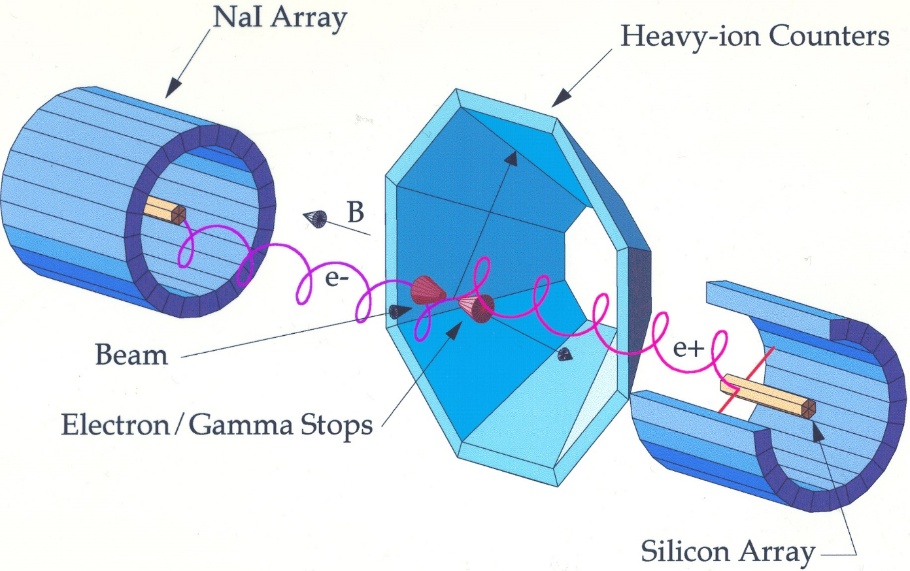
And away we go…

Slide 10
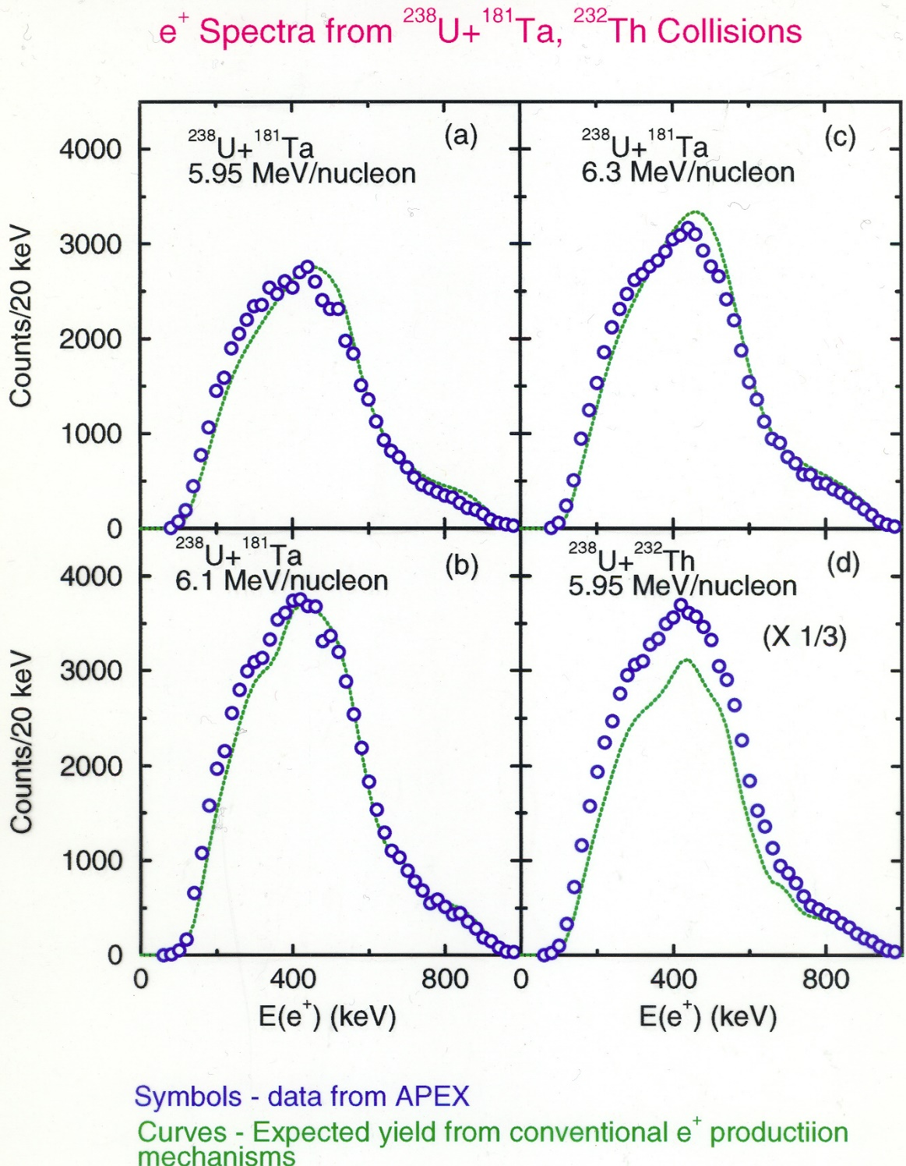
Positrons alone – lots of counts, no peaks
With expected signals

Slide 11
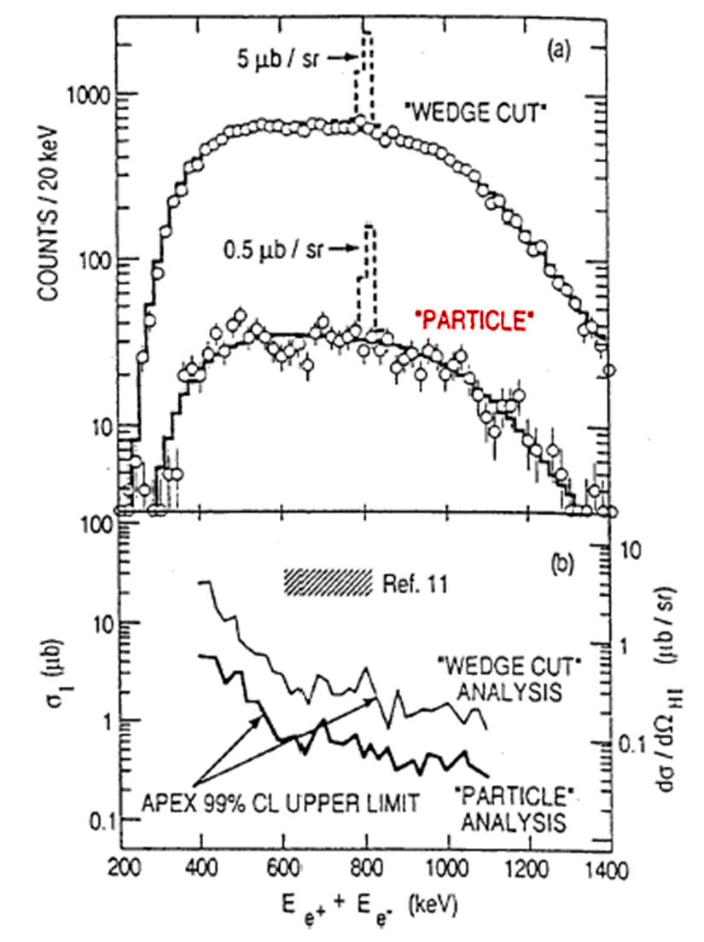
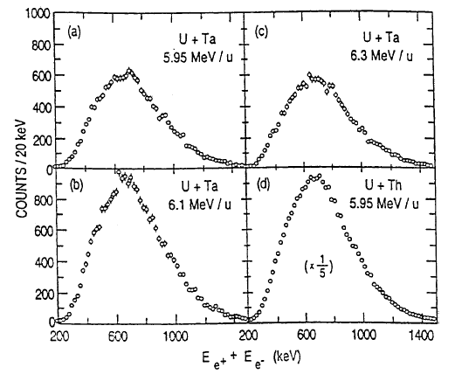
Positrons and electrons: still lots of counts and still no peaks
John’s
analysis

Slide 12
Goals of APEX
“Some of the original discoverers, needless to say, are not happy…”
“Yale physicist Allan Bromley, president-elect of the APS and a former White House science adviser, describes the dispute simply as ‘a very difficult and unpleasant business. No question about it.’"
Confirmation of "the effect"
Better Statistics
Systematic Studies - Peaks as a function of: you name it!
  - d^{N}σ/d(everything)
A Final Answer to the problem…
We never got past #1…
In October 1995, the APEX physicists were the first to publish their results, in PRL. They had been unable to reproduce the GSI peaks. As Argonne's Schiffer puts it, "We found absolutely no sign of the [peaks] that had been reported before."
G. Taubes, Science 257 (1997)

Slide 13
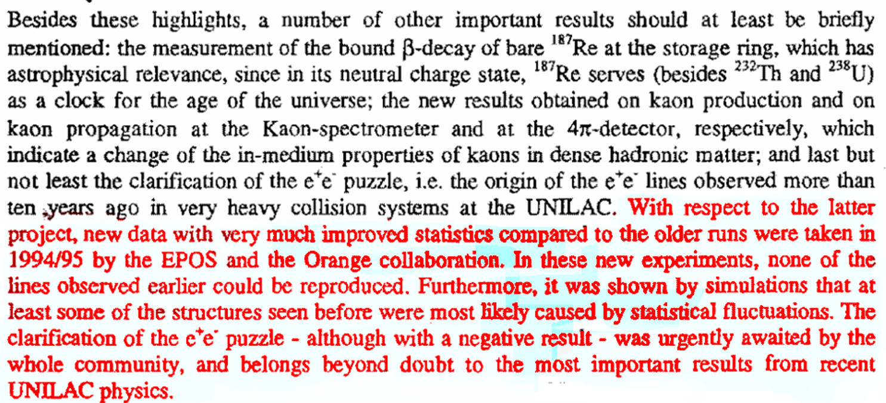
GSI Simultaneously surrenders and claims victory!
(1995 GSI Progress Report)

Slide 14
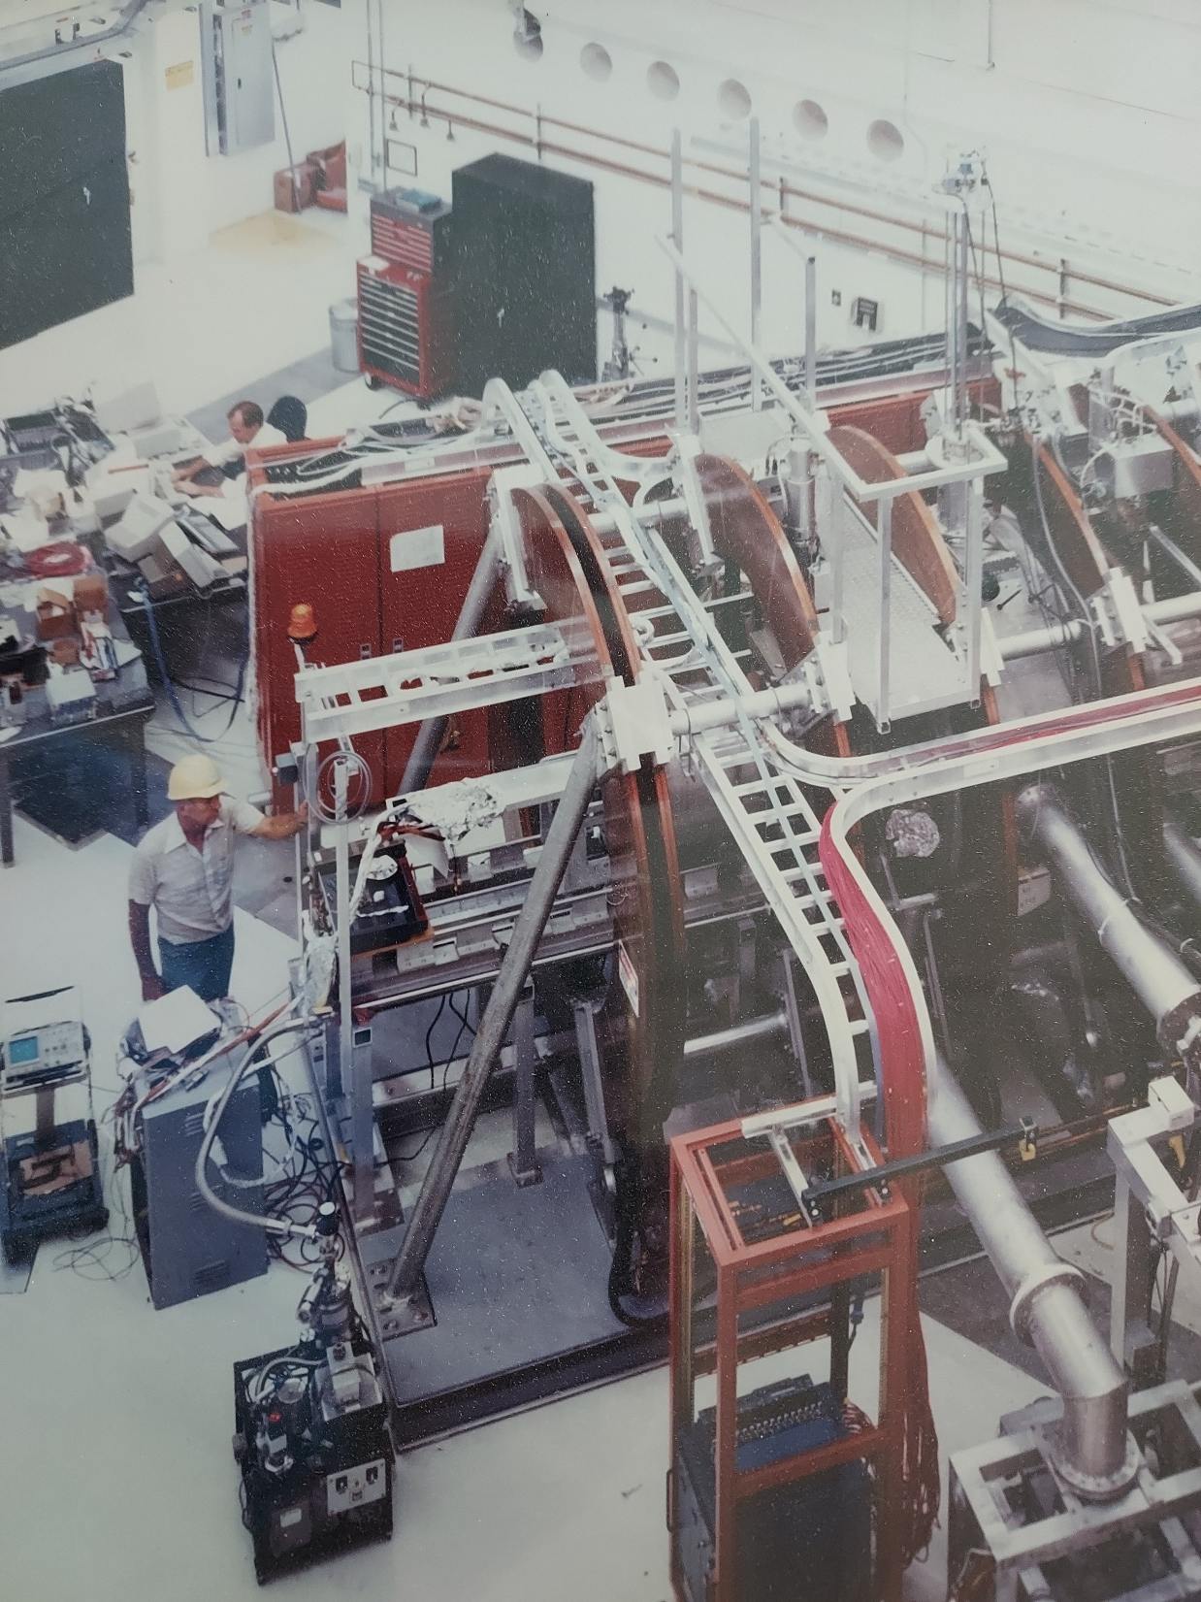
Chapter 2. “I don’t know John, that sounds a little crazy…”
The conversation took place somewhere
around here…

Slide 15
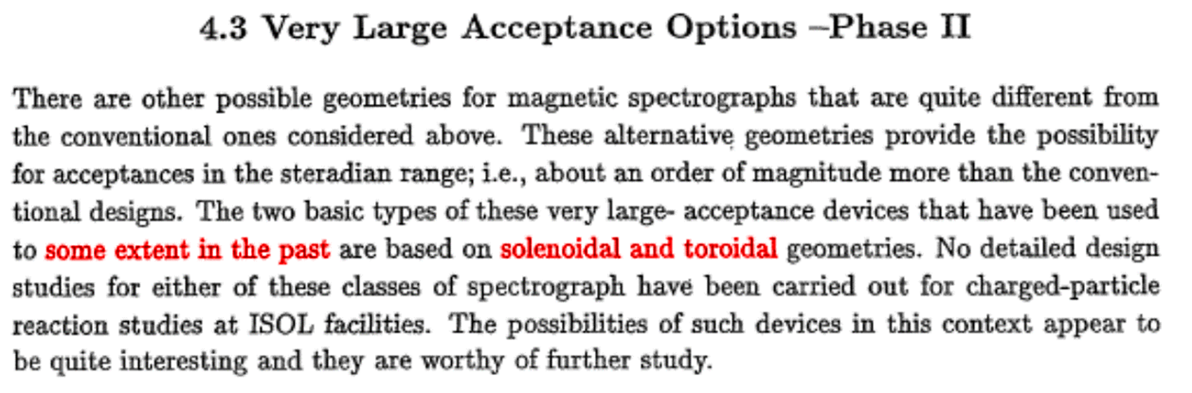
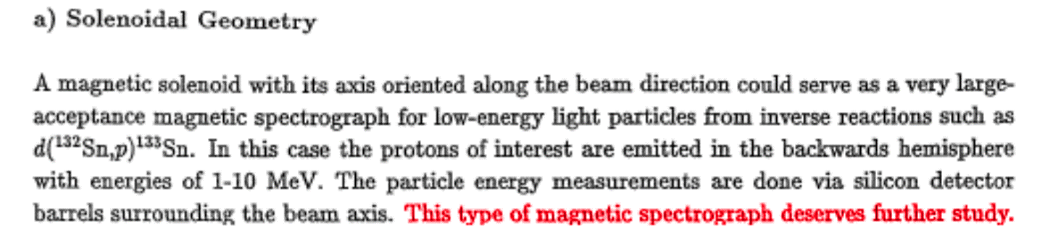
Something that would become RIA
Why?

Slide 16
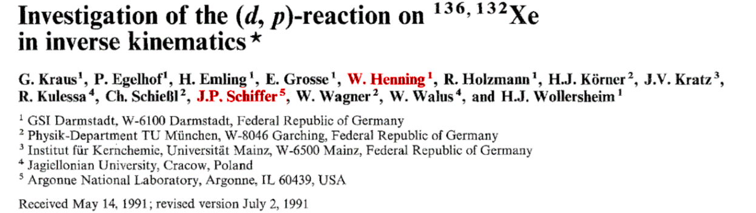

Why? #1:

Slide 17
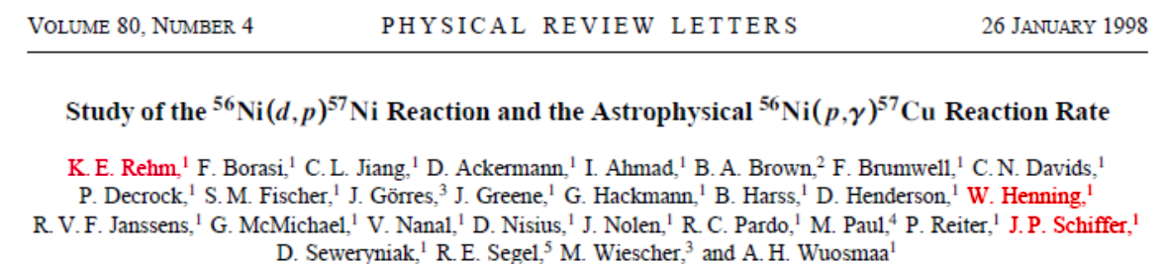
#2

Slide 18
What do we need to Establish the Single-Particle Structure of Exotic (Neutron-Rich) Nuclei
John Schiffer
Argonne Nat’l. Lab
&
Alan Wuosmaa
Western Michigan University
RIA Equipment Workshop
ORNL March 19, 2003

Slide 19
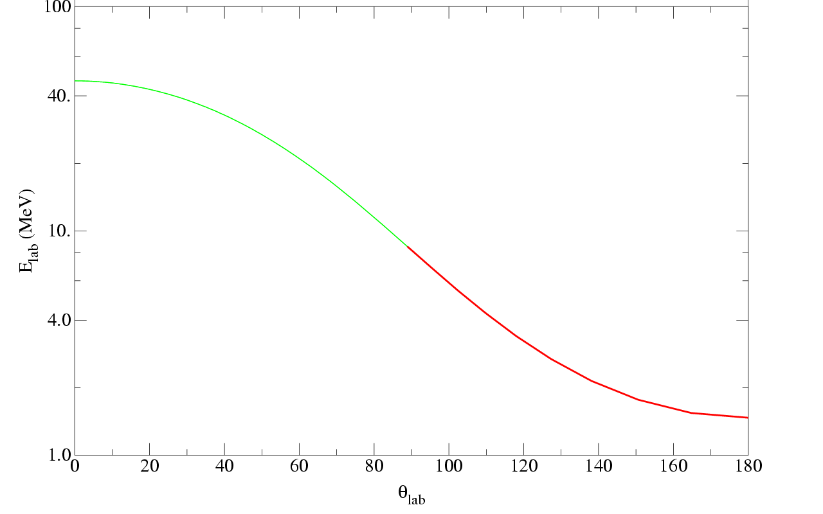
d(¹³²Sn,p) kinematics
RIA Equipment Workshop
ORNL March 19, 2003

Slide 20
Schematic design
Solenoid
Low energy p,t
B
Forward angles
Silicon Detector
B
Target
Beam
Beam
Stop
Backward angles
RIA Equipment Workshop
ORNL March 19, 2003

Slide 21
Solenoid transport for d(¹³²Sn,p)
Particle energy (MeV)
E(¹³²Sn)=7 MeV/u
B =2T
E_{X}=0.0 MeV
E_{X}=2.0 MeV
Solenoid angle (deg)
RIA Equipment Workshop
ORNL March 19, 2003
Axis position (cm)

Slide 22

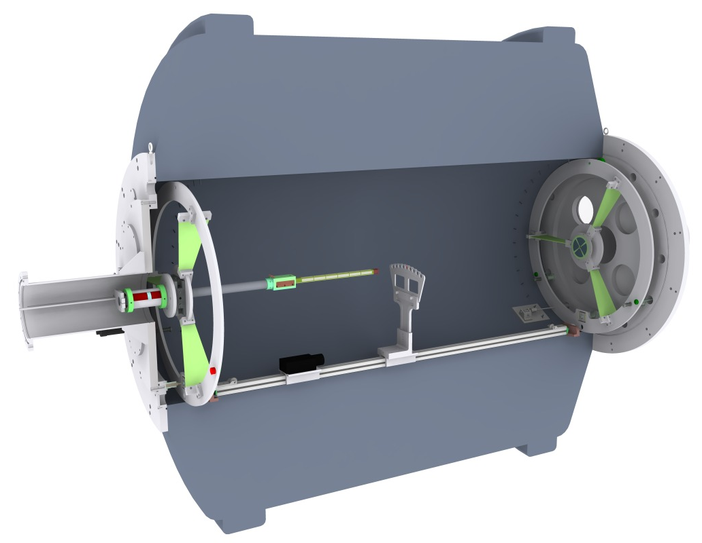
HELIcal Orbit Spectrometer -HELIOS
John’s acronym: SOIREE
SOlenoid for Inverse REaction
Experiments
“A fancy evening affair”
B_{MAX}=2.85 T
2.35 m
0.9 m
Silicon Array
Target
Beam
Recoil Detectors
Laser
rangefinder
X-Y-θ positioning
stage
J.P. Schiffer, RIA equipment workshop 1999
AHW et al., NPA 746, 267c (2004)
AHW et al., NIMPRA 580, 1290 (2007)
J. C. Lighthall et al., NIMPRA 622, 97 (2010)

Slide 23
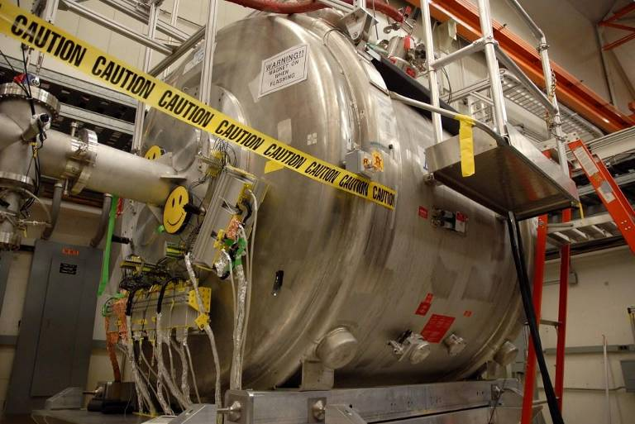
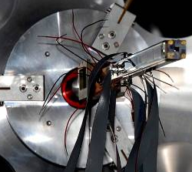
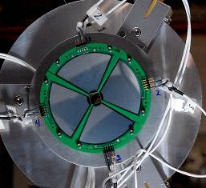
HELIOS at ATLAS

Slide 24
It works as advertised!
²⁸Si(d,p)²⁹Si
Diagonal lines: states in ²⁹Si
Horizontal lines: α source
J. C. Lighthall et al., NIMPRA 622, 97 (2010)

Slide 25
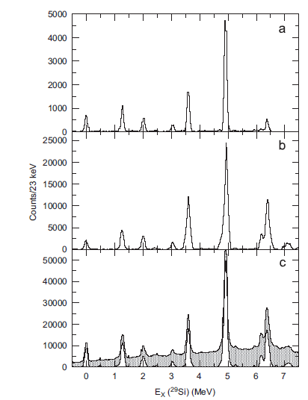
And then a miracle occurs...
d(²⁸Si,p)²⁹Si
with HELIOS
HELIOS provides vastly improved
acceptance and excitation-energy resolution
J. C. Lighthall et al., NIMPRA 622, 97 (2010)

Slide 26
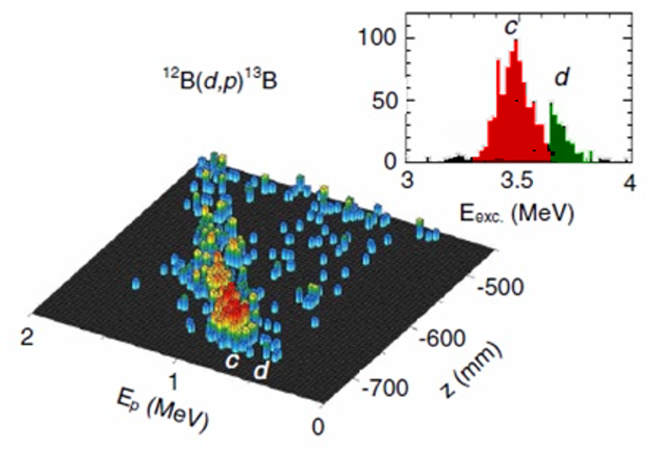
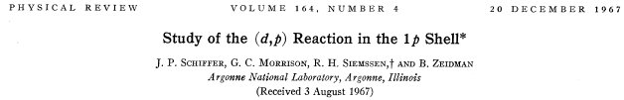
¹¹B(d,p)¹²B
¹²B(d,p)¹³B
1/2⁺
5/2⁺

Slide 27
(d,p) light nuclei
S. Bedoor et al., PRC 88, 011304(R) (2013)
¹³B(d,p)¹⁴B
AHW et al., PRL 105, 0132501 (2010)
¹⁵C(d,p)¹⁶C
P. T. MacGregor et al., PRL 104, L051301 (2021)
(ISS Measurement)
C. R. Hoffman et al., PRC 88, 044317 (2013)
¹⁷N(d,p)¹⁸N

Slide 28
(d,p) heavy nuclei
D. K. Sharp et al., PRC 87, 014312 (2013)
⁸⁶Kr(d,p)⁸⁷Kr
T. L. Tang et al., PRL 124, 062502 (2020)
(ISS measurement)
B. P. Kay et al., PRC 84, 024325 (2011)
²⁰⁶Hg(d,p)²⁰⁷Hg

Slide 29
(d,^{3,4}He) reactions
J. Chen et al., PRC 100, 061314 (2019)
AHW et al., PRC 90, 061301(R) (2014)
¹²B(d,³He)¹¹Be
M. Salathe et al., PRC 102, 064317 (2020)
T. L. Tang et al., PRC 105, 064307 (2022)
³⁶S(d,³He)³⁵P
(Isomeric beam!)

Slide 30
(In)elastic scattering
J. Chen et al., PRC 106, 064312 (2022)
S. A. Kuvin et al., PRC 96, 041301(R) (2017)
¹⁵C(d,d)
¹⁰B(p,p’)
¹⁵C(d,d’)¹⁵C(5/2⁺)

Slide 31
(t,p) reactions
D. G. McNeel et al., PRC 103, 064320 (2021)
²⁶Mg(t,p)²⁸Mg
And ³²Si(t,p)³⁴Si (C. R. Hoffman)
coming from SOLARIS
¹⁰Be(t,p)¹²Be (B. P. Kay)
SOLARIS

Slide 32
Fission!

Slide 33
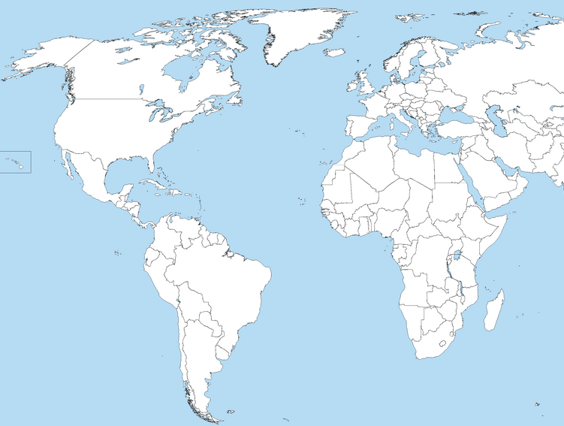

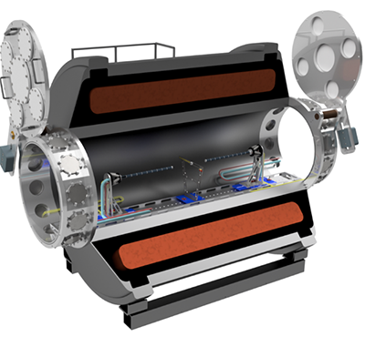
A proliferation of solenoids: the future is in all of them, and maybe more to come…
HELIOS @ ANL
SOLARIS @ FRIB
ISS @ CERN/HIE-ISOLDE

Slide 34
Summing up
John and Solenoidal Spectrometers have a long history (and I didn’t even mention the 17 keV neutrino!)
Solution of sorts to an important fundamental physics problem – sadly with a negative result
Happier outcome with reaction spectrometer
A new universe of possibilities
(At least) 22 physics publications since 2010 (2 so far from ISS)
Three devices are currently in operation - Can there be more?
A fine legacy!

Slide 35
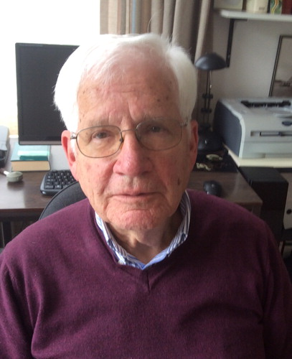
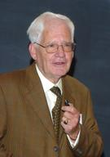
More we’ve lost
Rolf Siemssen, 1933-2021
“It is the Schiffer spirit that
makes this place what it is”
(ATLAS 25th anniversary)

