Slide 1
AMS searches for the unknown: quarks, superheavies, and Ca-41
Walter Kutschera
Vienna University, Faculty of Physics, Isotope Physics
Vienna Environmental Research Accelerator (VERA)
Symposium in Honor of John Schiffer
Physics Division, Argonne National Laboratory
10-11 July 2023

Slide 2
I arrived with my family
in Chicago in 1978

Slide 3
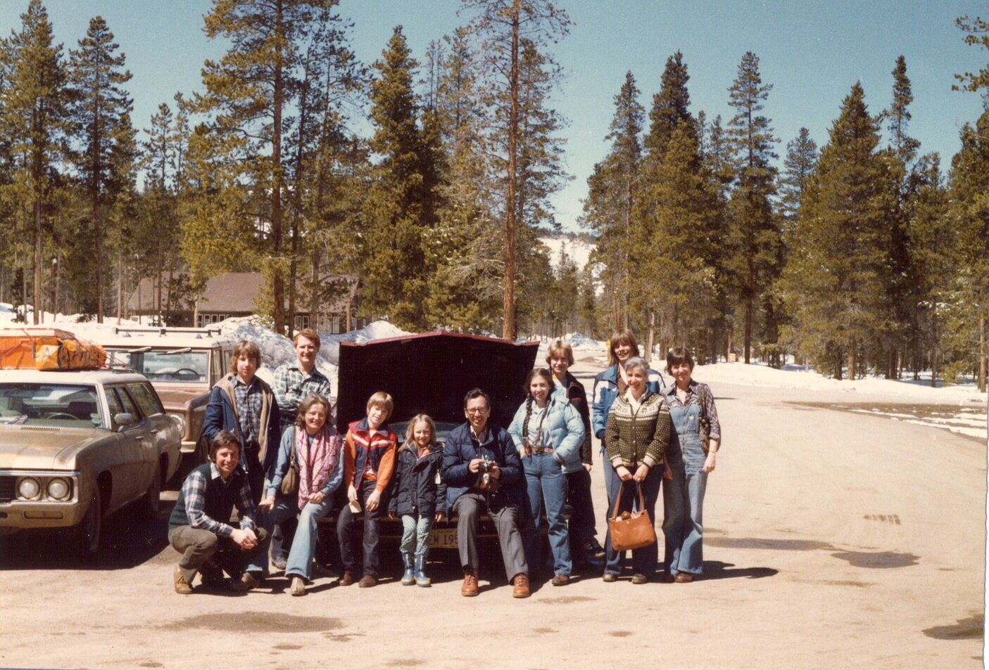
Ski vacation in Winter Park, Colorado, March 1979
Schiffers (John, Marianne, Celia, Peter), Gemmells (Don, Anne, Peter, Steve), Kutscheras (Walter, Gundl, Joerg, Peter, Stefanie)

Slide 4
Search for Free Quarks

Slide 5
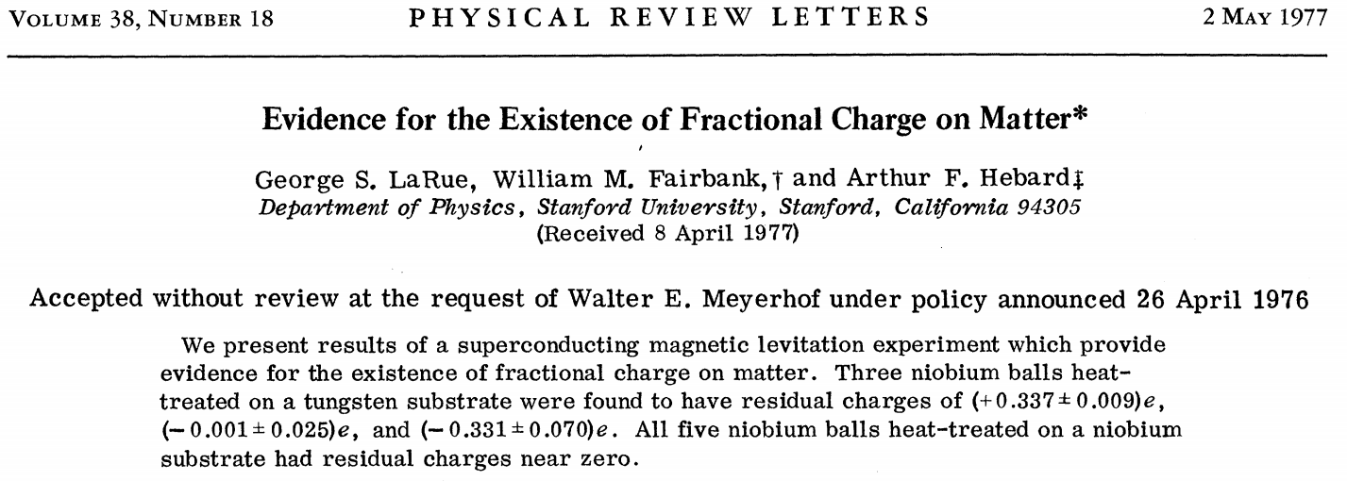

Slide 8
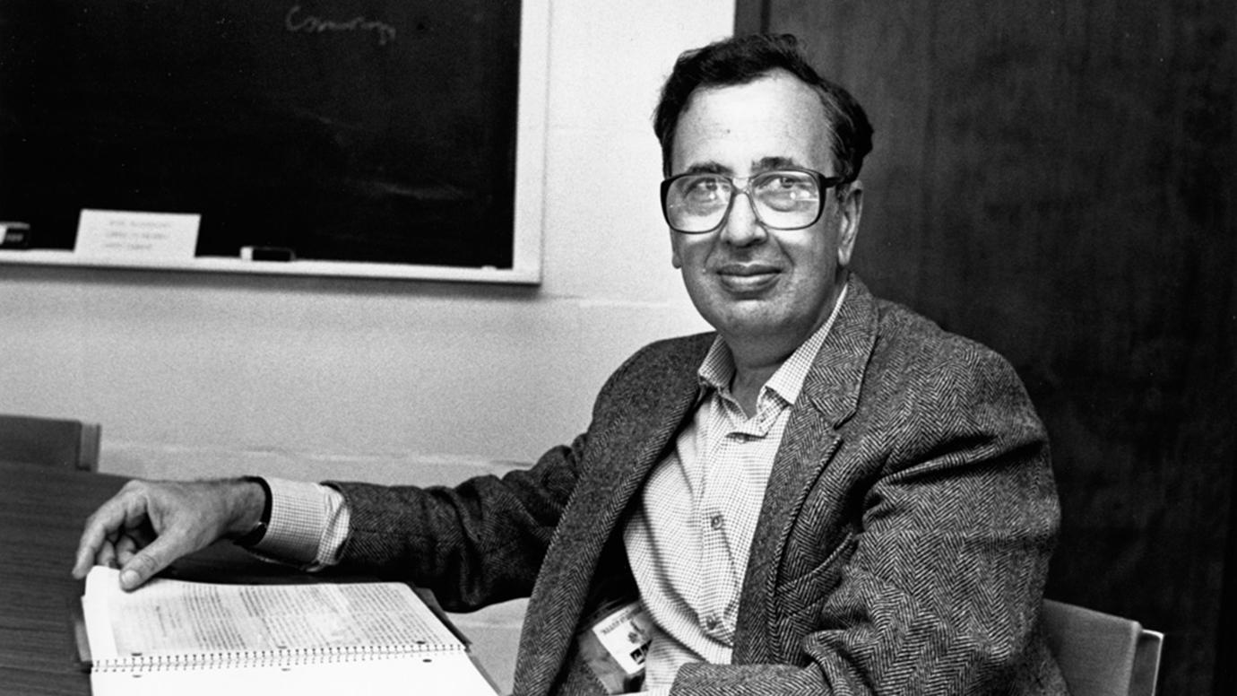
John P. Schiffer
John Schiffer at his University of Chicago office, 1987

Slide 9
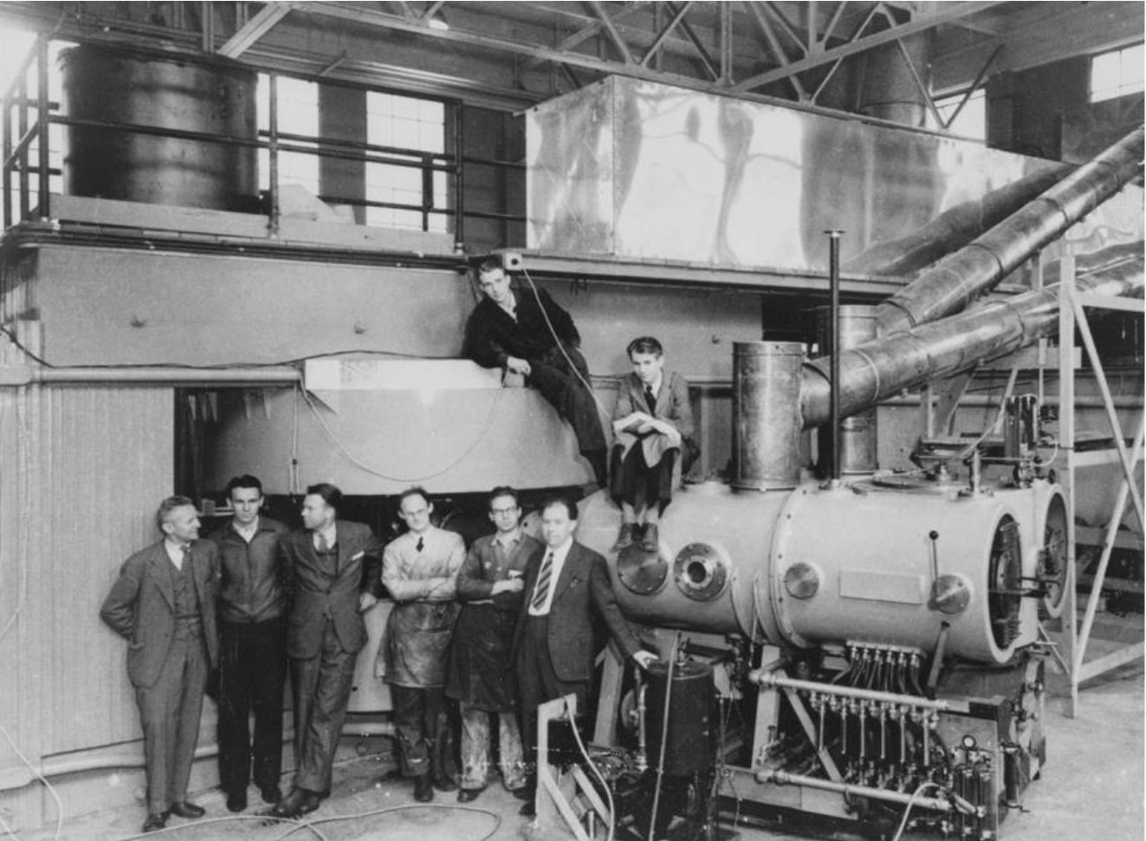
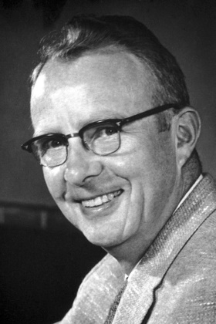
Louis Alvarez
Luis Alvarez
(1911 -1988)
E. O. Lawrence
The first us of an accelerator as a mass spectrometer: The goal was to produce ³He in d +d reactions and measure ist radiactive decay.
L. W. Alvarez and R. Cornog,
³He in helium
Phys. Rev. 56 (1939) 379
L. W. Alvarez and R. Cornog
Helium and hydrogen of mass 3
Phys. Rev. 56 (1939) 613
The 60-inch cyclotron in Berkeley, ~1939

Slide 10
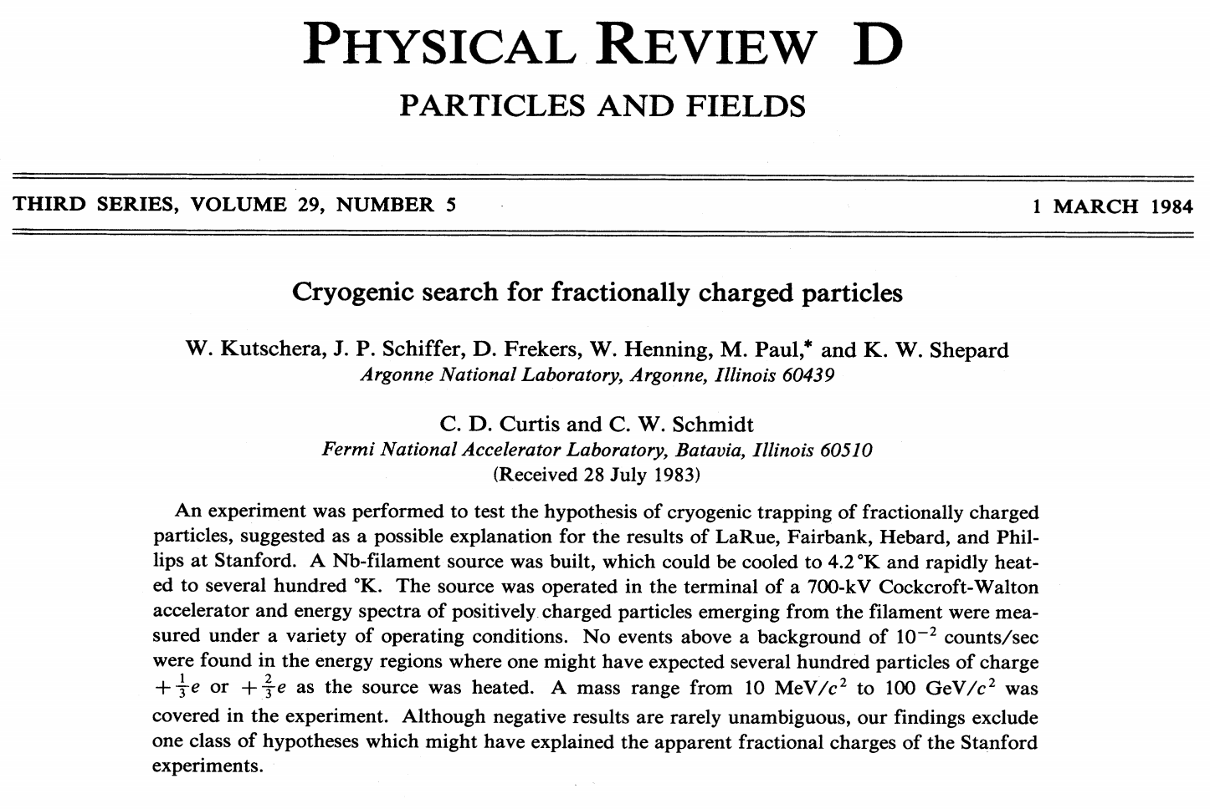
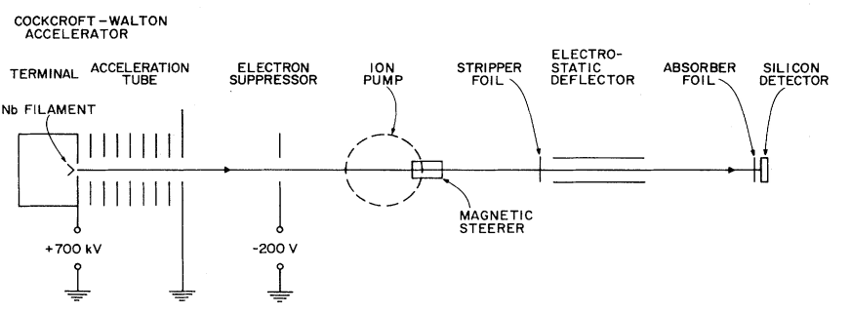

Slide 11
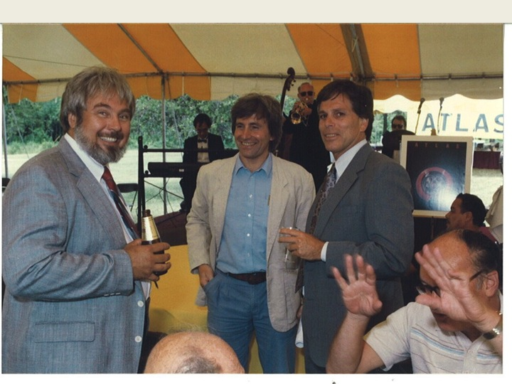
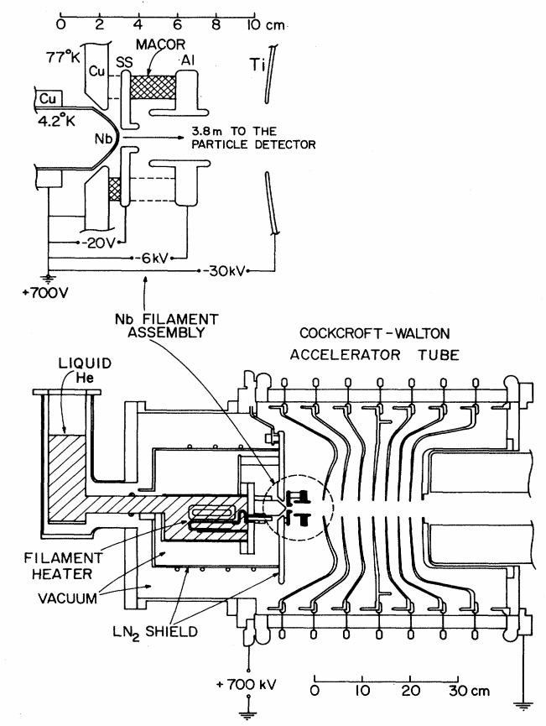
The ion source with a
cryogenic Nb filament
Ken Shepard
Is it possible to detect the minute amount of radiogenic ⁴¹K* from the decay of ⁴¹Ca in the presence of omnipresent ⁴¹K?
Here are a few ideas [Maden 2016, 2022]:
The concentration of potassium (K) in bone apatite has been measured to be 47 ppm [Combes et al. 2016].
With TIMS one can measure ⁴¹K/³⁹K ratios for 10 ng potassium samples with a reproducibility of 100 ppm (1 STDEV).
If 3 STDEV of ⁴¹K is the minimum one needs to detect the ⁴¹K* excess, one calculates 3×10⁹ ⁴¹K atoms for 10 ng K.
Assuming an age of 100,000 years for bone apatite, the number of ⁴¹Ca and ⁴¹K* atoms will be the same, i. e. 3×10⁹ atoms.
Assuming ⁴¹Ca/⁴⁰Ca = 5×10⁻¹⁵, one calculates 3×10⁹/5×10⁻¹⁵ = 6×10²³ ⁴⁰Ca atoms. This corresponds to 40 g calcium or 100 g apatite.
This allows a K concentration of only 0.1 ppb. This is ~500.000 lower
than the 47 ppm concentration reported in the literature.

Slide 12
Result

Slide 13
Search for Superheavy Nuclei

Slide 14
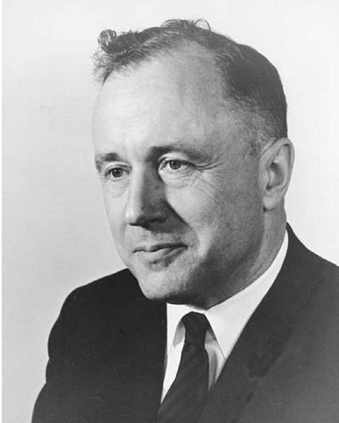
Superheavy nuclei
Frederick J. Werner and John A. Wheeler
Phys. Rev. 109 (1958) 126-144
Z = 147, A = 500
John Archibald Wheeler
(1911-2008)

Slide 15
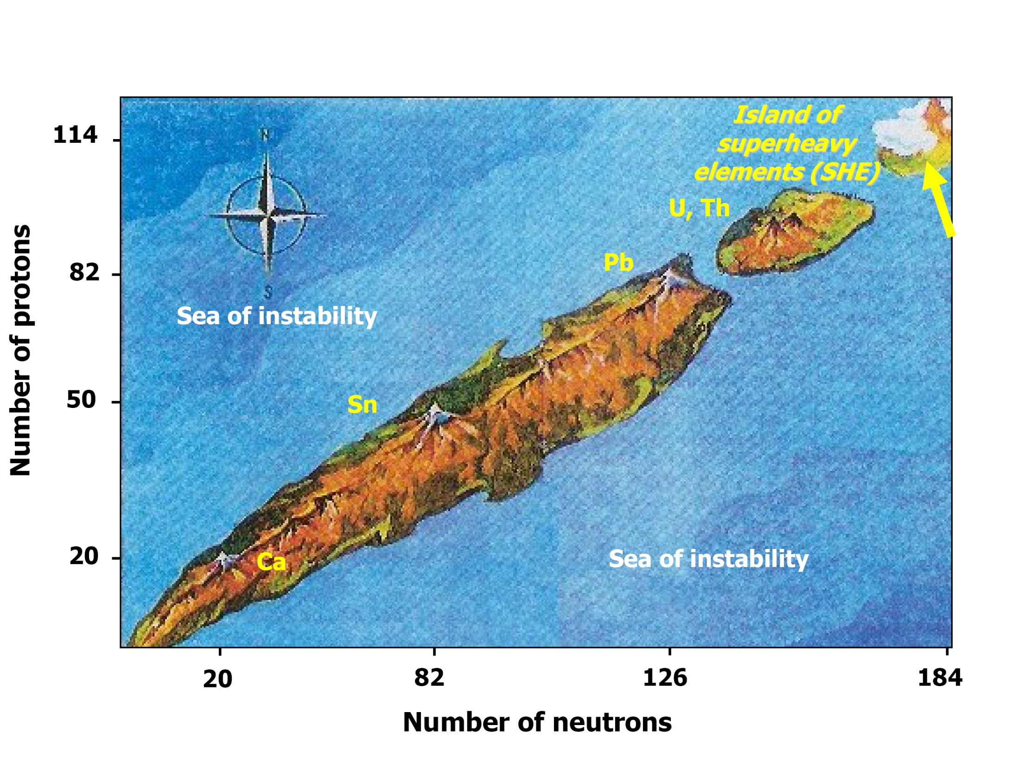
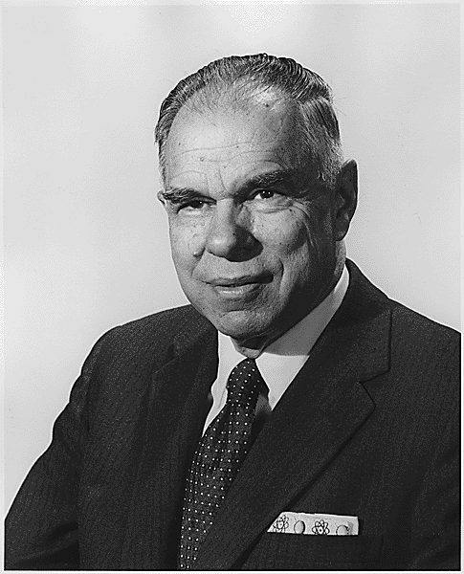
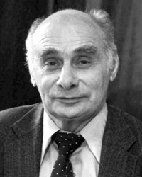
Early History of Superheavy Elements (SHE)
In the late 1960s, shell model corrections of the liquid drop model led to a region of stability for superheavy elements: Myers & Swiatecky, Nilsson, Strutinsky, Nix, Möller, ....
Island of superheavy elements (SHE)
Sea of instabilty
Glenn T. Seaborg
(1912-1999)
Georgi N. Flerov
(1913-1990)

Slide 16
Superheavy nuclei
Frederick J. Werner and John A. Wheeler
Phys. Rev. 109 (1958) 126-144
Z = 147, A = 500
Calculation of half-lives for superheavy nuclei
E. O. Fiset and J. R. Nix
Nucl. Phys. A 193 (1972) 647-671
Z = 110, N = 184, t_{1/2} = 2.5×10⁹ yr
John Archibald Wheeler
(1911-2008)

Slide 17
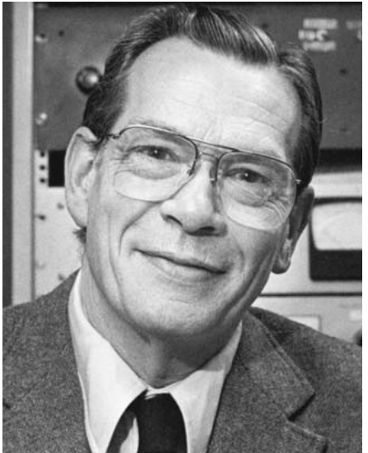
Superheavy nuclei
Frederick J. Werner and John A. Wheeler
Phys. Rev. 109 (1958) 126-144
Z = 147, A = 500
Calculation of half-lives for superheavy nuclei
E. O. Fiset and J. R. Nix
Nucl. Phys. A 193 (1972) 647-671
Z = 110, N = 184, t_{1/2} = 2.5×10⁹ yr
John Archibald Wheeler
(1911-2008)
Search for naturally occurring
superheavy element Z = 110, A = 294
W. S. Stephens, J. Klein, and R. Zurmühle
Phys. Rev. 109 (1980) 126-144
²⁹⁴110/Pt < 1x10⁻¹¹
Roy Middleton
(1927-2004)

Slide 18
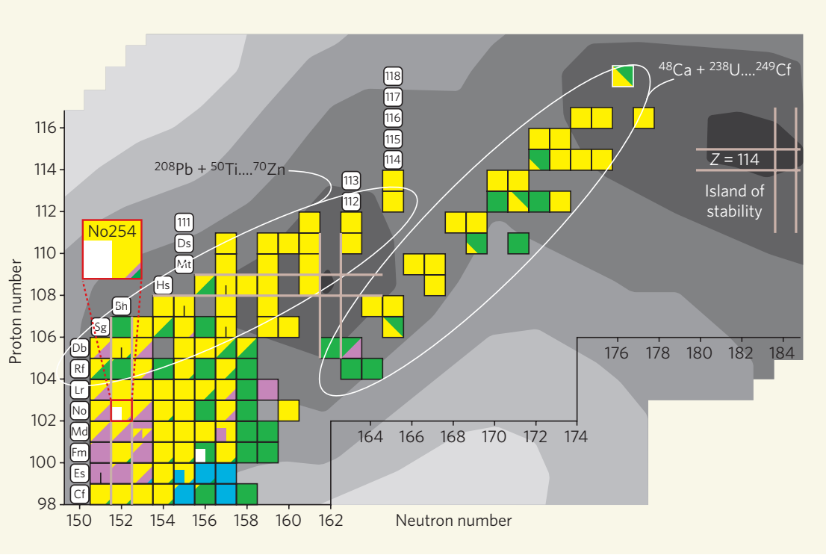
Island ahoy!
Mark A. Stoyer
Nature 442 (2006)

Slide 19
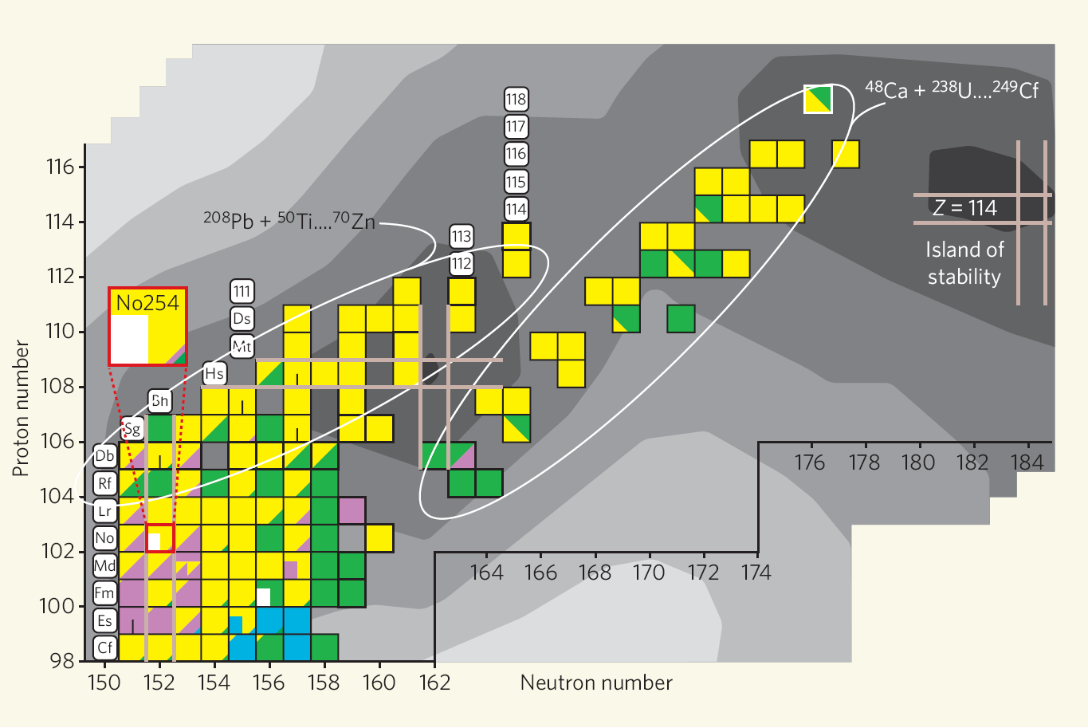
0.06s
2.6 s
34 s
Region investi-gated with AMS
11 s

Slide 20
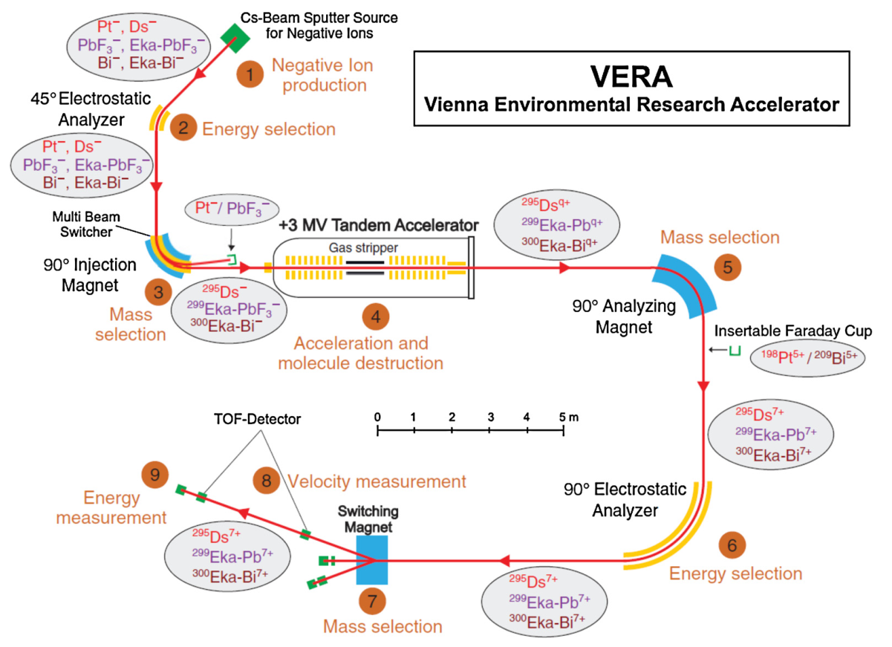
Franz Dellinger

Slide 21
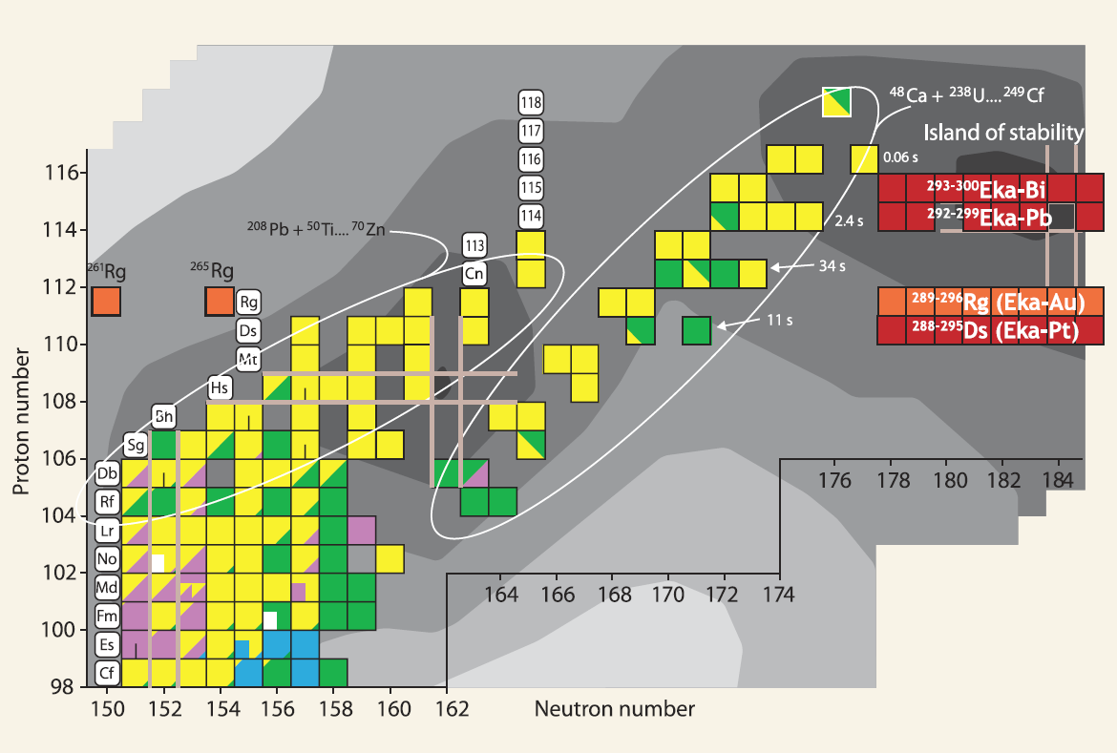
Search for SHE nuclides in Nature
Positive evidence from ICP-SF-MS:
Marinov et al., Jerusalem, 2007, 2009, 2010
Upper limits from AMS:
Lachner et al., Munich, 2008
Dellinger et al., Vienna, 2010, 2011
Ludwig et al., Munich 2012
²⁹²Eka-Th
< 4 × 10⁻¹⁵
~ 1 × 10⁻¹²
< 5 × 10⁻¹³
< 6 × 10⁻¹⁴
< 7 × 10⁻¹⁶
< 3 × 10⁻¹⁶
< 2 × 10⁻¹⁵
(1-10) × 10⁻¹⁰
Neutron number
Summary of SHE searches with AMS in:
G. Korschinek & W. Kutschera, Nucl. Phys. A 944 (2015) 190
^{211,213,217,218}Th: (1-10) x 10⁻¹¹

Slide 22
Radiocalcium Dating: an unfinished dream
⁴¹Ca, half-life = 100,000 years
(¹⁴C, half-life = 5,700 years)

Slide 23
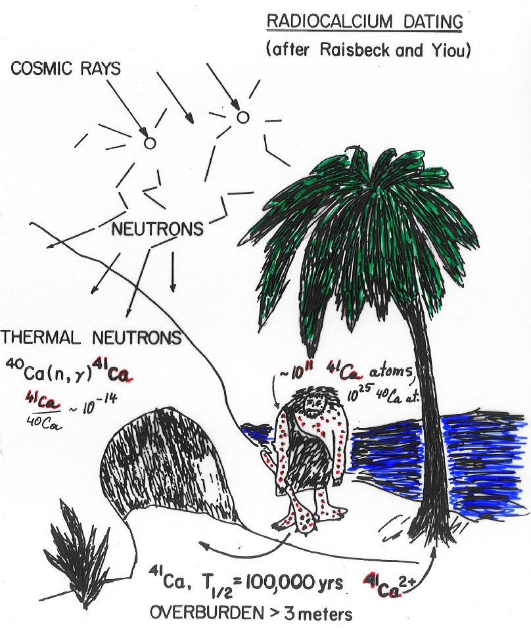
RADIOCALCIUM DATING
(Figure by Walter Henning)
⁴⁰Ca
96.941
⁴¹Ca
10⁵ yr
⁴²Ca
0.647
⁴³Ca
0.135
³⁹K
93.258
⁴⁰K
0.0117
⁴¹K
6.730
⁴²K
12.4 h
⁴¹Ca + e‒ → ⁴¹K* + ν_{e}
⁴⁰Ca(n,γ) ⁴¹Ca
⁴¹Ca/⁴⁰Ca ~ 5ˣ10⁻¹⁵
For comparison:
we have ~10¹⁵ ¹⁴C atoms in our body)
~10¹¹ ⁴¹Ca atoms
First dating ideas with ⁴¹Ca:
Y. Yamaguchi, Prog. Theor. Phys. 1963
G. Raisbeck & F. Yiou, Nature 1979
First detection of ⁴¹Ca in bones with AMS:
W. Henning et al. Science 1987

Slide 24
Absolute dating with ⁴¹Ca
(W. Kutschera & M. Paul, Poster at the Radiocarbon Conference in Zurich, 2022)

Slide 25
Absolute dating with ⁴¹Ca
(W. Kutschera & M. Paul, Poster at the Radiocarbon Conference in Zurich, 2022)
⁴¹Ca decays into ⁴¹K* (radiogenic ⁴¹K)
As a function of time: ⁴¹Ca_{t} = ⁴¹Ca_{o} ˣ e^{–λt},

Slide 26
Absolute dating with ⁴¹Ca
(W. Kutschera & M. Paul, Poster at the Radiocarbon Conference in Zurich, 2022)
⁴¹Ca decays into ⁴¹K* (radiogenic ⁴¹K)
As a function of time: ⁴¹Ca_{t} = ⁴¹Ca_{o} ˣ e^{–λt},
Since ⁴¹Ca_{o} is always the sum of ⁴¹Ca_{t} + ⁴¹K_{t}*
the age of a bone sample can be calculated from
t = 1/λ ˣ ln(1 + ⁴¹Ca_{t}/⁴¹K_{t}* )

Slide 27
Absolute dating with ⁴¹Ca
(W. Kutschera & M. Paul, Poster at the Radiocarbon Conference in Zurich, 2022)
⁴¹Ca decays into ⁴¹K* (radiogenic ⁴¹K)
As a function of time: ⁴¹Ca_{t} = ⁴¹Ca_{o} ˣ e^{–λt},
Since ⁴¹Ca_{o} is always the sum of ⁴¹Ca_{t} + ⁴¹K_{t}*
the age of a bone sample can be calculated from
t = 1/λ ˣ ln(1 + ⁴¹Ca_{t}/⁴¹K_{t}* )
Both ⁴¹Ca_{t} and ⁴¹K_{t}* must be measured – but ⁴¹Ca₀ need not be known. (no calibration required)

Slide 28
Absolute dating with ⁴¹Ca
(W. Kutschera & M. Paul, Poster at the Radiocarbon Conference in Zurich, 2022)
⁴¹Ca decays into ⁴¹K* (radiogenic ⁴¹K)
As a function of time: ⁴¹Ca_{t} = ⁴¹Ca_{o} ˣ e^{–λt},
Since ⁴¹Ca_{o} is always the sum of ⁴¹Ca_{t} + ⁴¹K_{t}*
the age of a bone sample can be calculated from
t = 1/λ ˣ ln(1 + ⁴¹Ca_{t}/⁴¹K_{t}* )
Both ⁴¹Ca_{t} and ⁴¹K_{t}* must be measured – but ⁴¹Ca₀ need not be known. (no calibration required)
⁴¹Ca_{t}/⁴⁰Ca ratios in bones have been measured in the 10⁻¹⁵ range, both with AMS and with ATTA.

Slide 29
Absolute dating with ⁴¹Ca
(W. Kutschera & M. Paul, Poster at the Radiocarbon Conference in Zurich, 2022)
⁴¹Ca decays into ⁴¹K* (radiogenic ⁴¹K)
As a function of time: ⁴¹Ca_{t} = ⁴¹Ca_{o} ˣ e^{–λt},
Since ⁴¹Ca_{o} is always the sum of ⁴¹Ca_{t} + ⁴¹K_{t}*
the age of a bone sample can be calculated from
t = 1/λ ˣ ln(1 + ⁴¹Ca_{t}/⁴¹K_{t}* )
Both ⁴¹Ca_{t} and ⁴¹K_{t}* must be measured – but ⁴¹Ca₀ need not be known. (no calibration required)
⁴¹Ca_{t}/⁴⁰Ca ratios in bones have been measured in the 10⁻¹⁵ range, both with AMS and with ATTA.
The major problem not yet solved is to measure the minute amount of radiogenic
⁴¹K*, and distinguish it from the background of normal ⁴¹K.

Slide 30
Favorable kinetics of the decay of ⁴¹Ca
Since the recoil energy of ⁴¹K* is rather low, ~2.2 eV, there is a high retention probability for ⁴¹K* to stay at the place of ⁴¹Ca. An interesting biomineral for dating bone is apatite, which forms small but hard crystals from Ca₅(PO₄)₃OH.

Slide 31
Favorable kinetics of the decay of ⁴¹Ca
Since the recoil energy of ⁴¹K* is rather low, ~2.2 eV, there is a high retention probability for ⁴¹K* to stay at the place of ⁴¹Ca. An interesting biomineral for dating bone is apatite, which forms small but hard crystals from Ca₅(PO₄)₃OH.
Two possible roads of detection:
1. Through the decay, ⁴⁰Ca₄⁴¹Ca (PO₄)₃OH) becomes ⁴⁰Ca₄⁴¹K* (PO₄)₃OH). It may be possible to
distiguish the two different molecules by molecular spectroscopy.

Slide 32
Favorable kinetics of the decay of ⁴¹Ca
Since the recoil energy of ⁴¹K* is rather low, ~2.2 eV, there is a high retention probability for ⁴¹K* to stay at the place of ⁴¹Ca. An interesting biomineral for dating bone is apatite, which forms small but hard crystals from Ca₅(PO₄)₃OH.
Two possible roads of detection:
1. Through the decay ⁴⁰Ca₄⁴¹Ca (PO₄)₃OH) becomes ⁴⁰Ca₄⁴¹K* (PO₄)₃OH). It may be possible to
distiguish the two different molecules by molecular spectroscopy.
2. High precision mass spectrometry my be able to measure the small change in the isotopic
ratios of ⁴¹K/³⁹K through the addition of radiogenic ⁴¹K*.

Slide 33
A challenge for mass spectrometry
Is it possible to detect the minute amount of radiogenic ⁴¹K* from the decay of ⁴¹Ca
in the presence of omnipresent stable ⁴¹K?

Slide 34
A challenge for mass spectrometry
Is it possible to detect the minute amount of radiogenic ⁴¹K* from the decay of ⁴¹Ca
in the presence of omnipresent stable ⁴¹K?
Here are a few ideas [Colin Maden, ETHZ, 2016, 2022]:

Slide 35
A challenge for mass spectrometry
Is it possible to detect the minute amount of radiogenic ⁴¹K* from the decay of ⁴¹Ca
in the presence of omnipresent stable ⁴¹K?
Here are a few ideas [Colin Maden, ETHZ, 2016, 2022]:
• The concentration of potassium (K) in bone apatite has been measured to be 47 ppm [Combes et al. 2016].

Slide 36
A challenge for mass spectrometry
Is it possible to detect the minute amount of radiogenic ⁴¹K* from the decay of ⁴¹Ca
in the presence of omnipresent stable ⁴¹K?
Here are a few ideas [Colin Maden, ETHZ, 2016, 2022]:
• The concentration of potassium (K) in bone apatite has been measured to be 47 ppm [Combes et al. 2016].
• With TIMS (Thermal Ionization Mass Spectrometry) one can measure ⁴¹K/³⁹K ratios for 10 ng potassium samples
with a reproducibility of 100 ppm (1 STDEV).

Slide 37
A challenge for mass spectrometry
Is it possible to detect the minute amount of radiogenic ⁴¹K* from the decay of ⁴¹Ca
in the presence of omnipresent stable ⁴¹K?
Here are a few ideas [Colin Maden, ETHZ, 2016, 2022]:
• The concentration of potassium (K) in bone apatite has been measured to be 47 ppm [Combes et al. 2016].
• With TIMS (Thermal Ionization Mass Spectrometry) one can measure ⁴¹K/³⁹K ratios for 10 ng potassium samples
with a reproducibility of 100 ppm (1 STDEV).
• If 3 STDEV of ⁴¹K is the minimum one needs to detect the ⁴¹K* excess, one calculates 3×10⁹ ⁴¹K atoms for 10 ng K.

Slide 38
A challenge for mass spectrometry
Is it possible to detect the minute amount of radiogenic ⁴¹K* from the decay of ⁴¹Ca
in the presence of omnipresent stable ⁴¹K?
Here are a few ideas [Colin Maden, ETHZ, 2016, 2022]:
• The concentration of potassium (K) in bone apatite has been measured to be 47 ppm [Combes et al. 2016].
• With TIMS (Thermal Ionization Mass Spectrometry) one can measure ⁴¹K/³⁹K ratios for 10 ng potassium samples
with a reproducibility of 100 ppm (1 STDEV).
• If 3 STDEV of ⁴¹K is the minimum one needs to detect the ⁴¹K* excess, one calculates 3×10⁹ ⁴¹K atoms for 10 ng K.
• Assuming an age of 100,000 years for bone apatite, the number of ⁴¹Ca and ⁴¹K* atoms will be the same,
i. e. 3×10⁹ atoms.

Slide 39
A challenge for mass spectrometry
Is it possible to detect the minute amount of radiogenic ⁴¹K* from the decay of ⁴¹Ca
in the presence of omnipresent stable ⁴¹K?
Here are a few ideas [Colin Maden, ETHZ, 2016, 2022]:
• The concentration of potassium (K) in bone apatite has been measured to be 47 ppm [Combes et al. 2016].
• With TIMS (Thermal Ionization Mass Spectrometry) one can measure ⁴¹K/³⁹K ratios for 10 ng potassium samples
with a reproducibility of 100 ppm (1 STDEV).
• If 3 STDEV of ⁴¹K is the minimum one needs to detect the ⁴¹K* excess, one calculates 3×10⁹ ⁴¹K atoms for 10 ng K.
• Assuming an age of 100,000 years for bone apatite, the number of ⁴¹Ca and ⁴¹K* atoms will be the same,
i. e. 3×10⁹ atoms.
• Assuming ⁴¹Ca/⁴⁰Ca = 5×10⁻¹⁵, one calculates 3×10⁹/5×10⁻¹⁵ = 6×10²³ ⁴⁰Ca atoms.
This corresponds to 40 g calcium or 100 g apatite.

Slide 40
A challenge for mass spectrometry
Is it possible to detect the minute amount of radiogenic ⁴¹K* from the decay of ⁴¹Ca
in the presence of omnipresent stable ⁴¹K?
Here are a few ideas [Colin Maden, ETHZ, 2016, 2022]:
• The concentration of potassium (K) in bone apatite has been measured to be 47 ppm [Combes et al. 2016].
• With TIMS (Thermal Ionization Mass Spectrometry) one can measure ⁴¹K/³⁹K ratios for 10 ng potassium samples
with a reproducibility of 100 ppm (1 STDEV).
• If 3 STDEV of ⁴¹K is the minimum one needs to detect the ⁴¹K* excess, one calculates 3×10⁹ ⁴¹K atoms for 10 ng K.
• Assuming an age of 100,000 years for bone apatite, the number of ⁴¹Ca and ⁴¹K* atoms will be the same,
i. e. 3×10⁹ atoms.
• Assuming ⁴¹Ca/⁴⁰Ca = 5×10⁻¹⁵, one calculates 3×10⁹/5×10⁻¹⁵ = 6×10²³ ⁴⁰Ca atoms.
This corresponds to 40 g calcium or 100 g apatite.
• This allows a K concentration of only 0.1 ppb. This is ~500.000 lower than the 47 ppm concentration
reported in the literature.

Slide 41
A challenge for mass spectrometry
Is it possible to detect the minute amount of radiogenic ⁴¹K* from the decay of ⁴¹Ca
in the presence of omnipresent stable ⁴¹K?
Here are a few ideas [Colin Maden, ETHZ, 2016, 2022]:
• The concentration of potassium (K) in bone apatite has been measured to be 47 ppm [Combes et al. 2016].
• With TIMS (Thermal Ionization Mass Spectrometry) one can measure ⁴¹K/³⁹K ratios for 10 ng potassium samples
with a reproducibility of 100 ppm (1 STDEV).
• If 3 STDEV of ⁴¹K is the minimum one needs to detect the ⁴¹K* excess, one calculates 3×10⁹ ⁴¹K atoms for 10 ng K.
• Assuming an age of 100,000 years for bone apatite, the number of ⁴¹Ca and ⁴¹K* atoms will be the same,
i. e. 3×10⁹ atoms.
• Assuming ⁴¹Ca/⁴⁰Ca = 5×10⁻¹⁵, one calculates 3×10⁹/5×10⁻¹⁵ = 6×10²³ ⁴⁰Ca atoms.
This corresponds to 40 g calcium or 100 g apatite.
• This allows a K concentration of only 0.1 ppb. This is ~500.000 lower than the 47 ppm concentration
reported in the literature.
Conclusion
“In order to reach the possible, one has to try again and again the impossible“
[Hermann Hesse, Nobel Prize in Literature 1946]

Slide 42
John & Marianne visiting
Walter & Gundl in the
Austrian Alps, 2006

Slide 44
Extras

Slide 45
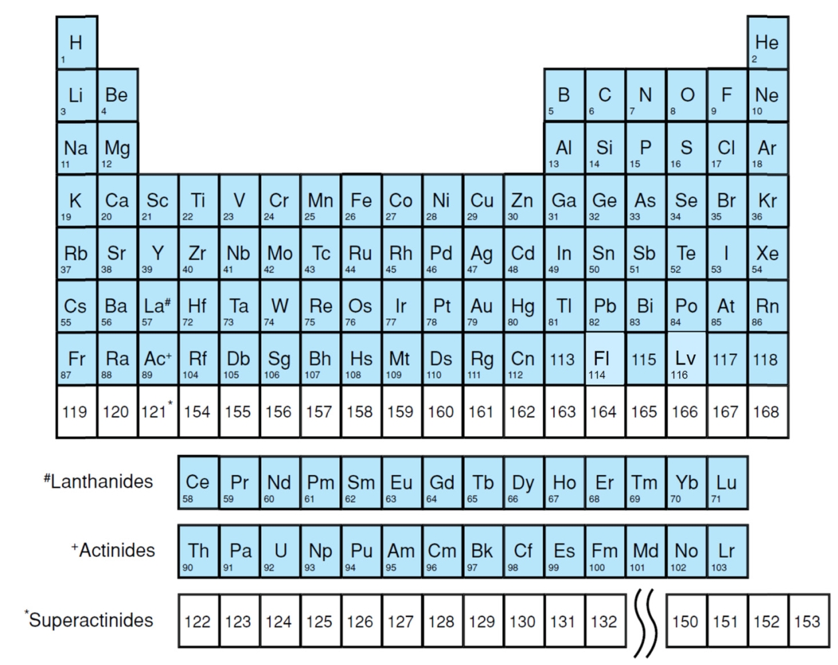
[Korschinek & Kutschera, 2015]

Slide 46
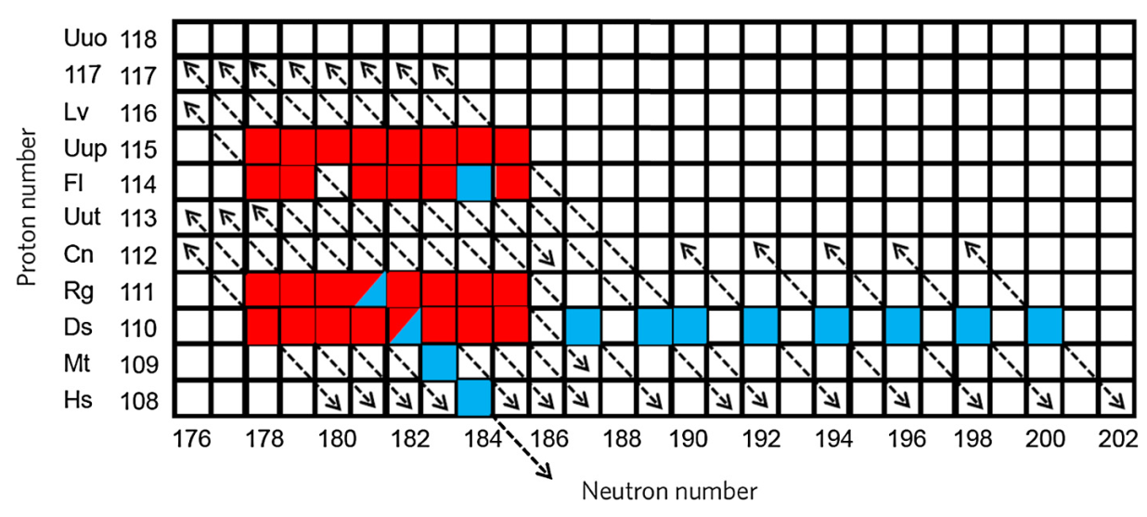
[Korschinek & Kutschera, 2015]

Slide 47
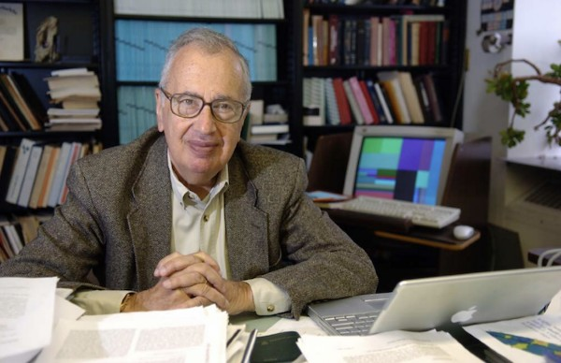
John Schiffer at his desk in the Physics Division of Argonne National Laboratory

