Slide 1
Nuclear reactions in the 1960s to medical isotopes in the 2020s
July 10, 2023
Jerry nolen
Physics Division
Argonne National Laboratory

Slide 2
Entered graduate school at Princeton 1961
Met John and Marianne in 1964 – John on sabbatical to Princeton
Gordon Conference 1964
Bird watching with John and Igal Talmi
(Celia born upon return to Argonne in 1964 in the same hospital as my second daughter during my post-doc at Argonne)
Thesis: Direct reactions, target making, ZnO reduction
Spectroscopic factors, nuclear structure Cu-67 energy levels – now making cu-67 for cancer therapy via photonuclear reactions
Isobaric Spin Conference – my second conference, March, 1966
John on 5 person organizing committee
My job to ensure Eugene Wigner got there from Princeton to deliver his invited talk.
Chose Argonne for post-doc – began in 1966
Found John counting oil drops in G-wing looking for free quarks.
Isospin > Isobaric analog states > Coulomb energy differences > Coulomb energies ~ neutron radius > Coulomb energy anomaly
3He,p reactions (populates analogue states at high excitation energies.
Went to MSU with emphasis on beam optics transition to SC cyclotrons while Argonne developing SC linacs. A1200 SC fragment separator – upfront.
Went back to Argonne in 1992 – phone call from John to be technical director of ATLAS following Bollinger retirement
Transition to medical isotope research ~ 2013 First isotope Cu-67 from a Zn-68 100-gram target Tried ZnO to Zn reduction w/magnesium – now switched to electroplating
Discussion with John about treatment of skin cancer with short-range betas – he chose Mayo Clinc
Next steps alpha emitters, then Auger emitters. Compound nucleus reactions 4He,2n etc. New use of Gammasphere – Amy’s thesis ~2023-2024

Slide 3
My first conference other than APS
Very inspiring
Most vivid memory: Bird watching with John and Igal Talmi

Slide 4
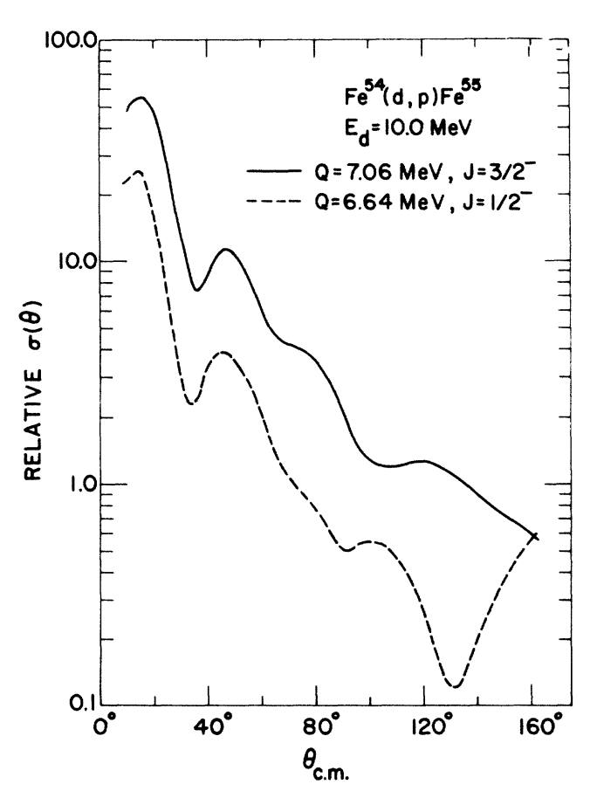
The era of direct reactions – 1960’s
“Lee and Schiffer” studies of spin-dependence in angular distributions
Direct reaction angular distributions are forward peaked, unlike compound nuclear reactions which are ~isotropic in CM. They are characteristic of angular momentum transfer, i.e. L= 1, 2, 3.
John and Linwood discovered that a characteristic “dip” occurred at back angles in (d,p) reactions. The systematics made spin assignments possible. (Phys Rev Letter in 1964.

Slide 5
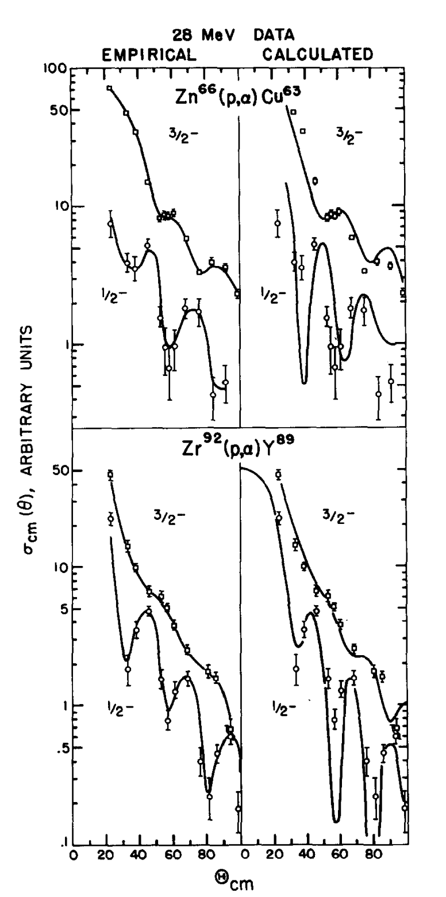
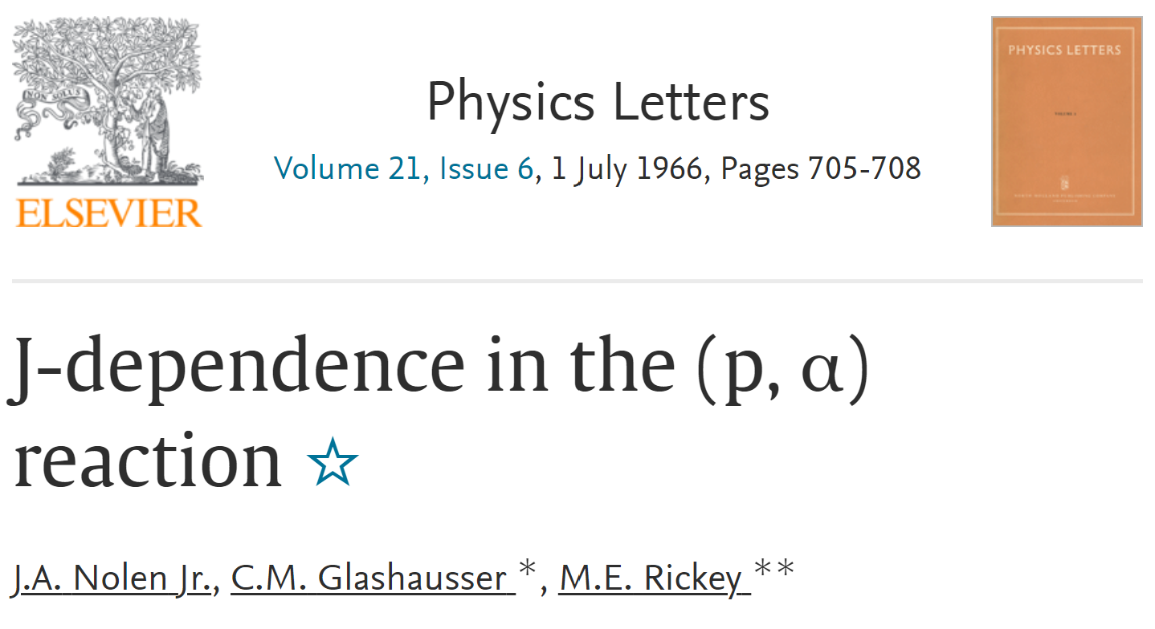
Following John’s lead we looked for j-dependence in (p,⁴He) reactions

Slide 6
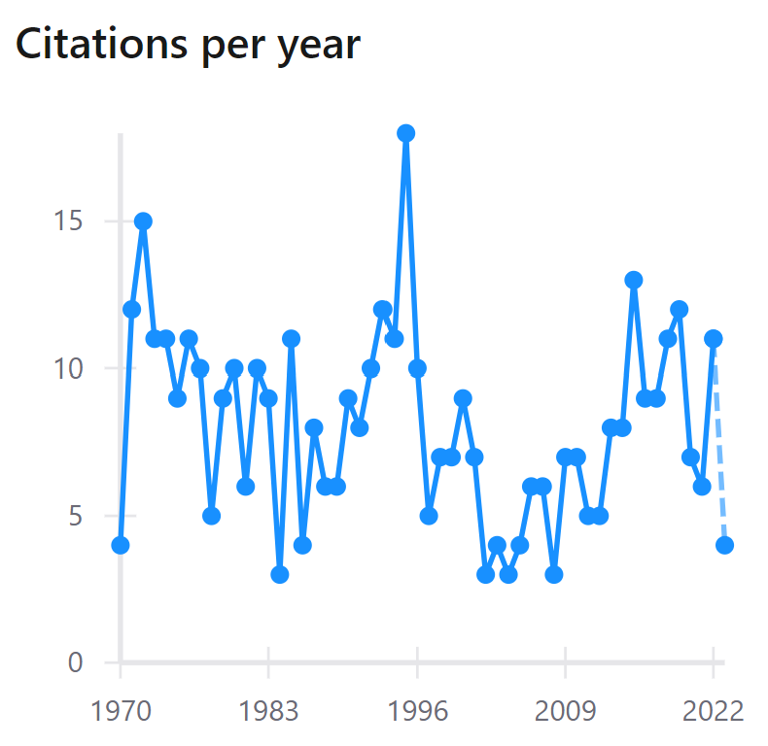
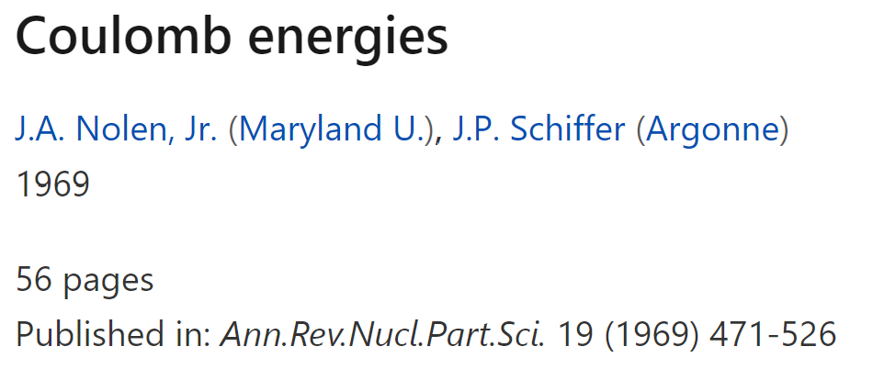
Isospin and isobaric analogue states
March, 1966: First conference on isospin in nuclear physics: led to the emphasis on Coulomb energies – working with John during my post-doc years at Argonne: “Coulomb energy anomaly”
Coulomb energy shift should be a measure of the rms radius of the valence neutron wave function: ~10% discrepancy; implies rms neutron radii are smaller than predicted.

Slide 7
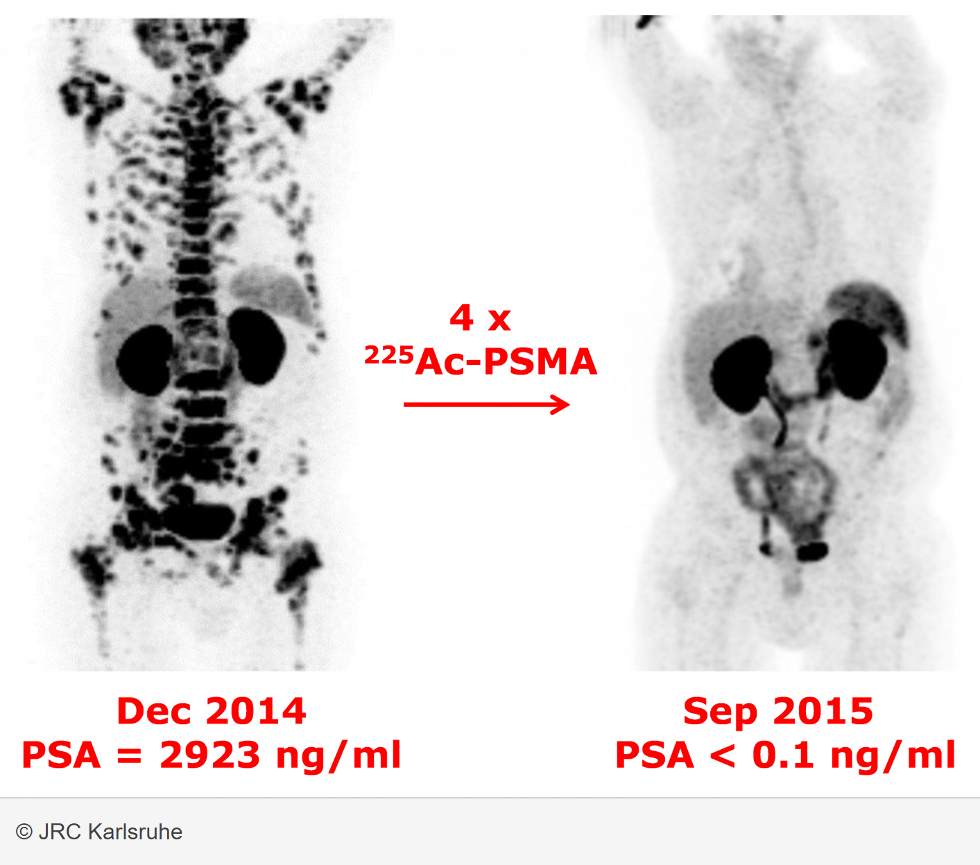
Transition to medical isotopes
Back to Cu-67 but for cancer therapy rather than nuclear structure: 100 gram Zn-68 target rather than 1 mg Zn-68 target
2010 Due to Mo-99 crisis, NNSA funded Argonne R&D Impacts: average people, national security, economic competitiveness, good of the nation
2016 DOE-SC launched an R&D program at LEAF on Cu-67 for cancer detection and treatment
2020 Radioisotopes identified as Strategic Initiative in Argonne’s Annual Lab Plan
CURRENT R2P2 optimizing reliability and quality of Cu-67 R2P2 working on several additional therapeutic isotopes
THIS YEAR DOE-IP participating in Long-Range Plans of Nuclear Physics (DOE-NP and NSF) and Nuclear Data (NNSA and DOE-NP)
FUTURE VISION Updated facilities with expanded capabilities
The study describes the ground breaking results of a first-in-human study of targeted alpha therapy of metastatic castration-resistant prostate cancer in 42 patients using ²²⁵Ac-PSMA617.
Notes:
Beginning with the “Mo-99 crisis” in 2010(?) NNSA sponsored a focused R&D program at Argonne and upgraded the power and energy of the LEAF electron linac
Beginning in 2016(?) SC launched an R&D program at LEAF based on the unique capabilities of the upgraded electron linac to use photonuclear reactions to bring the emerging therapeutic isotope Cu-67 to the radiopharmaceutical end users
It is presently the highest priority of the Argonne R2P2 program to optimize both the reliability and quality of Cu-67 for sale through the SC-IP NIDC
Argonne recognized the potential of R2P2 and made it one of the lab’s strategic initiatives begining 2 years ago as featured in the Annual Lab Plan
Beyond Cu-67 the goals of R2P2 going forward include additional therapeutic isotopes: a beta-emitter (Sc-47), alpha emitters (Ac-225 & At-211), and Auger-electron emitters (e.g. Tb-155 & Pt-191)
Our longer-range goal is the construction of a dedicated dual accelerator facility with greatly expanded capabilities using superconducting electron and light-ion linacs

Slide 8
Argonne’s Radioisotope Research and Production Program (R2P2)
The dominant theme is the development of medical isotopes & related technologies primarily applied to cancer and immune system therapy
Development of production & delivery methods of emerging beta emitters, e.g. ⁶⁷Cu, ⁴⁷Sc
Radio-assisted chemotherapy and advanced applications of Auger emitters
Present
Future
Research
Isotopes for targeted alpha therapy:
e.g. ²²⁵Ac

Slide 9
New GammaSphere Applications in Medical Isotope Cross Section Data Benchmarking
Compound nucleus reactions rather than direct reactions
Amy Renné
Argonne National Laboratory
University of Chicago
Medical Physics Doctoral Candidate
June, 2023

Slide 10
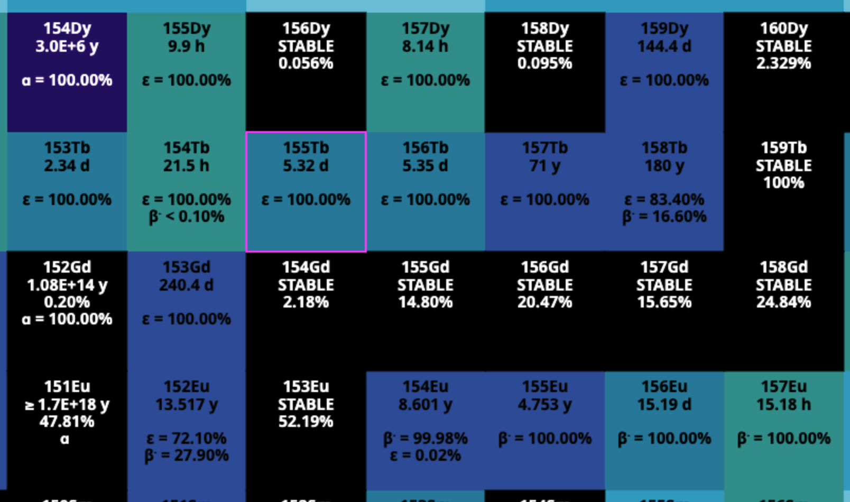
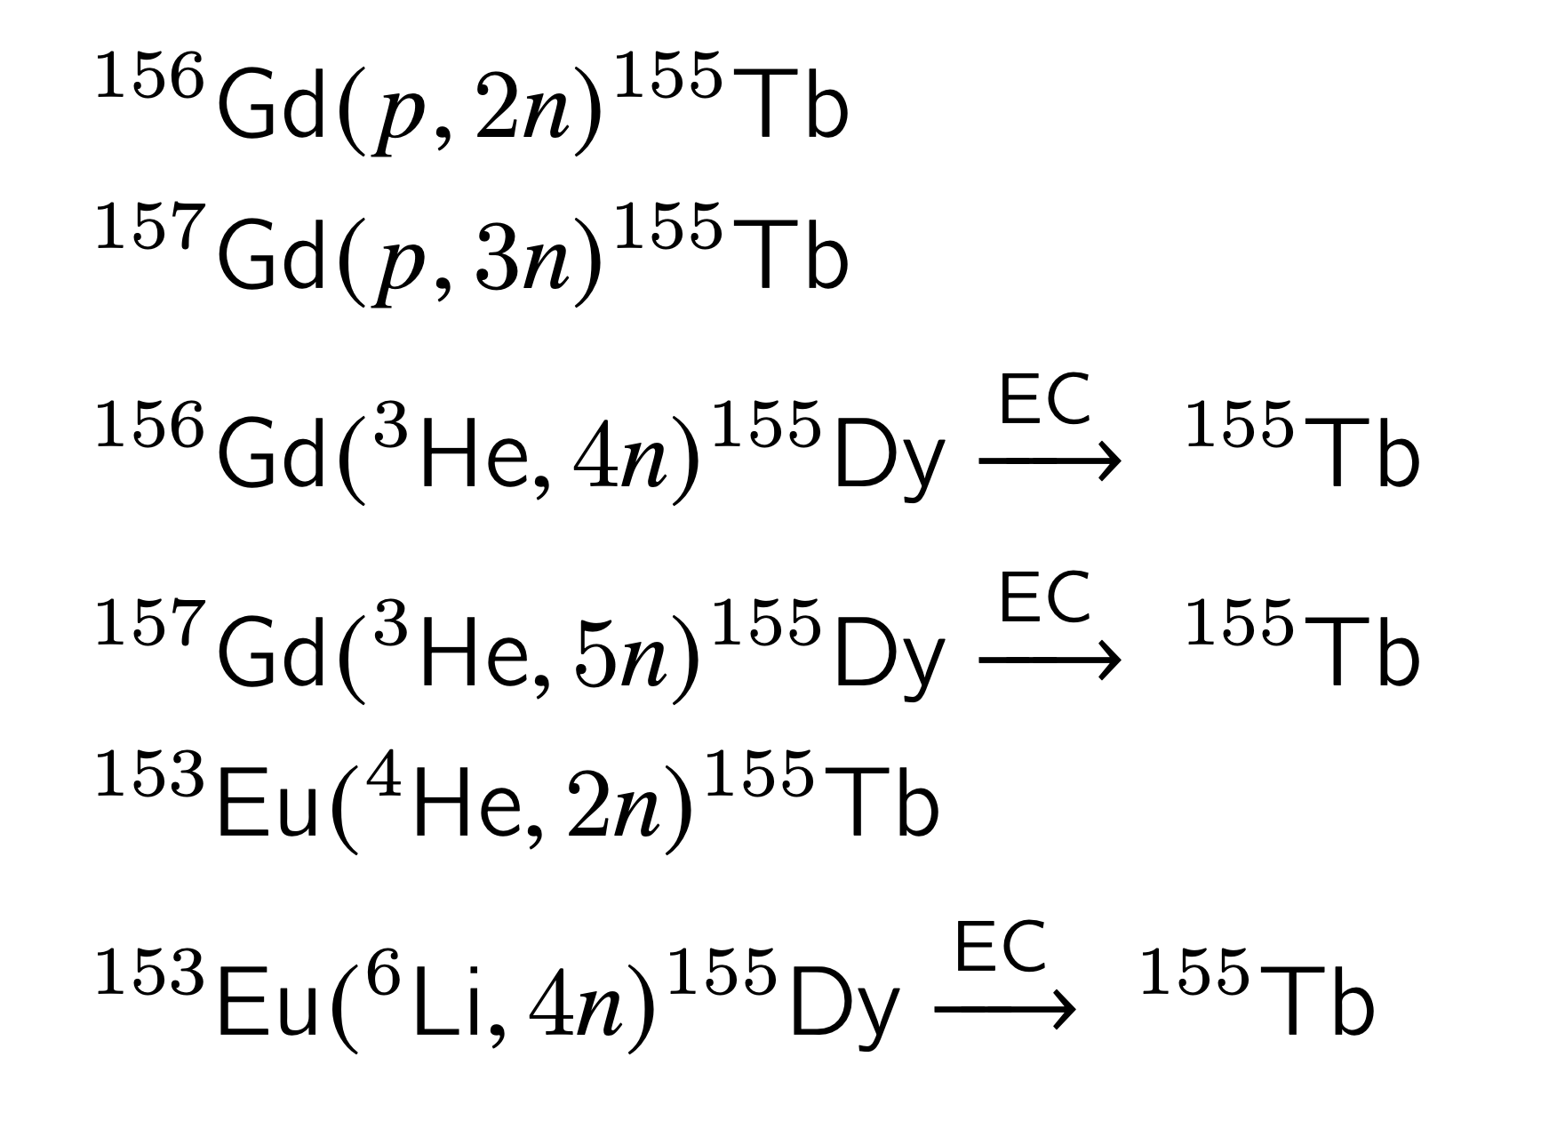
motivation
Case study: Terbium-155
Promising Auger-Meitner therapeutic isotope
Proton Induced
Light-Ion
Induced
Simulated reactions using:
PACE
TALYS
EMPIRE
10

Slide 11
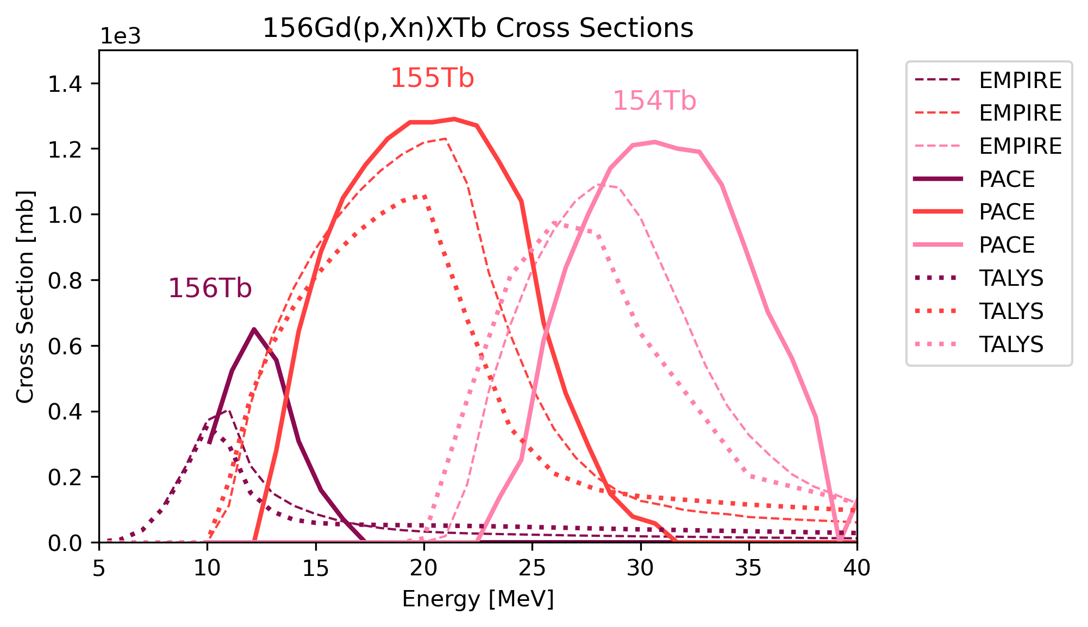
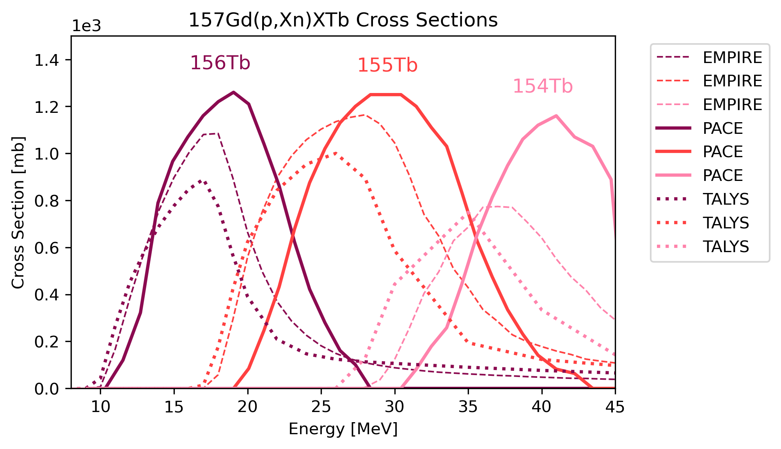
motivation
Proton induced reactions
Qualitative but not quantitative agreement

Slide 12
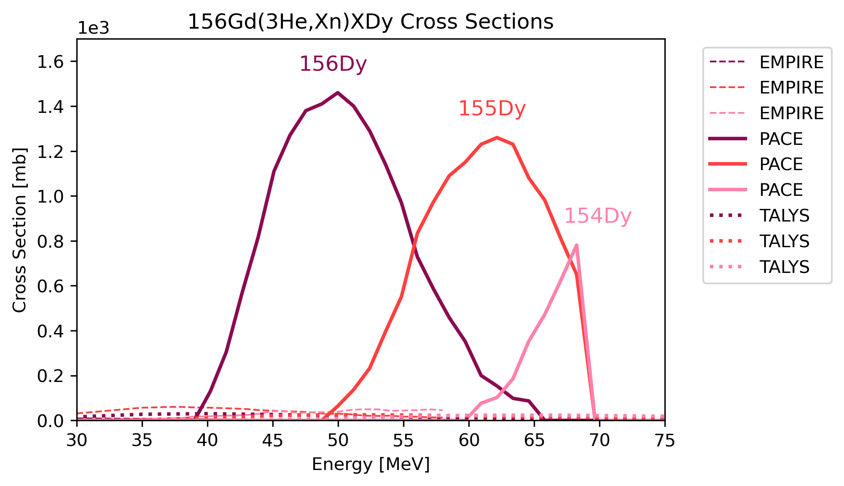
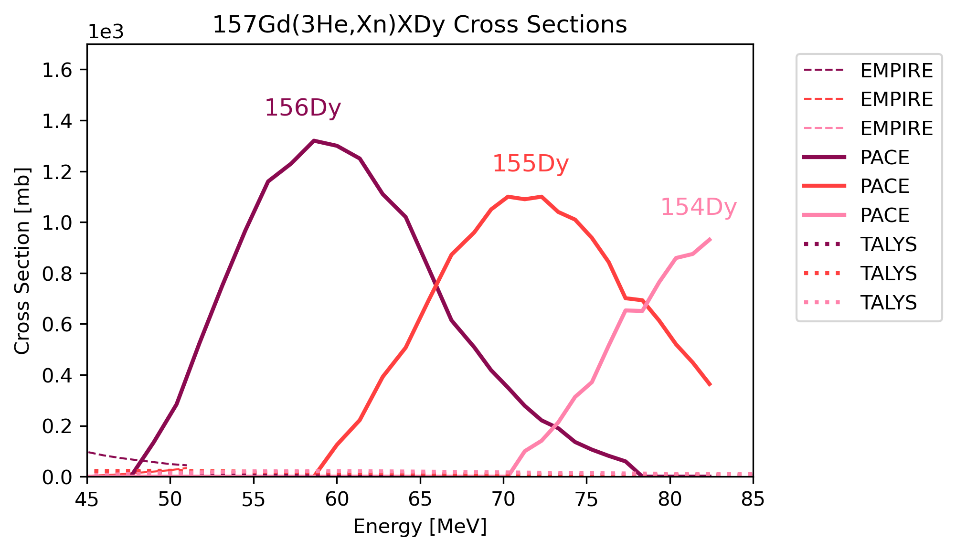
motivation
Light-ion induced reactions: ³He
TALYS/EMPIRE show extremely low predictions
Notes:
Probably need to remove this slide

Slide 13
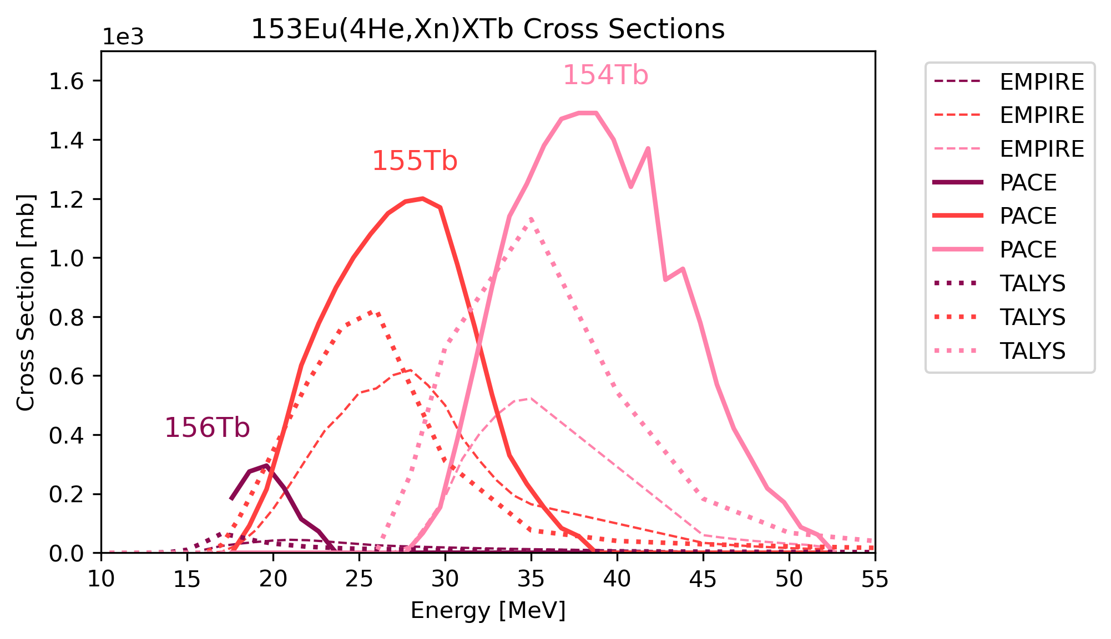
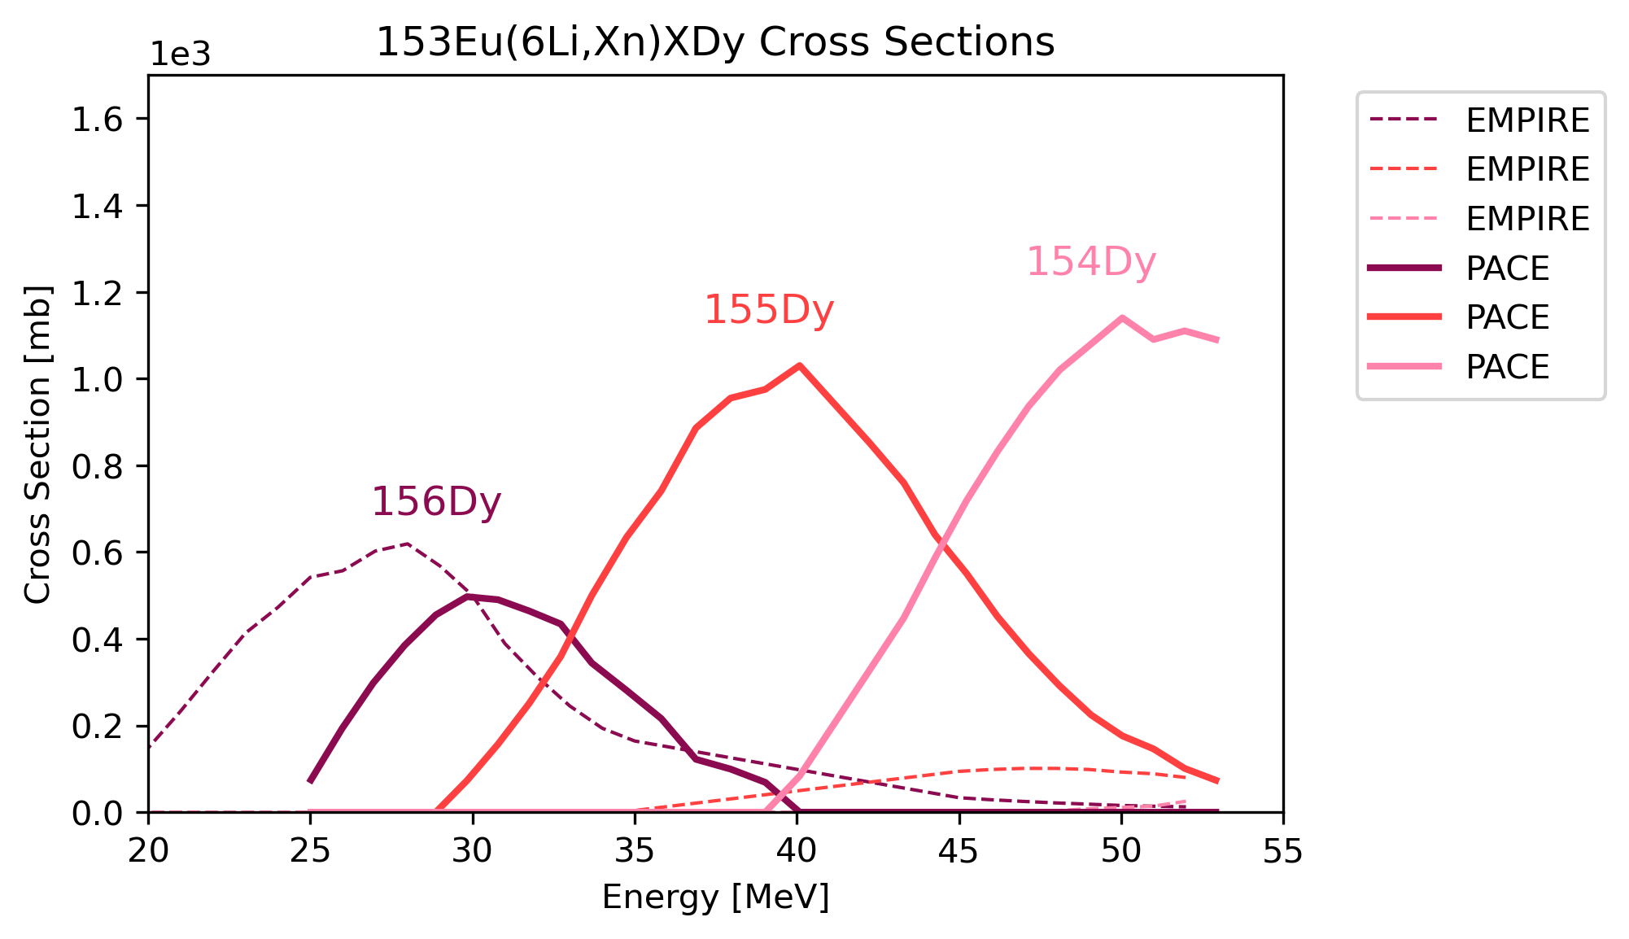
motivation
Light-ion induced reactions: ⁴He, ⁶Li
⁴He $→$Qualitative but not quantitative agreement
⁶Li $→$ TENDL lacks any prediction

Slide 14
motivation
The Bottleneck Problem
Compound-nucleus reaction cross section data is essential to the medical isotope pipeline
We face a lack of experimental cross section data for novel CN reactions
Current cross section measurement methods are time consuming
Simulated cross section predications are unreliable for novel reactions

Slide 15
motivation
The Bottleneck Solution
Compound-nucleus reaction cross section data is essential to the medical isotope pipeline
We face a lack of experimental cross section data for novel CN reactions
Current cross section measurement methods are time consuming
Simulated cross section predications are unreliable for novel reactions
Measure more cross sections of light-ion induced reactions!
Define a more efficient method for cross section measurement!
Use new cross section data to improve nuclear reaction code parameters!

Slide 16
MOtivation
What does GammaSphere Have to do with this??
Use GammaSphere for rapid benchmark cross section data collection of compound-nucleus reactions to improve nuclear reaction model parameters, expedite the isotope production stage, and get new isotopes to the clinic faster

Slide 17
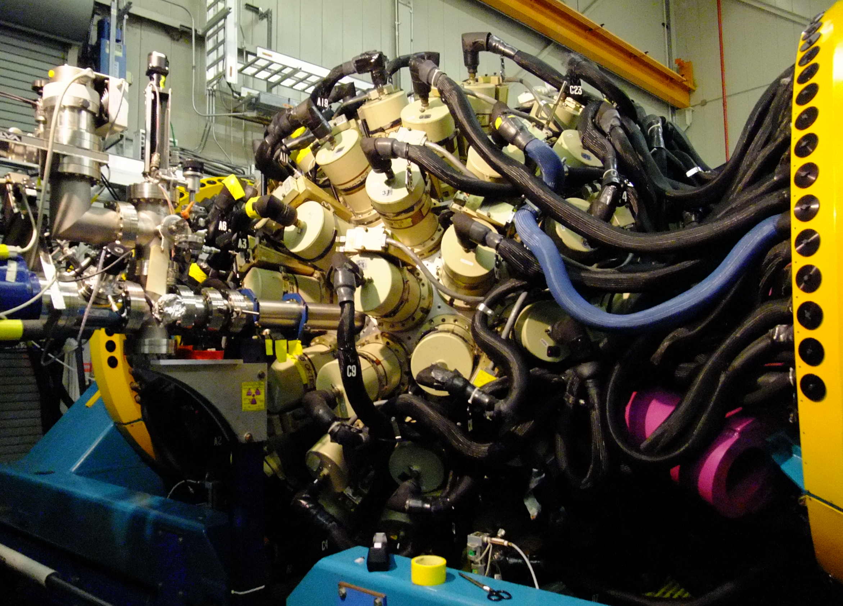
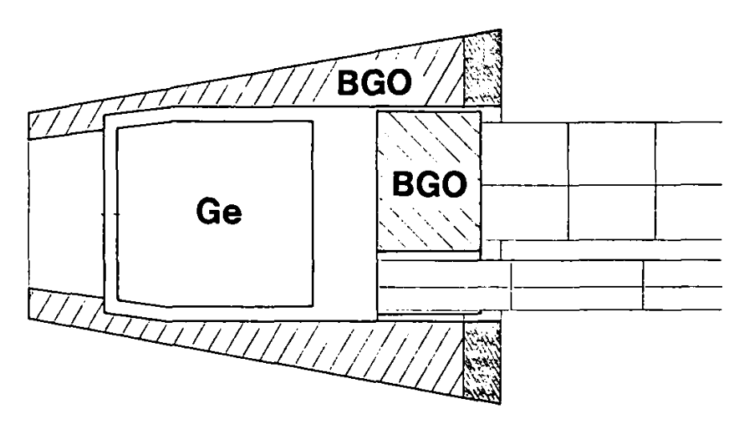
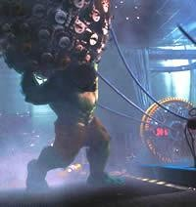
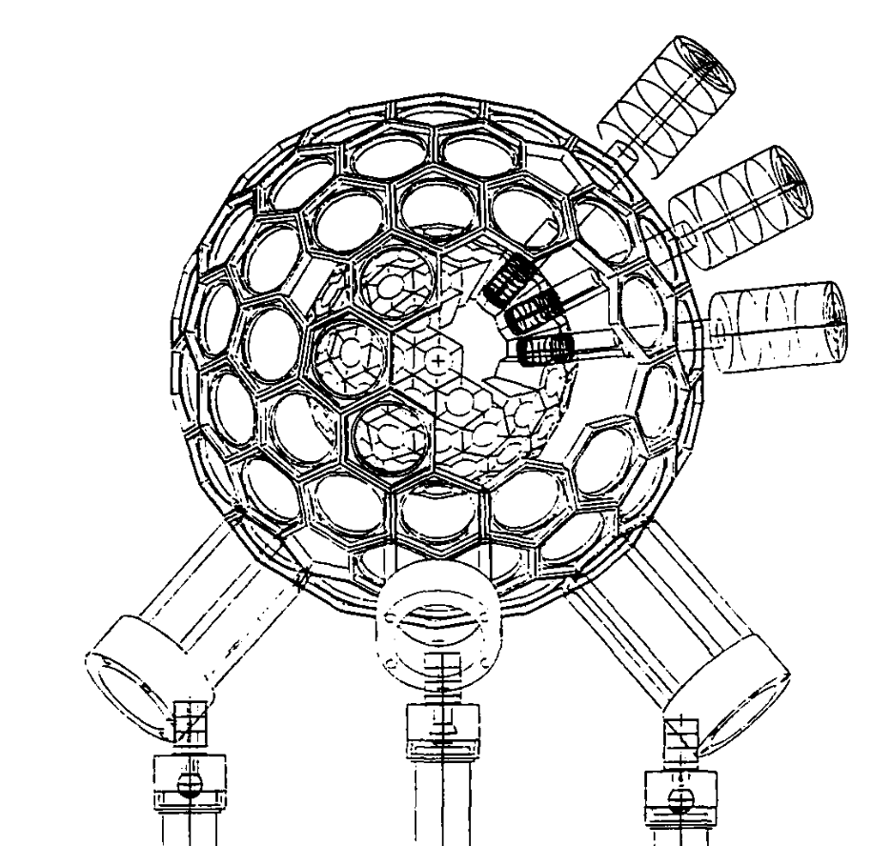
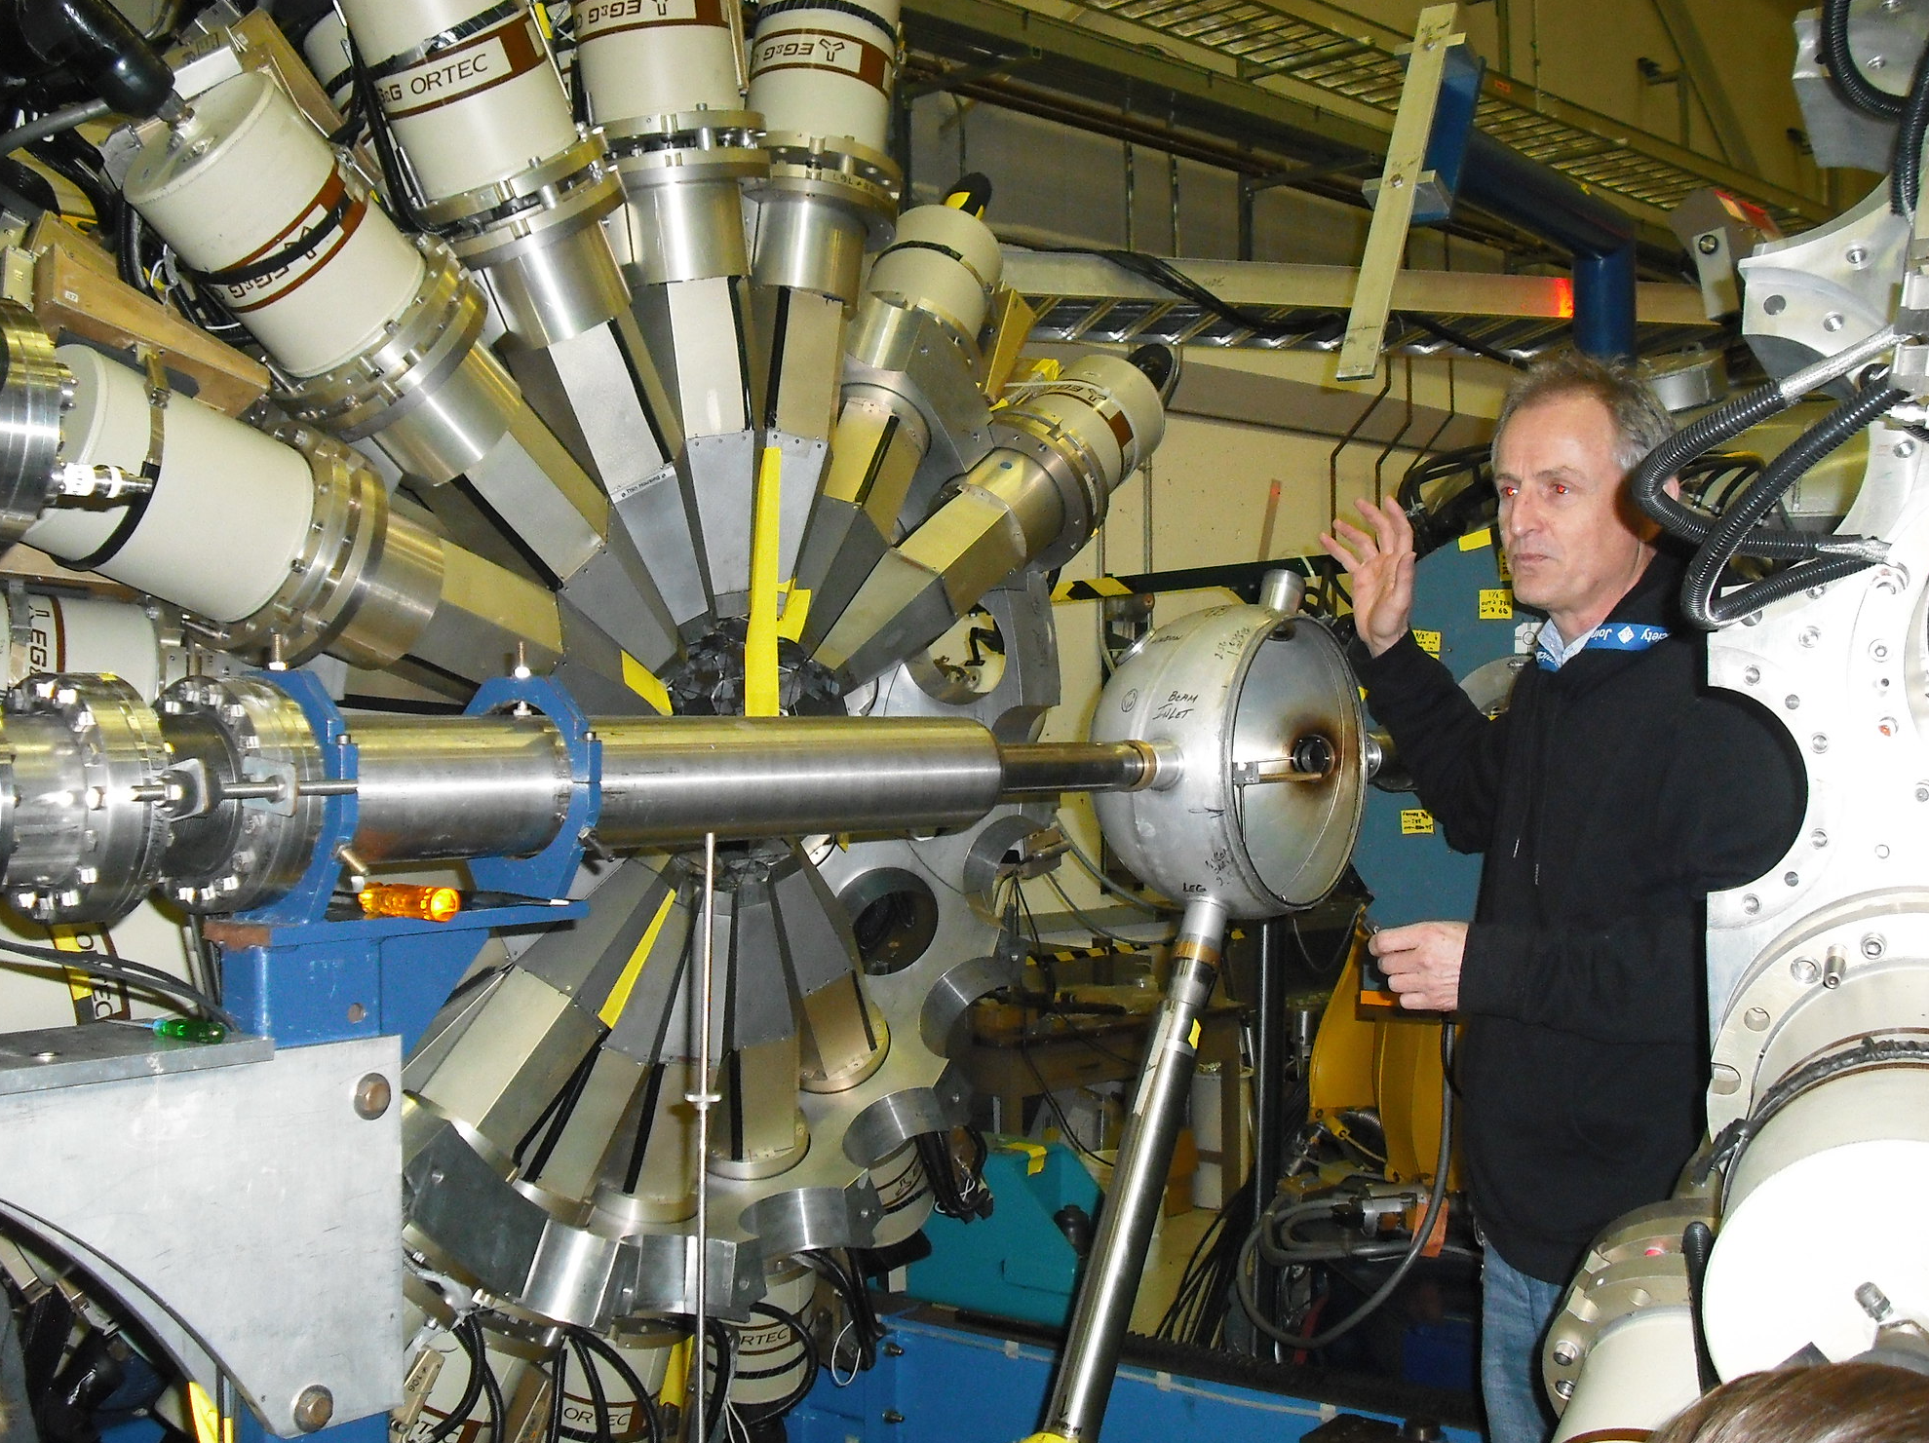
Gammasphere project
What is GammaSphere?
Powerful spectrometer for nuclear structure research
100 HPGe detectors with BGO Compton suppressors $→$ high energy resolution
Icosahedron geometry $→$ high-fold coincidence capability
In process of upgrading analogue electronics to digital
A
Real-time measurement of evaporation residue isotope distributions following light-ion CN reactions
B
Figure 4: Views of GammaSphere: Kim Lister standing near the target chamber with the 2 hemispheres open (lower left) and the full sphere closed (upper right). Sketch of the GammaSphere detector system (B) and a single detector element (A). Bonus image of GammaSphere’s cameo in ‘The Hulk’ (2003).
Notes:
- BGO suppressors: protect the suppressor elements from direct gamma-ray hits, and prevent false rejection from these gamma rays
- Also distinguishes gammas from neutrons to give better gamma multiplicity

Slide 18
Gammasphere project
Objectives
Use GammaSphere to measure beam-on prompt gamma cascades that populate ground states following light-ion induced CN reactions
Reconstruct residue isotope excitation functions from prompt gamma data
Validate method by comparing to beam-off residue isotope decay gammas
Use this new rapid cross section measurement method to improve optical model and level density parameters in nuclear reaction codes
Notes:
much faster than standard staked-foil method

Slide 19
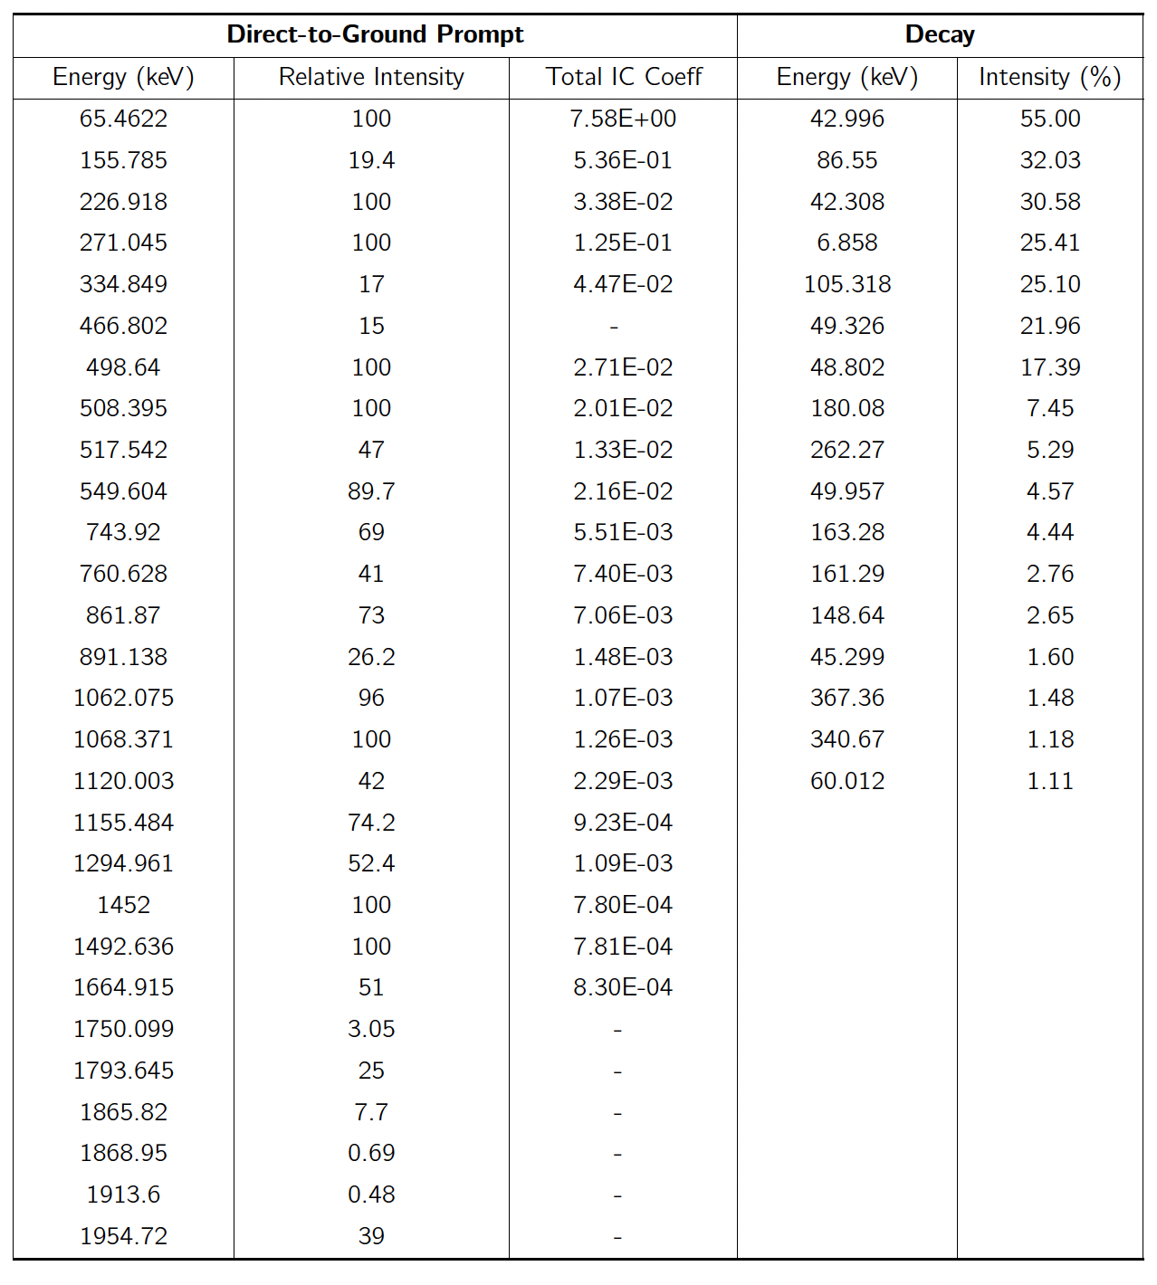
Novel cross section measurement Methodology
Tb-155 energy level and decay gammas

Slide 20
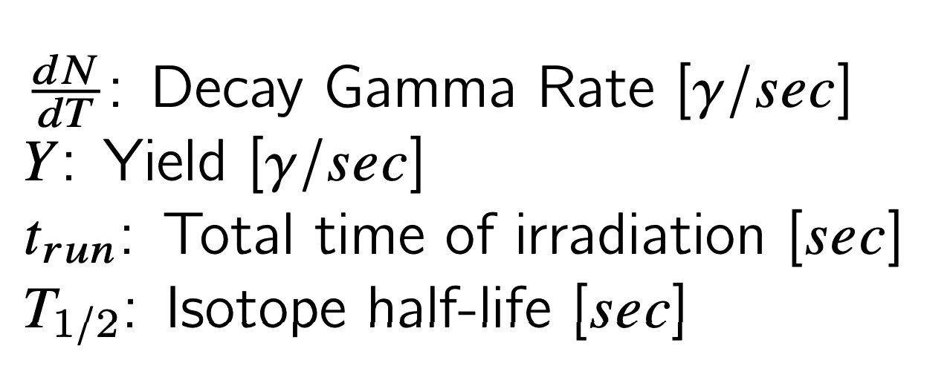
Terbium-155 Case study
Gamma rate calculations
Prompt Gammas Rate:
Decay Gammas Rate:

Slide 21
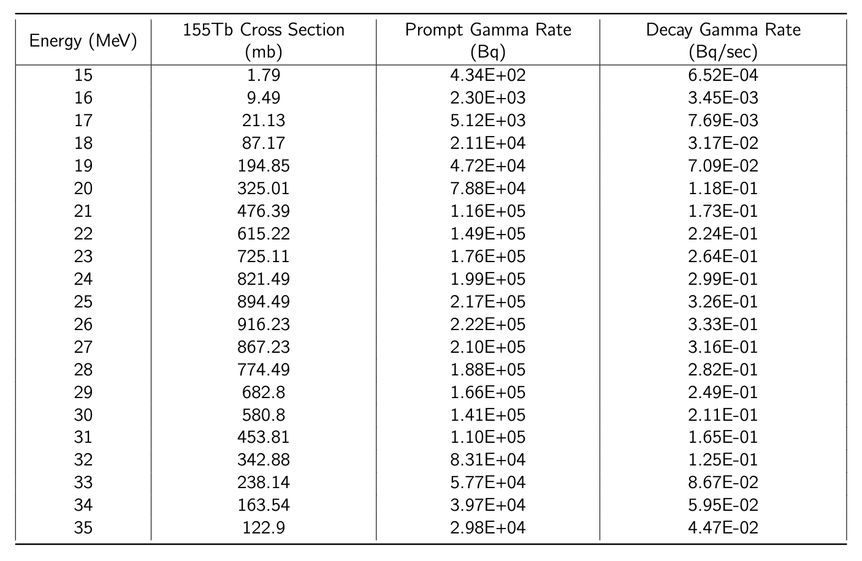
Terbium-155 Case study
Comparison of rates
At peak production energy (26 MeV), a cross section measure- ment using decay gamma analysis would require 185hrs to achieve the same rate achieved in less than a second via prompt gamma methods.

Slide 22
Summary
Why is this Project Relevant?
The compound nucleus fusion-evaporation reaction mechanism with light ion beams has not been fully utilized for the production of medical isotopes
It is very time consuming to optimize all the parameters for production of any given emerging isotope
We propose a new approach to this bottleneck using ATLAS plus GammaSphere
ATLAS can provide any light ion beam in the right energy range for these studies
Recently upgraded GammaSphere is the perfect instrument for these studies
The new approach we intend to validate is to measure the “direct to ground prompt gamma” selected from the high-rate gamma cascades in the compound nucleus.
This is a very fast, new way to measure thin target excitation functions vs the present thin target stack activation method
This new method is especially important in optimizing production of a large number of potentially useful Auger-Meitner electron emitters for cancer therapy
Medical Physicist
Nuclear Physicist
Production
Radiochemist
Biologist
Clinical Studies

