Slide 1
Early Years, Moessbauer Effect,
and Inverse Reactions with RIBs
Walter F. Henning

Slide 2
John was born on November 22, 1930
in Budapest, the Capital of Hungary.
According to John his father, a medical
doctor, was fascinated by physics: as a radiologist he cooled x-ray tubes, used and tested filters, and experimented with x-ray dyes.
John started secondary school (Gymnasium) at the age of 10. The school was known for being good in mathematics and sciences.
John learned later that famous physicists, Eugene Wigner and John von Neumann, had been students there.

Slide 3
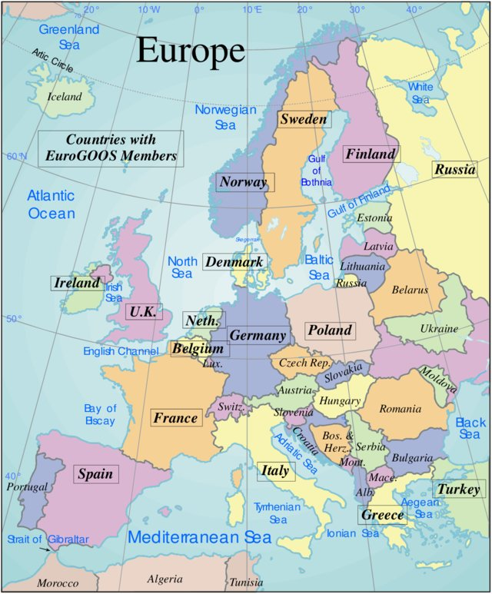
In 1947 John leaves Hungary for New York,
where his father’s brother lives

Slide 4
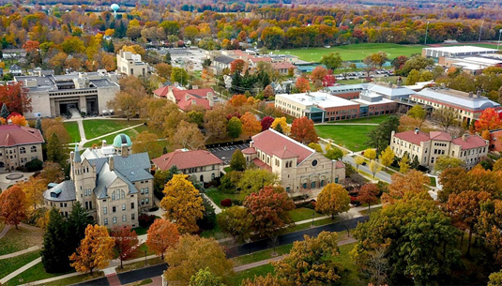
Oberlin College
1948-1951

Slide 5
In 1951 John enters graduate school at Yale, at the age of 20.
A year later John wants to become a theorist.
Asks Gregory Breit for a research assistance ship.
Breit says “no”, because of “only a B+” in Introductory Theoretical Physics.

Slide 6
Ernie Pollard, in charge of the Yale cyclotron contract with A.E.C.
accepts John.
John’s first job: to paint the cyclotron blue.
Needs 2 attempts: First time not a true “Yale blue”.

Slide 7
In his biography John writes: “Running on a cyclotron then, was much different from running on an accelerator today: The person whose experiment it was, had to operate the accelerator, the detectors, and keep the log book. Signing up for 4 days of beam time meant running 24hours, sleep for 12, then run another 24 hours,….
John gets his PhD in 3 years, in 1954.

Slide 8
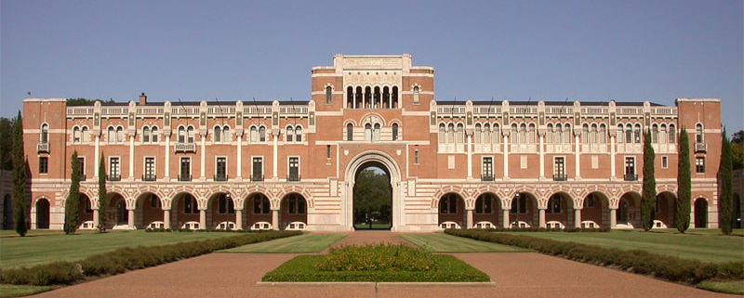
John writes some 50 letters for a job: to universities, companies, labs.
Accepts a postdoc position at Rice University at Houston.
The 6MV Van de Graaff from High Voltage Engineering provides
precise energy and the fact that the energy could easily be varied.
A lot of exciting experiments and results over the next few years.
In John’s own words: “My real training in physics came at Rice”.
Rice University

Slide 9
Rice University

Slide 10
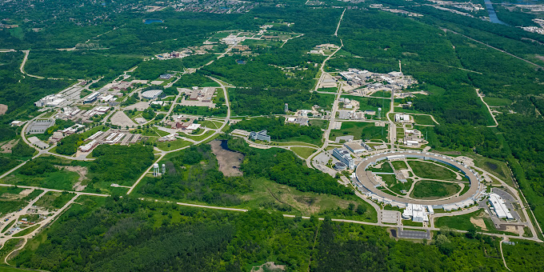
1956 - 2022
Argonne National
Laboratory
Rice University

Slide 11
1956 - 2022
Argonne National
Laboratory
Rice University

Slide 12
1956 - 2022
Argonne National
Laboratory
Rice University

Slide 13
Early Years, Moessbauer Effect,
and Inverse Reactions with RIBs
The 1951-1959 time period with Yale, Rice, and Argonne, which I chose to call the early years, was very exciting. It is impossible to do justice to John’s many publications and scientific achievements during this time. But let me briefly discuss one example.

Slide 14
The example: Proton strength functions. 4 Remarks:
1. A topic which John addressed at 2 sites, Rice University and Argonne.
And, typical for John, always recognizing new opportunities when they open up.
Here the idea to use neutron detectors (long counters) available from developments and research at the Argonne Reactor, for integral thick-target measurements of the (p,n) yields on essentially all elements, and extract from the yields the proton strength (rather than from painstakingly characterizing resonances in inelastic scattering).
The paper (PR Letter) was immediately followed by 2 theoretical publications; one (PR Letter by V. R. Weisskopf) right next to John’s Letter.
3. This was John’s first “Letter” publication.
4. Times have changed

Slide 15
The example: Proton strength functions. 4 Remarks:
1. A topic which John addressed at 2 sites, Rice University and Argonne.
And, typical for John, always recognizing new opportunities when they open up.
Here the idea to use neutron detectors (long counters) available from developments and research at the Argonne Reactor, for integral thick-target measurements of the (p,n) yields on essentially all elements, and extract from the yields the proton strength (rather than from painstakingly characterizing resonances in inelastic scattering).
The paper (PR Letter) was immediately followed by 2 theoretical publications; one (PR Letter by V. R. Weisskopf) right next to John’s Letter.
3. This was John’s first “Letter” publication.
4. Times have changed

Slide 17
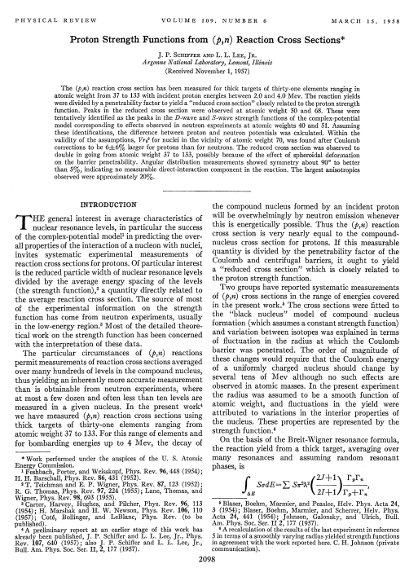
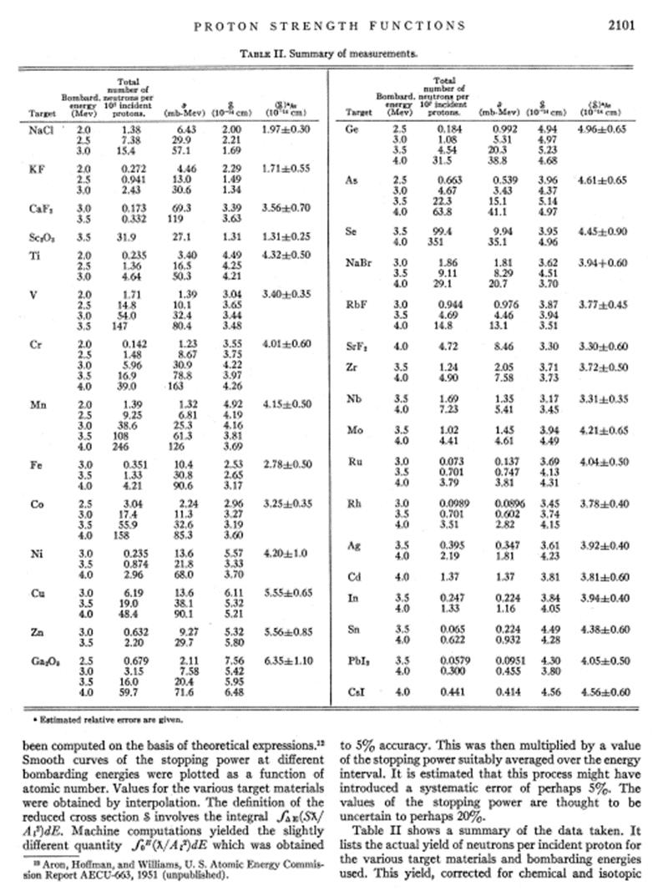

Slide 18
The example: Proton strength functions. 4 Remarks:
1. A topic which John addressed at 2 sites, Rice University and Argonne.
And, typical for John, always recognizing new opportunities when they open up.
Here the idea to use neutron detectors (long counters) available from developments and research at the Argonne Reactor, for integral thick-target measurements of the (p,n) yields on essentially all elements, and extract from the yields the proton strength (rather than from painstakingly characterizing resonances in inelastic scattering).
The paper (PR Letter) was immediately followed by 2 theoretical publications; one (PR Letter by V. R. Weisskopf) right next to John’s Letter.
3. This was John’s first “Letter” publication.
4. Times have changed

Slide 19
The example: Proton strength functions. 4 Remarks:
1. A topic which John addressed at 2 sites, Rice University and Argonne.
And, typical for John, always recognizing new opportunities when they open up.
Here the idea to use neutron detectors (long counters) available from developments and research at the Argonne Reactor, for integral thick-target measurements of the (p,n) yields on essentially all elements, and extract from the yields the proton strength (rather than from painstakingly characterizing resonances in inelastic scattering).
The paper (PR Letter) was immediately followed by 2 theoretical publications; one (PR Letter by V. R. Weisskopf) right next to John’s Letter.
3. This was John’s first “Letter” publication.
4. Times have changed

Slide 20
The example: Proton strength functions. 4 Remarks:
1. A topic which John addressed at 2 sites, Rice University and Argonne.
And, typical for John, always recognizing new opportunities when they open up.
Here the idea to use neutron detectors (long counters) available from developments and research at the Argonne Reactor, for integral thick-target measurements of the (p,n) yields on essentially all elements, and extract from the yields the proton strength (rather than from painstakingly characterizing resonances in inelastic scattering).
The paper (PR Letter) was immediately followed by 2 theoretical publications; one (PR Letter by V. R. Weisskopf) right next to John’s Letter.
3. This was John’s first “Letter” publication.
4. Times have changed

Slide 21
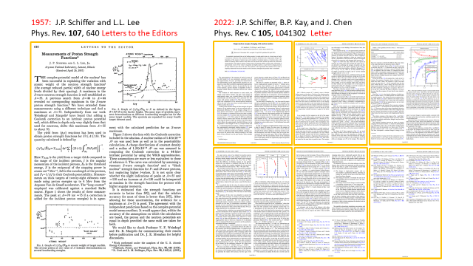

Slide 23
Moving on: In 1957-58 a new concept of accelerators was approaching reality: the tandem Van de Graaff. John was eager to have such an accelerator at Argonne; doubling p and d energies! But other labs were ahead. One was to be completed in 1959 at Harwell; ~ 16 miles South of Oxford. He applied for, and received, a (prestigious) Guggenheim fellow-ship. And planned to start the Harwell stay in the summer of 1959.
But then something happened that caught his interests. Giving a seminar in Los Alamos, somebody mentioned this “strange effect” that was published in an obscure German journal: Resonant gamma-ray absorption when the absorbing material was cooled. The Moessbauer Effect.
Back at Argonne, John checked the journal and read the text in German (with knowledge of the language dating back to his childhood).

Slide 24
Early Years, Moessbauer Effect,
and Inverse Reactions with RIBs

Slide 25
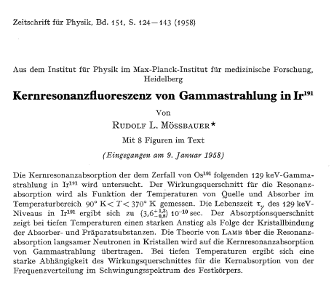

Slide 27
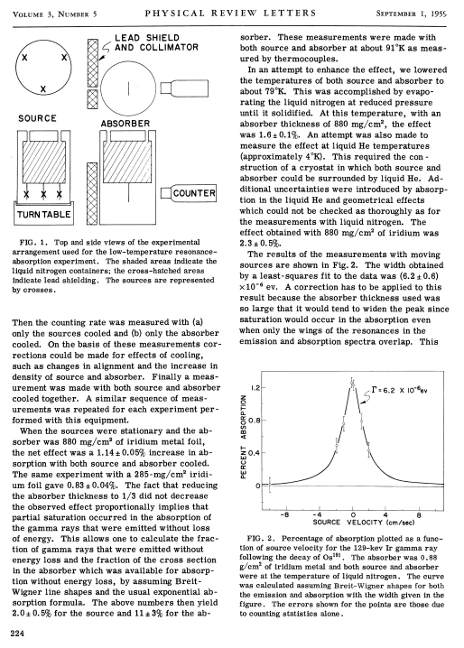
Verifying Moessbauer’s Discovery

Slide 28
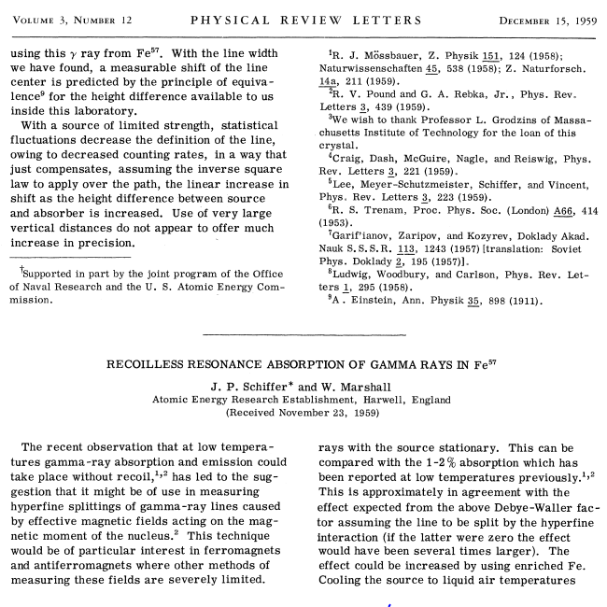
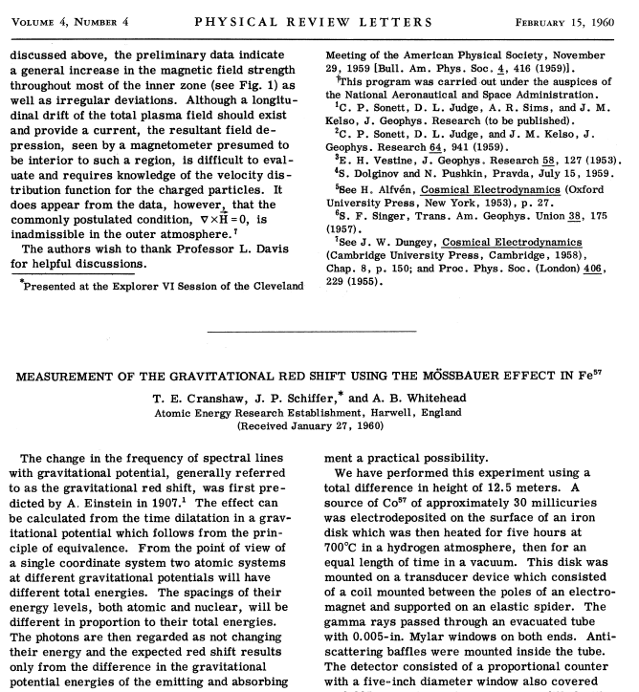

Slide 29
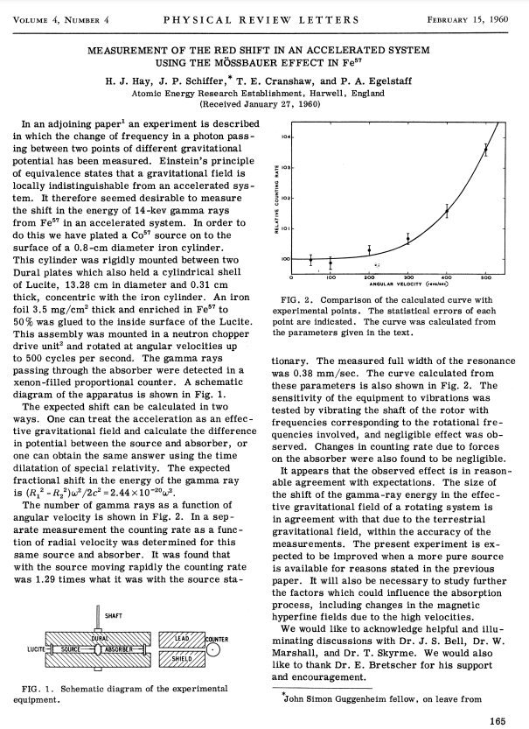

Slide 30
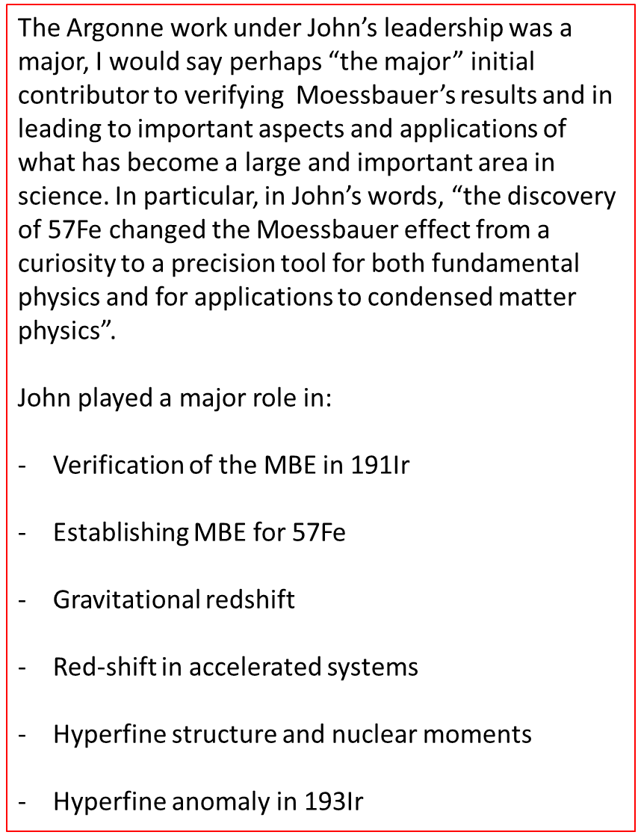

Slide 33
Rice University

Slide 34
1958: John crossing the Atlantic Ocean for the first time in an airplane
Rice University

Slide 35
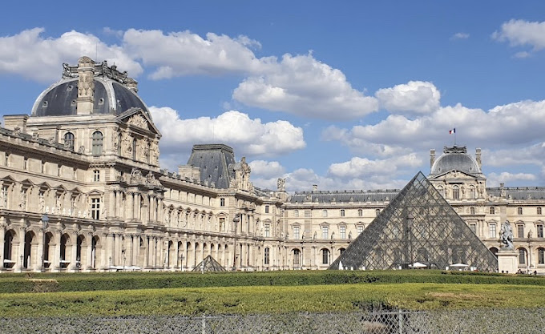
Int. Conf. Paris 1958
Louvre

Slide 36
Copenhagen
Hamburg
Groningen
Utrecht
Int. Conf. Paris 1958
Bonn
Saclay
Louvre

Slide 37
Early Years, Moessbauer Effect,
and Inverse Reactions with RIBs

Slide 39
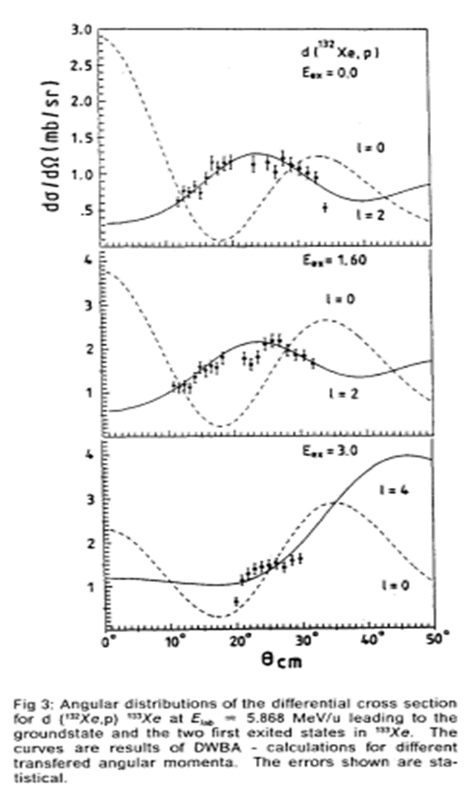

Slide 40
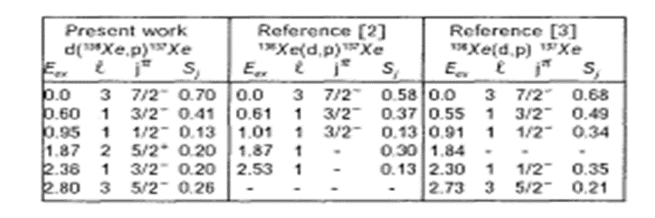

Slide 42
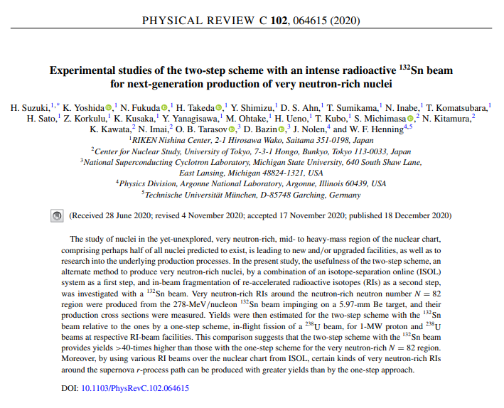

Slide 48
Early Years, Moessbauer Effect,
and Inverse Reactions with RIBs
Thank you, John!

