Slide 1

DVCS and HEMP at COMPASS experiment for GPD studies
Takahiro Iwata
On behalf of COMPASS Collaboration

Slide 2
Outline
Physics motivations
GPD, DVCS, HEMP
COMPASS at CERN
DVCS measurements at COMPASS
2016 data for exclusive photon production
2012-16 data Transverse extension of partons
GPD and HEMP
Transverse-target spin asymmetries in HEMP of ρ and ω
SDMEs in HEMP of ρ and ω
Exclusive π⁰ production cross section
Summary

Slide 3
Physics motivations
We are interested in ;
How are hadrons made up with the partons?
What is the origin of nucleon spin?
How is the nucleon spin made up with parton’s spin and OAMs? (Spin puzzle)
How is the nucleon spin correlated with the motion of partons?
What is the relation between Bjorken-x and the transverse position of the partons?
How does the spin influence the position distribution?
courtesy of Yu-Hsiang Lien, COMPASS (DIS2021)
One of the key concepts to solve the problems is the Generalized Parton Distributions (GPDs)

Slide 4


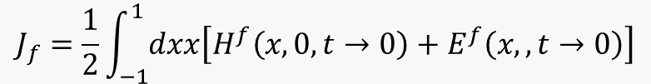
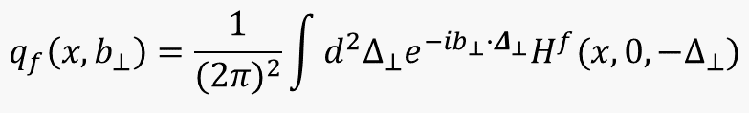
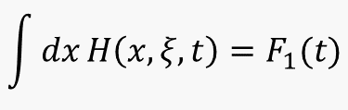
Generalized Parton Distributions
GPD is important concept merging the Form Factor (FF) and the PDF
Form Factor probes transverse position of partons
GPD provides correlation between x and the position of the partons
γ, π, ρ, ω…
forward limit gives PDF,
x+ξ
x-ξ
x
$$H\left(x,0,0\right)=q(x)$$
$$GPDs$$
t
hard exclusive productions
elastic scattering
moments of GPDs are form factors, e.g.
$$\int{dx}H\left(x,ξ,t\right)=F_{1}(t)$$
PDF probes longitudinal parton momentum (x)
impact-parameter representation:
$$q_{f}\left(x,b_{⊥}\right)=\frac{1}{{(2π)}^{2}}\int{d^{2}Δ_{⊥}e^{−ib_{⊥}∙Δ_{⊥}}H^{f}(x,0,−Δ_{⊥})}$$
x
$$J_{f}=\frac{1}{2}\int_{−1}^{1}{dxx\left[H^{f}\left(x,0,t→0\right)+E^{f}\left(x,,t→0\right)\right]}$$
DIS
Ji’s sum rule :

Slide 5

Deeply Virtual Compton Scattering (DVCS)
DVCS: most simple reaction
in order to study GPDs
$$Q_{large}^{2}, x_{Bj}$$
4 (chiral-even) GPDs for each quark flavor in LO and leading twist
No Nucleon spin flip
With Nucleon spin flip

Slide 6


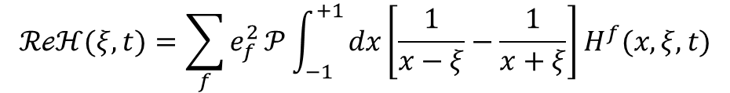

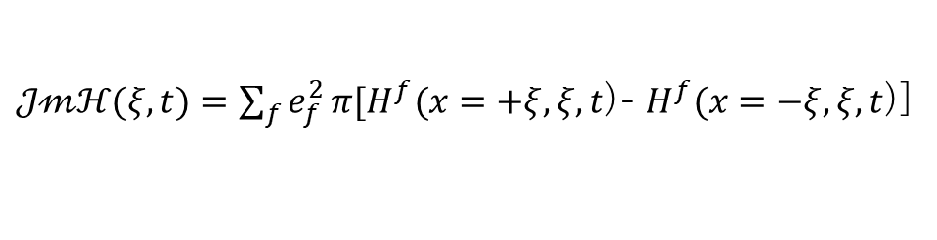

Transverse imaging and Pressure distribution with GPD
In experiments, GPD is accessed through
Compton Form Factor (CFF):
transverse imaging of nucleon
GPD
CFF
convolution hard process $⊗\text{GPD}$
$ℋ(ξ,t$)=$\sum_{f}{e_{f}^{2}}\int_{−1}^{+1}{dx\left\{\frac{1}{ξ−x−iε}−\frac{1}{ξ+x−iε}\right\}H^{f}(x,ξ,t)}$
$$t,ξ fixed$$
with complex integration
Imaginary part
Nature volume 557,
396–399 (2018)
$𝒥𝓂ℋ(ξ,t)=\sum_{f}{e_{f}^{2}}π[H^{f}(x=+ξ,ξ,t$)- $H^{f}(x=−ξ,ξ,t$)]
pressure distribution inside the proton
Real part
$$ℛℯℋ(ξ,t)=\sum_{f}{e_{f}^{2}}𝒫\int_{−1}^{+1}{dx\left[\frac{1}{x−ξ}−\frac{1}{x+ξ}\right]H^{f}(x,ξ,t)}$$
Imaginary part
dispersion relation
$ℛℯℋ$($ξ,t$)= $𝒫\int_{−1}^{+1}{dx}\left\{\frac{1}{ξ−x}−\frac{1}{ξ+x}\right\}ℐ𝓂ℋ(ξ,t) + D(t)$
Notes:
In DVCS the experimentally accessible quantity is a Compton Form Factor
as defined here.
The imaginary part of the CFF provides information on the transverse imaging of the nucleon.
dispersion relations connect the real and the imaginary parts of CFFs:
the residual term D(t) is related to the pressure distribution inside the nucleon.

Slide 7

Hard Exclusive Meson Production （HEMP)
HEMP is alternatively important in GPD studies
take account of the meson structure
HEMP allows to give chiral-odd GPDs
Sensitive to gluon GPDs (same order in α_{s})
Provide different flavor combinations for different mesons
We look at transverse-spin asymmetries,
spin-density matrix elements for exclusive vector meson production, and cross section for exclusive π⁰ production
$H_{T}$, $E_{T}$ , ${\tilde{E}}_{T}$ and ${\overline{E}}_{T}≡2{\tilde{H}}_{T}+E_{T}$
Diehl, Vinnikov, Phys. Lett. B 609 (2005) 286
Distribution Amplitude: structure of the meson

Slide 8
COMPASS

Slide 9
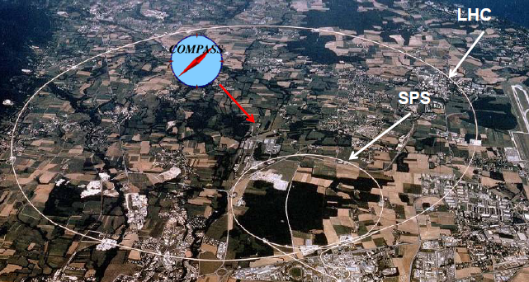
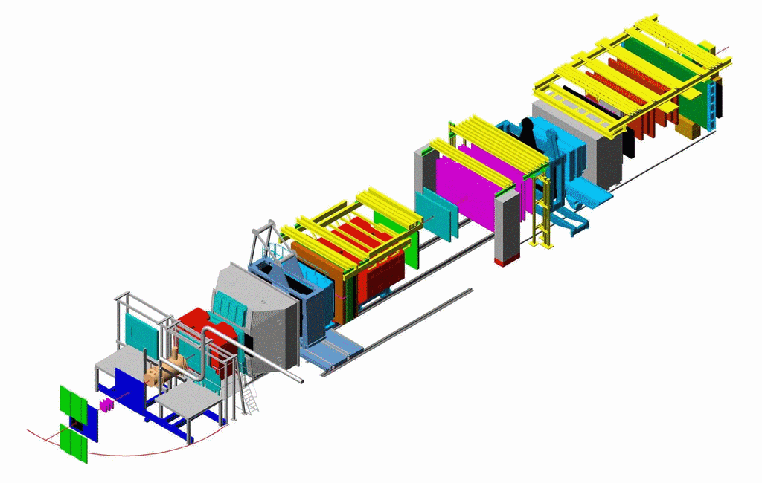
COMPASS at CERN
Straws
SDC
MWPC
W45
data taking: 2002-2022
SciFi
Silicon
Micromegas
GEMs
MuonWall
Polarised
solid Target
(NH₃ for p,
⁶LiD for d)
E/HCAL
E/HCAL
SM1
SM2
P-id by RICH
Pol.
beam
fom SPS
160-200 GeV,
pol. = 80%
MuonWall
RICH
two stage spectrometer
tracking, calorimetry, PID

Slide 10
DVCS

Slide 11
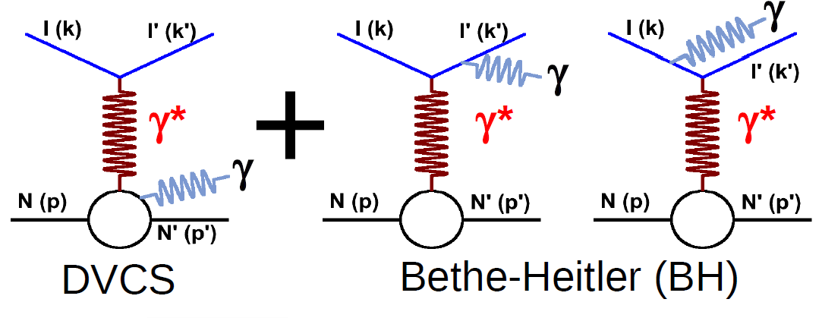
DVCS measurements @ COMPASS
study exclusive photon production for DVCS
Bethe-Heitler(BH) process also gives the same final state
Dedicated data taking for DVCS (and HEMP)
2012 pilot run for 4 weeks
→ Analysis finished and published
Long runs in 2016/17
  2x6 months
  2016+2017 statistics: 9x 2012
  Analysis on going → preliminary results
2016 data will be presented in this talk

Slide 12
Dedicated Setup for DVCS & HEMP @ COMPASS
CAMERA recoil proton detector
surrounding a 2.5m long LH2 target
Ring-B
ECAL0
Shashalyk, 2200 ch.
Ring-B
Ring-A
Ring-A

Slide 13






Access to CFFs @ COMPASS
opposite charge and spin states for μ-beam
spin
charge
160GeV
$$μ^{+←}$$
&
$$μ^{−→}$$
[1] beam charge & spin sum
easier, to be done first
in the COMPASS kinematics
small $x_{B}$ and $\left|t\right|$, for proton target ($F_{1}>F_{2}$)
[2] beam charge & spin difference
$$s_{k}^{i}=sin⁡(kφ_{γγ^{⋆}})$$
BH cancels
$$c_{k}^{i}=cos⁡(kφ_{γγ^{⋆}})$$
challenging, but promising
$i:$ DVCS/BH/I

Slide 14

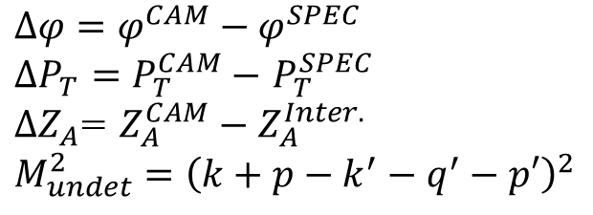



2016 data Exclusive photon production
30% of 2016
information given by the spectrometer and also CAMERA
$$Δφ$$
$$ΔP_{T}$$
CAMERA
spectrometer
$$Δφ=φ^{CAM}−φ^{SPEC}$$
$ΔP_{T}=P_{T}^{CAM}−$ $P_{T}^{SPEC}$
$ΔZ_{A}$= $Z_{A}^{CAM}−Z_{A}^{Inter.}$
$$M_{undet}^{2}={\left(k+p−k^{′}−q^{′}−p′\right)}^{2}$$
$$ΔZ_{A}$$
$$M_{undet}^{2}$$
exclusive events surely selected

Slide 15

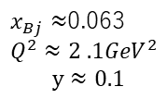

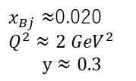
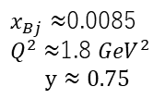
2016 data Charge Spin sum ; $φ$disturibution
30% of 2016 data analyzed
$ν:$ virtual photon energy
$$φ=φ_{γ^{∗}γ}$$
high ν
middle ν
low ν
dominant
BH
DVCS above
the BH contribution
$x_{Bj}≈$0.0085
$Q^{2}$ $≈$1.8 ${GeV}^{2}$
$$y≈0.75$$
$x_{Bj}≈$0.020
$Q^{2}$ $≈2$ ${GeV}^{2}$
$$y≈0.3$$
$x_{Bj}≈$0.063
$Q^{2}$ $≈2$ $.1{GeV}^{2}$
$$y≈0.1$$

Slide 16



2016 data DVCS cross section
cancellation
DVCS cross section evaluated from 10 < $ν$ < 32 GeV data
$$∝$$
cancellation
calculable
(well known)
$$∝$$
$$φ=φ_{γ^{∗}γ}$$
subtract BH contribution and integrating over φ
cross section for virtual photon
flux

Slide 17

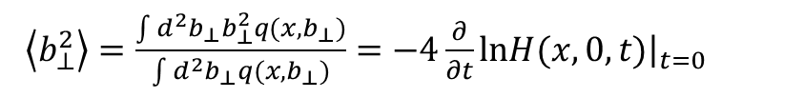
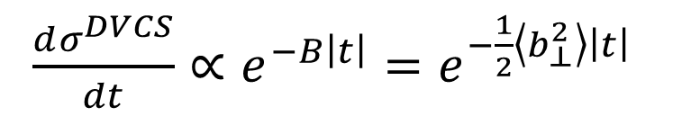

2012-16 data Transverse extension of partons
$$c_{0}^{DVCS}≈{(ℐ𝓂ℋ)}^{2}$$
in COMPASS with $x_{Bj}=0.06$
Impact-parameter representation
$$\text{[}\text{Burkardt}\text{, }\text{Int}\text{. }\text{J}\text{. }\text{Mod}\text{. }\text{Phys}\text{. }\text{A}\text{18 (2003) 173]}$$
COMPASS
2016(30%)
The DVCS cross section allows to probe
the transverse extension of partons
$\frac{dσ^{DVCS}}{dt}∝e^{−B\left|t\right|}=e^{−\frac{1}{2}\left\langle b_{⊥}^{2}\right\rangle \left|t\right|}$
COMPASS
2012 (PLB793)
$\left\langle b_{⊥}^{2}\right\rangle =\frac{\int{{d^{2}b}_{⊥}b_{⊥}^{2}q(x,b_{⊥})}}{\int{d^{2}}b_{⊥}q(x,b_{⊥})}=−4\frac{∂}{∂t}{\left.lnH(x,0,t)\right|}_{t=0}$
Notes:
Three sigma difference between 2012 and 2016 data
same experimental condition with the beam
more advanced analysis with 2016 data
pi0 contamination with different thresholds
binning with 3 variables(t, Q2,nu) or 4 variables (t, phi, Q2,nu)
different binning in t
better description in nu

Slide 18
HE vector meson P

Slide 19
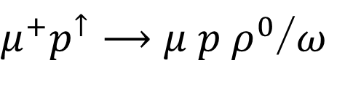



Transverse-target spin asymmetries for HEMP of ρ and ω
$μ^{+}p^{↑}⟶μ p ρ^{0}$/$ω$
160 GeV/c $μ^{+} with P_{μ}≈−80\%$
data collected with the standard setup with the polarized target
promising agreement with
GPD-GK model
with pion pole
$ρ^{0}→π^{+}$ $π^{−}$
$ω→π^{+}$ $π^{−}π^{0}$
asymmetries small,
compatible with 0,
except
indication of GPD H_{T} contribution
EPJ A50 (2014) 146
reasonable agreement with
GPD-GK model
COMPASS NPB 865 (2012)1, PLB731 (2014) 19
COMPASS NPB915 (2017)
2007&10 data for NH3 target
2010 data for NH3 target

Slide 20
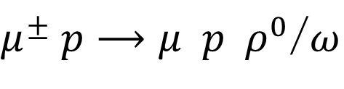

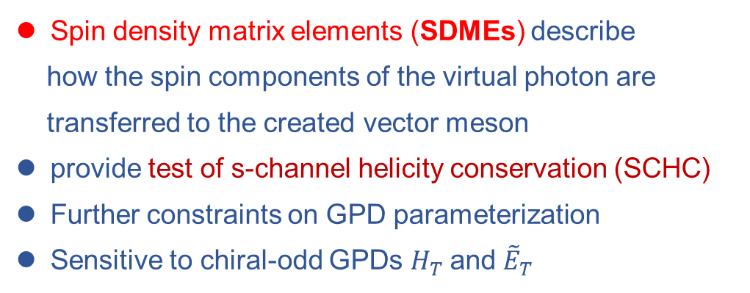

Spin density matrix elements for HEMP of ρ and ω
$μ^{±} p⟶μ p ρ^{0}$/$ω$
160 GeV/c $μ^{±} with P_{μ}≈∓80\%$
Spin density matrix elements (SDMEs) describe
how the spin components of the virtual photon are
transferred to the created vector meson
provide test of s-channel helicity conservation (SCHC)
Further constraints on GPD parameterization
Sensitive to chiral-odd GPDs $H_{T}$and ${\tilde{E}}_{T}$
a set of the SDMEs
$$dσ∝𝒲\left(ℜ,Φ,φ, cosθ\right)$$
23 SDMEs in total:
15 unpolarized and 8 polarized
spin state of the vector meson is given by the decay angular distribution

Slide 21
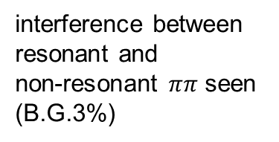

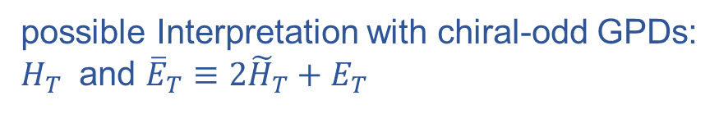
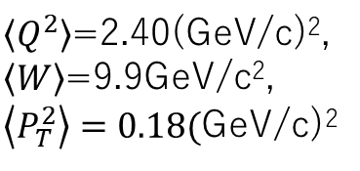

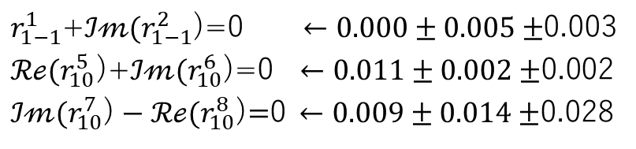
Spin density matrix elements for HEMP of ρ
data collected with the dedicated setup with the H2 target
COMPASS 2012 data
$ρ^{0}→π^{+}$ $π^{−}$
misidentified KK peak < 0.4 GeV
[1]
interference between
resonant and
non-resonant $ππ$ seen
(B.G.3%)
[2]
[3]
If SCHC($λ_{γ}$= $λ_{V}$) holds:
measurements
[1]
$r_{1−1}^{1}$+$ℐ𝓂(r_{1−1}^{2}$)=0$←0.000±0.005±$0.003
${ℛℯ(r}_{10}^{5}$)+$ℐ𝓂(r_{10}^{6}$)=0$←0.011±0.002±$0.002
$ℐ𝓂(r_{10}^{7}\text{)}−{ℛℯ(r}_{10}^{8}$)$=$0$←0.009±0.014±$0.028
[2]
[3]
$\left\langle Q^{2}\right\rangle$=2.40(GeV/c)²,
$\left\langle W\right\rangle$=9.9GeV/c²,
$\left\langle P_{T}^{2}\right\rangle =0.18($GeV/c)²
All other elements should be 0
Clear deviation of SCHC
possible Interpretation with chiral-odd GPDs:
$H_{T}$ and ${\overline{E}}_{T}≡2{\tilde{H}}_{T}+E_{T}$
Goloskokov, Kroll, EPJC 74 (2014) 2725
EPJC (2023) 83 924

Slide 22


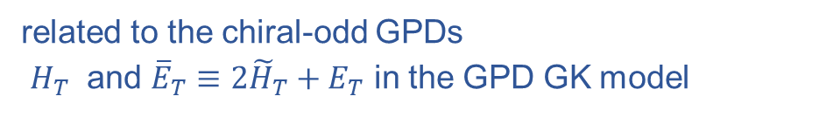
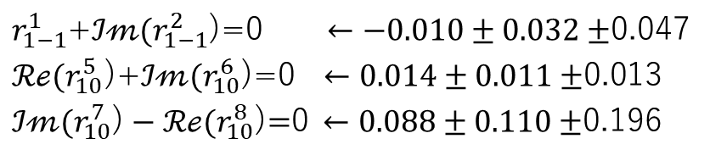

Spin density matrix elements for HEMP of ω
COMPASS 2012 data
$ω→π^{+} π^{−}π^{0}$
$$(Br≈89\%)$$
[1]
[2]
[3]
If SCHC($λ_{γ}$= $λ_{V}$) holds:
measurements
[1]
$r_{1−1}^{1}$+$ℐ𝓂(r_{1−1}^{2}$)=0$←−0.010±0.032±$0.047
${ℛℯ(r}_{10}^{5}$)+$ℐ𝓂(r_{10}^{6}$)=0$←0.014±0.011±$0.013
$ℐ𝓂(r_{10}^{7}\text{)}−{ℛℯ(r}_{10}^{8}$)$=$0$←0.088±0.110±$0.196
[2]
[3]
All other elements should be 0
Clear violation of SCHC
for ${{ℛer}_{10}^{04} \text{and} r}_{00}^{5}$
related to the chiral-odd GPDs
$H_{T}$ and ${\overline{E}}_{T}≡2{\tilde{H}}_{T}+E_{T}$ in the GPD GK model
COMPASS EPJC (2021) 81126

Slide 23
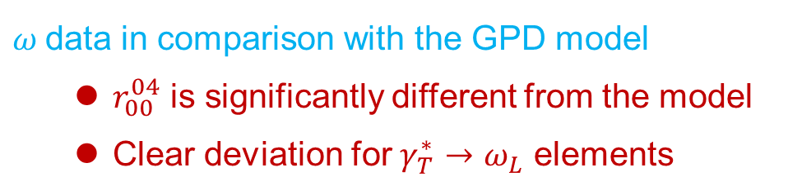
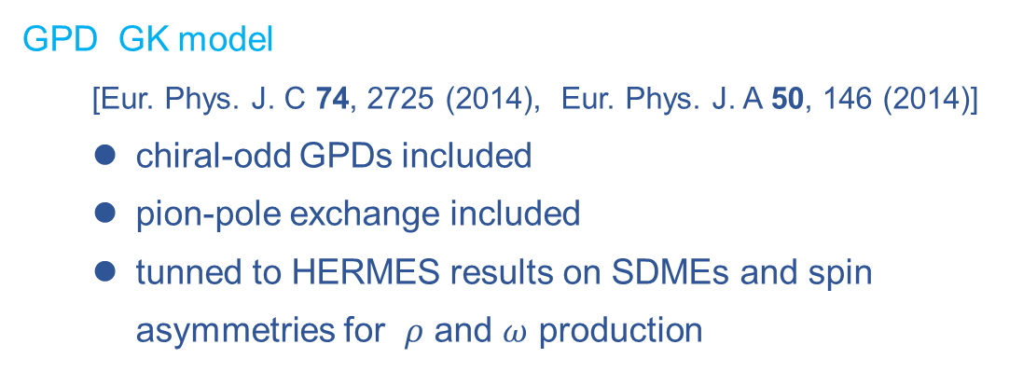
Spin density matrix elements for HEMP of ω
COMPASS 2012 data
$ω$data in comparison with the GPD model
  $r_{00}^{04}$ is significantly different from the model
  Clear deviation for $γ_{T}^{∗}→ω_{L}$ elements
GPD GK model
[Eur. Phys. J. C 74, 2725 (2014), Eur. Phys. J. A 50, 146 (2014)]
  chiral-odd GPDs included
  pion-pole exchange included
  tunned to HERMES results on SDMEs and spin asymmetries for $ρ$ and $ω$ production
COMPASS EPJC (2021) 81126

Slide 24
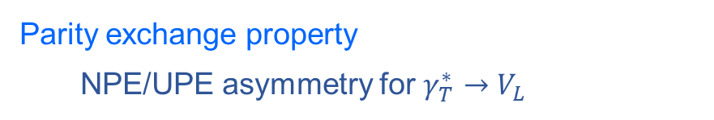
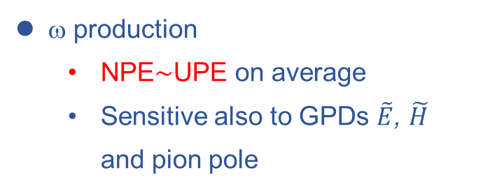
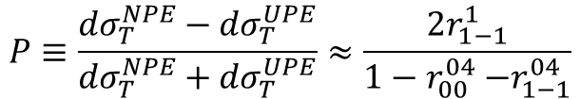
ρ and ω comparison ; Parity exchange property
Parity exchange property
  NPE/UPE asymmetry for $γ_{T}^{∗}→V_{L}$
NPE
$$P≡\frac{{dσ}_{T}^{NPE}−{dσ}_{T}^{UPE}}{{dσ}_{T}^{NPE}+{dσ}_{T}^{UPE}}≈\frac{2r_{1−1}^{1}}{1−r_{00}^{04}{−r}_{1−1}^{04}}$$
ρ
ρ production
  NPE dominant
  Sensitive to GPDs E, H
NPE
ω production
  NPE$\sim$UPE on average
  Sensitive also to GPDs $\tilde{E}$, $\tilde{H}$
  and pion pole
ω
UPE

Slide 25

HE $π^{0}$P

Slide 26

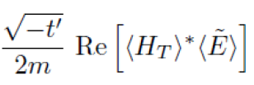






Exclusive π⁰ production cross section
$$μ^{±} p⟶μ p π^{0}$$
160 GeV/c $μ^{±} with P_{μ}≈∓80\%$
COMPASS
<x_{B}>= 0.10
close to 1
2016 data collected with the dedicated setup with the H2 target
$$\frac{dσLT}{dt}$$
$$M_{γγ}$$
$\frac{dσ}{dtdφ}\sim A+Bcos\left(2φ\right)$ + $C$ cos$\left(φ\right)$
SIDIS B.G.
$\left(35±10\right)\%$
$\left\langle GPD\right\rangle$: denotes convolution of GPD and DA of the meson
$$t^{′}=t−t_{min}, where \left|t_{min}\right| is minimum value of \left|t\right|$$
L,T indices indicate polarization of virtual photon. Double index –interference

Slide 27
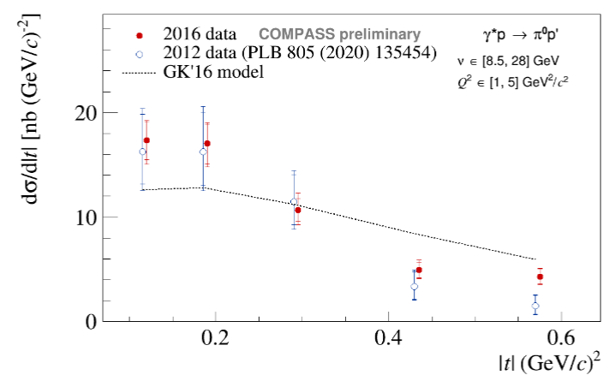
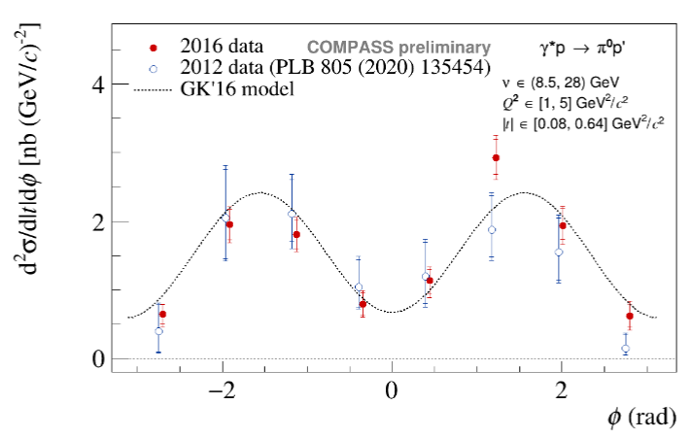
Exclusive π⁰ production cross section
$$μ^{±} p⟶μ p π^{0}$$
160 GeV/c $μ^{±} with P_{μ}≈∓80\%$
NEW Oct 2023
NEW Oct 2023
Models: GK Kroll Goloskokov EPJC47 (2011) Also GGL: Golstein Gonzalez Liuti PRD91 (2015)

Slide 28
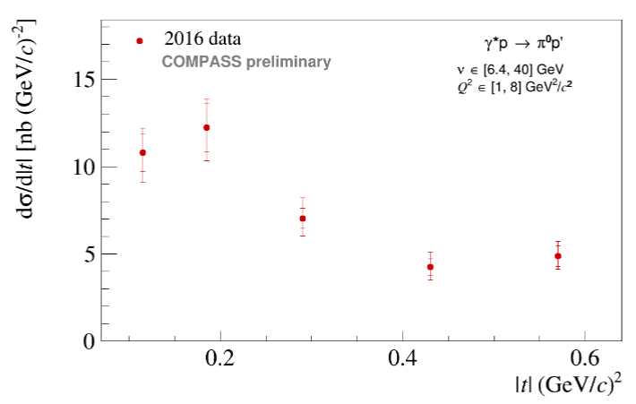
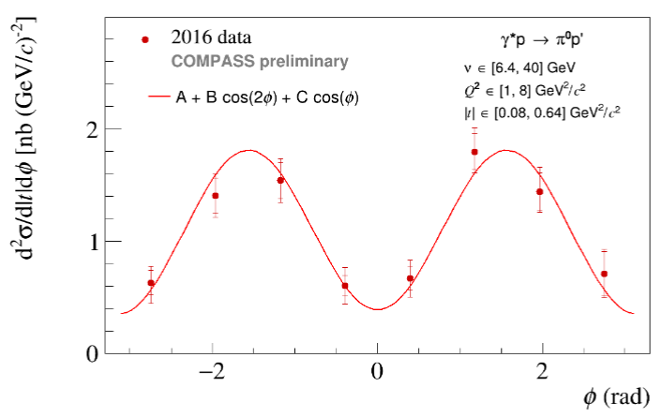


Exclusive π⁰ production cross section
ECAL0 (2016/17) to enlarge the kinematic domain
2016 data in larger $ν$ and Q² domain
NEW Oct 2023
In a larger ($ν$, Q²) domain
NEW Oct 2023
NEW Oct 2023
NEW Oct 2023

Slide 29

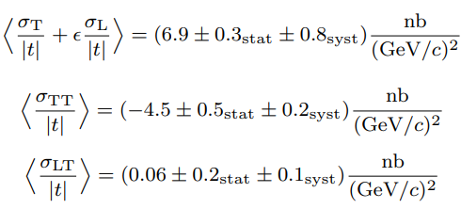
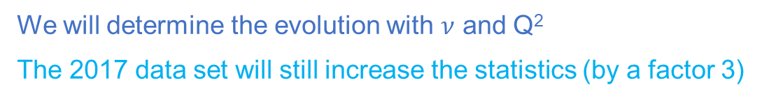

Exclusive π⁰ production cross section
$$μ^{±} p⟶μ p π^{0}$$
@COMPASS <x_{B}>= 0.13
160 GeV/c $μ^{±} with P_{μ}≈∓80\%$
from the fit
negative
→ role of ${\overline{E}}_{T}$
rather small
$$\frac{dσLT}{dt}$$
We will determine the evolution with $ν$ and Q²
The 2017 data set will still increase the statistics (by a factor 3)
$\left\langle GPD\right\rangle$: denotes convolution of GPD and DA of the meson
$$t^{′}=t−t_{min}, where \left|t_{min}\right| is minimum value of \left|t\right|$$
L,T indices indicate polarization of virtual photon. Double index –interference

Slide 30
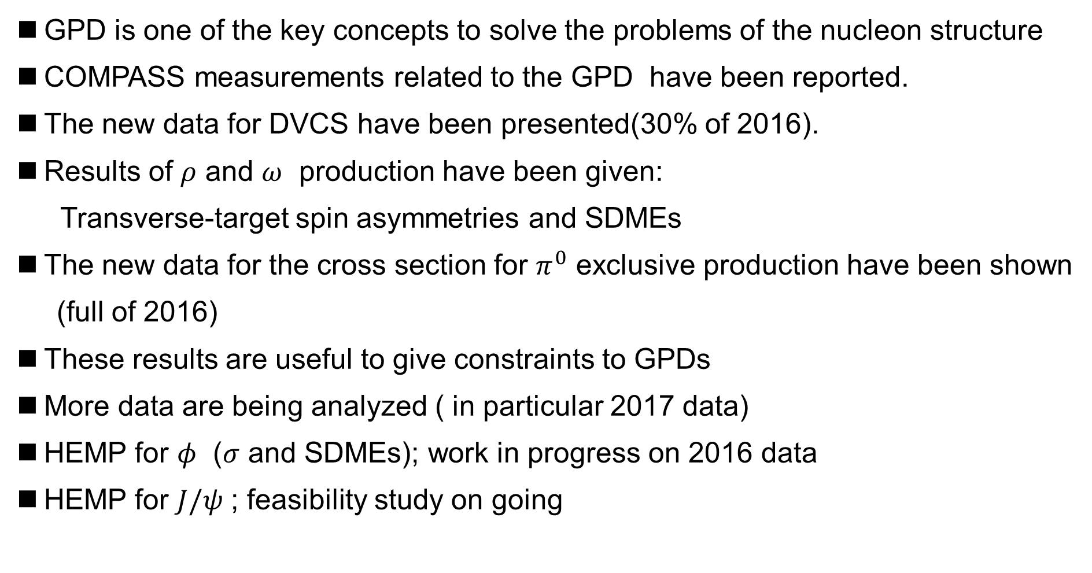
Summary and outlook
GPD is one of the key concepts to solve the problems of the nucleon structure
COMPASS measurements related to the GPD have been reported.
The new data for DVCS have been presented(30% of 2016).
Results of $ρ$ and $ω$ production have been given:
  Transverse-target spin asymmetries and SDMEs
The new data for the cross section for $π^{0}$ exclusive production have been shown
(full of 2016)
These results are useful to give constraints to GPDs
More data are being analyzed ( in particular 2017 data)
HEMP for $φ$ ($σ$ and SDMEs); work in progress on 2016 data
HEMP for $J/ψ$ ; feasibility study on going

Slide 31


Slide 32
Background for excl.-ρ production
SDME
Target spin asymmetry
SIDIS B.G. 22%
(from LEPTO)
SIDIS B.G. 17%
(from LEPTO)
COMPASS PLB731 (2014) 19
COMPASS arXiv:2210.16932v1 acc. EPJC
angular distribution corrected by SIDIS MC
angular distribution corrected by SIDIS MC

Slide 33
Background for excl.-ω production
SDME
Target spin asymmetry
diffractive B.G. 14%
(from HEPGEN)
SIDIS B.G.
(from LEPTO)
SIDIS B.G. 28%
(from LEPTO)
COMPASS EPJC (2021) 81126
angular distribution corrected by MC
angular distribution corrected by MC

Slide 34
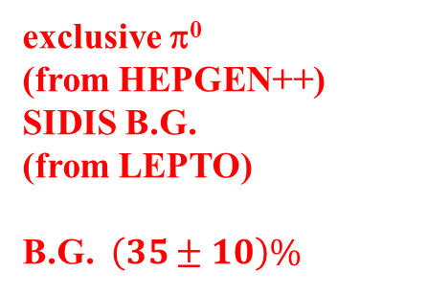
Background for excl.-π⁰ production
exclusive π⁰
(from HEPGEN++)
SIDIS B.G.
(from LEPTO)
B.G. $\left(35±10\right)\%$

Slide 35
Summary table for GPDs

