Slide 1

QCD-Vacuum, hQCD and G-FFs
I. Zahed
Argonne 24’

Slide 2
Outline
Vacuum : Glue/String
2-GFF : N,D,He4
J-GFF : pp,ppbar
Photo : Jpsi,etac

Slide 3
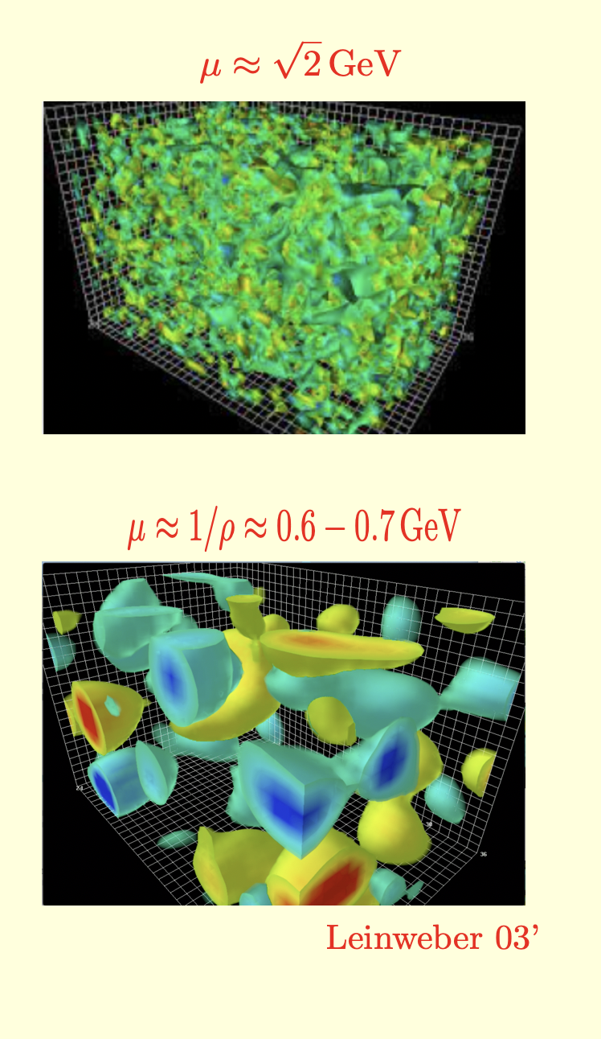
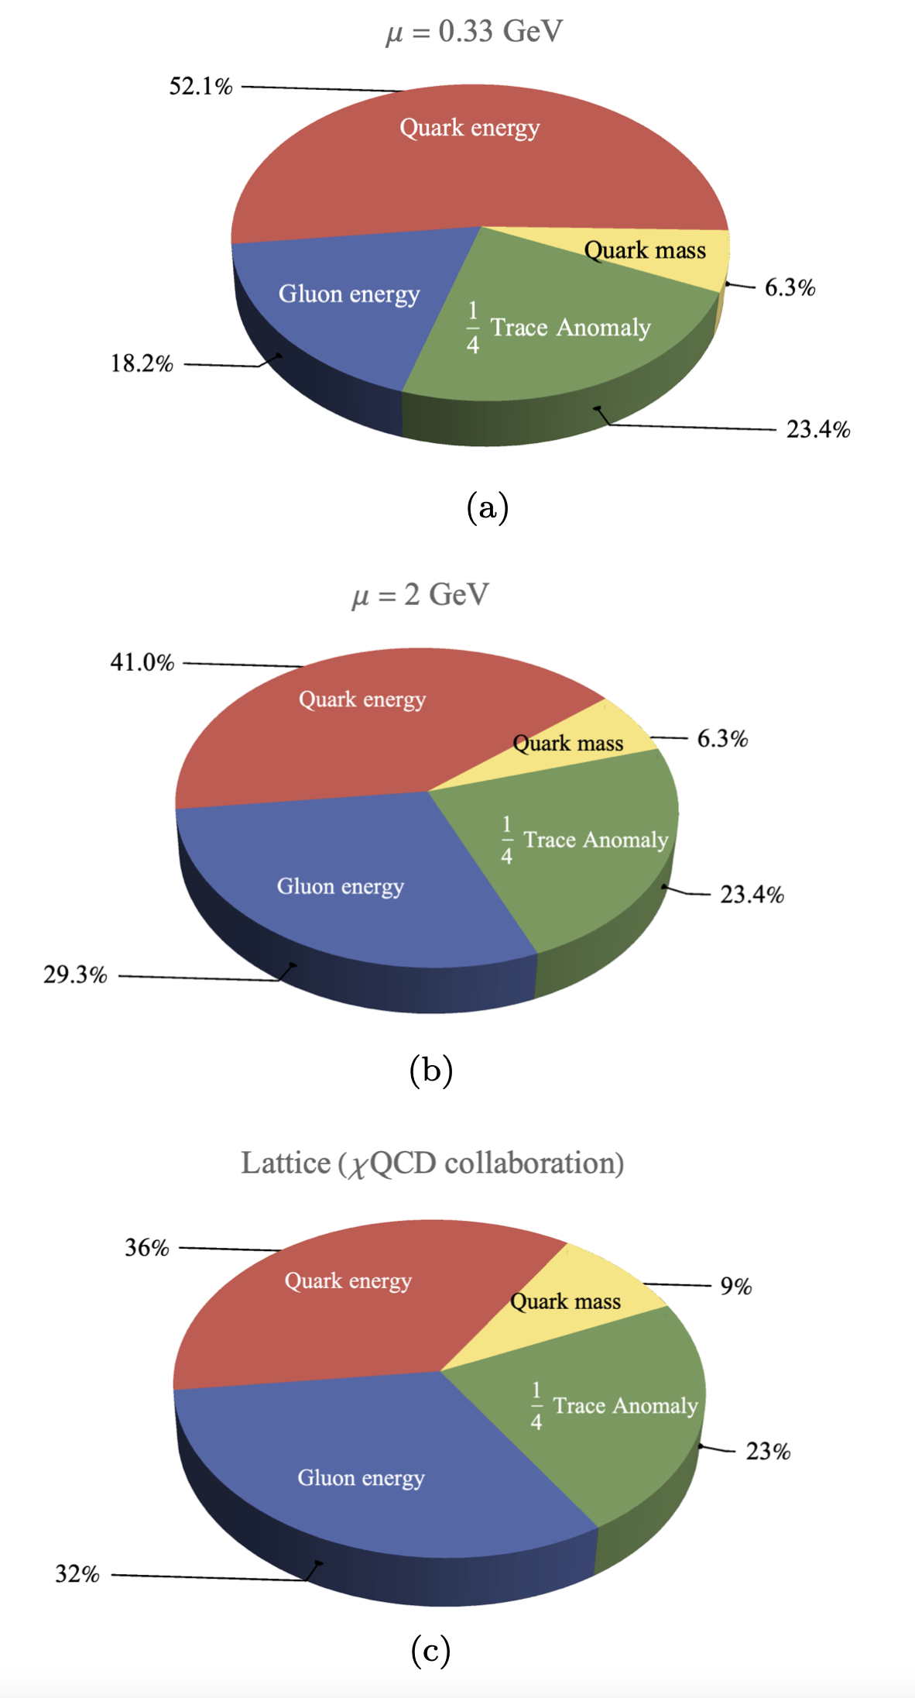
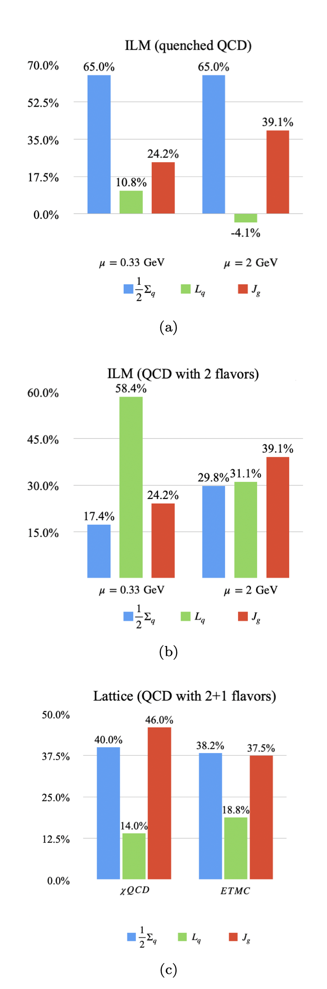
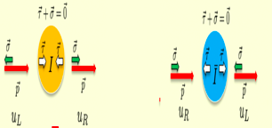
4D topological vacuum: ILM
mass and spin
Ji mass SR
Ji spin SR
Liu-Shuryak-Zahed 23’

Slide 4
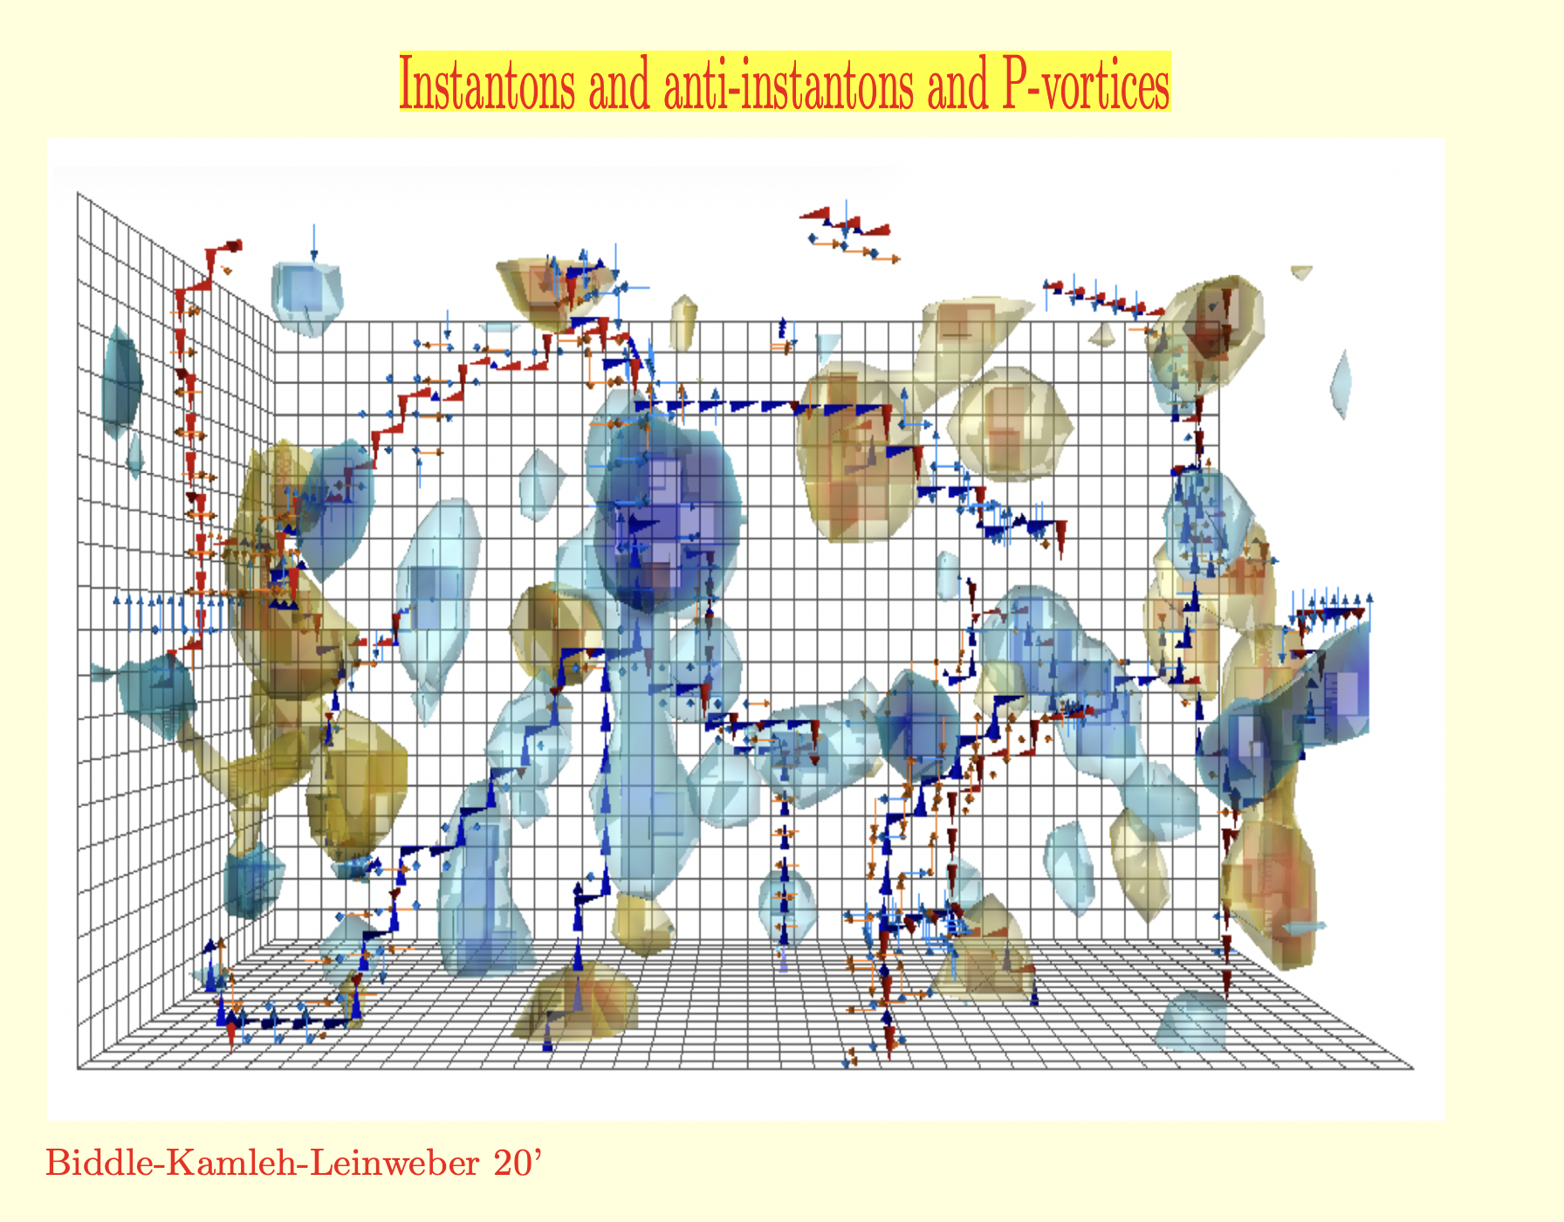
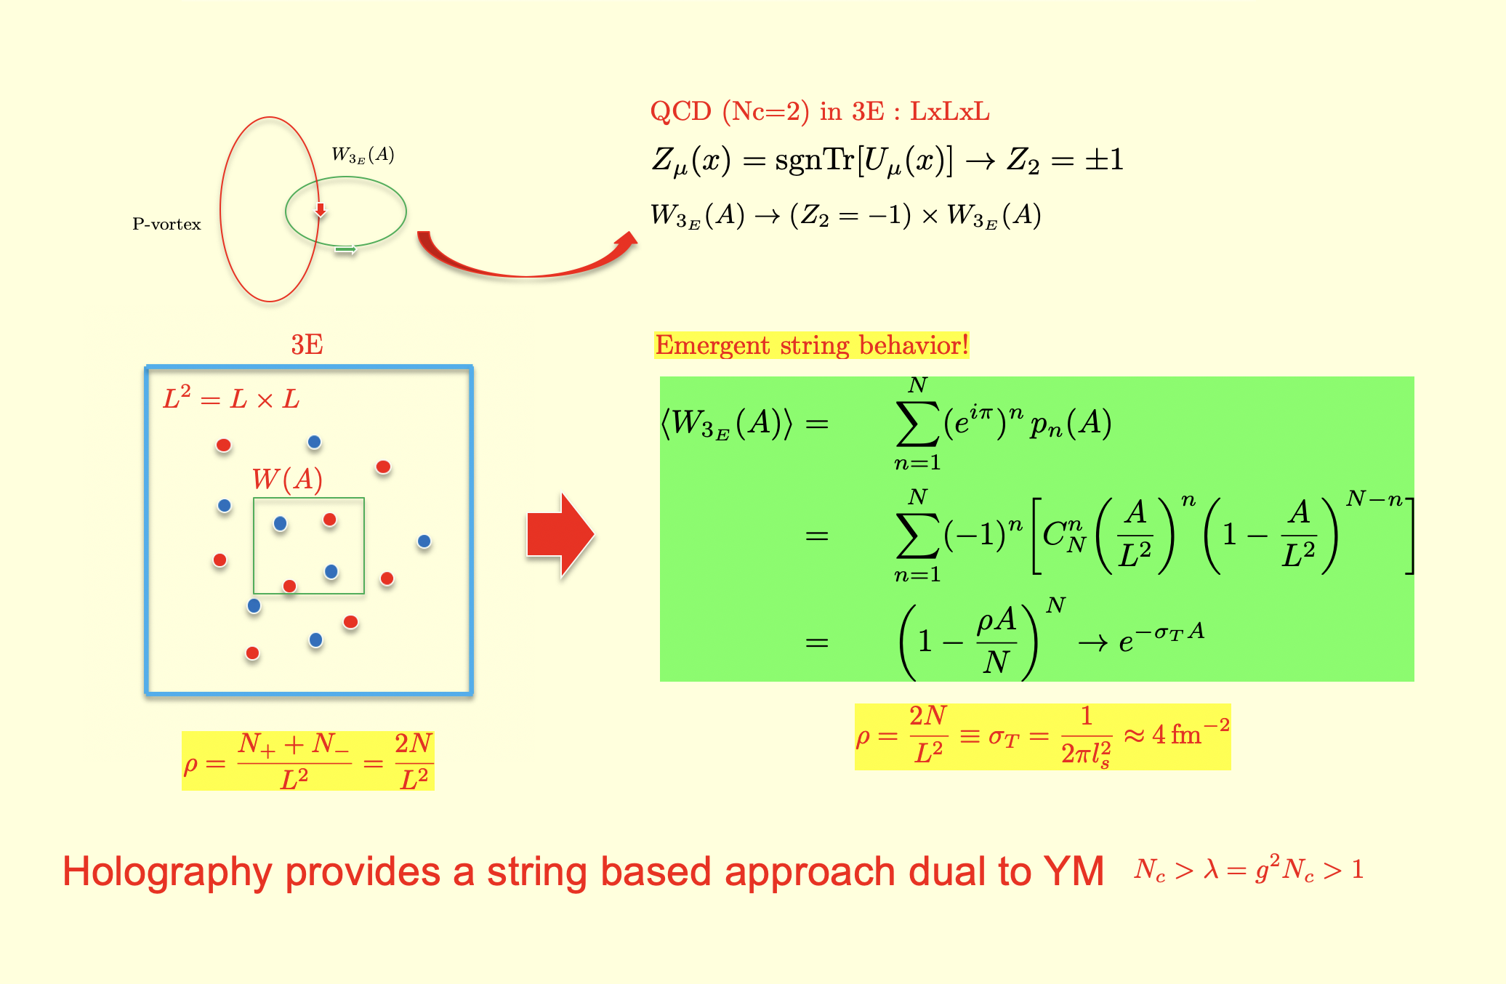
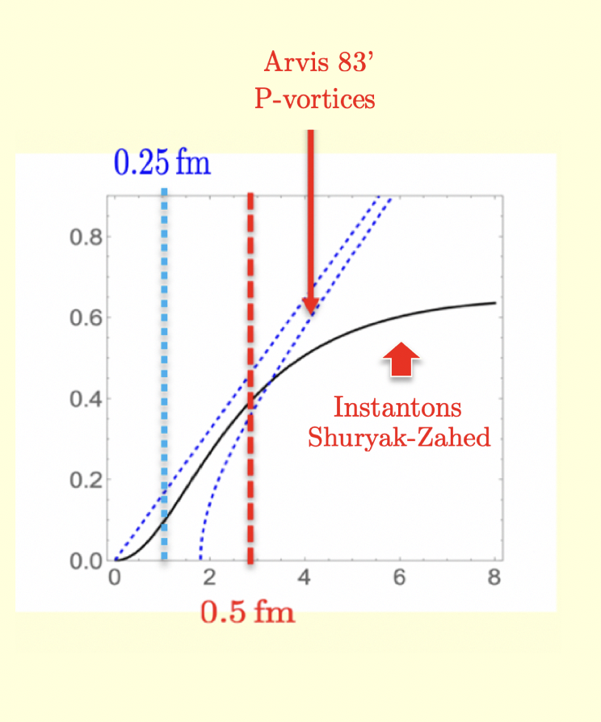
Topology: 4D and 2D
Emergent strings
Effective QQ

Slide 5
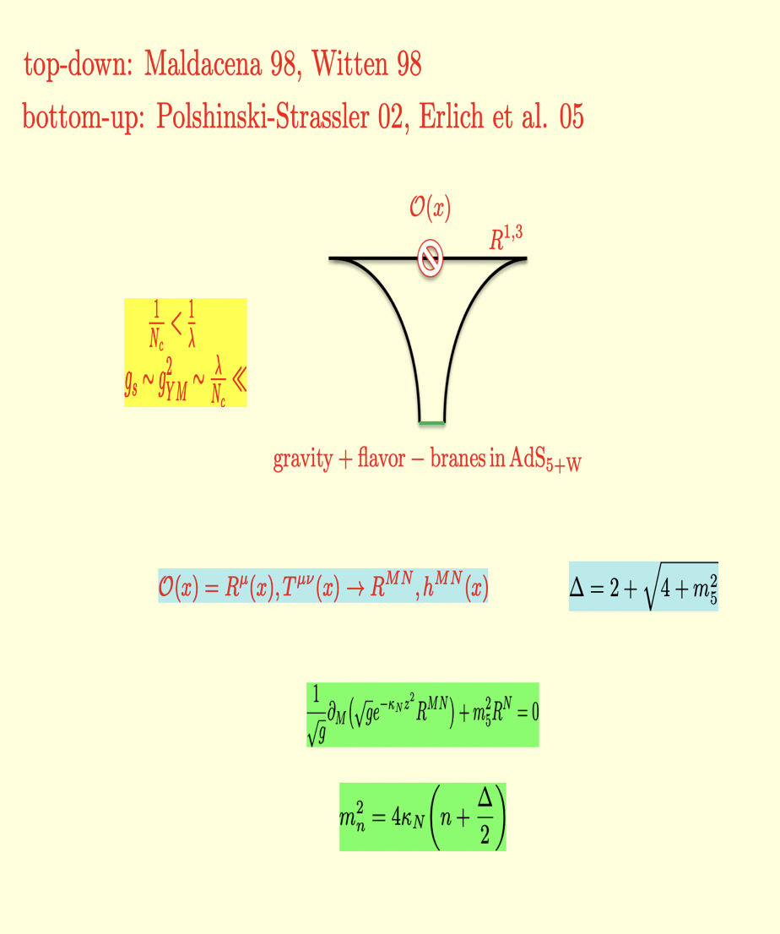
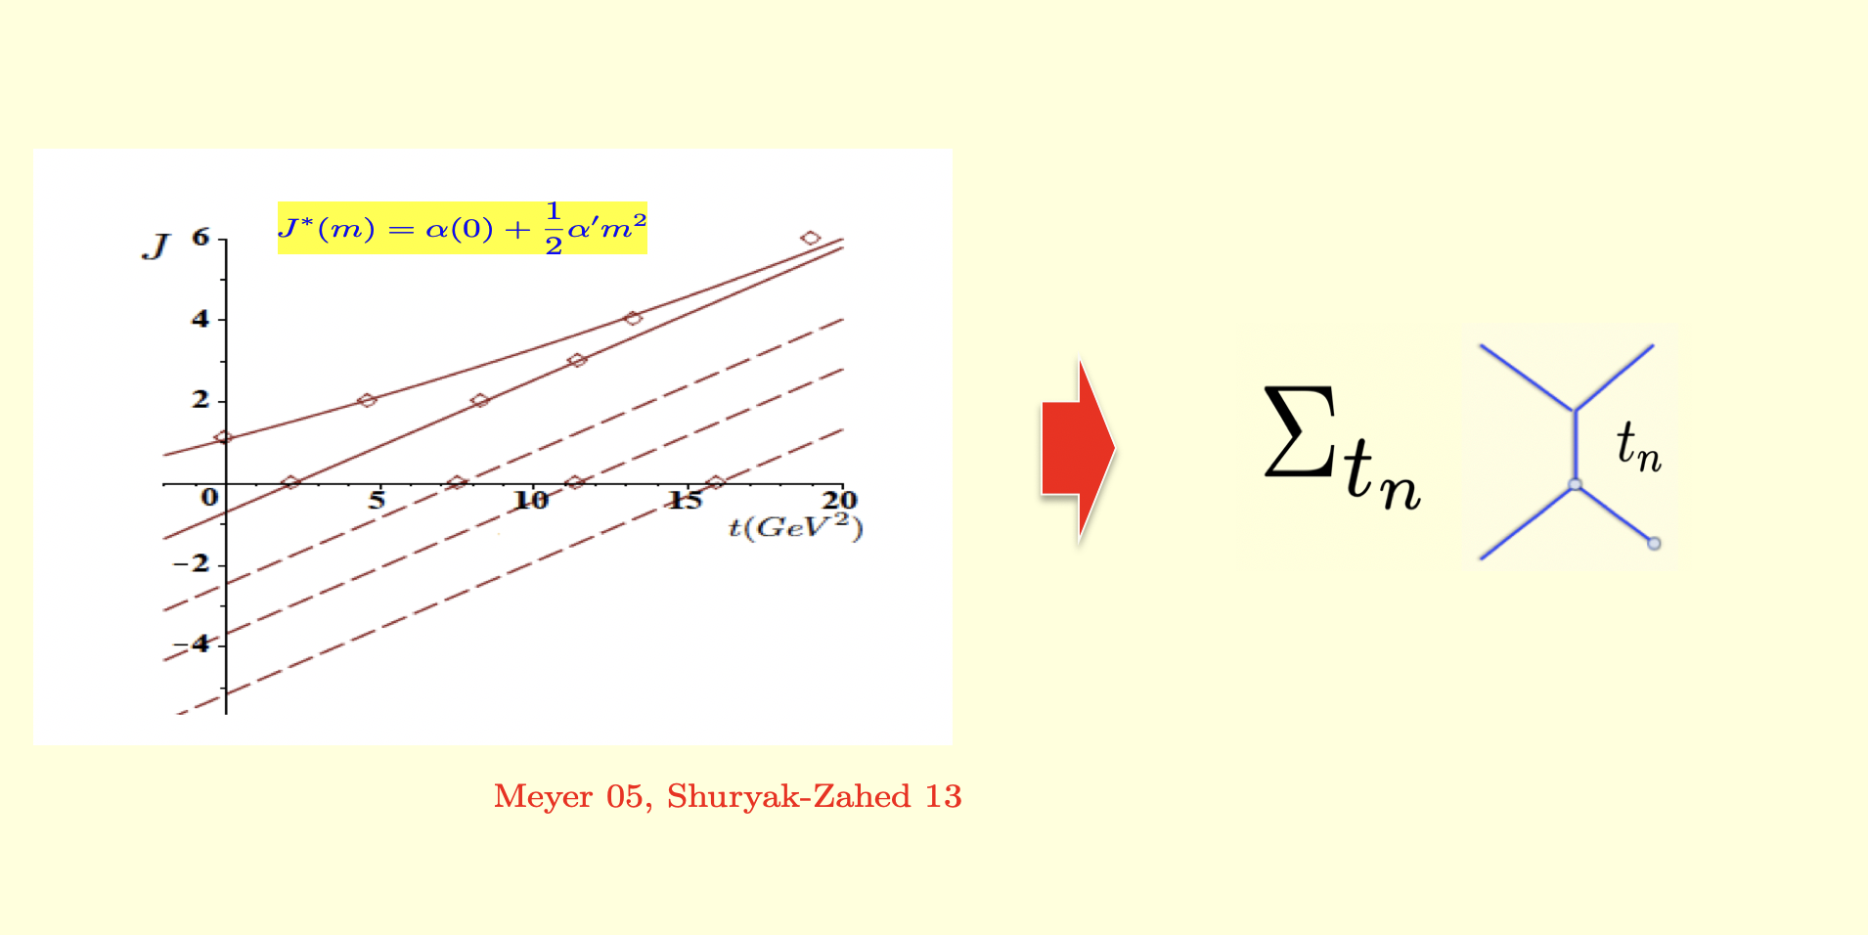
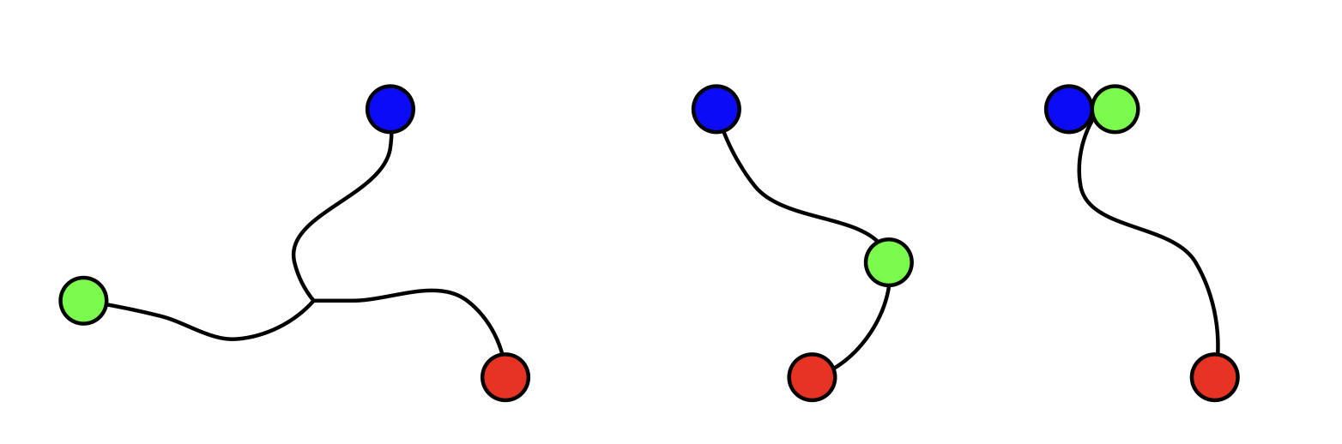
Emerging strings and resonance dual
Holography as a string field theory

Slide 6
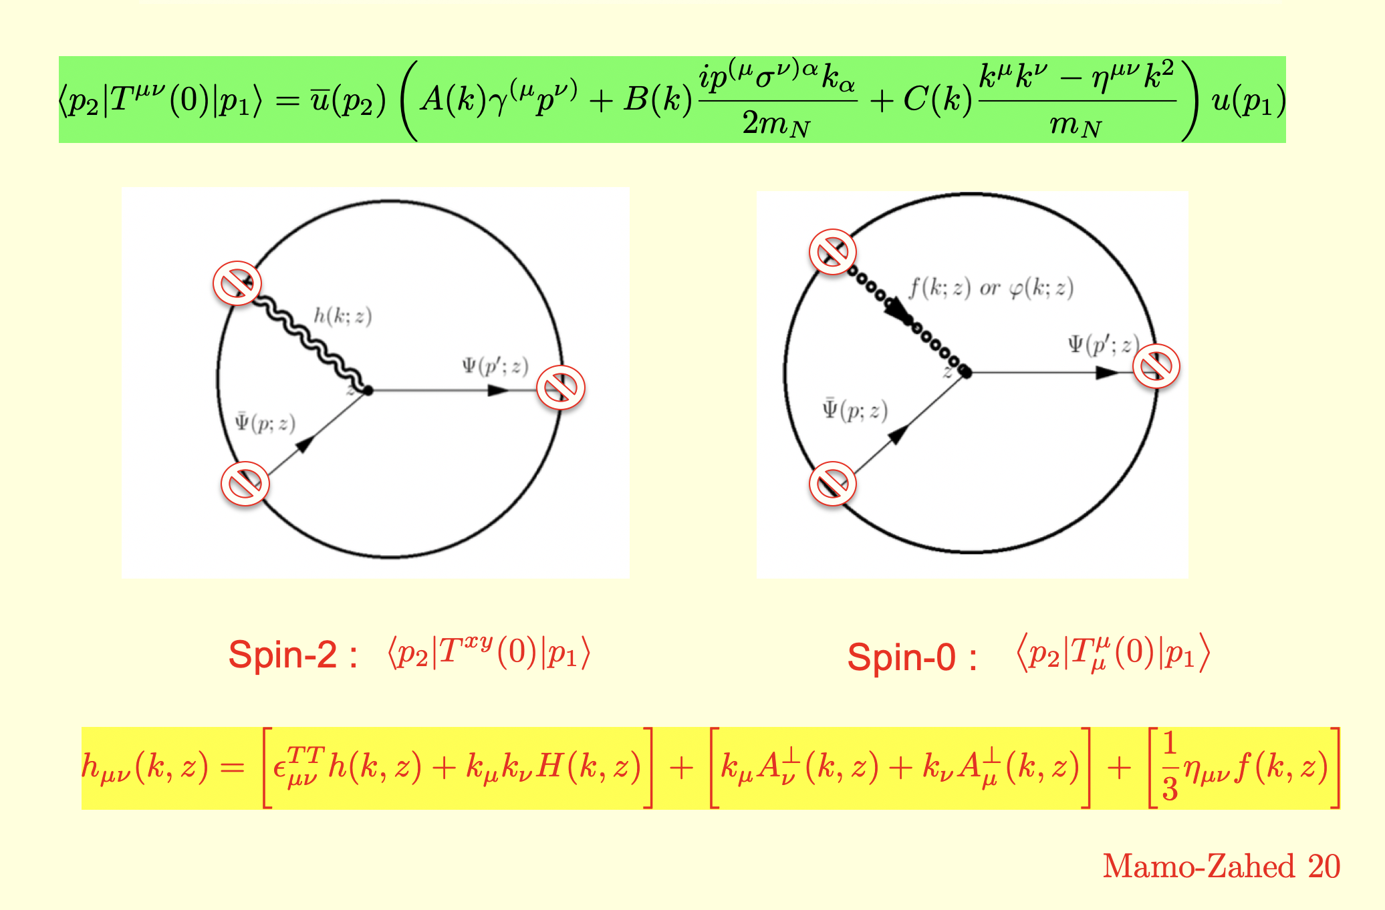
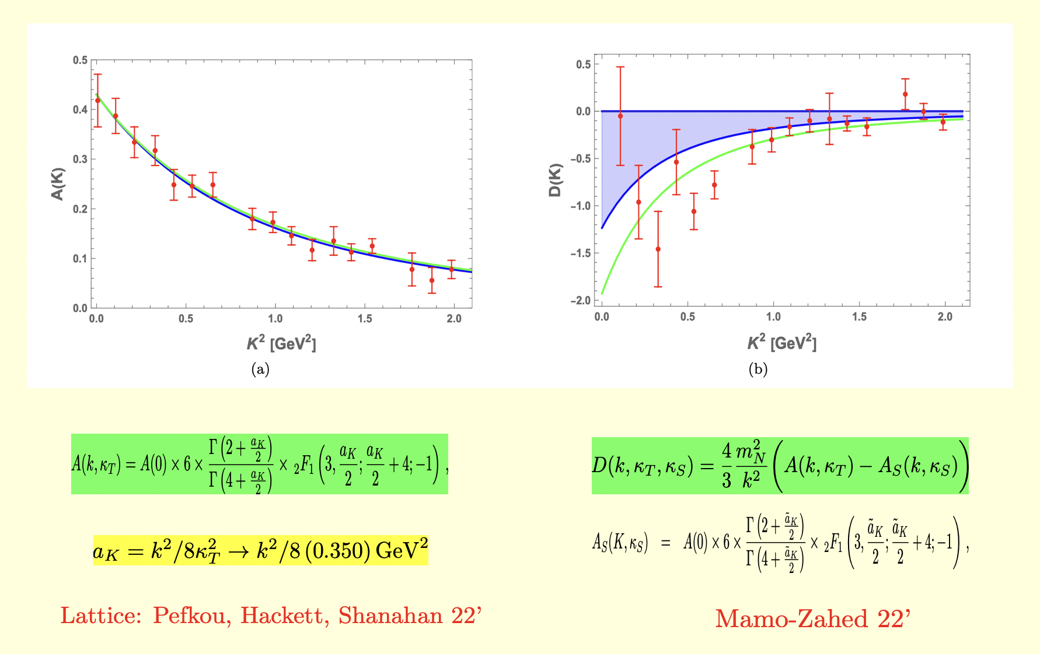
GFs from holography
GFs holography vs Lattice

Slide 7
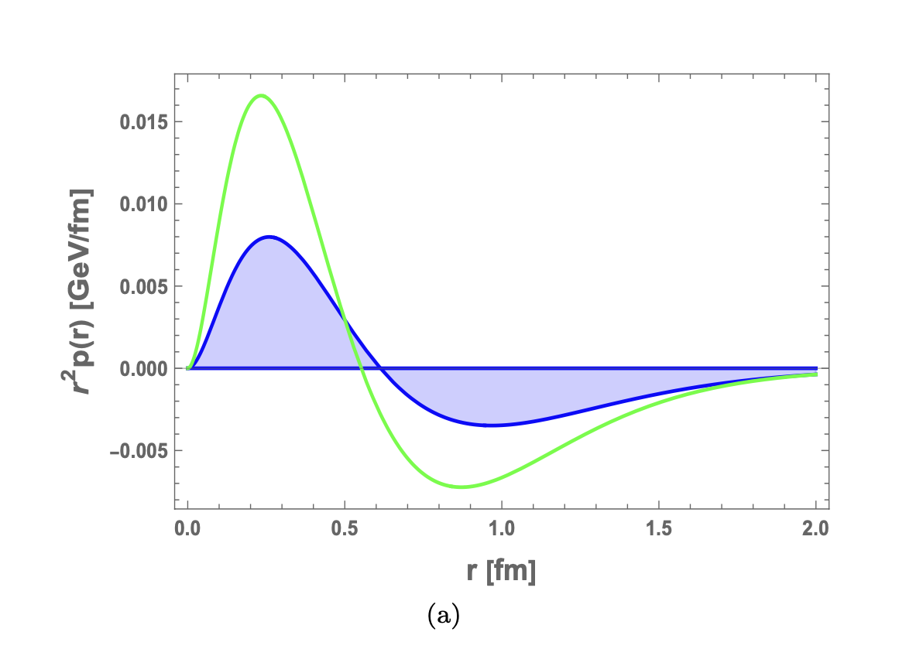
Genealogy of D=4C-term and Pressure
Negative!
Tripole!

Slide 8
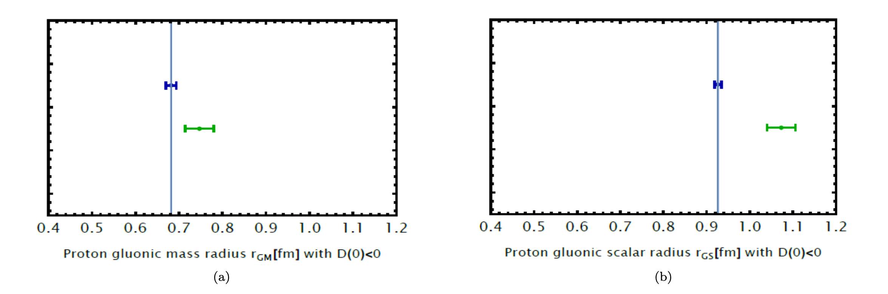
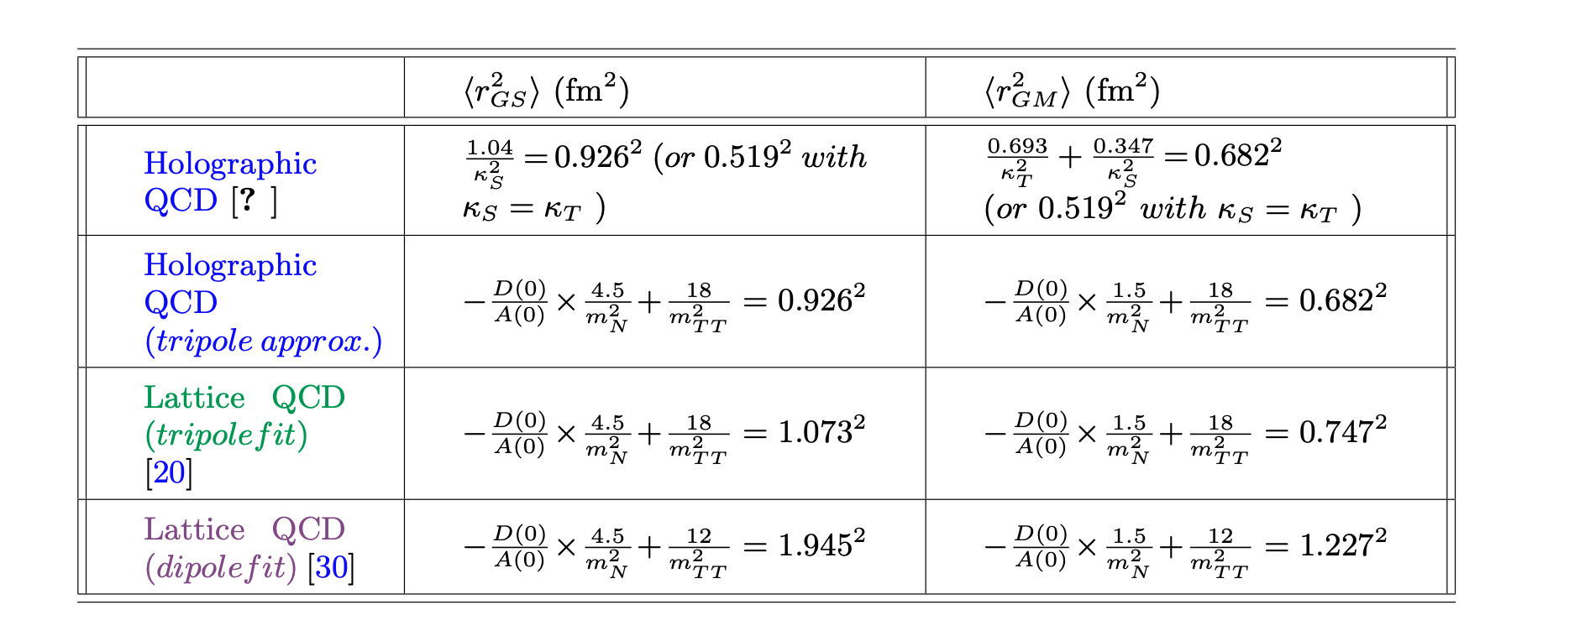
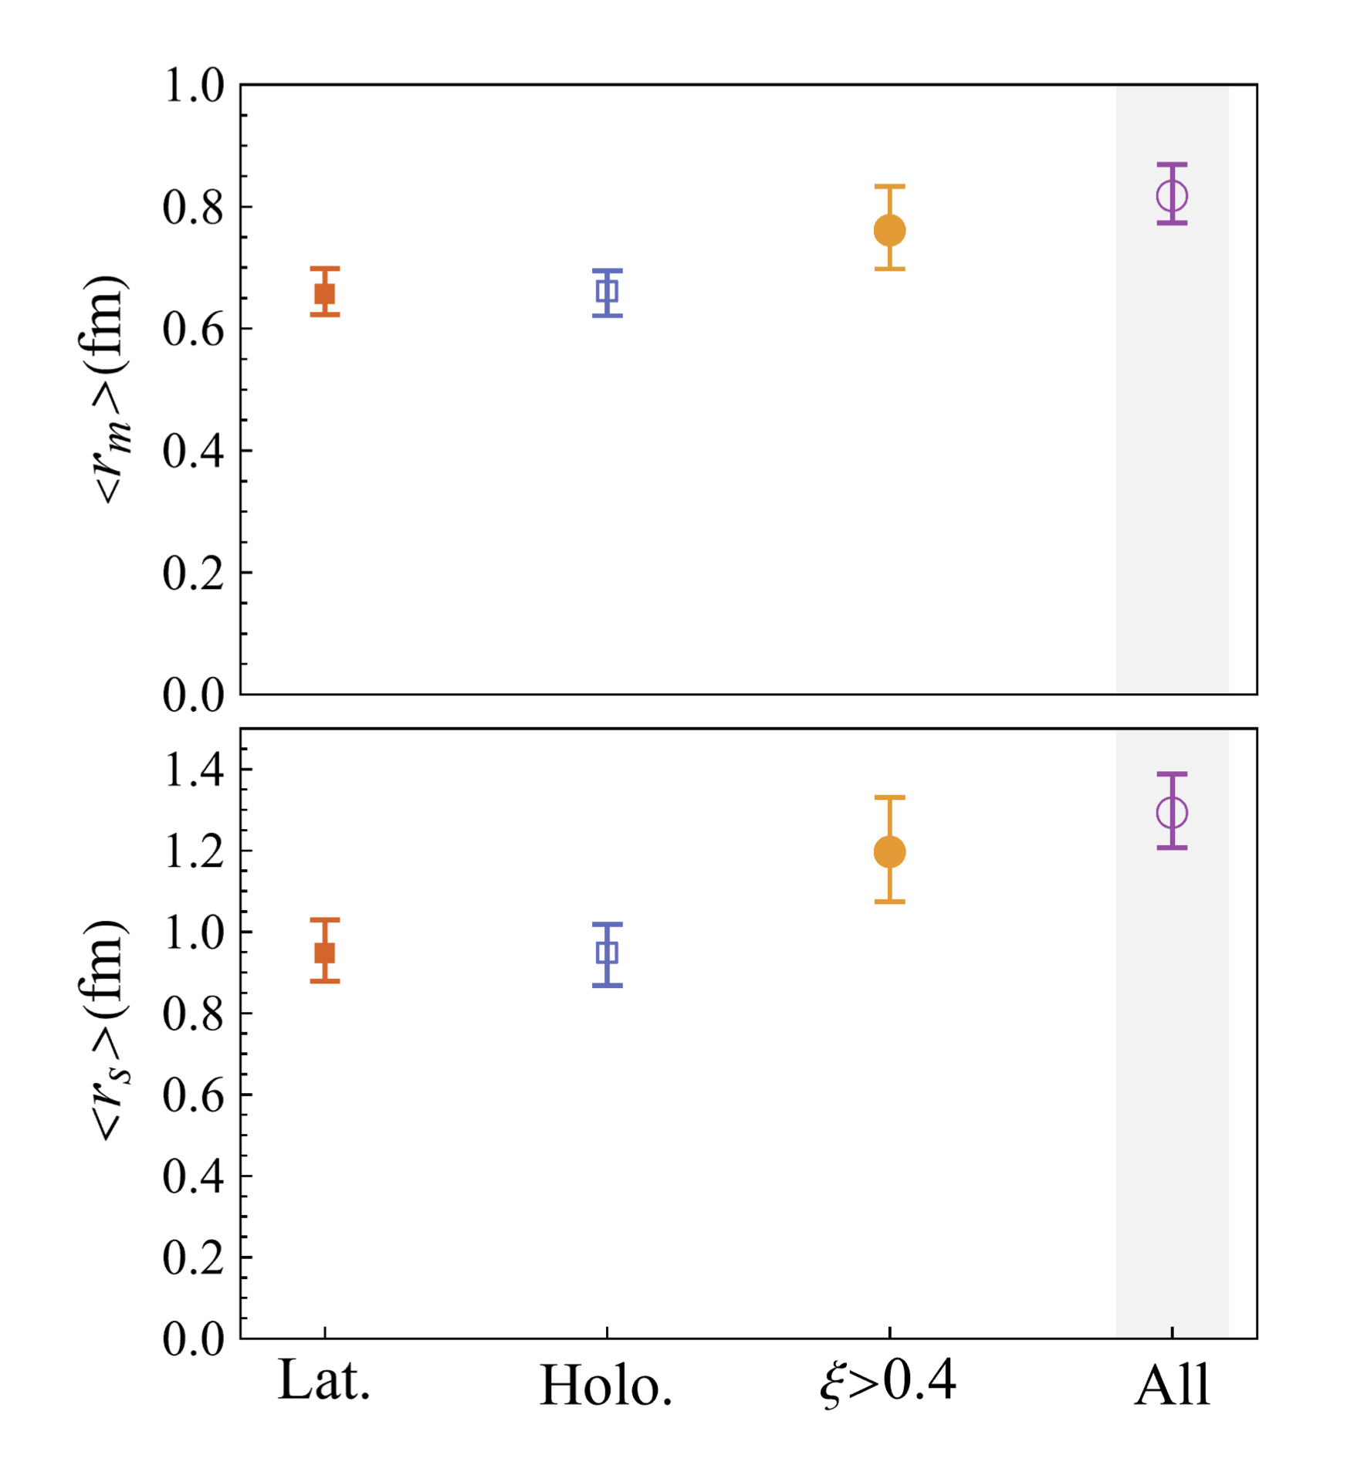
Gravitational radii

Slide 9
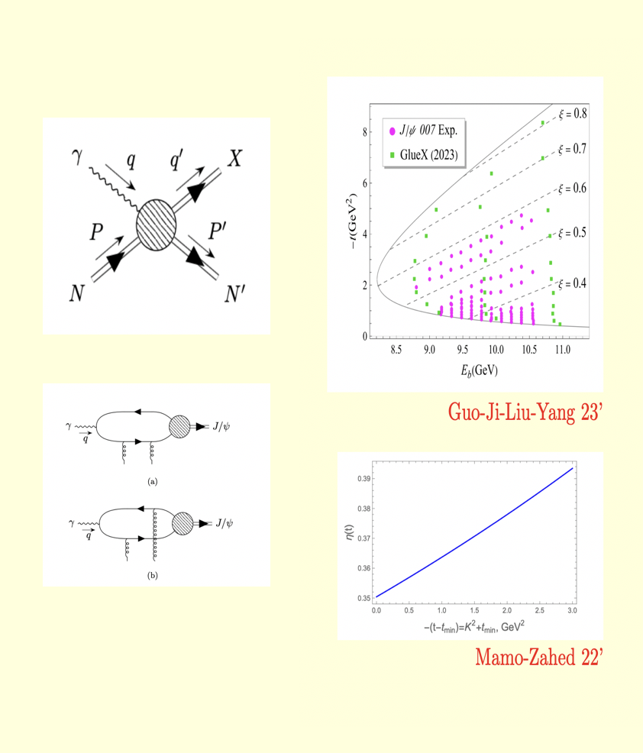
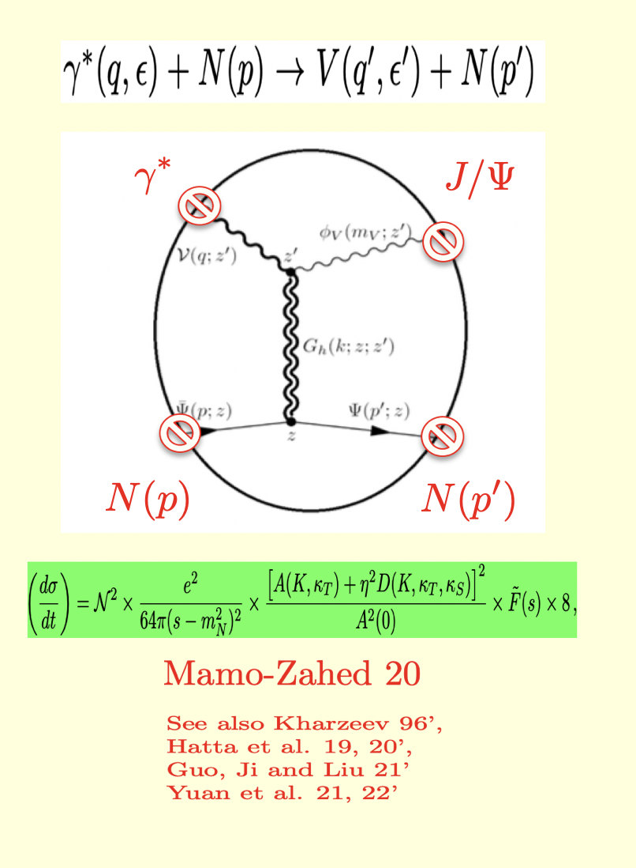
J/psi photoproduction at Jlab
Holographic dual

Slide 10
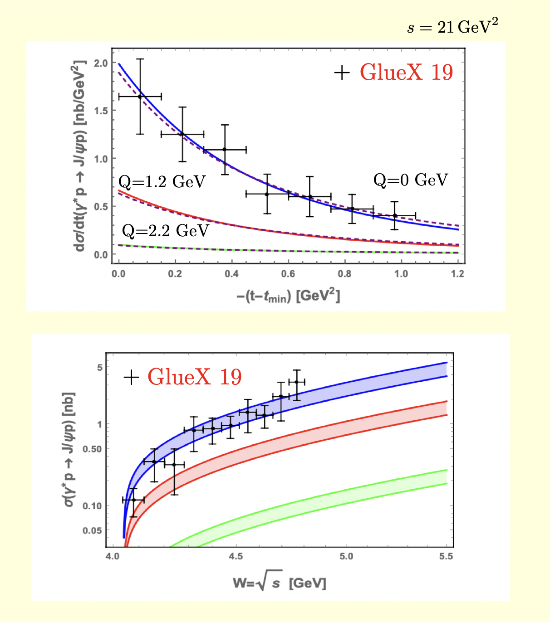
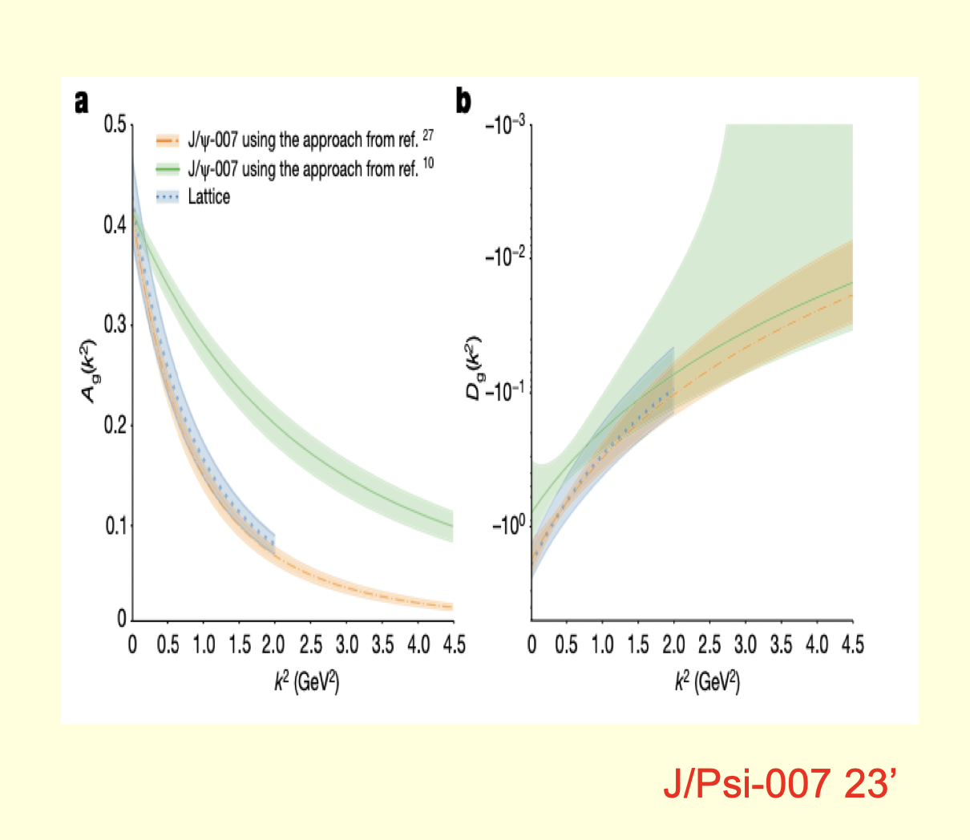
A-FF measured by GlueX 19’
A-FF and D-FF measured by 007 23’

Slide 11
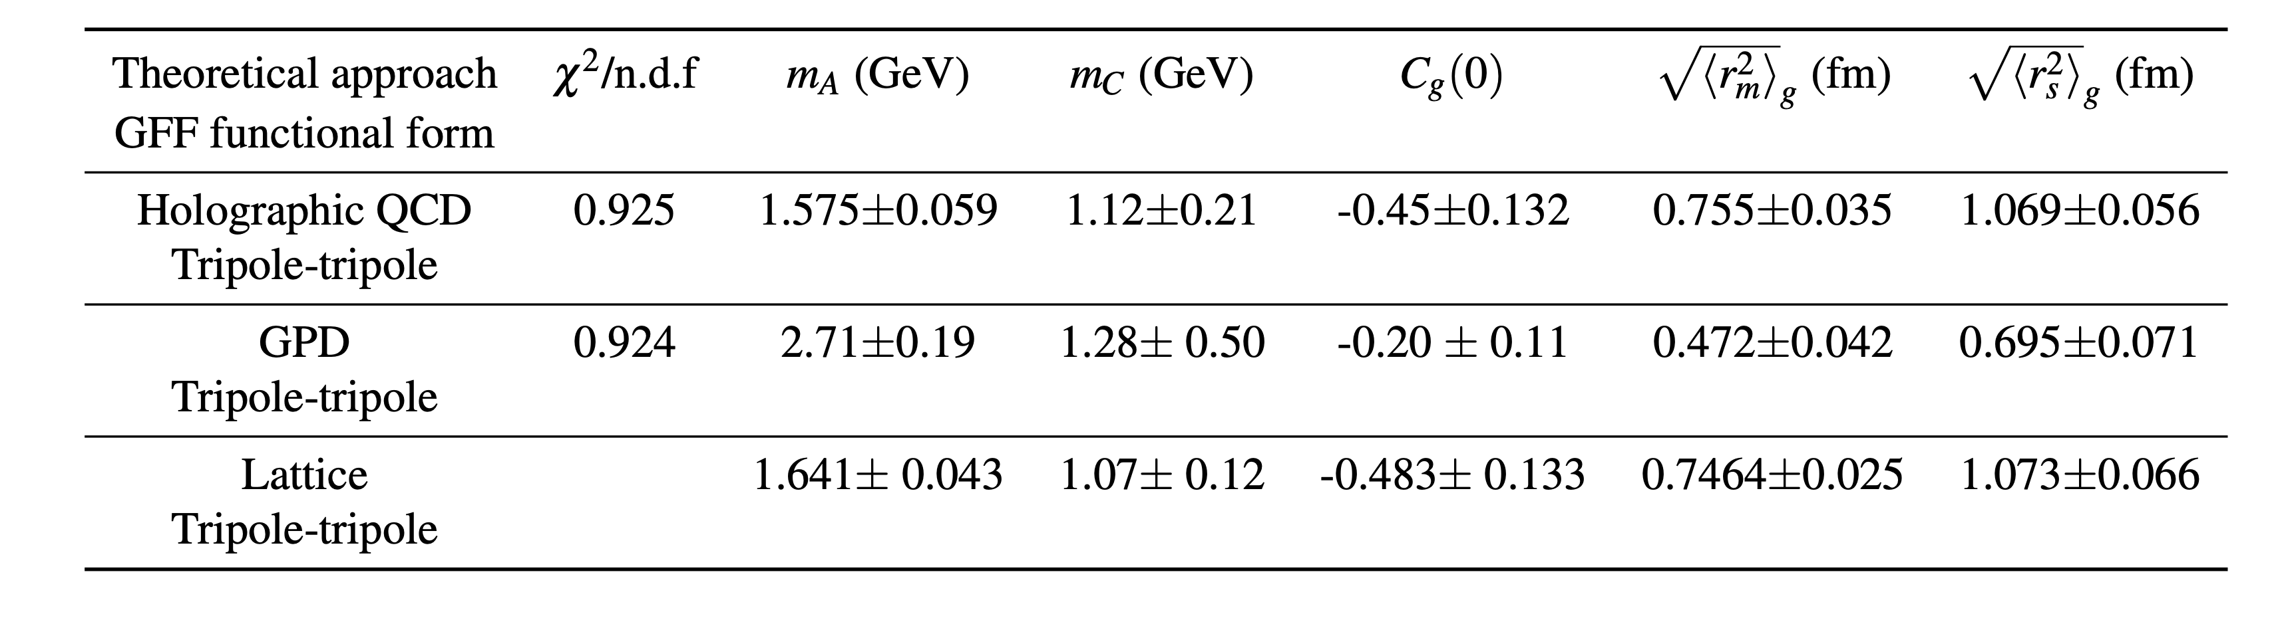
A-FF and D-FF measured by 007 23’
Extracted mass radii by 007 23’

Slide 12
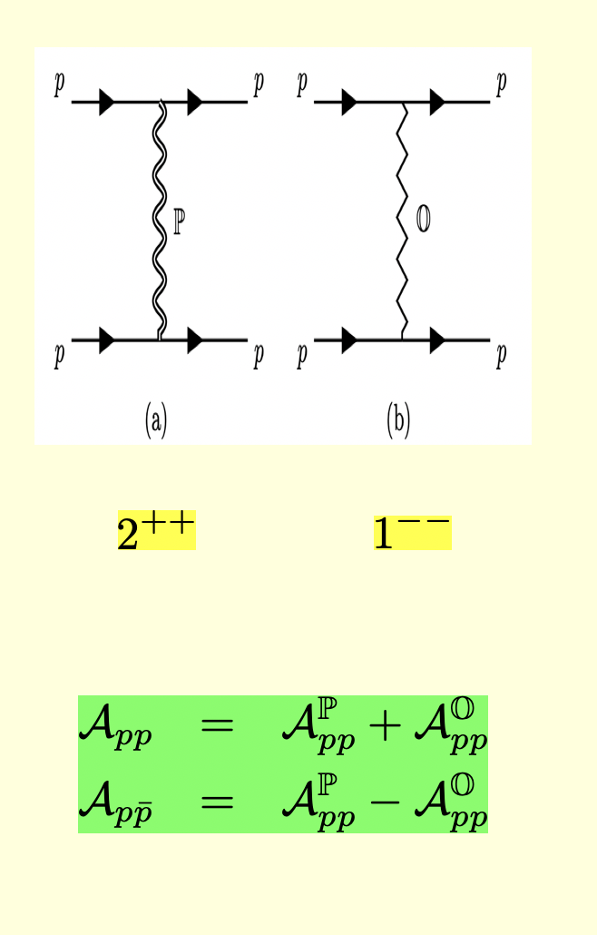
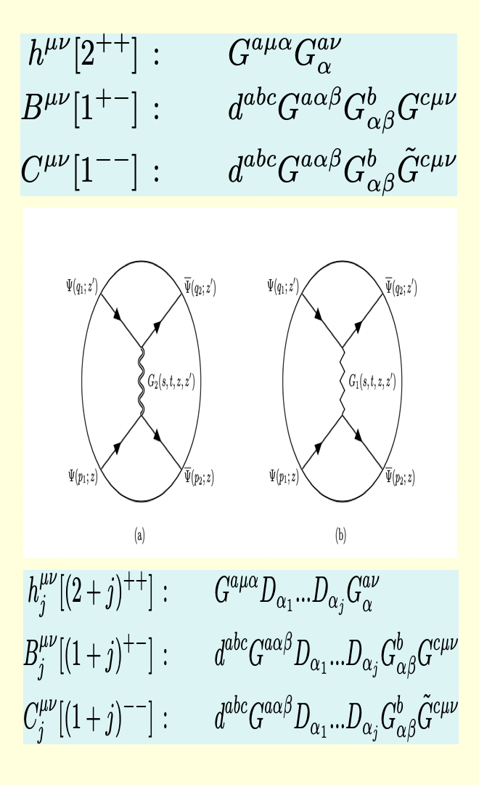
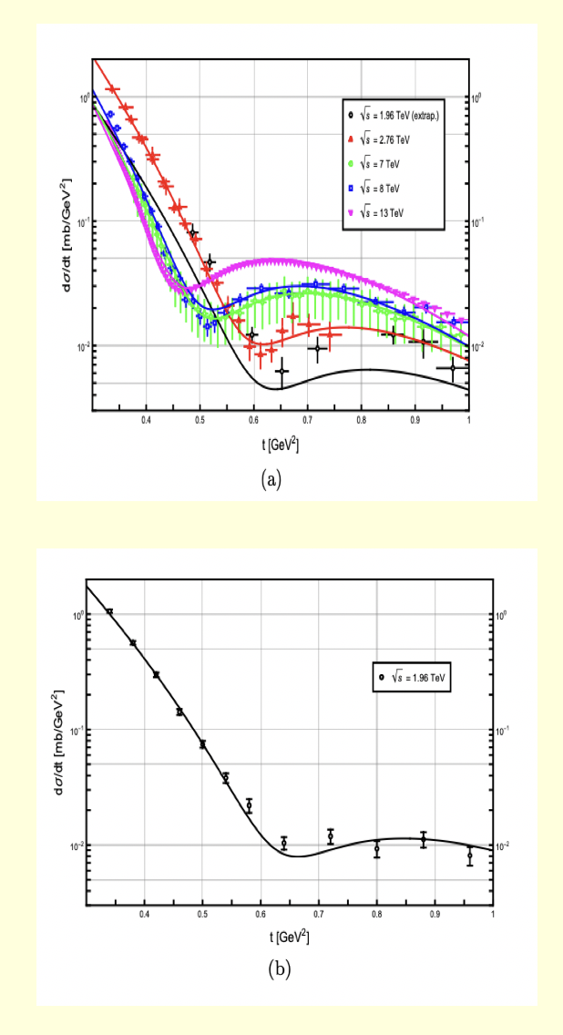
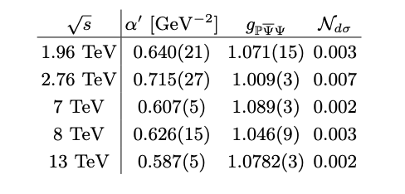
pp at large s
pp in hQCD
hQCD @ TOTEM/DO
Hechenberger-Mamo-Zahed 23’

Slide 13
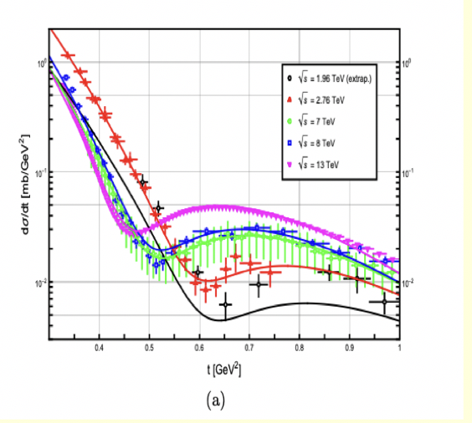
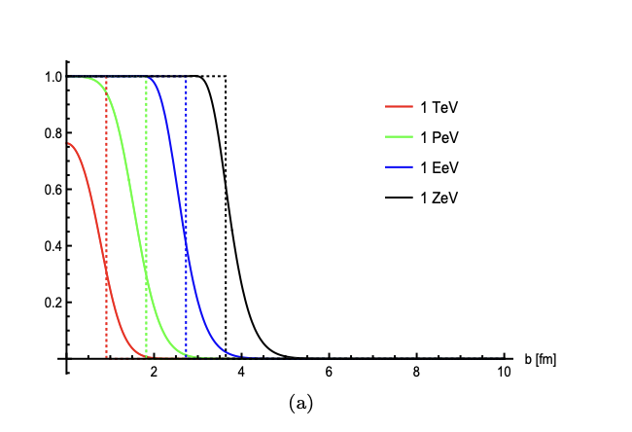
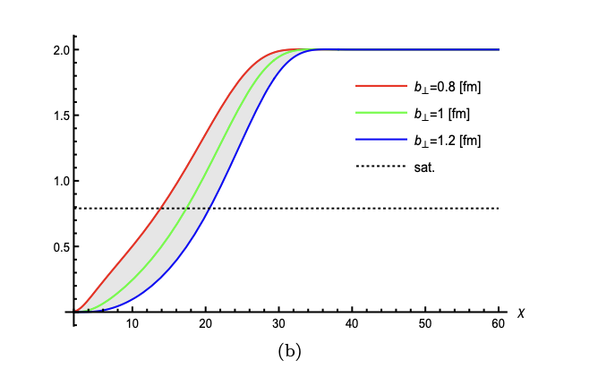
hQCD Saturation:
Low-x ‘matter’
hQCD/TOTEM/DO
hQCD Black-disc
Hechenberger-Mamo-Zahed 23’

Slide 14
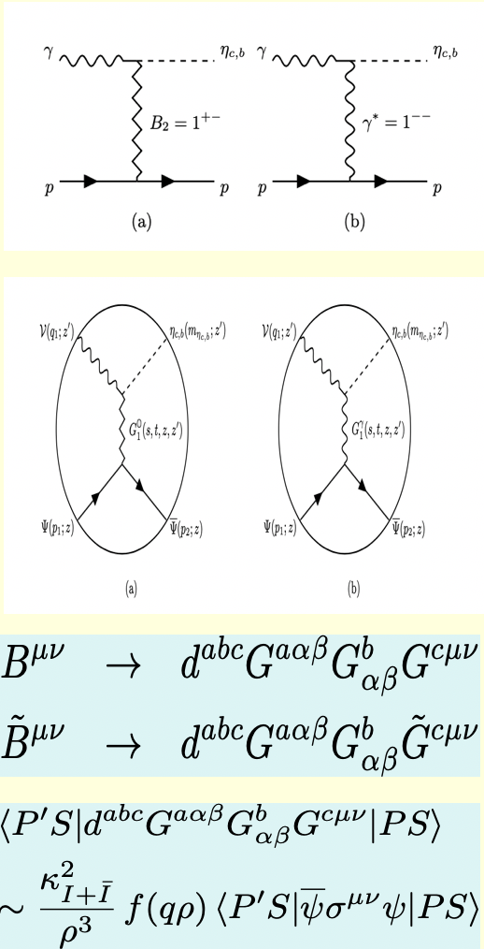
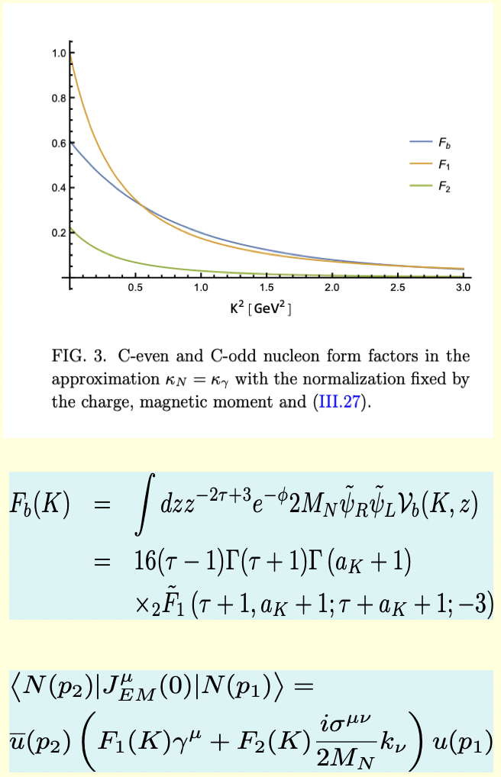
etac,b photo-production
hQCD C-odd FFF
Hechenberger-Mamo-Zahed 24’

Slide 15
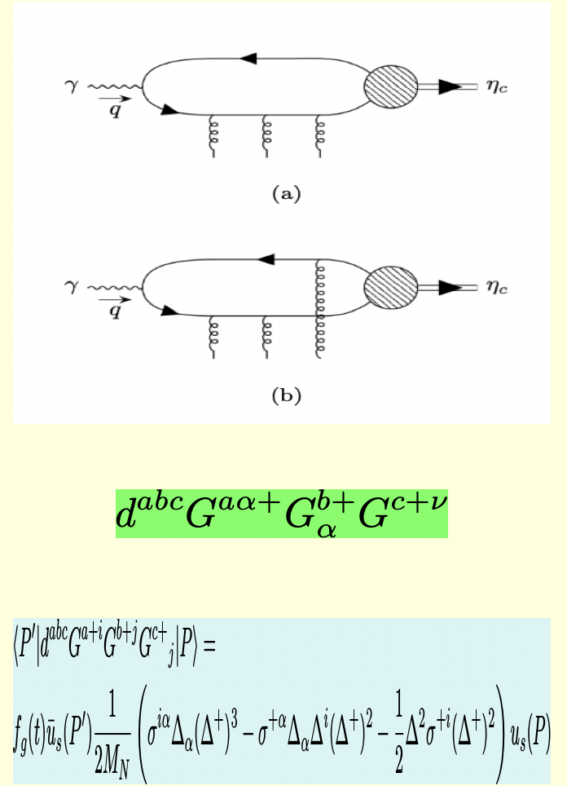
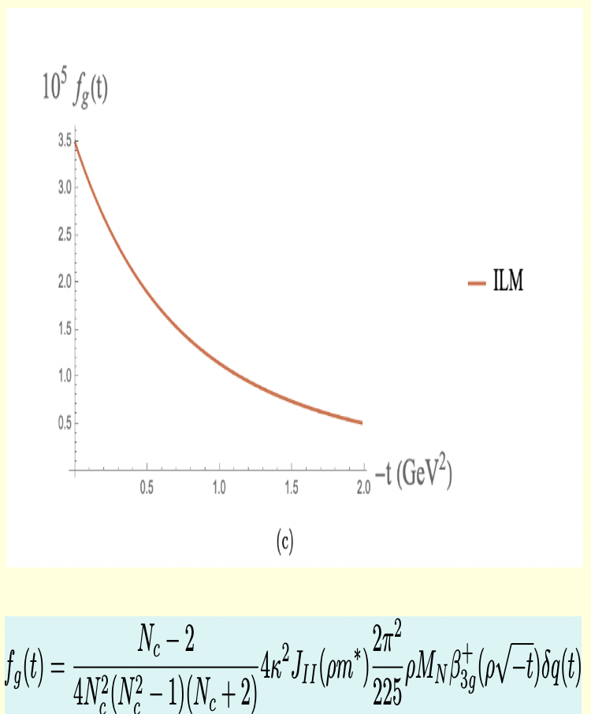
etac photoproduction pQCD
pQCD C-odd FF
Ma 03’, Liu-Zahed 24’
Liu-Zahed 24’

Slide 16
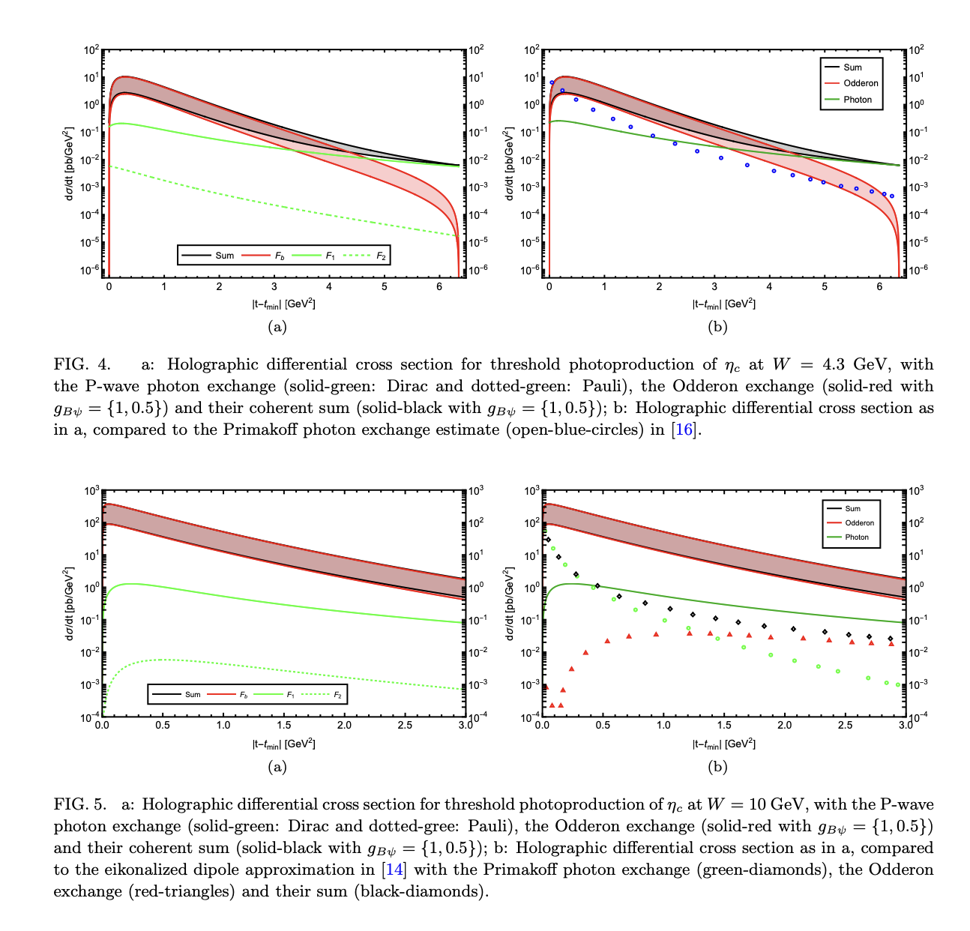
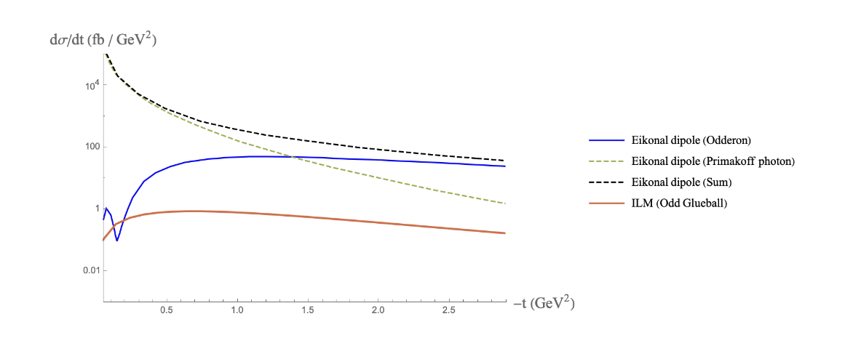
hQCD results for etac
pQCD results for etac
Liu-Zahed 24’
Hechenberger-Mamo--Zahed 24’

Slide 17
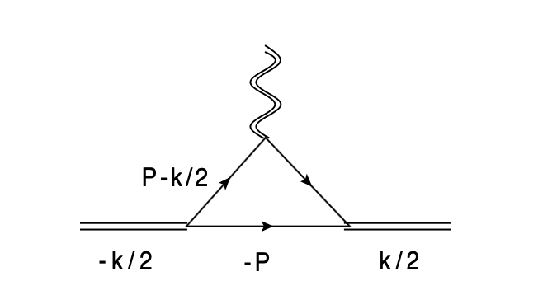
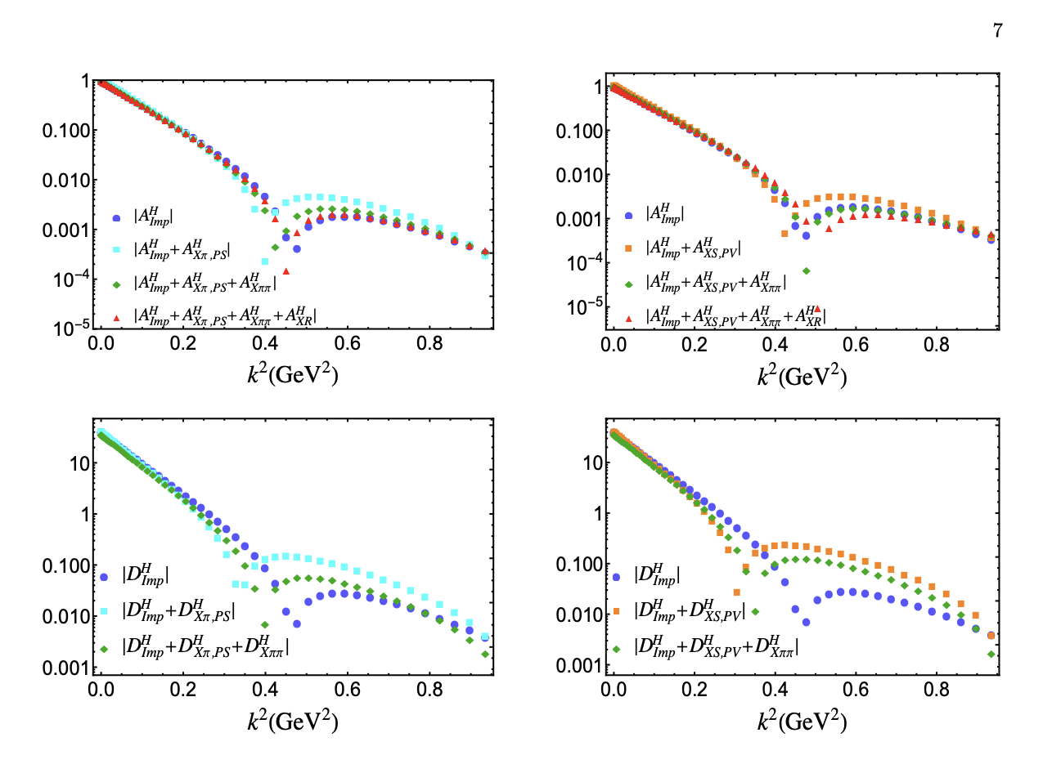
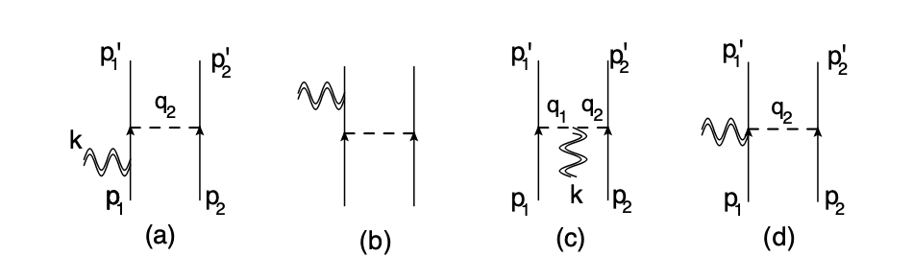
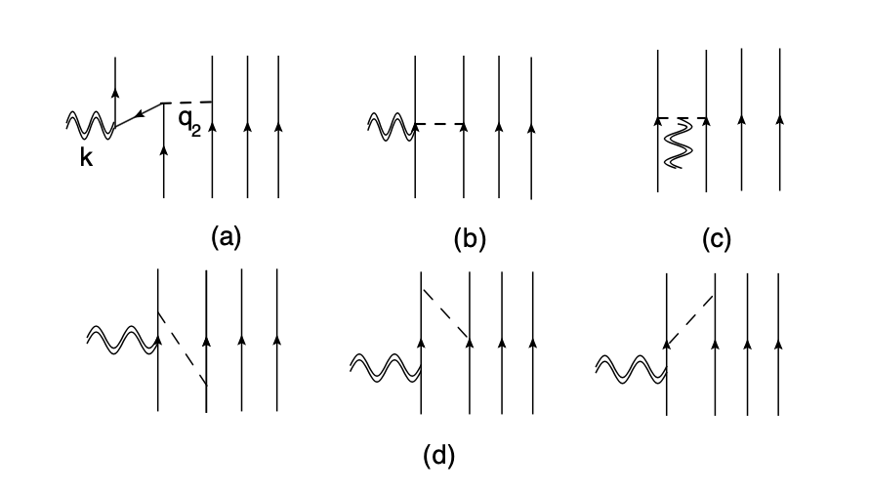
Deuteron and Helium-4 GFF
Helium-4 GFFs : K-Harmonic
He-Zahed 23’-24’

Slide 18
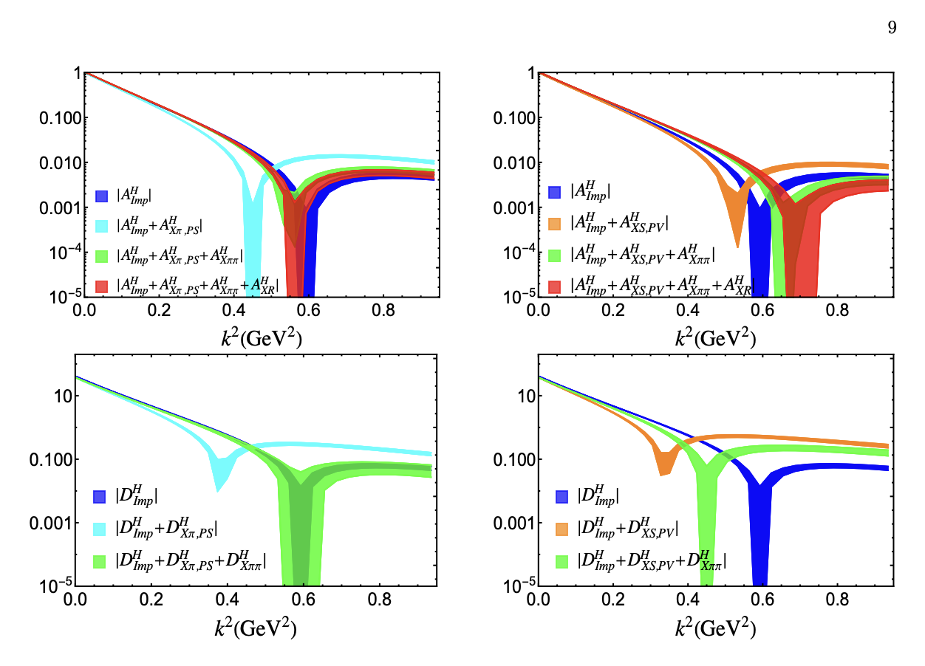
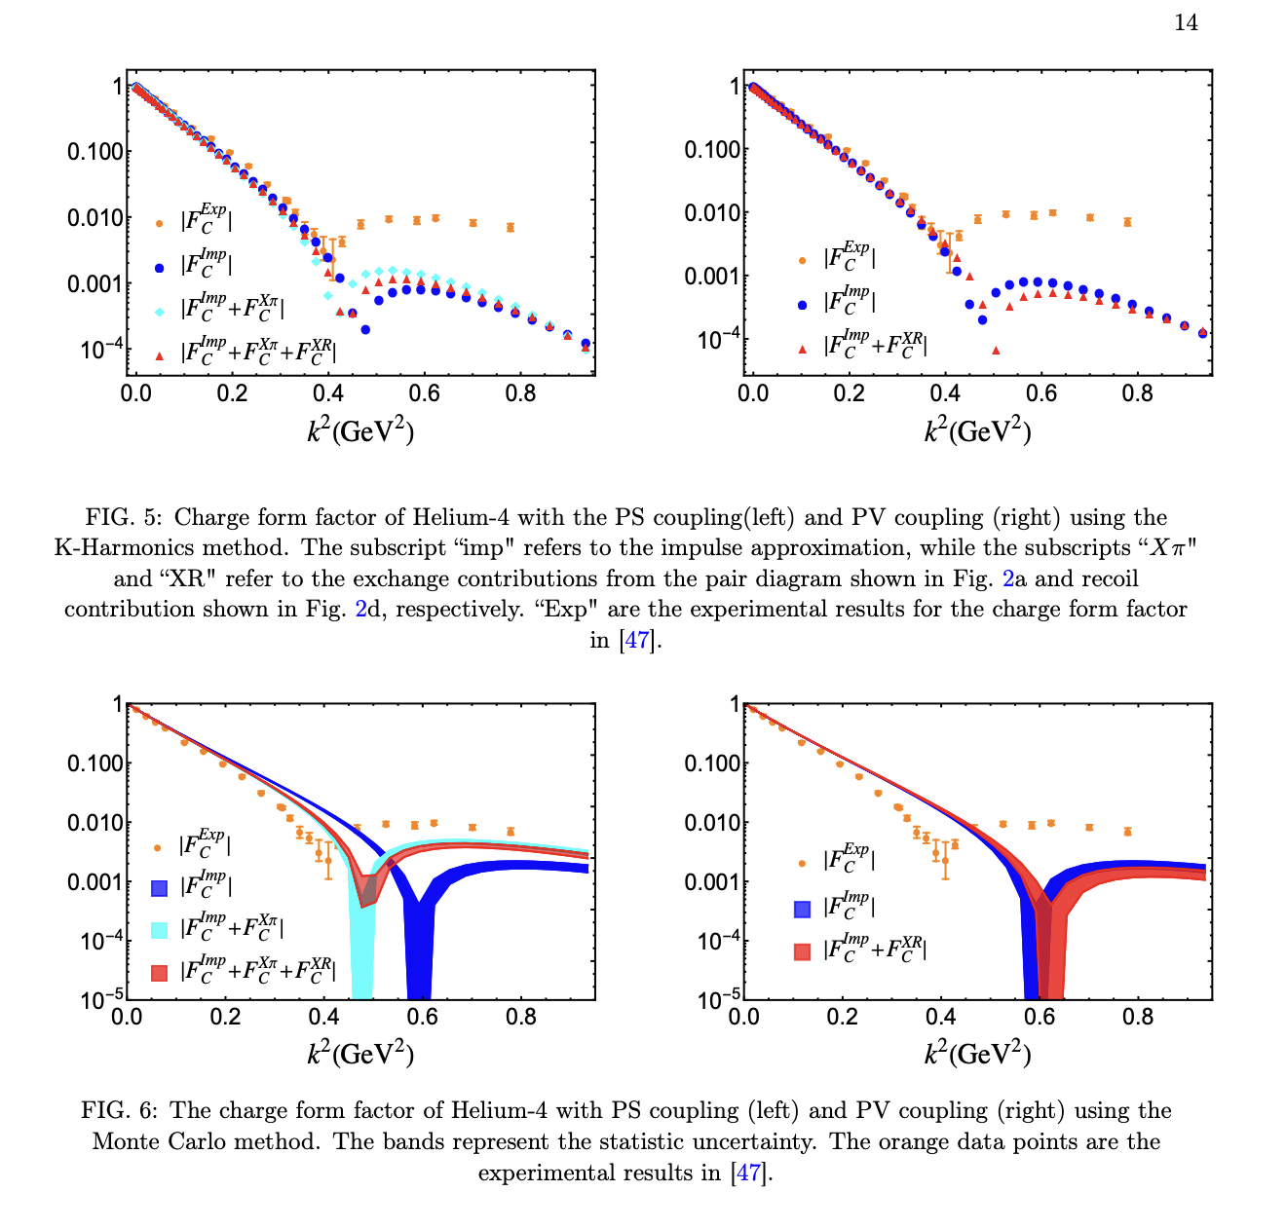
Helium-4 GFFs: Argonne v14
Helium-4 EMFFs: K and v14
He-Zahed 24’

Slide 19
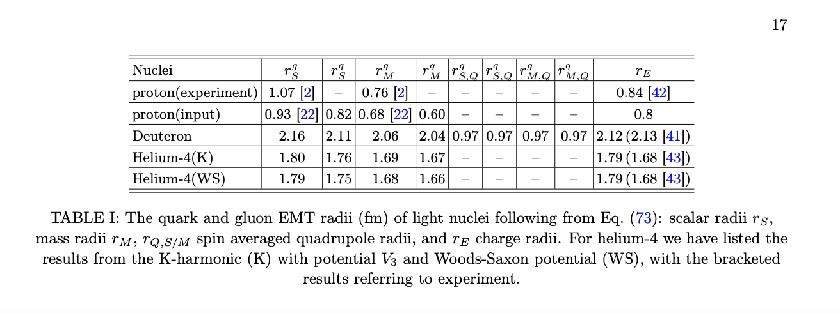
Radii EM and GFF: N, D, H4
He-Zahed 23’

Slide 20
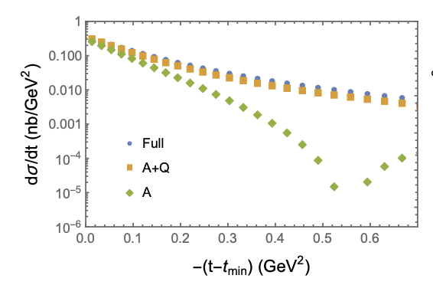
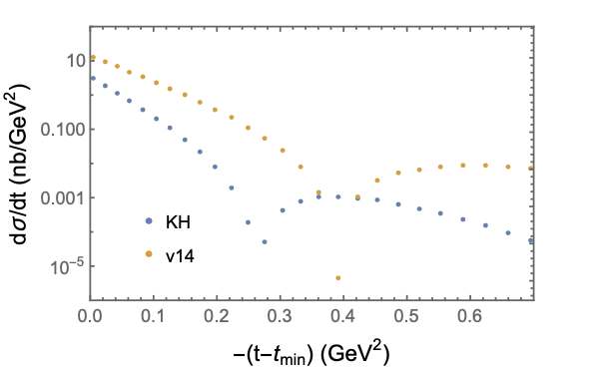
Diff-t for D and He-4
Impulse approximation
He-Zahed 24’

Slide 21
Summary
Vacuum : topo-glue-string
Spin-Mass : topo-fluctuations
Low-x matter: Reggeized string
N,D,He-GFF : photo @ Jlab
j-GFF : pp/ppb @ TOTEM/DO

