Slide 1
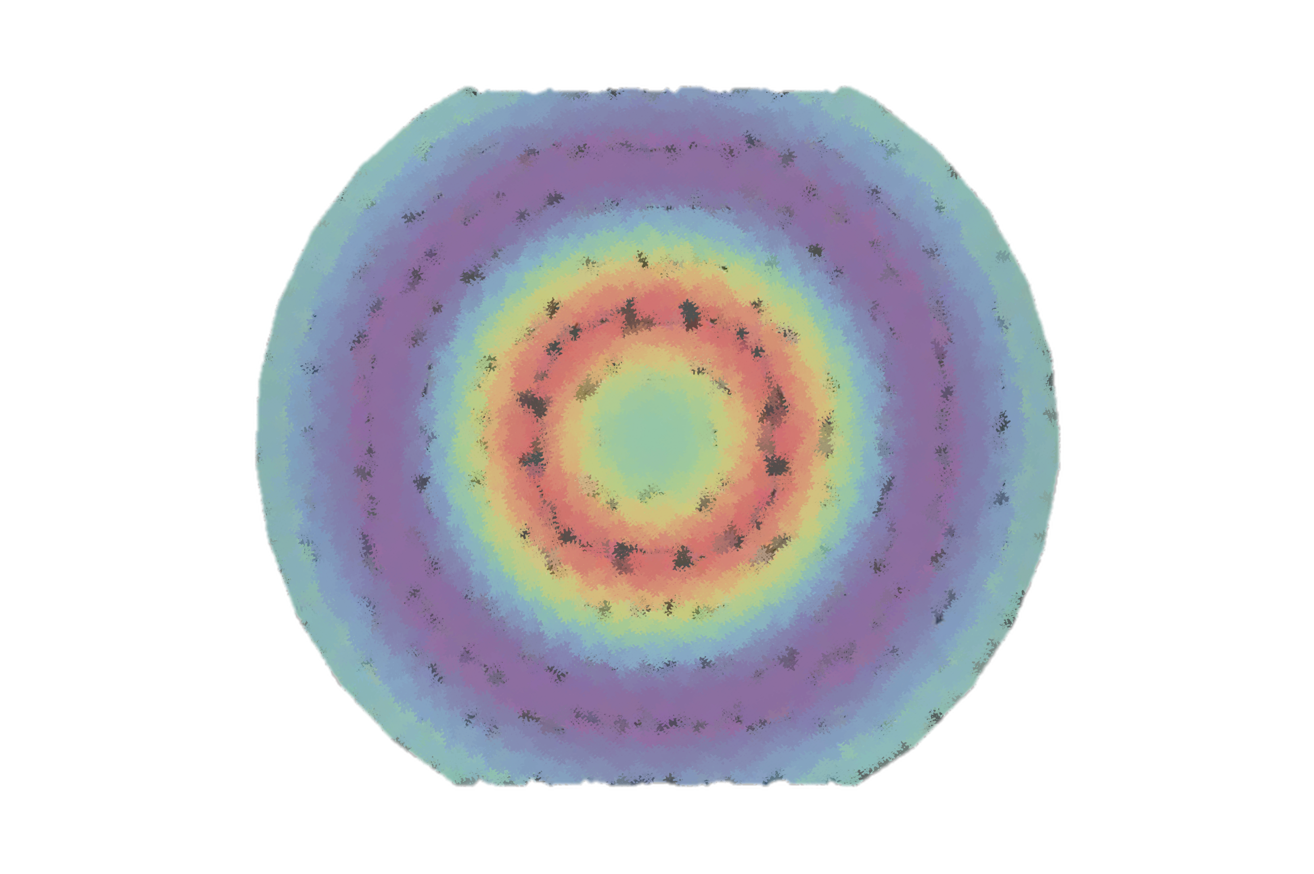
The strange mechanical structure of the proton
erhtjhtyhy
STRANGE
Henry Klest
SoLID Workshop
June 2024

Slide 2
We know that the proton mechanical structure is strange,
but how STRANGE is it?

Slide 3
Motivation
Proton gravitational form factors (GFFs) encode information about the matrix elements of the QCD energy-momentum tensor

Slide 4
Motivation
Proton gravitational form factors (GFFs) encode information about the matrix elements of the QCD energy-momentum tensor
D-term at zero momentum transfer represents a fundamental property of the proton, on par with charge, spin, and mass.

Slide 5
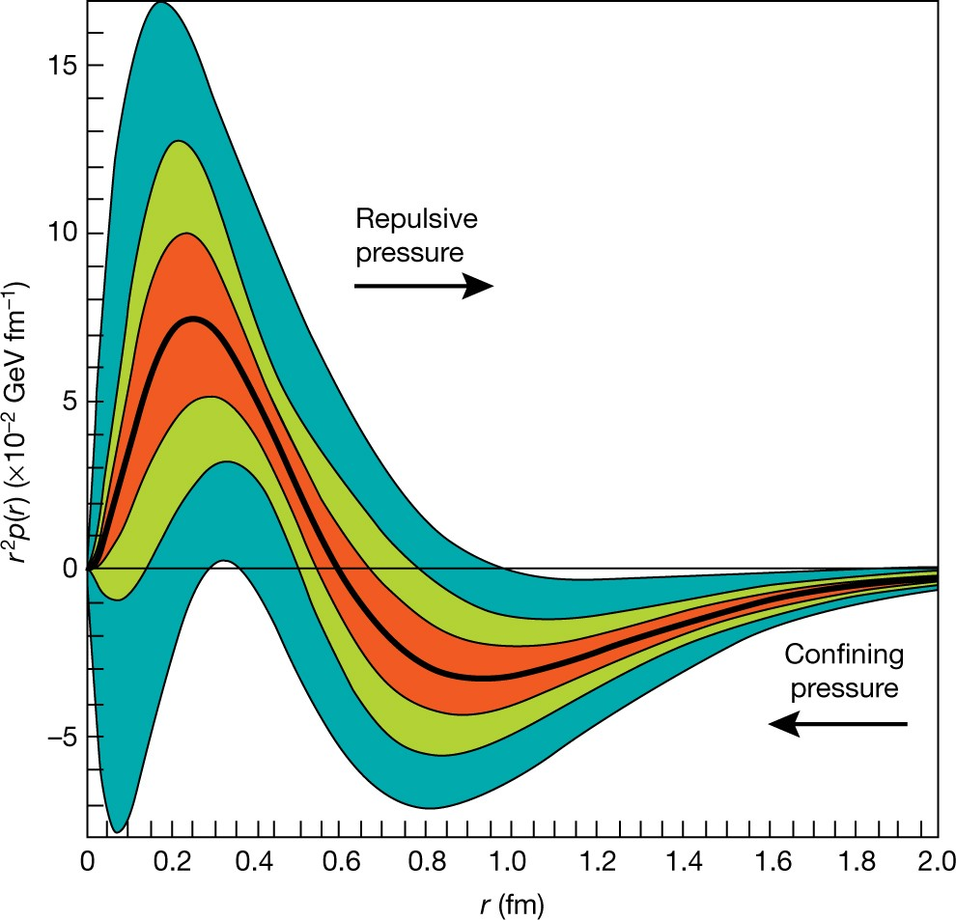
Motivation
The D-term provides a gateway for extraction of various mechanical properties of the proton, including:
Pressure distribution*
Mechanical radius*
Normal & shear force distributions
*only defined for the total D-term, not individual partonic components

Slide 6
How do we measure it?
The total D-term is related to the partonic D-terms by a simple sum rule:
Different processes provide insights into the various partonic D-terms
Only know total D-term once all the partonic components are known!

Slide 7
Gluons: Accessible via near-threshold production of $J/ψ$ and ϒ

Slide 8
Up & down quarks: Accessible via DVCS cross section & beam-spin asymmetries

Slide 9
Strange quarks: Accessible via ?

Slide 10
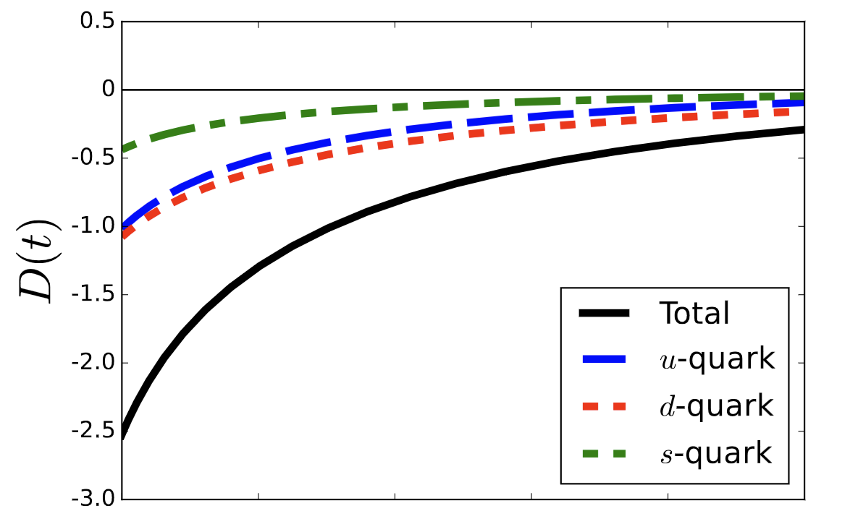
Who cares about D_{s}?
At first glance, D_{s} should be small
However, large-N_{c} predicts that the D-term is ”flavor-blind”, i.e. D_{u} ~ D_{d} despite their different number densities
D_{u} ~ D_{d} is supported by lattice results
Extending this argument, could D_{u} ~ D_{d} ~ D_{s}?
Calculation by Won et al. in the $χQSM$ suggests that D_{u} ~ D_{d} ~ 2D_{s}
This would make D_{s} a non-negligible contributor to the total D-term, and thus necessary for a full extraction of many of the mechanical properties of the proton!

Slide 11
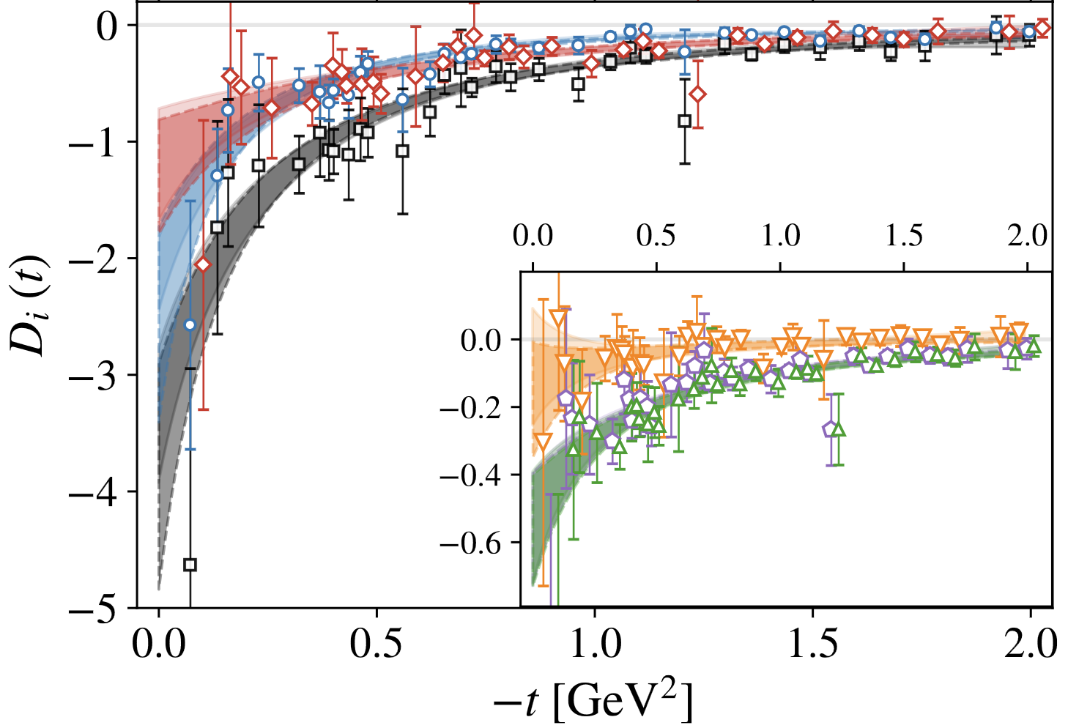
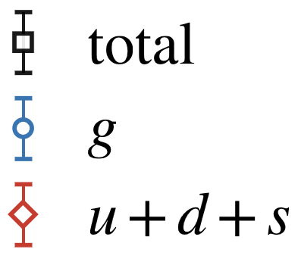
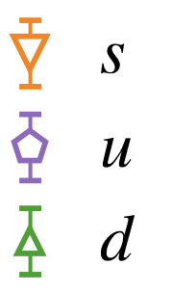
Who cares about D_{s}?
On the other hand, the lattice results by Hackett et al. show that D_{s} is consistent with zero
Uncertainties are still large, but the results do not exclude positive values of D_{s}
D_{s} > 0 suggests the intriguing possibility that strange quarks exert forces in opposite direction to up & down quarks!

Slide 12
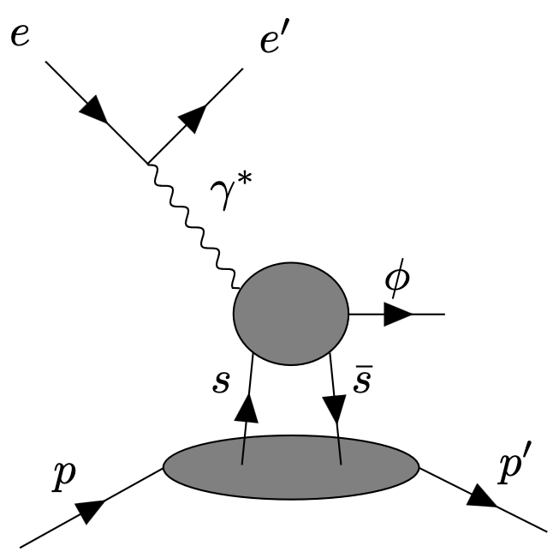
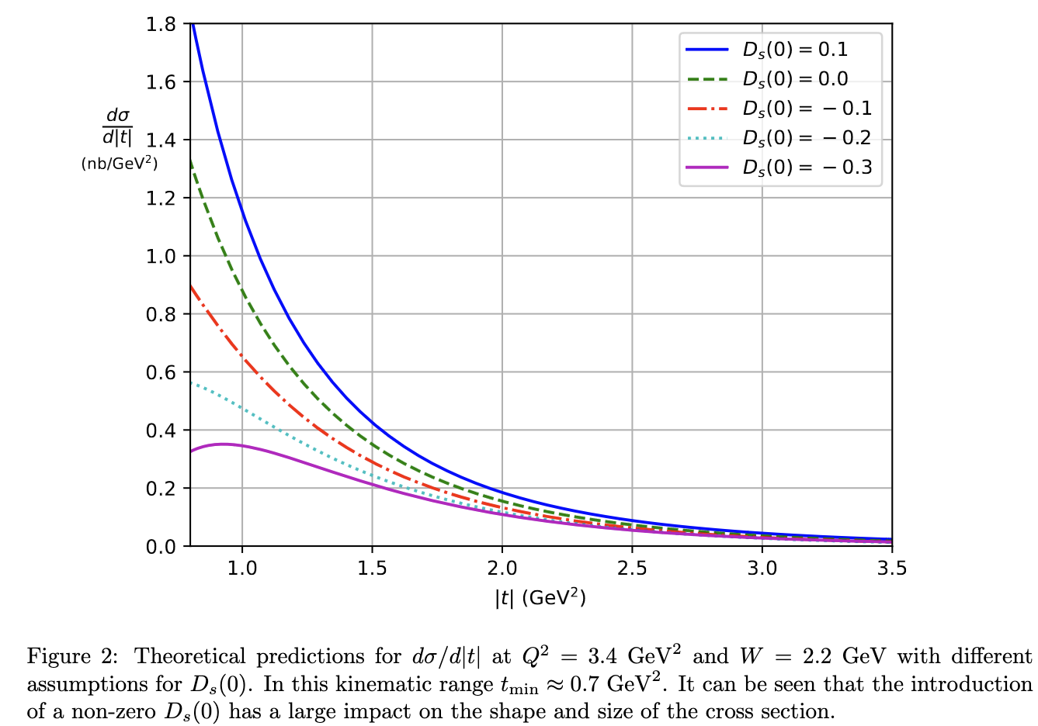
Accessing the strangeness d-term
Information on strangeness in the valence region of the proton is limited in general
Disentangling it from up & down requires use of specialized processes, e.g. W/Z exchange or kaon SIDIS
Recently, Hatta & Strikman proposed that near-threshold electroproduction of ɸ mesons could provide sensitivity to the strangeness D-term
Utilized a novel OPE framework that applies in the near-threshold region (unlike the collinear framework)
This is the only known process to access this potentially important piece of the sum rule!
ArXiv:2102.12631

Slide 13
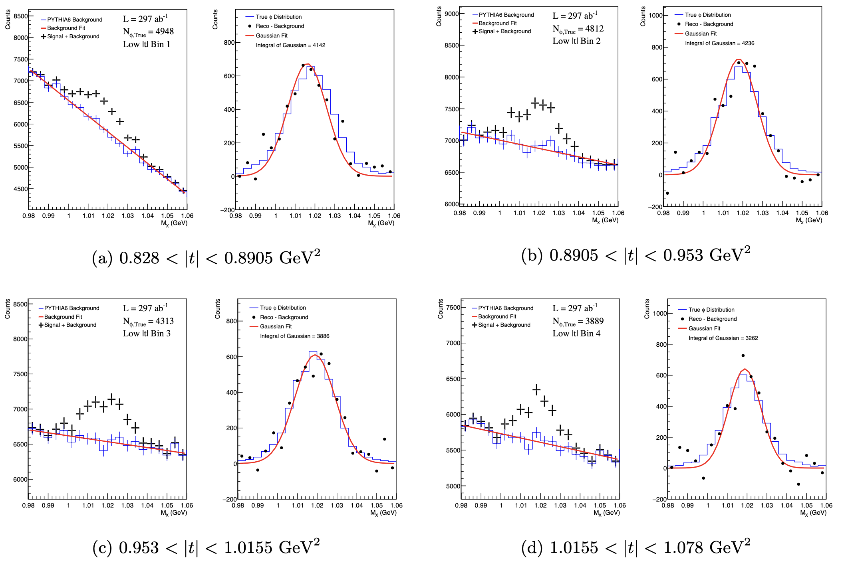
Hall C LOI
To this end, we put a letter of intent to perform a measurement of exclusive ɸ production at Q² ~ 3.5 GeV² and W ~ 2.2 GeV²
Cross section so near to the threshold is very small, need high luminosity!
Reconstruct ɸ in the missing mass spectrum of H(e,e′p) reaction
Use the excellent resolution of the Hall C spectrometers to pick out the ɸ peak above a large physics background
Background is irreducible unless additional particles can be detected
~30 PAC days required to achieve reasonable precision on ɸ yield in multiple |t| bins

Slide 14
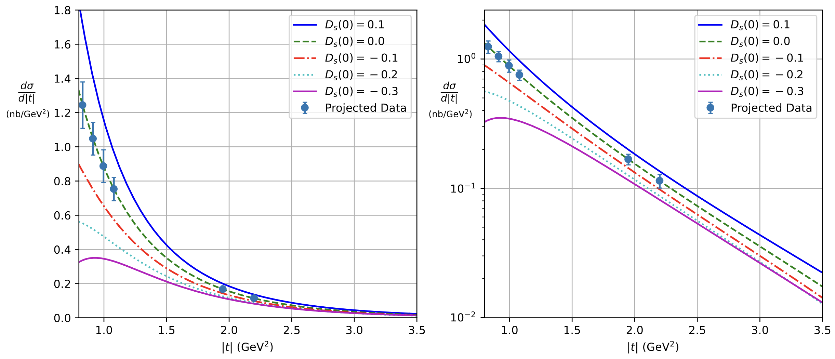
Estimated cross section uncertainty per point is ~10%
Largest uncertainty from background subtraction
Projected results show good sensitivity to D_{s}, on par with the lattice precision!

Slide 15
Reality check
The reality is (as always) that it’s not so simple!
Other physics processes can contribute to ɸ electroproduction
This will dilute the sensitivity to the D-term
Needs more phenomenological input before we can really claim an extraction of D_{s}
E.g. calculation of gluon exchange contribution within the same framework
Additional caveats:
Calculation wants Q² $≫\left|t\right|$
For $\left|t\right|$ ~ 1 GeV² is Q² ~ 3.5 GeV² high enough?
Non-linear behavior observed in the photoproduction cross section for $W<2.4$ GeV, resonances?
Pomeron exchange
(insensitive to D_{s})
Strange exchange (sensitive to D_{s})
Two gluon exchange (insensitive to D_{s})

Slide 16
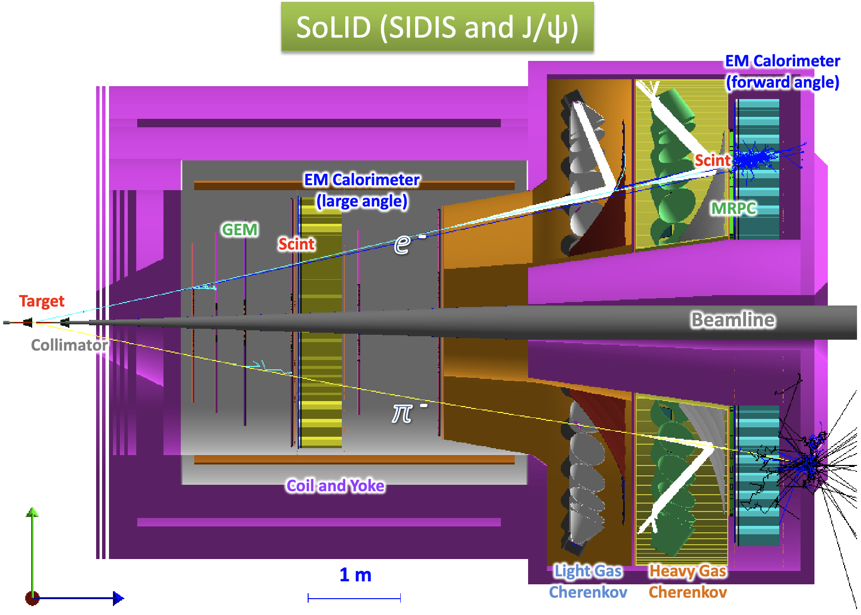
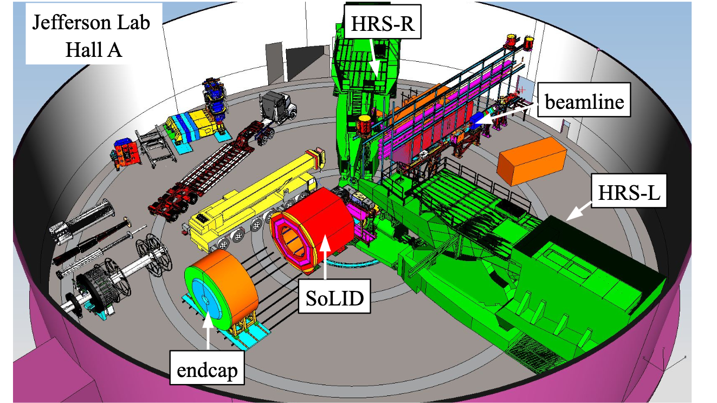
Next Steps: SoLID
Explore SoLID’s capabilities to measure exclusive ɸ at higher Q²
Large acceptance
Means ɸ decay products can be measured directly
Background can be substantially reduced
More statistics & continuous kinematic coverage for multidimensional measurement

Slide 17
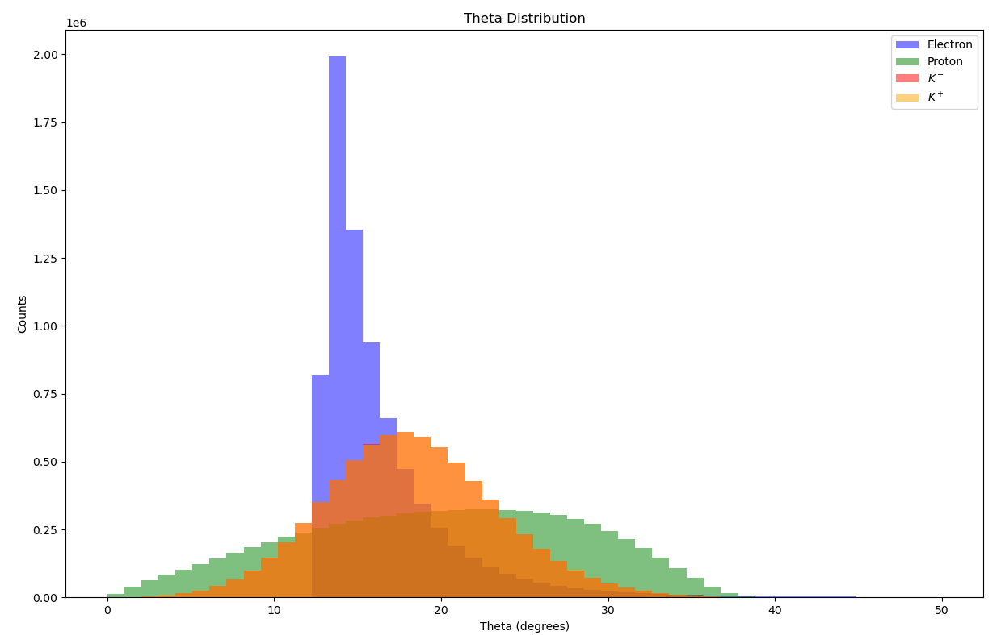
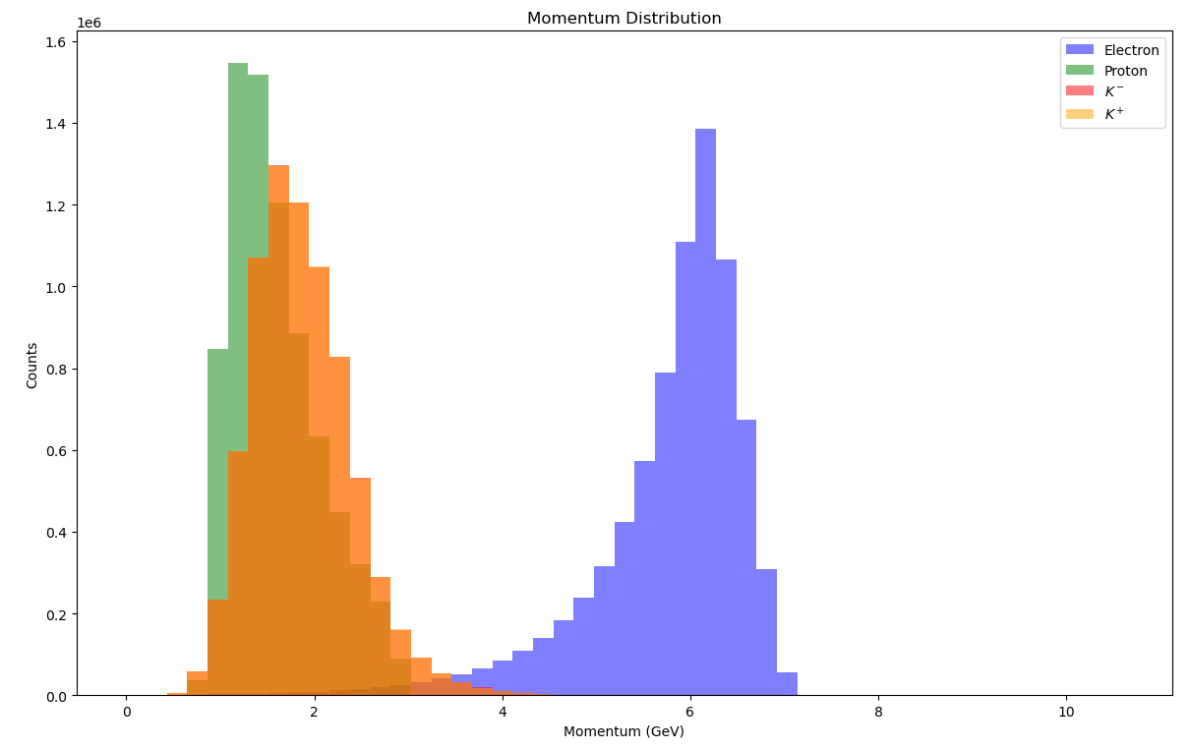
Particle distributions
Generated Kinematics:
1.96 < W < 2.4 GeV
Q² > 3.5 GeV²
|t| < 4 GeV²
The most important region is low-t, where the proton momenta are low
ɸ takes most of the momentum of the virtual photon
Produced roughly back-to-back to the scattered electron

Slide 18
Solid Analysis strategy
How much information we need to reconstruct these exclusive ɸ events?
Option 1: Fully exclusive reconstruction
Require $e+p+K^{+}+K^{−}$ (or $e+p+h^{+}+h^{−}$ )
Option 2: One missed particle
$e+p+K$ or $e+2K$
Use missing mass to reconstruct the remaining particle
Resolution on M_{x} is not great
Option 3: Full missing mass
Only reconstruct $e+p$
Background is overwhelming & resolution not good enough to pick out a ɸ peak

Slide 19
Solid Analysis strategy
How much information we need to reconstruct these exclusive ɸ events?
Option 1: Fully exclusive reconstruction
Require $e+p+K^{+}+K^{−}$ (or $e+p+h^{+}+h^{−}$ )
Option 2: One missed particle
$e+p+K$ or $e+2K$
Use missing mass to reconstruct the remaining particle
Resolution on M_{x} is not great
Option 3: Full missing mass
Only reconstruct $e+p$
Background is overwhelming & resolution not good enough to pick out a ɸ peak
Assume this technique for all that follows

Slide 20
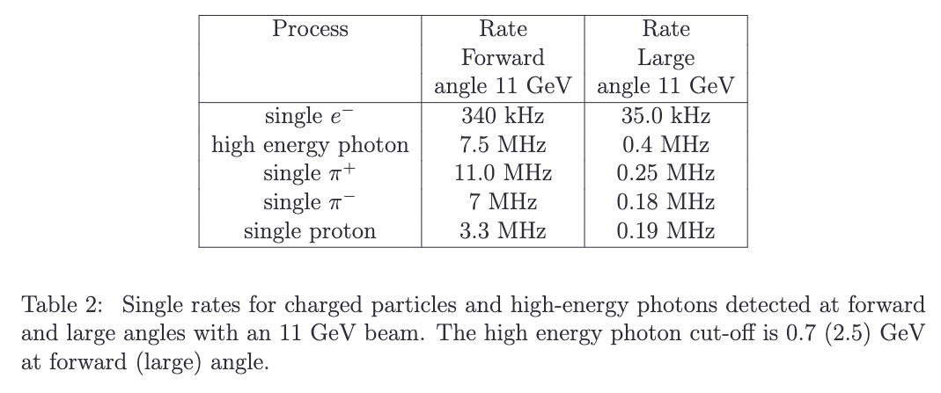
trigger strategy
Cannot use $J/ψ$ or TCS triggers
$H(e,e′p)$ channel isn’t enough to reconstruct a ɸ on its own
Don’t lose anything by requiring a triple coincidence in the trigger
Trigger on electron at large angle + two charged hadrons at forward angles
Detected $e+p+K^{+}+K^{−}$ rate from signal ɸ events is ~10 Hz
Large angle electron trigger threshold of 3 GeV
Going from 2.5 to 3 GeV reduces photon rate by a factor of 4.4 with respect to the $J/ψ$ number of ~400 kHz
R_{Trig.} $=\left(R_{π,FA}+R_{p,FA}+R_{γ,FA}\right)∗\left(R_{π,FA}+R_{p,FA}+R_{γ,FA}\right)∗T_{Window}∗\left(R_{e,LA}+R_{γ,LA}+R_{h,LA} \right)∗T_{Window}$
Where R is the rate of triggers

Slide 21
trigger strategy
Cannot use $J/ψ$ or TCS triggers
$H(e,e′p)$ channel isn’t enough to reconstruct a ɸ on its own
Don’t lose anything by requiring a triple coincidence in the trigger
Trigger on electron at large angle + two charged hadrons at forward angles
Detected $e+p+K^{+}+K^{−}$ rate from signal ɸ events is ~10 Hz
Large angle electron trigger threshold of 3 GeV
Going from 2.5 to 3 GeV reduces photon rate by a factor of 4.4 with respect to the $J/ψ$ number of ~400 kHz
R_{Trig.} $=$ ~80 kHz
Rate is high, should be reduced if we want to run in parallel with existing proposals
Streaming RO? TOF in trigger? Track trigger?

Slide 22
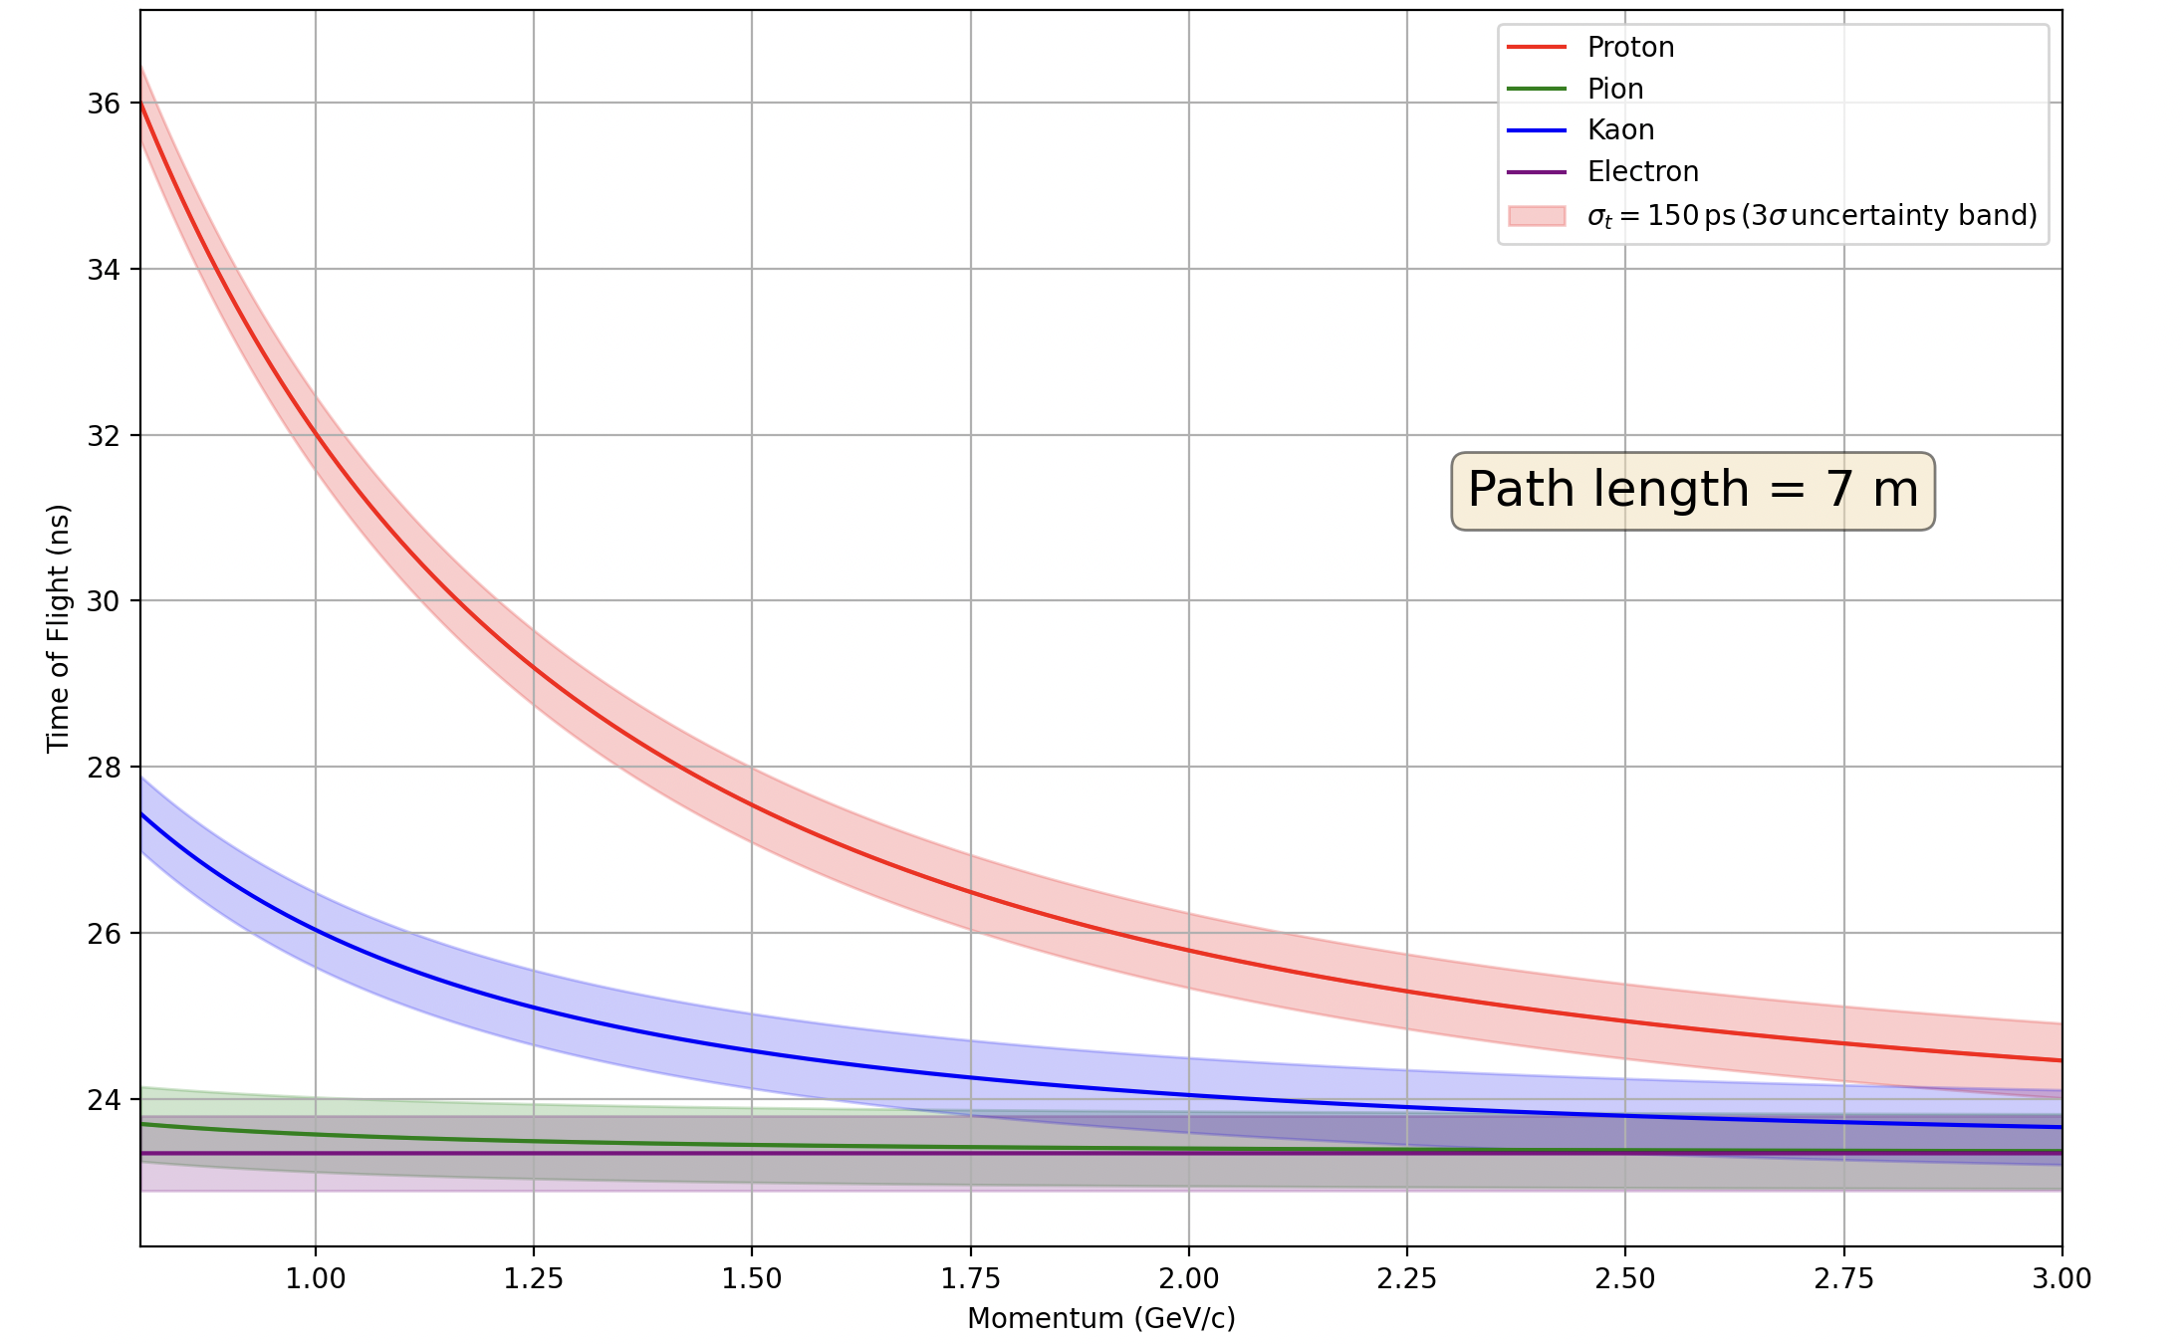
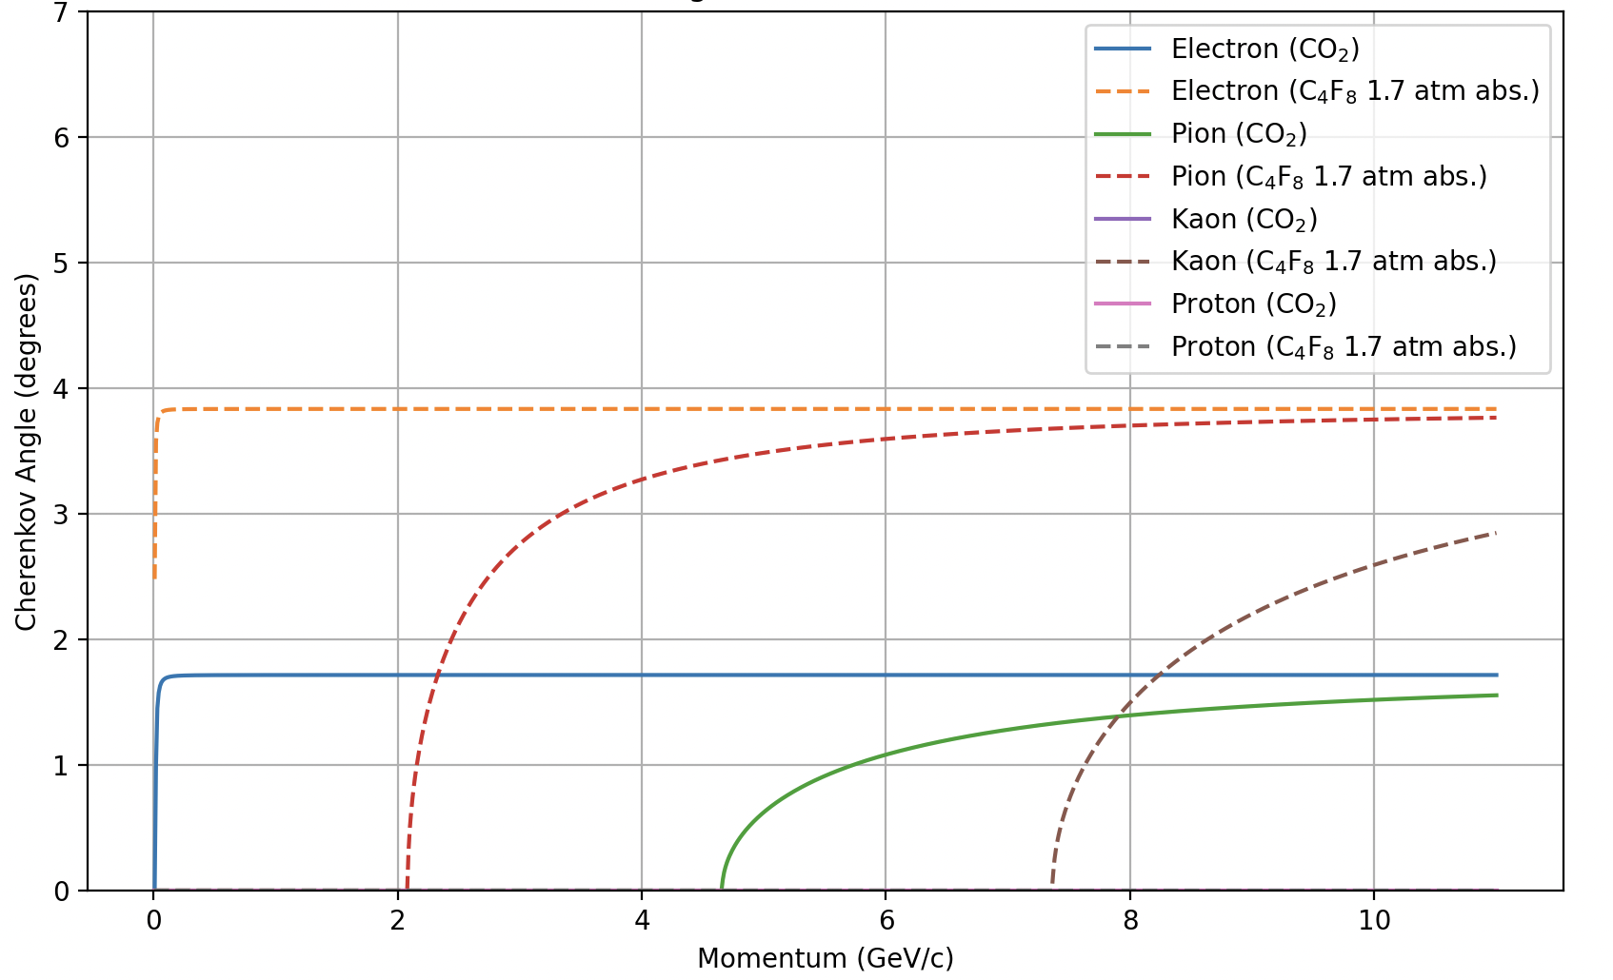
PID
Kaons from decay of ɸ should be PID’d to reduce background
Range of K^{+,-} momentum from ~1-4 GeV in forward detector
HGC will provide $π$ rejection above 2.5 GeV
150 ps TOF covers 3σ $π/K$ up to ~2.5 GeV
MRPC would handle this better, reduce the reliance on HGC near its threshold
Scattered proton is low momentum, typically 1-2 GeV
TOF should be able to handle it

Slide 23
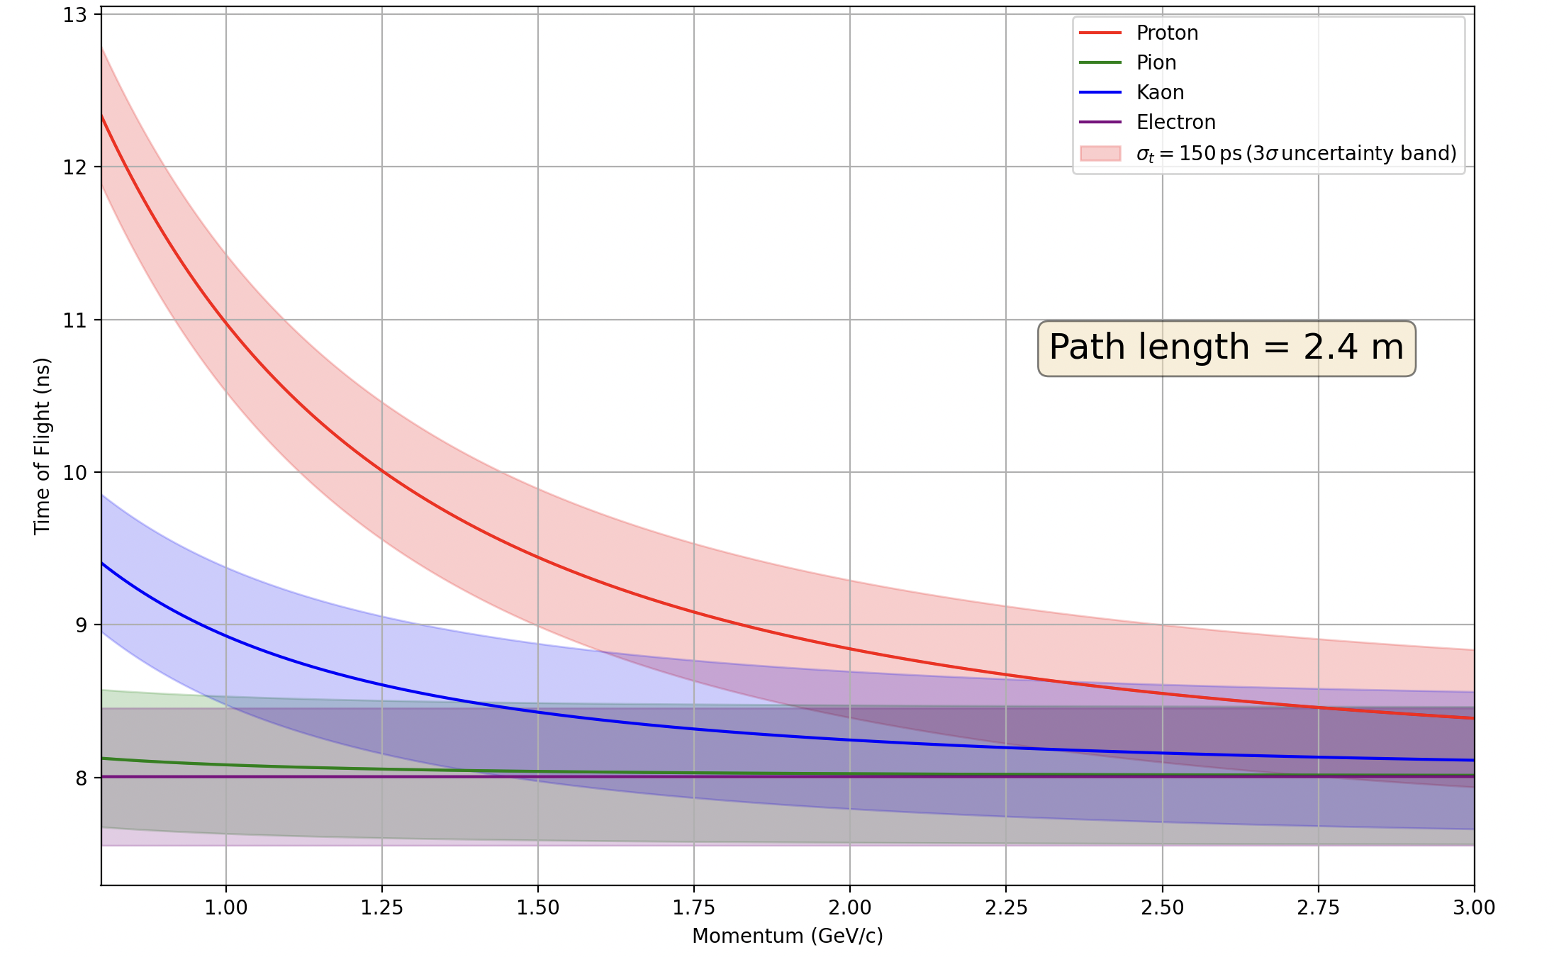
Analysis strategy
Kaons:
Forward detector has superior PID
Longer TOF baseline + Cherenkovs to reject fast pions
MRPC would handle PID over whole momentum range
SPD TOF could handle it up to where the HGC turns on
Require kaons to be in forward detector
Protons:
Large-angle detector can PID protons up to ~ 2 GeV with SPD TOF
Allow protons in forward or large angle detectors
Electrons:
Acceptance for fully exclusive reconstruction is best when electron is at large angle
Require electron in large angle

Slide 24
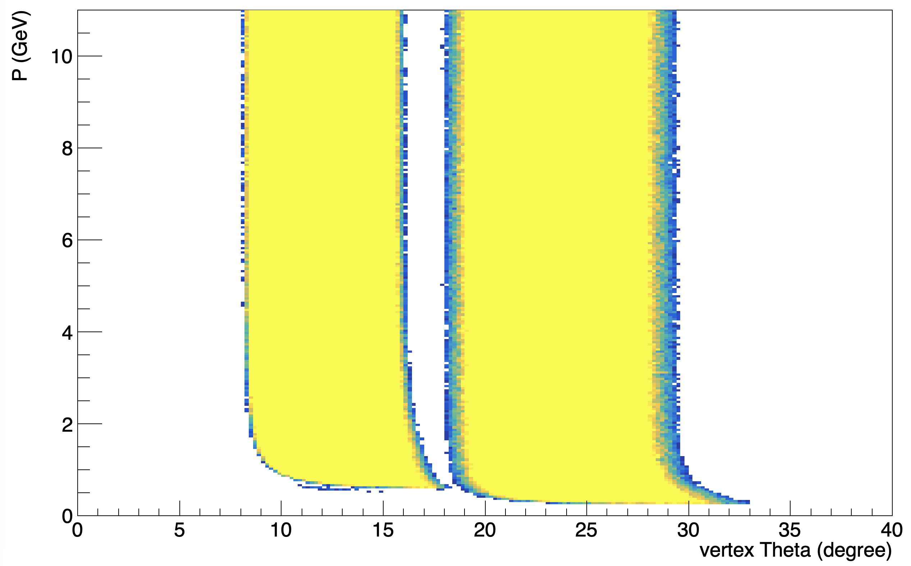
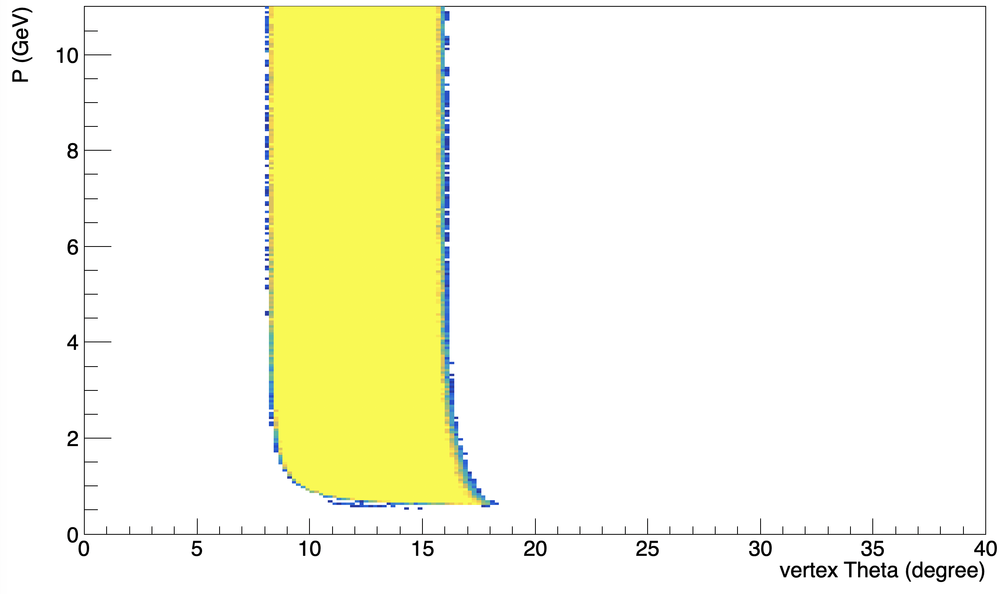
Acceptances & Momentum smearing
Utilize an approximate acceptance map for $J/ψ$ setup
Scaled by a factor of 0.9 for projections
Assume a 2% resolution on reconstructed momentum
Ideally would use full detector simulation including PID
Protons + electrons
Kaons
FAD
LAD
FAD

Slide 25
Acceptances & Momentum smearing
Utilize an approximate acceptance map for $J/ψ$ setup
Scaled by a factor of 0.9 for projections
Assume a 2% resolution on reconstructed momentum
Ideally would use full detector simulation including PID
Protons + electrons
Kaons
MAD?
FAD
LAD
RAD?
FAD
BAD?
SAD?

Slide 26
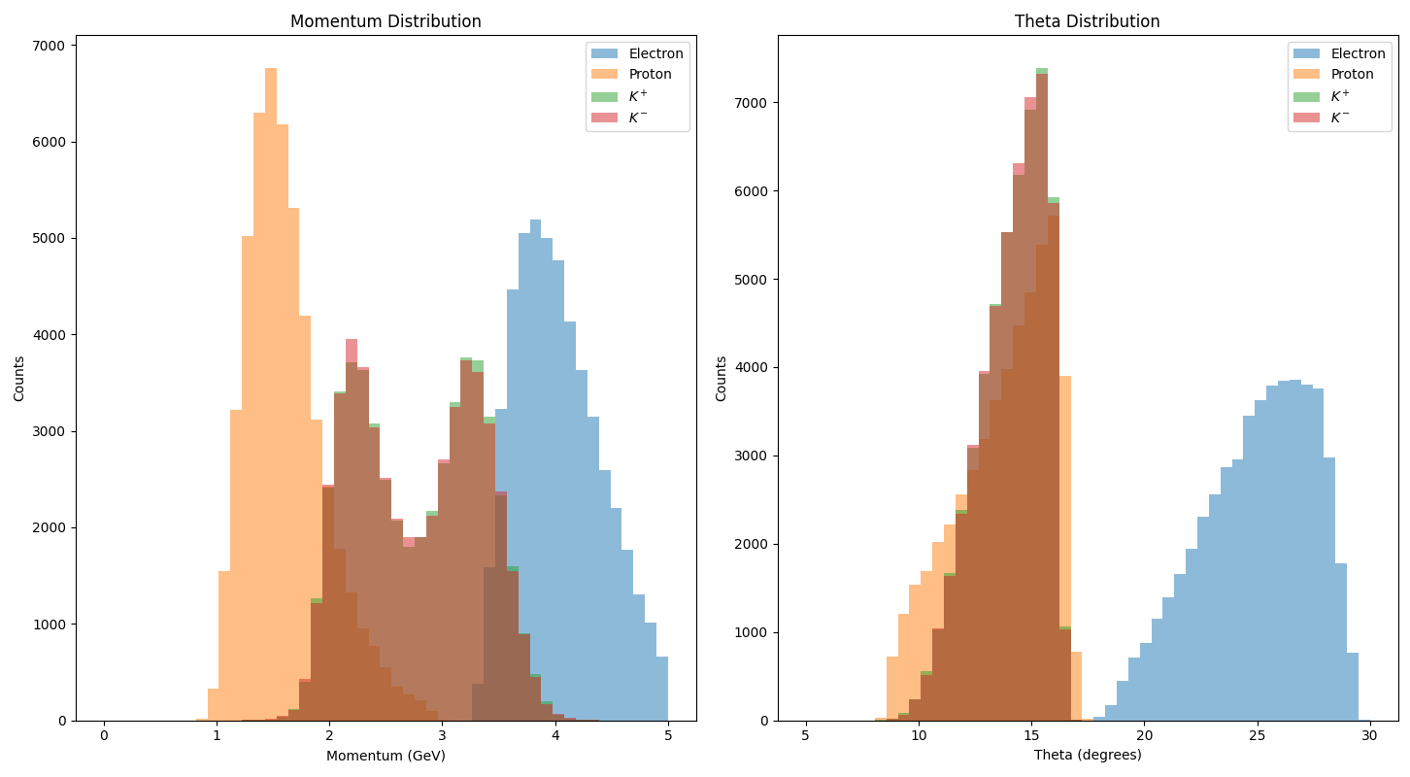
Reconstructed Quantities
50 days at 10³⁷ cm⁻²/s
Kinematics strongly constrained by requirement of being near-threshold
Highest statistics at quite high Q²
Ideal for comparison to OPE predictions!
Sufficient statistics to measure multi-differentially in W, Q²!

Slide 27
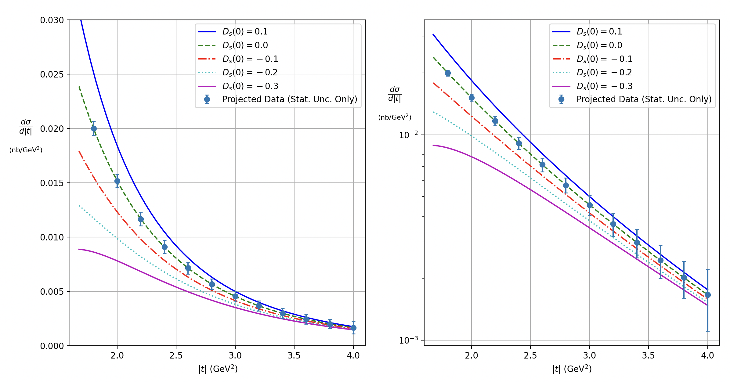
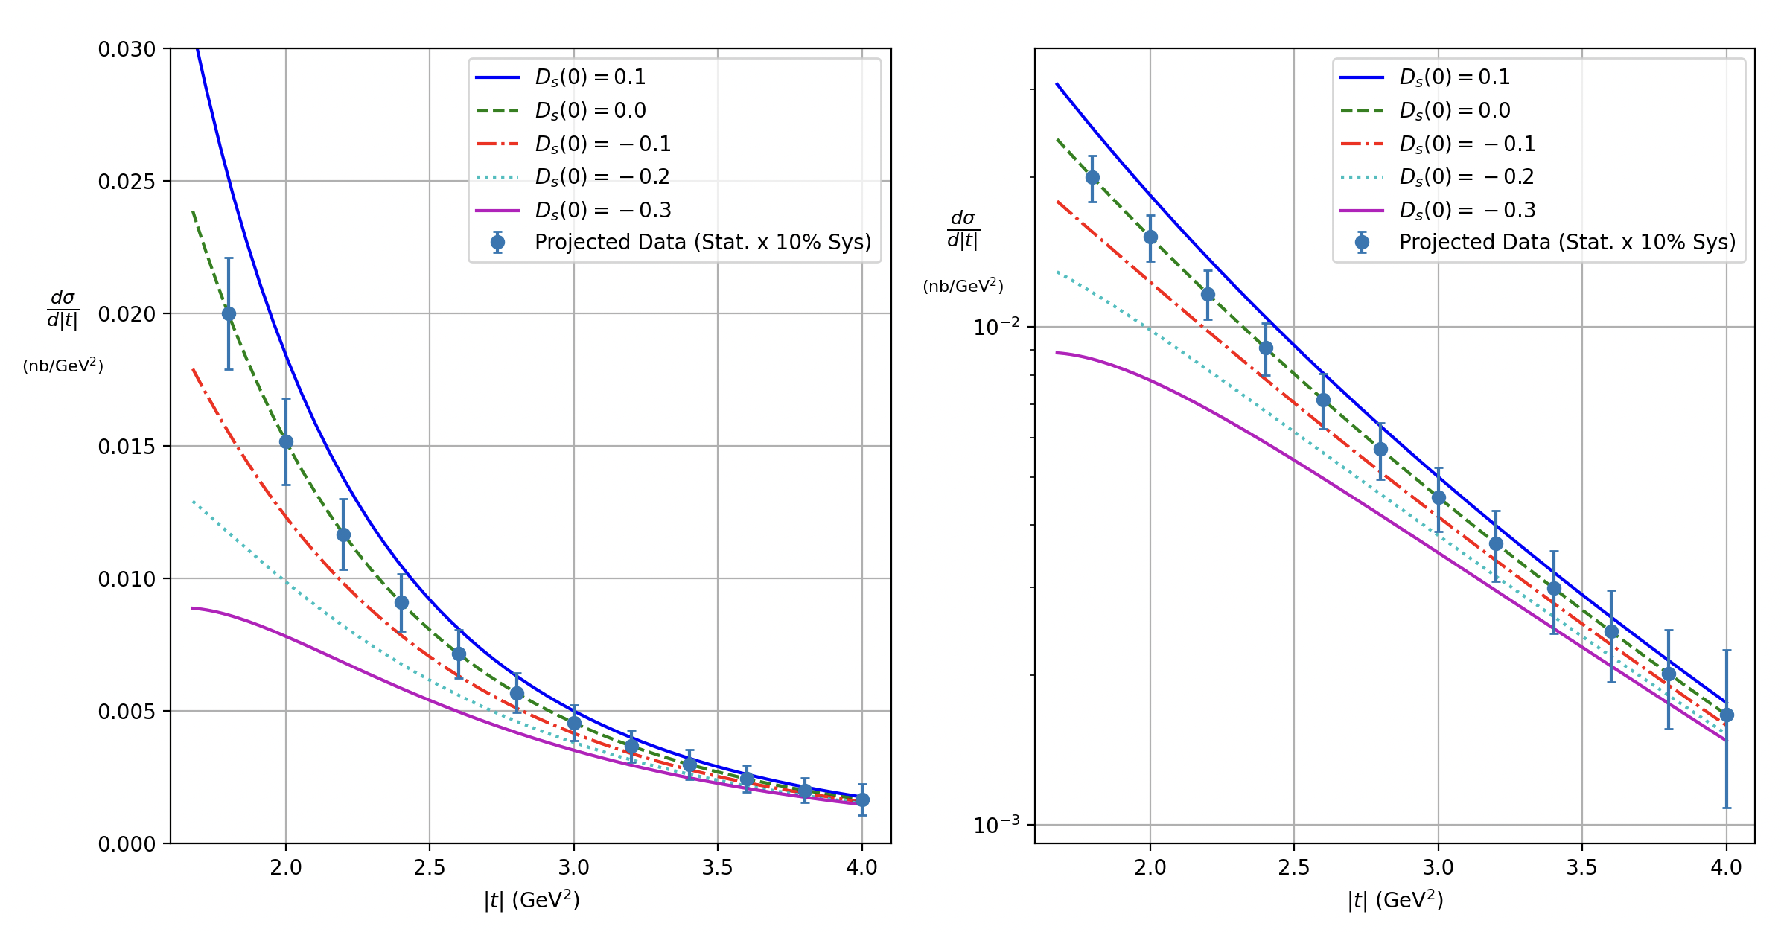
Projections
First look at some projections
Assume 50 days at 10³⁷ cm⁻²/s
~43 ab⁻¹
Events generated according to CLAS12 model
8 < Q² < 9 GeV² (2-3x Hall C)
2.2 < W < 2.4 GeV
This is only one bin of many!
Pessimistic assumption of 10% uncertainty in quadrature with statistical uncertainties
Even in the pessimistic scenario, exhibits good sensitivity to D_{s}!
Stat. Unc. Only
10% Sys. $⊕$ Stat.

Slide 28
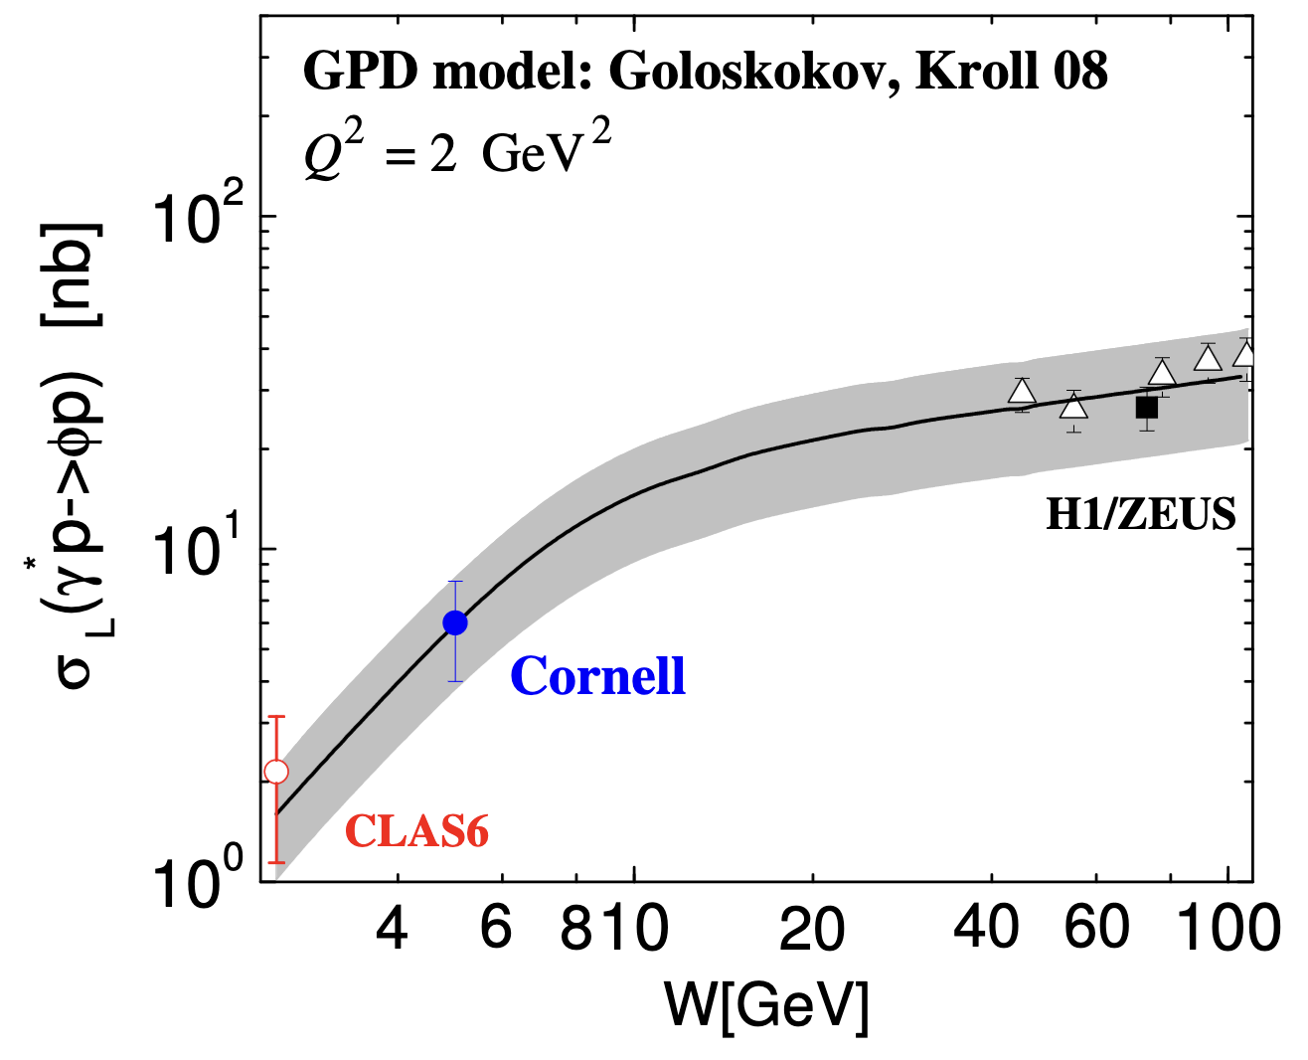
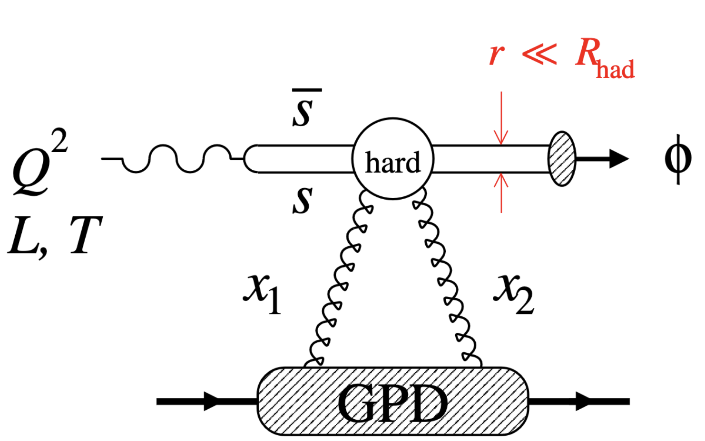
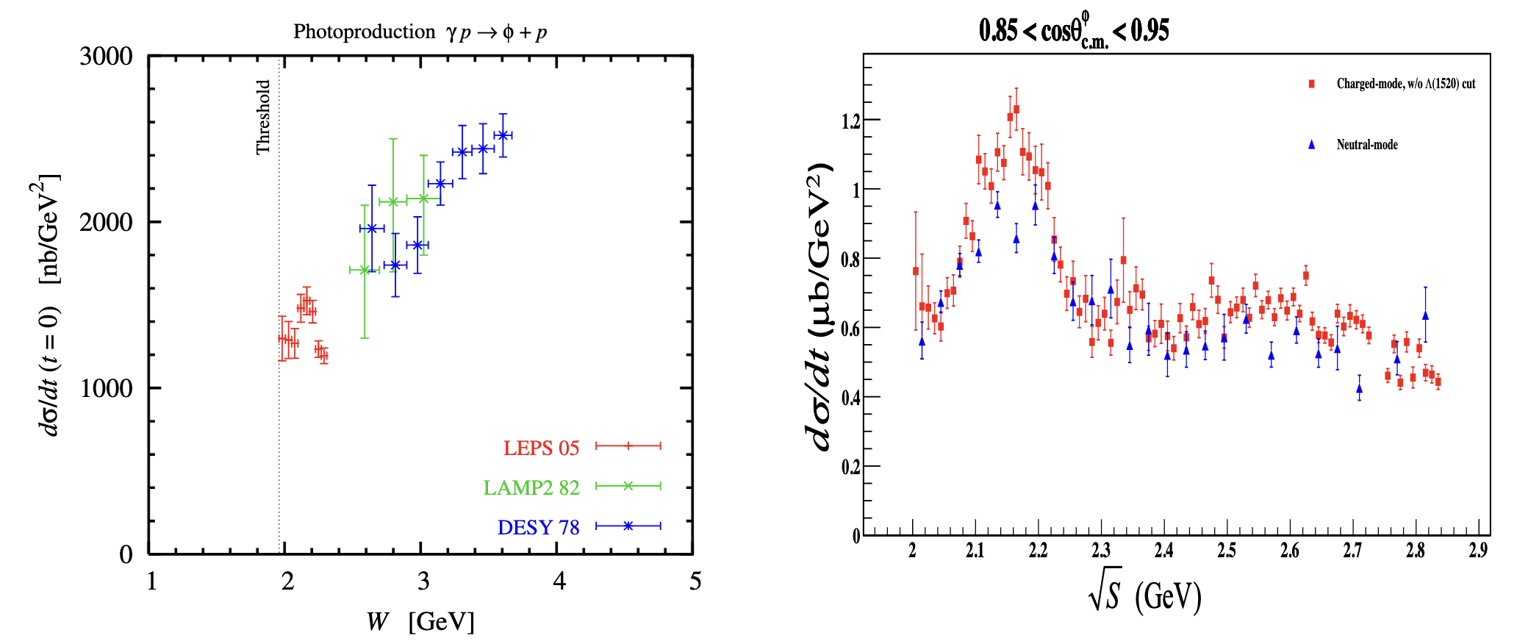
Beyond D_{s}
To leading order, exclusive ɸ @ SoLID can access the same physics as ɸ @ CLAS12
At large W the exclusive ɸ process is proposed to be sensitive to the gluon GPD at high-x
Much larger cross section
High precision attainable
Investigate the non-monotonic behavior observed in ɸ photoproduction
Study how it evolves into the electroproduction regime
Needs continuous acceptance in W provided by SoLID

Slide 29
Conclusion
If we ever want a complete experimental measurement of the total D-term of the proton, will need to measure the strangeness D-term
More theoretical & phenomenological input is needed!
SoLID provides a unique opportunity to measure near-threshold exclusive ɸ electroproduction, the only known process sensitive to D_{s}
Only SoLID will have the luminosity & acceptance to perform a percent-level measurement of this cross section in the foreseeable future

Slide 30
Backup

Slide 31
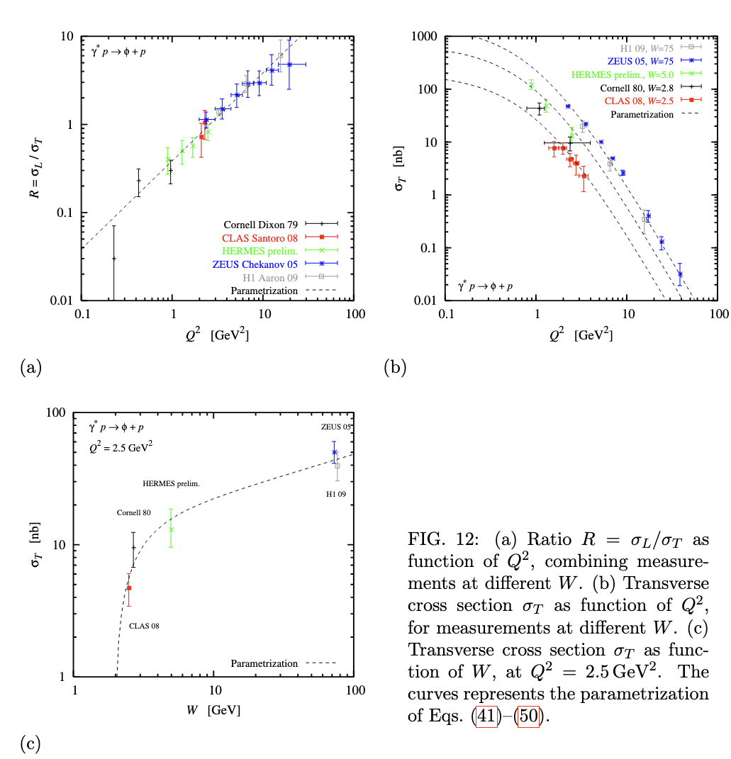
Cross section Model
Utilize the parameterization of world data developed for CLAS12 exclusive ɸ proposal to PAC39
Events generated according to these parameterizations using the lAger event generator
$t$-dependence parameterized as a dipole

Slide 32
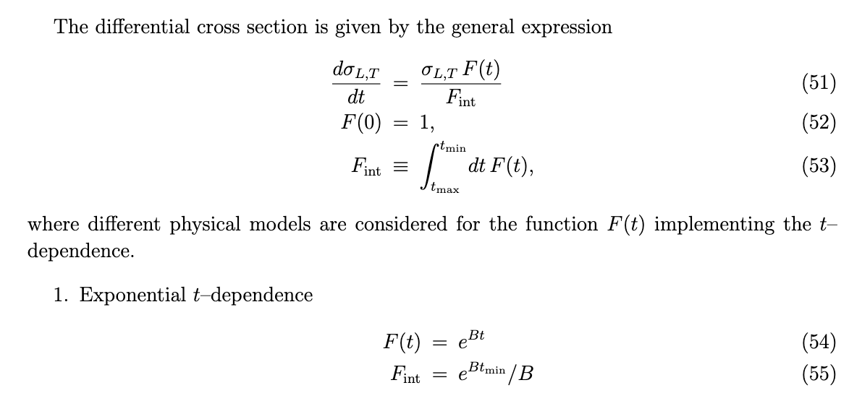
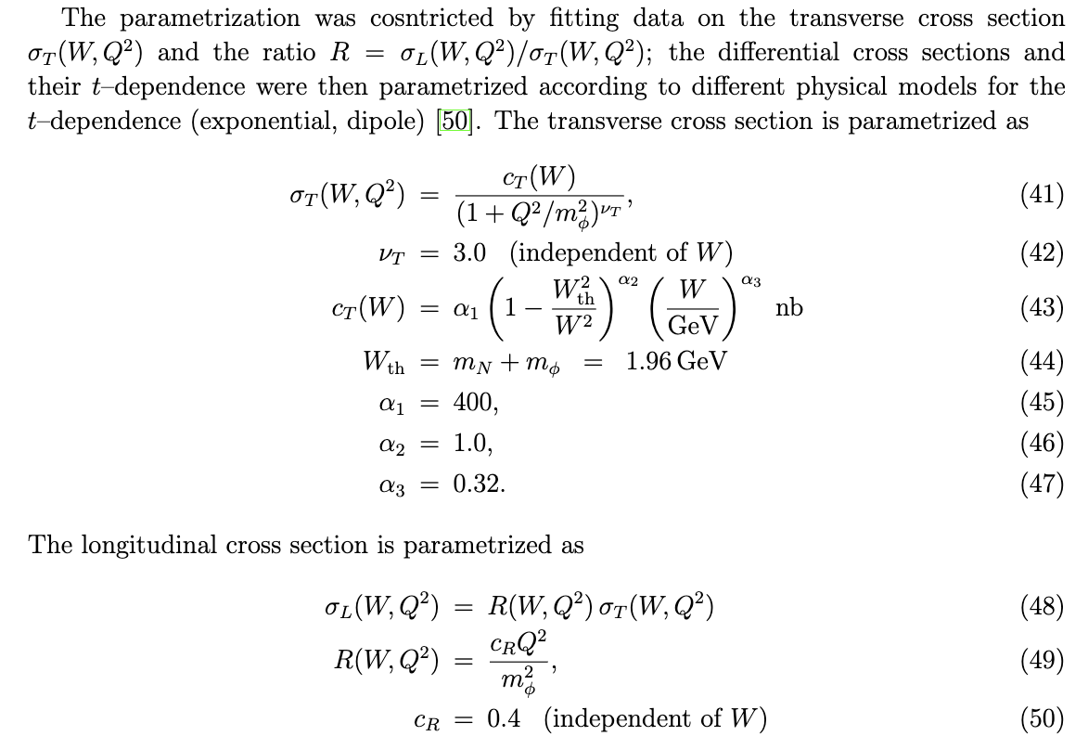
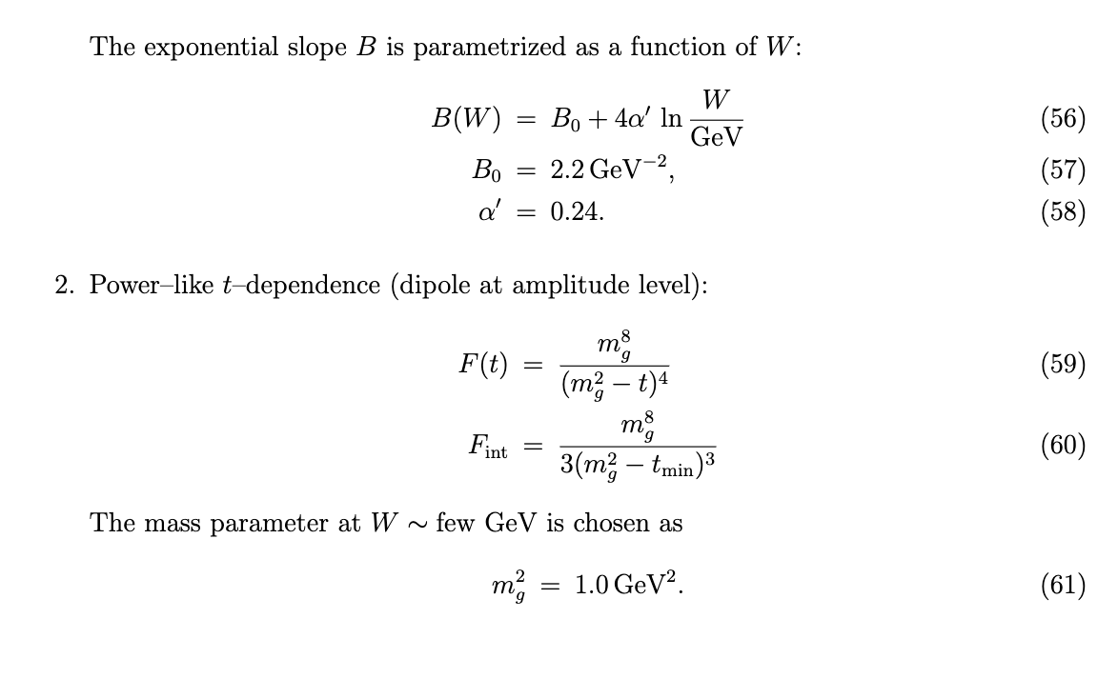
Cross section Model

