Slide 1


ECAL Progress
Dong Liu , Ziqi Huang, Hao Sun, Shulong Ji , Cunfeng Feng
ShanDong University
June 22 , 2024
SoLID Collaboration Meeting June 2024

Slide 2
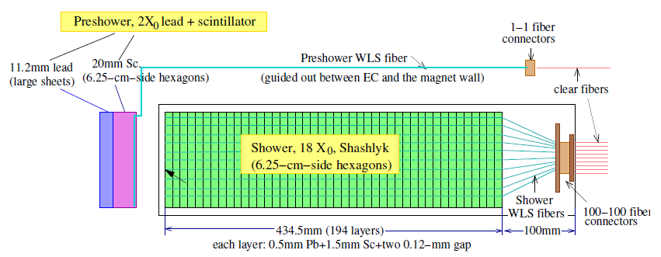
Shashlyk Style Ecal Design
Longitudinal design: preshower + shower (2+18 X₀)
  Preshower: one layer lead and scintillator.
  Shower module: (0.5mm lead + 0.1mm reflector×2 + 1.5mm scintillator) ×194 + 96 WLS fibers penetrate.
Transversal design: 100 cm² hexagon, arranged in a ring shape
Notes:
为了满足以上性能指标要求，我们设计了。。。。。加入了。。。设计。它的结构如下图所示。Preshower，中间主体部分是。。。。。。最终使用时。。。。。。

Slide 3
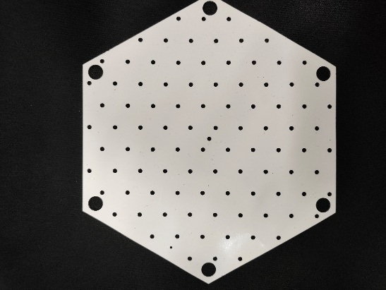
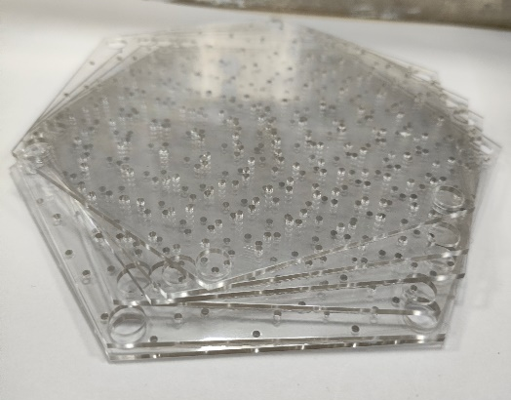
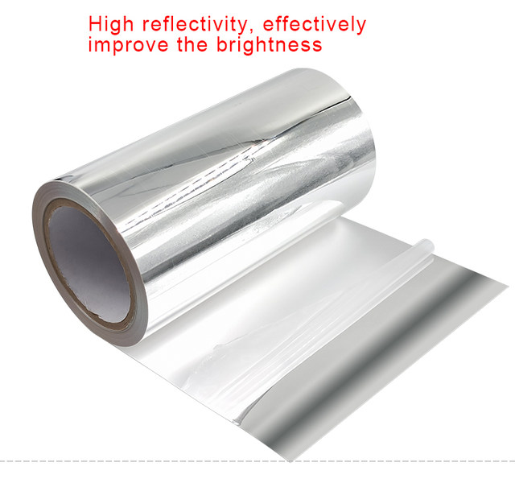
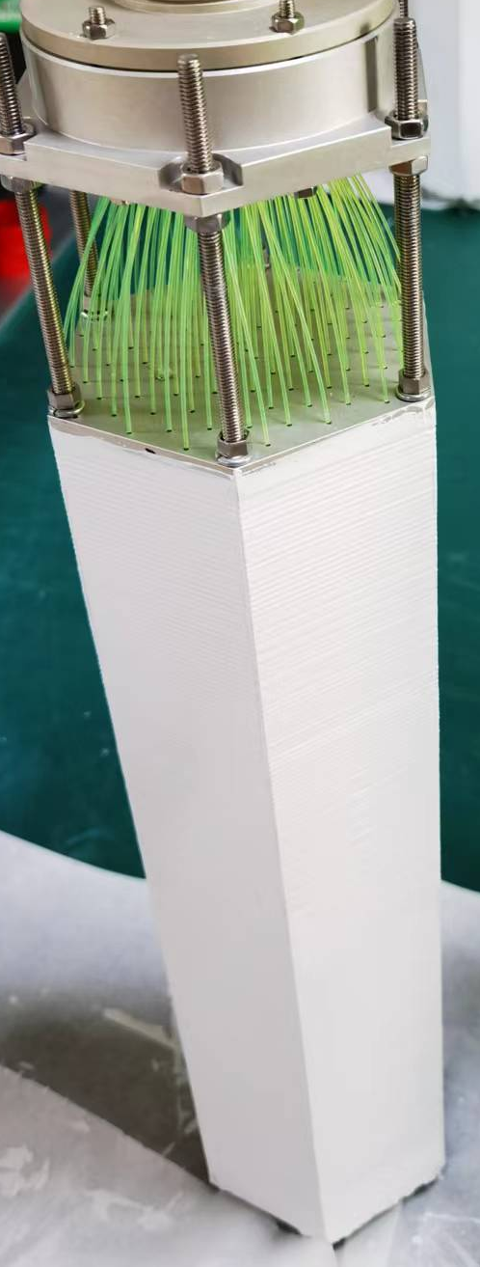
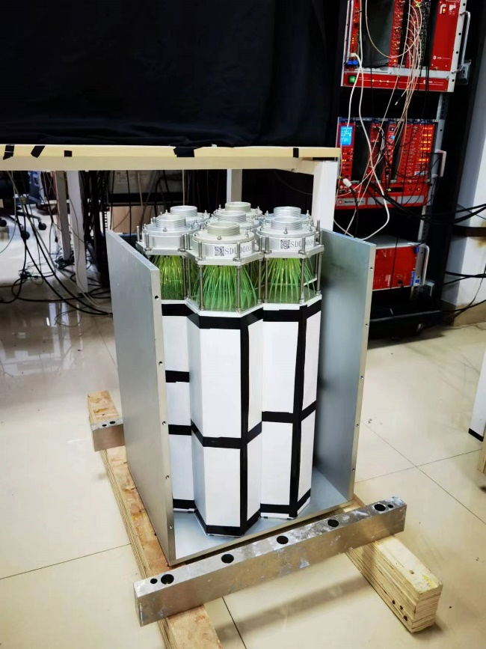
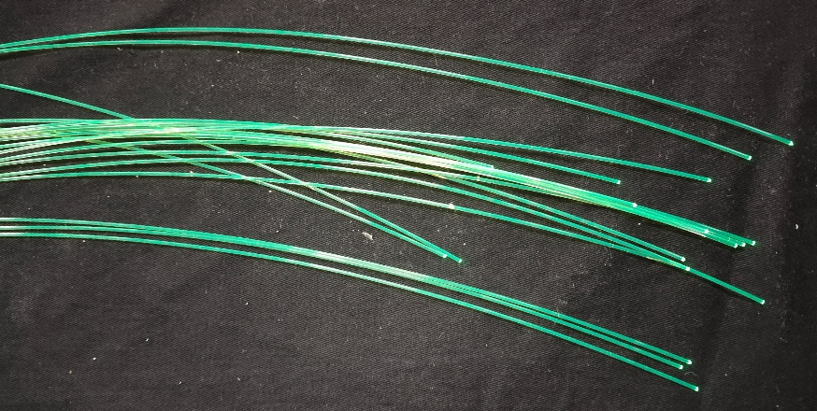
Ecal Material Overview
Lead Sheet with Reflective Coating
Plastic Scintillator
ESR
Part | Type/Material
Scintillator | KEDI/Hengxin
WLS fiber | Y11 multi-cladding
outside surface | TiO₂
fiber end reflector | ESR film
lead | paint TiO₂*
optical reflective glue
tyvek
*instead of reflective layer between lead
WaveLength-Shifting fiber
Notes:
铅片，星睿安电子科技有限公司。胶
闪烁体和铅片。。。。。。6.5cm。
WLS fiber
ESR 3M
自己混合出的光学反射胶。也是TiO2.

Slide 4
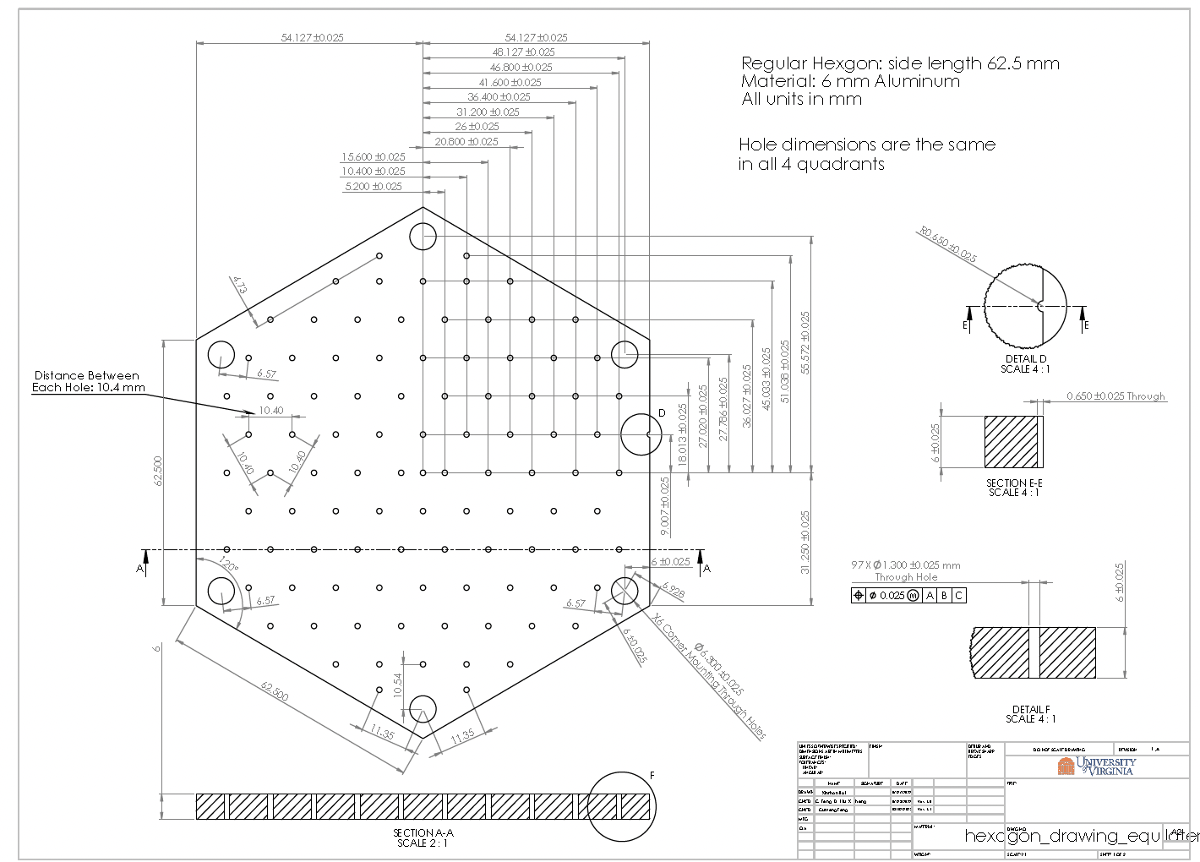
Scintillator
Kedi Scintillator - Old Hole Design
Hengxin Scintillator - New Hole Design and injection mold
  Batch0: Plastic without Scintillating Material for Size Testing
  Batch1 ( June 2023 ): 200 pieces
  Batch2 (Mar 2024): 1500 pieces
New Design -Xinzhan Bai

Slide 5
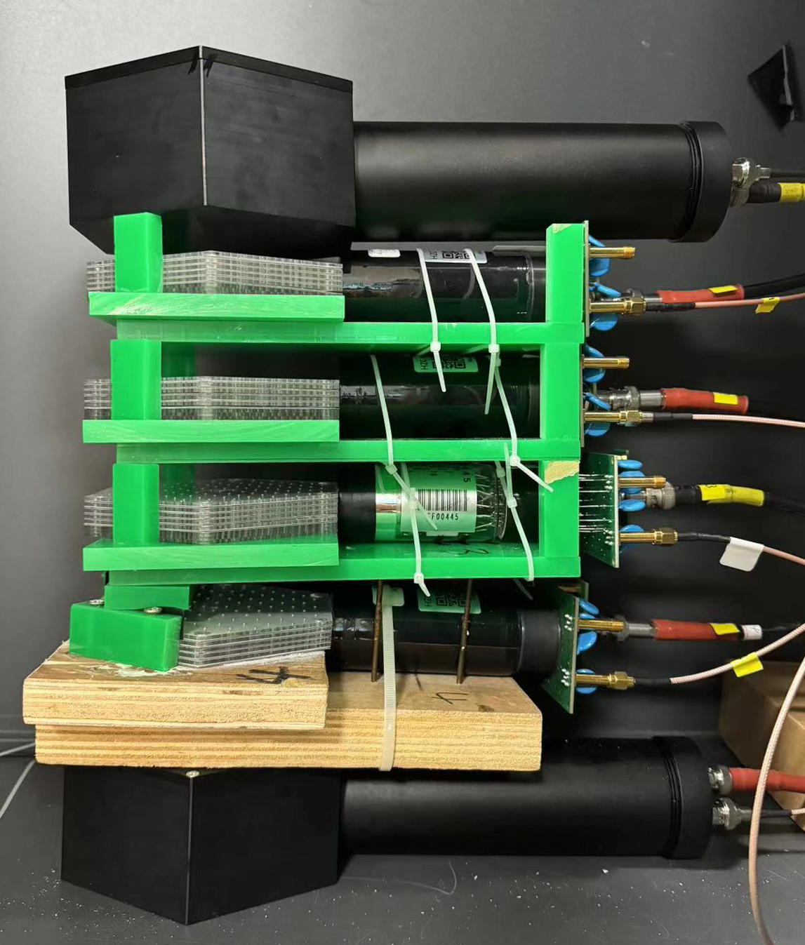
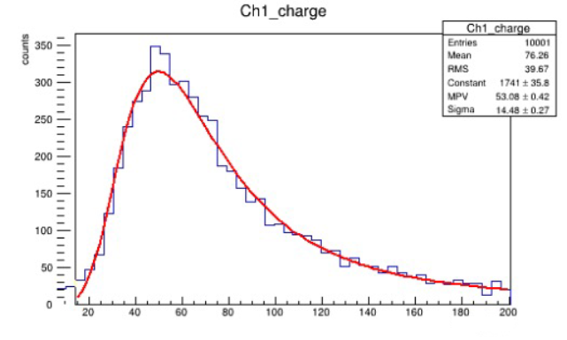
Cosmic Test for Light Yield
Test 4 Groups of Scintillators Each Time. G1-G4
Each Group: 5 Pieces of Scintillators
Trigger top
PMT 0
Scintillator G1
PMT1
Scintillator G2
PMT2
Scintillator G3
PMT3
Scintillator G4
PMT4
Trigger bottom
PMT5
Obtain the MPV Value for each group

Slide 6
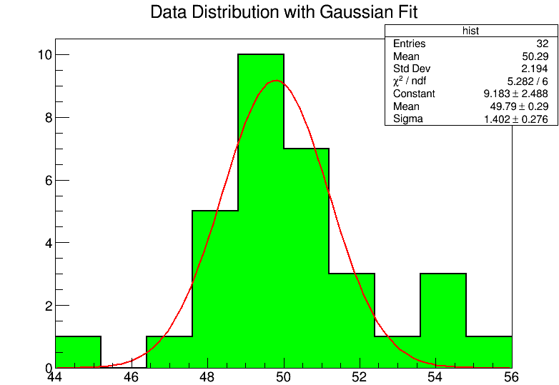
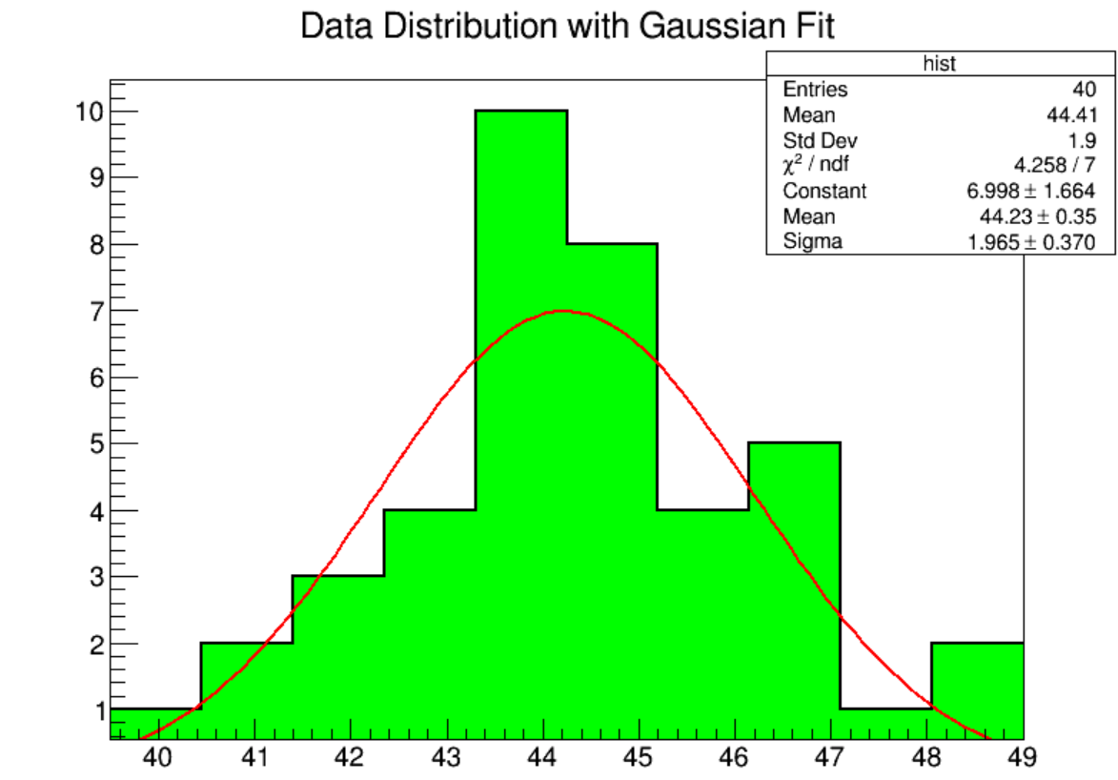
Test Results
NPE NPE
Hengxin batch1 （ σ =1.4，Mean=49.8） Hengxin batch2（ σ =2.0，Mean=44.2）
32 groups 40 groups

Slide 7
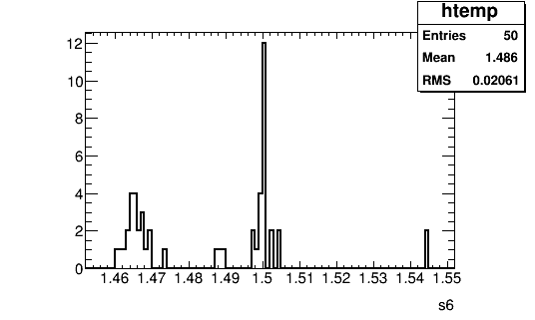
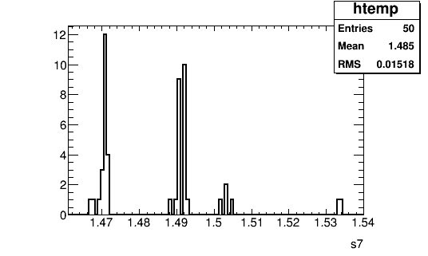
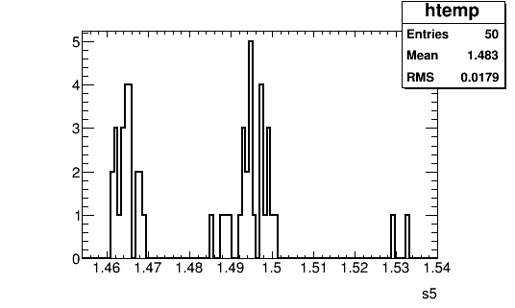
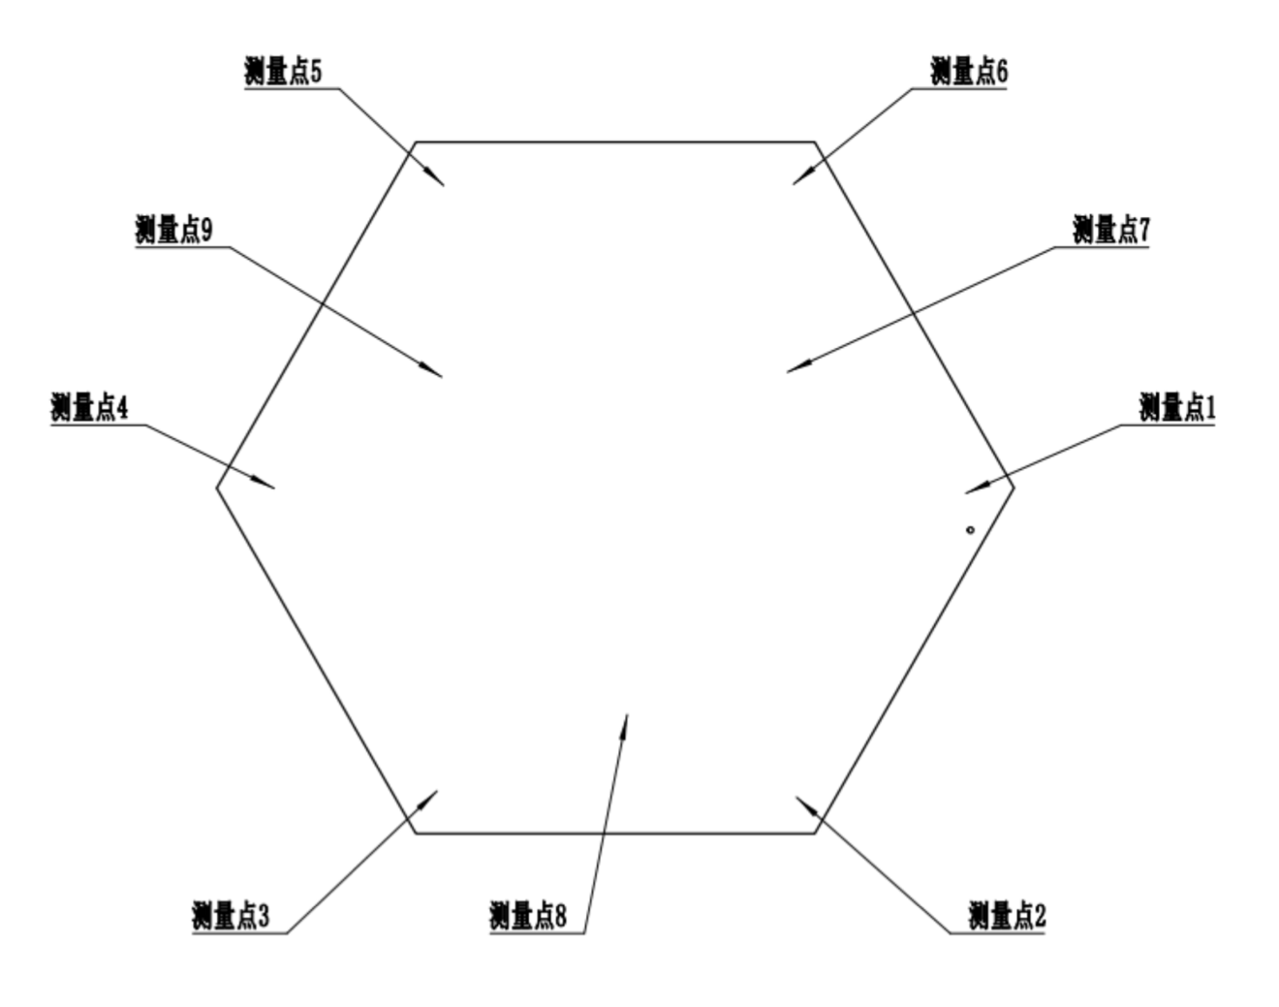
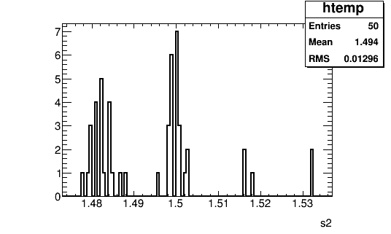
Thickness of Kedi Scintillator. ~1.49mm
Thickness Variation for a Single Point:
±0.02mm

Slide 8
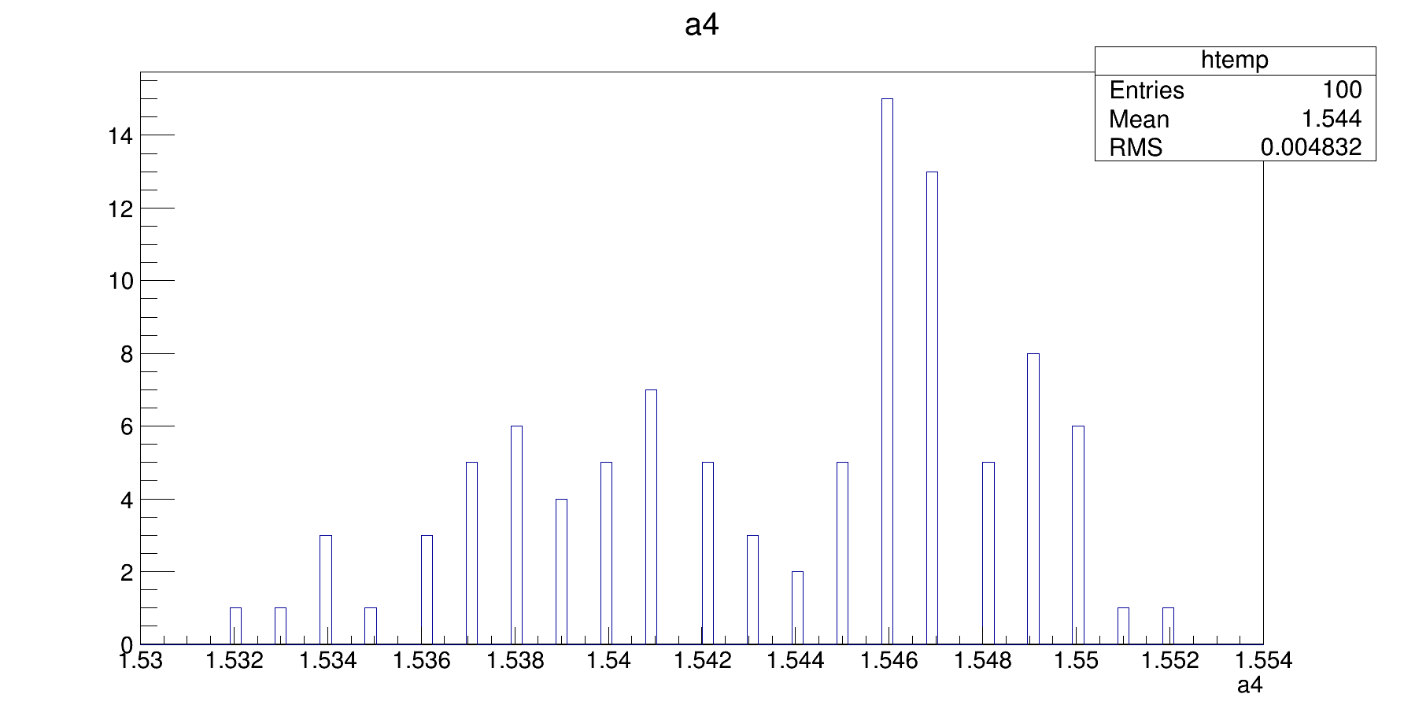
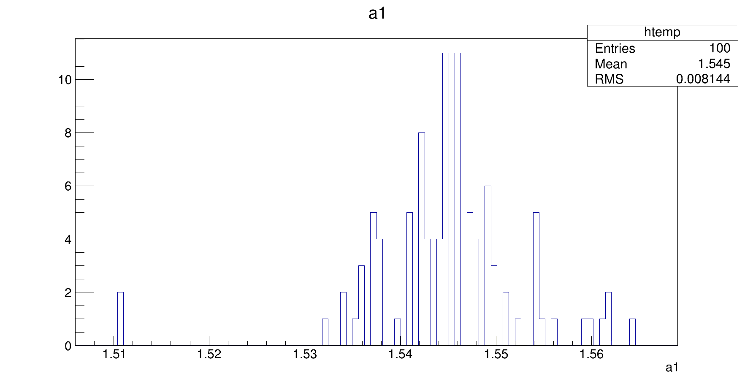
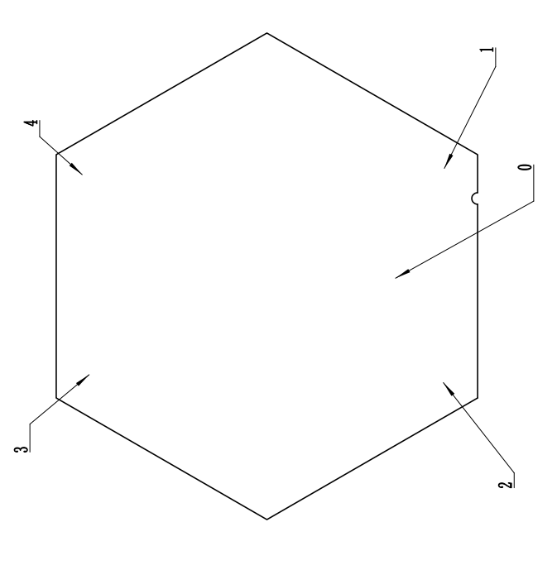
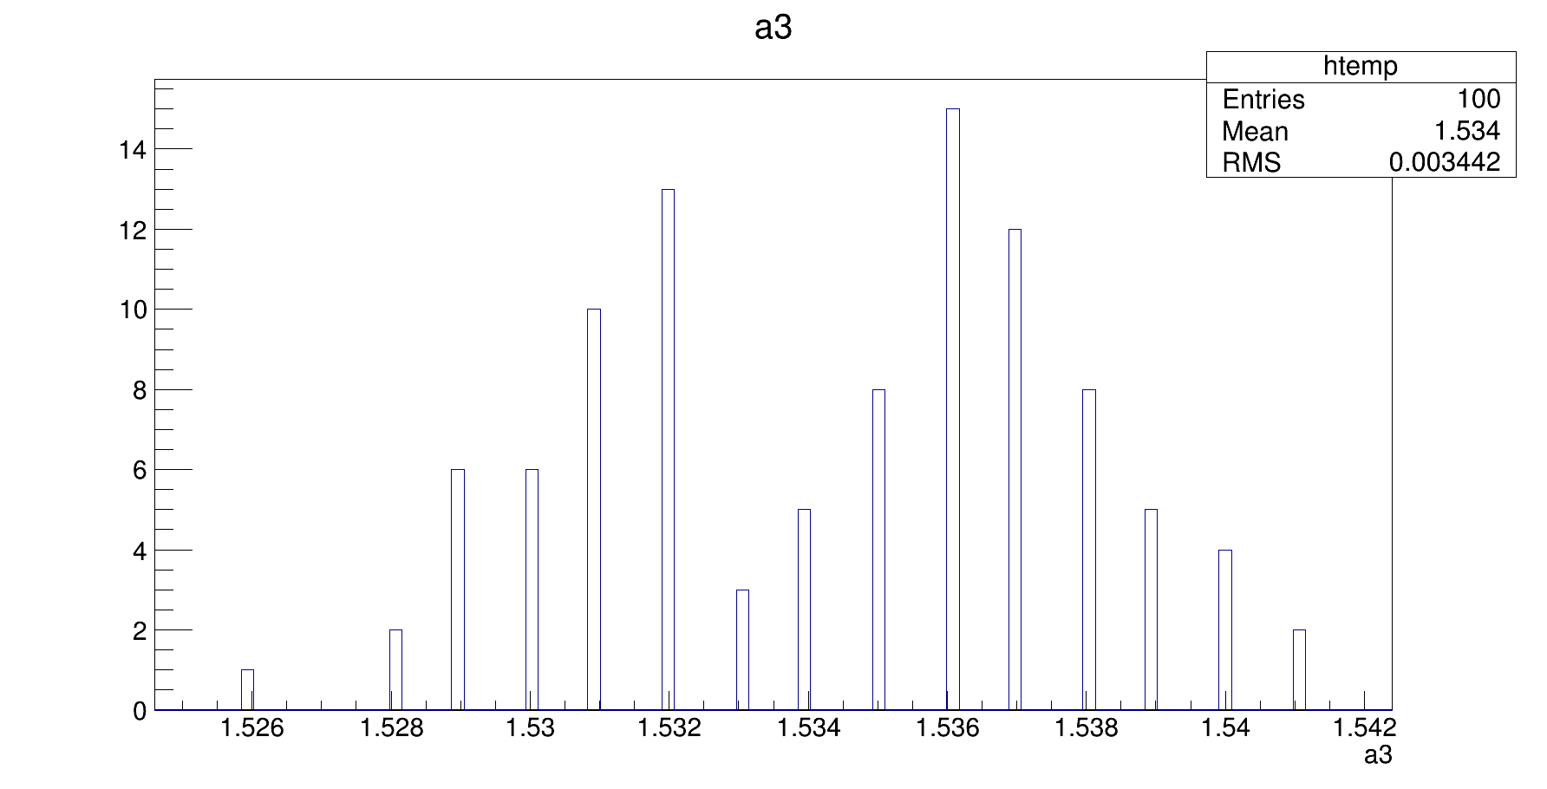
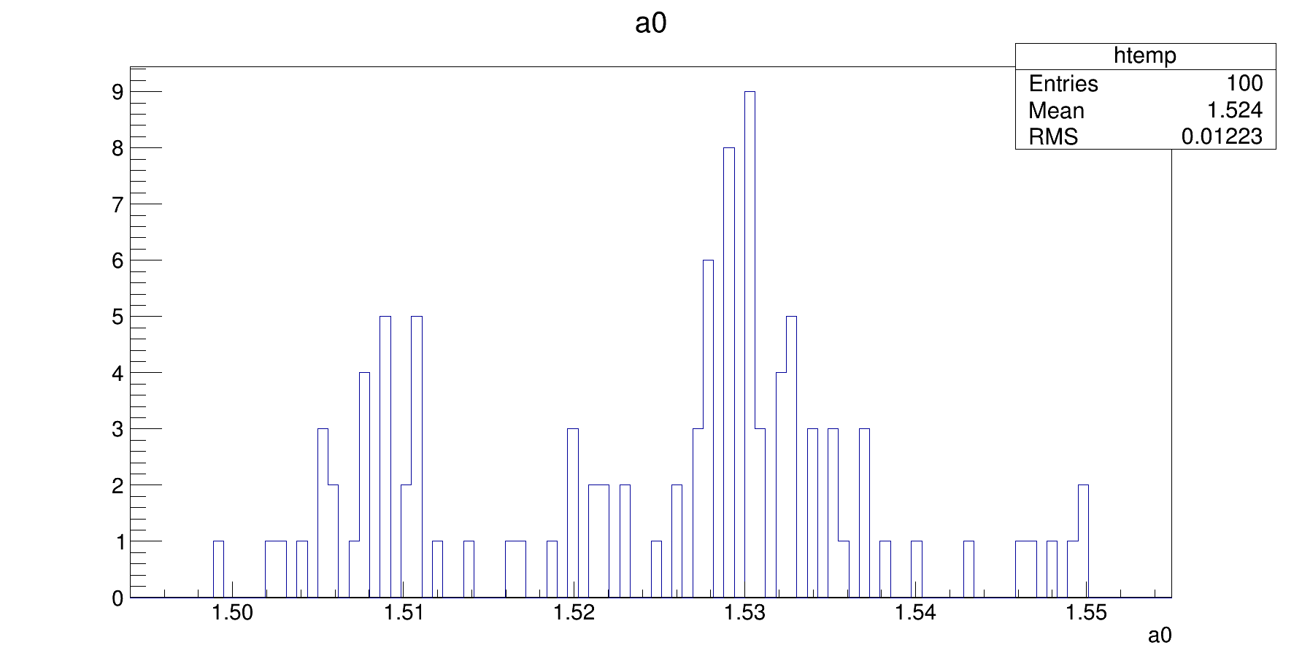
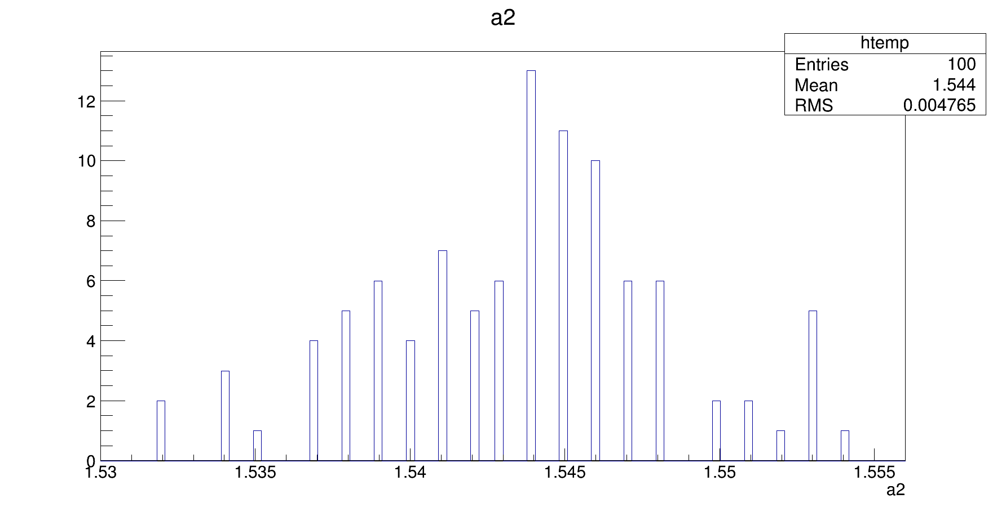
Thickness of Hengxin Batch 0 Plastic Piece: ~1.54mm

Slide 9
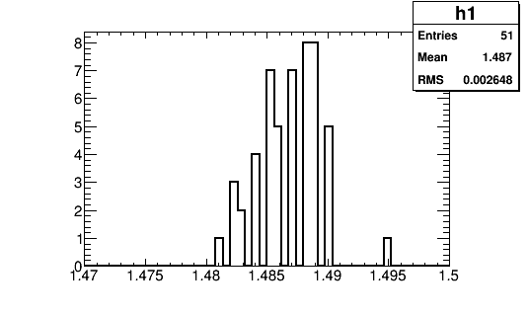
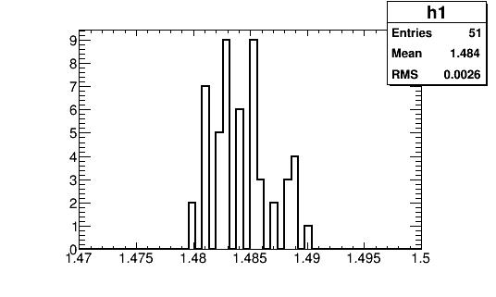
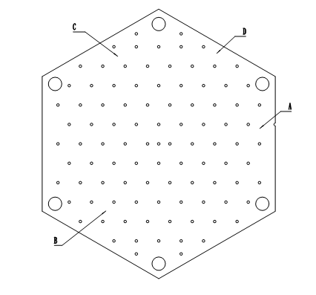
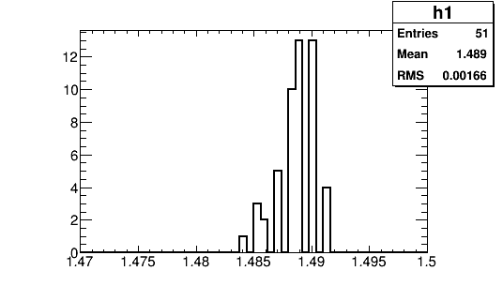
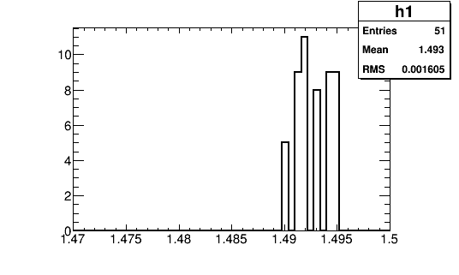
Thickness of Hengxin Batch 2 Scintillator: ~1.49mm (After Thickness Reduction)
mm
mm

Slide 10
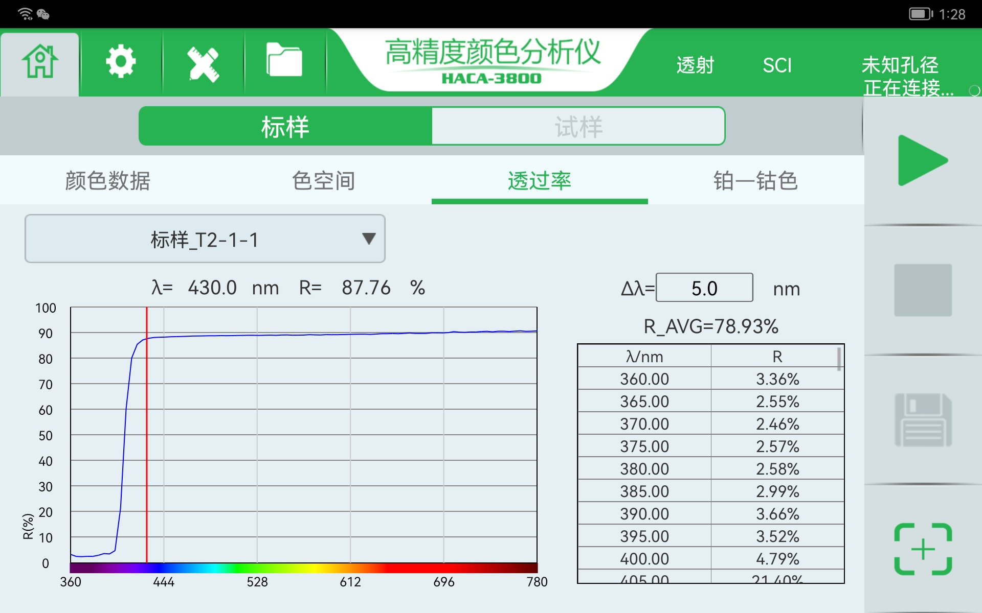
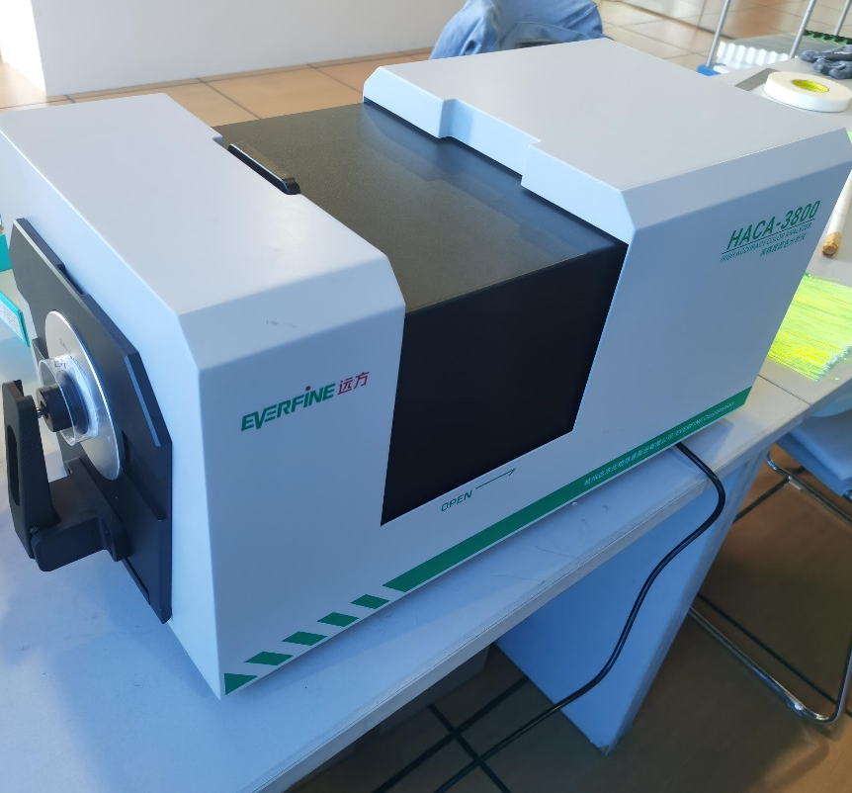
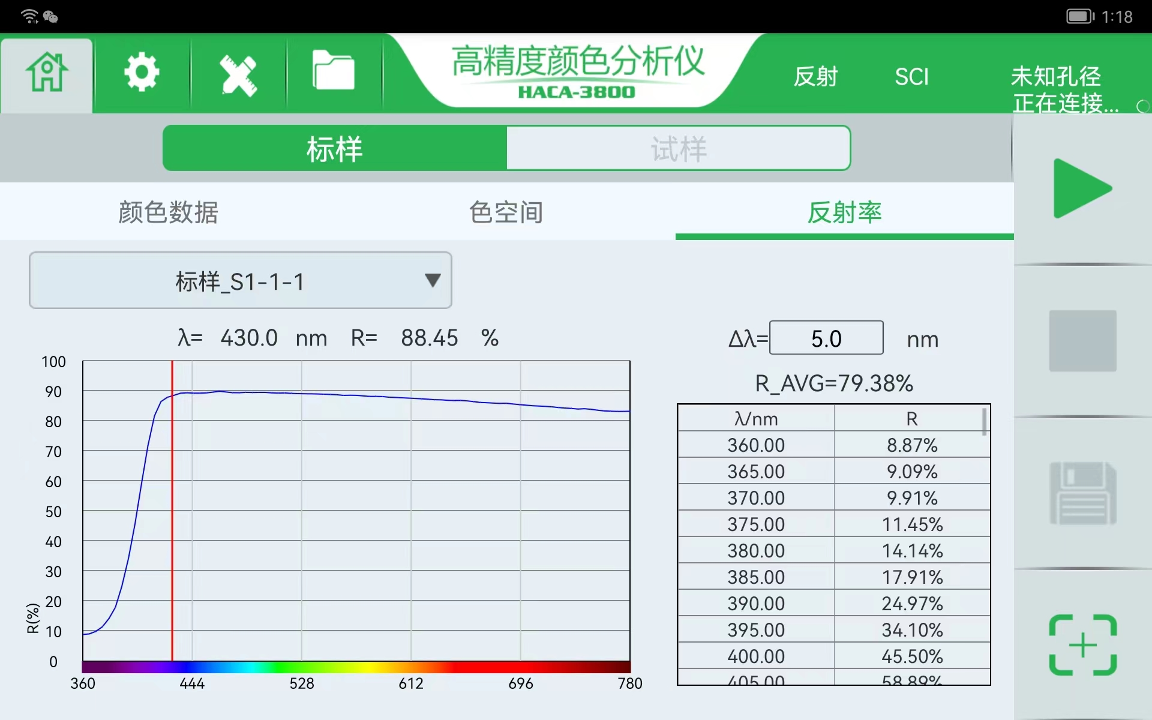
Transmissivity and Reflectivity Test
HACA-3800
Scintillator
Transmissivity
Lead
Reflectivity

Slide 11
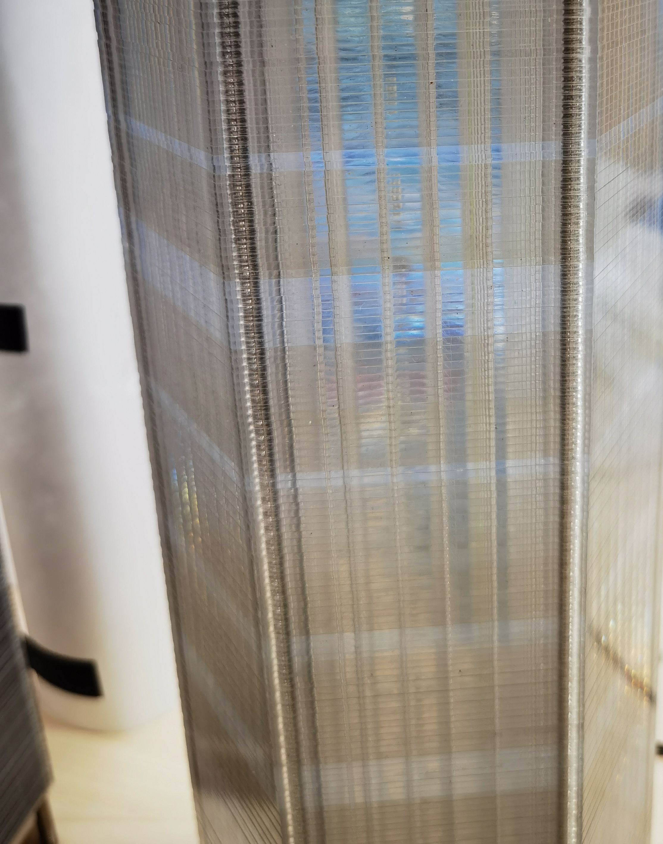
Transmissivity Test for Scintillator
Scintillator | Hengxin | Kedi
 |  | light | dark
sample1 | 86.9 | 87.8 | 84.2
sample2 | 87.6 | 87.9 | 84.7
sample3 | 87.6 | 86.4 | 86.9
sample4 | 87.6 | 86.4 | 86.1
sample5 | 87.6 | 87.7 | 85.3
sample6 |  | 87.5 | 85.2
Average | 87.5 | 87.3 | 85.4
light
dark
dark
light
dark
light

Slide 12
Reflectivity Test for Lead
lead | current | for 7 towers | Nica
sample1 | 88.45 | 79.95 | 89.25
sample2 | 89.43 | 85.18 | 89.23
sample3 | 88.81 | 82.66 | 86.97
sample4 | 89.06 | 83.01 | 88.98
sample5 | 85.77 | 90.44 | 88.99
sample6 | 89.47 | 80.29 | 87.08
Average | 88.5 | 83.6 | 88.4

Slide 13
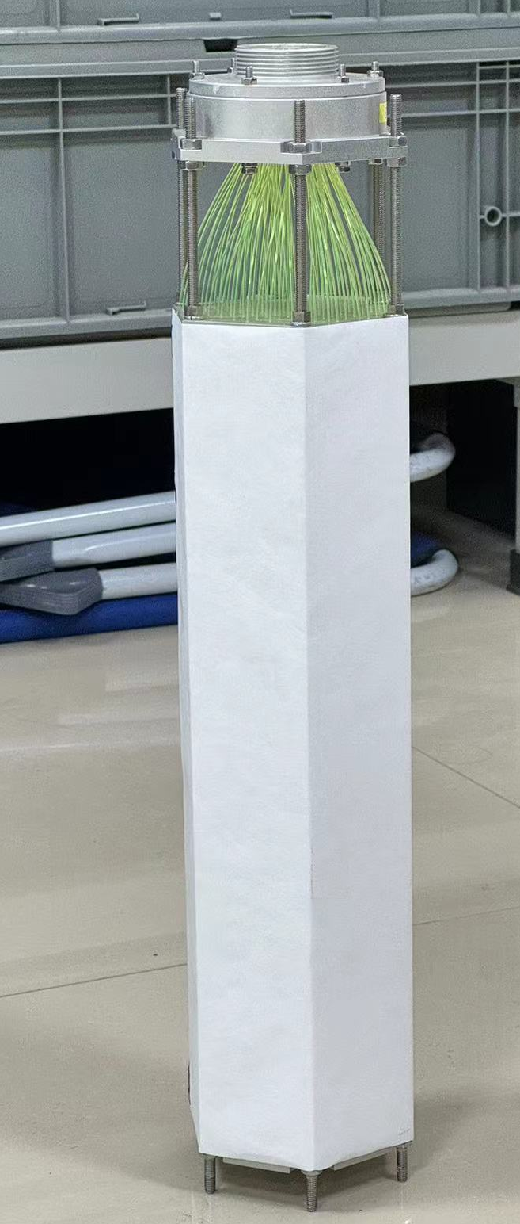
New module assemble
New Hole Design and Injection Mold:
KURARAY Y11 Multi-Cladded WLS Fiber
Hengxin batch2 Scintillator
3M ESR Film as Fiber End Mirror (Reflectivity >98%) Lead Paint with TiO₂
Module Outside Surface Paint with TiO₂

Slide 14
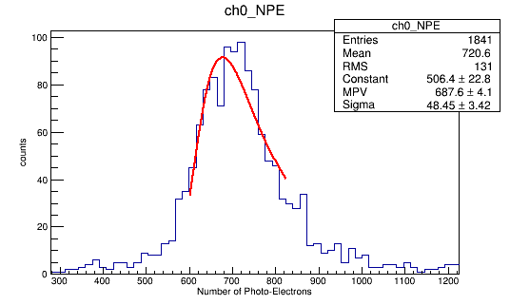
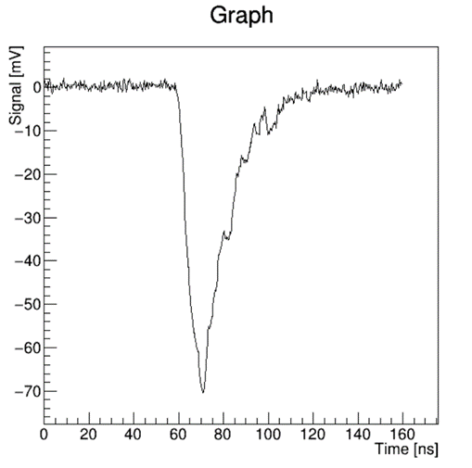
Cosmic Ray Test with Vertical Muon
Calculate Number of Photo-Electrons(NPE)
Calculate the charge of signal
1) perform an integral over the entire waveform
2) subtract the baseline from the waveform integral
NPE = charge / (1.6 * 10⁻¹⁹) / gain
Incident particle μ
MPV： 687.6 ± 4.1
Waveform of One Event
Notes:
对量能器来说，能量分辨率是最为主要的性能参数。而光产额的，，多少直接影响着能的表现。我们对，，。得到光电子数。同时为了保证每个事例沉积在灵能器找那个的能量一致，要求入射粒子是数值入社，完全穿过强能器。这是因为如果倾斜。具体的做法就是筛选出只有一个量能器有信号的事例。

Slide 15
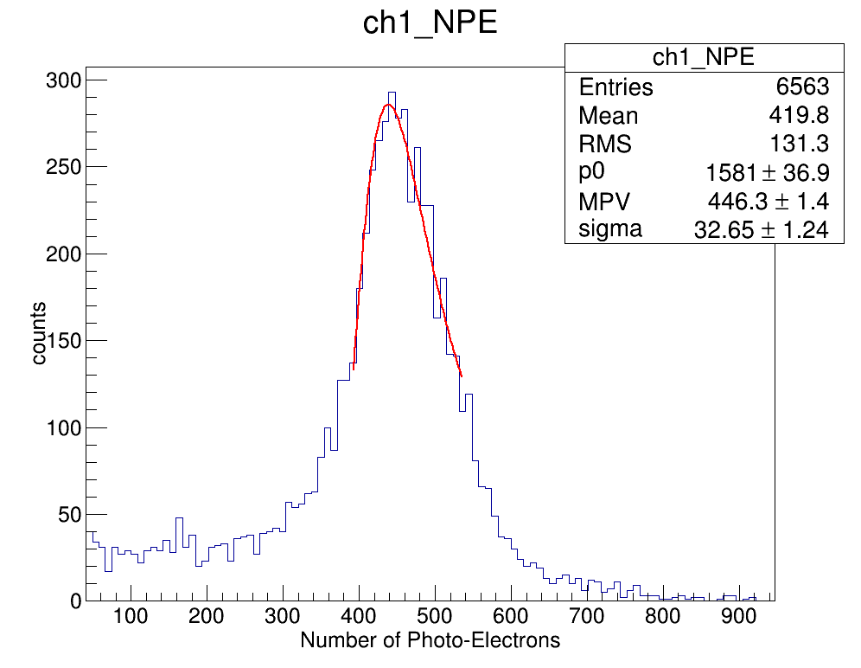
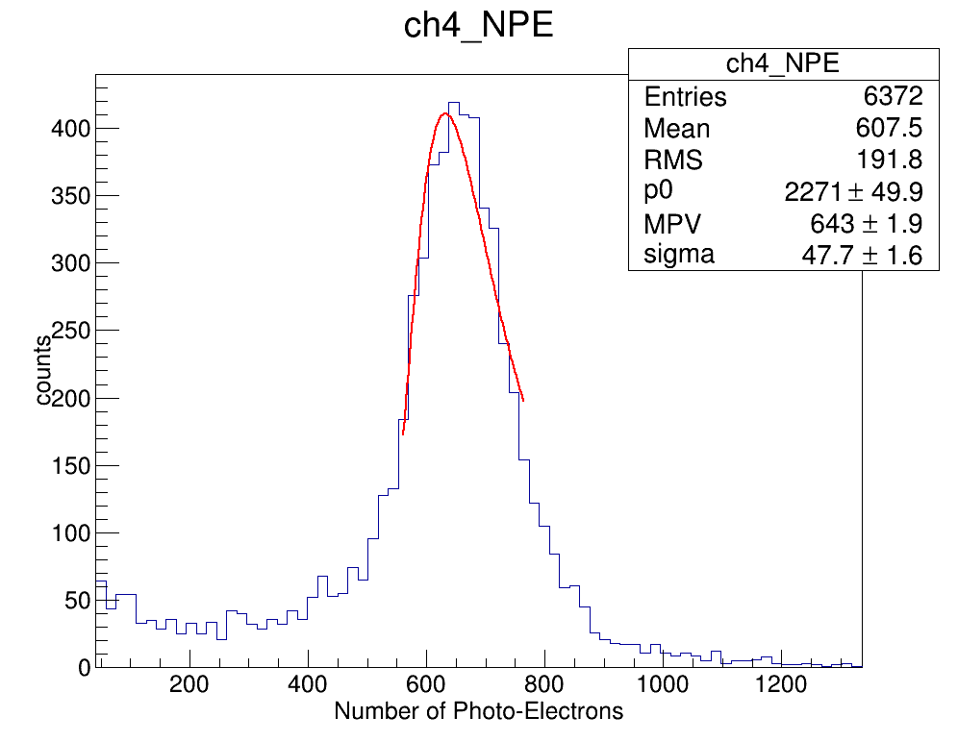
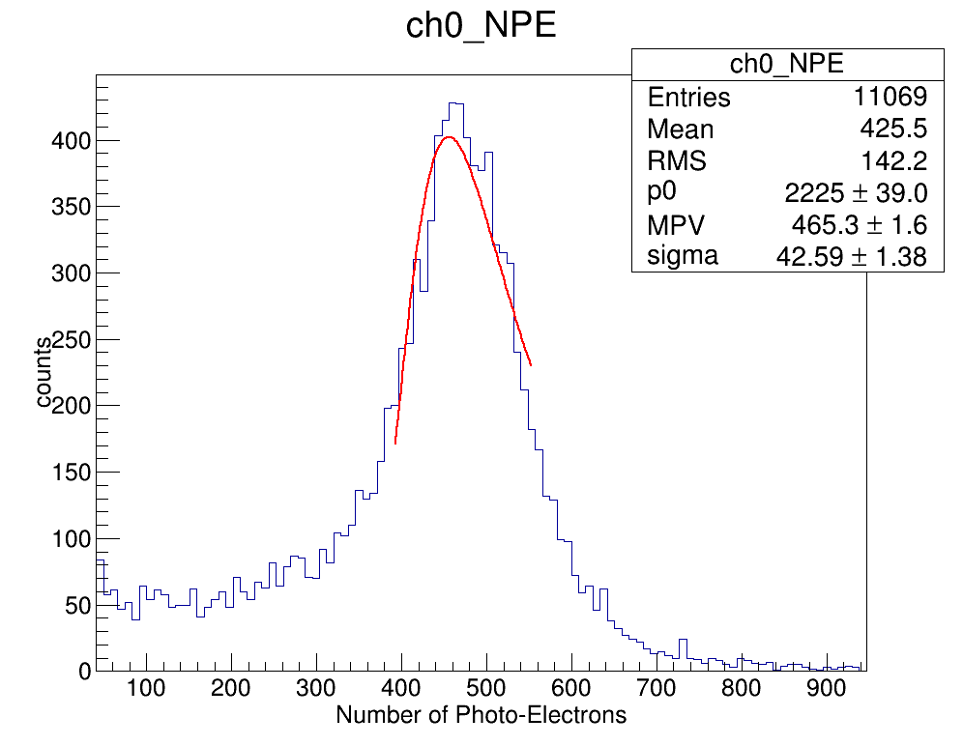
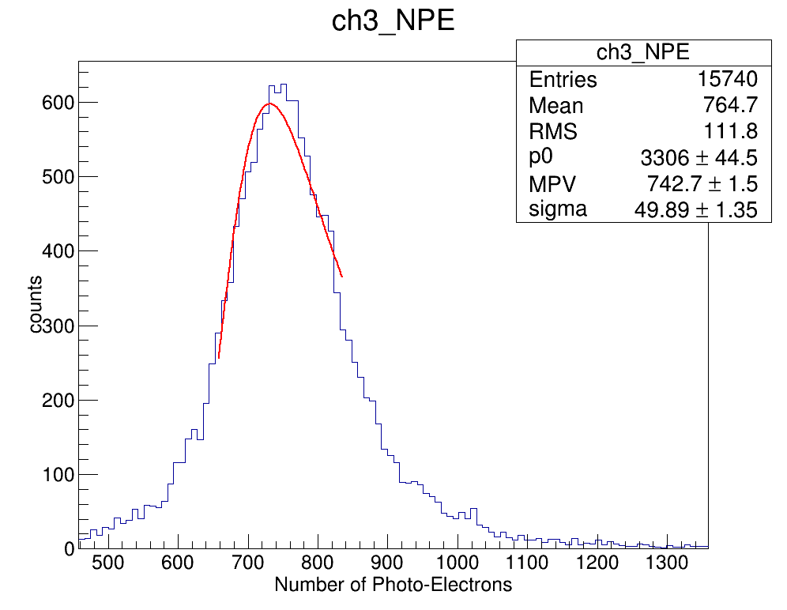
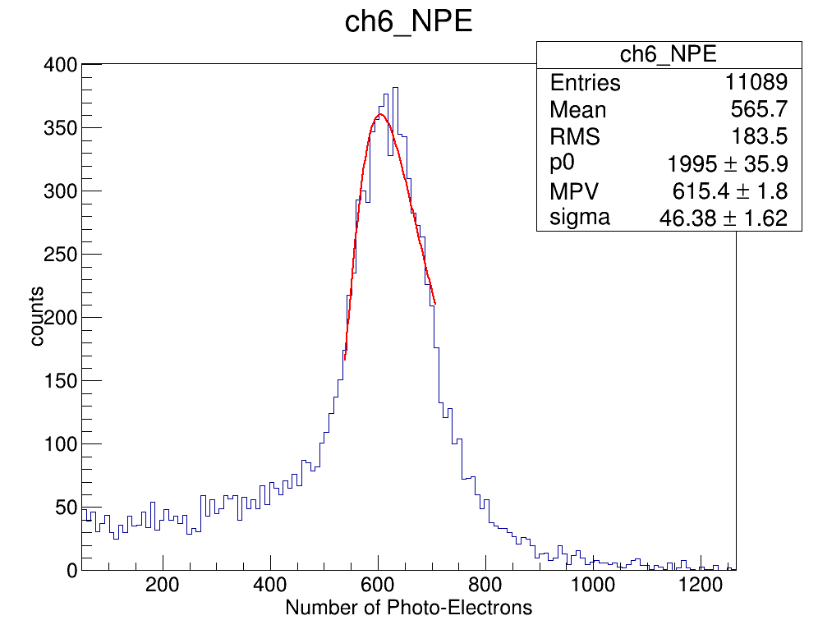
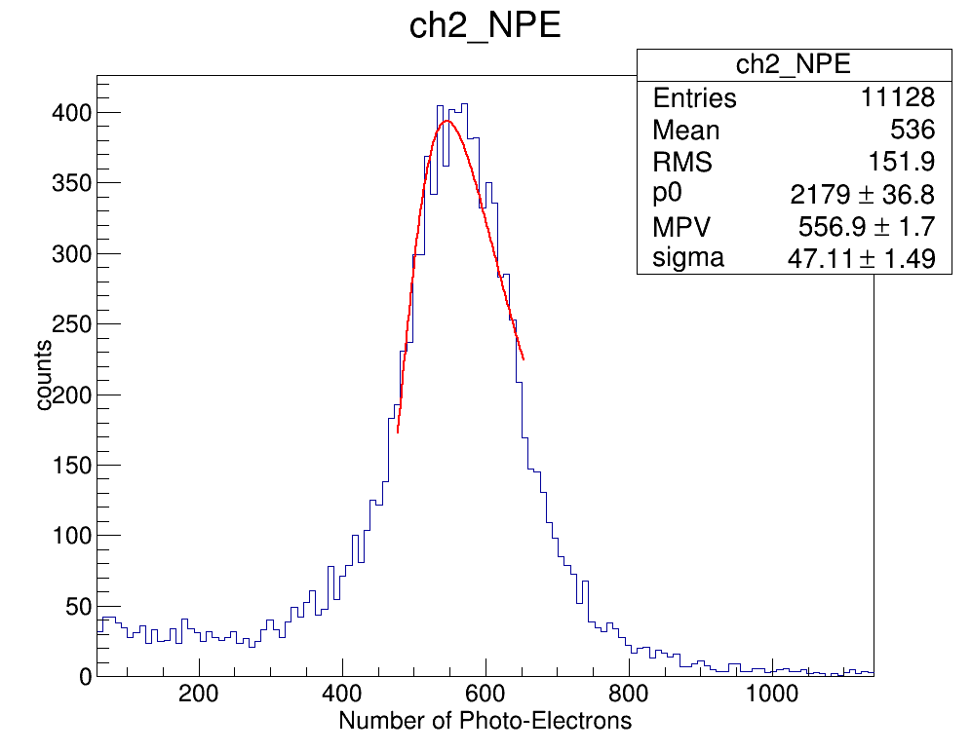
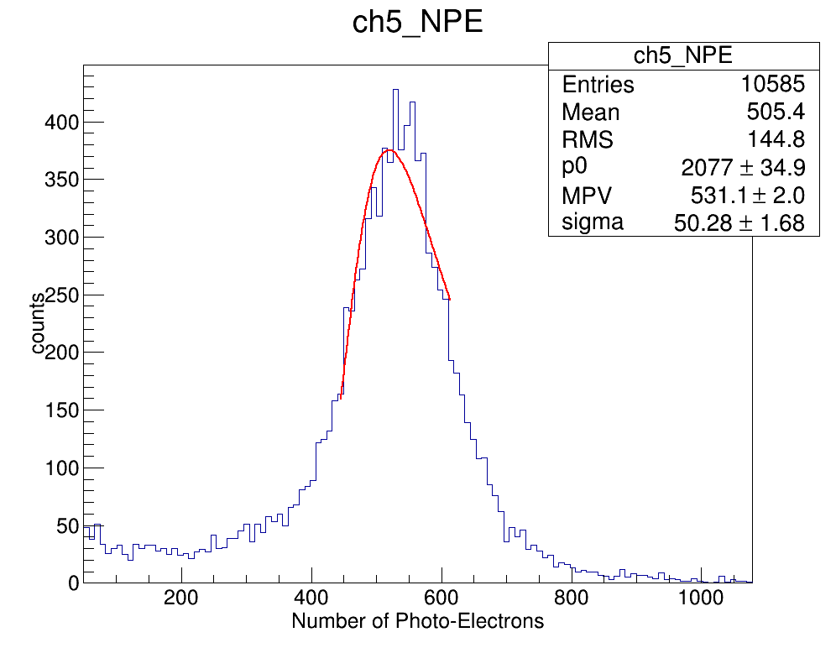
Comparison with Super-module 2023
Super-module 2023
The position of histograms corresponds to the module position in the frame
Resolution = σ /mpv
MPV
resolution
Super-module 2023 New
channel
Notes:
结果，7个图是就是7个量能器各自的NPE分布的直方图。其中每个图的位置和测试时量能器在框架中的位置是一一对应的。同时我们还对直方图进行了廊道拟合得到MPV值和sigma值。MPV反映了NPE大小，而sigma除以mpv就是我们所定义的能量分辨率。这幅图就是mpv与resoution的统计图。可以看到。。。。。

Slide 16
Conclusions
Assembled a New Module with New Hole Design
Test Results are Compatible with Old Modules

