Slide 1
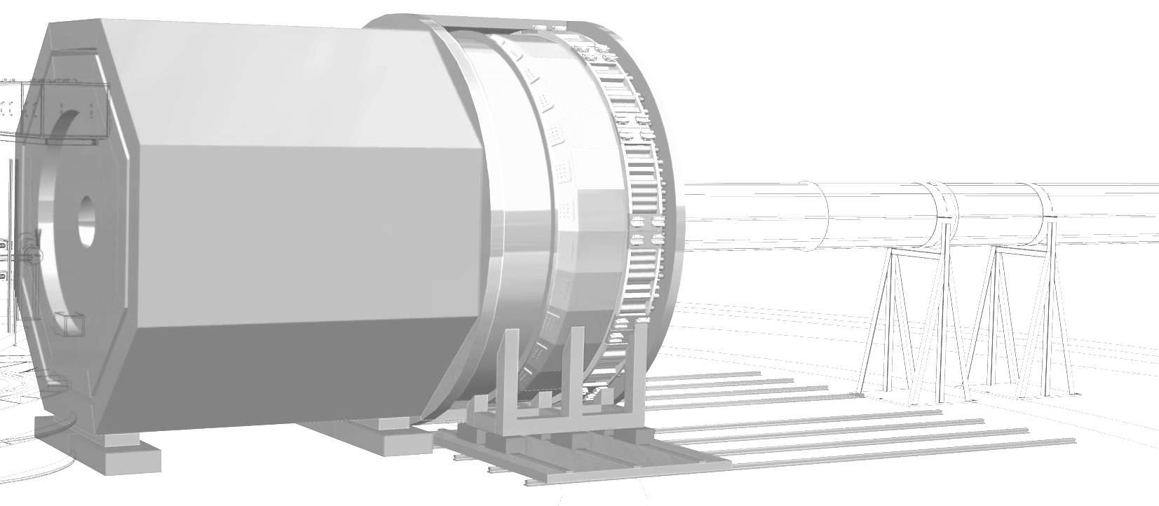



SoLID DAQ preRD and plans
Data Acquisition
SoLID collaboration meeting
June 22nd 2023
Alexandre Camsonne

Slide 2
Outline
Capital
Testing
GEM chip
  VMM
  SALSA
  APV25
Streaming DAQ
Conclusion

Slide 3
Capital equipement DAQ
Requested
Updated
Item | cost/item | number | total
FADC 250 | 6000 | 104 | 624000
Gigabit serial connectors |  |  | 40000
Cables | 100 | 1664 | 166400
VETROC | 4000 | 30 | 120000
TD | 3000 | 16 | 48000
VTP | 10000 | 31 | 310000
SSP | 5000 | 4 | 20000
VTP | 8000 | 1 | 13000
TS | 4000 | 1 | 4000
TID | 3000 | 31 | 93000
SD | 2500 | 32 | 80000
VXS crate | 15000 | 32 | 480000
VME CPU | 7000 | 32 | 224000
 |  | Total | 2217400
 | FTE/year cost | months
Syracuse | 80000 | 12 | 80000
FEDAQ | 120000 | 2 | 20000
Hall C | 120000 | 2 | 20000
 |  |  | 2337400
Item | cost/item | number | total
FADC 250 | 6127 | 104 | 637208
Gigabit serial connectors | 40000 | 1 | 40000
Cables | 100 | 1664 | 166400
VETROC | 4000 | 30 | 120000
TD | 3000 | 16 | 48000
VTP | 12500 | 31 | 387500
SSP | 5000 | 4 | 20000
VTP | 12500 | 1 | 12500
TS | 4000 | 1 | 4000
TID | 3000 | 31 | 93000
SD | 2500 | 32 | 80000
VXS crate | 19000 | 32 | 608000
VME CPU | 9500 | 32 | 304000
 |  | Total | 2520608
 | FTE/year cost | months
Syracuse | 67000 | 12 | 134000
FEDAQ | 120000 | 2 | 20000
Hall C | 120000 | 2 | 20000
 |  |  | 2694608

Slide 4
Testing
SBS GEn
  VTP readout
  APV25
  High data rate : 2.1 GB/s
NPS
  Calorimeter trigger
SBS GEp
  Calorimeter trigger
HKS
  Trigger with Cerenkov
  High resolution TOF with MRPC
+ parasitic beam tests

Slide 5
Future SoLID preRD
Highest priority : GEM chip
  Evaluate SALSA chip in high background environment
  Improve VMM board signal to noise
  Test with uRWell
Calorimeter and Cerenkov readout
  FADC ASIC to be placed on detector : only LV and optical fibers going out instead of BNC cables
High resolution timing
  AARDVARC test in beam
  High resolution FADC timing ASICS

Slide 6
VMM test
Ordered two test board 1500 $ x 2
Build 6 SoLID prototype boards
Evaluation board : can look at data with detector small subset of channels
  Issue with external trigger but waiting for new firmware
  Can check pedestal width
  Signal to noise with detector with source and cosmics
  Look at direct readout signals for 12 channels of detector
Prototype development for data performance, test direct output with detector and X-ray source

Slide 7
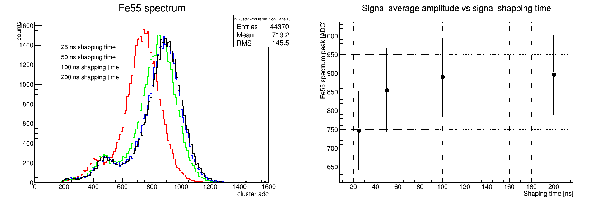
Signal gain vs shaping time, gain = 3 mV/fC
From source data, 25 ns shaping only about 15 % lower than 50 ns, so 25 ns shaping useable

Slide 8
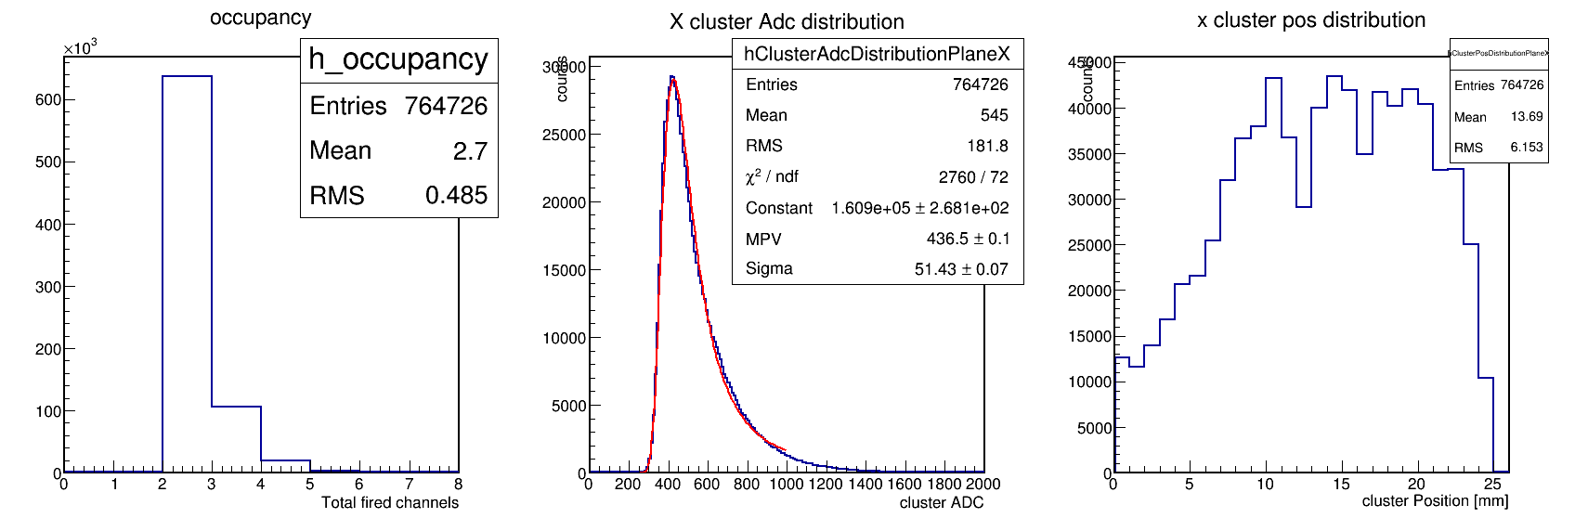
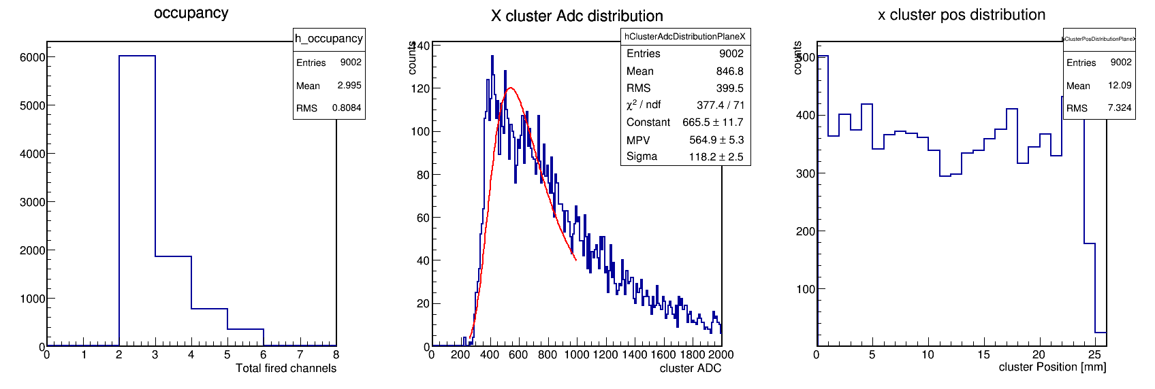
HV =
Sr90
Cosmic

Slide 9
128 channel VMM prototype for SoLID
Features
  Fast 6-bit ADC data from each channel allows for high hit rates (~10MHz/ch)
  Dual readout paths (fiber)
    10GbE for low radiation environments (FPGA → SFP+)
    Readout using CERN rad hard components (FPGA → GBTx → VTRx)
  Power and signal interface through mezzanine cards
    Initially use commercial components on mezzanines
    Later mezzanines with rad hard components – no modification of base board
  Mitigation of effects of radiation on FPGA by triplicating logic and adding voting circuitry (TMR)
  Status
    Commercial component mezzanine boards fabricated
    Base board fabrication in early May

Slide 10
VMM 6-bit Direct Output data format
Peak amplitude converted to 6-bit value
160 MHz
Flag
(serial data)
DDR - 320 Mb/s (data on both edges)
Hit time
(6.25 ns resolution)
OR
SDR - 160 Mb/s (data on single edge)

Slide 11
VMM 6-bit ADC direct data
(VMM evaluation board read out with Xilinx FPGA development card)

Slide 12
VMM
VTRx
GBTx
50mm
FPGA
Base board
SFP+
VMM
GBT-SCA
128 channel VMM prototype
FPGA power mezzanine
VMM power mezzanine
Assembly side view
215mm

Slide 13
VMM dead time pulser test 6 bit
Dead time is :
  25 ns ( peaking time )
  +
  5 ns ( peak finding )
  +
  25 ns data conversion
  +
  7 x 6.25 ns data transfer
  =
  ~120 ns
  Can go down to ~ 90 ns when using DDR ( 6.25 / 2 )

Slide 14
VMM dead time pulser test 10 bit
Dead time is :
  25 ns ( peaking time )
  +
  5 ns ( peak finding )
  +
  25 ns data conversion
  +
  7 x 6.25 ns data transfer
  =
  ~120 ns
  Can go down to ~ 90 ns when using DDR ( 6.25 / 2 )

Slide 15
Sr90 VMM 6 bit 16mV/fC GEM at 4200 V

Slide 16
Noise 6 bit 16mV/fC Sr90
Amplitude for MIP not change much
Pedestal width dependent on peaking time

Slide 17
Conclusion VMM testing so far
90 ns dead time in 6 bit mode
Some noise seen in prototype
Noise larger with decreasing integration time
MIP a bit low in dynamic range of 6 bit prototype
Implementing 10 bit to cross compare with evaluation board
250 ns for 10 bit mode
Implement higher gain : Compton preAMP maybe ? Or higher gain chip
Would like to explore SALSA option : same performance as APV25 with no dead time

Slide 18
Streaming readout overview

Slide 19
Streaming readout
Send all data from each detector continuously ( or self triggered )
Pro
  No trigger
  If can be recorded : record all physics available
  If cannot be recorded : full reconstruction and record event of interest with advanced triggering or loose trigger
  AIML algorithm very efficient with unbiased data samples
Con
  Need deadtime less electronics : ideally all FADCs ( but high power comsuption)
  Large amount of data to transfer to computer farm : cost in network
  Large amount of data to be processed
  Large amount of data to be recorded

Slide 20
Streaming readout option numbers
Detector | Area m2 | SIDIS | Singles rate MHz | Event size bytes | Data rate GB | PVDIS | Singles rate MHz | Event size bytes | Data rate GB | JPSi | Singles rate MHz | Event size bytes | Data rate GB
LGC | 0.7 | 16 | 112 | 16 | 1.792 | 80 | 560 | 88 | 49.28 | 40 | 280 | 16 | 4.48
HGC | 1.2 | 160 | 1920 | 16 | 30.72 |  | 0 | 88 | 0 |  | 0 | 16 | 0
SPD_FA | 15.2 | 0.02 | 3.04 | 16 | 0.04864 |  | 0 | 88 | 0 | 0.06 | 9.12 | 16 | 0.14592
SPD_LA | 3.7 | 0.12 | 4.44 | 16 | 0.07104 |  | 0 | 88 | 0 | 0.25 | 9.25 | 16 | 0.148
EC_preshower_FA | 19 | 33 | 6270 | 16 | 100.32 | 90 | 17100 | 88 | 1504.8 | 77 | 14630 | 16 | 234.08
EC_shower_FA | 19 | 10 | 1900 | 16 | 30.4 | 9 | 1710 | 88 | 150.48 | 14 | 2660 | 16 | 42.56
EC_preshower_LA | 4.1 | 45 | 1845 | 16 | 29.52 |  | 0 | 88 | 0 | 80 | 3280 | 16 | 52.48
EC_preshower_LA | 4.1 | 5 | 205 | 16 | 3.28 |  | 0 | 88 | 0 | 19 | 779 | 16 | 12.464
GEM | 37 | 800 | 296000 | 16 | 4736 | 500 | 185000 | 16 | 2960 | 1600 | 592000 | 16 | 9472
 | Rate in GB/s |  |  |  | 4932 |  |  |  | 4664 |  |  |  | 9818
Around 10 to 5 TB/s, about 1000 more data than triggered

Slide 21
AI/ML hardware acceleration
Could gain factor of ~ 100 processing with GPUs, might be able to do better

Slide 22
Salsa
Collaboration of Irfu CEA Saclay and U. of Sao Paulo.
SALSA
64-Ch, updated design from SAMPA V5, migrating to 65 nm CMOS.
Peaking time: 50 – 500 ns
Inputs: Cin optimized for 200 pF; Rates: 25 kHz/Ch; Dual polarity.
ADC: 12 bits, 10 – 50 MSPS.
Extensive data processing capabilities.
Triggerless and triggered operation.
Power: 15 mW/Ch
Gbps links.
I2C configuration.
Evaluation board available this year - Might want a dedicated SoLID version to match tracker low gain operation and handle high rates at input

Slide 23
Conclusion
Capital equipment
  All elements for SoLID DAQ besides CPU procured
Developments of SoLID trigger and readout in previous and upcoming experiments
ASICs development could benefit SoLID
GEM chip solution to be finalized
  VMM can work but not ideal
  SALSA promising but need R&D for high rate operation
  APV25 readout update can be fall back for 100 k channels
Streaming option
  About 5 to 10 TB/s about 1000 more than triggered
  Might be able to handle with AIML progress, network progress and CPU
  Streaming readout is an option with upgrade of data links and HPDF
SoLID in streaming mode, could be the ultimate JLab detector – Just run detector at full luminosity all the time and extract all possible physics after the run

