Slide 1
Streaming Readout
at JLab
David Lawrence
Jun. 22, 2024

Slide 2
Streaming Grand Challenge
slide from Jan. 5, 2024 presentation by Rolf Ent
The Streaming Grand Challenge began in 2018.
Significant progress has been made since then on several fronts that include deployment of SRO-capable fast electronics, firmware development, and software (ERSAP, JANA2, InstaRec,...).
Phase II of the SRO GC is now beginning.

Slide 3
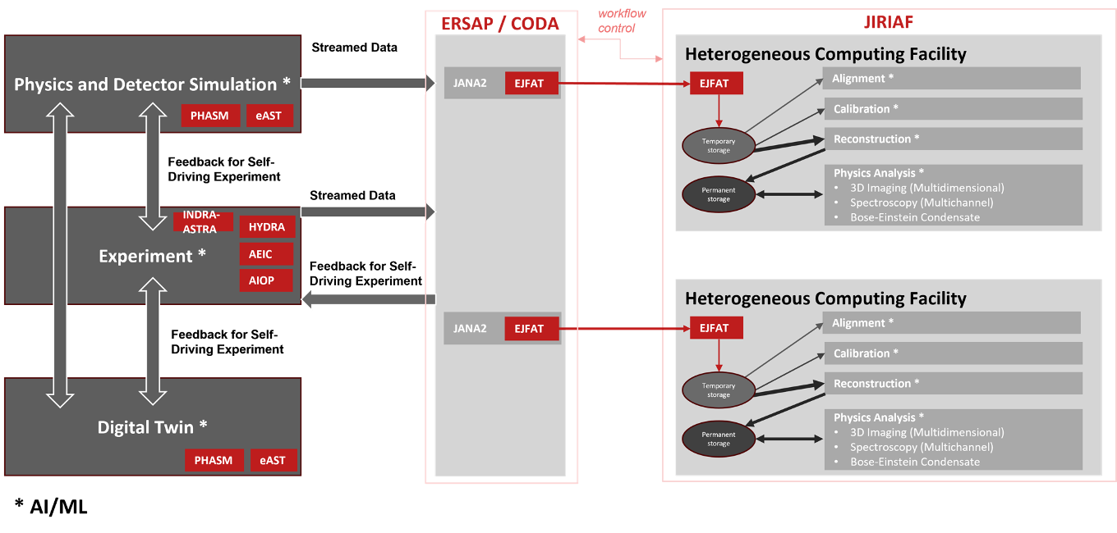
Streaming Grand Challenge Phase II
Diagram from early 2024 by Rolf Ent, Markus Diefenthaler, Brad Sawatsky, and David Lawrence

Slide 4
SRO GCII
Q1
Q2
Q3
Q4
Q1
Q2
Q3
Q4
Q1
Q2
Q3
Q4
Q1
Q2
Q3
Q4
Q1
Q2
Q3
Q4
CY2024
CY2025
CY2026
CY2027
CY2028
BDX
PRAD Electronics on loan (1 crate)
RTDP Tool Functional
PRELIMINARY
Full SRO hardware capability
Auto. Calib.
(FTOF)
Auto. Calib.
(PCAL)
Auto. Calib.
(TOF/CTOF/DC)
Auto. Calib.
(RICH/SVT)
Stream to CC
(partial detector)
Auto. Calib.
(ECAL)
CLAS12
DCRB firmware
(capture 2 sectors)
Data Stream - partial
(Hall-B to NERSC)
Event Identifiers
Event Filters
CLAS12
full scale
Hall-C
SRO Capable Hardware (all)
Legacy Data Formatter
Auto. Calib.
(SHMS)
HMS + SHMS
full scale
Event Identifiers
Auto. Calib.
(HMS)
Event Filters

Slide 5
monitoring
Calib.
calib
DB
Analyzer
(recon)
SHMS
Filter Module
ET
Data
Lake
EJFAT
Filter Module
HMS
ROOT files
(recon)
Filter Module
CODA
streaming
monitoring
Filter Module
JANA2
EJFAT reassembly
EVIO SRO Parser
Event Identifiers
Event Filters
Legacy Data Formatter

Slide 6
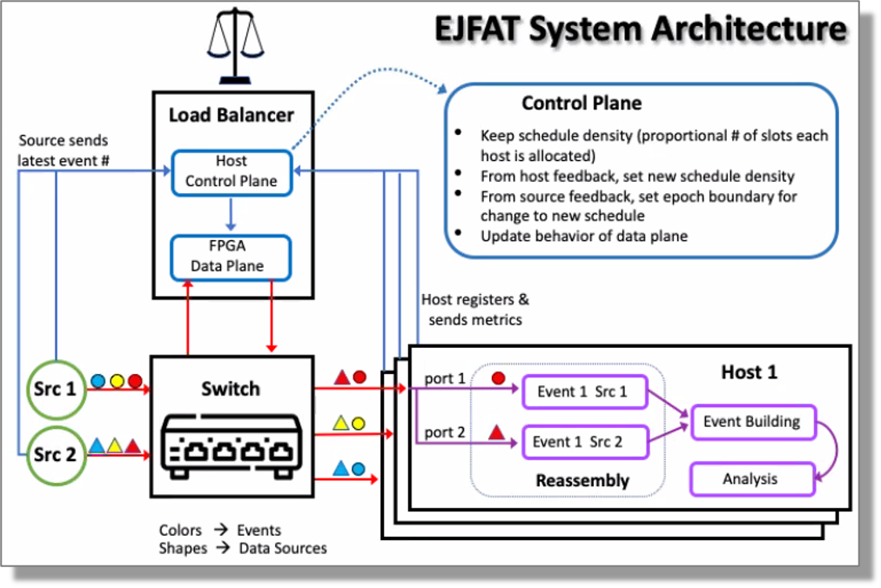
ESnet/JLab FPGA Accelerated Transport

Slide 7
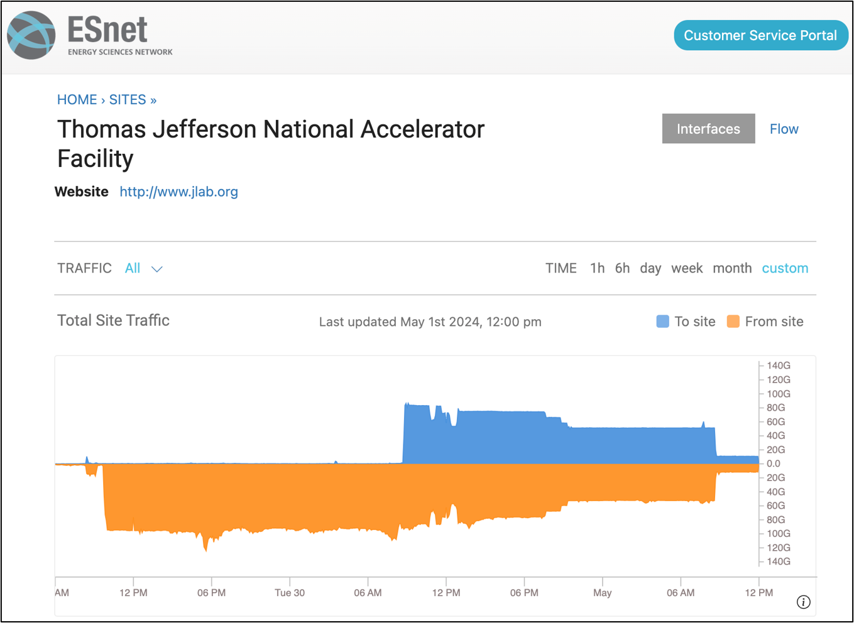
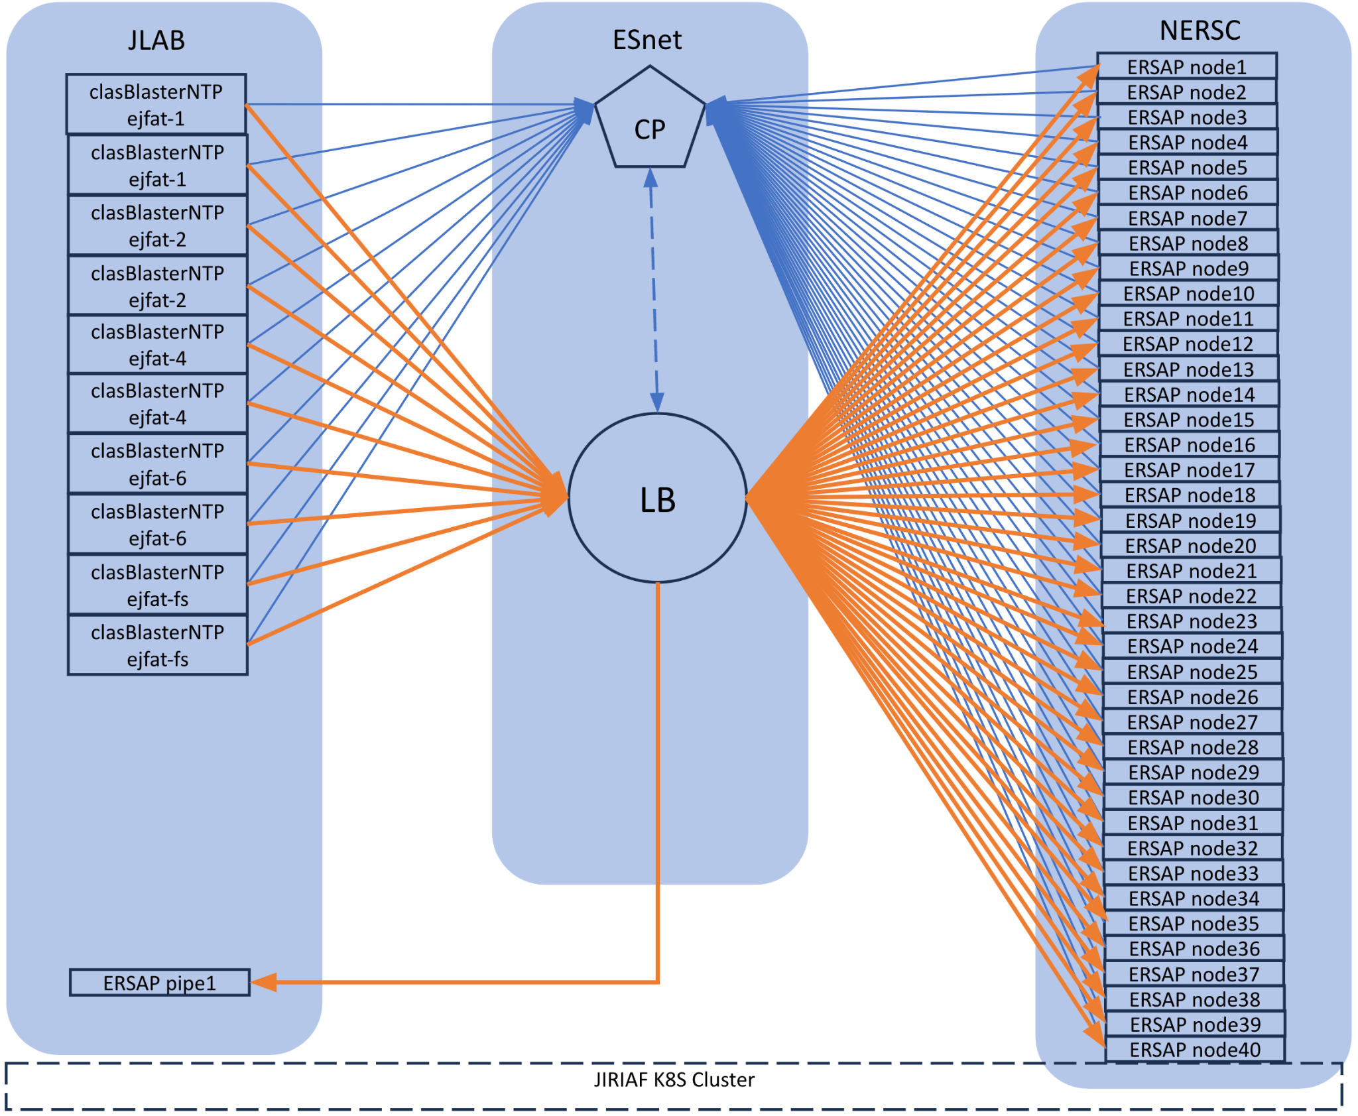
GCII: JIRIAF + EJFAT + NERSC Testing
PI: Vardan Gyurjyan LDRD Project (funding FY23, FY24)
PI: Graham Heyes
ASCR Project
Project Lead: Michael Goodrich
Stream exercise sending CLAS12 data from JLab to NERSC using the JIRIAF system​
CLAS12 Data
(archival)
Virginia
California
80Gbps returning to JLab
100Gbps from JLab to NERSC

Slide 8
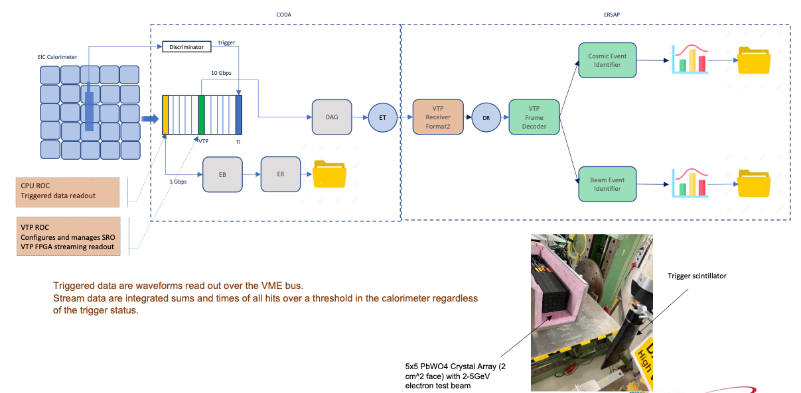
ERSAP - Environment for Real-time Streaming, Acquisition and Processing
EIC prototype calorimeter SRO pipeline at DESY. CODA & ERSAP
ERSAP design is event reactive actors, networked by data pipelines.
• Compositional actors with conditional data routing at runtime.
• Flow-based programming paradigm
recent beam test at DESY included ERSAP environment for online processing
Funded through JLab SciOPS

Slide 9
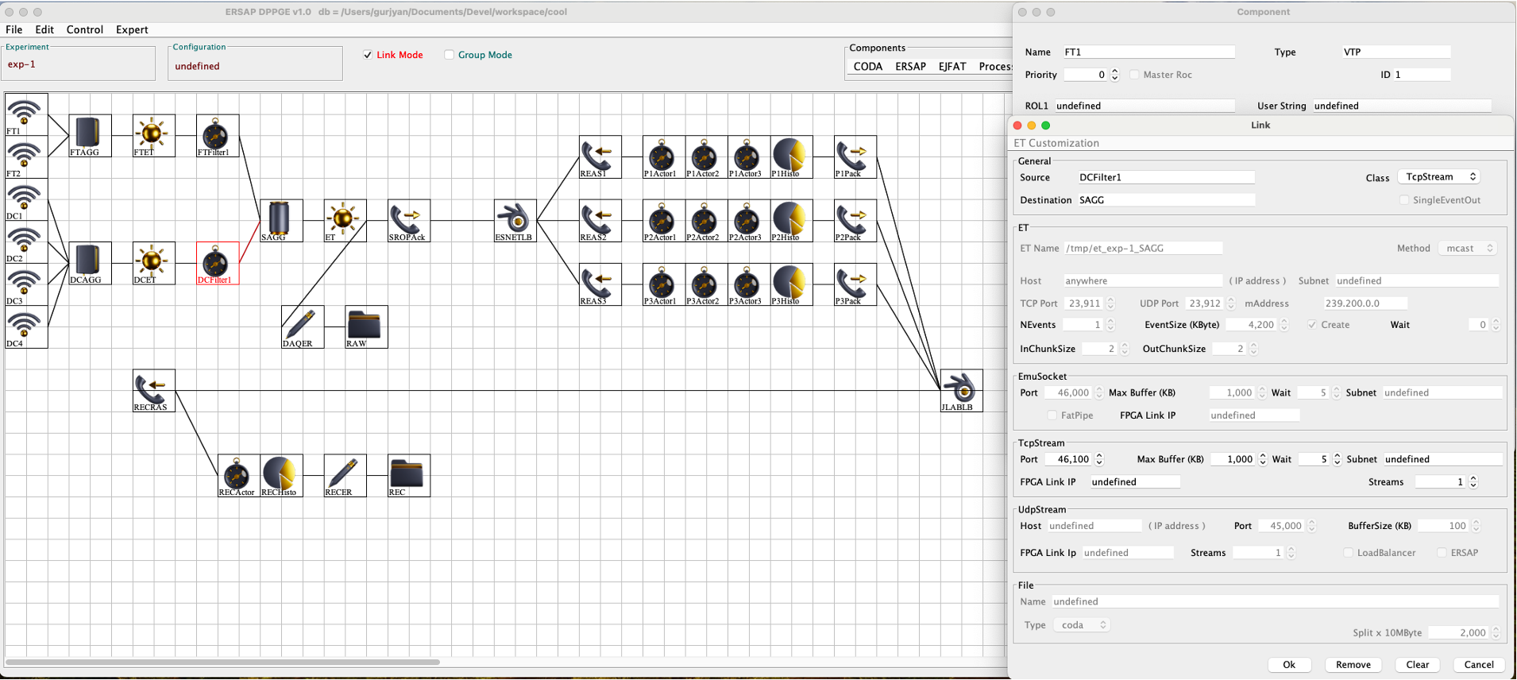
GCII:
DPPGE + DPOL (SRO Replacement for JCEdit + COOL)
Graphical Configuration of multi-process, distributed system
Vardan Gyurjyan

Slide 10
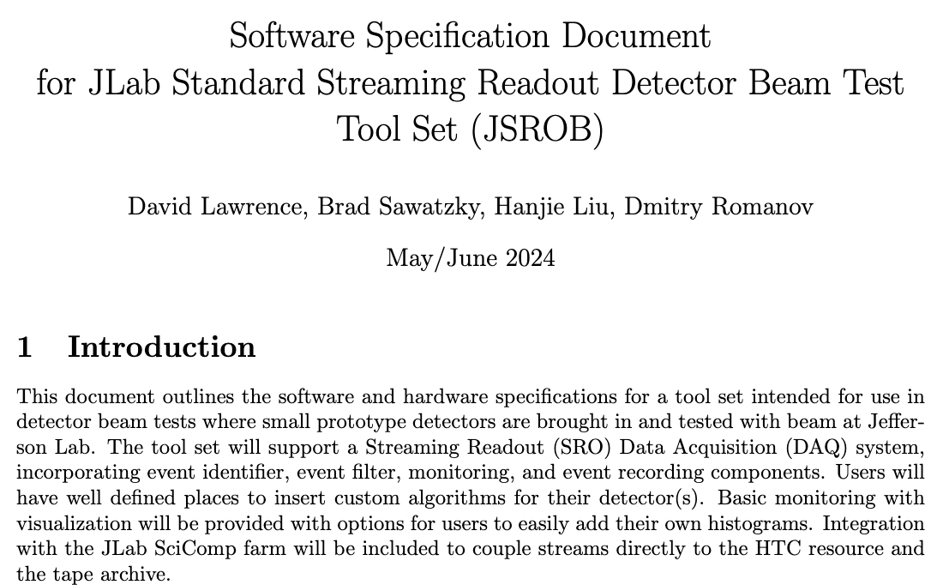
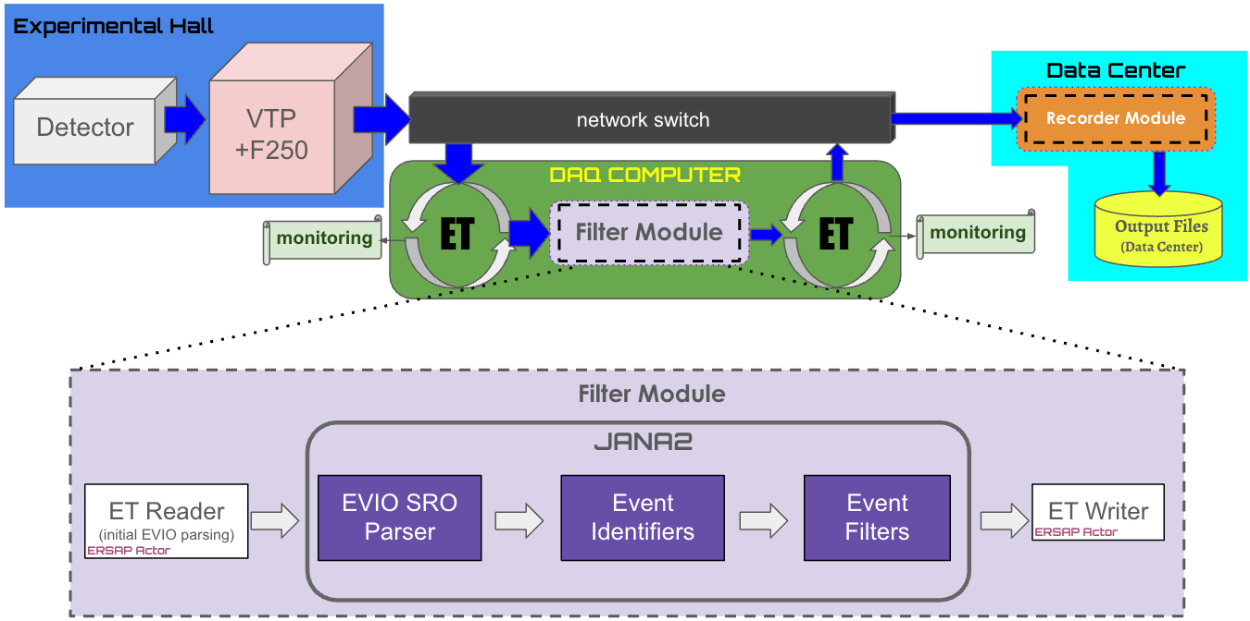
GCII: Standard Test Setup
Hanjie L. - Hall-C
Dmitry R. - EIC
Brad S. - SciComp+ENP
David L. - EPSCI

Slide 11
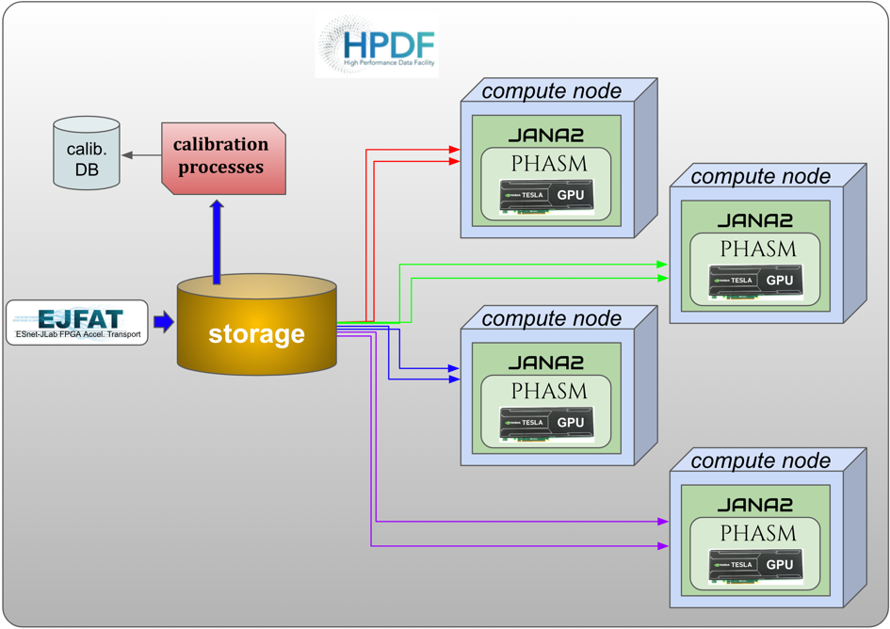
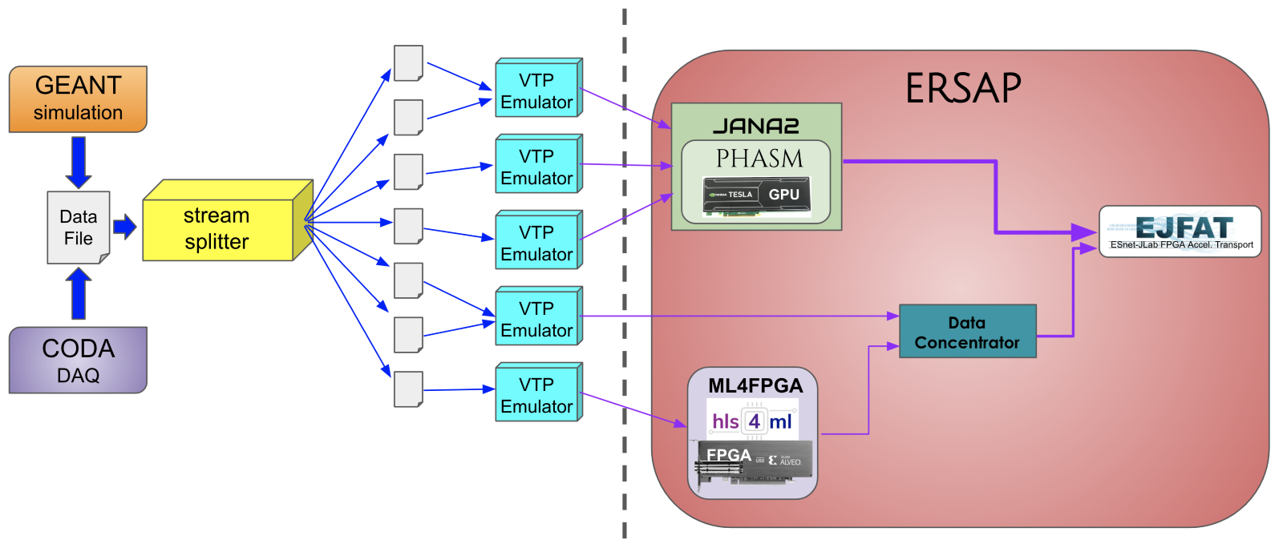
Simple Example of a Streaming Readout (SRO) System
GCII: Real-Time Development Platform
Experimental Physics Software and Computing Infrastructure
Highly configurable multi-stream source allows realistic streaming simulations
Onsite components will implement first stages of data filtering/reduction
Offsite processing must incorporate built-in calibration latencies and storage. This will also help inform HPDF design

Slide 12
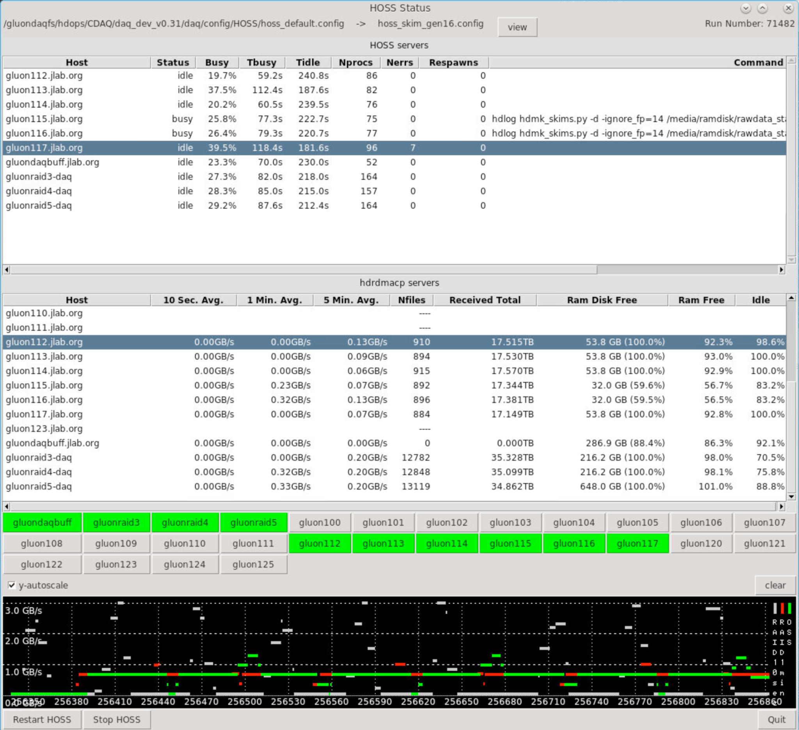
HOSS!
EPJ Web of Conferences 251, 04005 (2021) https://doi.org/10.1051/epjconf/202125104005
HOSS = Hall-D Online Skim System
This is responsible for distributing raw data to multiple RAID disks DAQ system writes to files in RAM disk.
Files transferred using RDMA only after file is closed
Fine time structure naturally introduced wherever buffering is implemented

Slide 13
Streaming Data
Perception
Reality

Slide 14
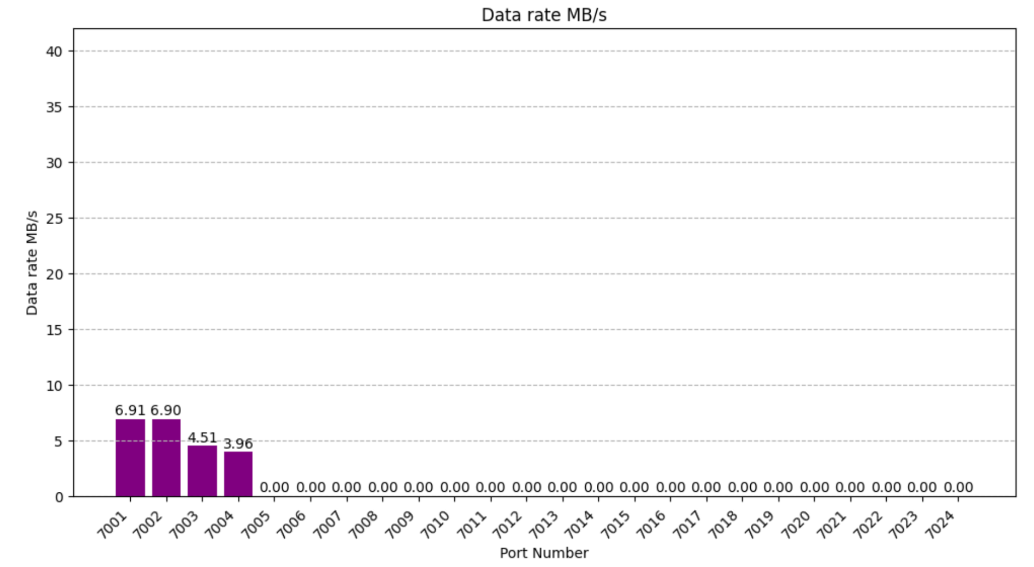
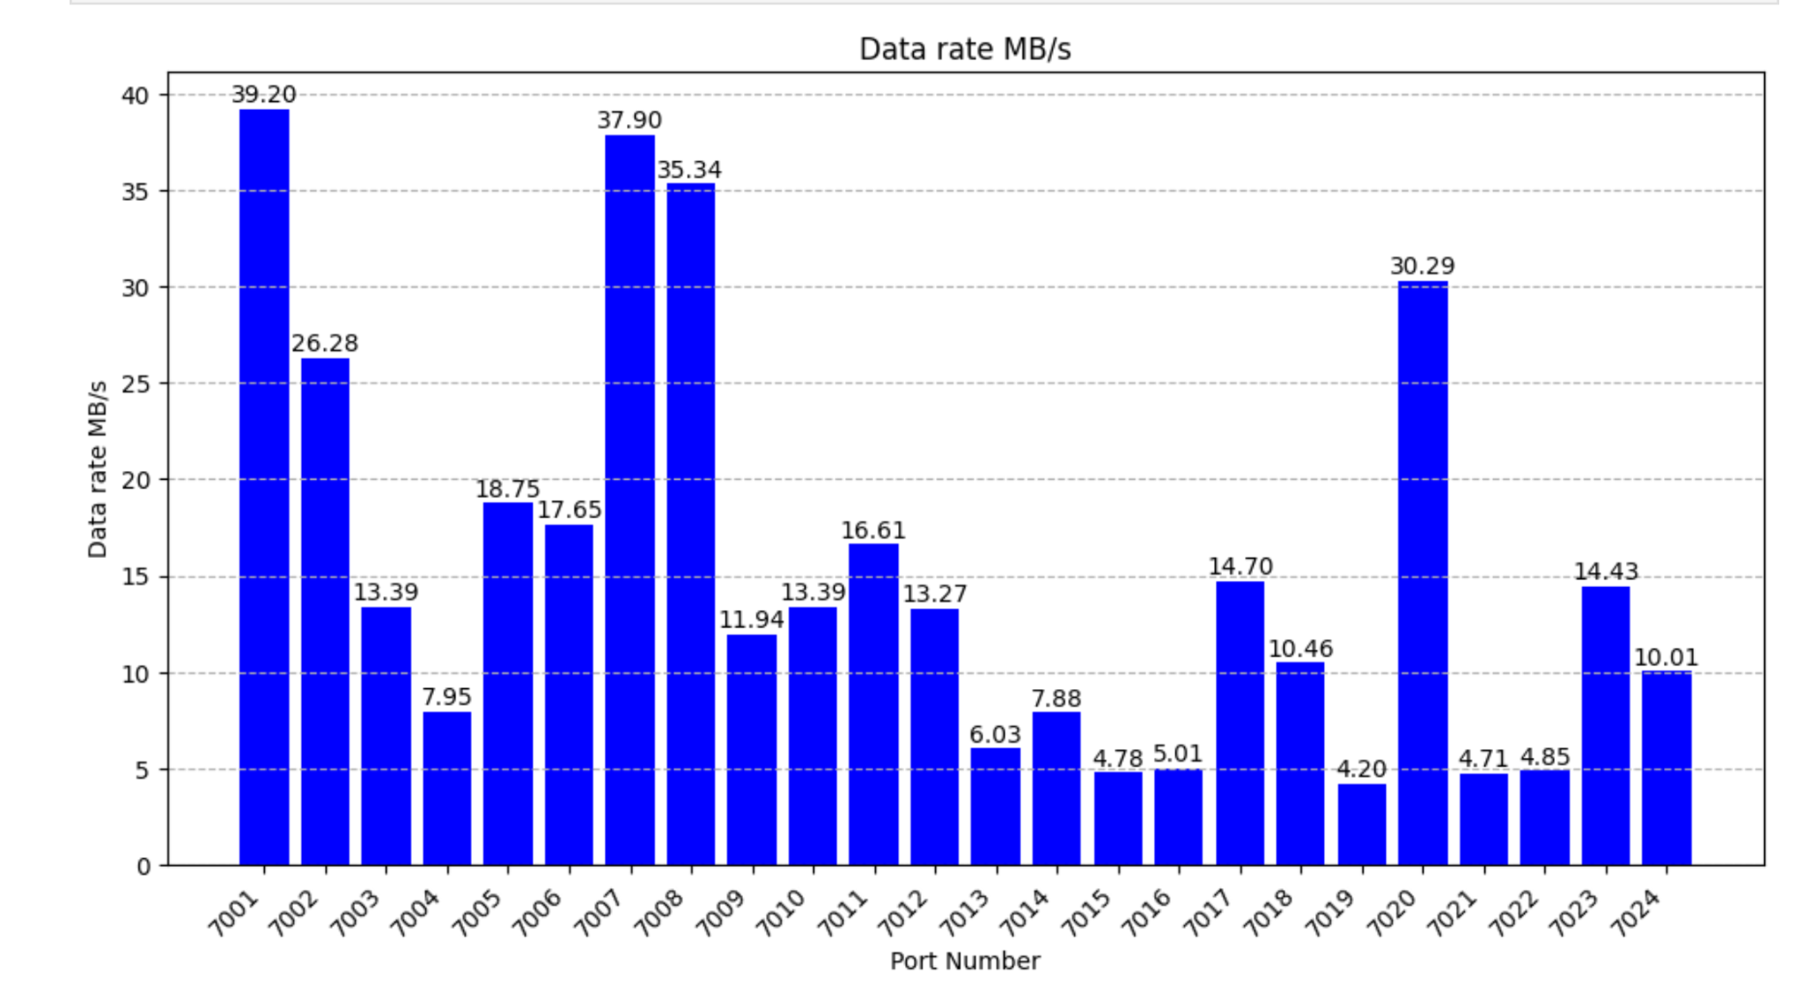
GCII: CLAS12 Data Capture
Data stream from VTPs in Hall-B to Data Center
Packets captured with hardware timestamps est. x10s of us resolution
Dec. 2023
(RG-K 100nA)
May 2024
(RG-E 5nA)
ECAL and PCAL for sector 2
Drift Chambers + all FADC250 for sectors 2 and 5
May 16th beam test where data streamed from CLAS12 to Data Center and packets captured with hardware timestamps.
355 MB/s
(sectors 2,5)
beam trip

Slide 15
PODIO ROOT Streaming
Experimental Physics Software and Computing Infrastructure
Disclaimer: This is not an efficient way to stream data and will almost certainly not be part of the final ePIC standard streaming configuration. It does provide a continuous streaming source that can be consumed by the current ePIC reconstruction software allowing other components of the streaming system to be sketched out.
Multiple pieces
Modified PODIO (allows data to come in form other than ROOT file on disk) Added openTDirectory() to ROOTReader as alternative to openFiles() https://github.com/AIDASoft/podio/issues/565 https://github.com/AIDASoft/podio/pull/579
podio2tcp utility (read from ROOT file and send data over network) Use zmq PUSH-PULL to do automatic load balancing https://github.com/JeffersonLab/SRO-RTDP/tree/main/src/utilities/cpp/podio2tcp
podiostream JANA2 event source plugin Reads events from network and provides them to EICrecon

Slide 16
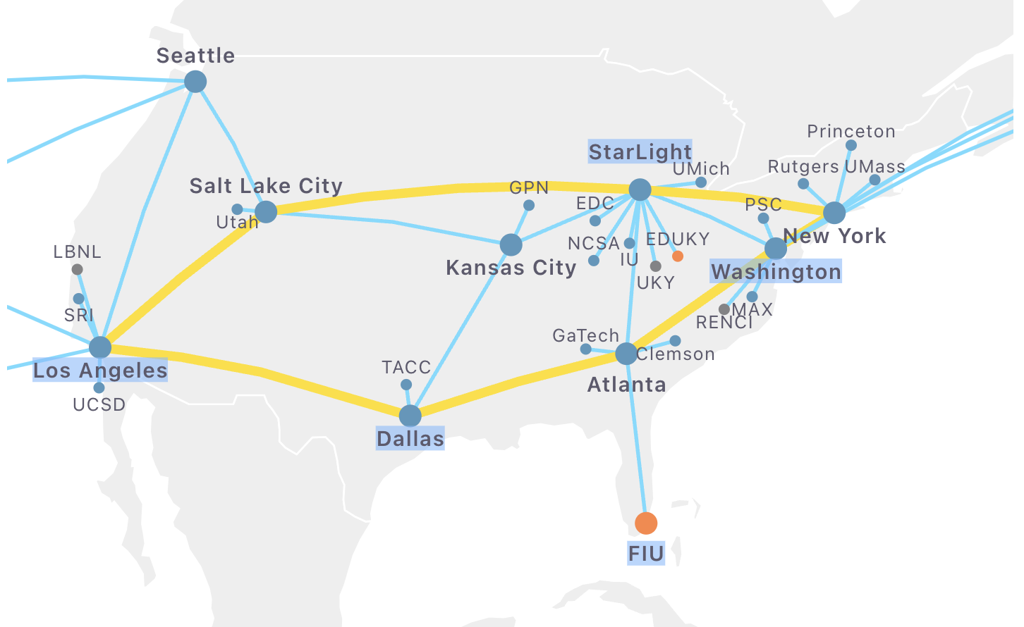
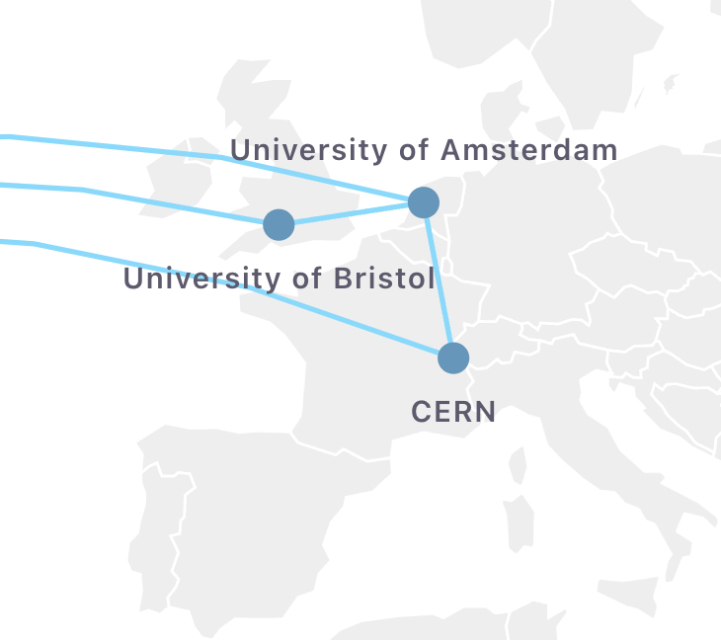
FABRIC Testbed
https://portal.fabric-testbed.net/
Experimental Physics Software and Computing Infrastructure
Create configuration of network+compute
(includes GPU and FPGA elements)
No large HPC resources, but good for testing distributed applications

Slide 17
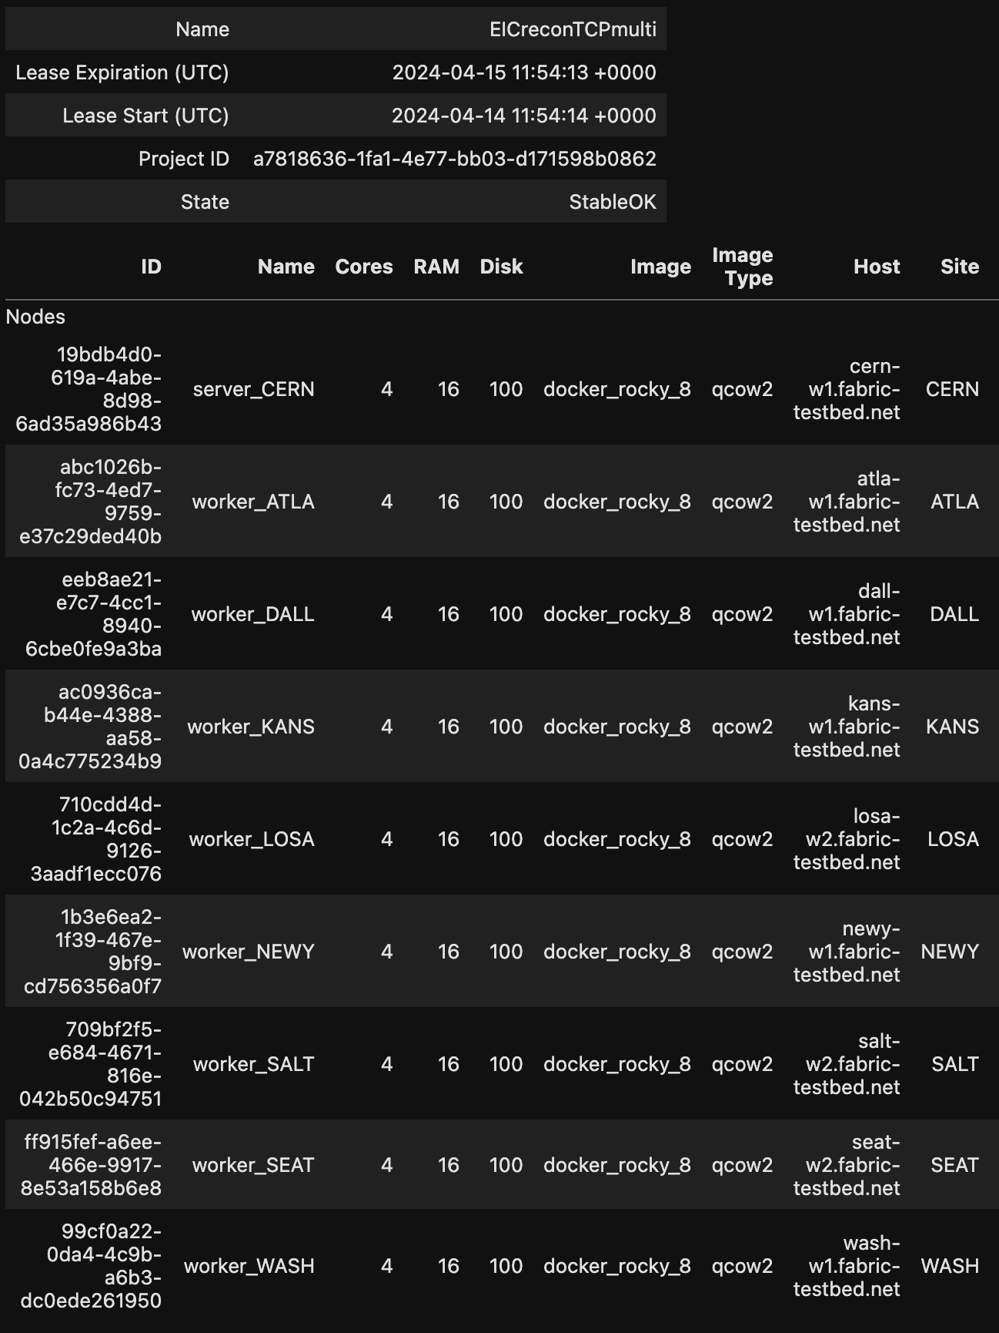
FABRIC test
Experimental Physics Software and Computing Infrastructure
Tested sending data from CERN to 8 locations in US.
Four EICrecon processes running at each location
32 consumers total
(event processing rate is few seconds per event)
Input file: SIDIS 10x100
/work/eic2/EPIC/EVGEN/SIDIS/pythia6-eic/1.0.0/10x100/q2_0to1/pythia_ep_noradcor_10x100_q2_0.000000001_1.0_run48.ab.hepmc3.tree.root

Slide 18
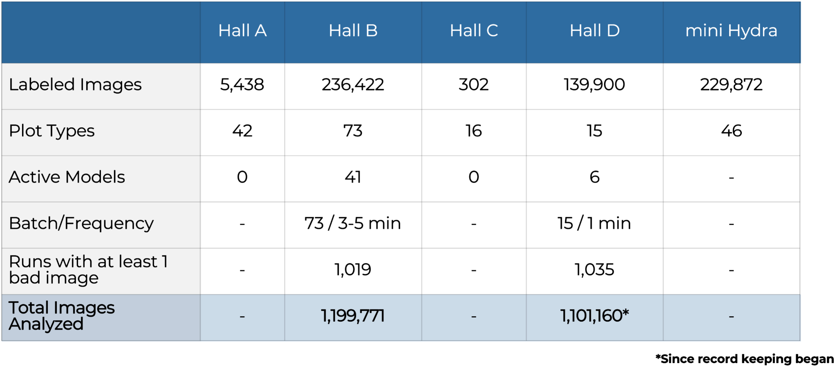
Hall-B deployment now rivals Hall-D in online images analyzed.
Mini-Hydra uses labeler only for offline calibration checkout
Interest from NASA at Open House. Meeting scheduled for Thursday

Slide 19
Summary
Streaming Readout will be the standard for the next generation of experiments at JLab
To get to there from here requires a number of pieces be developed and coupled into a coherent system
A key requirement is automated calibration of the detector.
This needs to be considered during detector development!
Monitoring at all stages is needed

Slide 20
BACKUPS

Slide 21
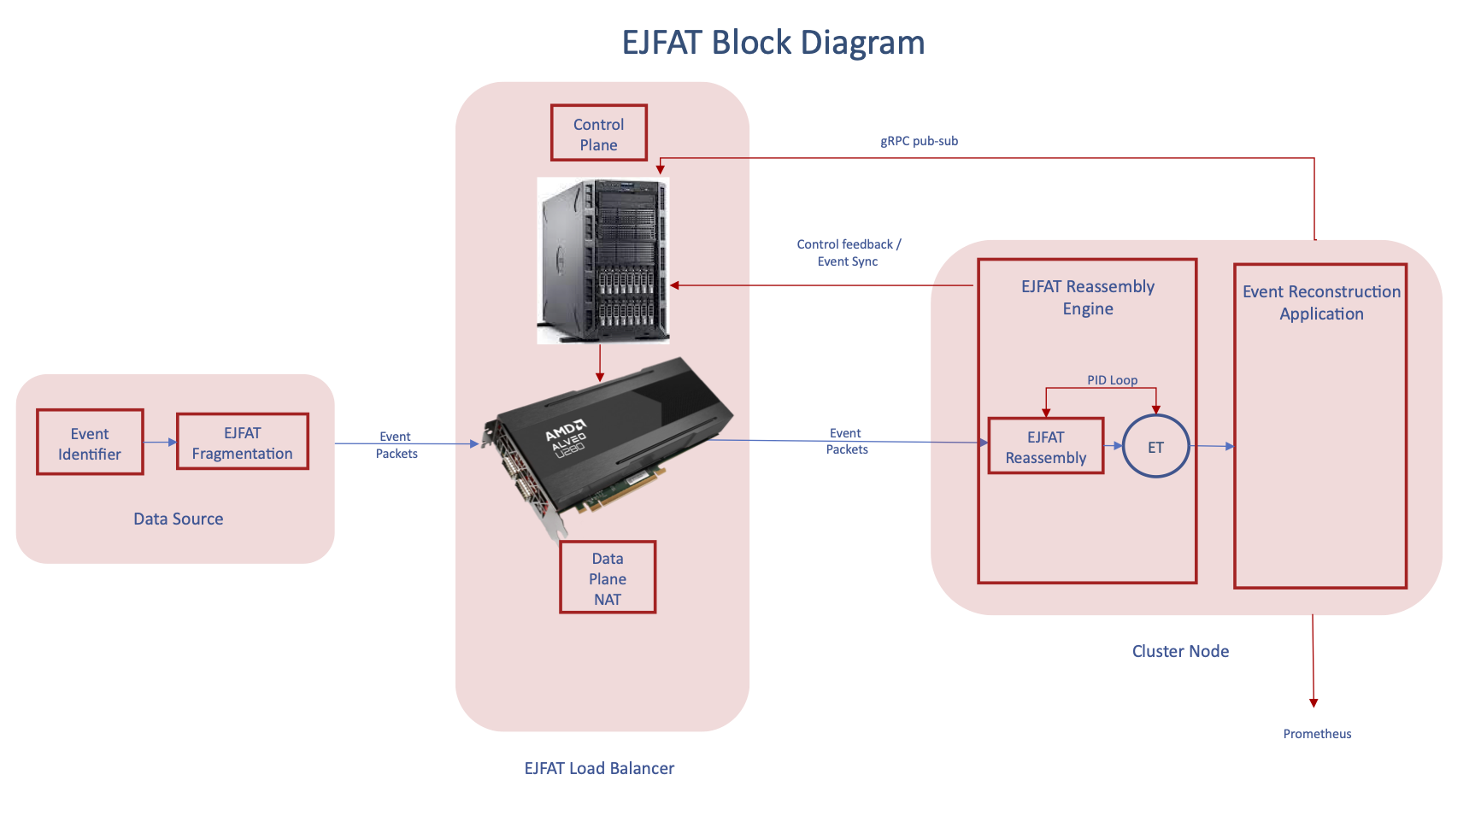
ESnet/JLab FPGA Accelerated Transport
(part of IRIAD effort)
Partnership between ESnet and JLab to provide high bandwidth, low latency transport of experimental data
Data packet headers re-written in FPGA to redirect to processing nodes
Smart load balancing by Control Plane application based on telemetry from processing nodes
Funded through DOE ASCR IRIAD project
PI: Graham Heyes
Project Lead: Michael Goodrich

